Slide 1

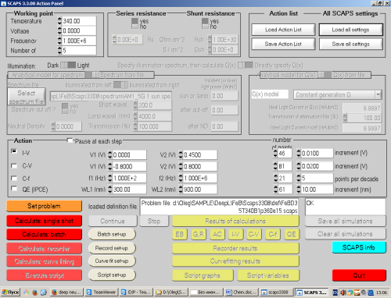
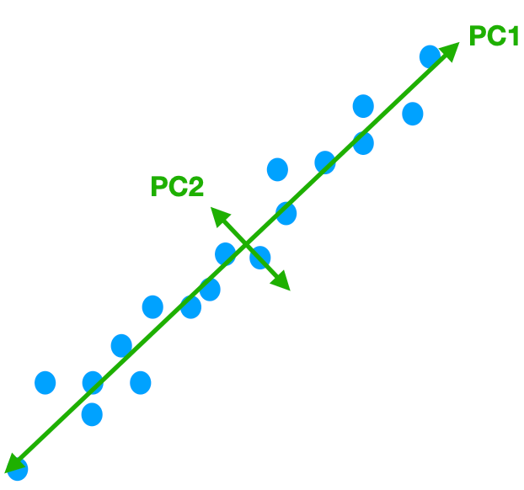
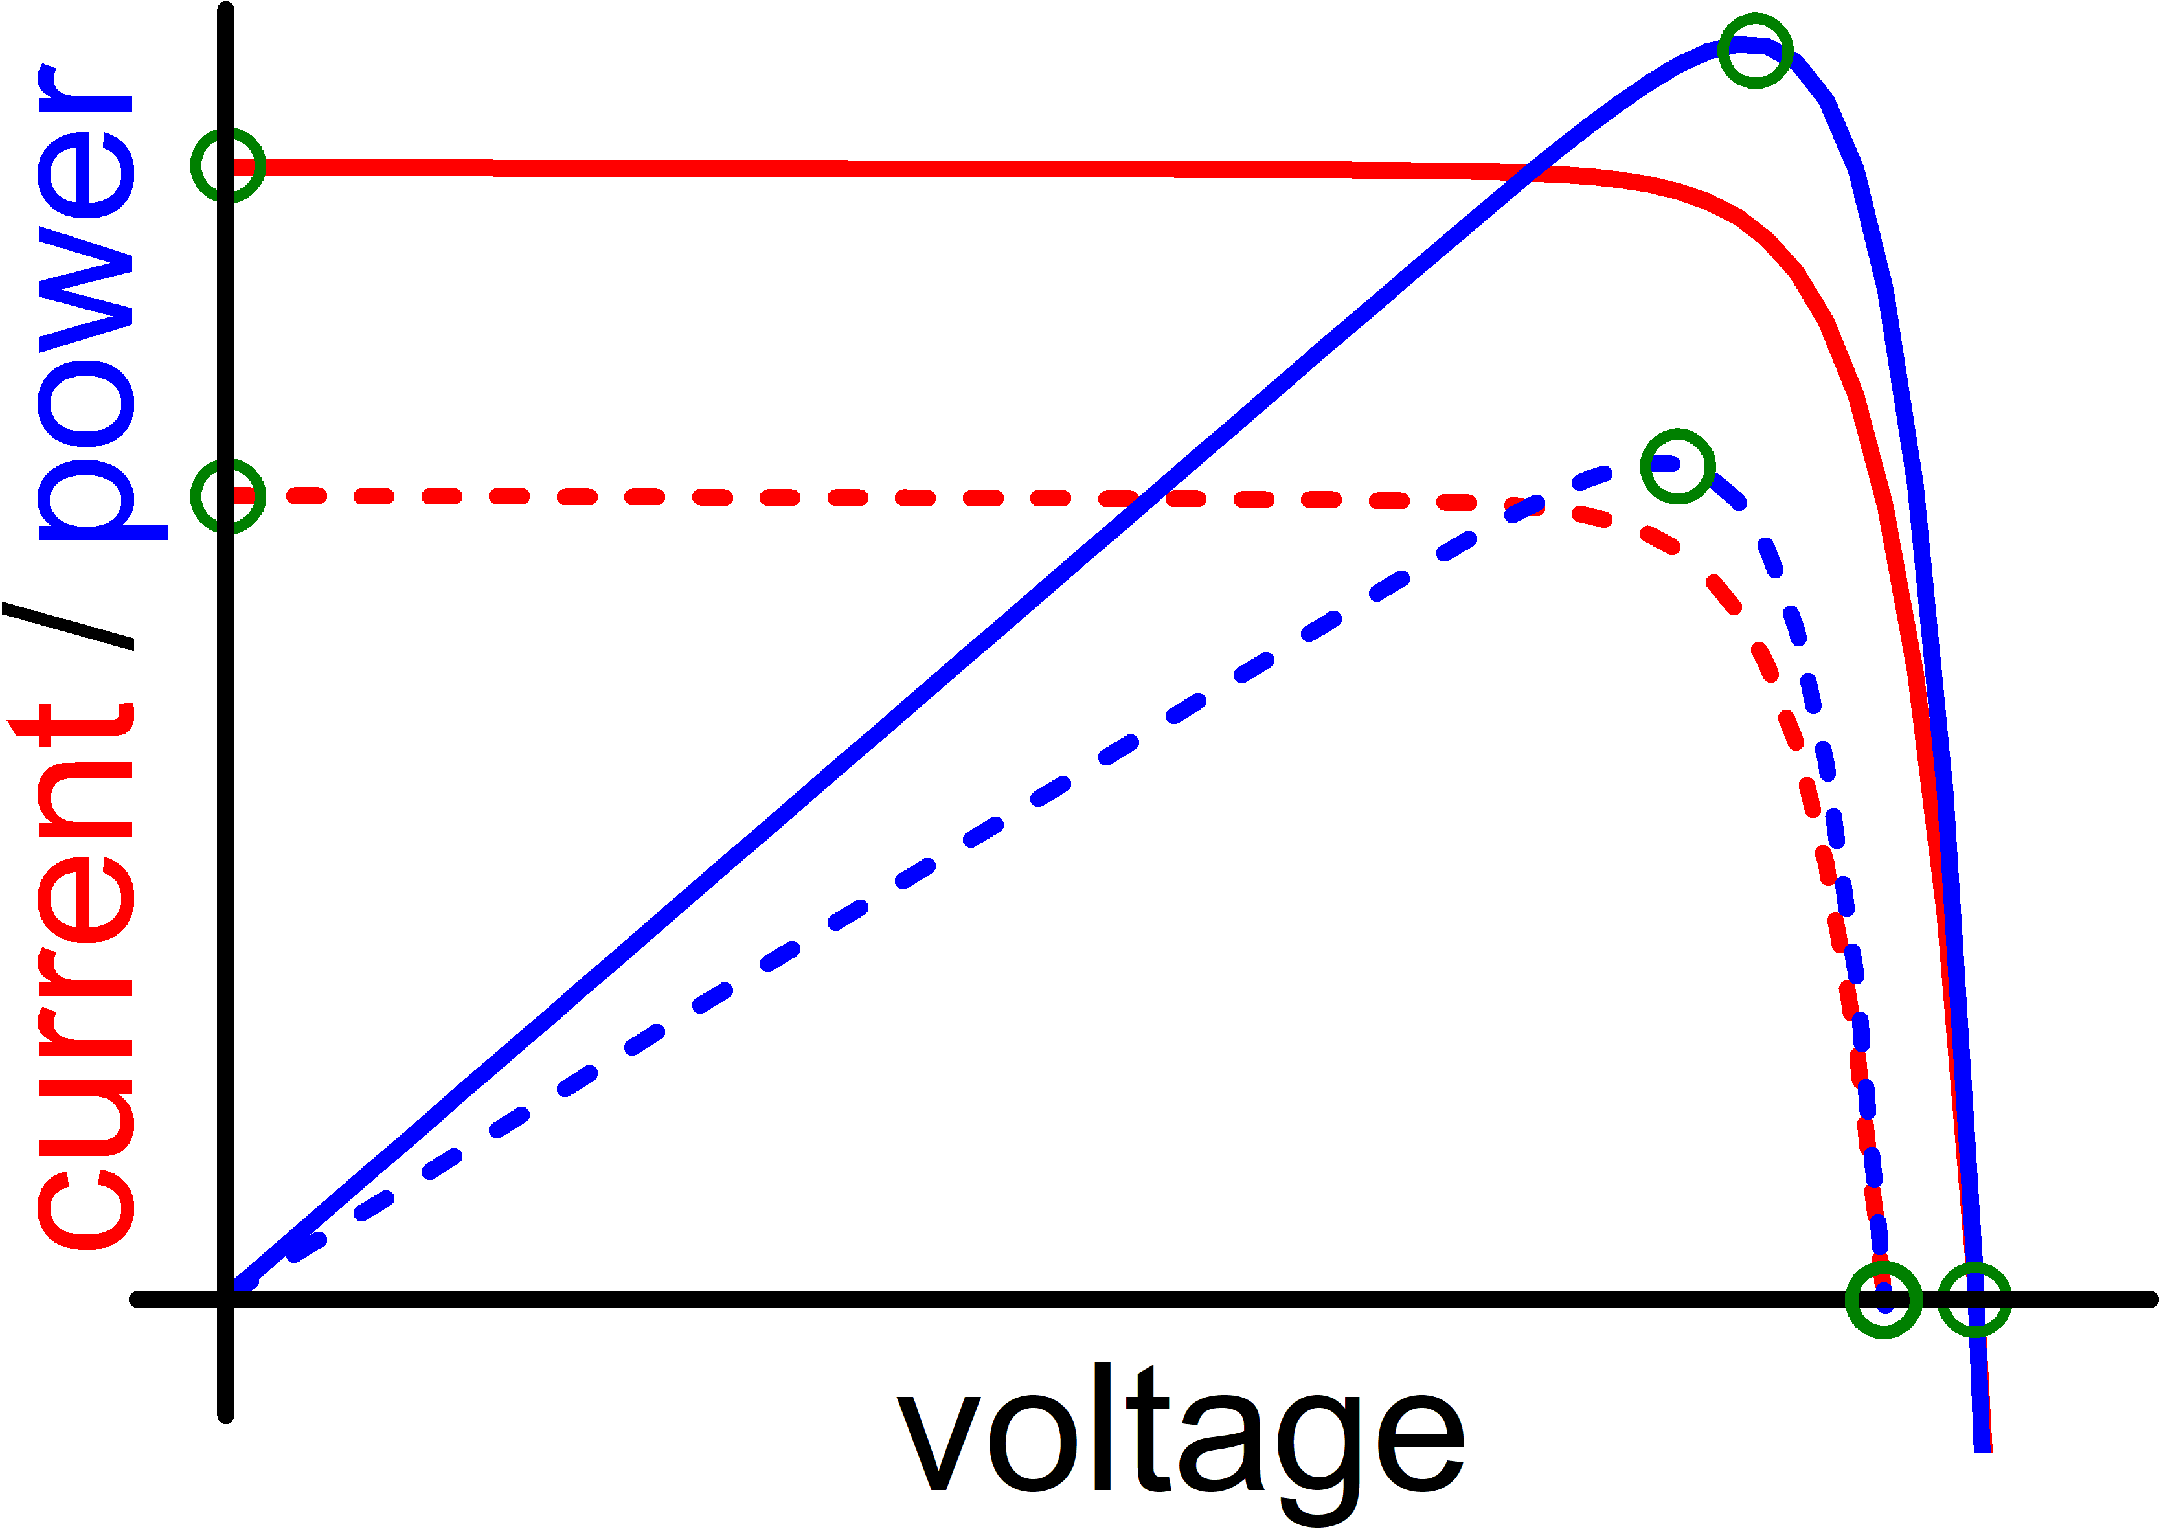
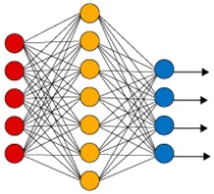
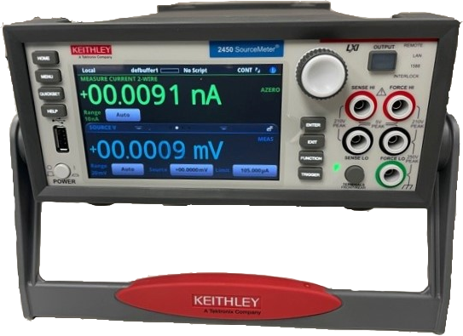

Data Collection
Data Pre-Processing
ML Algorithms
datasets
SCAPS
PCA
AM1.5
RF
train
GB
940 nm
XGB
simulation
SVR
DNN
measurement
N_{Fe}-altered
test
N_{B}-altered
T-altered
All-altered
experimental
Regression
Model Evaluation
MSE, MAPE, R²

Slide 2
datasets
SCAPS
PCA
AM1.5
train
940 nm
simulation
measurement
N_{Fe}-altered
test
N_{B}-altered
T-altered
RF
All-altered
GB
experimental
XGB
SVR
DNN

Slide 3
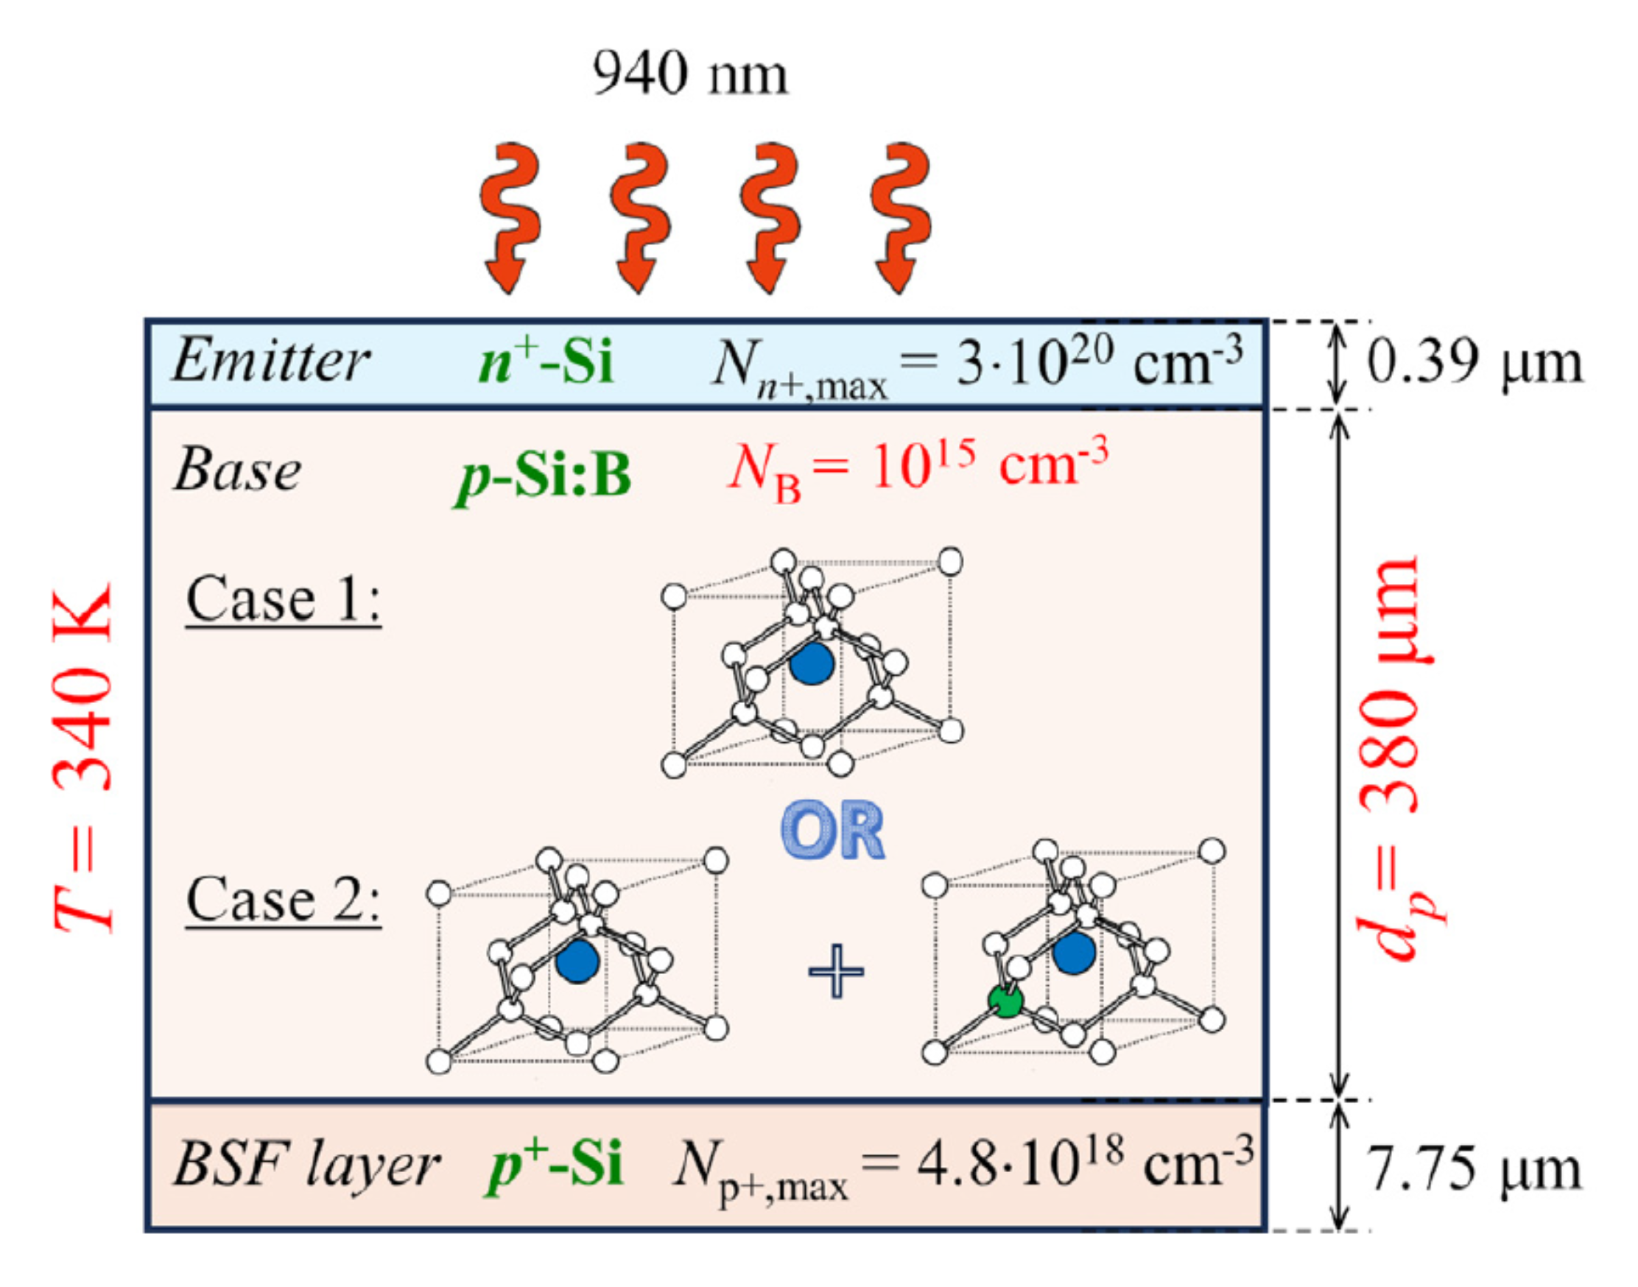
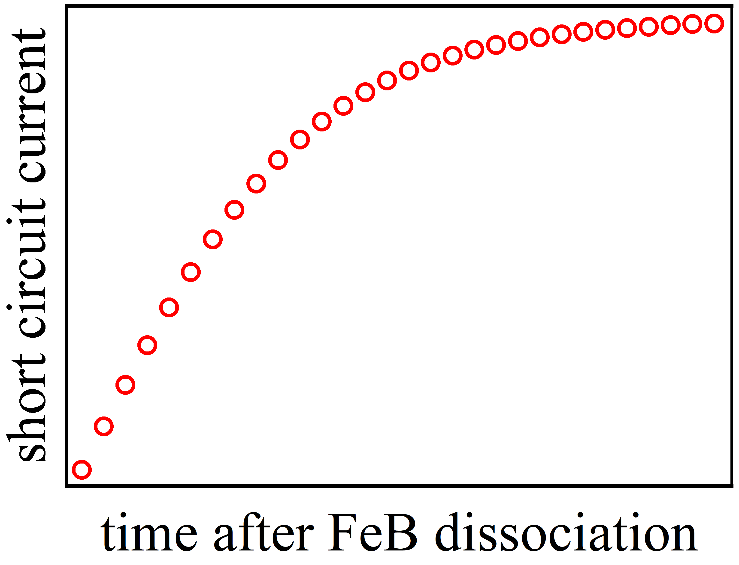
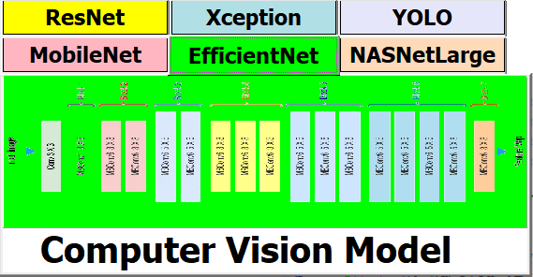
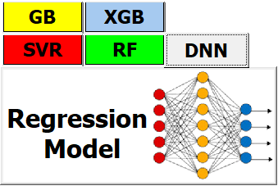
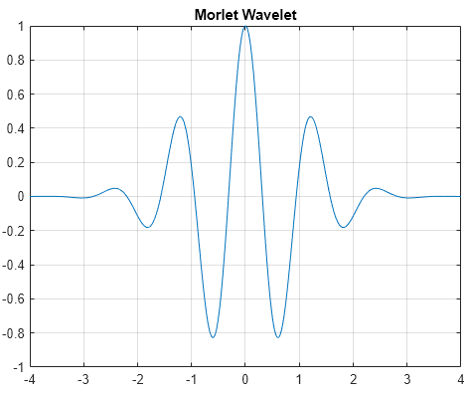
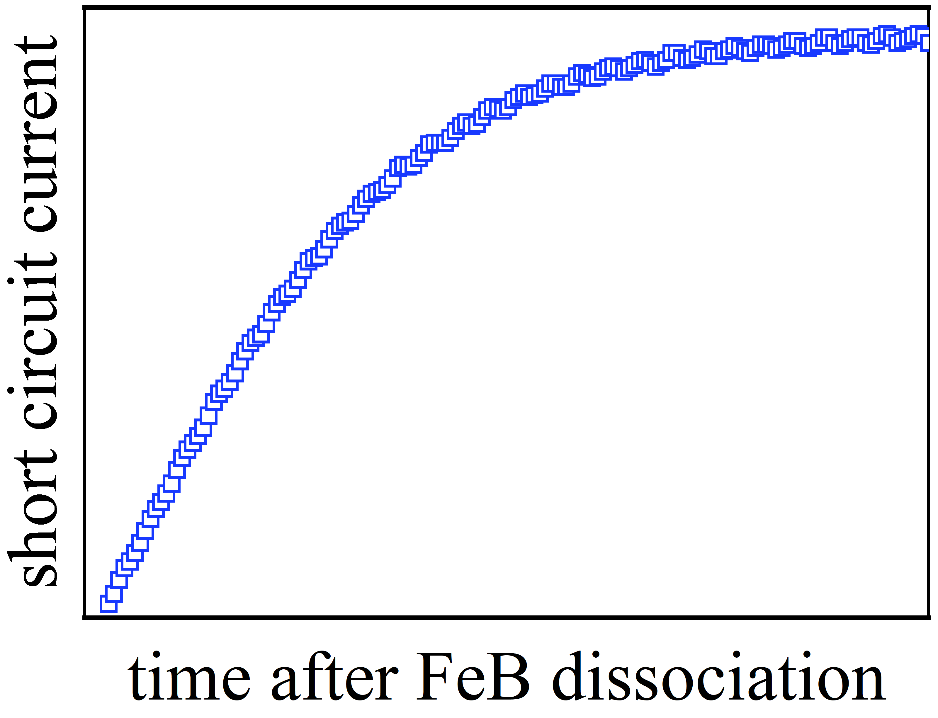
SCAPS

