Slide 1




Characterization of novel solar energy converters based on meta-heuristic algorithms
Taras Shevchenko National University of Kyiv, Kyiv, Ukraine
olegolikh@knu.ua

Slide 2


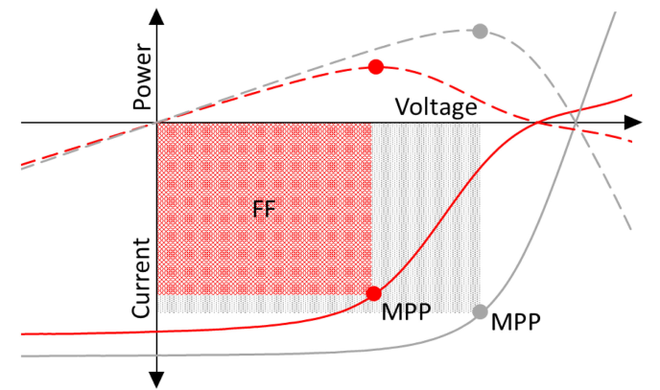
S-shaped IV curves
conventional solar cells (SCs)
S-shaped SCs
area of observation:
Si-heterojunction SCs;
thin-film SCs (CdTe, CI(G)S, and a-Si);
organic SCs;
perovskite SCs;
quantum dot SCs;
hybrid SCs
reasons:
charge trapping at the cathode interface;
rectifying Schottky junction at the anode interface;
change of the electric field distribution;
presence of strong interface dipoles;
unbalanced charge transport

Slide 3
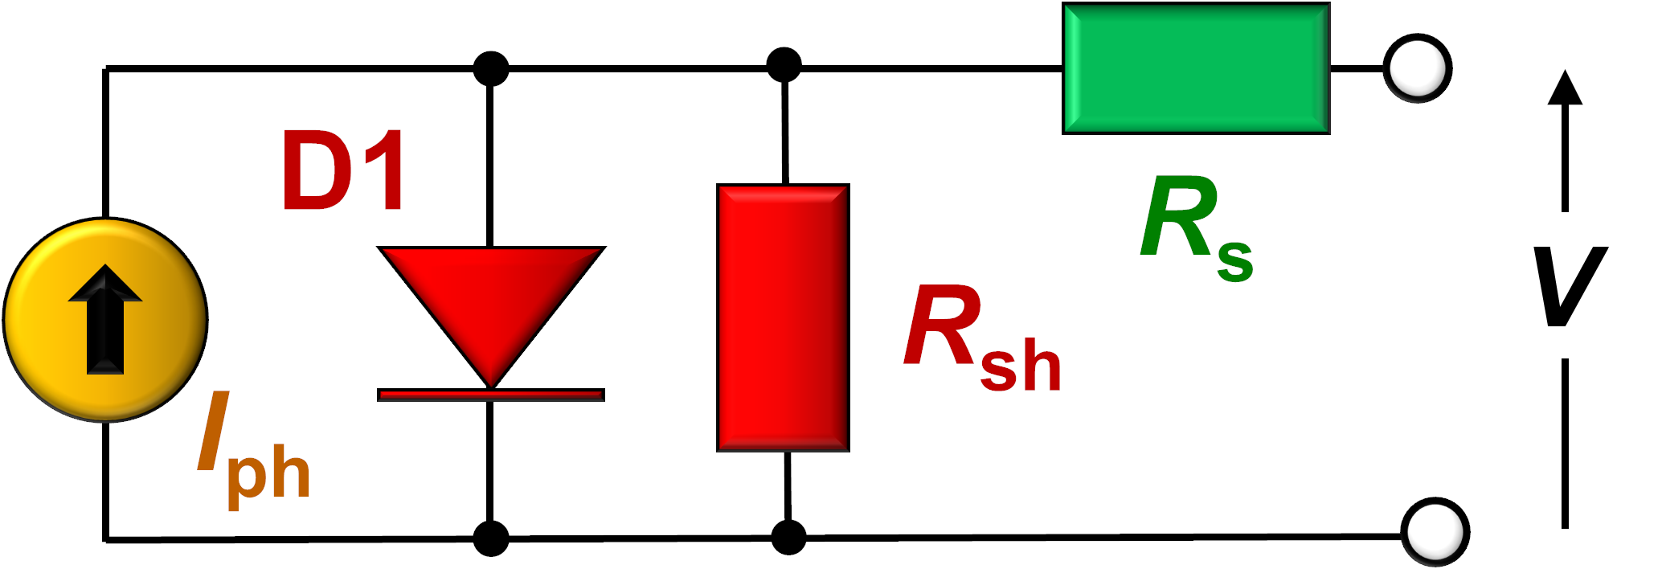
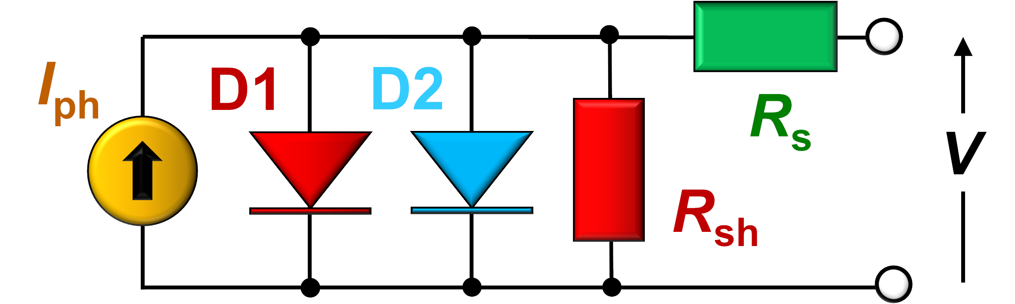
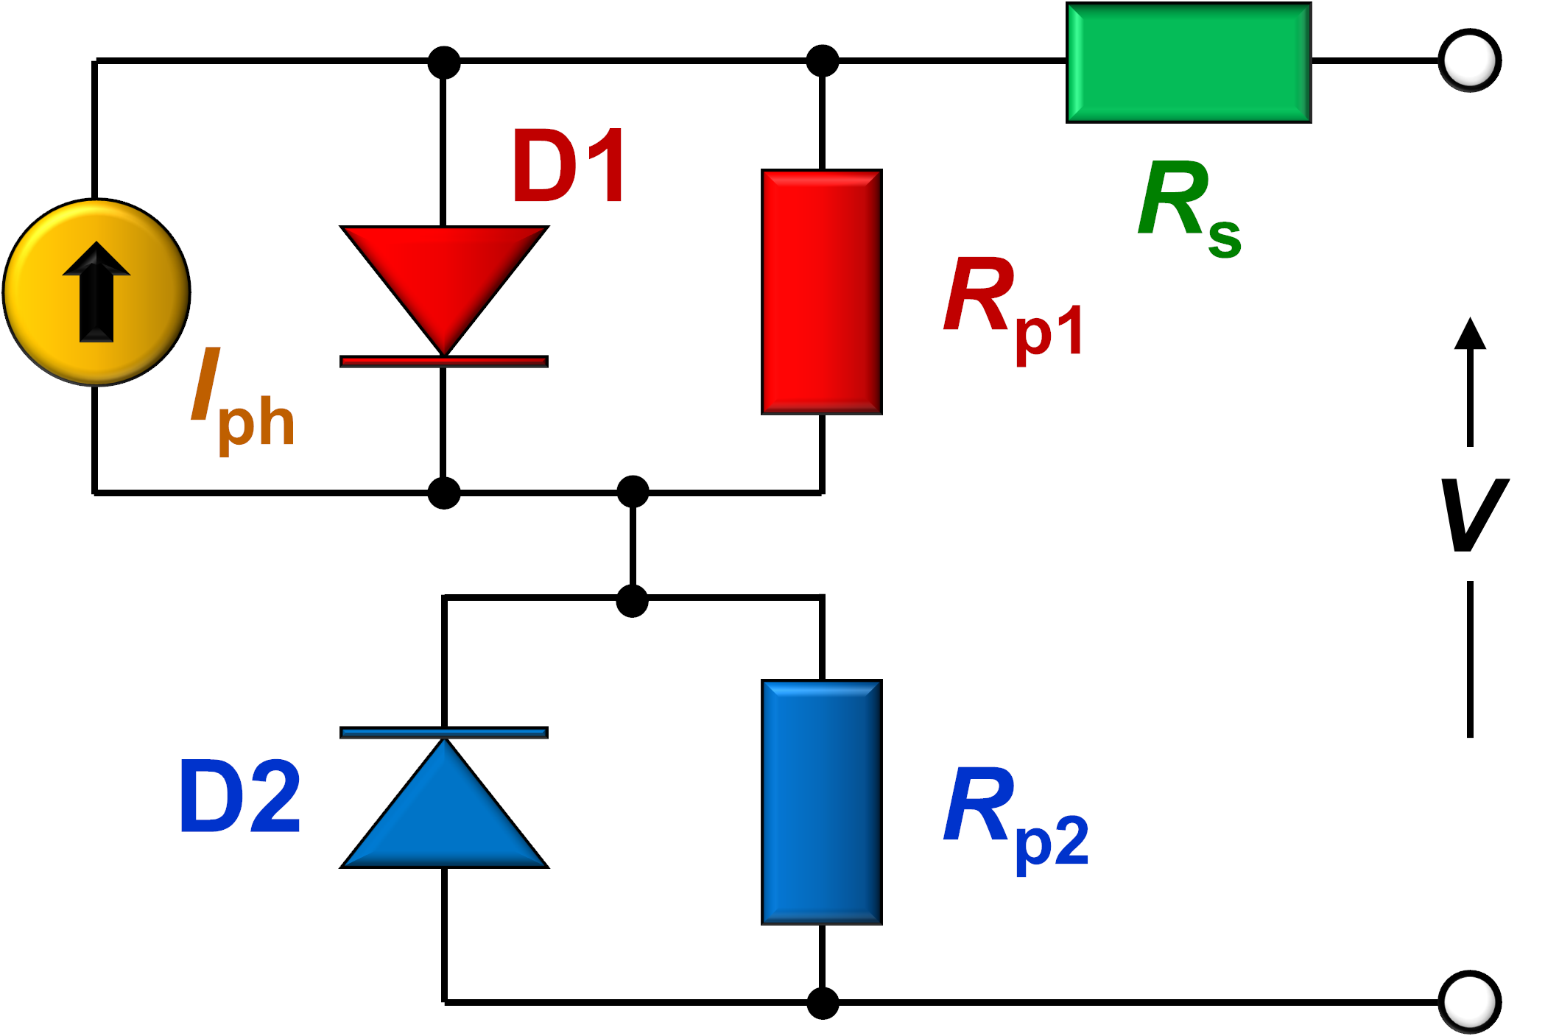

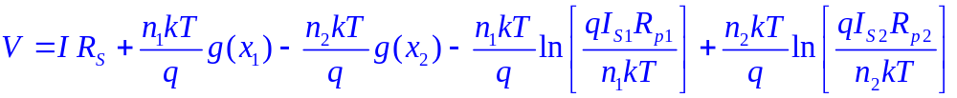

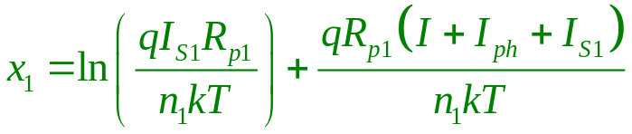
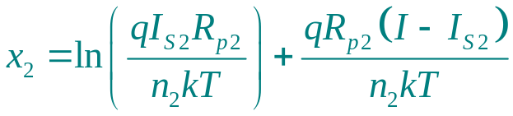
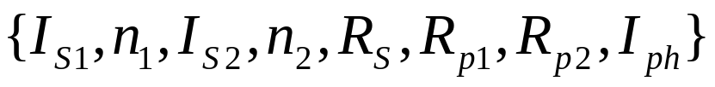
equivalent-circuit model
conventional SCs
S-shaped SCs

Slide 4
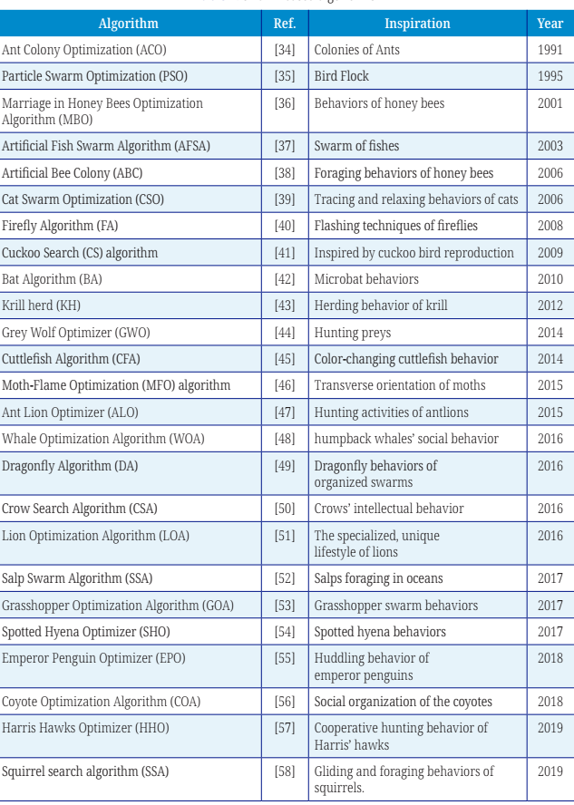
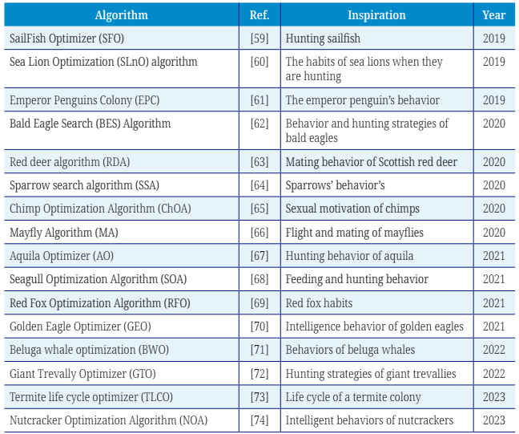
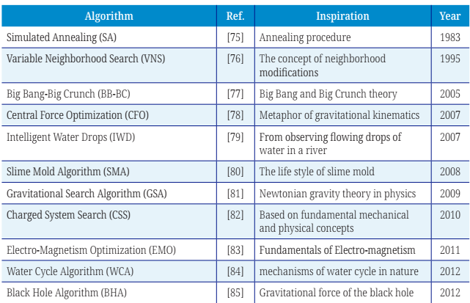
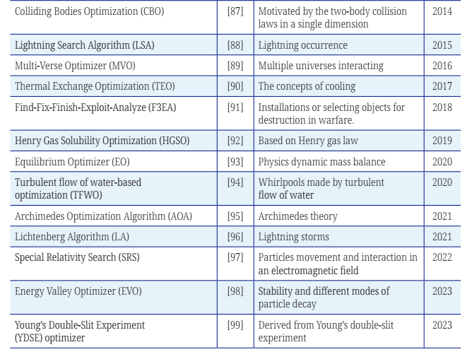



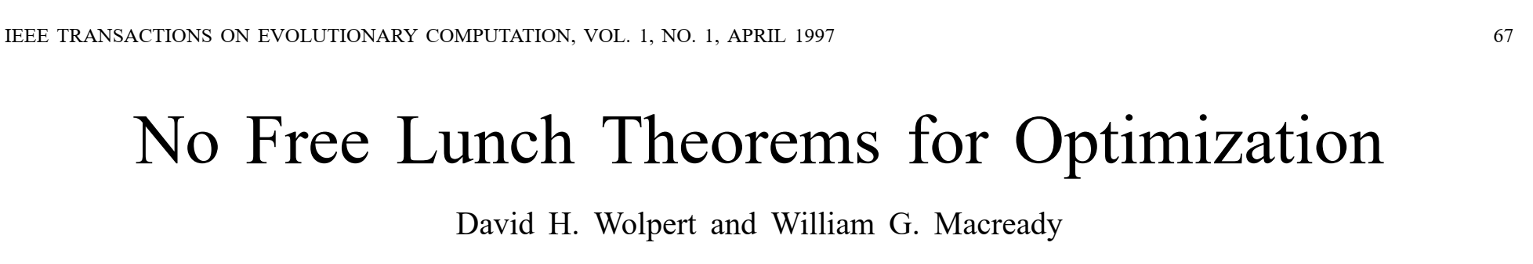
meta-heuristic algorithms

Slide 5

meta-heuristic algorithms
Differential evolution (DE)
Adaptive differential evolution with the Lagrange interpolation argument (ADELI)
Differential evolution with neighborhood-based adaptive evolution mechanism (NDE)
Success history based DE with hybridization mutation strategies and population size reduction (EBLSHADE)
Water wave optimization (WW)
neural network algorithm (NNA)
teaching learning based optimization (TLBO)
Generalized oppositional teaching learning based optimization (GOT
LBO)
Simplified teaching–learning based optimization algorithm (STLBO)
Particle swarm optimization (PSO)
Modified artificial bee colony (MABC)
Chaotic Whale Optimization Algorithm (CWOA)
Improved sine cosine algorithm (ISCA)
Improved JAYA (IJAYA)

Slide 6
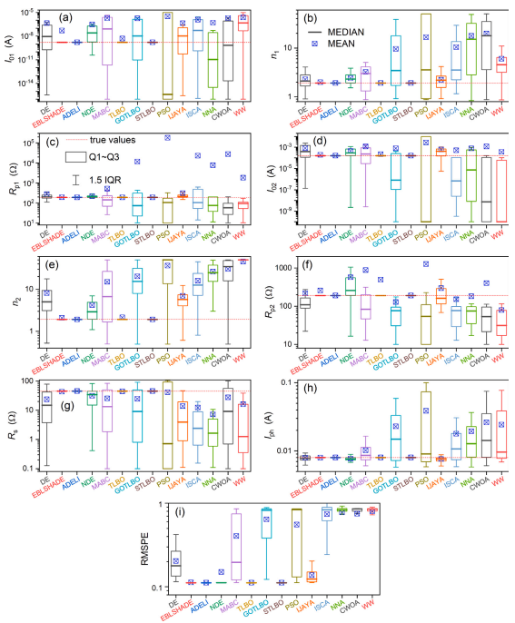
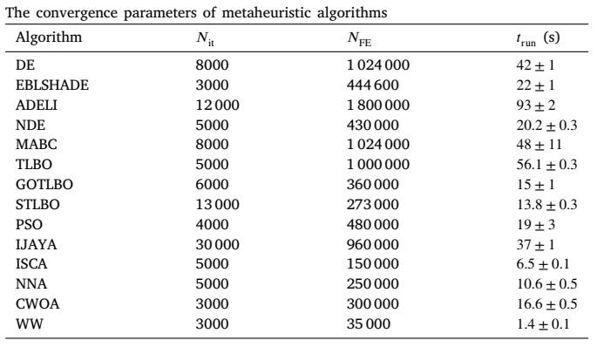
fitting result

Slide 7
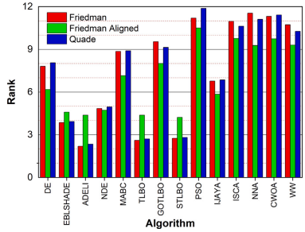
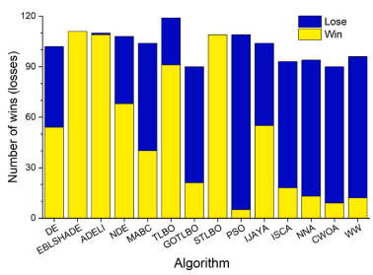
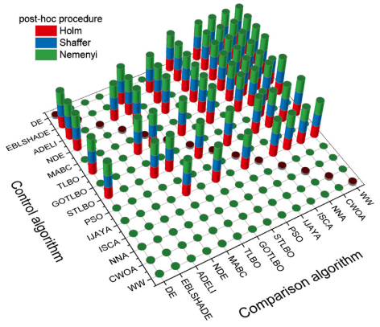
nonparametric test result
Pairwise comparisons (Wilcoxon signed-rank test)
1xN comparisons (Friedman, Friedman Aligned, and Quade tests)
NxN multiple comparisons (Friedman test with Shaffer’s static, Nemenyi, and Holm post-hoc procedures )

Slide 8

Conclusion
work explores the feasibility of employing meta-heuristic algorithms to address parameter extraction challenges of photovoltaic cells exhibiting S-shaped current–voltage characteristics.
employing a square error-based fitness function provides clear advantages in addressing the given problem compared to an absolute error-based fitness function.
STLBO and ADELI exhibit superior performance in accuracy
and reliability compared to other algorithms.
Detailed information:
https://doi.org/10.1016/j.mseb.2024.117506

Slide 9

olegolikh@knu.ua

