Slide 1






Characterization of impurity contamination in solar cells with the assistance of machine learning
Taras Shevchenko National University of Kyiv, Kyiv, Ukraine

Slide 2



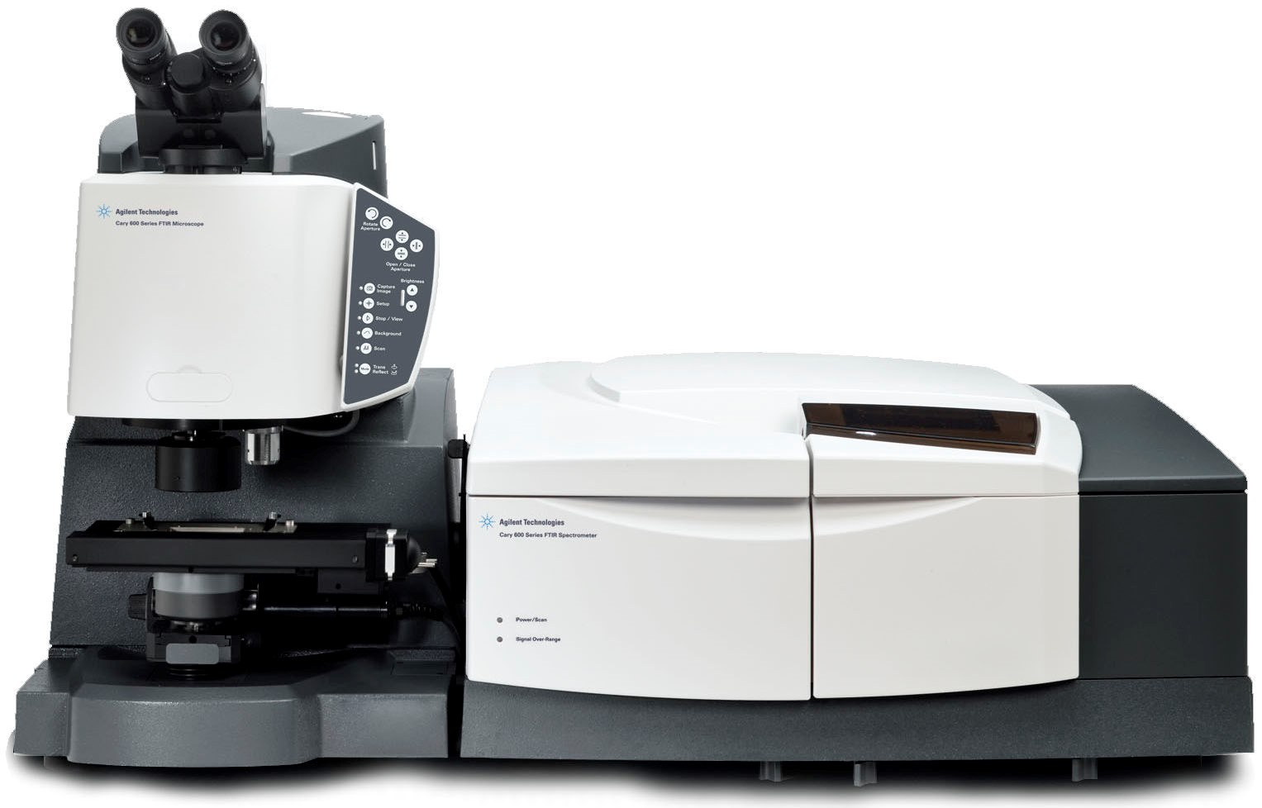
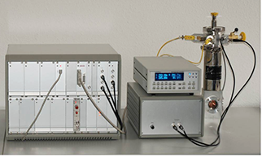
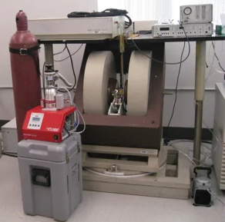
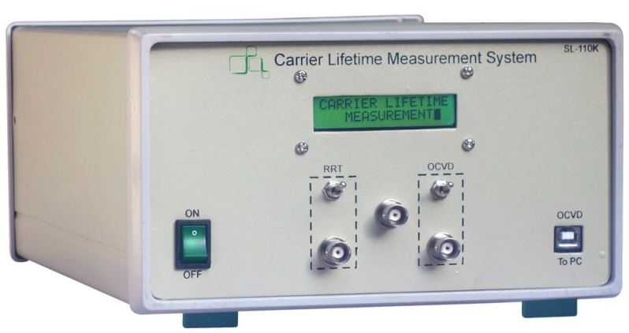
Characterization of impurity contamination in solar cells with the assistance of machine learning
Non-destructive methods aimed at estimating the concentration of recombination-active defects are numerical:
Fourier-transform infrared spectroscopy
deep level transient spectroscopy
minority carrier
lifetime measurements
electron-paramagnetic resonance
…
However, these techniques
are time-consuming
involve the use of unconventional conditions (low temperatures, magnetic fields, etc)
require special equipment
require specially prepared samples.

Slide 3



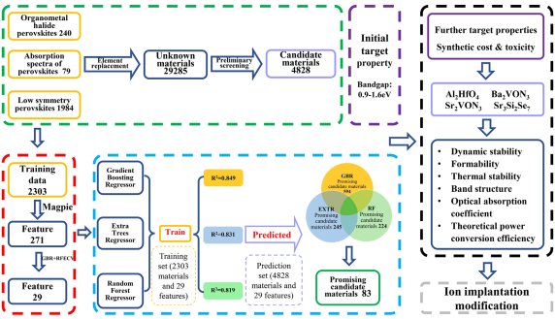
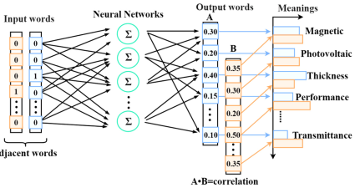
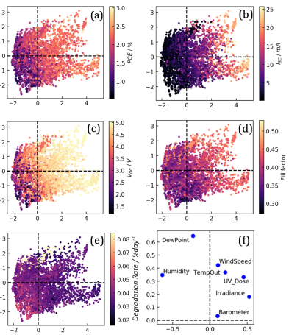
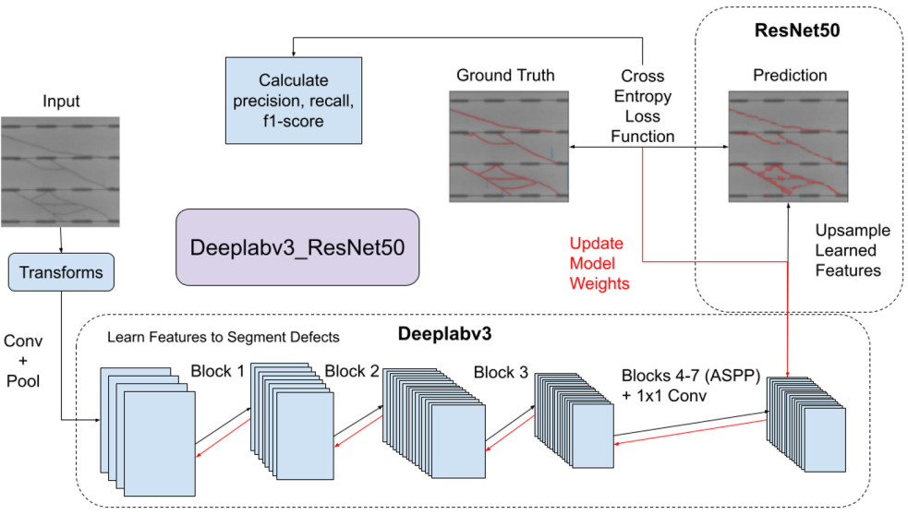
Characterization of impurity contamination in solar cells with the assistance of machine learning
artificial intelligence in
…everyday life
DALL·E 2
…and photovoltaics
identify potentially important PV materials based on
their optical and symmetry properties
mentions of names in literature
Appl. Phys. Lett.119 231902
J Appl. Phys.131 064902
defect detection from EL images
SC degradation prediction
IEEE J. Photovoltaics 12 p.53
Prog. PV Res. Appl. 29 p.127

Slide 4
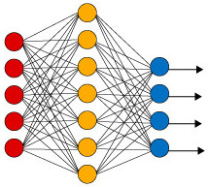
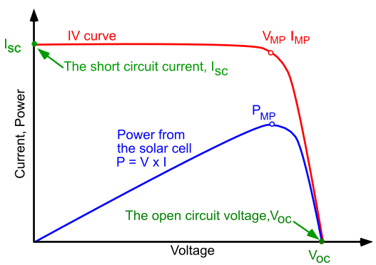

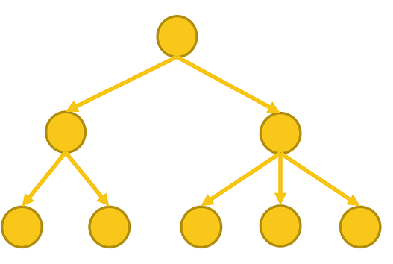
Characterization of impurity contamination in solar cells with the assistance of machine learning
Main goal:
method aimed at assessing impurity concentrations in solar cells, based on applying machine learning to data obtained from current-voltage characteristic
method is express, low-cost and does not require additional equipment

Slide 5
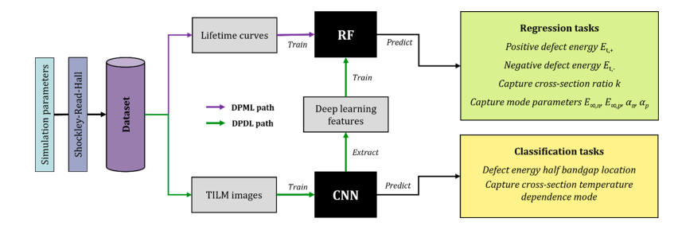
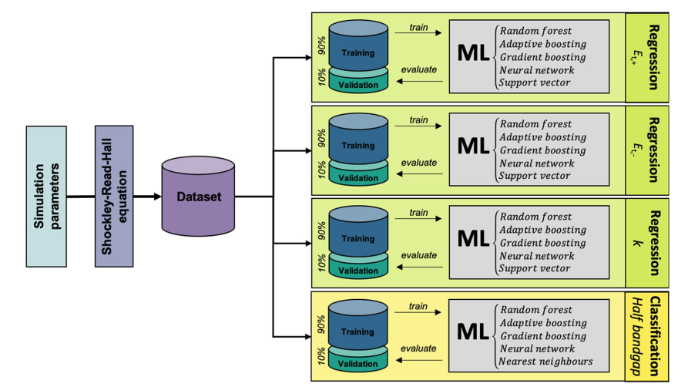
Characterization of impurity contamination in solar cells with the assistance of machine learning

Slide 6
Characterization of impurity contamination in solar cells with the assistance of machine learning

Slide 7
Characterization of impurity contamination in solar cells with the assistance of machine learning

Slide 8

Characterization of impurity contamination in solar cells with the assistance of machine learning
olegolikh@knu.ua

