Slide 1

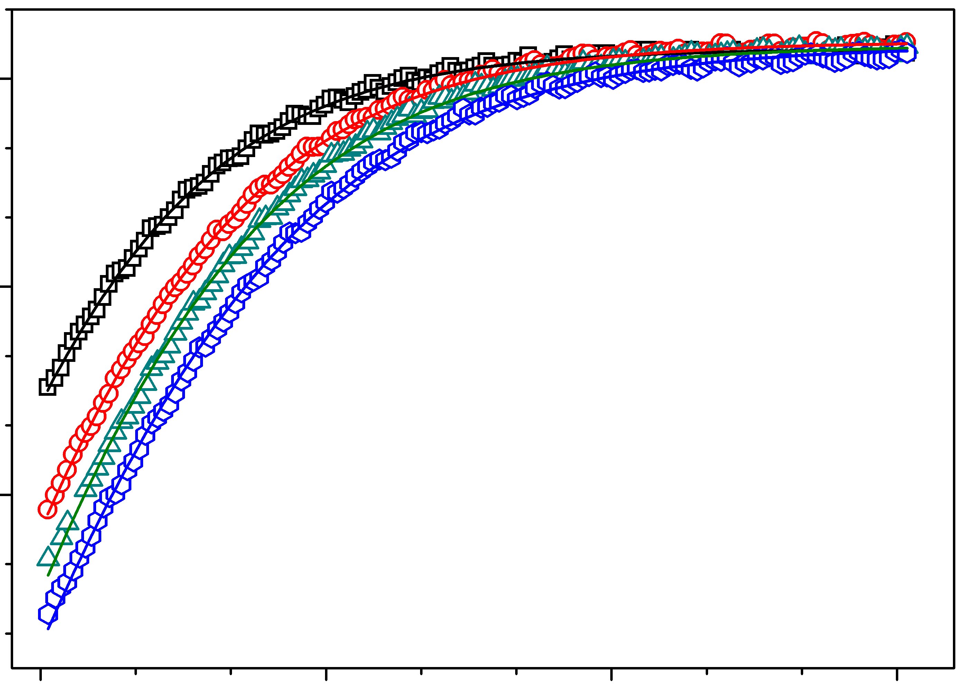

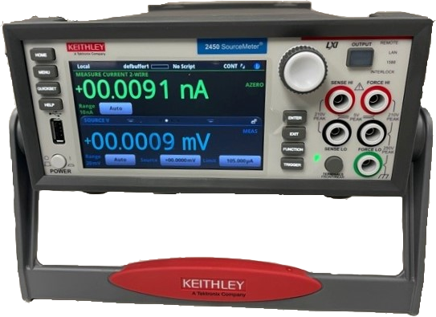
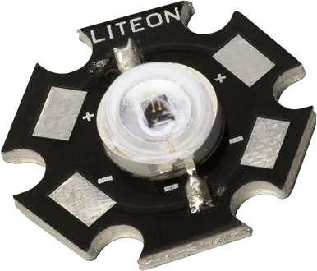
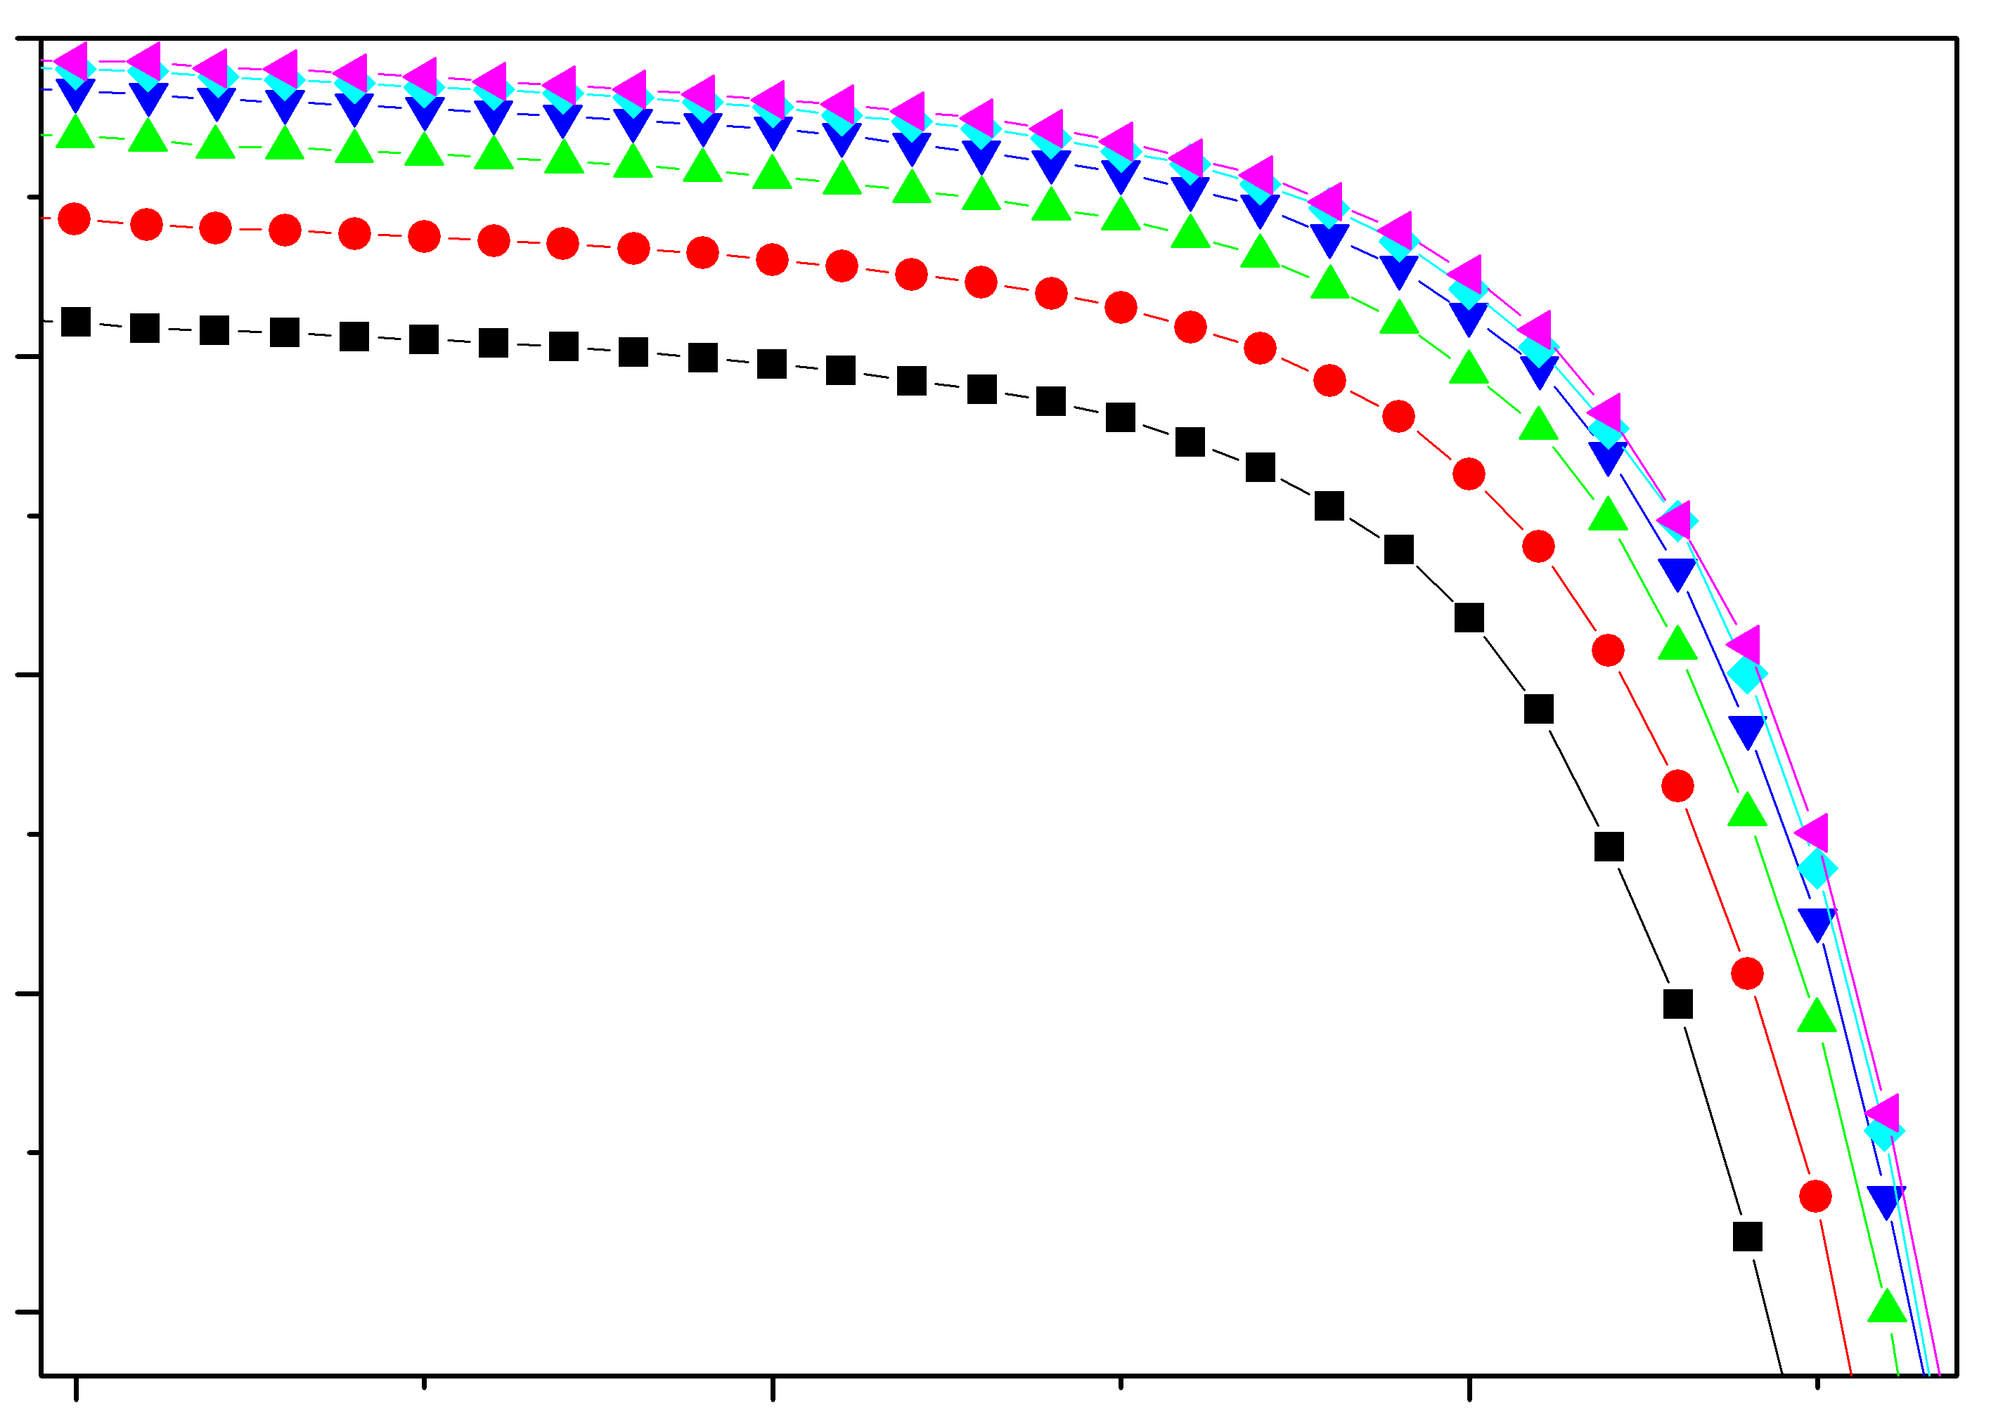
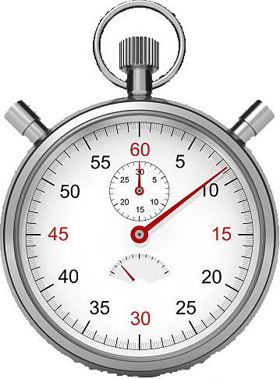
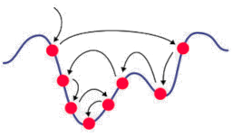

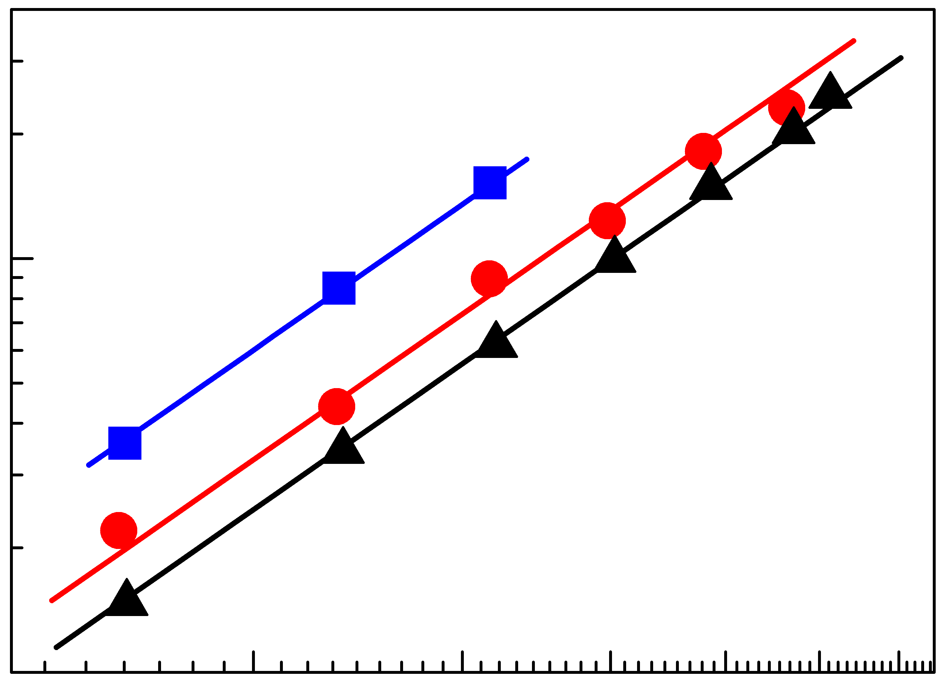
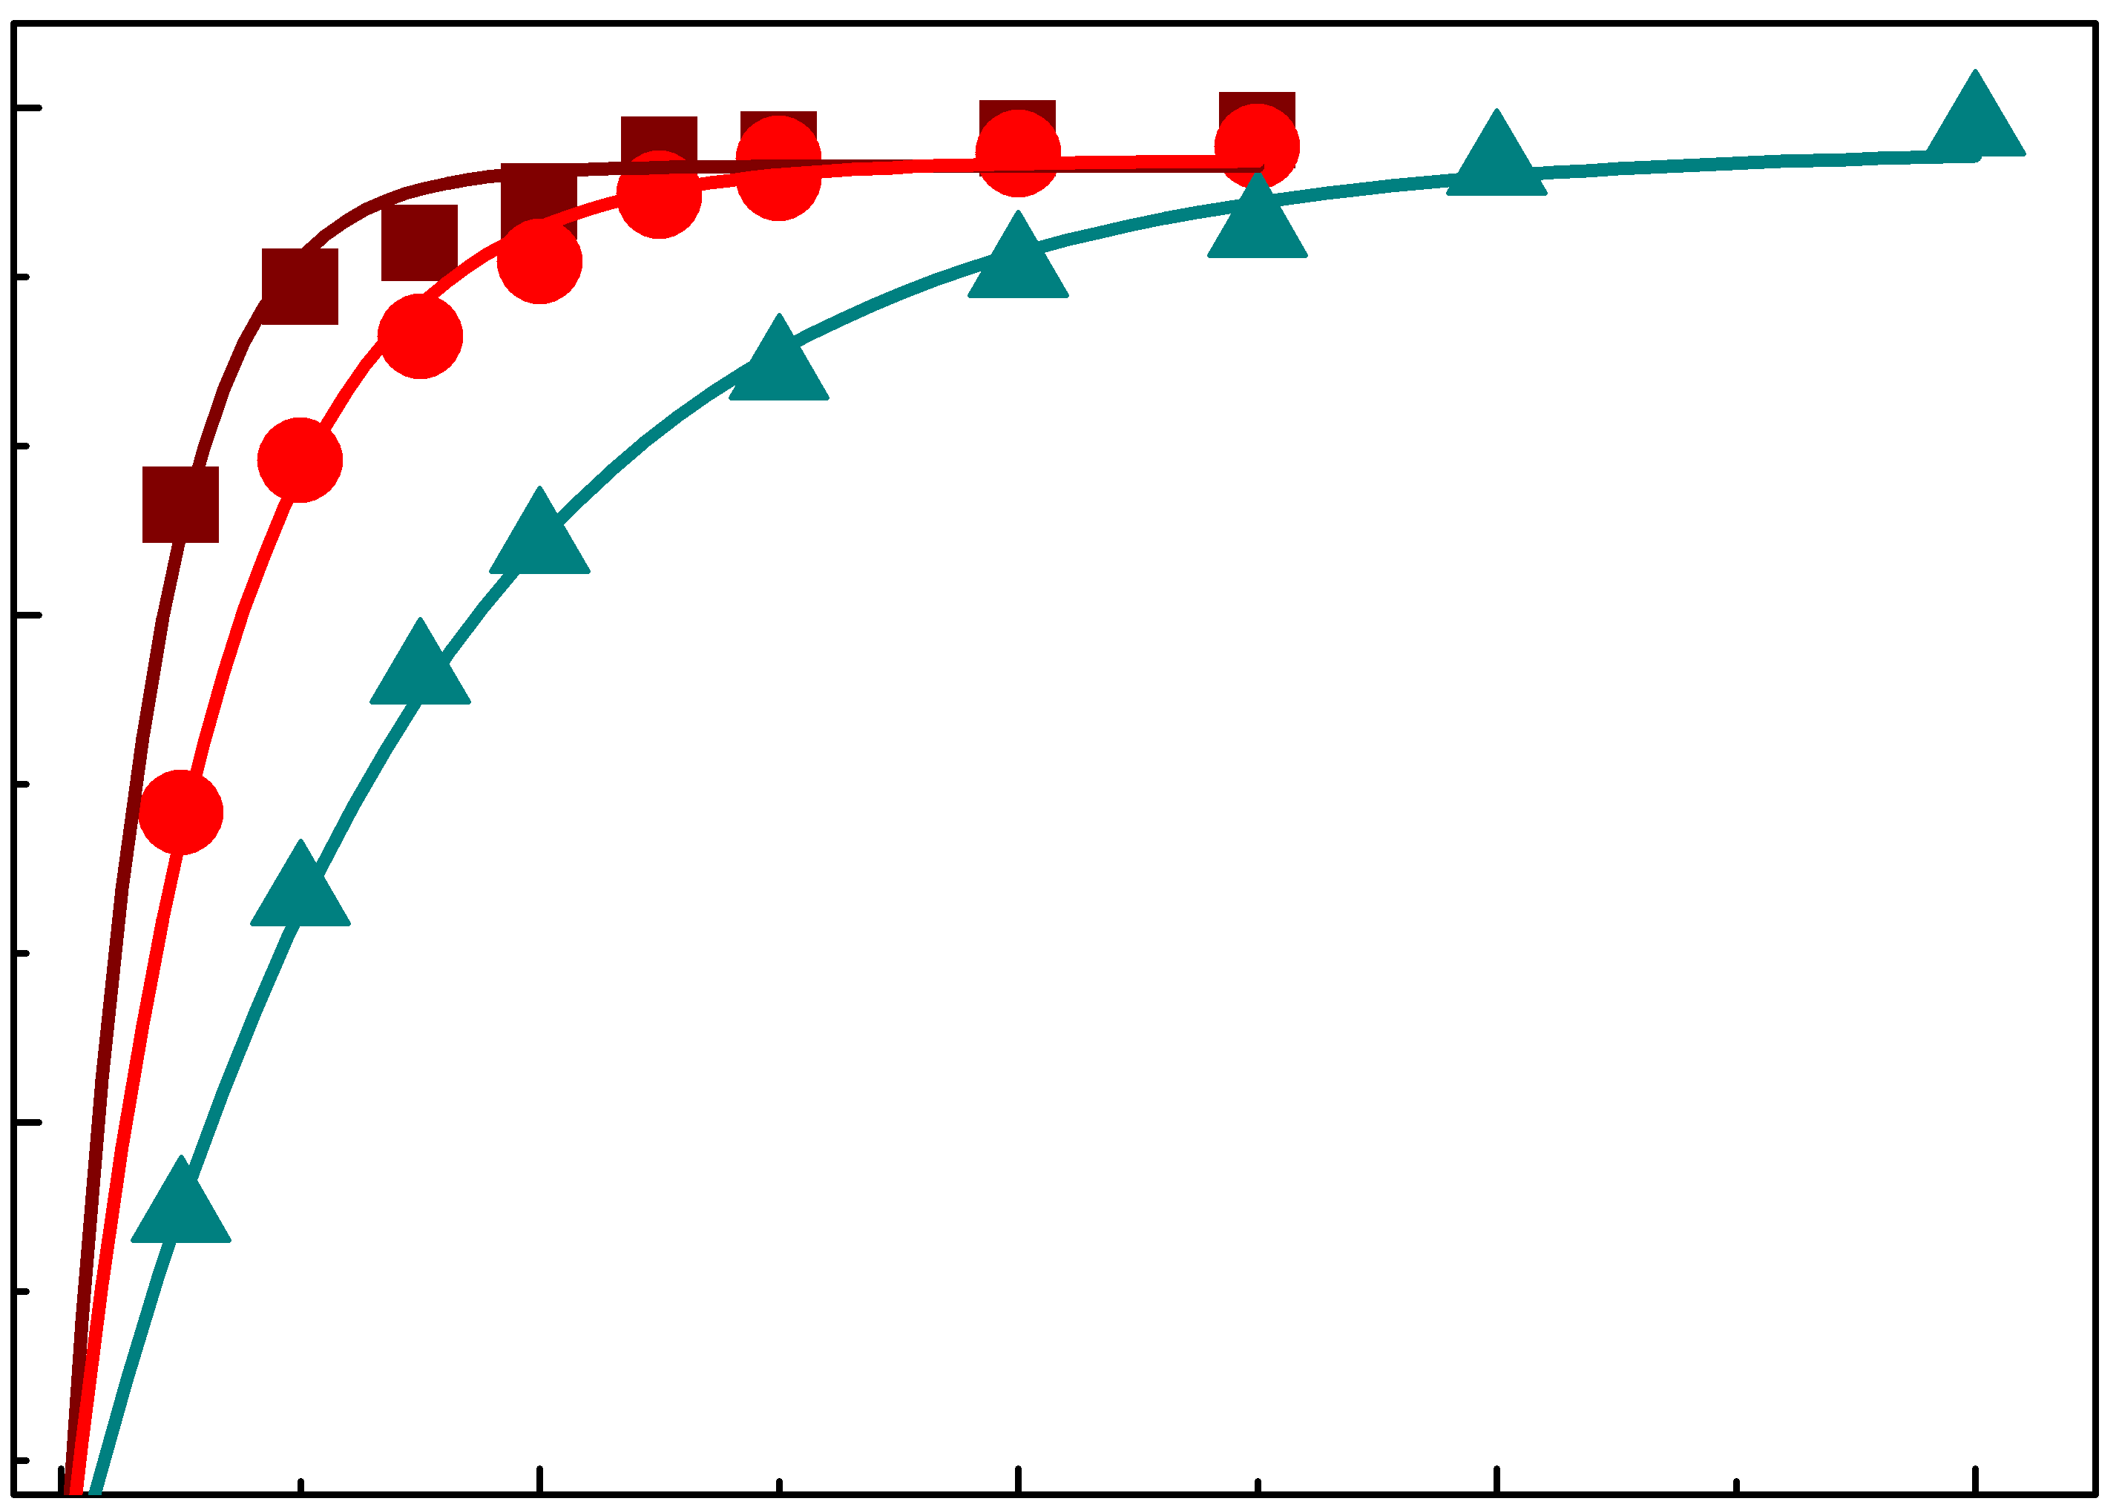
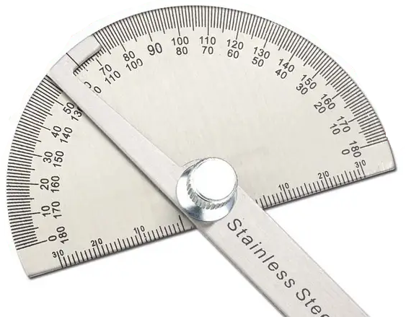
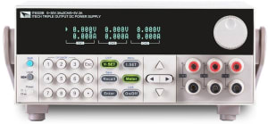
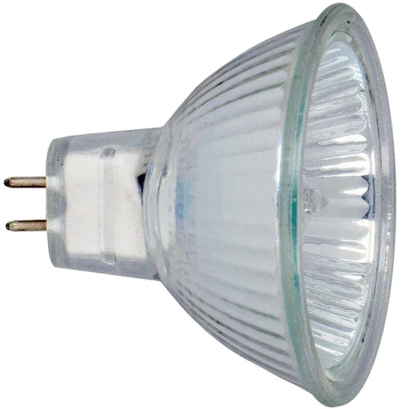
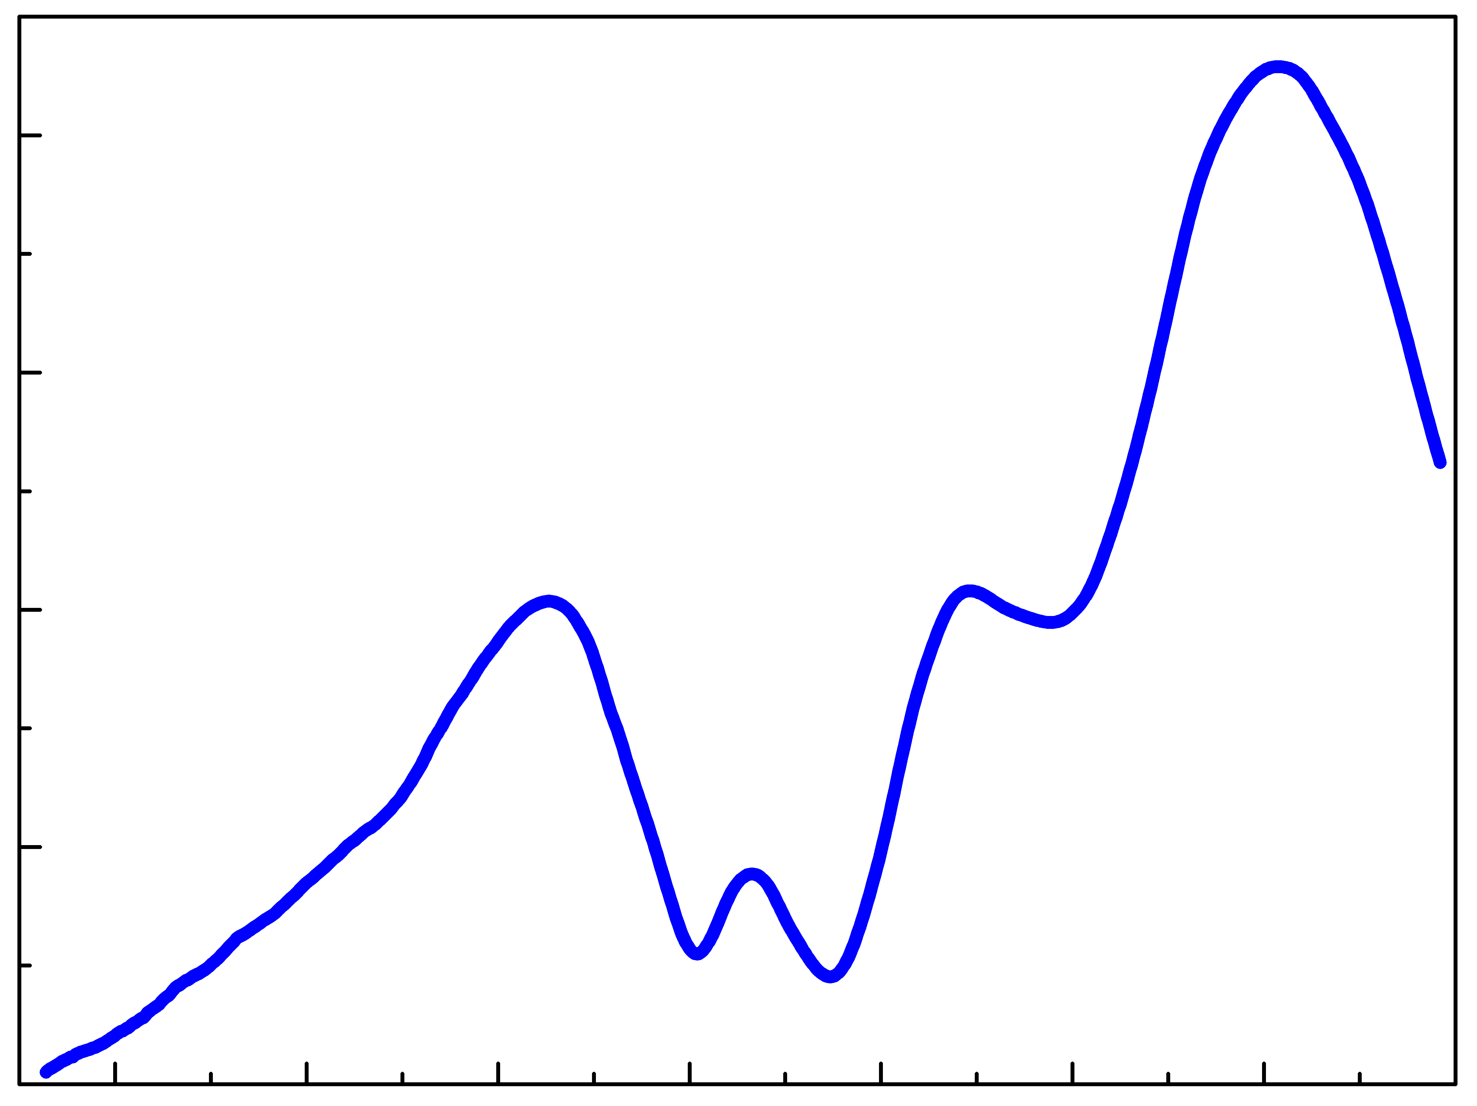
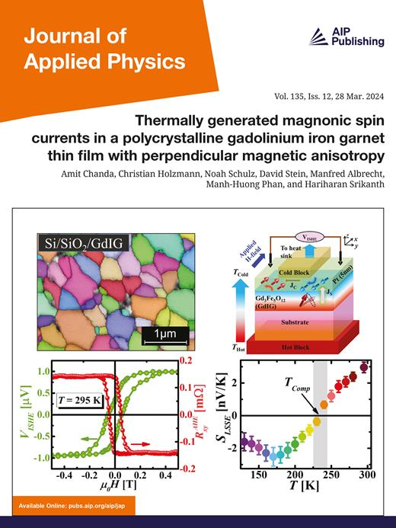
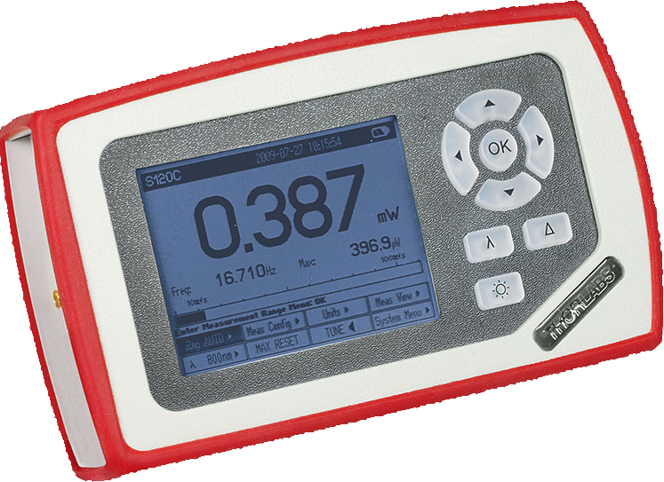
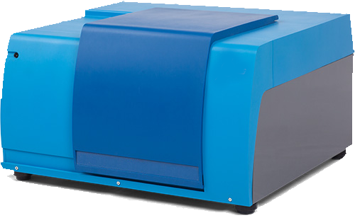
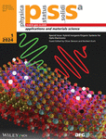
IV measuring
Isc(t) fitting
conclusion
2
3
8
shot-circuit
current
K depends on light
REDR !
current
voltage
time
K determination
solar cell illumination
quantifying FeB
decay
7
1
4
dsissosiation
rate
[Fe_{i} ]
Illumination time
carrier generation rate
lamps’ characterization
carrier generation rate estimation
5
6
intensity
wavelength

Slide 2

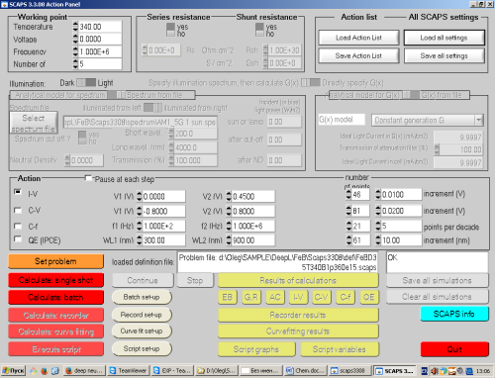
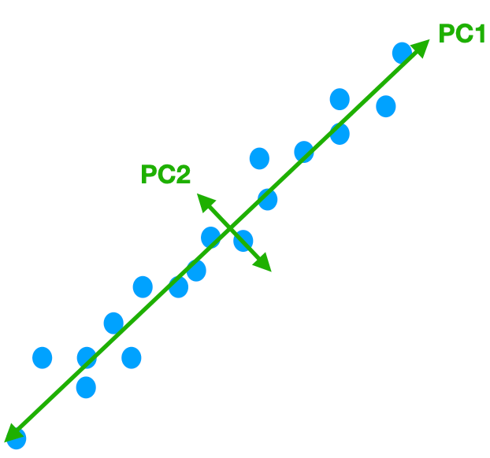
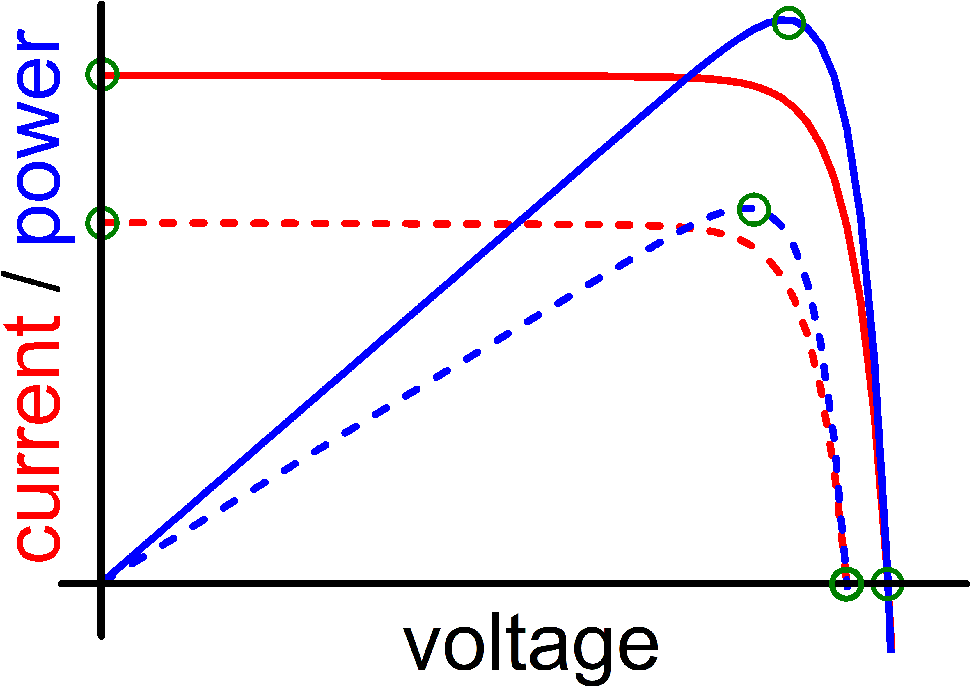
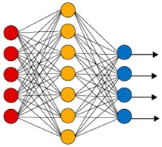
Data Collection
Data Pre-Processing
ML Algorithms
datasets
SCAPS
PCA
AM1.5
RF
train
GB
940 nm
XGB
simulation
SVR
DNN
measurement
N_{Fe}-altered
test
N_{B}-altered
T-altered
All-altered
experimental
Regression
Model Evaluation
MSE, MAPE, R²

Slide 3
datasets
SCAPS
PCA
AM1.5
train
940 nm
simulation
measurement
N_{Fe}-altered
test
N_{B}-altered
T-altered
RF
All-altered
GB
experimental
XGB
SVR
DNN

