Slide 1



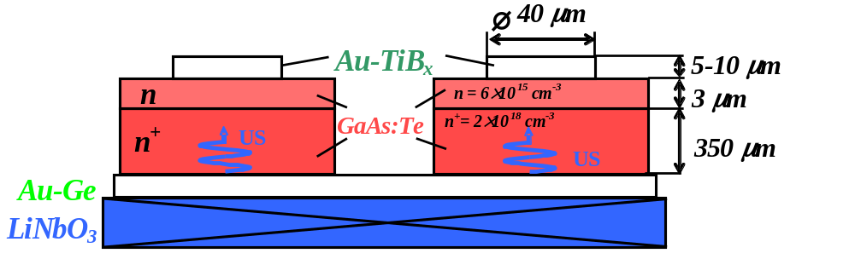
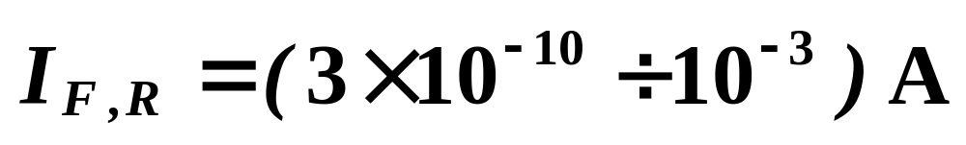
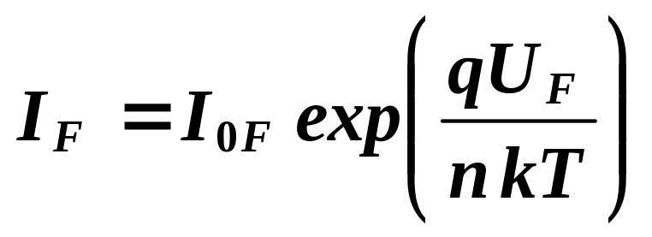


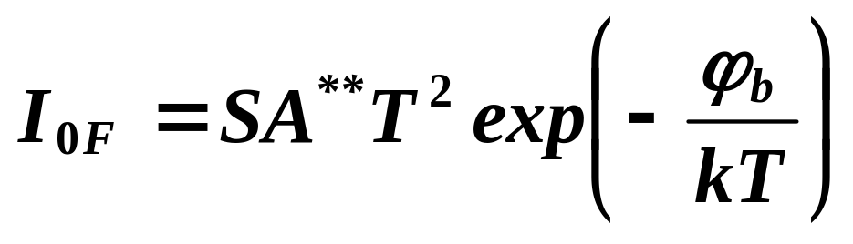

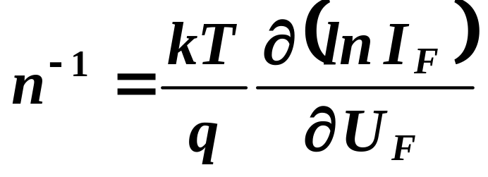
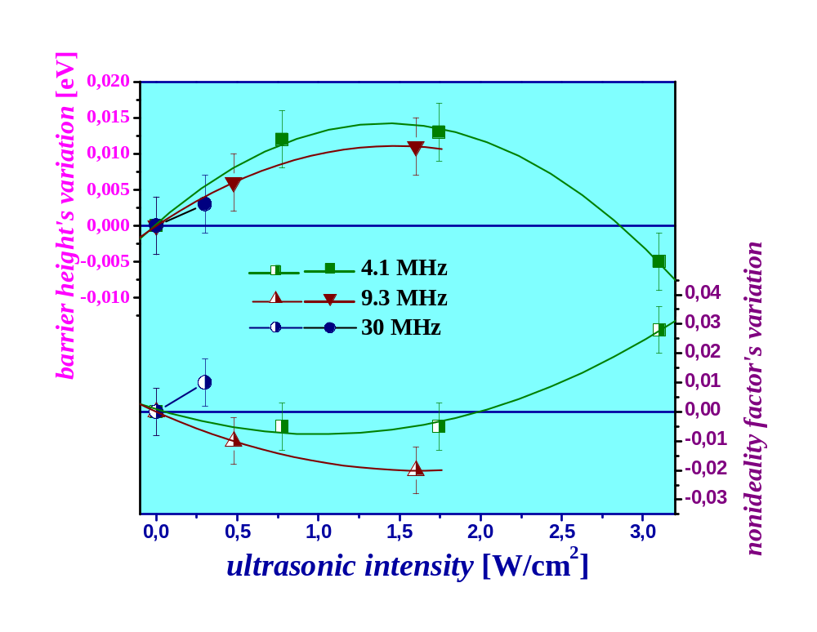
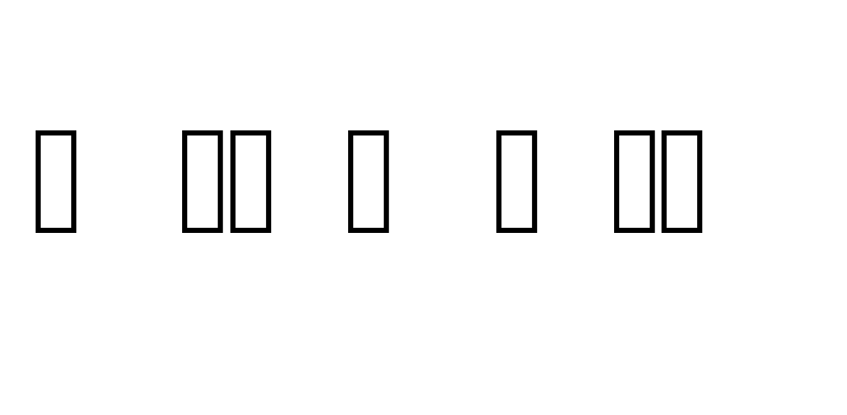
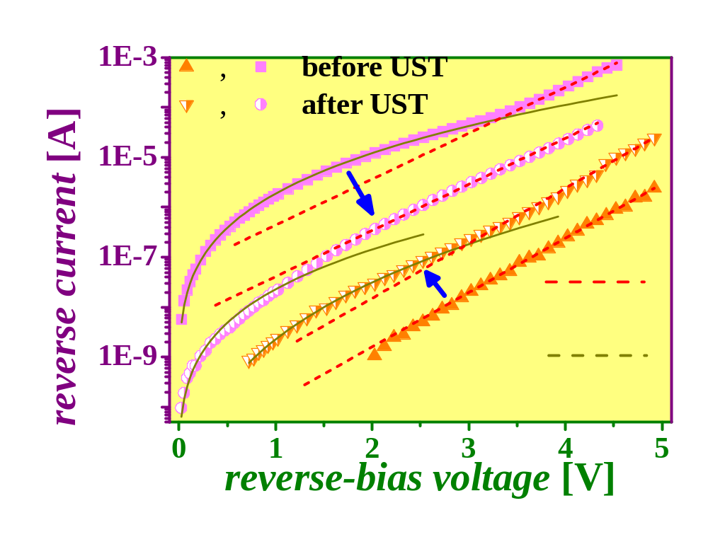
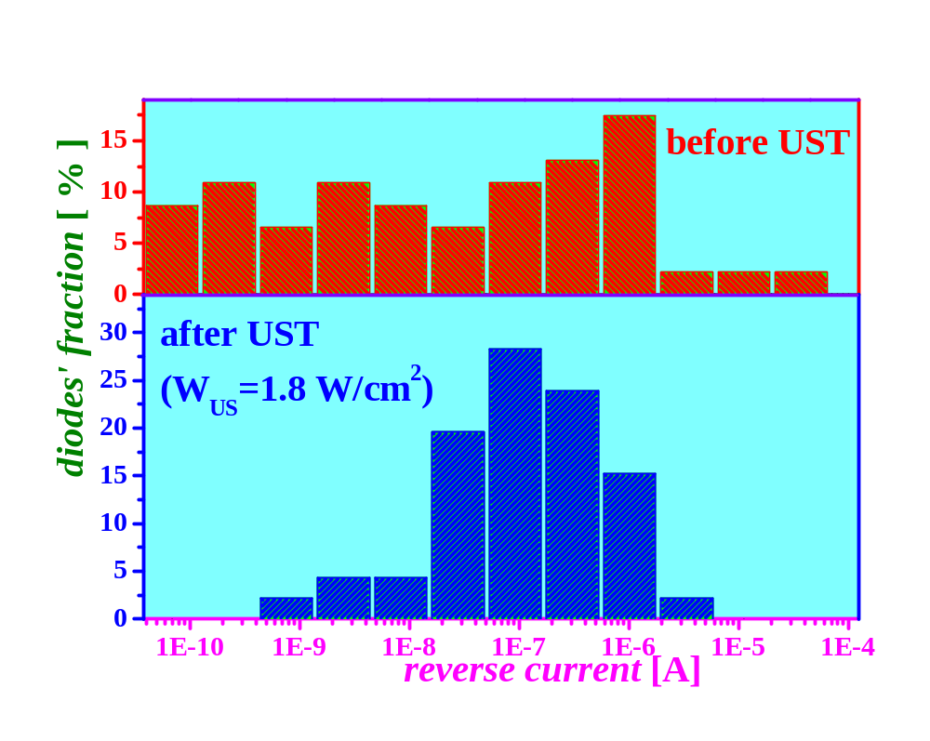
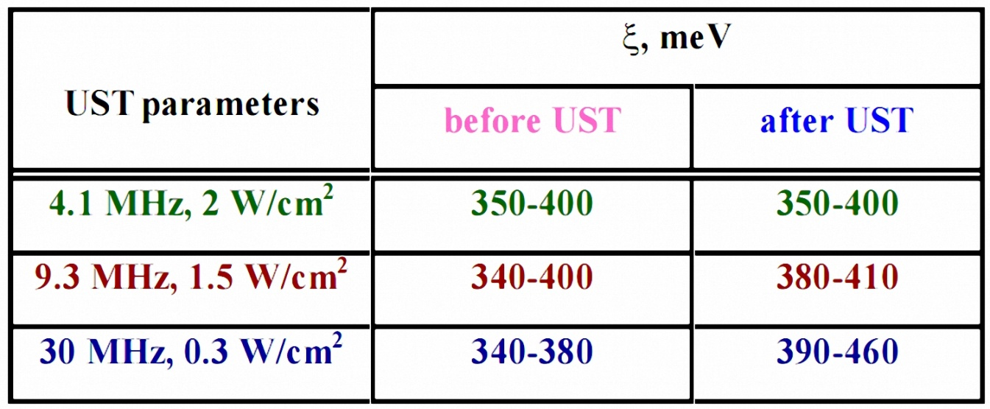

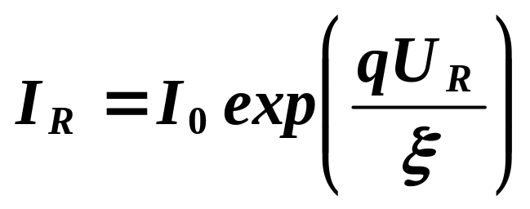
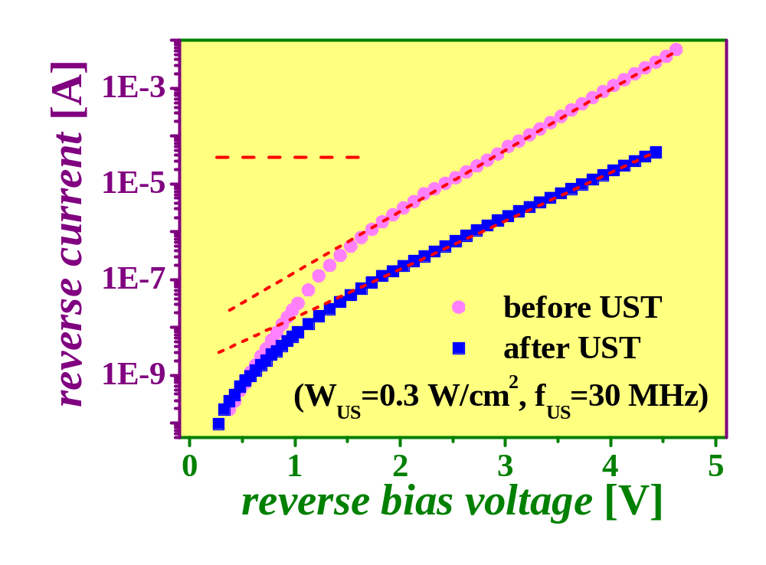
Abstract
The effect of ultrasonic treatment on the current–voltage characteristics of Au–TiB–n–n⁺-GaAs diode structures has been studied. It is revealed that ultrasonic treatment influences slightly (about 5 %) on Schottky barrier height and nonideality factor. The value of a reverse current may be changed by one or two orders of magnitude, and at low-intensity ultrasound the character of changes depend on prevailing mechanism of current transfer whereas at high-intensity ultrasound (>2.5 W/cm²) the reverse current increases in all cases. The existence of frequency dependence of ultrasound influence on metal-semiconductor structures’ parameters has been shown. It is revealed that ultrasonic treatment favors a significant increase in the homogeneity of the characteristics of devices manufactured using integral heat sink technology. The observed effects can be connected with acousto-induced smoothing of the local inhomogeneities of heterostructures’ interfaces and with defects redistribution and generation in ultrasonic field.
Experiment details
ultrasonic treatment (UST) characteristic
frequency f_{US} - 4.1, 9.3, 30 MHz
intensity W_{US} - up to 3 W/cm²
current-voltage measurements
duration t_{US} - 5 hour
I-U curves
nonideality factor
Results
Schottky barrier height ϕb
Diodes
1st group
2nd group
reverse current I_{R}<10⁻⁷ A
reverse current I_{R}>2×10⁻⁷ A
ln I_{R} ~ U_{R}
ln I_{R} ~ U_{R}^{1/4}
TUNNELING mechanism of current transfer
THERMIONIC mechanism of current transfer
ϕ _{b}=(0.730÷0.750) eV, n = 1.06÷1.08
Dependencies of an acousto-induced variations of ϕ _{b} and n versus ultrasonic treatment intensity
W_{US} < 2 W/cm²
IR
IR
UST
IR
(10-100) times
ln I_{R} ~ U_{R}
UST
IR
ln I_{R} ~ U_{R}^{1/4}
(10-500) times
W_{US} > 2.5 W/cm²
IR
IR
UST
The typical reverse branches of I–U curves for diodes of the first and second groups measured before and after UST (W_{US}=1.8 W/cm², f_{US}=4.1 MHz).
(10-100) times
IR
Histograms showing distributions of the reverse current (at U_{R}=2 V) before and after ultrasonic treatment
IR
UST
(10-100) times
charge carriers’ TUNNELING through the energy barrier is prevailing drift mechanism
[Semiconductors 31, 115 (1997); 34, 1305 (2000)]
charge carriers’ transition through a chain of deep levels formed by structural defects in the space charge region
ln I_{R} ~ U_{R}
The reverse branches of I–U curves measured before and after UST,
W_{US} =0.3 W/cm2, f_{US} =30 MHz.
I_{R} is determined by the concentration of defects creating deep levels
characteristic energy ζ depends on defect’s type
ultrasonic of higher frequencies influences semiconductor defect’s subsystem more effectively

