Slide 1

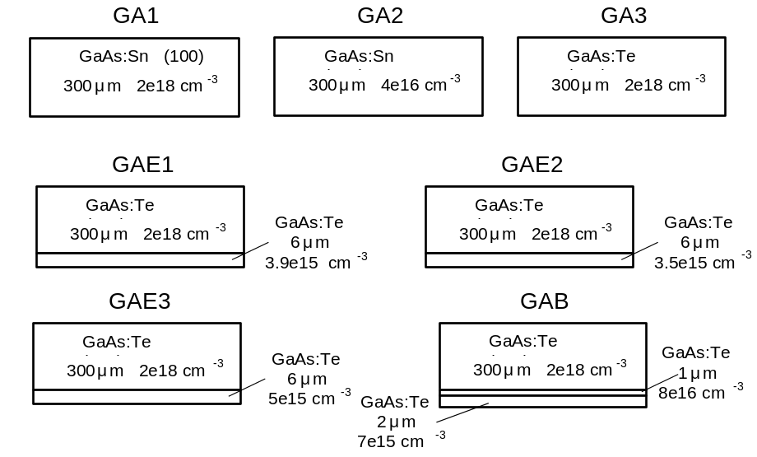
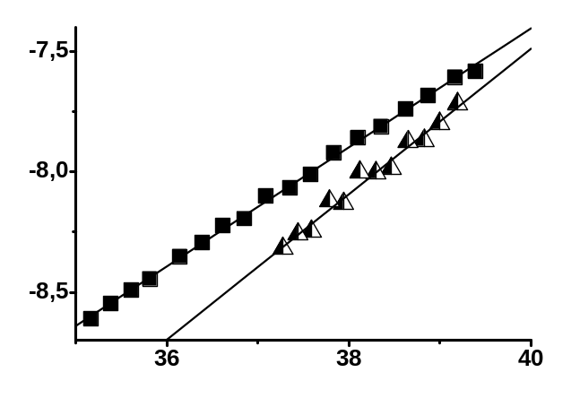
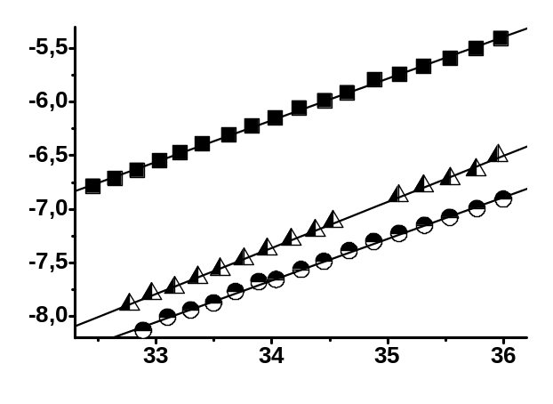
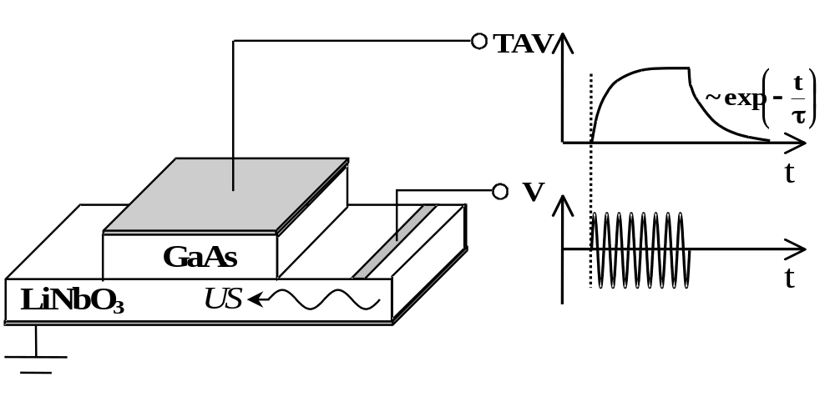
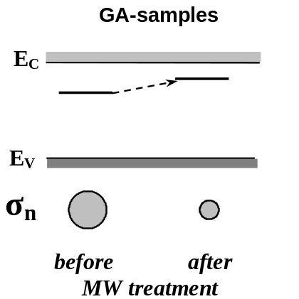
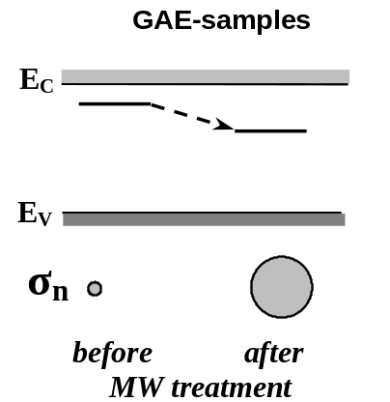

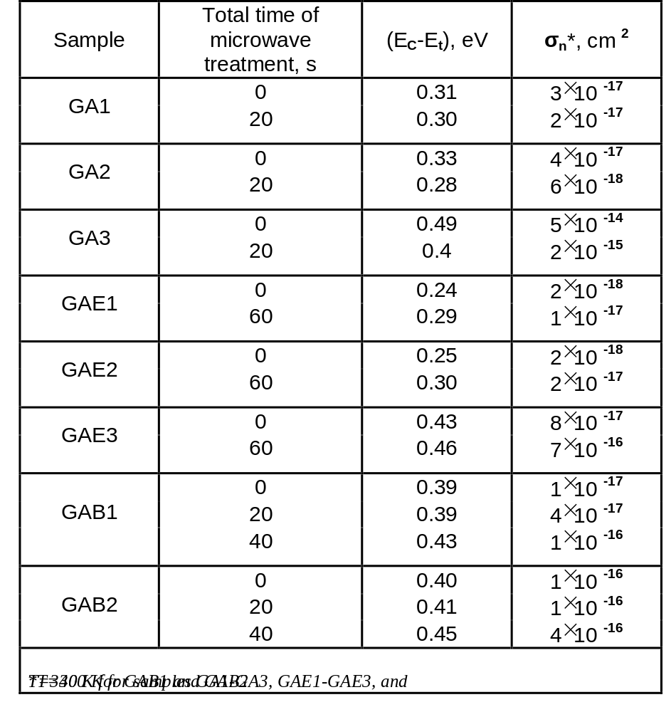


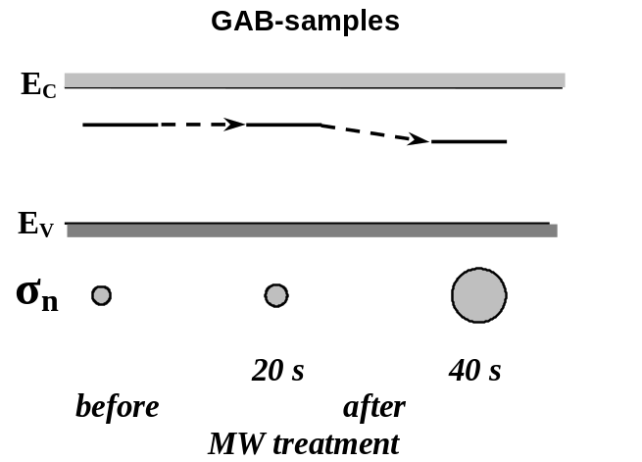

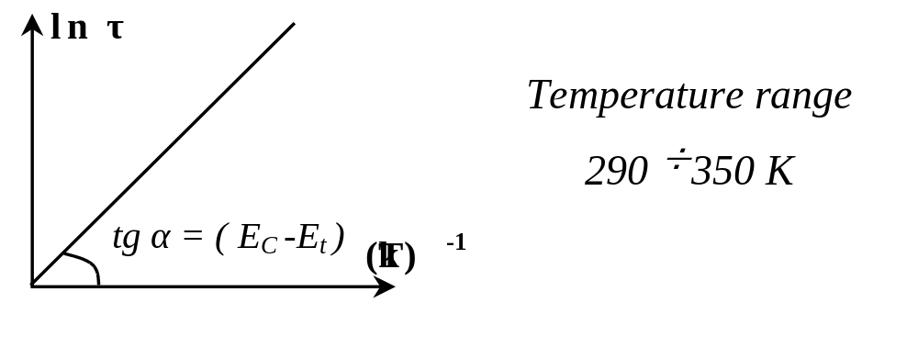
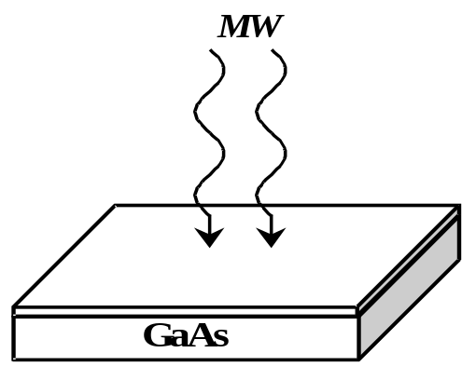
Acoustoelectric Transient Spectroscopy of Microwave Treated GaAs-Based Structures
O.Ya. Olikh
Department of General Physics, Physics Faculty, Kiev Shevchenko National University, Ukraine
e-mail: olikh@univ.kiev.ua
Abstract
The effects of microwave treatment influence on the cross section for electron capture and energetic level in forbidden gap of the deep levels at GaAs monocrystals and n-n⁺ epitaxial structures have been investigated using acoustoelectric transient spectroscopy
Samples
ln τ
ln τ
GAE2-sample
GAB1-sample
before
before
after, 40 s
The method of acoustoelectric transient spectroscopy
after, 60 s
after, 20 s
(kT) ⁻¹, eV ⁻¹
(kT) ⁻¹, eV ⁻¹
Results
– free electron thermal velocity
N_{c} – effective density of states at the bottom of the conductivity band
– electron capture cross section
– energy depth of the electronic trap level
Microwave Treatment
Conclusion
The microwave irradiation influence on the electron capture cross section and the energy level of centers in the forbidden gap of n-GaAs monocrystal and n-GaAs-based epitaxial structures has been investigated for the first time.
It is found that the deep level parameters are modified, and the character of changes is different for monocrystals and epitaxial structures.
The observed changes is likely to be due to defects gettering in the material surface layer and internal stress relaxation, induced by the microwave treatment applied.
frequency – 2.45 GHz
specific power density – 1.5 W/cm ²
treatment time – (20 ÷ 60) s
room temperature

