Slide 1

C-DLTS
Principle of operation and limits of application
E. Fretwurst
Institute for Experimental Physics, University of Hamburg
Principle of operation and basics
The C-DLTFFT-System at Hamburg
Different hardware tools
Principle of operation
Methods of defect parameter evaluation, limits and systematic errors
High Resolution option, basics, an example and practical limits
Summary
1 E. Fretwurst, University of Hamburg Workshop on Defects, Hamburg, August 23-2006

Slide 2
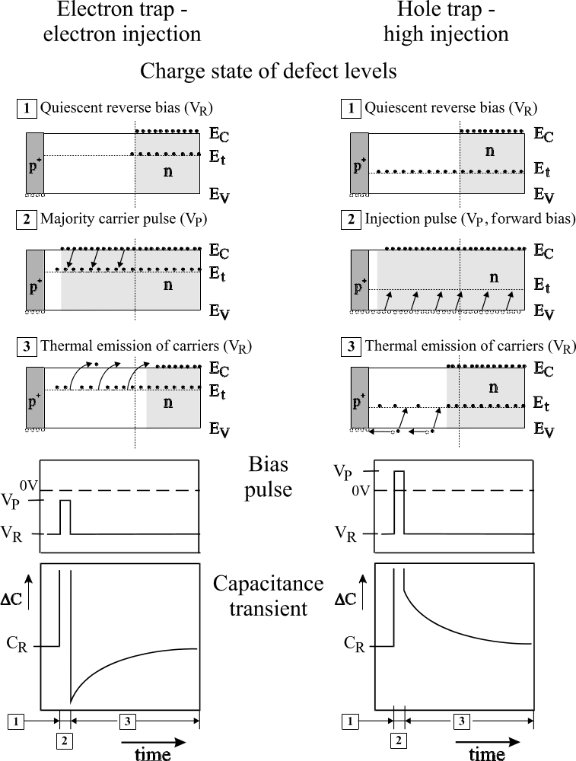
Principle of Operation
Traps in the space charge region of a p⁺-n diode
Left: Electron trap Right: Hole trap
[1] Constant reverse bias (V_{R})
traps empty traps filled
[2] Carrier injection (V_{p})
electron capture hole capture
[3] Thermal emission of trapped carriers (V_{R})
electron emission hole emission
Bias pulse
V_{p} < 0 V_{p} > 0
Capacitance transients ΔC(t) = C(t) – C_{R}
for t > t_{p}
negative positive
2 E. Fretwurst, University of Hamburg Workshop on Defects, Hamburg, August 23-2006

Slide 3
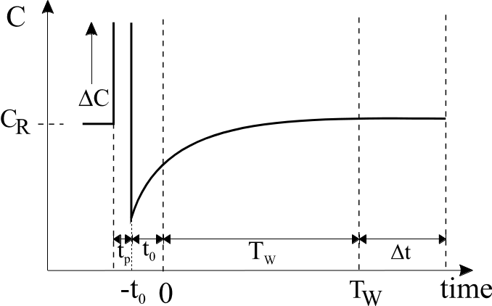
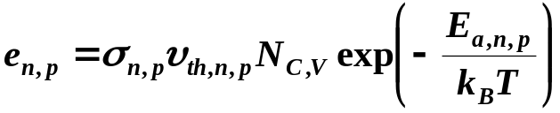
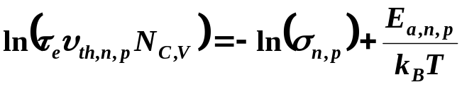
Transient analysis
Capacitance transient:
ΔC(t) = C(t) – C_{R} = ΔC₀·exp(-(t+t₀)/τ_{e})
Emisson time constant: 1/τ_{e} = e_{n} + e_{p}
for e_{n} » e_{p} → 1/τ_{e} = e_{n}
e_{n},e_{p} emission rates for electrons, holes
From measured transients as function of T:
→ τ_{e}(T) values are extracted
→ From Arrhenius plot activation energy E_{a,n,p} and capture
cross section σ_{n,p} can be extracted using:
assuming σ_{n,p} independent on T
⇒
Different DLTS techniques:
Analog signal processing:
double boxcar integrator
lock-in amplifier
analog correlator
Digital signal processing:
various correlator functions
Fast Fourier Transformation FFT
Laplace Transformation
Refolding of “period scans”
3 E. Fretwurst, University of Hamburg Workshop on Defects, Hamburg, August 23-2006

Slide 4
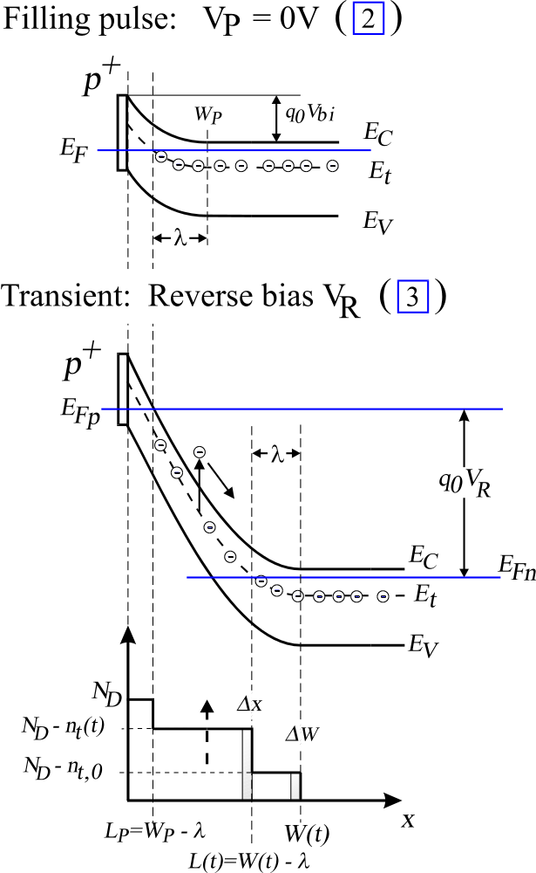
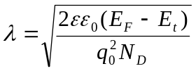
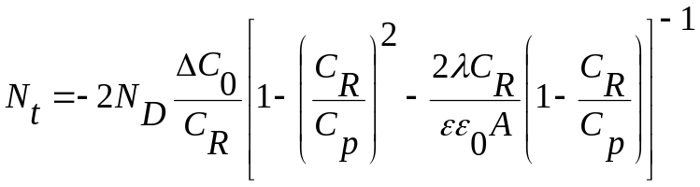
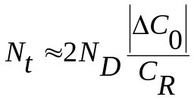
Determination of Defect Concentration
Band bending diagrams for deep acceptor:
[2] during filling pulse
[3] during transient phase
Transition region:
Defect concentration N_{t}:
Amplitude of the C-transient ΔC₀ ∝ N_{t}
For λ << W_{R} simplifies to:
4 E. Fretwurst, University of Hamburg Workshop on Defects, Hamburg, August 23-2006

Slide 5
Requirements, Limitations
C-DLTS requirement:
Exponential behavior of capacitance transient if
ΔC << C_{R} or N_{t} << N_{s}
Trap concentration << shallow doping concentration
→ This implies a limitation for the maximal particle fluence range which can
be investigated
E.g. for N_{s} = 10¹² cm⁻³, N_{t}/N_{s} = 0.1 and a defect with an introduction rate of
g = 1 cm⁻¹ the maximal fluence would be Φ_{max} ≈ 10¹¹ cm⁻²
Lower limit for detectable trap concentrations:
Depends on the sensitivity of the C-bridge and S/N ratio
E.g. for ΔC_{0,min} ≈ 5 fF, C_{R} ≈ 50 pF → (N_{t}/N_{s})_{min} ≈ 2(ΔC_{0,min}/C_{R}) ≈ 2·10⁻⁴
Limitations in the detection of trap levels:
Very shallow trap levels could not be measured due to freeze-out of free charge carriers
(w_{R} → d = diode thickness; C_{R} = C_{d} = constant)
Detection of very deep trap levels might be difficult since the change of the occupation
might be very small
Minority carrier trap levels could only be detected by forward biasing if c_{p} >> c_{n} ,
otherwise optical injection of minority carriers
5 E. Fretwurst, University of Hamburg Workshop on Defects, Hamburg, August 23-2006

Slide 6

DLTFFT-System in Hamburg
from PhysTech GmbH
PULSE
CONTROL
VOLTAGE
AMP
ANTI-ALIAS.
FILTER
TRANSIENT
RECORDER
PROCESSOR
Optical Injection
Bias: +/- 20 V
HV: +/- 100 V
t_{p} min: 1 µs
Rin = 1 MΩ
gain: 1-128
Bessel 8. order
1 Hz to 100 kHz
32 K d.p.
64xoversampl.
12 bit resolution
18 correl. functions
FFT processing
C compensation
FAST PULSE
Bias:+/- 16 V
t_{p} min: 10 ns
CRYOSTAT
DUT
PC
BOONTON 72B
Capacitance Meter
T-sensor
DT-470 SD
LakeShore 340
Temperature Controller
6 E. Fretwurst, University of Hamburg Workshop on Defects, Hamburg, August 23-2006

Slide 7
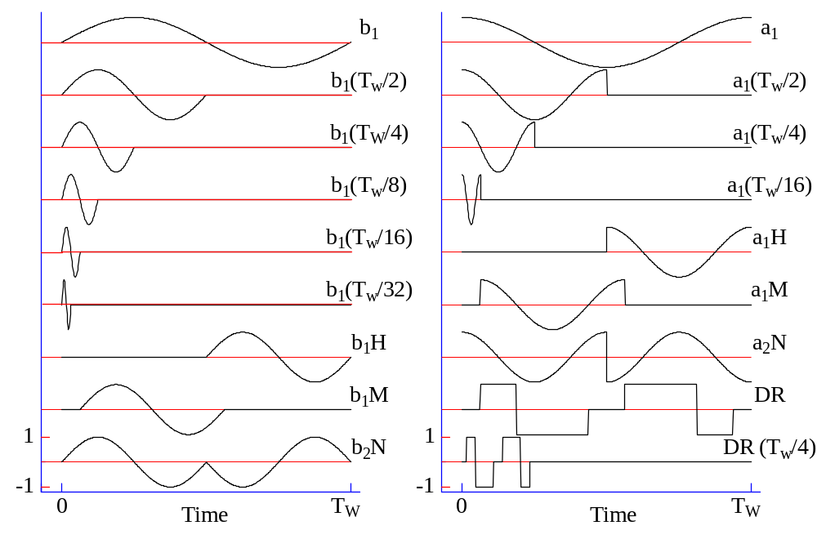
Digital signal processing
using 18 correlator functions
7 E. Fretwurst, University of Hamburg Workshop on Defects, Hamburg, August 23-2006

Slide 8
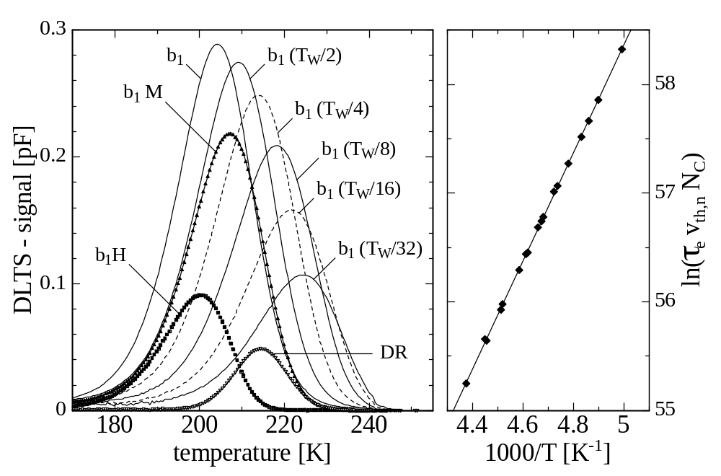
DLTS spectra and maximum analysis
DLTS spectra obtained with different correlators (left).
Arrhenius plot (right) contains data obtained with all 18 correlators.
( transition V^{(-/0)}, ⁶⁰Co γ−irrad. 10 Mrad; V_{R}=-10 V, V_{p}=0 V, T_{w}=200 ms, t₀=6 ms)
8 E. Fretwurst, University of Hamburg Workshop on Defects, Hamburg, August 23-2006

Slide 9
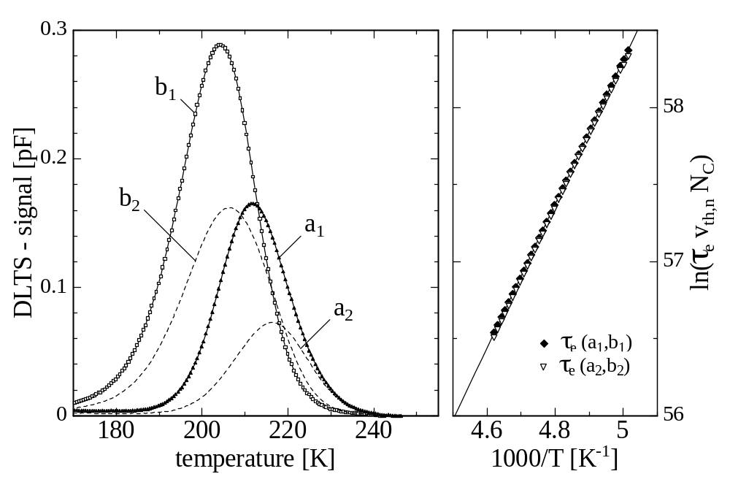
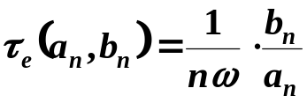
DLTFFT spectra and direct analysis
Direct evaluation:
The emission time constant can be evaluated from the correlator signals a_{n}(T), b_{n}(T) at all temperatures where the signals are above
a given threshold
E.g.
DLTS spectra obtained with sine and cosine correlators a₁, b₁, a₂ and b₂.
Same measurement as shown before. Arrhenius plot contains data obtained from the direct evaluation method.
9 E. Fretwurst, University of Hamburg Workshop on Defects, Hamburg, August 23-2006

Slide 10
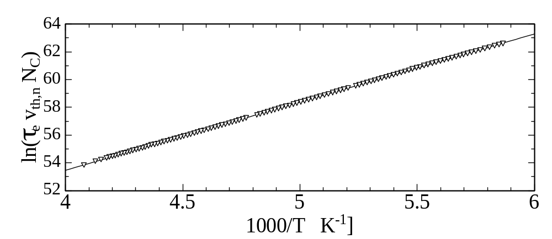
Variable time window method
Time window T_{w} is changed with temperature T
The ratio τ_{e}/T_{w} is kept constant (≈ 0.2) → optimal signal
τ_{e} values extracted from a_{n} and b_{n} for first T-steps
Program produces Arrhenius plot → allows calculation of optimal T_{w} for
the next temperature
Restriction: transients have to be exponential (estimated by the program)
Advantage: large T-range for the Arrhenius plot → accurate defect parameters
Draw back: no DLTS spectrum is produced
Example: Arrhenius plot for same defect as shown before. T-range: 170 – 245 K
10 E. Fretwurst, University of Hamburg Workshop on Defects, Hamburg, August 23-2006

Slide 11
Comparison of the three methods
Defect parameters obtained for the 3 different methods for V^{(-/0)}:
Type of evaluation E_{a} [eV] σ_{n} [cm²]
Maxima with 3 T_{w} 0.427 2.6×10⁻¹⁵
Direct with 3 T_{w} 0.420 1.7×10⁻¹⁵
Variable time window 0.424 2.2×10⁻¹⁵
T_{w} = 40, 200, 2000 ms
Recalculation of time constants for different temperatures:
Temperature 180 K 200 K 230 K
τ_{e} - maxima evaluation 3.05 s 157 ms 4.70 ms
τ_{e} - direct evaluation 2.97 s 160 ms 5.05 ms
τ_{e} - variable T_{w} 2.97 s 156 ms 4.77 ms
11 E. Fretwurst, University of Hamburg Workshop on Defects, Hamburg, August 23-2006

Slide 12
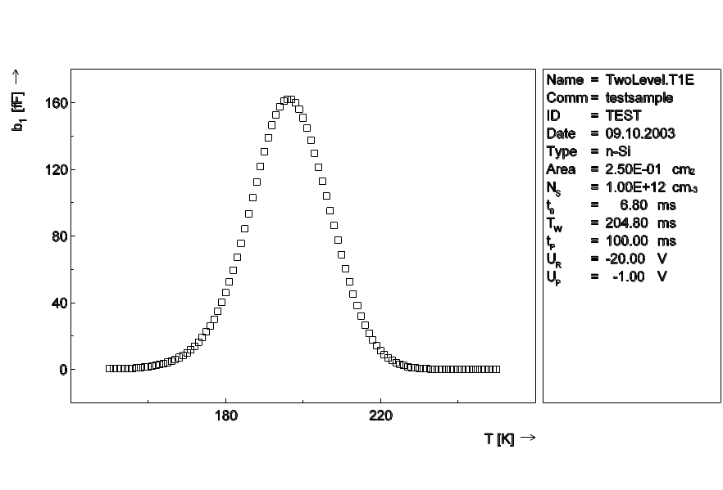
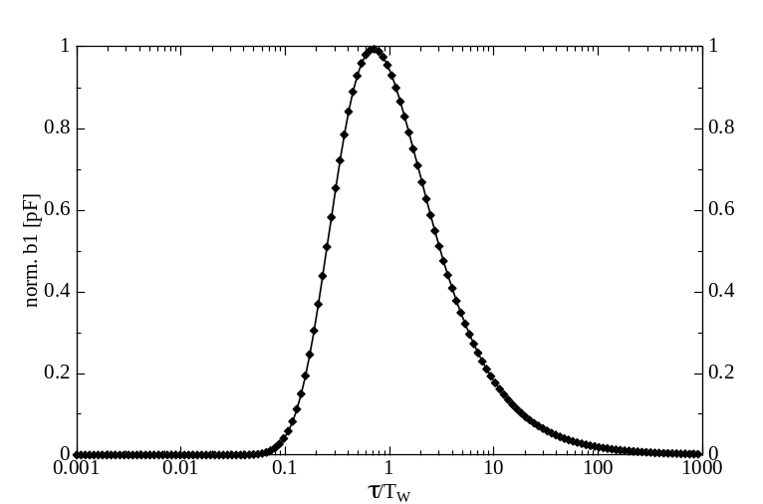
High resolution method
Principle of operation:
Period scan at constant temperature: Transients measured as function of T_{w} near the DLTS peak max.
Calculated correlator coeff. a_{n}(T_{w}), b_{n}(T_{w}) are normalized and transformed → a’_{n}(τ), b’_{n}(τ)
Refolding of a’_{n}(τ), b’_{n}(τ) → distribution function f(τ) (Gaussian-like) of the involved trap levels
Simulated DLTS spectrum for two levels with similar properties: E₁ = 0.410 eV, σ = 1·10⁻¹⁵ cm²
N₁ = 4·10¹⁰ cm⁻³; E₂ = 0.400 eV, σ = 2·10⁻¹⁵ cm²
N₂ = 6·10¹⁰ cm⁻³
Normalized b₁ coefficient versus τ/T_{w} with constant t₀/T_{w} = 0.25 (t₀: delay time after fill pulse, T_{w}: time window for recorded transient)
12 E. Fretwurst, University of Hamburg Workshop on Defects, Hamburg, August 23-2006

Slide 13
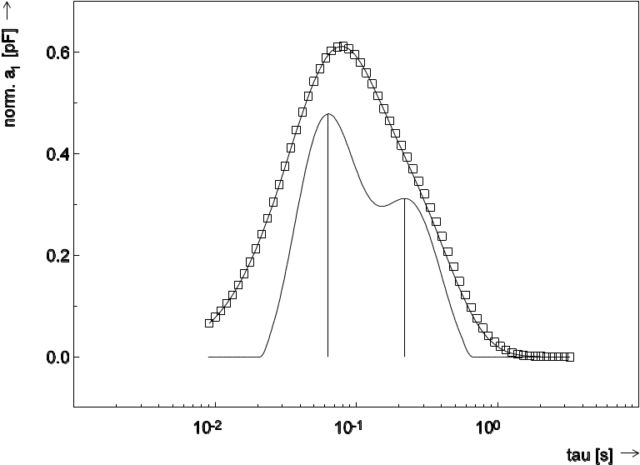
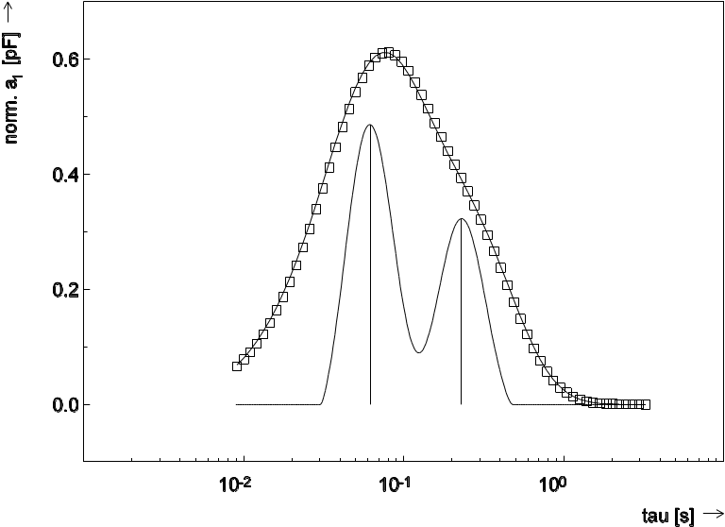
Refolded spectra
Refolding of the normalized coefficient a’₁(τ) with order N₁= 40 (left) or N₂ = 60 (right)
[N is related to the width of the distribution function of the τ values (Gauss-like)]
Squares: transformed data points of measured transients during T_{w} scan
Solid lines: refolded function f(τ) for two levels for different order N
Vertical lines: indicate the peak maxima
Results from simulations at different temperatures:
For both trap levels the parameters E_{a}, σ_{n} and N_{t} are well reproduced
ΔE_{a}/E_{a} ≤ 0.5 %, Δσ_{n}/σ_{n} ≤ 10 %, ΔN_{t}/N_{t} ≤ 1 %
Limitations: Time constants of transitions should differ by a factor of > 2 and the ratio of the concentrations should be ≥ 0.1
13 E. Fretwurst, University of Hamburg Workshop on Defects, Hamburg, August 23-2006

Slide 14
Summary
C-DLTS is a very powerful tool for:
Evaluation of defect parameters (majority and minority carrier traps):
- Activation energy E_{a} and capture cross sections σ_{n,p}
- Accuracy of E_{a} and σ_{n,p} depends on S/N of transients, accuracy of T
measurement, extent of temperature range and evaluation method
- Direct measurement of σ via variation of filling pulse duration, with fast pulse
option σ ≈ 10⁻¹² cm² detectable (e.g. for TD)
- Separation of closely spaced trap levels possible by Laplace- or High Resolution-
DLTS (limited by minimal τ difference and ratio of trap concentrations)
Evaluation of trap concentrations N_{t}:
- N_{t}/N_{s} ∝ ΔC/C_{R} → sets lower and upper limit for detectable N_{t},
- (N_{t}/N_{s})_{min} ≈ 10⁻⁴, (N_{t}/N_{s})_{max} ≈ 0.1 (ΔC « C_{R}), for higher values up to 0.4 CC-DLTS
- Accurate N_{t} evaluation needs λ correction
- N_{t} depth profiles could be measured by variation of fill pulse and reverse bias
14 E. Fretwurst, University of Hamburg Workshop on Defects, Hamburg, August 23-2006

