Slide 1
REACTIONS OF INTERSTITIAL CARBON WITH BACKGROUND IMPURITIES IN N- AND P-TYPE SILICON STRUCTURES
L.F. Makarenko*, L.I. Murin** , M. Moll***,
F.P. Korshunov**, S.B. Lastovski**
* Belarusian State University, Minsk, Belarus
**Institute of Solid State and Semiconductor Physics, Minsk, Belarus
***CERN, Geneva, Switzerland

Slide 2
Modeling of radiation induced defect kinetics plays an important role in finding ways to improve radiation hardness of silicon particle detectors. It helps to predict effects of different impurities on radiation damage.
But is it enough experimental data for correct modeling?
Let’s consider a part of such modeling related to interstitial carbon reactions.

Slide 3
The description of C_{i} reactions is based on three assumptions which are valid for low irradiation fluences:
Substitutional carbon (C_{s}) atoms are the main traps for silicon intersitials in high resistivity silicon crystals.
Only isolated carbon atoms in interstitial position created by the Watkins replacement mechanism are the only source of mobile carbon species responsible for the formation of carbon related complexes stable at room temperature.
Kinetics of their formation at low irradiation fluences is controlled by C_{i} diffusion coefficient and C_{i} capture radii by oxygen, substitutional carbon and doping impurities (phosphorous etc.).
First, it is the appearance of interstitial carbon in Si
C_{s} + Si_{i} → C_{i} + Si_{s}
Reaction of mobile interstitial carbon with other impurities
C_{i} + O_{i} → C_{i}O_{i} (1)
C_{i} + C_{s} → C_{i}C_{s} (2)

Slide 4
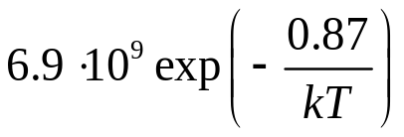
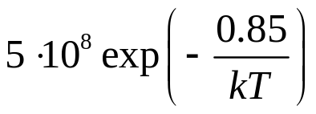
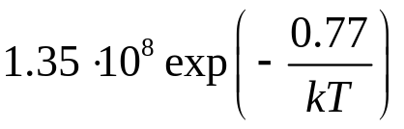
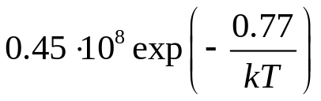
Table 1. Experimental data on interstitial carbon lifetime limited by oxygen and carbon trapping
Research group | Trapping rate by 10¹⁶ cm⁻³ of O_{i}, s⁻¹ | Trapping rate by 10¹⁶ cm⁻³ of C_{s}, s⁻¹ | Ratio of capture radii | Experi-mental method
UK (G. Davies et al.) | ⎯ |  | 1/3 | IR
USA (L.Kimerling et al.) |  | ⎯ | 1 | DLTS
USSR (L. Murin et al.) |  |  | 3 | Hall effect

Slide 5
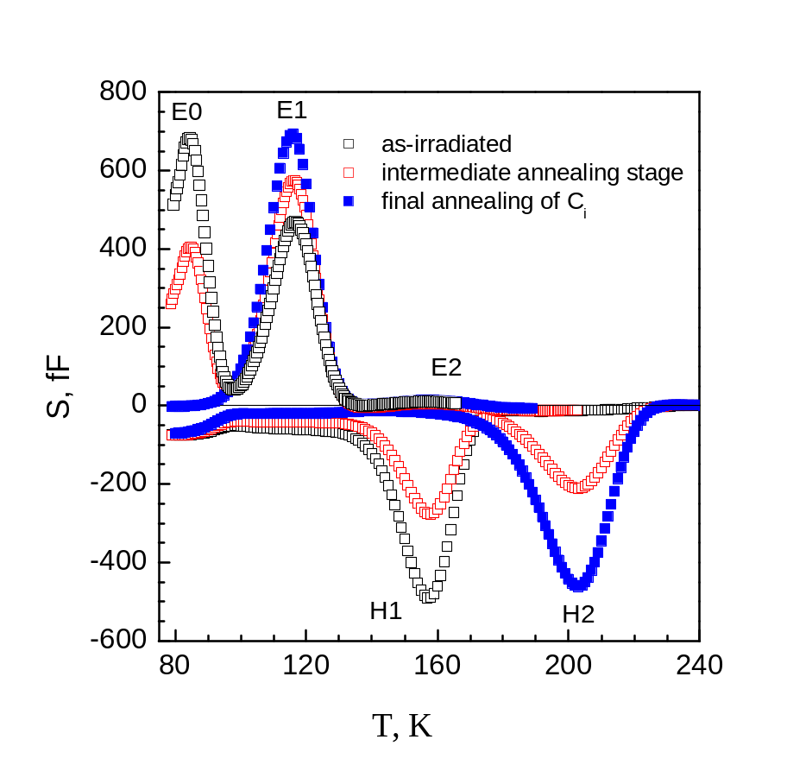
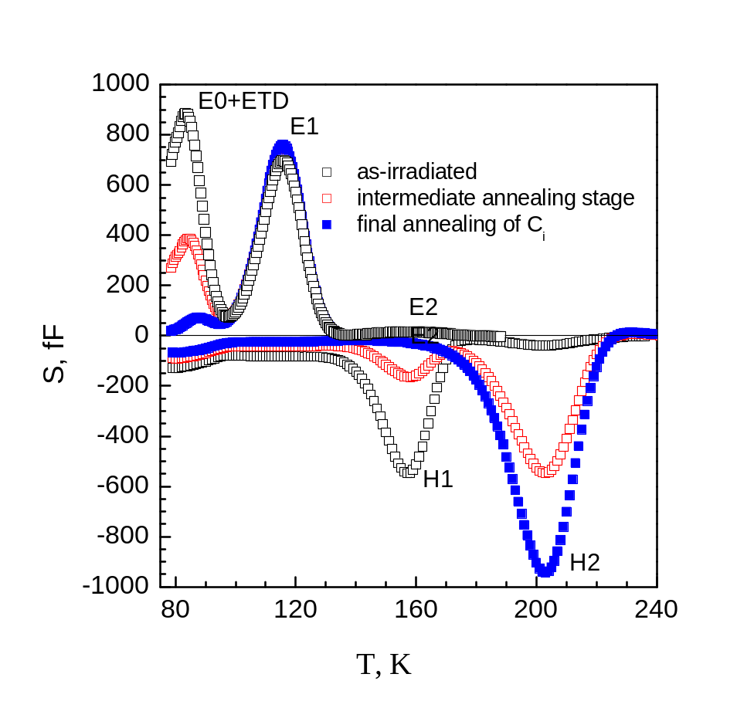
Fig. 1. DLTS spectra obtained for STFZ (a) and DOFZ (b) detectors
Ci: E(-/0)=Ec − 0.12 eV (E0),
E(0/+)=Ev + 0.28 eV (H1);
CiOi: E(0/+)=Ev + 0.36 eV (H2);
CiCs: E(-/0)=Ec −0.17 eV (E1b),

Slide 6
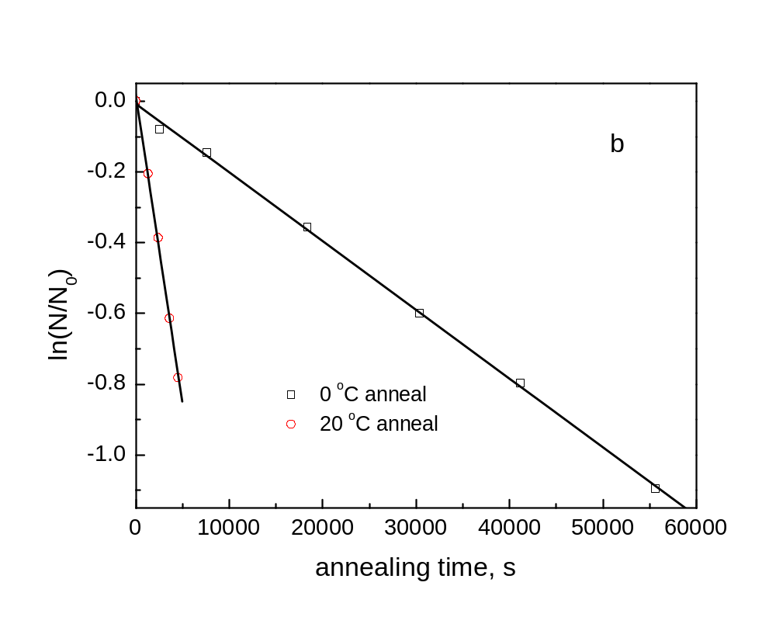
Fig.2. Annealing kinetics E0 peak in DOFZ detectors

Slide 7
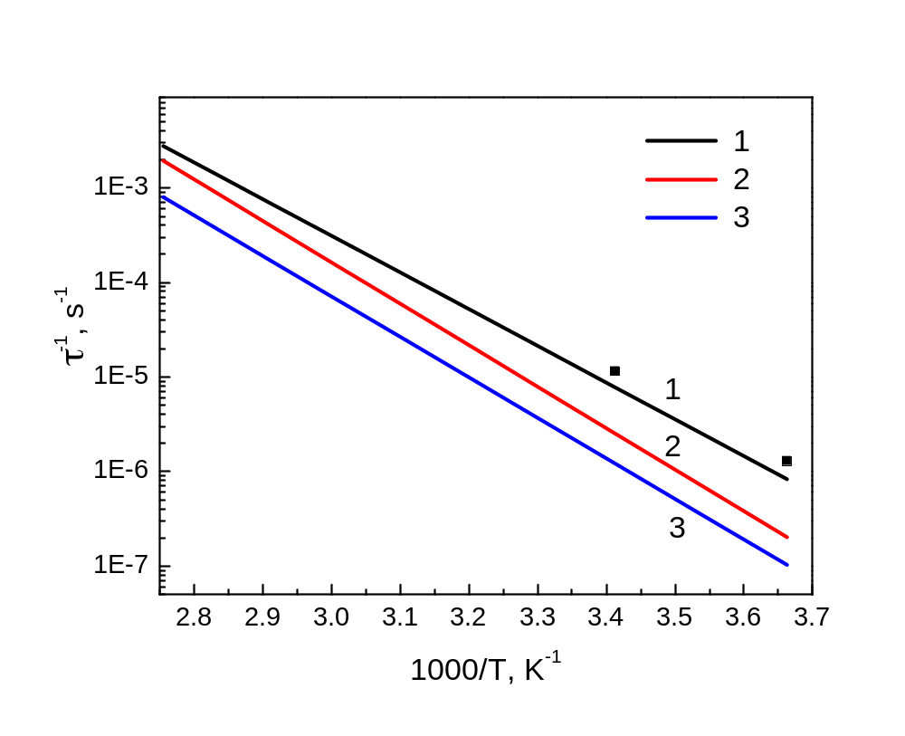
Fig.3. Comparison of rates of C_{i} and O_{i} reactions for
[Oi]=10¹⁶ cm⁻³, obtained by different researchers:
USSR – (1), UK – (2), USA – (3). Points present our results fot DOFZ detectors (CD-diodes). Oxygen content was chosen equal to 1.7⋅10¹⁷ cm⁻³ according to SIMS data.

Slide 8
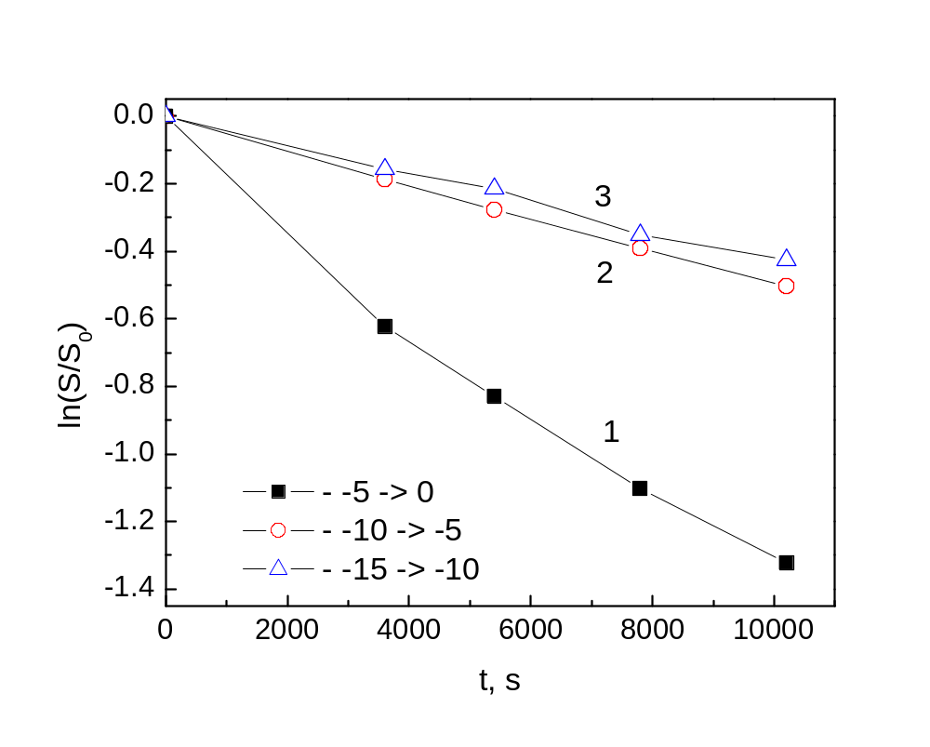
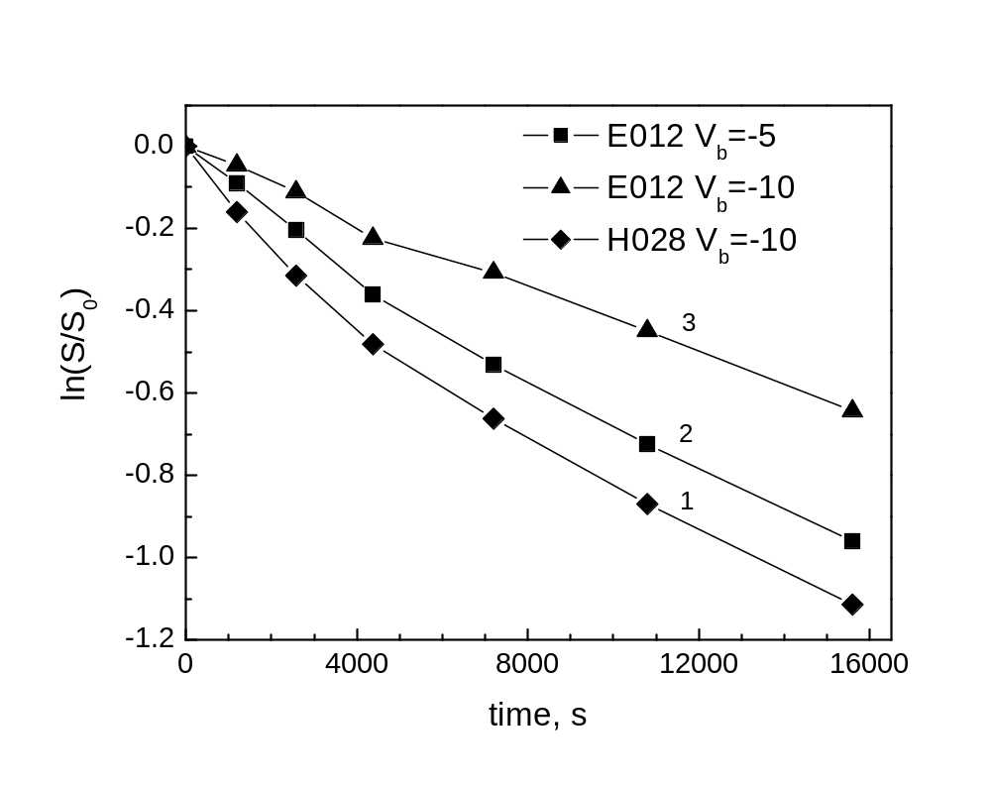
Fig.4. Annealing kinetics of E0 (C_{i}^{(-/0)}) peak in STFZ detector DLTS signal was measured at different bias voltages -5 V and -10 V for <100> diode. Filling pulse amplitude was 5 V. Annealing temperature was 60 °C.
Fig.5. Annealing kinetics of H1 (C_{i}^{(0/+)}) (1,4) and E0 (C_{i}^{(-/0)}) (2,3,5,6,) peaks in STFZ detector DLTS signal was measured at different bias voltages -5 V (2,5) and -10 V (1,3,4,6 ) for <111> diode. Filling pulse amplitude was 5 V. Annealing temperature was 60 °C.

Slide 9
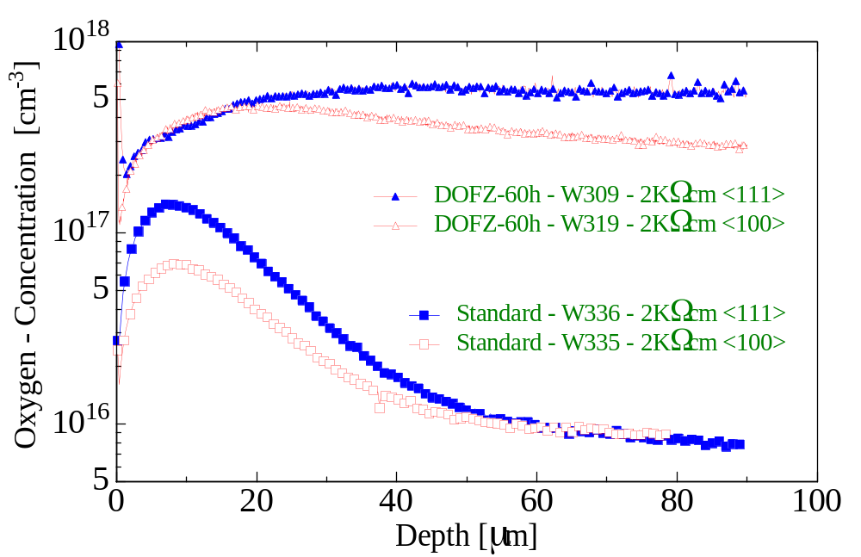
Fig.6. Oxygen profile in Si detectors measured by SIMS.

Slide 10
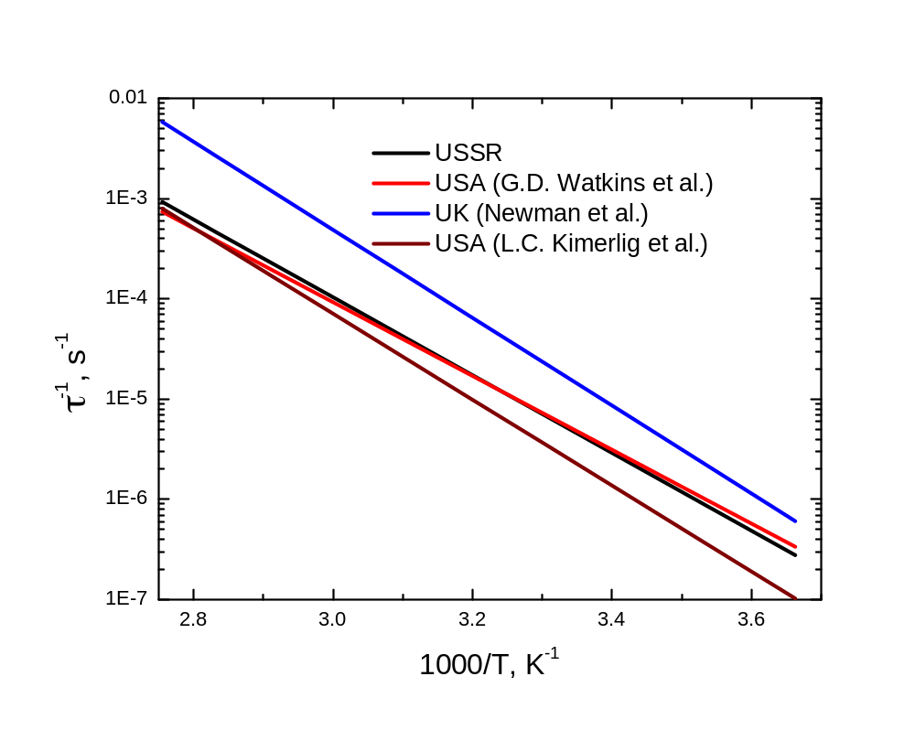
Fig.7. Comparison of rates of Ci and Oi reactions for
[Oi]=1016 cm-3, obtained by different researchers:
USSR – (1), UK – (2), USA – (3).

Slide 11

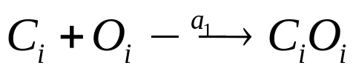
The difference between p- and n-Si detectors is related to the formation of C_{i}O_{i} precursor (C_{i}O_{i}*) in p-type material. The existence of the this complex has been evidenced both by IR measurement. As it has been shown in earlier not all C_{i} atoms form directly C_{i}O_{i} complex. A fraction of C_{i} is kept in the form C_{i}O_{i}* complex which only afterwards transforms to stable CiOi configuration.
Energy level of C_{i}O_{i}* is about E_{v}+0.34 eV which is only about 0.02 eV less than energy level of C_{i}O_{i}. However it is enough to distinguish these defects from each other.
There are no evidence of the formation of C_{i}O_{i}* in n-Si obtained by DLTS. It was observed only p-type diodes or strongly irradiated Si crystals used for IR studies.

Slide 12
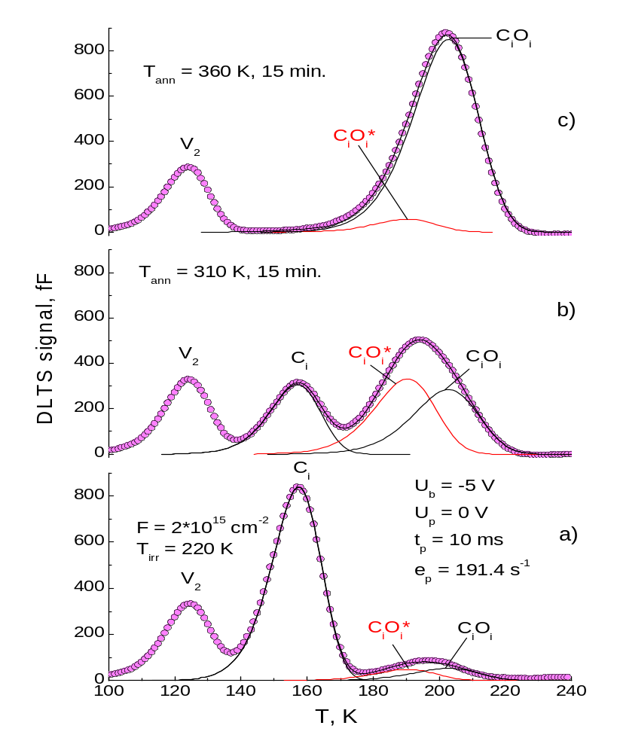
Fig. 8. Evolution of the DLTS spectra for a p-type Si (ρ=18 Ohm⋅cm) upon isochronal annealing. The spectra were measured after irradiation with 3.5 MeV electrons for a dose of 2⋅10¹⁵ cm⁻² at about 220 K (a), after 15 min anneals at 310 K (b) and 360 K (c). The solid lines are fitting curves obtained by a least-square procedure.

Slide 13
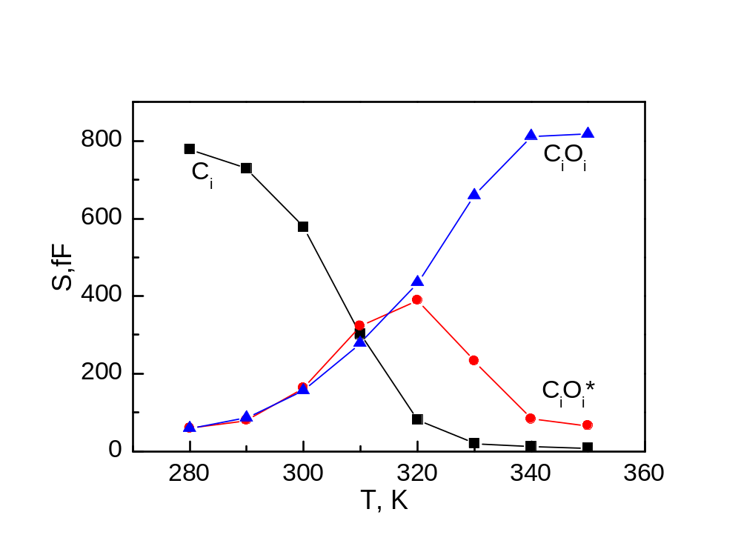
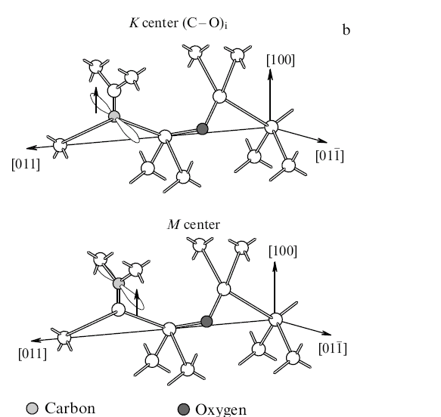
Fig. 9. Isochronal annealing behavior of the C_{i}, C_{i}O_{i}* and C_{i}O_{i} defects.
Fig. 10. Models of K center [Trombetta, Watkins 1987] and M-center [Mukashev et al., 2000].

Slide 14
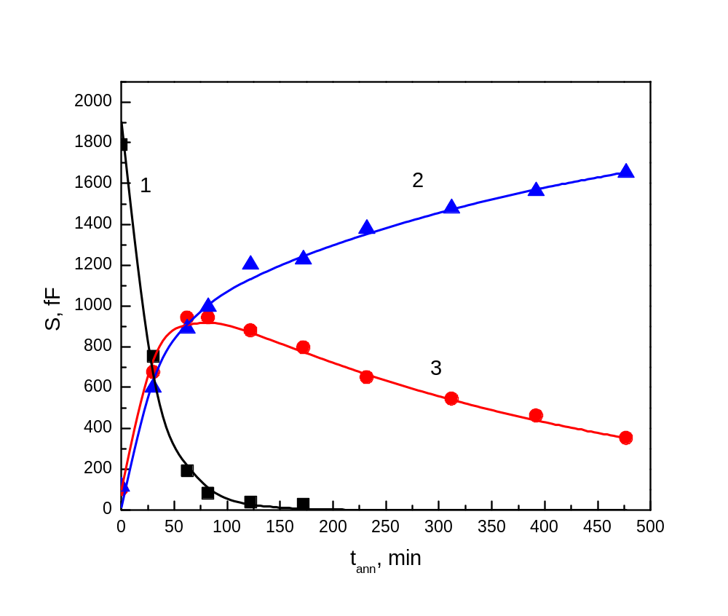
Fig.11. Fitting of isochthermal annealing data.

Slide 15
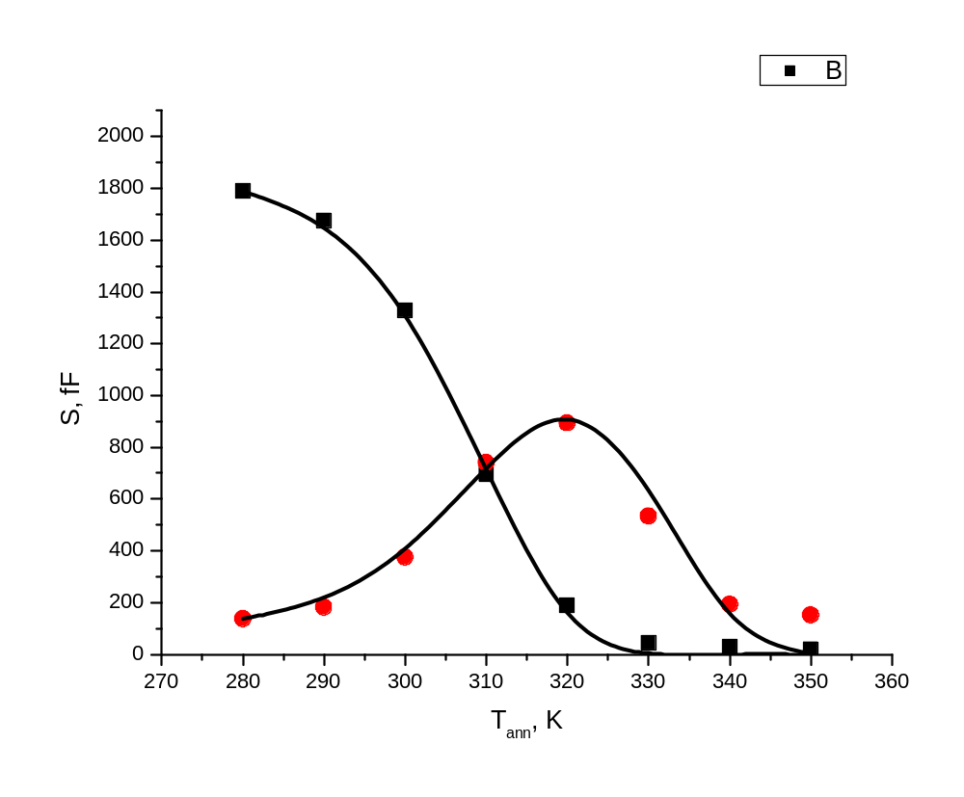
Fig.12. Fitting of isochronal annealing data.
E_{ann}(C_{i})=0.77 eV, E_{r}(C_{i}O_{i}*)=1.06 eV.

Slide 16
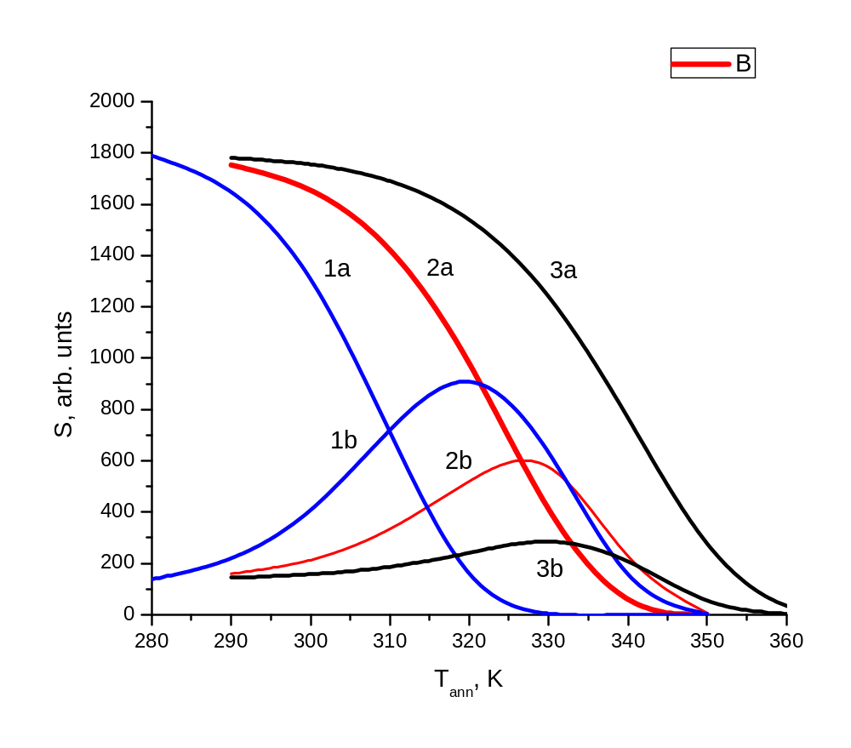
Fig.13. Modeling of CiOi* formation during isochronal ennealing in p-Si crystals with different oxygen content. [O_{i}] decreases with the number of the curve.

Slide 17
Conclusions
It seems that to treat Ci annealing data in the interval 0-20 °C data of Markevich and Murin for oxygen content determination in n-Si are most appropriate.
In p-Si there occurs the formation of metastable CiOi* complex. This process should be taken into account while modeling interstitial carbon reactuions.
It has been shown that the rate of interstitial carbon annealing in detectors made of high resistivity silicon depends on the distance from the diode surface. This is first of all caused by inhomogeneous depth distribution of oxygen in fully processed detectors.
Interstitial carbon reactions can be used to monitor background impurity content and their depth distribution in fully processed detector structures

