Slide 1


Room Temperature Defect Annealing in High-Purity N-type Si
J.H. Bleka et al.
University of Oslo, Department of Physics, Physical Electronics,
P.O. 1048 Blindern, N-0316 Oslo, NORWAY
^{and}
University of Oslo, Centre for Materials Science and Nanotechnology P.O. 1128 Blindern, N-0318 Oslo, NORWAY
Department of Physics

Slide 2
Samples
P⁺- n⁻ - n⁺ Si diodes, standard process by SINTEF
  MCz, SFz – as processed
  MCz, SFz – pre-annealed at 450 ºC for 1h
  MCz, SFz – hydrogenated in HF + 450 ºC, 1h
6 MeV electrons at RT, 2-5x10¹² cm⁻²
Storage at RT

Slide 3
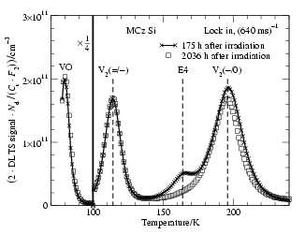
P⁺-n⁻-n⁺ MCz diode
N_{d}~5x10¹² cm⁻³
6 MeV e⁻, 5x10¹² cm⁻²
Bleka et al., ECS Trans, in press (2006)

Slide 4
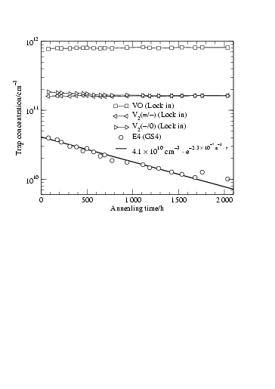
VO, V₂^{=/-}, V₂^{-/0} and E4 vs time at RT
P⁺-n⁻-n⁺ MCz diode
N_{d}~5x10¹² cm⁻³
6 MeV e⁻, 5x10¹² cm⁻²

Slide 5
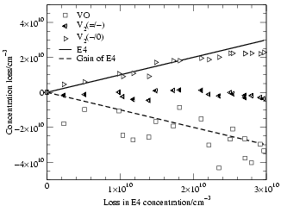
Loss of VO, V₂^{=/-} and V₂^{-/0} vs loss of E4
P⁺-n⁻-n⁺ MCz diode
N_{d}~5x10¹² cm⁻³
6 MeV e⁻, 5x10¹² cm⁻²

Slide 6
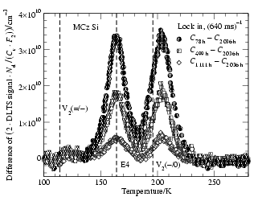
Difference between DLTS spectra
E5
P⁺-n⁻-n⁺ MCz diode
N_{d}~5x10¹² cm⁻³
6 MeV e⁻, 5x10¹² cm⁻²
E4
E_{c}-0.37 eV
σ_{app}~10⁻¹⁴ cm²
E5
E_{c}-0.45 eV
σ_{app}~3x10⁻¹⁵ cm²

Slide 7
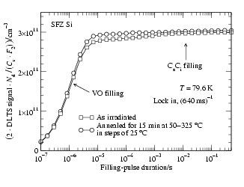
Filling pulse measurements for the VO peak
P⁺-n⁻-n⁺ SFz diode
N_{d}~4x10¹² cm⁻³
6 MeV e⁻, 2x10¹² cm⁻²
C_{s}C_{i} (and C_{i}) is not involved in the annealing of E4/E5

Slide 8
Further observations
E4/E5 occur with the same relative initial concentration (~25% of [V₂]) and exhibit the same annealing rate at RT irrespective of
MCz (as-processed, pre-annealed, pre-annealed+hydrogenated),
SFz (as-processed, pre-annealed, pre-annealed+hydrogenated) and
DOFZ (as-processed, pre-annealed, pre-annealed+hydrogenated)

Slide 9
Speculations
V + Y ↔ E4
V + O_{i} → VO
[Y] ~ [E4][O_{i}]/[VO] ≈ 2x10¹⁶ cm⁻³
Y=C_{s}?? Not consistent with the results for oxygen-lean SFz

Slide 10
Speculations
V + Y ↔ E4
V + O_{i} → VO
[Y] ~ [E4][O_{i}]/[VO] ≈ 2x10¹⁶ cm⁻³
Y=C_{s}?? Not consistent with the results for oxygen-lean SFz
E4 → VO + Y
Y = Si_{i} ??
Further work remains

Slide 11
Acknowledgements
Financial support from
- the Norwegian Research Council (NFR – Strategic programs on micro/nanotechnology and materials science (NANO/FUNMAT))
the Nordic Research Training Academy (NorFA)
- University of Oslo (Functional materials program)
is gratefully acknowledged.

