Slide 1
Infrared Spectroscopy IR
(FTIR)
Leonid Murin ^{1,2}
¹ Joint Institute of Solid State and Semiconductor Physics, Minsk, Belarus
² Oslo University, Centre for Materials Science and Nanotechnology, Oslo, Norway

Slide 2
OUTLINE
Some general notes
Electronic transitions
Local Vibrational Mode spectroscopy

Slide 3
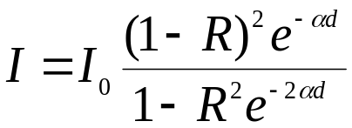
BACKGROUND - WHAT IS MEASURED
The light transmitted through a sample of thickness d with
polished parallel surfaces is described as
where:
I₀ is the light intensity incident on the sample
α is the frequency dependent absorption coefficient
R is reflectivity (R ≈ [(n-1)/(n+1)]² ≈ 0.3 in the mid infrared)

Slide 4
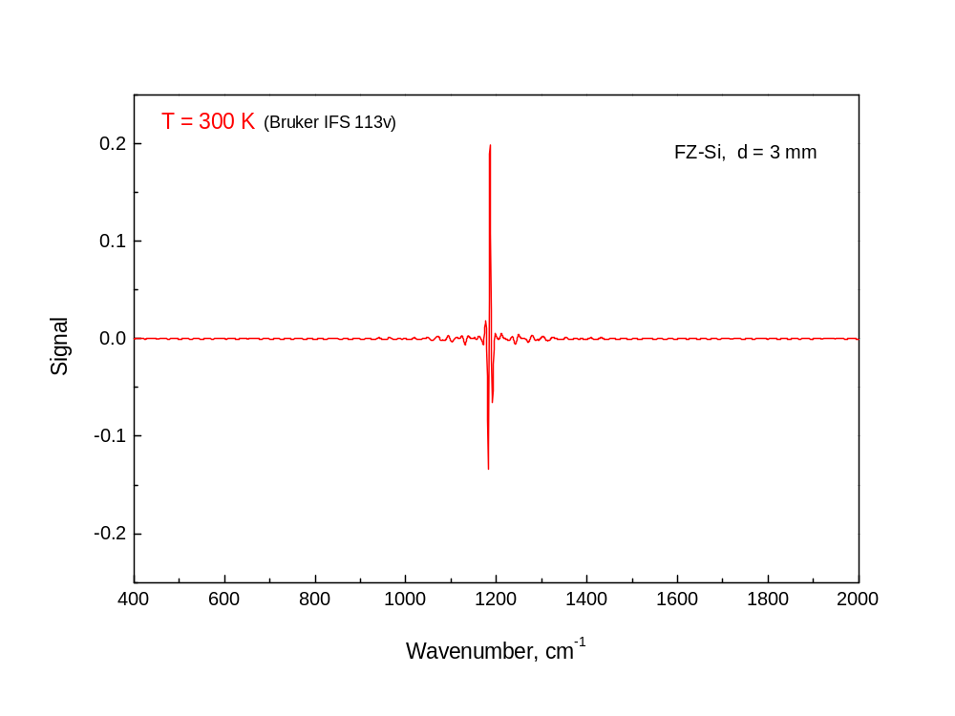

Slide 5
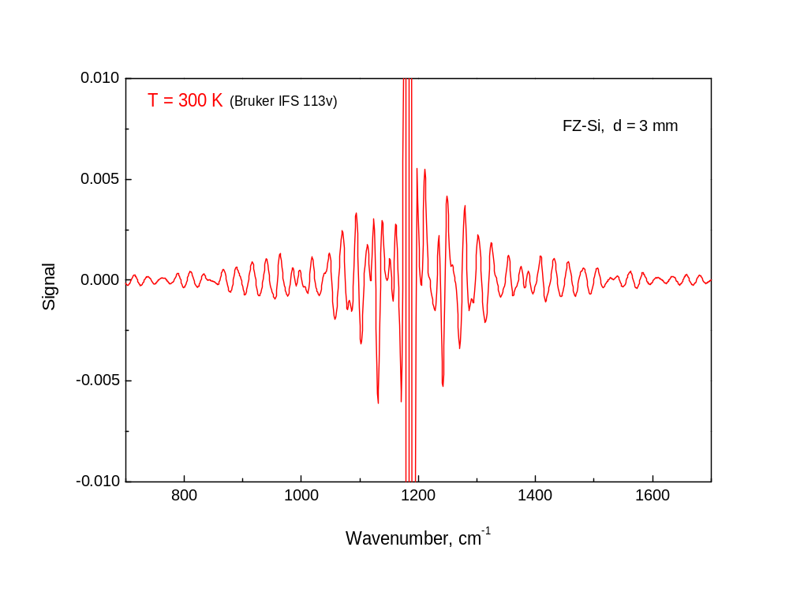

Slide 6
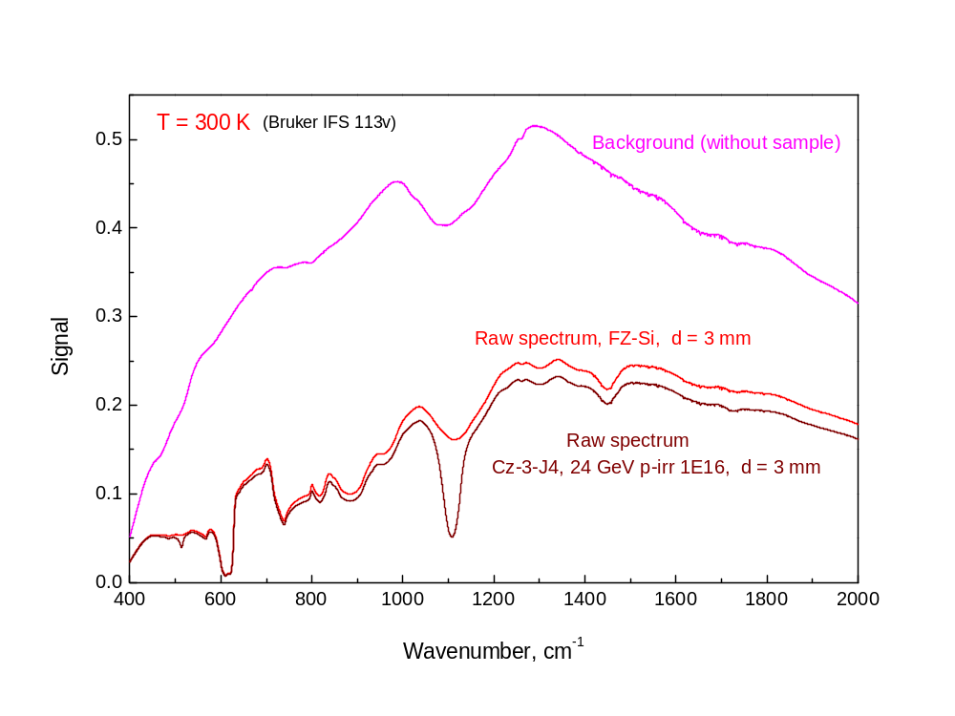

Slide 7
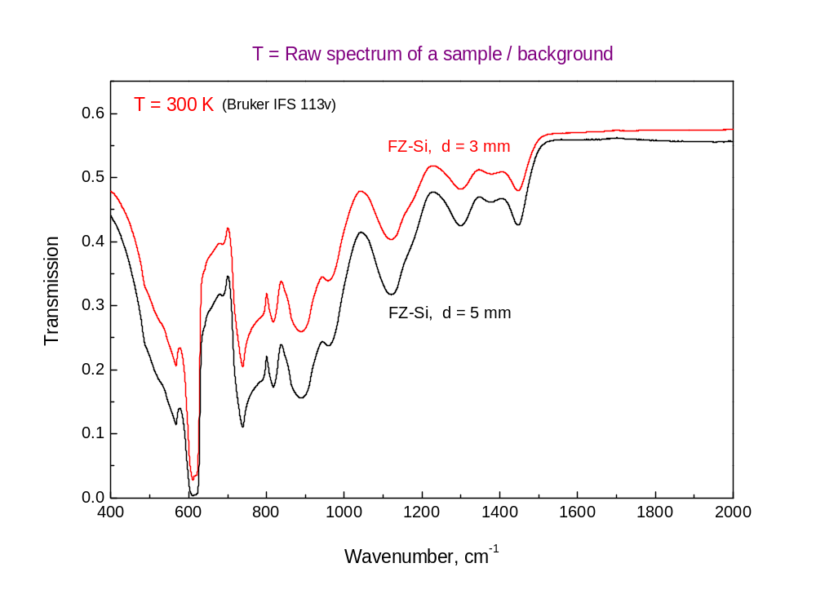

Slide 8
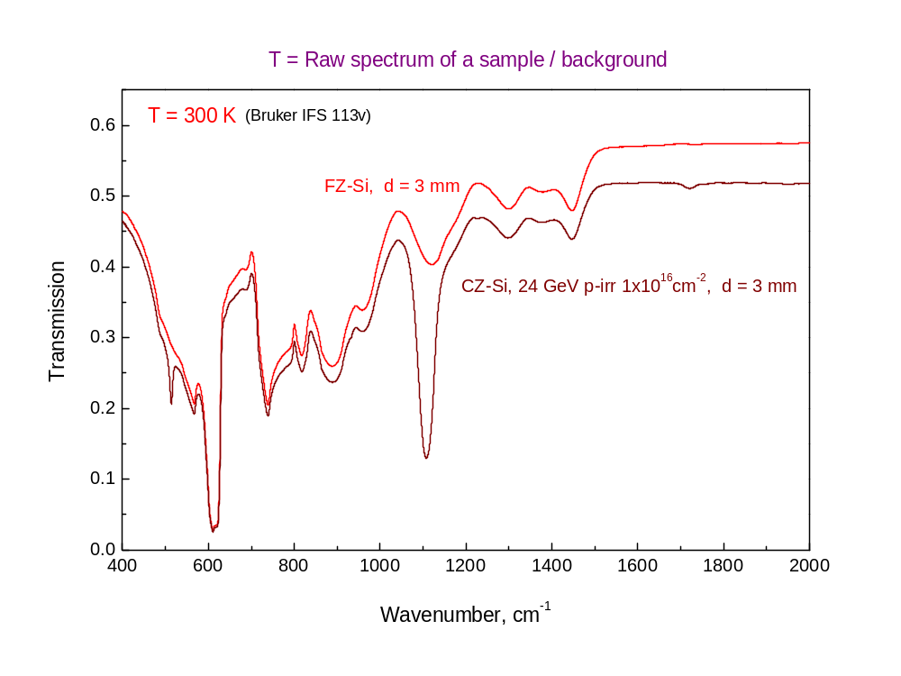

Slide 9
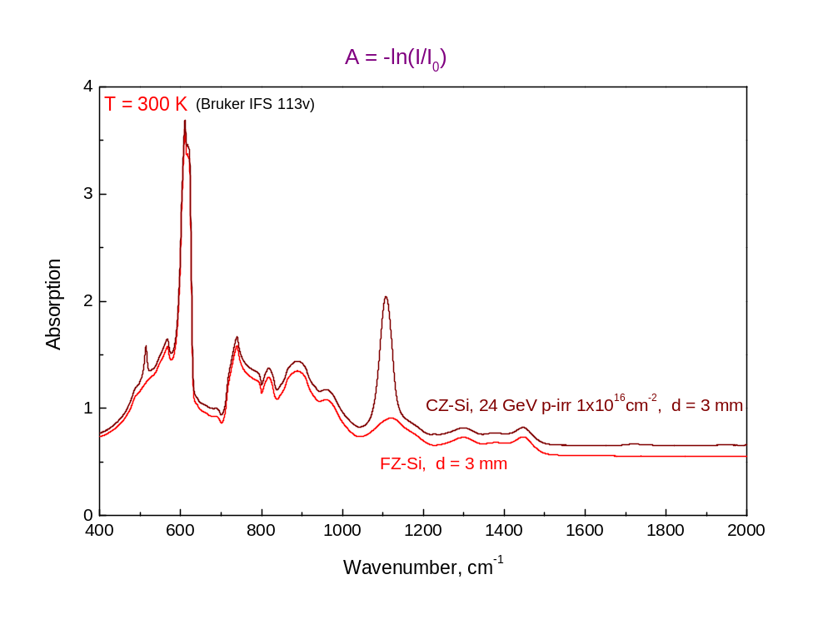

Slide 10
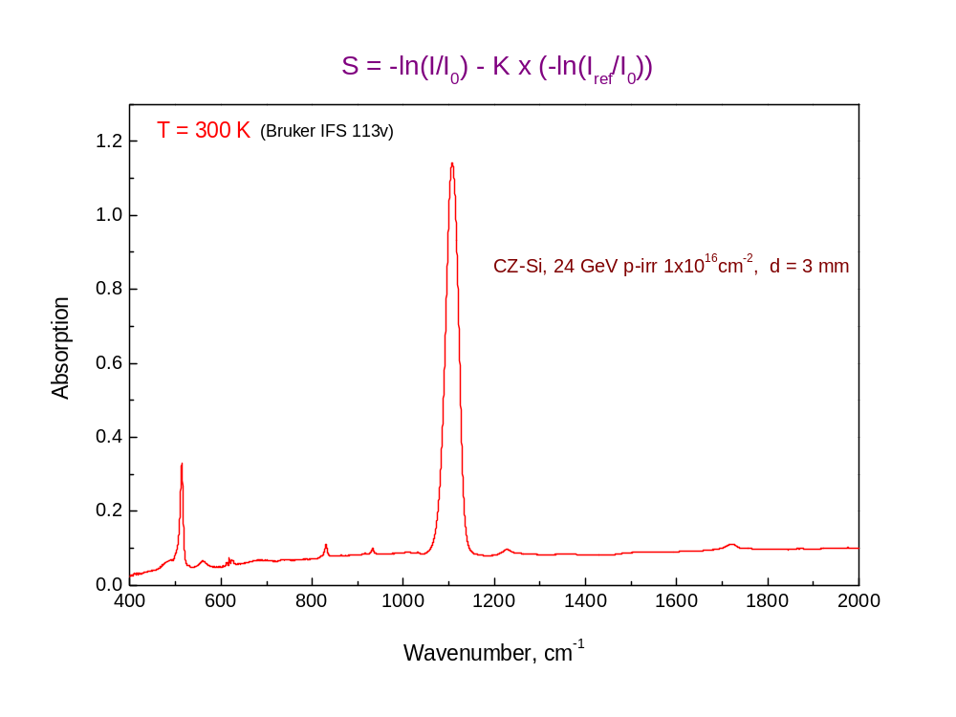

Slide 11
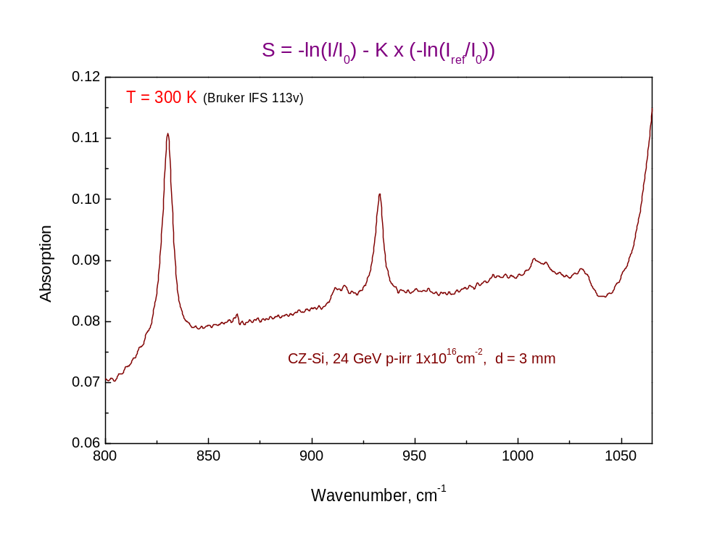

Slide 12
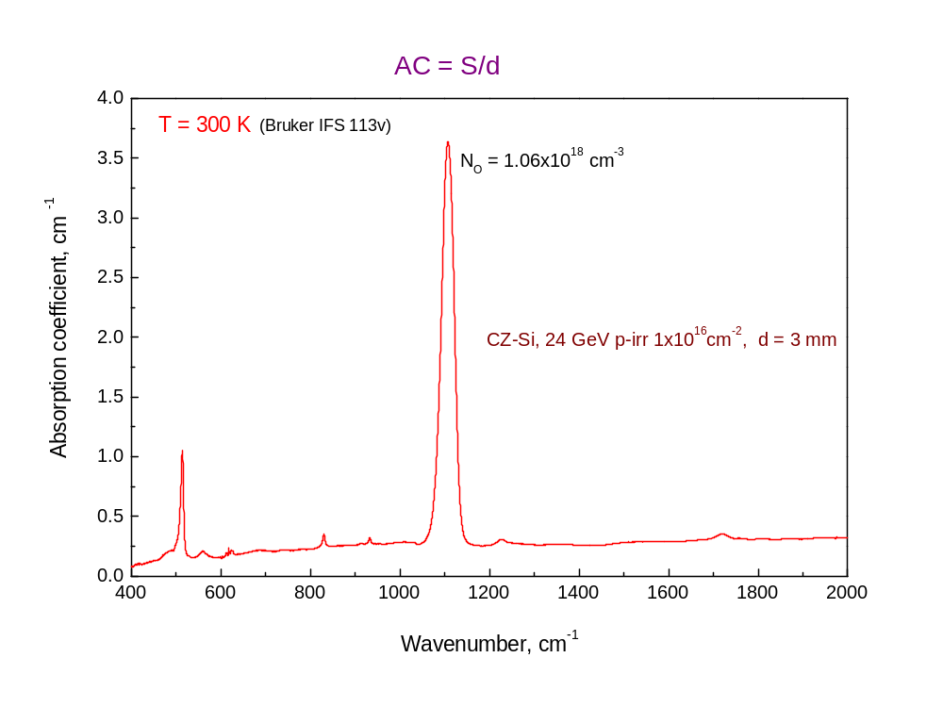

Slide 13
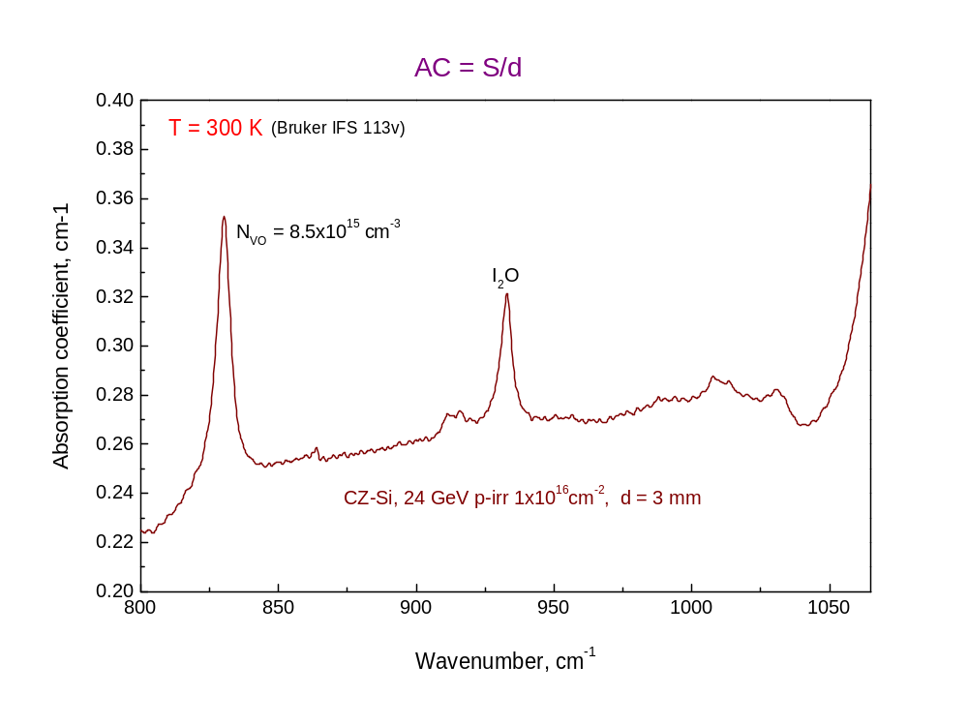

Slide 14
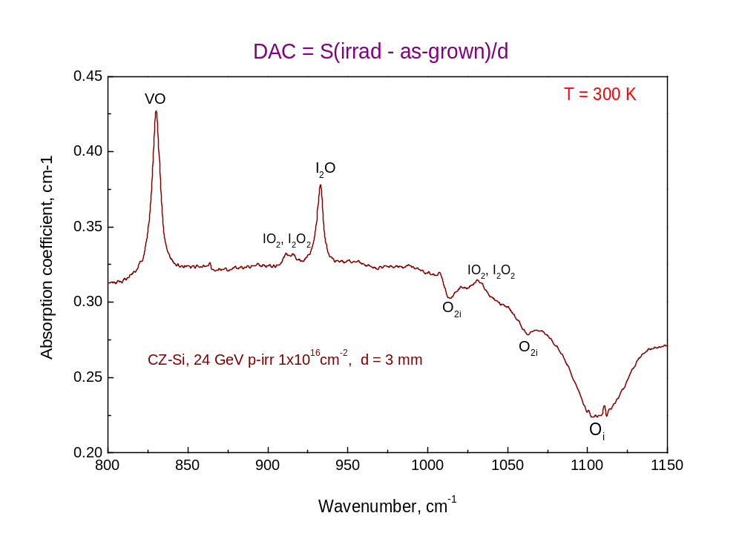

Slide 15
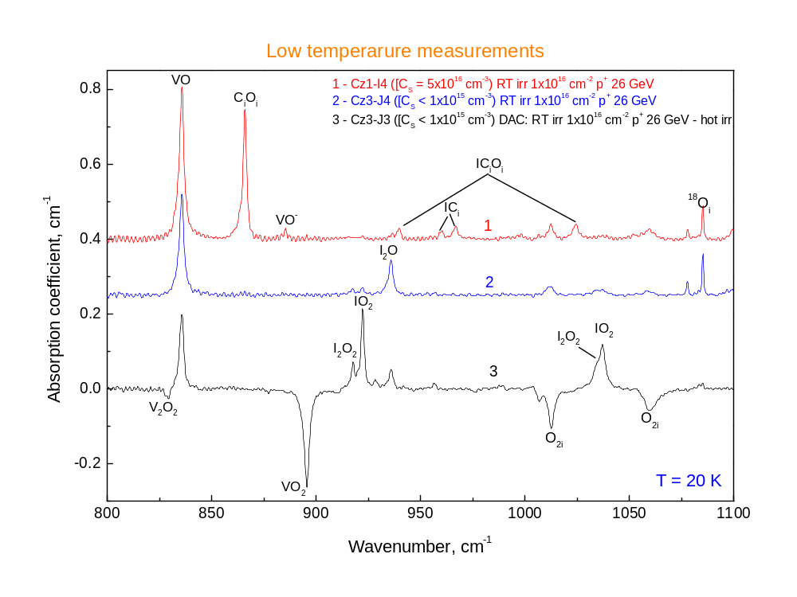

Slide 16
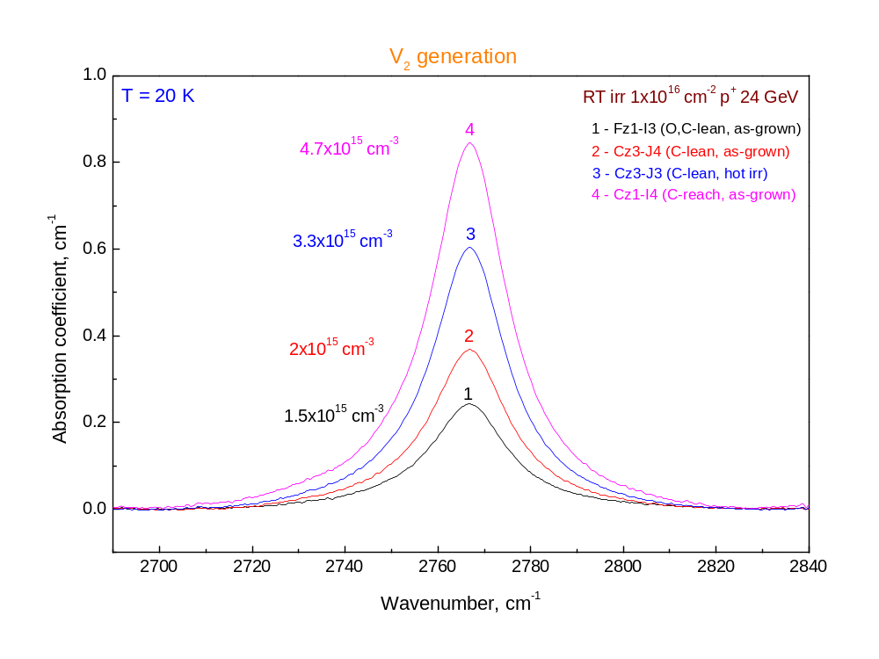

Slide 17
Electronic transitions
Shallow donors and acceptors
Group VI (S, Se, Te) etc
Thermal double donors (as an example:
L.I. Murin, V.P. Markevich, J.L. Lindstrom, M. Kleverman
Spectroscopic observation of the TDD0 in silicon,
Physica B 340–342 (2003) 1046–1050).

Slide 18
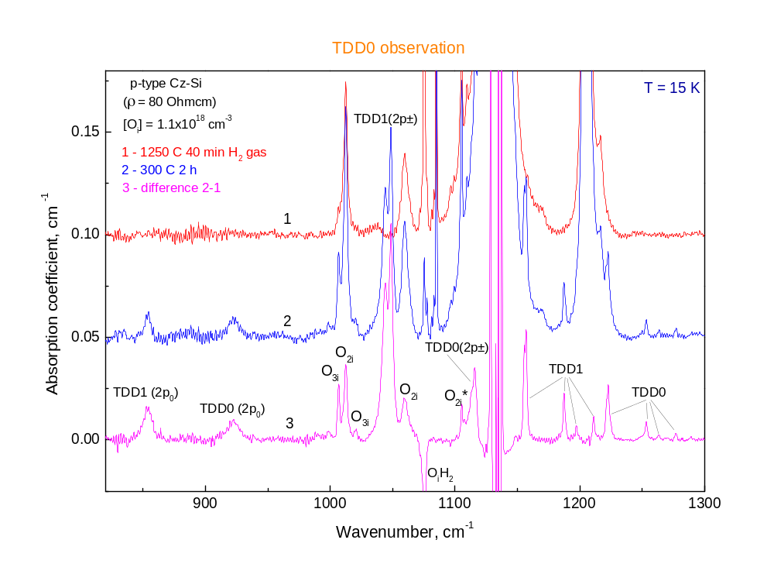

Slide 19
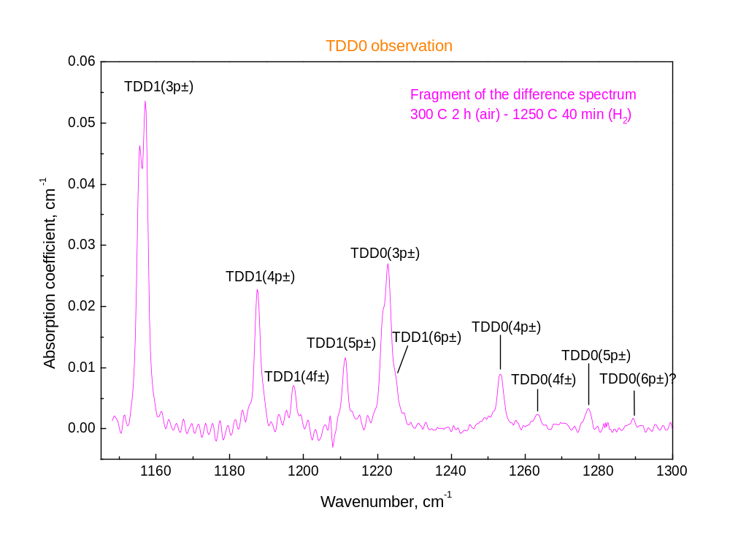

Slide 20
Detection limit
Calibration:
α = 1 cm⁻¹ corresponds approximately
to N_{TDD} = 10¹³ cm⁻³
Detection of α = 0.01 cm⁻¹ (N_{TDD} = 10¹¹ cm⁻³) is
reliable

Slide 21
LVM spectroscopy
“LVM spectroscopy assumes now a very central role among the large number of semiconductor characterization techniques which have been developed over the years and which are continuously refined and improved. When applicable, this technique allows, in many cases, the precise identification of impurity species and their crystal lattice location with excellent sensitivity. Besides, LVM spectroscopy with perturbations such as polarization of the probe light, uniaxial and hydrostatic stress, and isotope substitution can be highly successful in identifying the structure and composition of various kinds of defect complexes.”
E.E Haller, Mat. Res. Soc. Symp. Proc. Vol. 378 (1995) 547-565.

Slide 22
Detection limits
Depend on:
Measurement temperature (LT or RT)
Sharpness of the lines
Wavenumber position
Detection limits normally are in the range
5x10¹³ – 1x10¹⁵ cm⁻³)

Slide 23
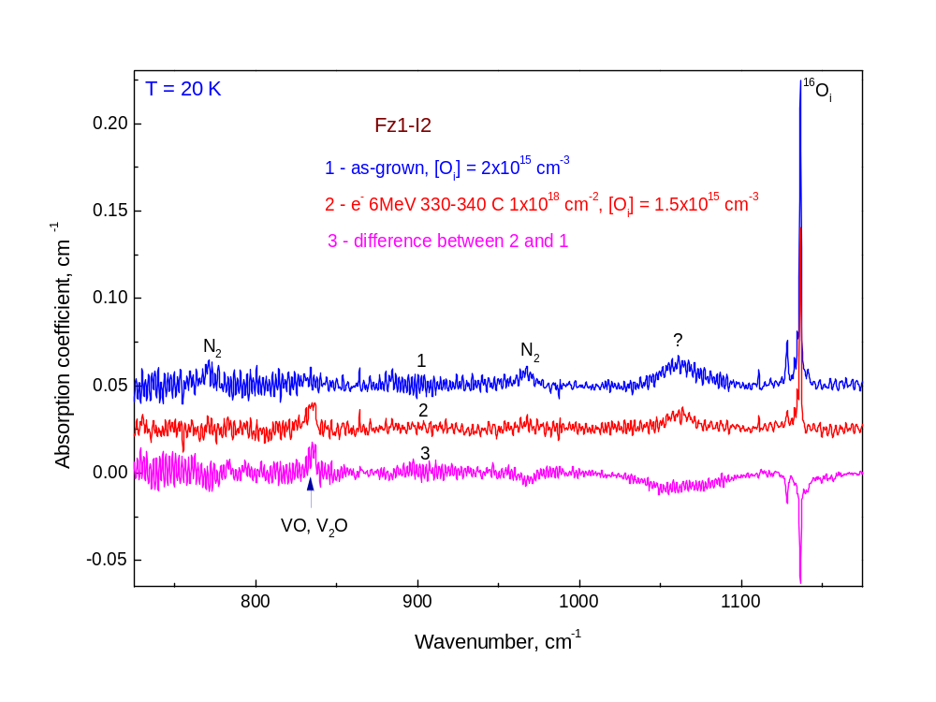

Slide 24
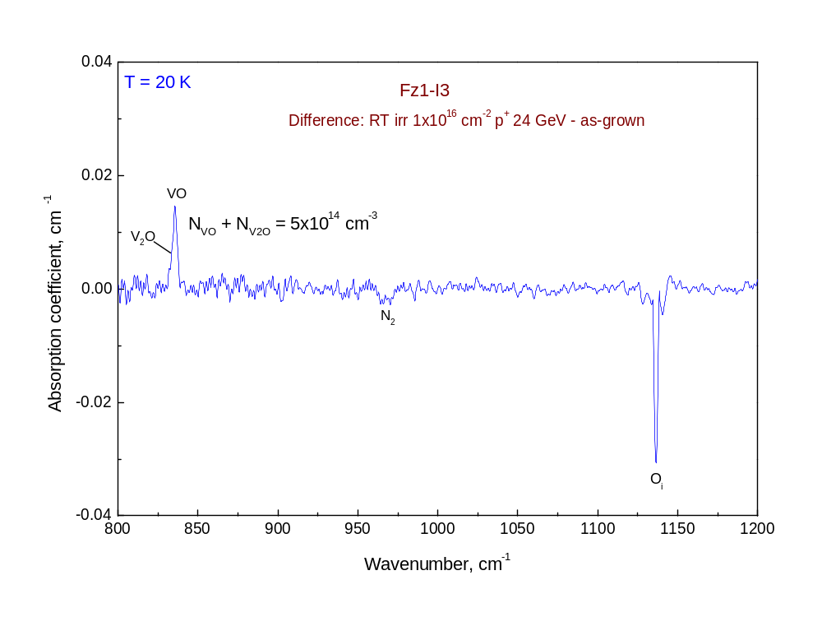

Slide 25
