Slide 1
V₂O and V₃O DEFECTS IN SILICON: FTIR STUDIES
Leonid Murin ^{1,2}
¹ Joint Institute of Solid State and Semiconductor Physics, Minsk, Belarus
² Oslo University, Centre for Materials Science and Nanotechnology, Oslo, Norway

Slide 2
OUTLINE
What we know
V₂O and V₃O formation upon irradiation at RT
V₂O and V₃O formation upon annealing
Comparison of electron and neutron irradiation
LVMs of excited states

Slide 3
BACKGROUND - WHAT IS KNOWN
V₂O defect
N.V.Sarlis, C.A. Londos, and L.G. Fytros (J. Appl. Phys. 81 (1997) 1645) have assigned the band at 839 cm⁻¹ (RT position) to this defect (neutron irradiated Cz-Si)
J.L. Lindström, L.I. Murin, V.P. Markevich, T. Hallberg, and B.G. Svensson (Physica B 273-274 (1999) 291) have assigned the band at 833.4 cm⁻¹ (LT position, 826 cm⁻¹ – RT position ) to V₂O (electron irradiated Cz-Si)
V₃O defect
Y.H Lee, J.C. Corelli and J.W. Corbett (Phys. Lett. 60A (1977) 55) assigned the band at 889 cm⁻¹ (RT position) to this defect
C.A. Londos, N.V.Sarlis, and L.G. Fytros (J. Appl. Phys. 81 (1999) 1645) have assigned a shoulder (at 884 cm⁻¹ (RT position)) of the 889 cm⁻¹ band (VO₂) to V₃O (neutron irradiated Cz-Si)

Slide 4
Formation of V₂O and V₃O
1. RT irradiation
V + O_{i} ⇒ VO (1)
V + VO ⇒ V₂O (2)
V + V₂O ⇒ V₃O (3)
The V capture radii appear to be very similar for reactions (1) and (2). So, at electron irradiation doses when [VO] does not exceed 3-5% of [O_{i}], the V₂O line (833.4 cm⁻¹) is practically not detectable (it is masked by the Si isotope lines of VO, see Fig 1a). However, at higher doses, when [VO] increases up to 10-20% of [O_{i}], the appearance of V₂O is clearly seen (Fig. 1b, the Si isotope lines are taken into account for all the defects, not shown). Along with the main V₂O band (at 833.4 cm⁻¹), a weaker band at 837 cm⁻¹ is developing. Besides, two weak lines, at 842.4 and 848.6 cm⁻¹, start to appear as well. These are suggested to arise from a V₃O defect.

Slide 5
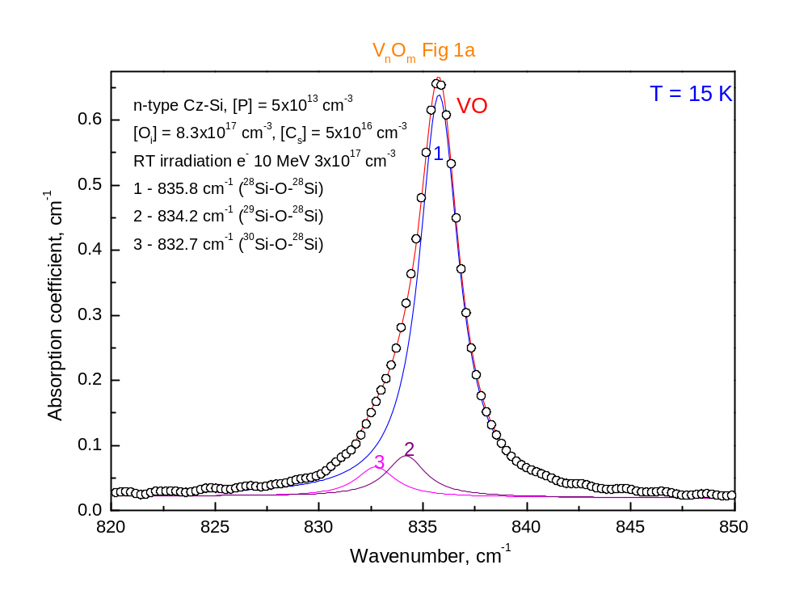

Slide 6
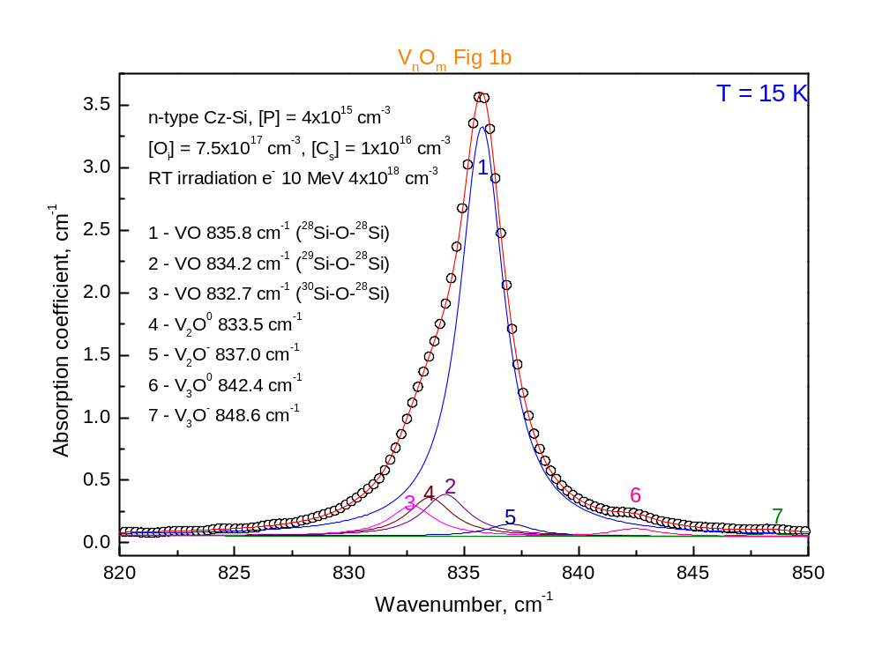

Slide 7
Formation of V₂O and V₃O
2. Annealing
Migration of V₂ that occurs at T > 150 C results in a further development of V_{n}O centres (Fig. 2a,b) via the V₂ interaction with O_{i}, VO and other defects
V₂ + O_{i} ⇒ V₂O (4)
V₂ + VO ⇒ V₃O (5)
V₂ + V₂O ⇒ V4O (6)

Slide 8
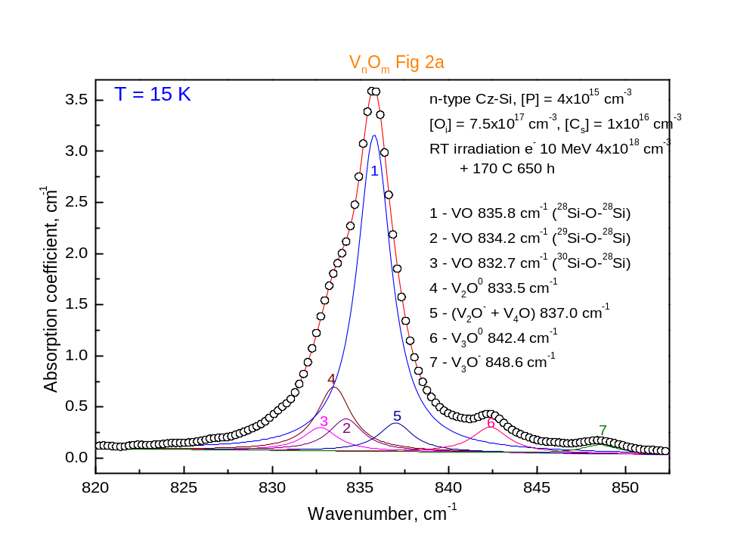

Slide 9
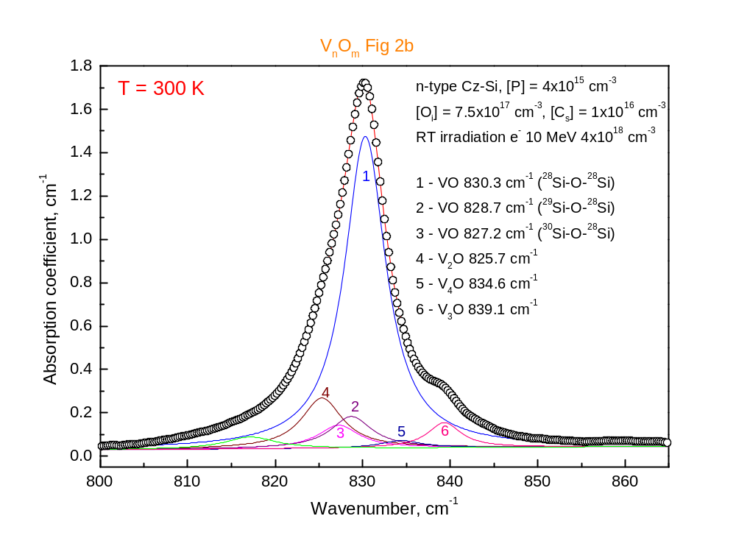

Slide 10
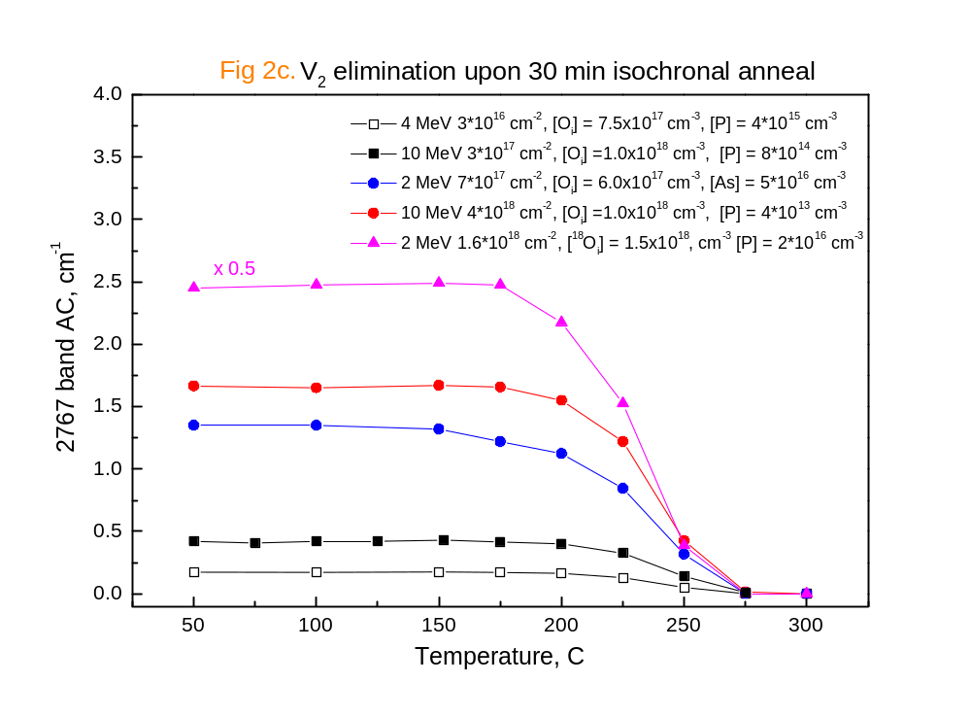
In electron-irradiated Cz-Si the interstitial oxygen appears to be a dominant trap of mobile divacancies. In crystals with different doping levels and irradiated with different doses, the main part of V₂ disappear during isochronal anneal in the same temperature region

Slide 11
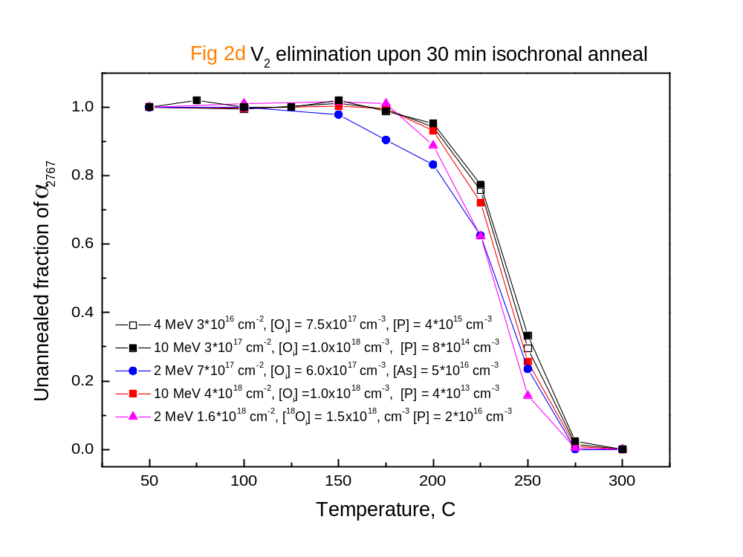

Slide 12
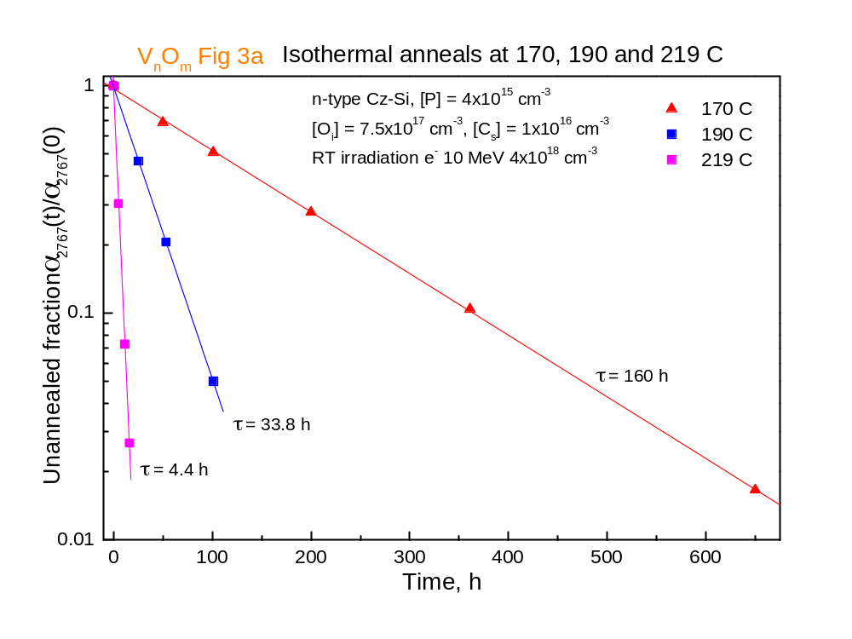

Slide 13
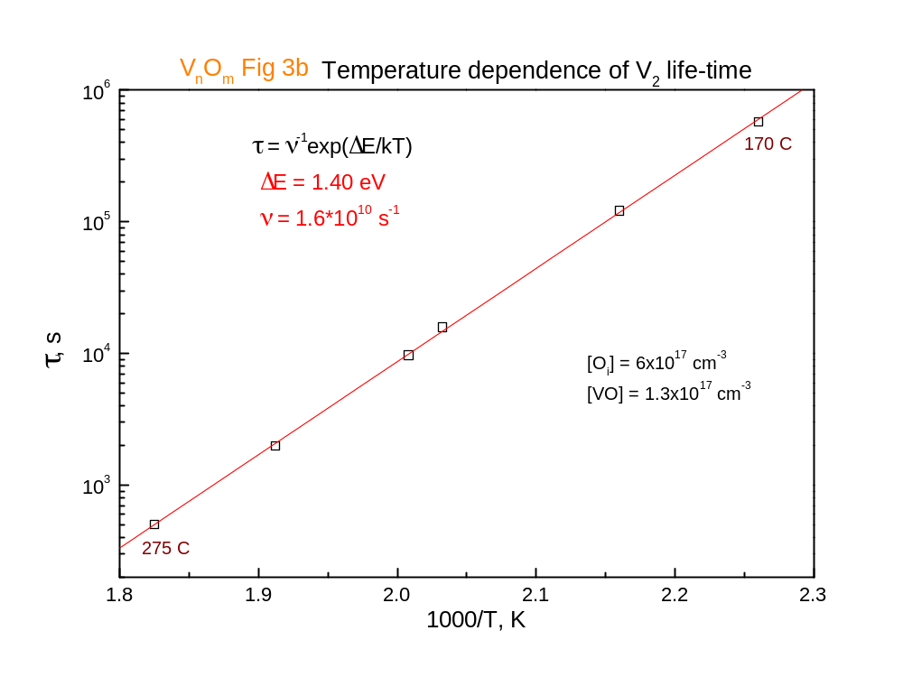

Slide 14
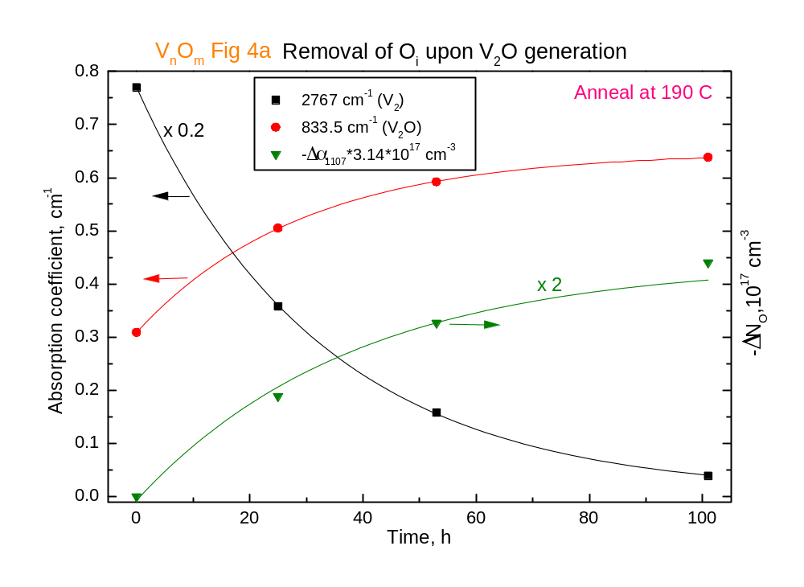
In samples with a high V₂ concentration, a noticeable decrease in [O_{i}] is observed (Fig. 4a), in accordance with reaction (4).

Slide 15
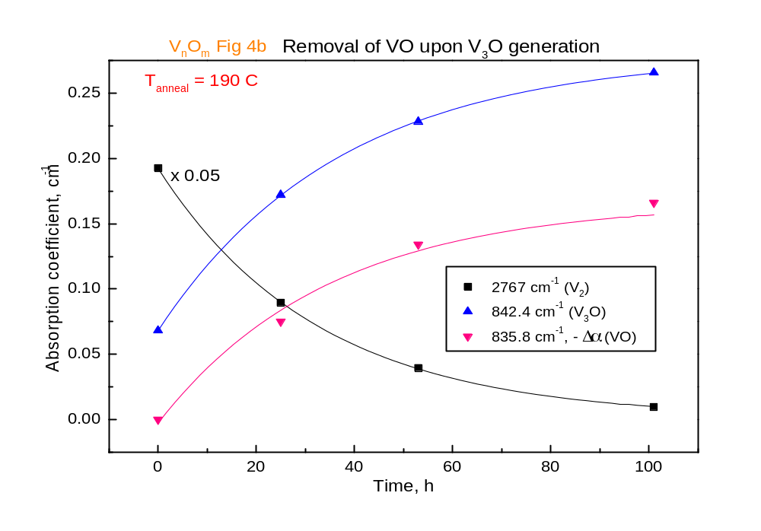
Due to occurrence of reaction (5) the concentration of A-centres is decreasing as well

Slide 16
However, reaction (5) can not account for the observed overall generation of V₃O, especially in samples with relatively low VO concentration. It is very likely, that V₃ has the same migration ability as V₂, and V₃O can be also generated via the reaction
V₃ + O_{i} ⇒ V₃O (7)

Slide 17
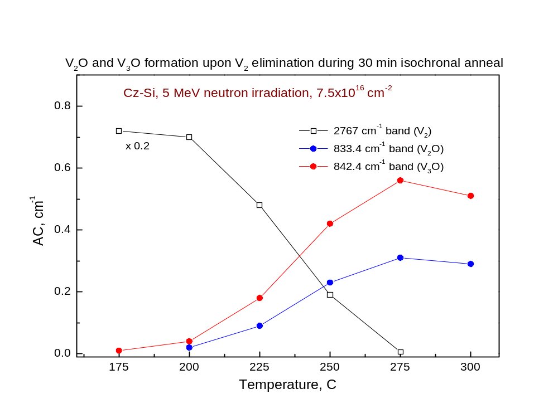

Slide 18
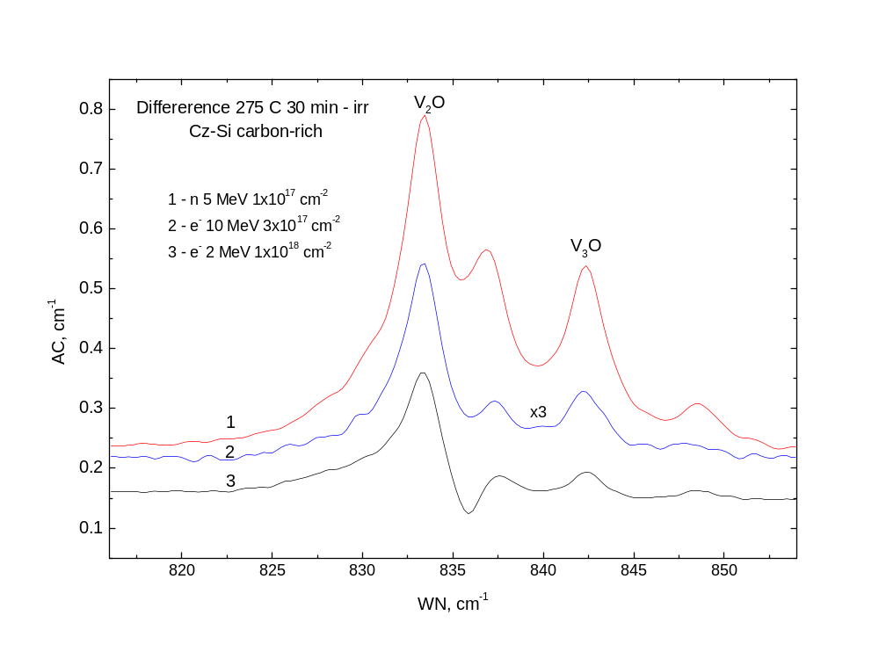

Slide 19
Note
It is interesting to note that the V₂H and V₃H defects detected in EPR and FTIR studies (P. Stallinga et al, PRB 58, 3842, (1998)) are also not distinguished in their annealing behaviour. According to the latter paper the ratio of V₃ and V₂ production rates is about 0.5 in proton implanted Si. In the case of 10 MeV electron irradiation, this ratio is about 0.2-0.3 (our estimations), but for neutron irradiation it increases again up to 0.5.

Slide 20
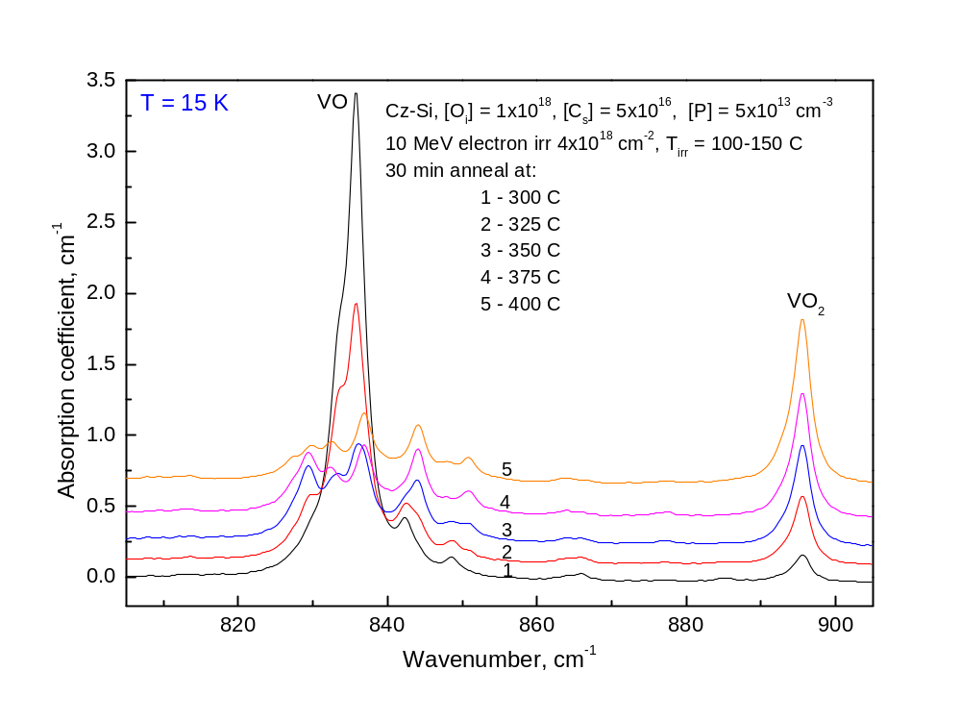

Slide 21
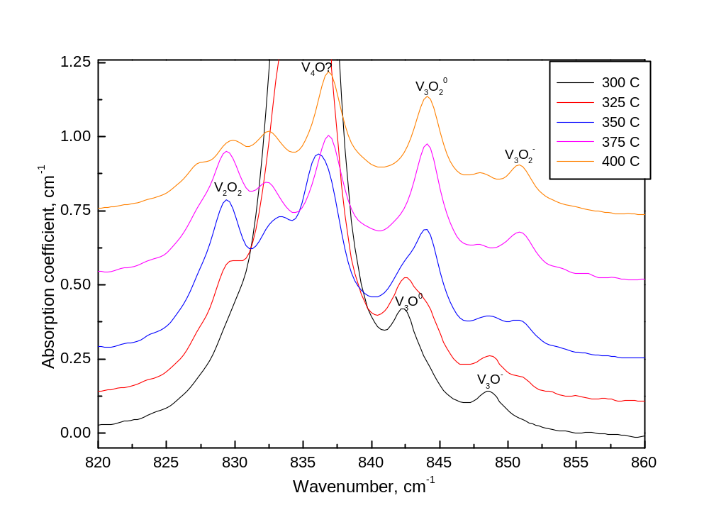

Slide 22
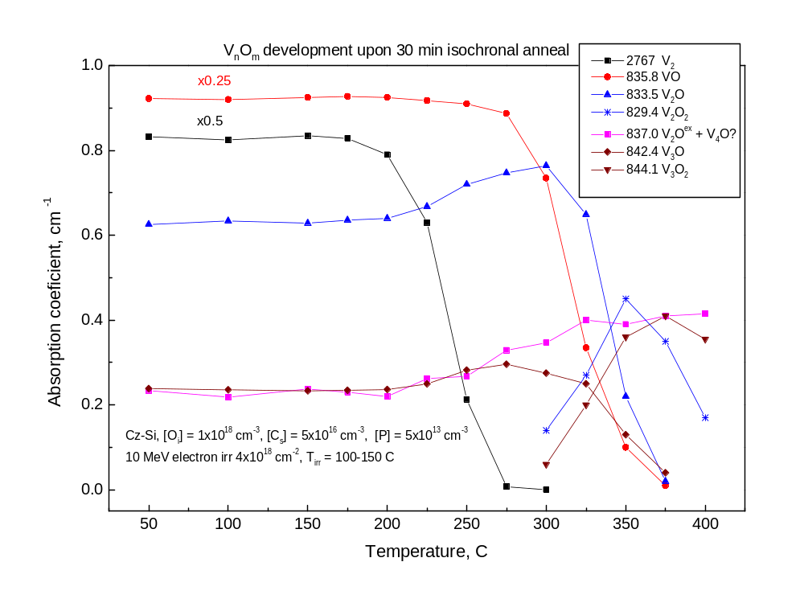

Slide 23
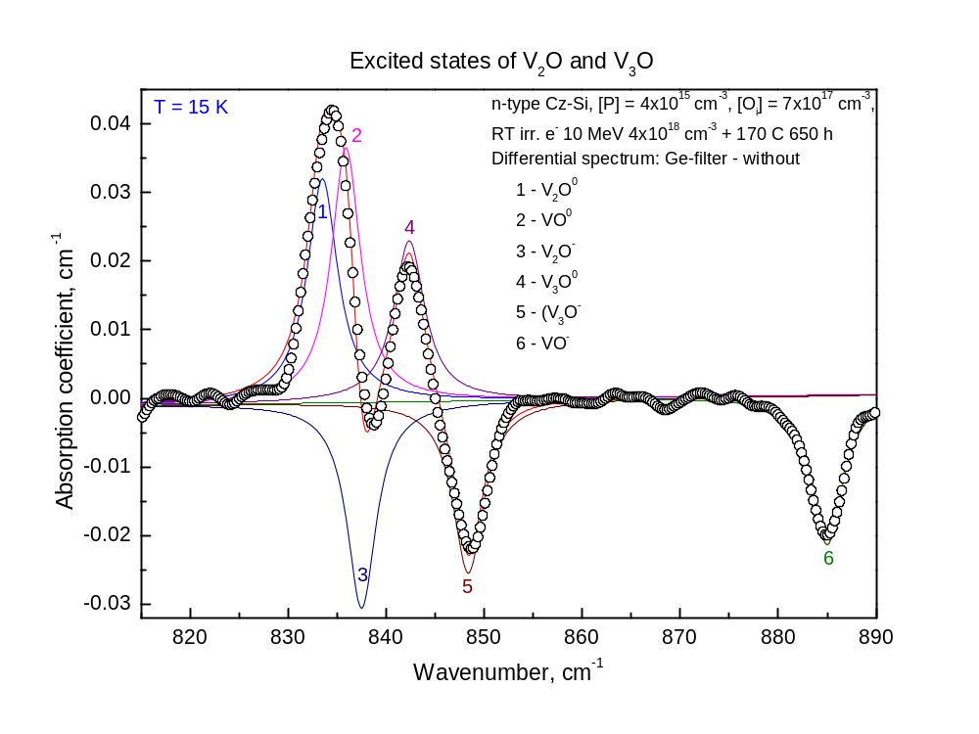

Slide 24
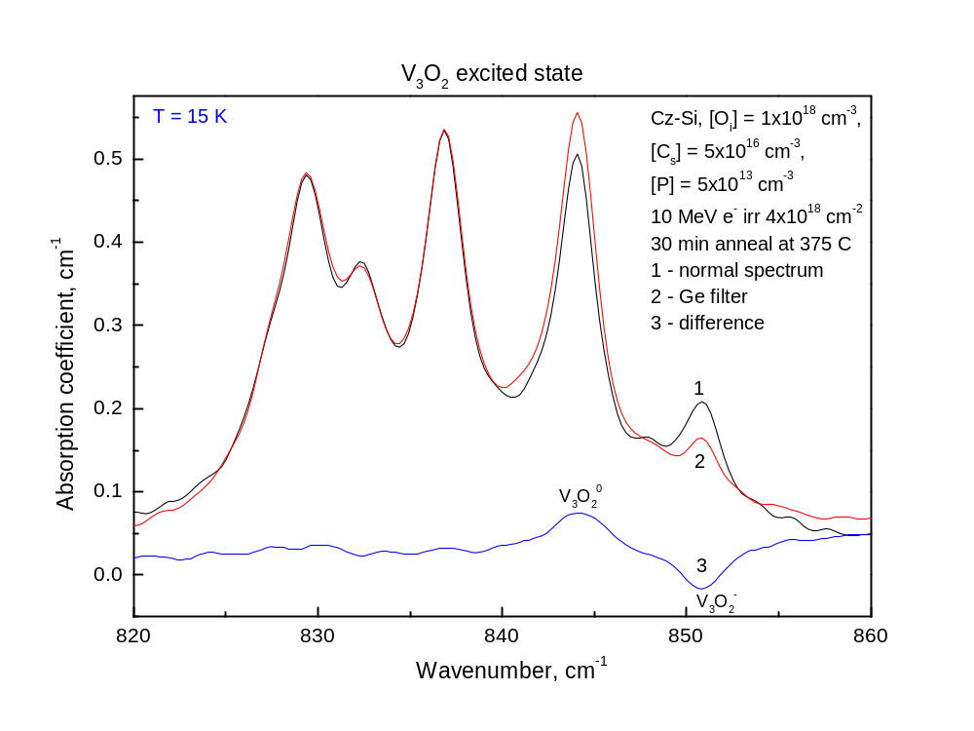

Slide 25
