Slide 1
FREE CARRIER ABSORPTION TECHNIQUES
- MICROWAVE & IR –
FOR CHARACTERIZATION OF IRRADIATED SILICON
E.Gaubas, J. Vaitkus
OUTLINE
Characteristics of the techniques and instrumentation
RT applications to control radiation induced recombination
Excess carrier decay temperature variations
Evaluation of carrier decay parameters

Slide 2
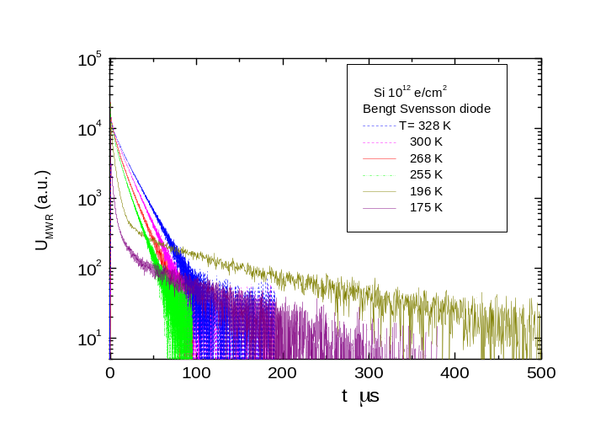
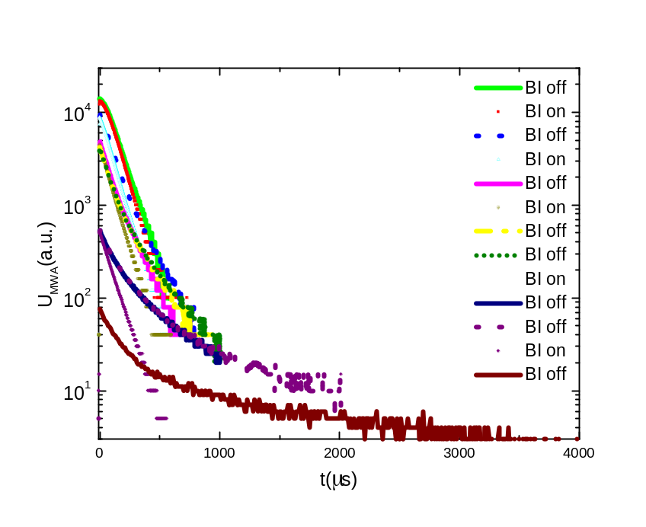
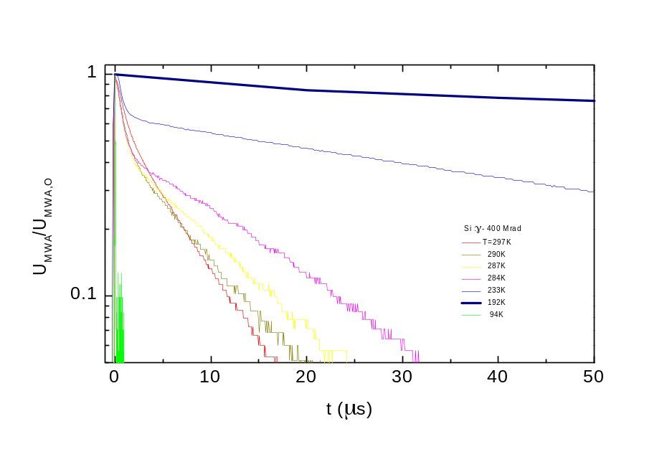
Carrier recombination and trapping
☼ Recombination (fast) and trapping (slow) constituents within transients of microwave absorption by free carriers (MWA) can be distinguished by combining analyses of the excess carrier decays dependent on the excitation intensity and bias illumination (BI).
RT
Transients at different temperatures
electrons-irradiated Si
protons-irradiated Si
Variation of MWA decays with excitation intensity (proportional to the initial amplitude) with and without additional cw illumination

Slide 3
Characteristics of the MW & IR techniques and instrumentation
Principle of the transient techniques
Density of free carriers is controlled
E
IRA α_{ω} =(4π/c)σ_{dc} {√ε/[1+(τ_{sc} ω)²]}∝ λ ²
MWA λ>100μm ⇒ α₀ =(4π/c √ε)σ_{dc}, α_{ω} < α₀
Transient:
Δα(t) ∝ Δ σ(t) ∝ μ_{FC} n_{exFC} (t)
IR, MW
cw probe
laser light
pulsed excitation
R
k

Slide 4
Advantages:
☼ direct control of carrier decay process:
- to separate impact of different recombination and trapping mechanisms,
- to determine type of defects (τ ~F(n_{ex}/n_{dop})), parameters of traps (τ ~F(T)), etc.
- to reveal complicated systems of defects, barriers, non-linear decay processes etc,
☼ contact-less and fast measurement procedure,
☼ non-destructive and distant measurement techniques:
IR (tens of cm), MW (from tens of μm to tens of mm),
☼ wide range of lifetime variations ( 1 ns (σN_{R} ≈10²) – 10 ms (σN_{R} ≈10⁻⁵), RT),
☼ relatively high spatial resolution (from tens of μm to tens of mm integration area),
☼ wide range of injection levels (n_{ex}/n_{dop} from 0.01 to 100 - for MW. and 1- 10³ for- IR).

Slide 5
Limitations:
☼ optically polished surfaces and relatively high excitation levels (n_{ex} ≥ 10¹⁶ cm⁻³) for IR,
☼ metallised areas are un-acceptable for examination,
☼ MW probing depth depends on material resistivity (decreases with resistivity),
☼ resolution of very short lifetimes ( <1 ns) is limited by oscilloscopic instrumentation and detector (MW / IR) circuits,
☼ examination of thin layered structures is complicated

Slide 6
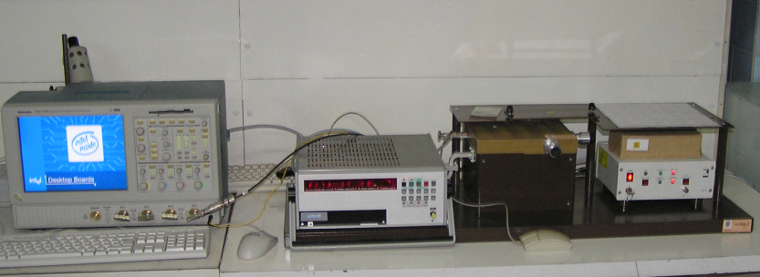
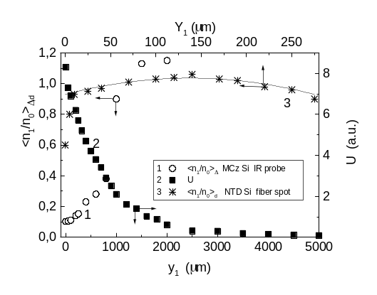
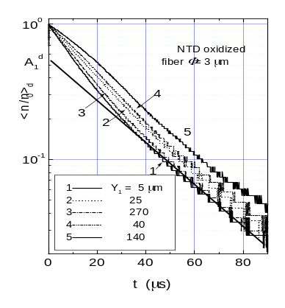
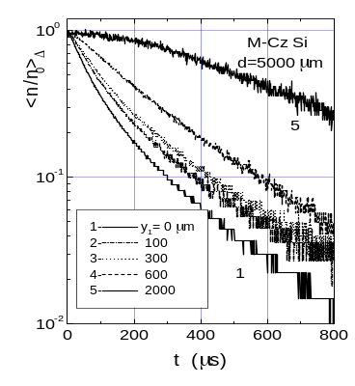
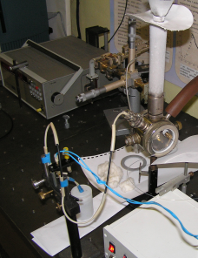
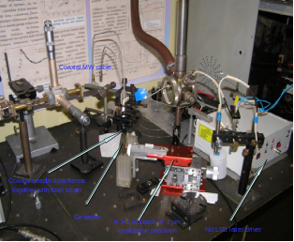
Analyser of the recombination parameters
Main instrument
Attenuator
of light density
Microchip laser STA-01
Sliding short
τ_{exc} ~700 ps, E_{exc} ≤ 10 μJ
sample
MW slit
antenna
Sliding short
MW bridge
M
M
B
B
tiltas
tiltas
Sliding short
MW oscillator
with adjustable power and frequency
M
MW circulator
B
cir
k
ulator
ius
≥
f
≥
f
0.5
0.5
GHz,
≤
GHz,
U
≤
U
1 mV/pd
1 mV/pd
MW detector
Amplifier (>50)
R_{load}
TDS-5104
Supplementary regimes
Coaxial needle-tip
MW antenna
Lifetime-temperature
variations
Lifetime depth-scans
-
-
x
Laser-fiber beam
z
Fiber excitation
Si
Ge
d

Slide 7
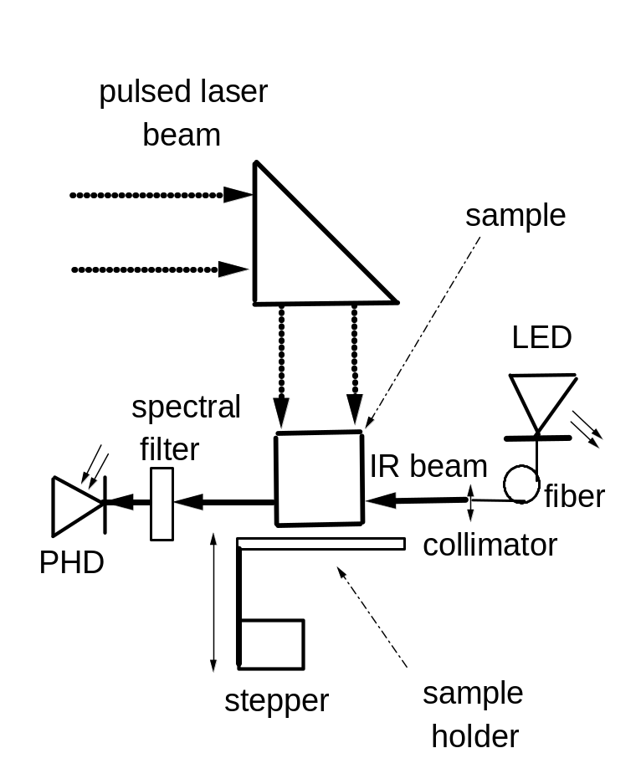
Moderate and high excitation level IR probe

Slide 8
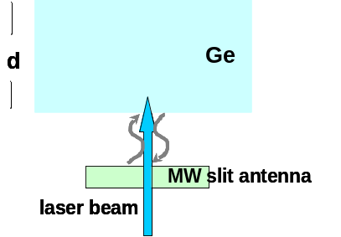
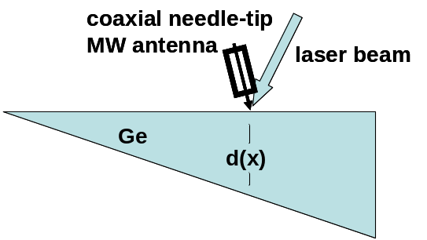
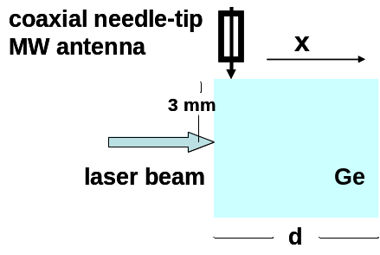
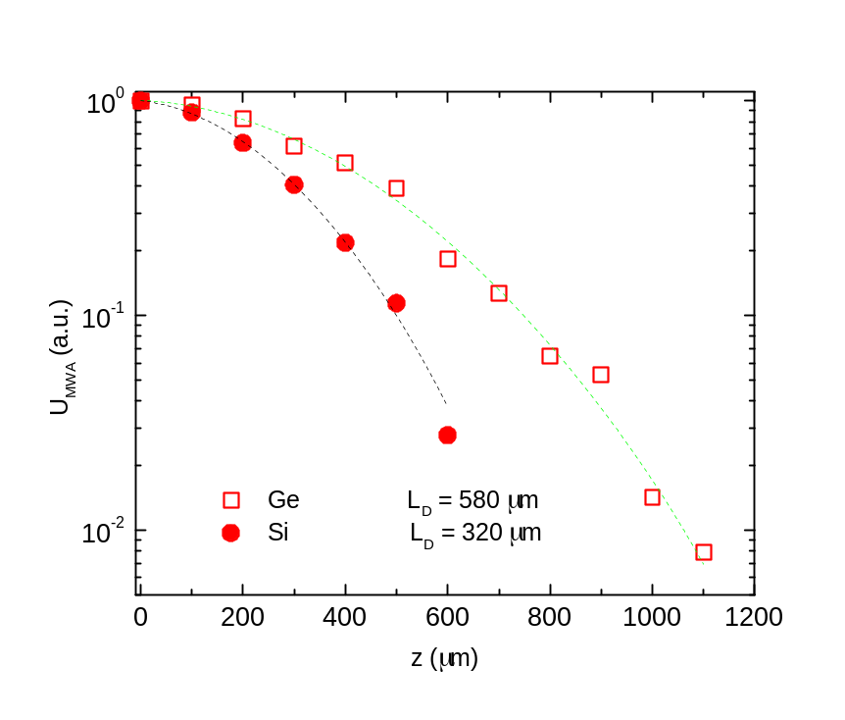
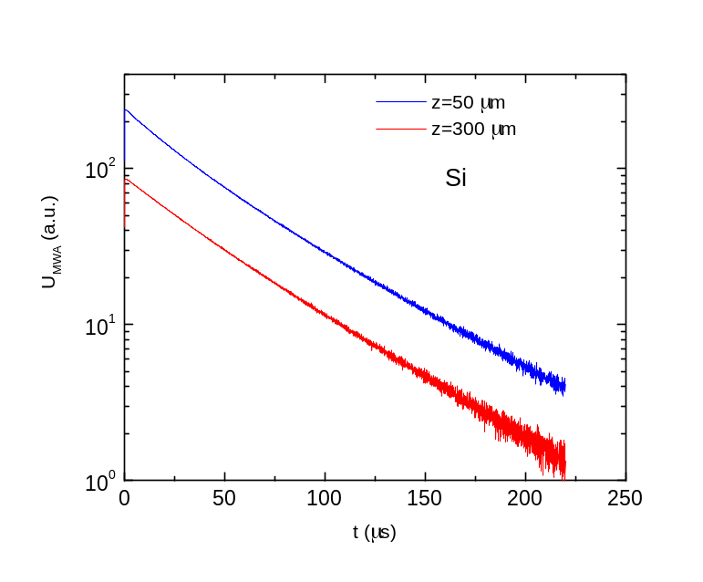

MW techniques for:
- estimation of carrier transport parameters
☼Parallel MWR
☼Oblique MWR
☼ Perpendicular MWR
Coaxial needle-tip
MW antenna
Si or
laser beam
-
-
x
z
or Si
d
Si or
Si orGe
Ge
D ≈ 67 cm²/s p-Ge
D ≈ 21 cm²/s p-Si
Laser beam
z
60 μm

Slide 9
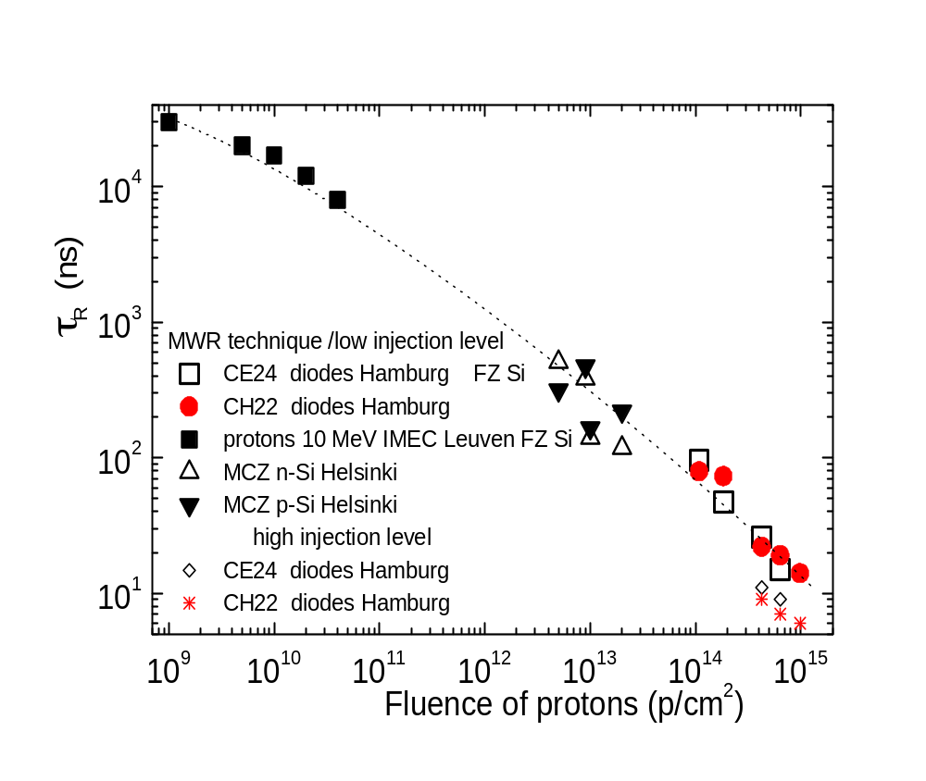
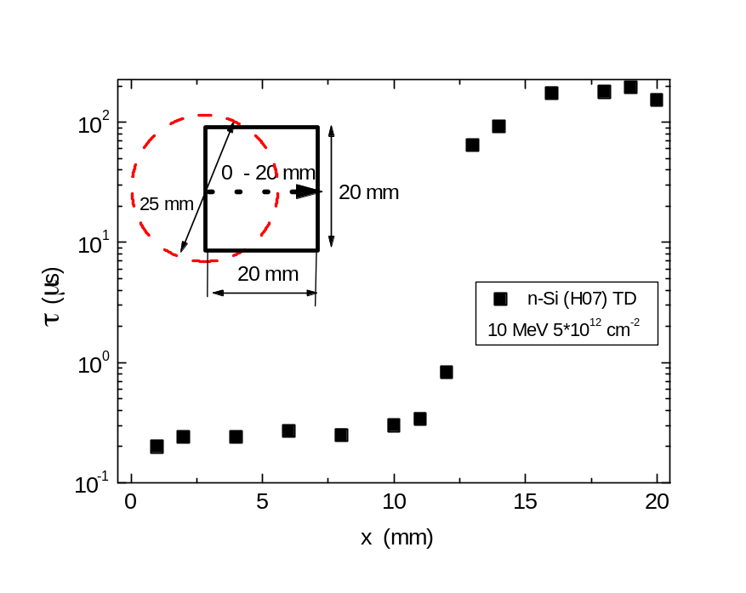
RT applications to control radiation induced recombination
Calibrated RT lifetime variations with fluence for definite particles,
exploited for the same material and structures, would enable one
to control the density of the radiation induced dominant traps
Proton irradiation
N|σ_{~10}⁻¹⁴ =8×10¹⁰ cm⁻³
N|σ_{~10}⁻¹⁶ =10¹⁷ cm⁻³
Lateral lifetime variation due to irradiation geometry with proton beam spot of 25 mm.
- not covered the range of moderate and the highest fluences,
- samples from different material (sources) exploited

Slide 10
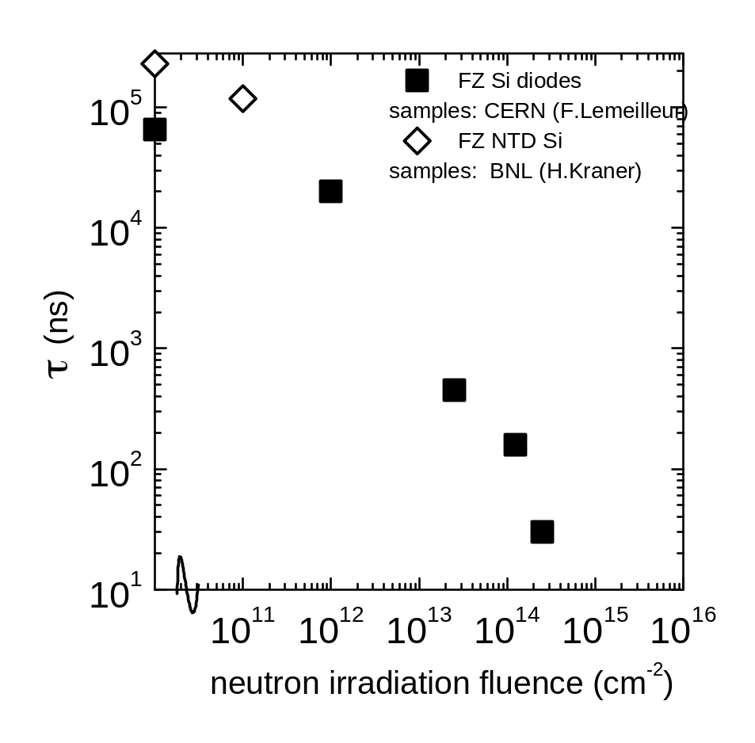
Neutron irradiation
- too small set of samples examined
Detection limit in the low fluence wing – density of the intrinsic recombination centers, thickness, quality of surface preparation Resolution in the high fluence range - RC of the MW detector-oscilloscope circuit ~1-2 ns

Slide 11
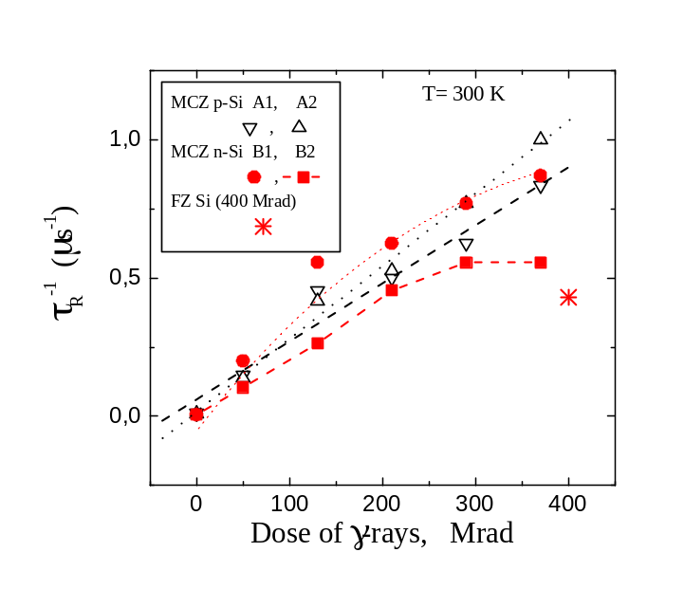
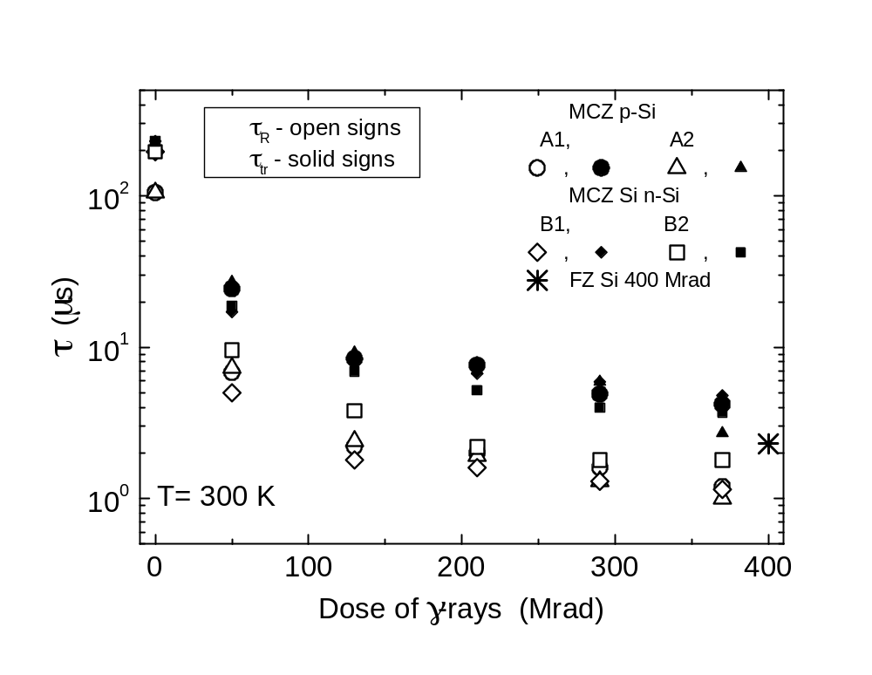
γ- rays irradiation (BNL-Helsinki samples)
for n-Si a non-linear dependence can be implied
1/τ_{R} = 1/τ* + σv_{th}N_{γ} = 1/τ* + σv_{th}(N_{γ0} + βγD),
τ* - carrier capture lifetime attributed to the intrinsic centers;
N_{γ0} –concentration of radiation defects at low dose;
D – irradiation dose;
β_{γ} = 5.7 ×10⁸ 1/Mrad [Z Li];
→ σ > 4 ×10⁻¹⁹ cm²

Slide 12
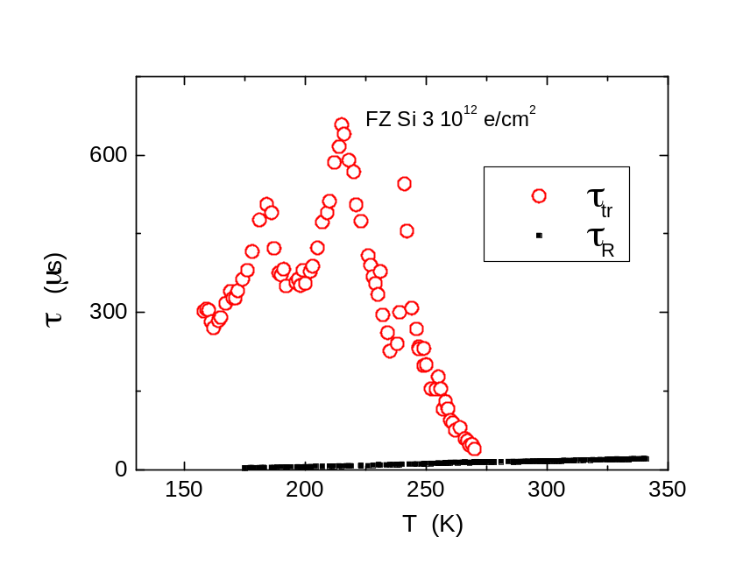
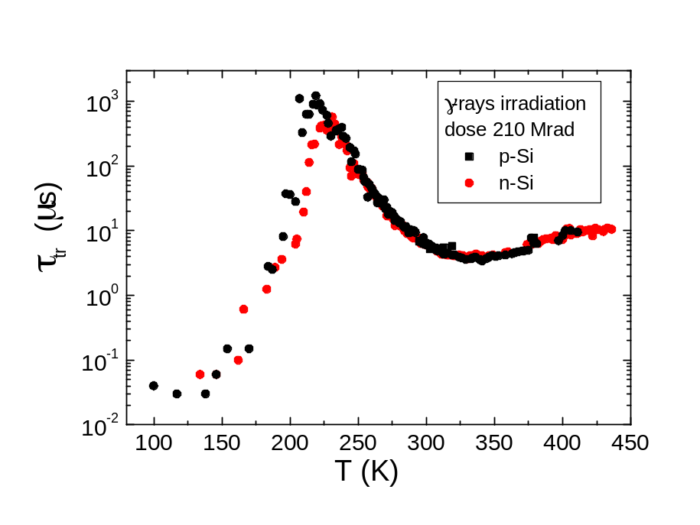
Excess carrier decay temperature variations
e-irradiated FZ Si
γ-irradiated MCZ Si
DLTS
0.17 eV
DLTS
0.24 eV
DLTS
0.42 eV
DLTS
DLTS

Slide 13
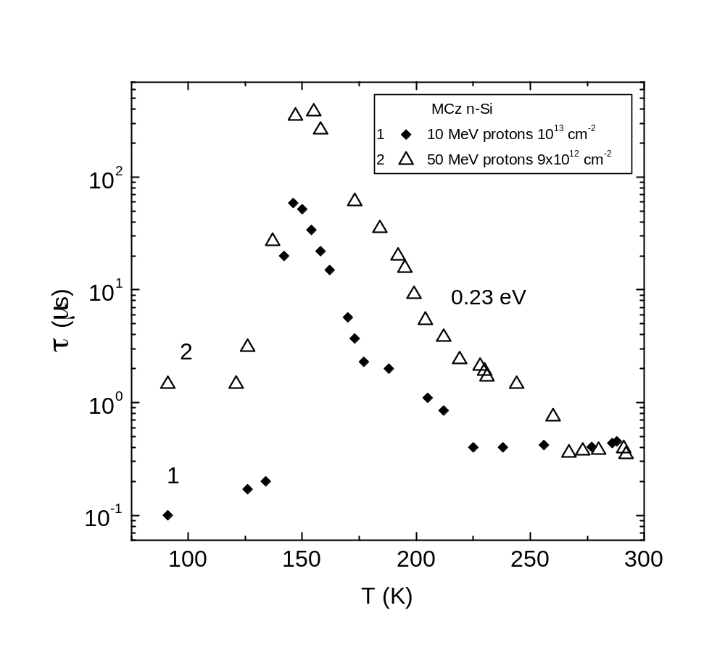
Excess carrier decay temperature variations
MWR proton-irradiated Si

Slide 14
Evaluation of carrier decay (trap) parameters
Generation lifetime
Electron capture lifetime
Recombination center, σ_{e} → σ_{h}
Trapping center, σ_{e} << σ_{h}
Hole capture lifetime
Hole capture lifetime
Hole thermal release lifetime
Generation lifetime
Recombination lifetime
Trapping lifetime
Separation of traps from the transient decay shape and variation with external factors;
Estimation of the parameters for a dominant recombination center:
σN_{R} ≈1/v_{th,T}τ_{minority} from absolute values of τ_{minority} if S-R-H approximation holds,
estimation of the ratio σ_{e}/σ_{h} from the τ dependency on excitation level,
evaluation of E_{R} from τ -T slope if no additional traps compete;
Detection limitations: τ_{ex}<< τ_{R}; simple system of the dominating traps; for radiation defects (N_{RD}>N_{R, intrinsic})
3) Evaluation of the parameters of trapping centers from temperature peaks/slopes in τ -T dependence
(variations of the trapping caused τ -T as usually prevails in T<T_{RT}, when density of trapping centers is high enough)

Slide 15
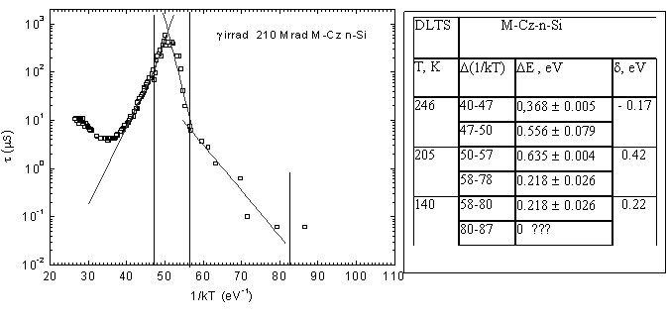
Precise simulation of the temperature dependent lifetime variations correlating with DLTS peaks – J.Vaitkus’ method
Multi-trapping
process
Single act of capture/thermal release
V₂^{=/-}
V₂^{-/o}
V-O
MWR decay τ_{as} peak
Common DLTS peaks

Slide 16
Summary
☼ Calibrated RT lifetime variations with fluence for definite particles, exploited for the same material and structures, would enable one to control radiation induced density of the dominant traps. However, calibration curves are not determined.
☼ Tentative examination of recombination characteristics dependent on fluence and particle species, by MWR using τ(T), I_{exc,} λ_{exc,} BI are carried out; τ_{as}(T) variations are correlated with those determined by DLTS technique in the range of relatively low fluences.
Thank You for attention!

