Slide 1


Irradiation-induced point defects in silicon; a selected overview
B.G. Svensson
University of Oslo, Department of Physics, Physical Electronics,
P.O. 1048 Blindern, N-0316 Oslo, NORWAY
^{and}
University of Oslo, Centre for Materials Science and Nanotechnology P.O. 1128 Blindern, N-0318 Oslo, NORWAY
Department of Physics
Hamburg, Aug-06

Slide 2
’Restrictions’
- ’Detector perspective’ – emphasis on electrically active defects
Room Temperature (RT) irradiation (unless stated otherwise)
D_{V} ~ 10⁻⁸-10⁻⁹ cm²/s, D_{I} ~10⁻⁴ cm²/s
Mainly lightly doped material (10¹² - 10¹⁵ cm⁻³)
Mainly dilute concentrations (10⁹ – 10¹⁴ cm⁻³)
O, C, H, (P, B) – NOT metallic impurities
HH, Aug-06

Slide 3
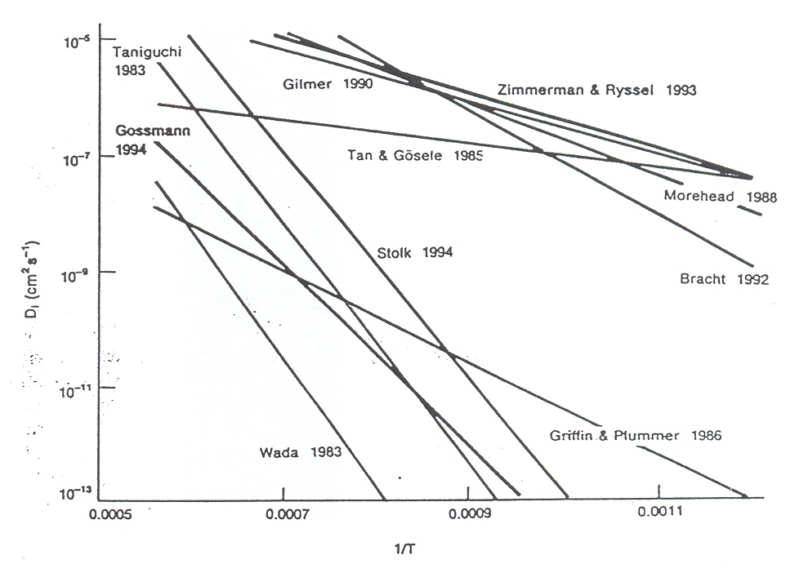
Indirect measurements and calculations of D_{I} in silicon
Compiled by: W. Taylor et al., Rad. Eff. 111/112, 131 (1989)
D. Eaglesham, Physics World, Nov-1995, p. 41

Slide 4
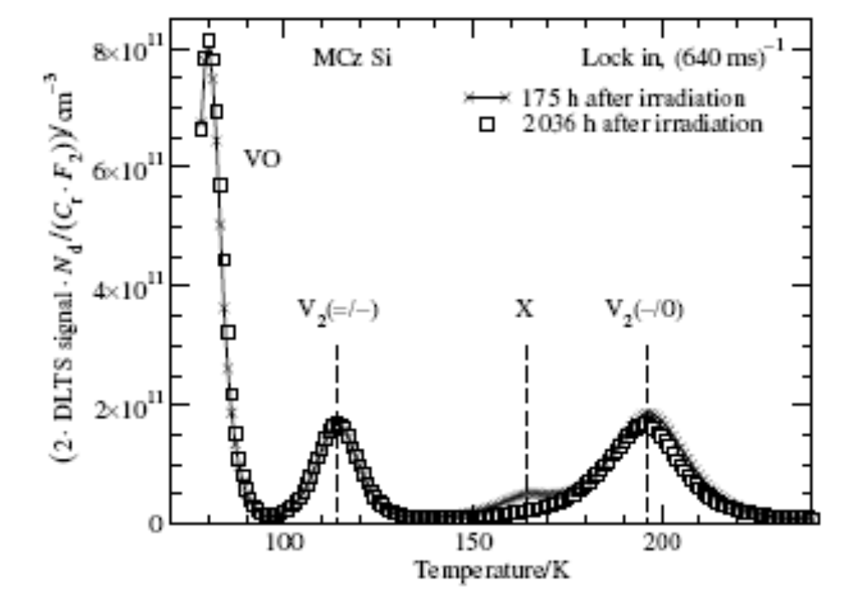
Typical DLTS-spectrum
P⁺-n⁻-n⁺ MCz diode
N_{d}~5x10¹² cm⁻³
6 MeV e⁻, 5x10¹² cm⁻²
E4
Bleka et al., ECS Trans, in press (2006)

Slide 5
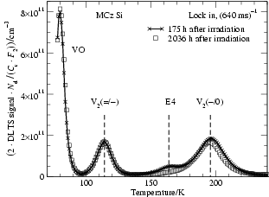
Typical DLTS-spectra
P⁺-n⁻-n⁺ MCz diode
N_{d}~5x10¹² cm⁻³
6 MeV e⁻, 5x10¹² cm⁻²
E4
Bleka et al., ECS Trans, in press (2006)

Slide 6
Silicon
Oxygen (O_{i})
Interstitial configuration
Vacancy oxygen (VO) center (0/-)
E_{C}
0.17 eV
E_{V}
For given irradiation conditions and low doses (<10¹⁴ cm⁻²), the production of VO is identical irrespective of the detector material used (SFZ, DOFZ, MCz, epi) !!

Slide 7
What about O_{I}I?
Most likely, it does exist as evidenced by IR and EPR measurements, (LVM at 944 and 956 cm⁻¹), in combination with low-temperature (LT) irradiation
Low binding energy, stable only up to 200-250 K !!
Further, OI₂ (LVM at 936 cm⁻¹) does probably also exist and is stable up to ~80 ºC. It forms directly during RT irradiation with fast neutrons and after LT-irradiation with MeV electrons + heating to RT (O_{i}I + I → OI₂)
Hermansson, Murin et al., Physica B 302/303, 188 (2001), and references therein

Slide 8
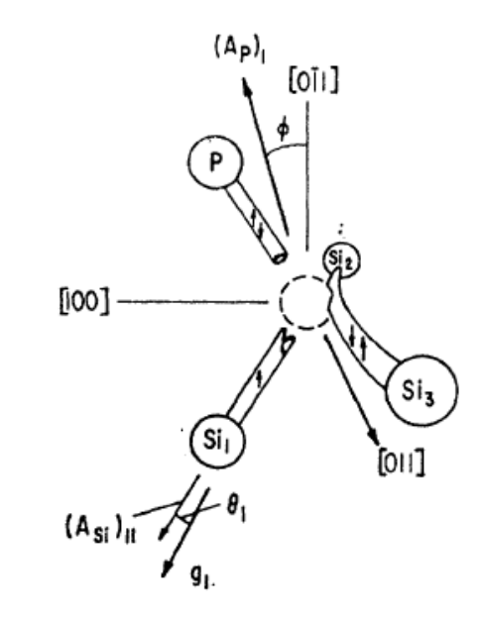
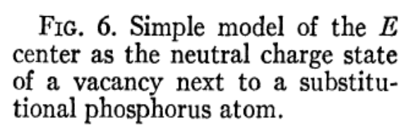
The E-center; VP, VAs, VSb
Acceptor-like state at E_{c}-0.44 eV
Dominant in highly doped Fz-Si (≥10¹⁶ cm⁻³)
Anneals at ~150 ºC (charge state dependent)
G.D. Watkins, J.W. Corbett, Phys. Rev. 134, A1359 (1964)
L.C. Kimerling et al., Sol. Stat. Comm. 16, 171 (1975)
S.D. Brotherton, P. Bradley, J. Appl. Phys. 53, 5720 (1982)
……
Most probably, of limited importance in n⁻-detector layers but dominant in n⁺-contact layers

Slide 9
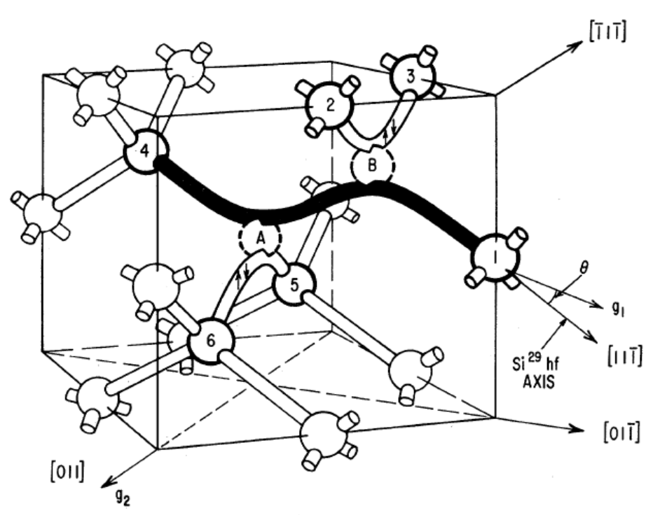
The V₂-center
Four different charge states (=,-,0,+) with corresponding levels at E_{c}-0.23, E_{c}-0.43 and E_{v}+0.20 eV
The most prominent intrinsic defect stable at RT
J.W. Corbett, G.D. Watkins, Phys. Rev. Lett. 7, 314 (1961)
……
Presumably of key importance in n⁻/p⁻ detector layers, either directly or indirectly

Slide 10
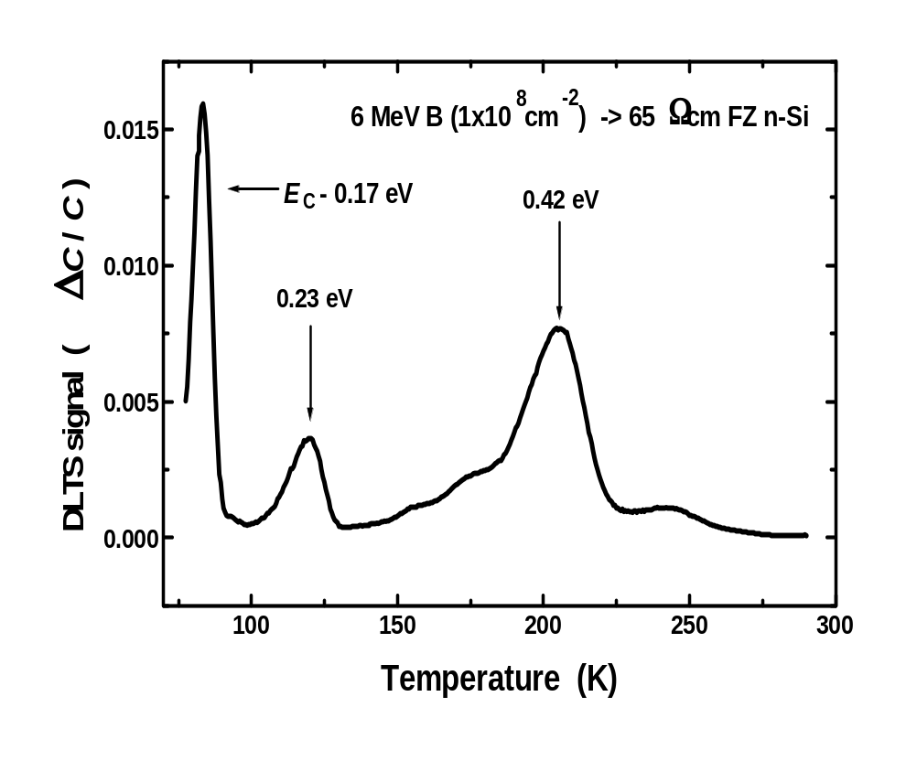
Generation of VO and V₂; mass effect
6 MeV ¹¹B
6 MeV e⁻
E4
Importance of V₂ (and higher order clusters) increases with increasing elastic energy deposition (NIEL), e.g., neutral hadrons

Slide 11
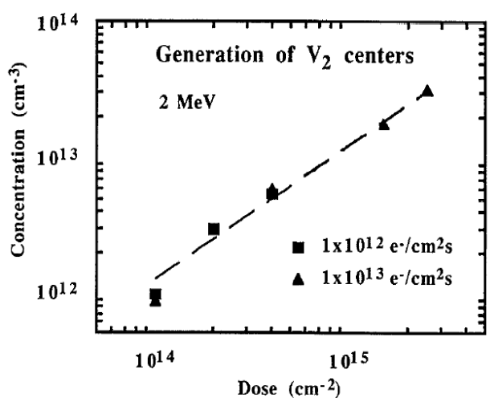
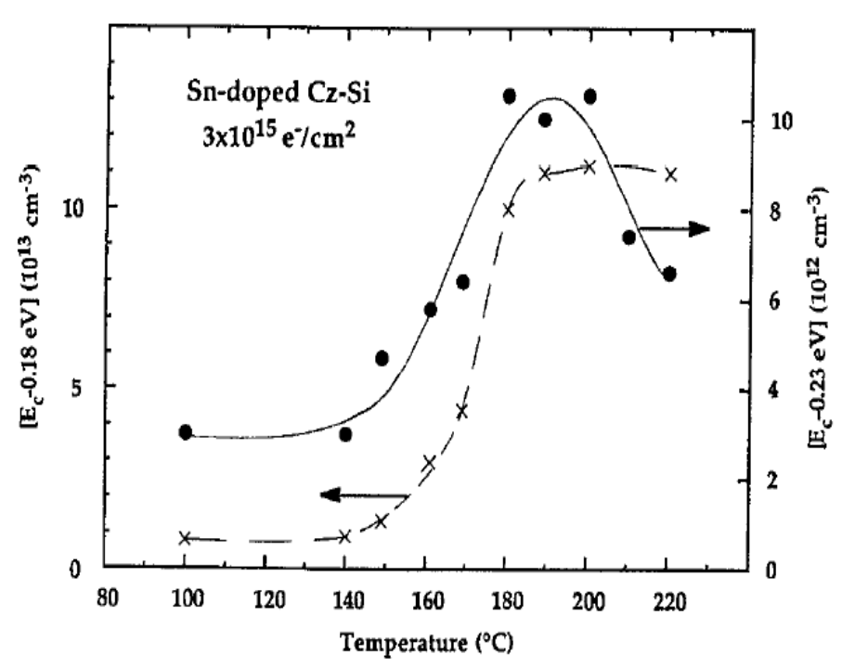
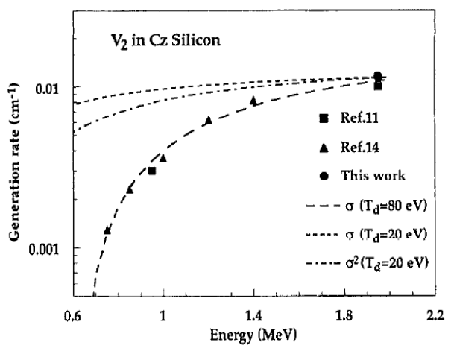
Generation mechanism for V₂
Svensson, Lindström, J. Appl. Phys. 72, 5616 (1992)
’Direct’ generation of V₂ prevails (pairing of V’s formed by different impinging electrons is negligible)!

Slide 12
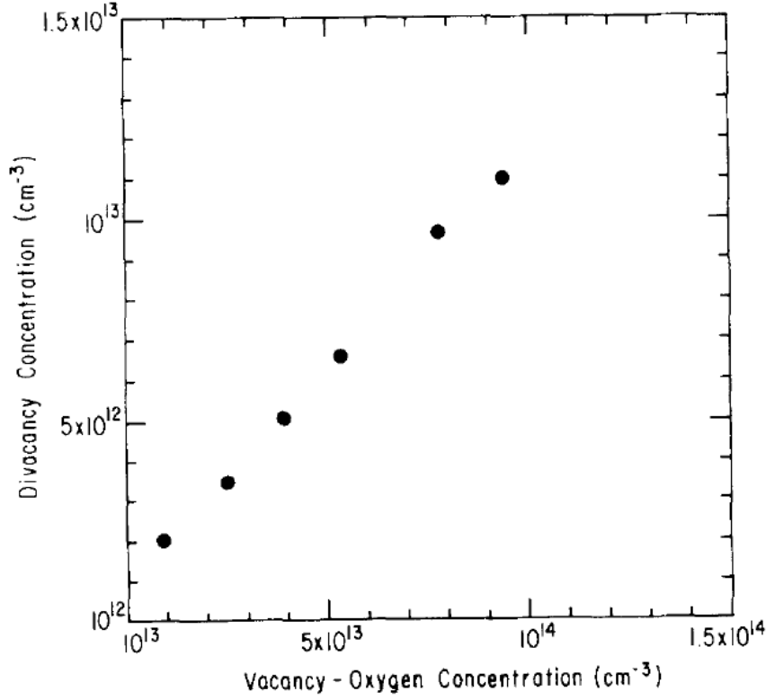
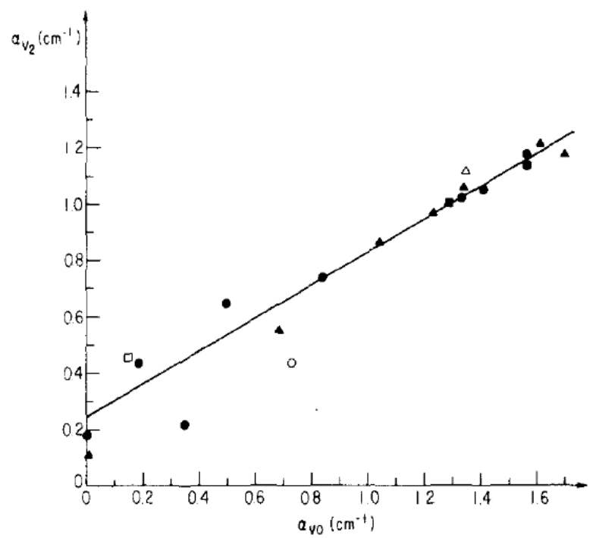
Linear correlation between VO and V₂ generation
2 MeV e⁻, 10¹⁸ cm⁻²
P-type Cz (~7 Ωcm)
1.5 MeV e⁻, 10¹⁴-10¹⁵ cm⁻²
N-type Fz and Cz (~3 Ωcm)
Lindström et al., J. Appl. Phys. 53, 5686 (1982)
Wang et al., Appl. Phys. Lett. 33, 547 (1978)
Oehrlein et al., ,J. Appl. Phys. 54, 179 (1983)
’Direct’ generation of V₂ prevails and identical annihilation process for VO and V₂. [C_{s}] has a crucial impact by suppressing V+I→Ø !

Slide 13
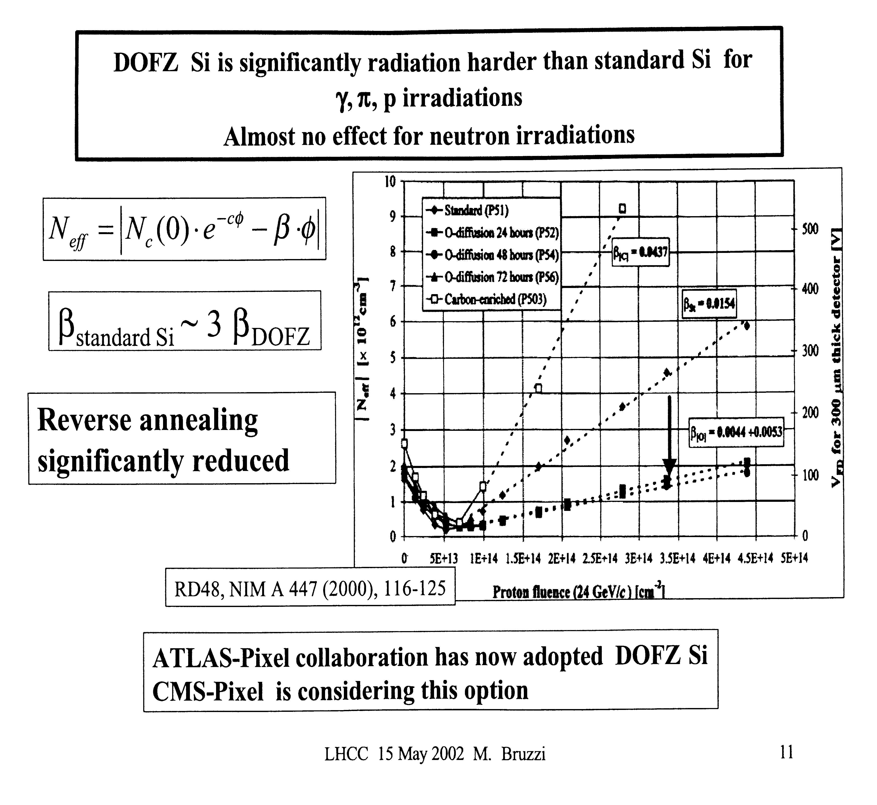
Impurity engineering of high-purity Si
The role of C_{s} may be indirect

Slide 14
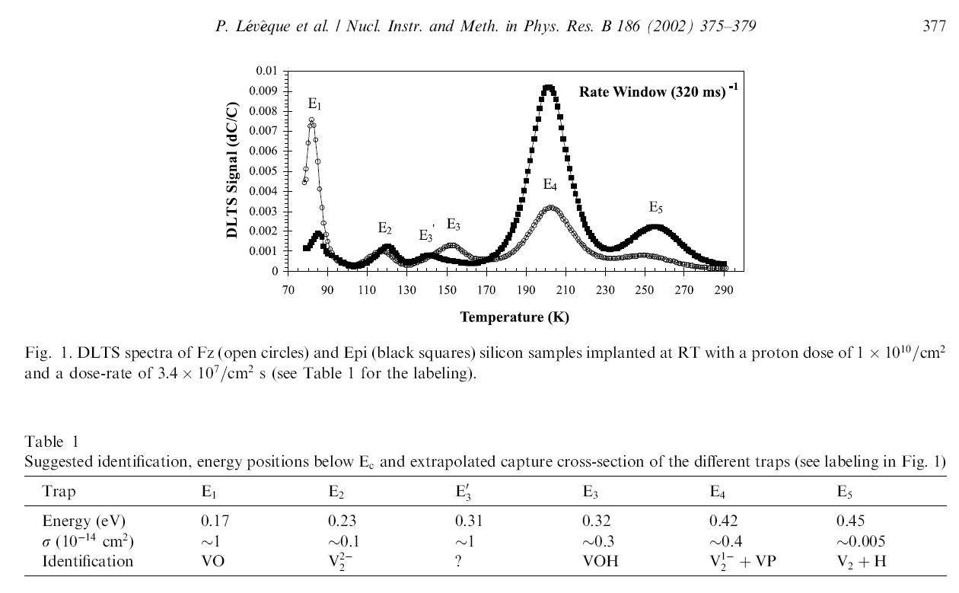
N-type epi (110 Ωcm, 50 μm, MBE-grown)
N-type Fz (75 Ωcm)
1.3 MeV H⁺
Generation of VO is strongly reduced in low-doped high-purity epi!! In fact, VP dominates ([P_{s}]~4x10¹³ cm⁻³)!

Slide 15
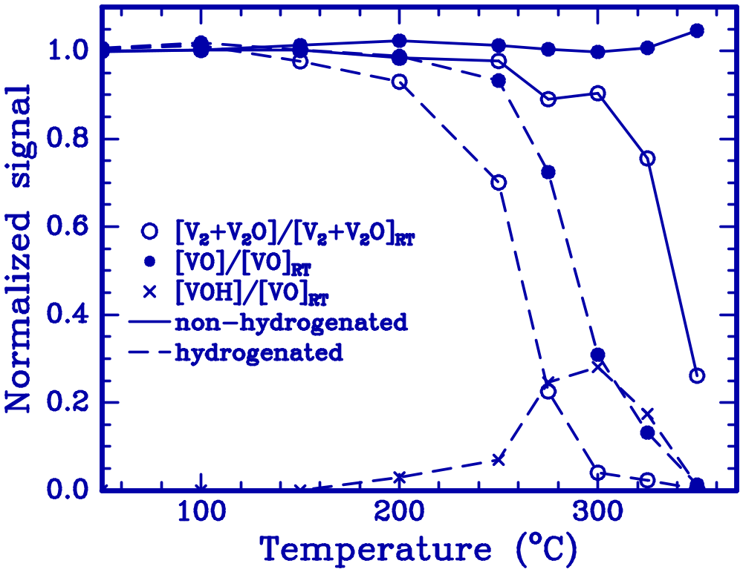
Annealing of VO and V₂
VO + O_{i} → VO₂
VO ↔ V + O_{i}
H + VO → VOH
H + VOH → VOH₂
V₂ + O_{i} → V₂O
V₂ ↔ V + V
H₂ + V₂ → V₂H₂ (?)
V₂O ↔ VO + V
........
DOFZ-Si
Monakhov et al., PRB 69, 153202 (2004)
D_{VO}~5e^{-1.8(eV)/kT} cm²/s
E_{diss}(VO)~2.0 eV
D_{V2}~0.003e^{-1.30(eV)/kT} cm²/s
E_{diss}(V₂)~1.7-1.8 eV
E_{diss}(V₂O)~2.0 eV

Slide 16
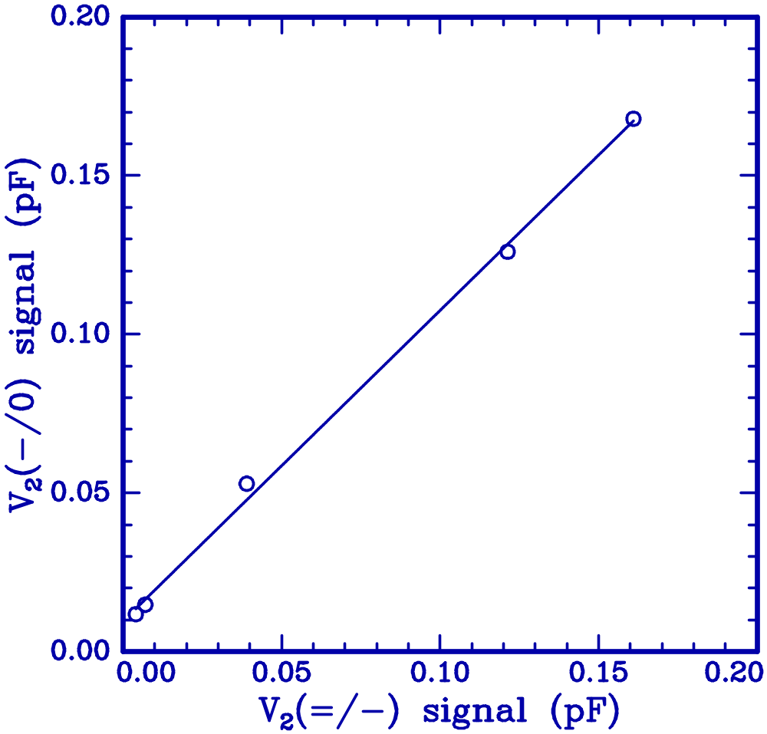
[E_{c}-0.43 eV] vs [E_{c}-0.23 eV] during
annealing of Hydrogenated DOFZ
V₂H is not a major ’player’!!
linear fit: y=A+Bx
A=0.010±0.002
B=0.98±0.02
Monakhov et al., PRB 69, 153202 (2004)

Slide 17
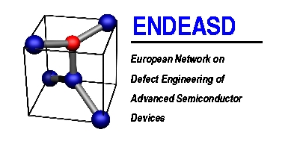
Interstitial carbon (C_{i})
Three different charge states (-,0,+) with corresponding levels at E_{c}-0.10 and E_{v}+0.27 eV
Extremely well-studied defect (PL, EPR, IR..) and it is the source of a multitude of other defects (including C_{i}-I (?))
G. Davies and R.C. Newman, Handbook of Semiconductors, Eds T.S. Moss, S. Mahajan (Elsevier, Amsterdam, 1994) ch. 21, p. 1557
Carbon is of key importance in n⁻/p⁻ detector layers, either directly or indirectly
C_{s} has a strong impact on the overall defect generation via its role as I-trap

Slide 18
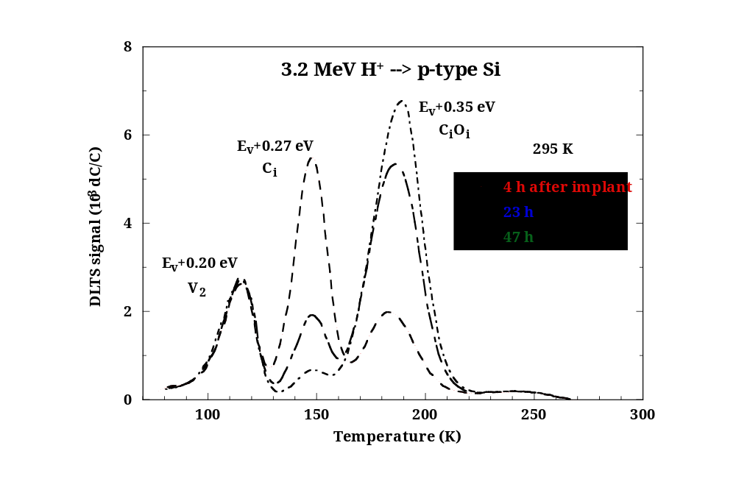
Evolution of C_{i} at RT; an illustration
Fz (~15 Ωcm)
[O_{i}]~1.2x10¹⁶ cm⁻³
[C_{s}]≤5x10¹⁵ cm⁻³
Lalita et al., NIMB 120, 27 (1996)

Slide 19
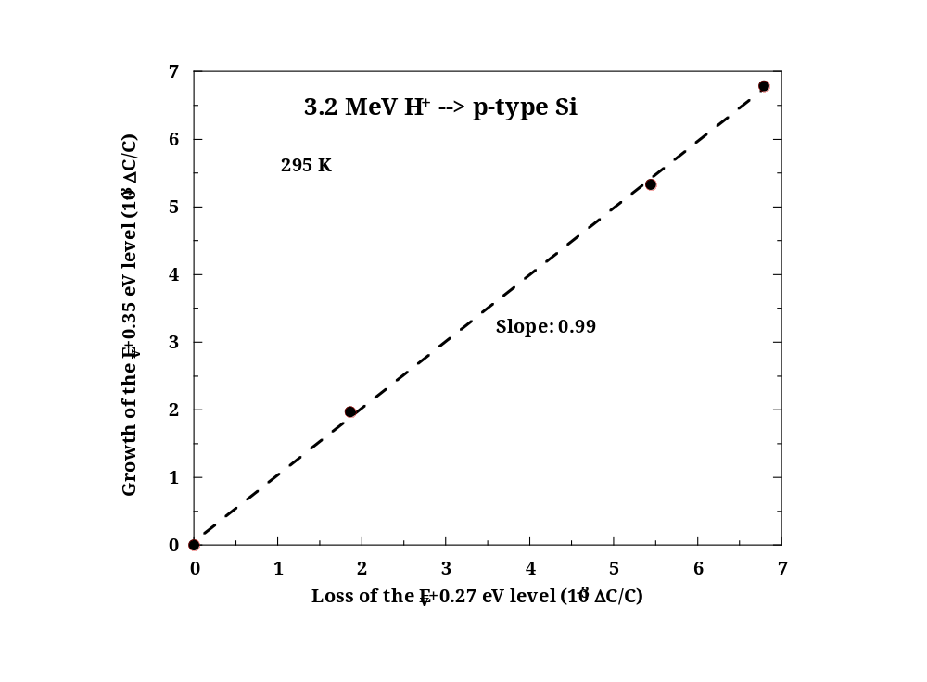
1:1 proportionality between loss of C_{i} and growth of C_{i}O_{i}
Lalita et al., NIMB 120, 27 (1996)

Slide 20
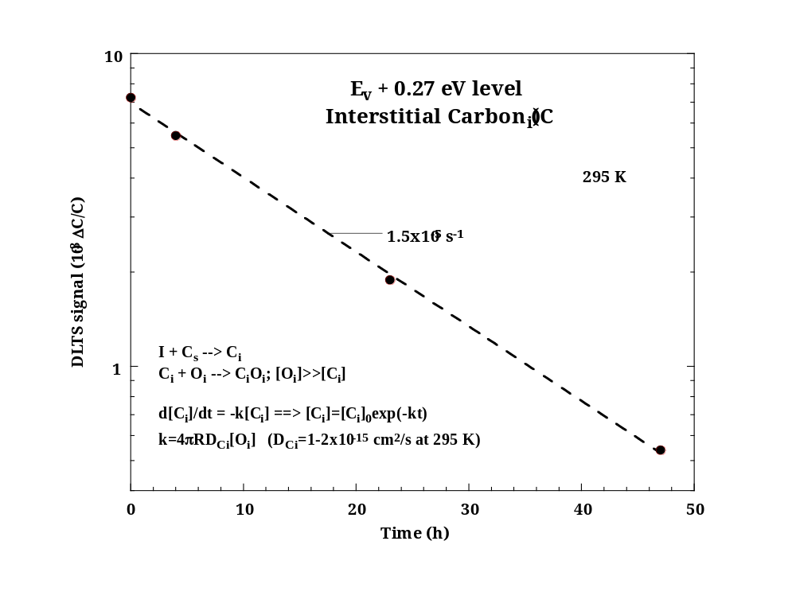
(C_{i})
Cf value by Tipping, Newman, Semicond. Sci. Techn. 2, 315 (1987)
D = 0.4exp(-0.87(eV)/kT) cm²/s
Lalita et al., NIMB 120, 27 (1996)

Slide 21
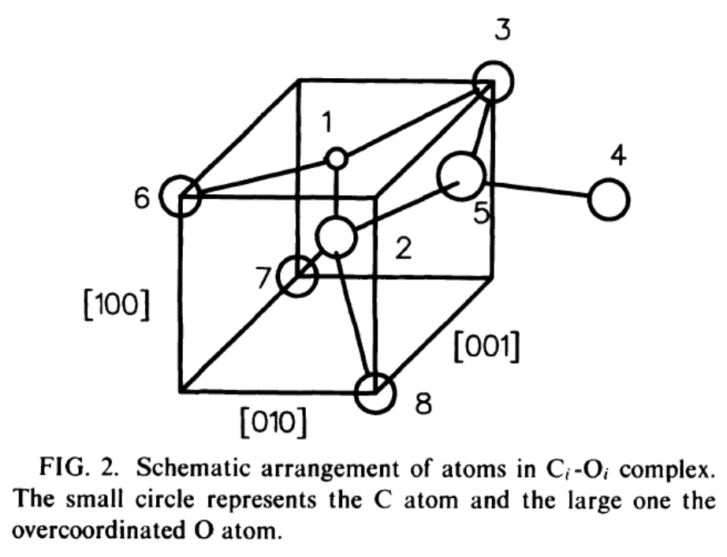
Interstitial carbon – interstitial oxygen (C_{i}O_{i})
At least two different charge states (0,+) with a corresponding level at E_{v}+0.35 eV, dominant in ’p-type spectra’
Extremely well-studied defect (PL, EPR, IR..)
Stable in excess of 300 ºC, E_{diss}~2.0 eV
Jones, Öberg , Phys. Rev. Lett. 68, 86 (1992)
Potential candidate as trap for migrating I’s; C_{i}O_{i}+I_{n} (n≥1) but such complexes are not yet confirmed spectroscopically for n>1

Slide 22
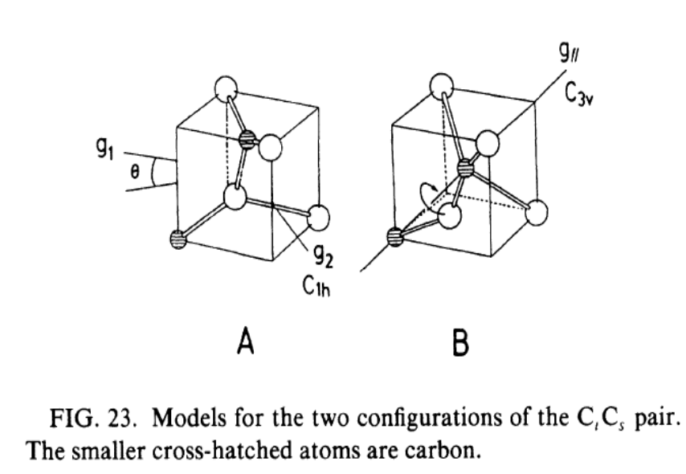
Dicarbon center (C_{S}C_{i})
Bistable with three different charge states (-,0,+) and levels at E_{c}-0.17 and E_{v}+0.09 eV for A-configuration (E_{c}-0.11 and E_{v}+0.05(?) eV for B)
Important in C-rich (O-lean) material
Extremely well-studied defect (PL, EPR, DLTS...)
Stable up to 250 ºC, E_{diss}~1.7-1.9 eV
Song et al., Phys.Rev.B42, 5765 (1990)
Potential candidate as trap for migrating I’s; C_{s}C_{i}+I_{n} (n≥1) and spectroscopic (optical) signals have been tentatively identified

Slide 23
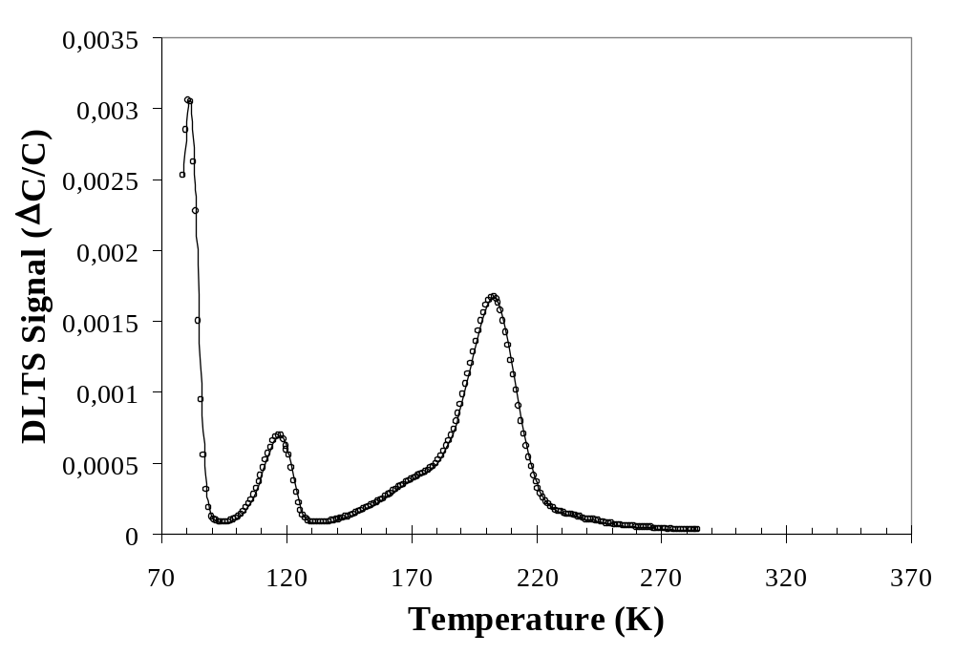
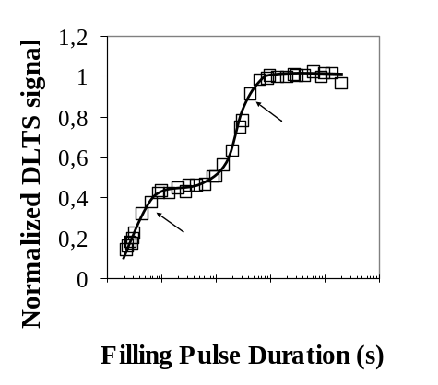
DLTS signals of C_{s}C_{i} and VO overlap
6 MeV ¹¹B → n-type FZ (65 Ωcm)
Lévêque et al., J. Appl. Phys. 93, 871 (2003)
In oxygen-lean material the contributions from VO and C_{S}C_{i} can be comparable (Filling-pulse measurements (or annealing) can be used to distinguish)!

Slide 24
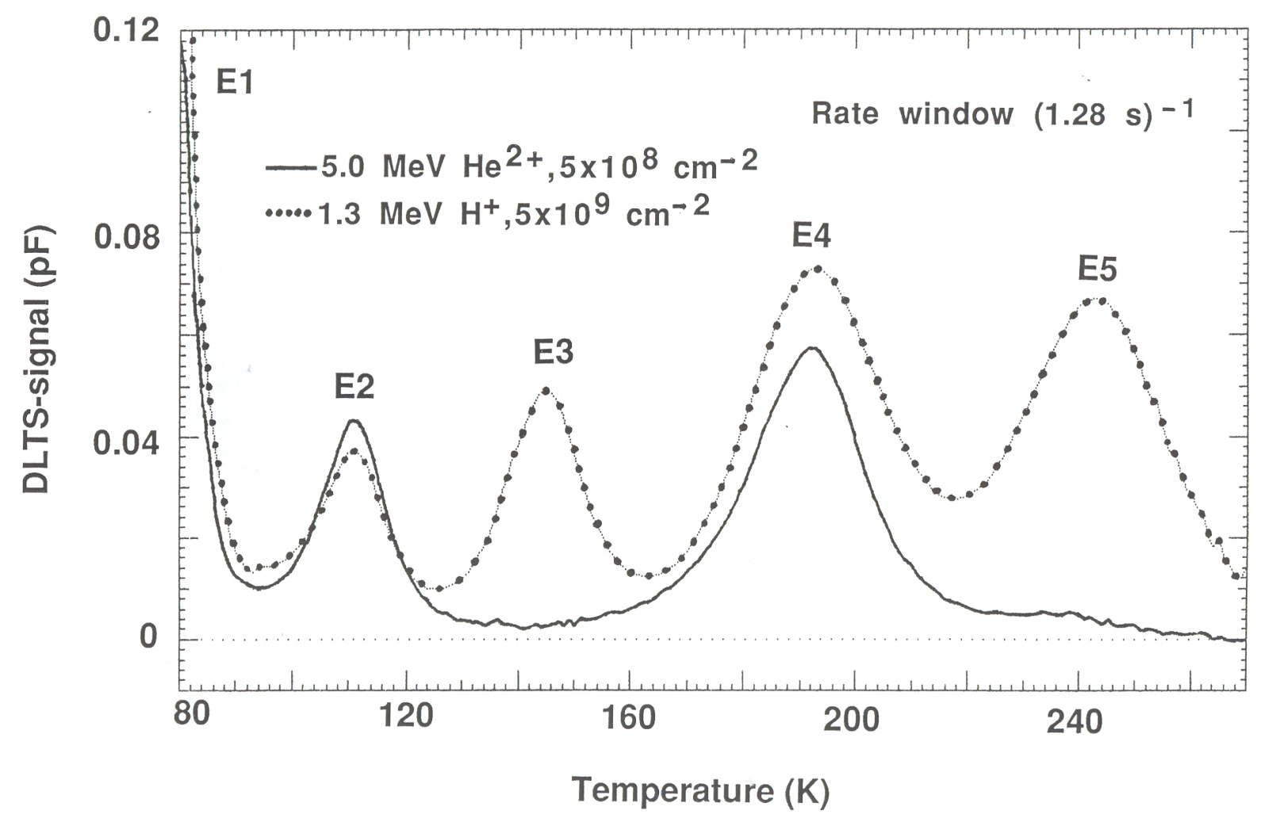
Hydrogen and irradiation-induced defects
N-type Fz, 175 Ωcm
E_{c}-0.45 eV
E_{c}-0.32 eV
Svensson et al., Mat.Sci.Eng. B4, 285 (1989)
Irmscher et al., J. Phys. C 17, 6317 (1984)
At least two H-related defects are clearly resolved where the shallow one has later been firmly identified as VOH with a donor state at E_{v}+0.27 eV!

Slide 25
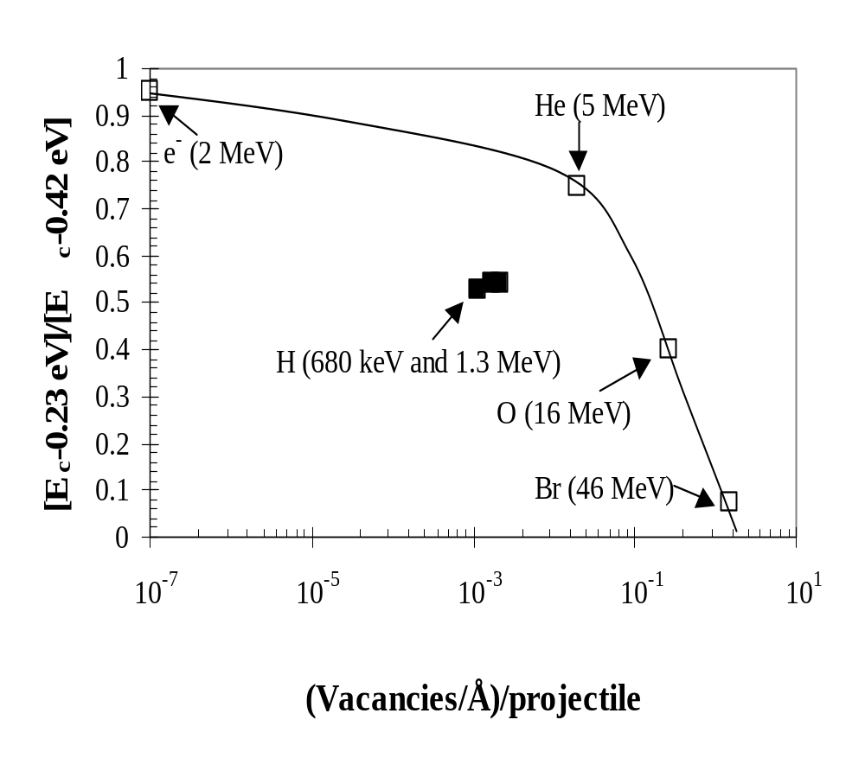
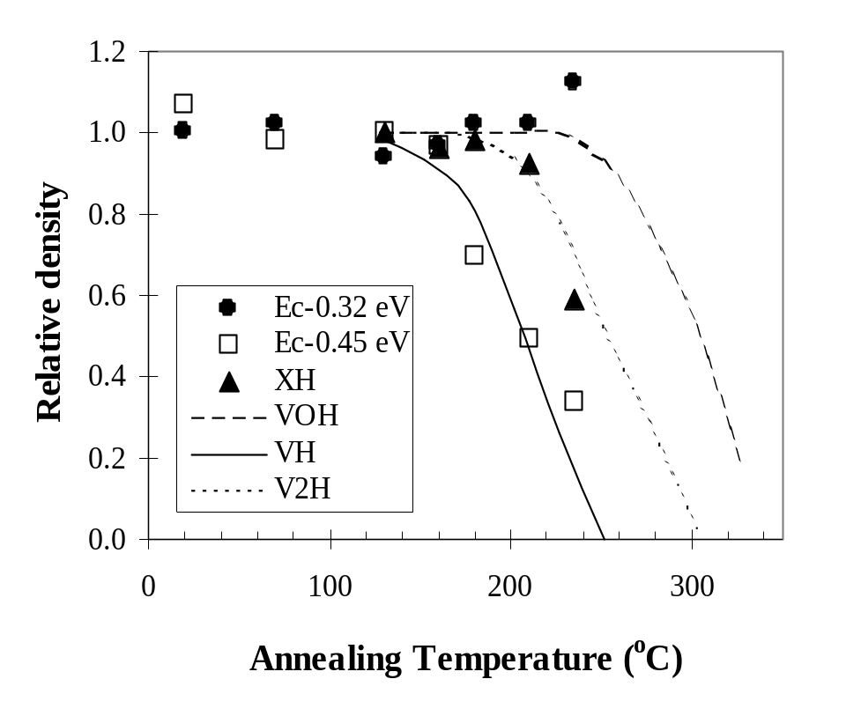
Evidence for a third irradiation-induced defect involving H
’XH’
Vacancies/Å/projectile
Lévêque et al., EP-JAP 23, 5 (2003)
Annealing temperature (ºC)
Comparison between DLTS (data points) and EPR results by Bonde-Nielsen et al., Physica B273/274, 167 (1999)
Lévêque et al., EP-JAP 23, 5 (2003)
The H-related level at ~E_{c}-0.43 eV (XH) is tentatively assigned to V₂H

Slide 26
Summary of findings for H + RT irradiation
VOH (0/-) E_{c}-0.32 eV, (0/+) E_{v}+0.27 eV
Forms directly during irradiation if free H is available
Occurs frequently during VO and V₂ annealing in ’H-rich’ material
Stable at temperatures in excess of 300 ºC
VH (0/-) (?) at E_{c}-0.45 eV with σ_{n}~10⁻¹⁷ cm²
’Free’ H is required for formation
Disappears at ~200 ºC
V₂H (0/-) (?) at ~E_{c}-0.43 eV, overlaps strongly with V₂(0/-)
Disappears at ~250 ºC
In lightly doped n-Si-detector material; [H], [H₂]<10¹⁴ cm⁻³ and even in intentionally hydrogenated DOFZ no effect is found below 200 ºC which implies ’strong’ trapping of the hydrogen by, e.g., carbon-related centers like C_{s}C_{i}H (T-center)

Slide 27
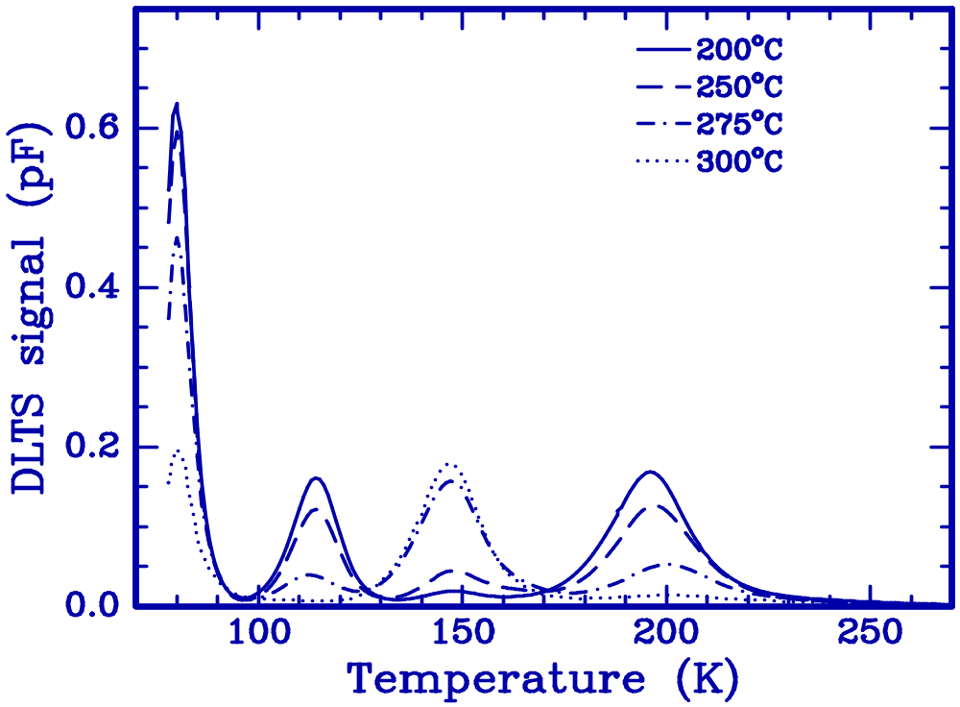
15 MeV e⁻ → Hydrogenated DOFZ-Si
VO
2h in H plasma at 300 ºC
N⁺-side exposed (700 mTorr)
V₂(=/-)
VOH
V₂(-/0)
Monakhov et al., PRB 69, 153202 (2004)

Slide 28
Some ’hot issues’
I-center (0/-) E_{c}-0.55 eV, (0/+) E_{v}+0.58 eV (?)
A key defect for type inversion (ΔN_{eff}) and leakage current in γ-irradiated p⁺-n⁻-n⁺detectors
Quadratic dose dependence, suppressed in DOFZ
’Standard’ interpretation and modeling of the oxygen effect suggest an identification as V₂O. This is, however, not consistent with annealing data for V₂ and theoretical model of V₂O...
Can we exclude involvement of carbon??
Clusters Influence of the W- (and X,J..) center? Small I-clusters (?) with shallow states appearing after neutron/ion irradiation...
How important is the di-interstitial, I₂? Mobile at RT (E_{migr}~0.9 eV)?! Similar generation rate as V₂?!
Vacancy clusters? E.g., V₆ is expected to be quite stable and should be detectable by electrical techniques?! Is broad band PL useful?
Role of the oxygen dimer, O₂? E_{migr}~1.4 eV, [O₂]~10¹⁴ cm⁻³ in DOFZ/MCz, interaction with other defects?

