Slide 1
Thermally Stimulated Currents Method
Ioana Pintilie
^{a)}National Institute of Materials Physics,
Bucharest-Magurele, P.O.Box MG-7, Romania
^{b)}Institute for Experimental Physics,
Hamburg University, D-22761, Germany

Slide 2
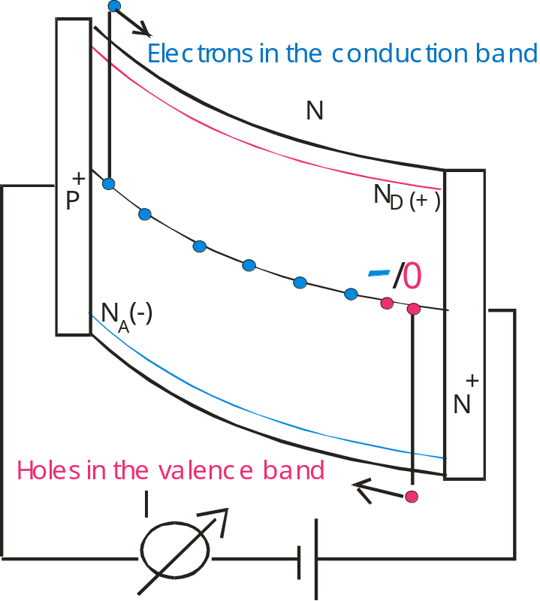
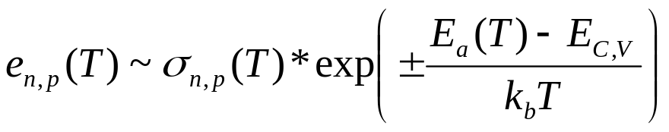
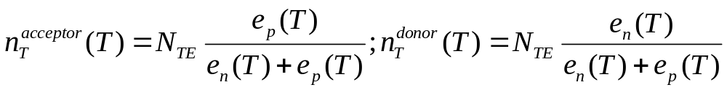
Electrical properties of Point Defects in the space charge region
Defect´ signature – emission rates
Effective doping concentration
given by the steady state occupancy
of the defect/impurity levels in SCR
2) Leakage current density
Effective generation centers (acceptor like)

Slide 3
Thermally Stimulated Currents Method
cooling the sample
filling of the traps:
during cooling under 0 bias (majority carriers)
or carrier injection at low T by biasing the diode/ illumination
recording the TSCurrent – the current due to charge emission from the traps is recorded as function of temperature during the heating of the sample with constant rate
p⁺- n – n⁺ diodes
Electrons in the conduction band
+
p
d
n
+
n
Holes in the valence band
I
Current

Slide 4
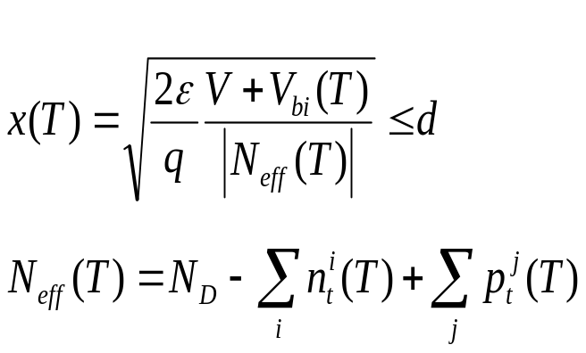
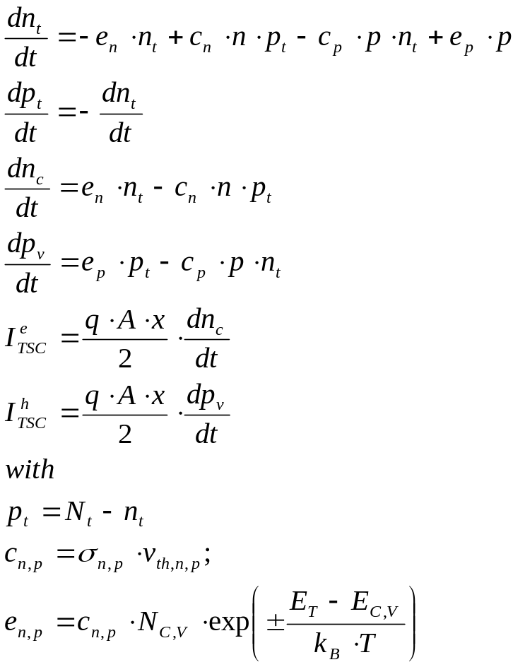
n_{t}(T_{fill}), p_{t}(T_{fill}):
electrons injection
n_{t}(T_{fill}) = N_{t}
holes injection
p_{t}(T_{fill}) = N_{t}
forward injection/illumination under 0V
p_{t}(T_{fill}) = N_{t}⋅c_{p}/(c_{n}+c_{p})
n_{t}(T_{fill}) = N_{t}⋅c_{n}/(c_{n}+c_{p})

Slide 5
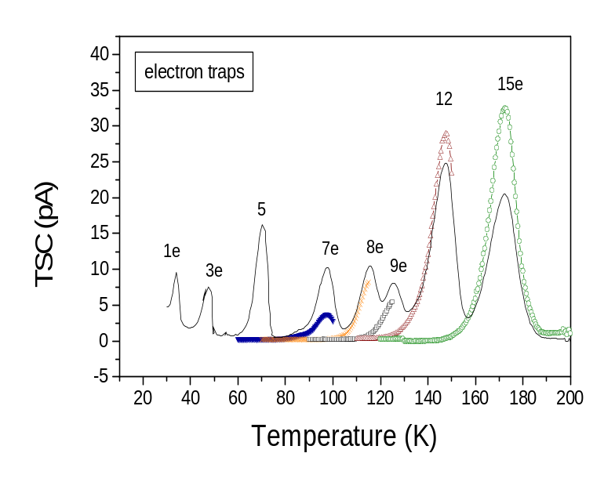
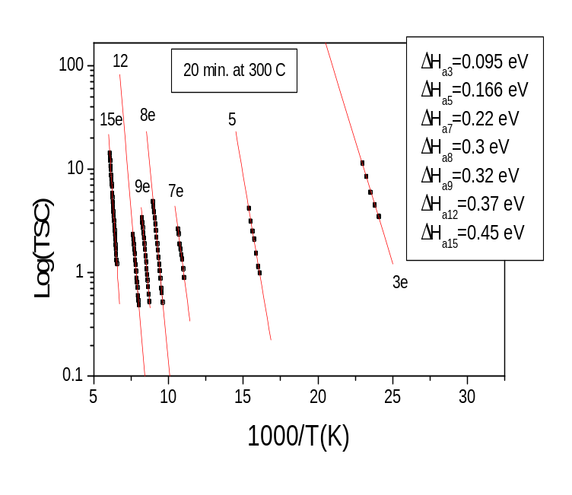
Activation enthalpy - the thermal cleanning procedure
For defects with e_{n}(T) >> e_{p}(T) (or viceversa) and for constant SCR width (x(T)=d) the increasing part of the TSC peak is ~ exp (ΔH_{n (p)}/kT)
⇒ ΔH_{n (p)} can be determined from Arrhenius plots
Concentration of defects – by integrating the TSC peak
Capture cross sections – by fitting the TSC peaks

Slide 6
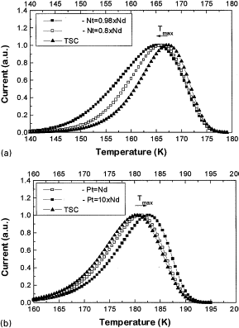
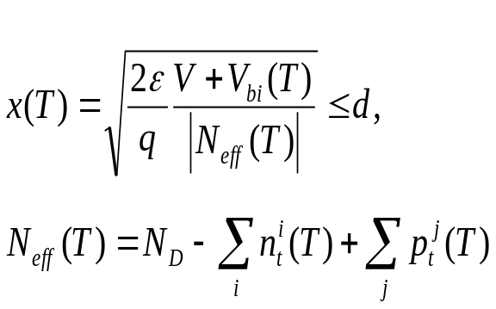
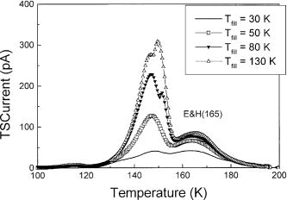
Problems - Temperature variation of SCR width (x(T) < d)
x < d
x < d
x = d
Nt >20xNd
x < d
x < d
x =d

Slide 7
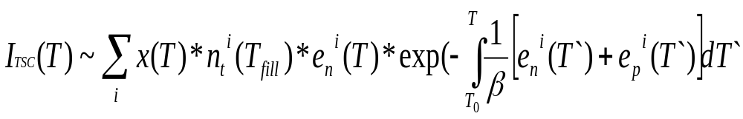
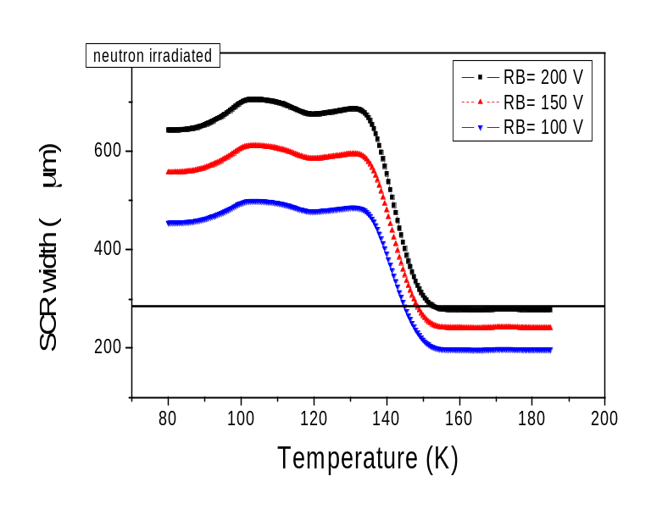
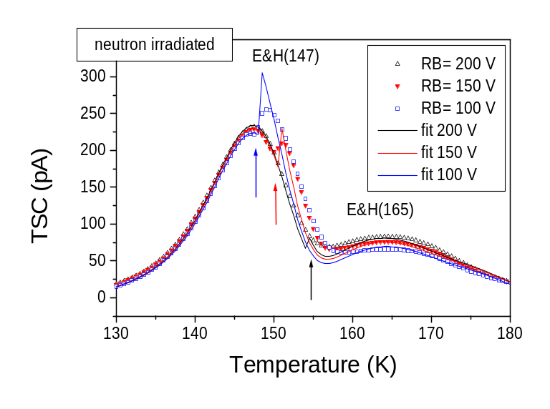
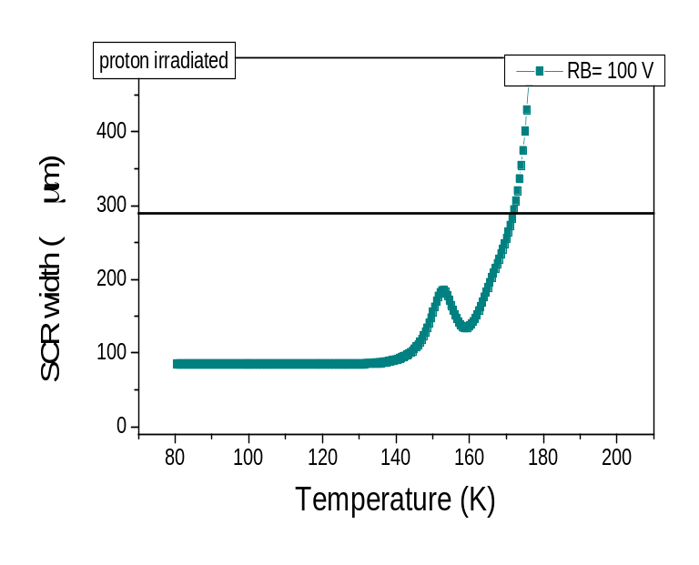
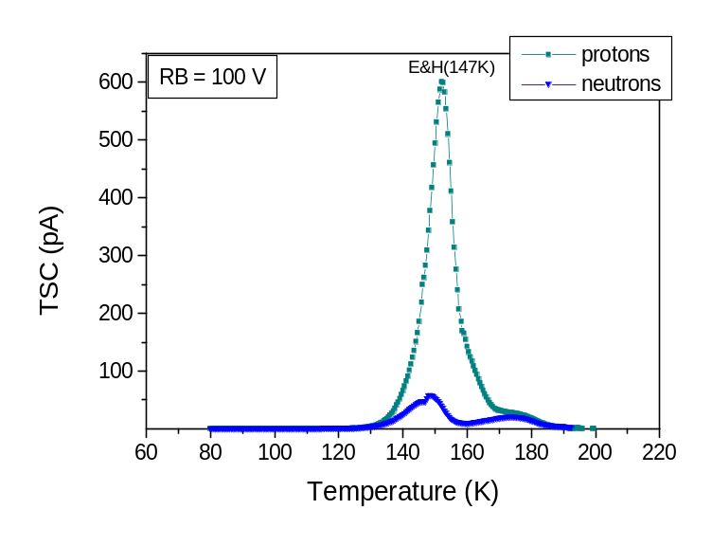

Slide 8
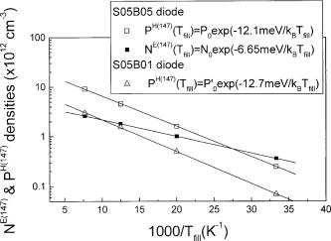
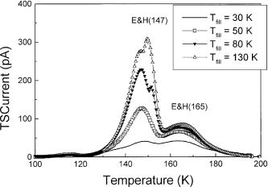
Evaluation of temperature dependent capture cross sections
Diodes with initial doping of N_{d} = 5·10¹¹ cm⁻³, N_{t} ~ 2·10¹³ cm⁻³

Slide 9
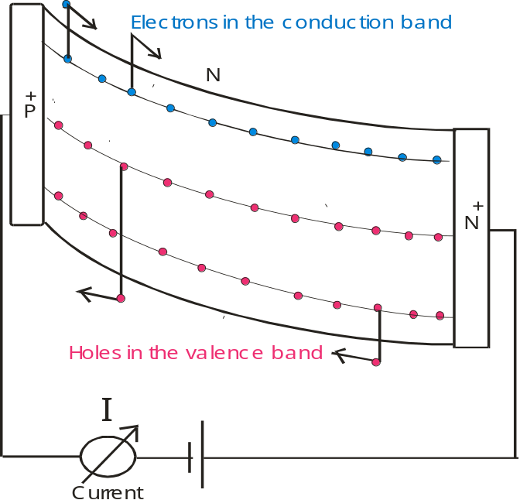
Deep acceptors acting like Generation centers
Emission from the filled traps
Steady state occupancy in the SCR
Electrons in the conduction band
N
P
+
N
(+)
D
/
0
N
A
(-)
N
+
n_{T} (T) ~ 80%N_{T}
what can be detected is
20% N_{T} emission of electrons
80% N_{T} emission of holes
Holes in the valence band

Slide 10
Thermally Stimulated Currents Method
advantage:
investigation of diodes with high traps concentration
N_{T} >N_{D}-N_{A}
- determination of ionisation energy (Thermal cleaning procedure)
- suitable for the detection of donor activity (Poole-Frenkel effect)
disadvantage:
- no direct defect identification possible
combination with other methods (e.g. EPR, FTIR)
limitation:
TSC_{min} > 0.1 pA
TSC_{max} – given by the possibility of depleting the diodes thickness (RB_{max}=500 V) during T scan
no direct measurement of the capture cross sections possible

