Slide 1
TSC results - University of Hamburg
I. Pintilie^{a),b)}, E. Fretwurst^{b)}, G. Lindström^{b)} J. Stahl ^{b)} and F. Hoenniger ^{b)}
^{a)}National Institute of Materials Physics, Bucharest-Magurele, P.O.Box MG-7, Romania
^{b)}Institute for Experimental Physics, Hamburg University, D-22761, Germany
Publications
I. Pintilie, E. Fretwurst, G. Lindstroem and J. Stahl, Appl. Phys. Lett. 81, No 1 (2002) 165
I. Pintilie, E. Fretwurst, G. Lindstroem and J. Stahl, Appl. Phys. Lett. 82, No 13 (2003) 2169
I. Pintilie, E. Fretwurst, G. Kramberger, G. Lindstroem, Z. Li and J. Stahl, Physica B: Condensed Matter 340-342 (2003) 578
I. Pintilie., E. Fretwurst, G. Lindstroem and J. Stahl, Nucl. Instr. and Meth. A 514 (2003) 18
G. Lindstroem, E. Fretwurst, G. Kramberger, I. Pintilie, Journal of Optoelectronics and Advanced Materials Vol. 6, No. 1, (2004) 23
J. Stahl, E. Fretwurst, G. Lindstroem and I. Pintilie, Physica B: Condensed Matter 340-342 (2003) 705
I. Pintilie, L. Pintilie, M. Moll, E. Fretwurst and G. Lindstroem, Appl. Phys. Lett 78 (2001) 550
J. Stahl, PhD Thesis, Hamburg University, 2004, DESY-Thesis-2004-28, ISSN 1435-8085
E. Fretwurst, G. Lindstroem, J. Stahl, I. Pintilie, Z. Li, J. Kierstead, E. Verbitskaya and R. Röder, Nucl. Instr. and Meth. A 514 (2003) 1-8

Slide 2
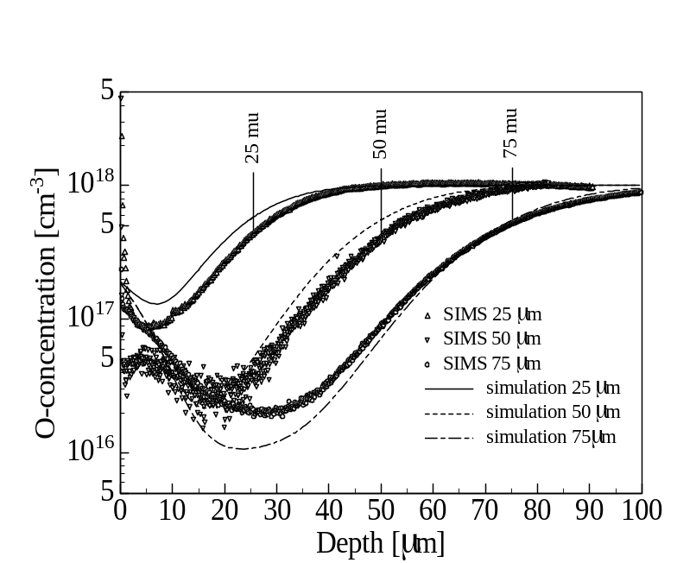
Material:
- STFZ, DOFZ, Cz and EPI (25, 50, 75 μm) diodes
- p⁺nn⁺ Si diodes, processed by CiS/Erfurt Germany
Sample | STFZ | DOFZ | EPI/Cz (50 μm) | Cz
SIMS [O] | <5*10¹⁶ | 1.2*10¹⁷ | ≈ 9*10¹⁶ | 8.1*10¹⁷
Irradiation:
- Co⁶⁰ γ-source at BNL, dose range 90 to 500 Mrad
- CERN (24 GeV protons) up to 6x10¹⁴/cm²
Measurements:
C-V, I-V, at RT
Thermally Stimulated Current

Slide 3
Detected Trapping levels
No
Level
Method
Ea(eV) ±
σ_{n}/σ_{p}
10⁻¹⁵cm²
Material
Obs.
1
H(42K)
TSC
+0.084
/0.5
DOFZ, Cz, Epi
150C-an-out
2
H(47K)
TSC
+0.1
/1
DOFZ, Cz, Epi
3
E(50K)
TSC
-0.11
2
DOFZ, Cz, Epi
150C-an-out, IO₂
4
VO^{-/0}
DLTS, TSC
-0.17
14
less in STFZ
5
H(87K)
TSC
+0.2
/2
DOFZ, Cz, Epi
after 150C ann.
6
I^{+/0}
TSC
+0.225
/1
7
BD(98K)
TSC
-0.225
DOFZ, Cz, Epi
Bistable donor -TDD
8
VV^{=/-}
DLTS
-0.215
0.1
9
CiOi^{+/0}
DLTS,TSC
+0.36
/2.3
10
E(147K)
TSC
-0.37
2.5
11
VV^{-/0}
DLTS,TSC
-0.42
2
12
I^{0/-}
DLTS,TSC
0.545/+0.58
2/90
suppressed in DOFZ, V₂O
13
Γ
DLTS,TSC
+0.66
0.05/5
suppressed in DOFZ

Slide 4
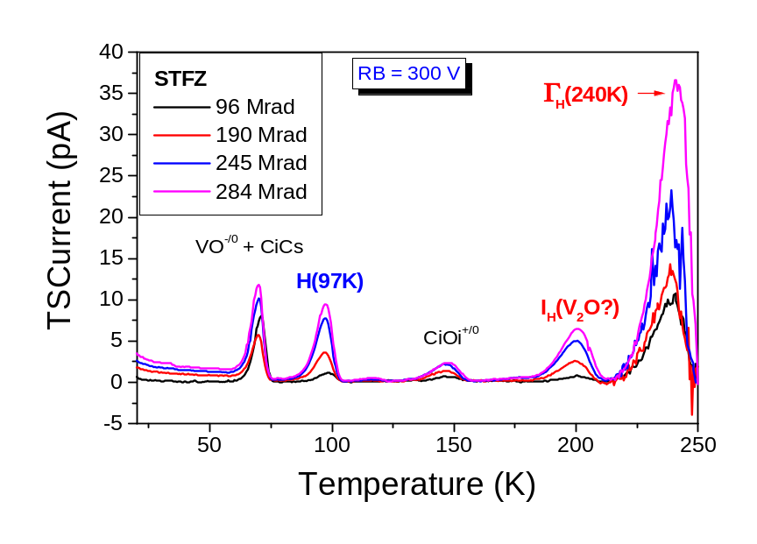
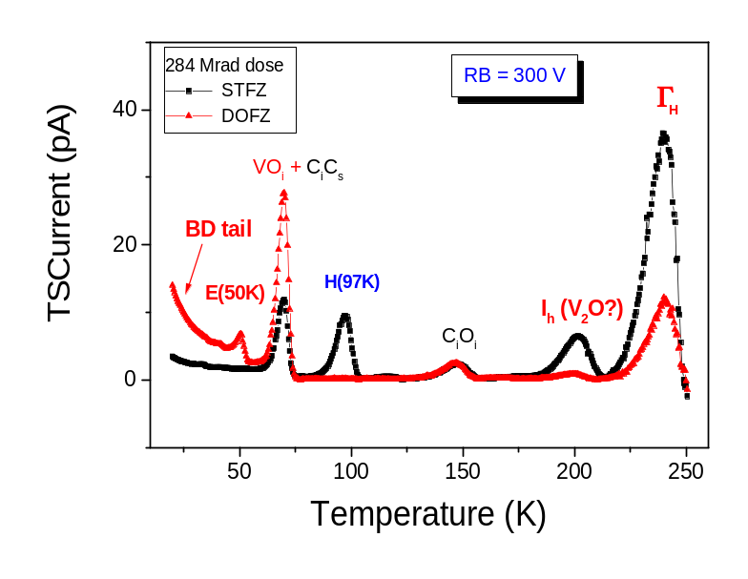
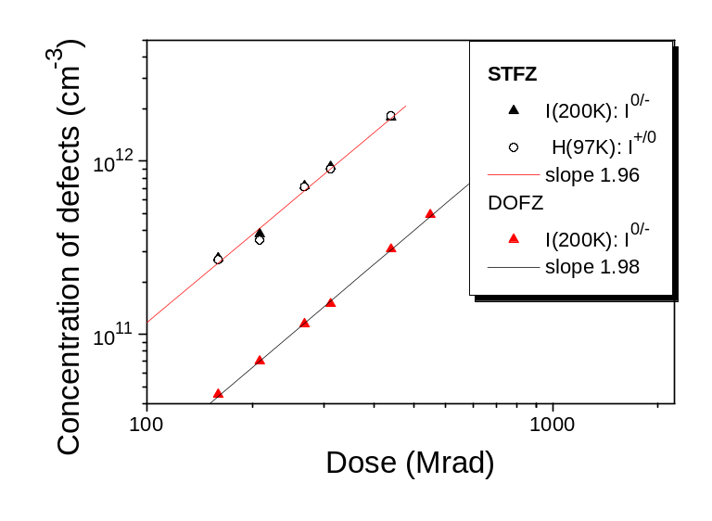
A) Co⁶⁰-γ irradiation (96-500 Mrad doses)
STFZ:
-H(97K)
-more I
-more Γ
DOFZ:
-BD tail + E(50K)
-more VO_{i}
I defect - almost quadratic dose dependence ⇒ defect formed through a second order procces (VO+V?)

Slide 5
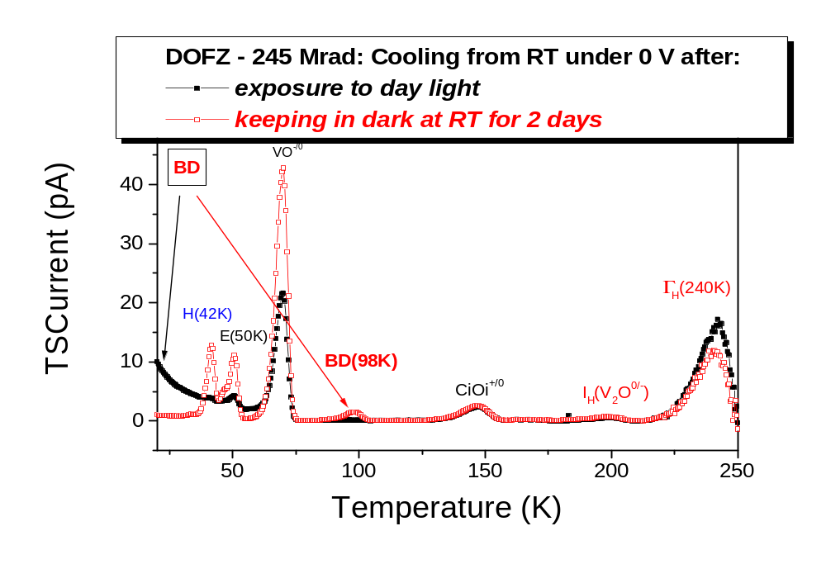
DOFZ – different experimental procedures
TDD1 and TDD2 in n type Si are bistable thermal donors (BTD) – they can exist also in a configuration which forms an Anderson negative U-system

Slide 6
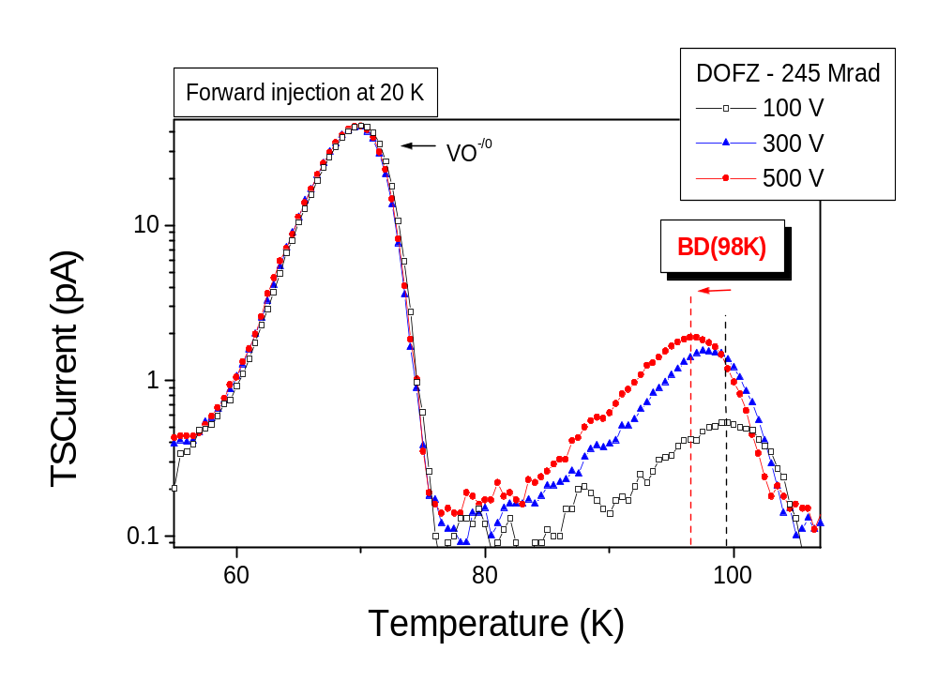
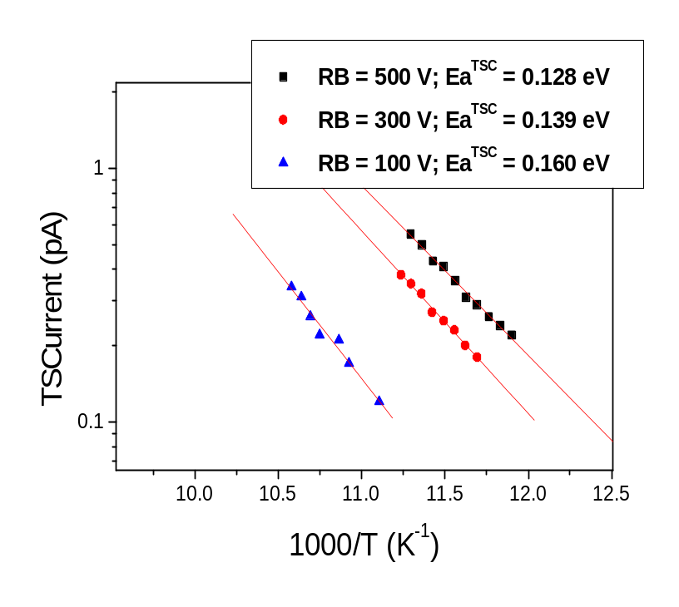
Donor activity of BD(98K) centers
If the Poole Frenkel effect is present ⇒ a shift of TSC peak to lower T should be seen when increasing the applied bias
ΔH = 0.225 eV - 0.00206xV^{1/4}

Slide 7
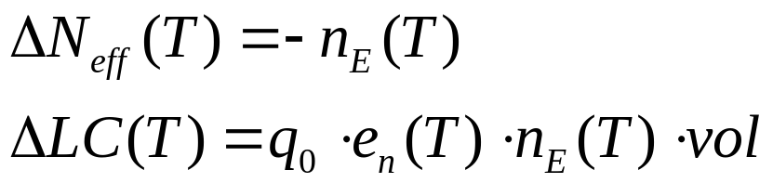
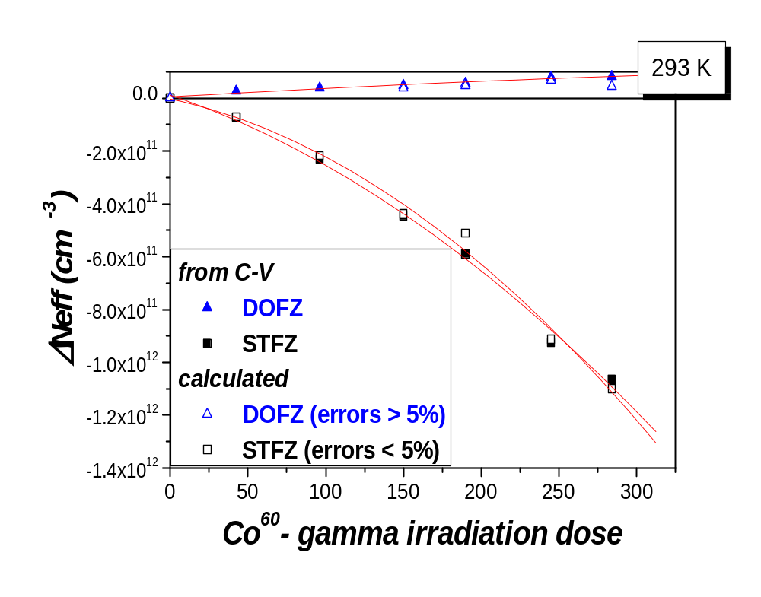
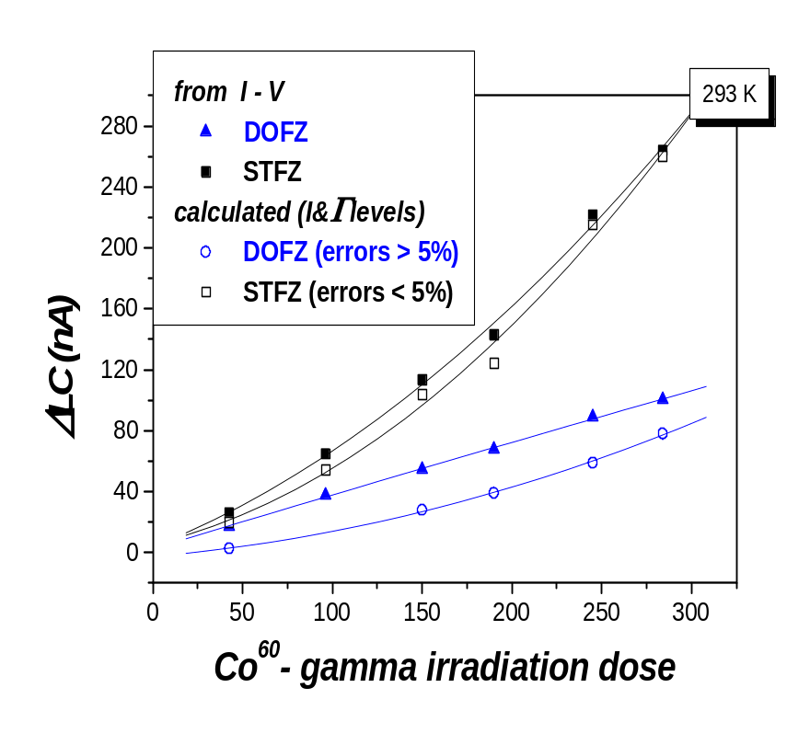
Gamma irradiation -Influence of I, Γ and BD defects on detector properties
excellent agreement with the I-V and C-V results at RT!

Slide 8
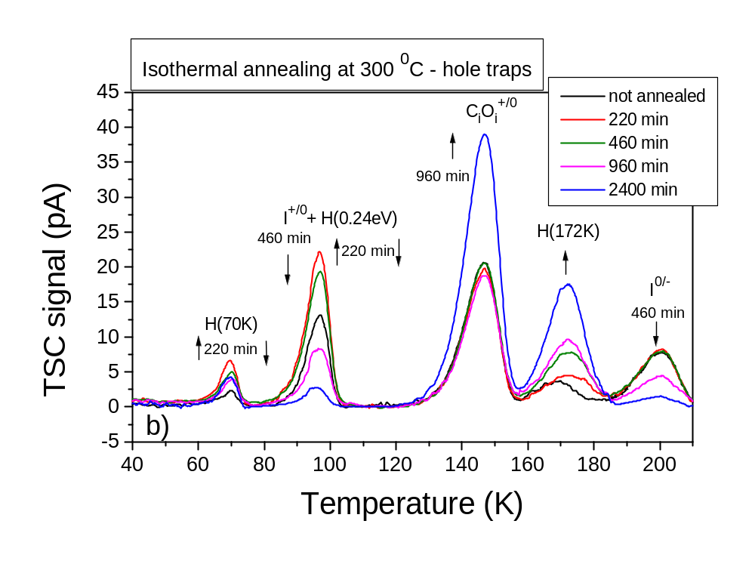
High temperature annealing studies
I) The I defect
STFZ
I center – stable at 300 ⁰C for the first 460 min

Slide 9
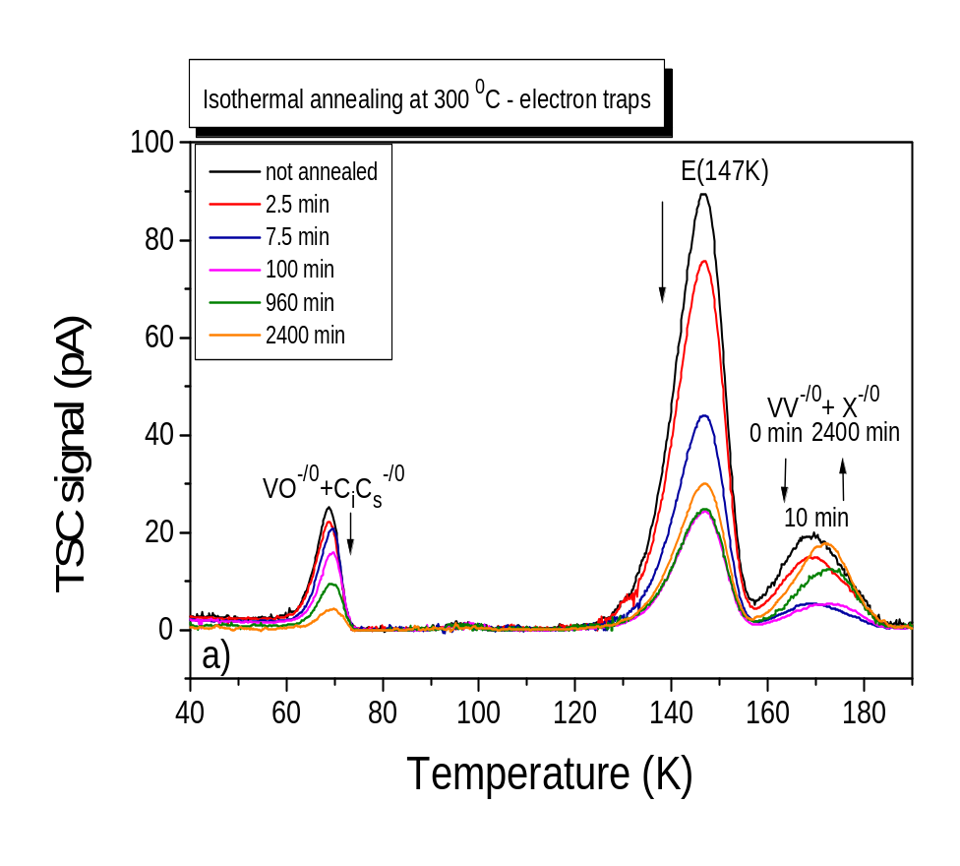
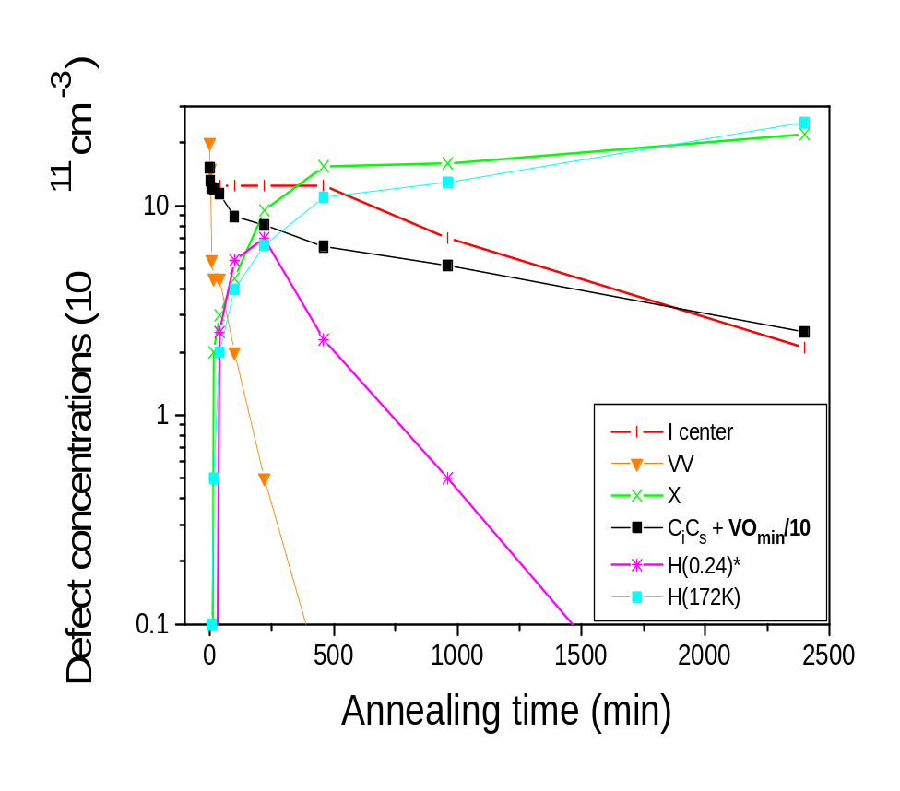
II) The X center
STFZ – 300 Mrad
In STFZ material the formation of X center is independent on the annealing of V₂

Slide 10
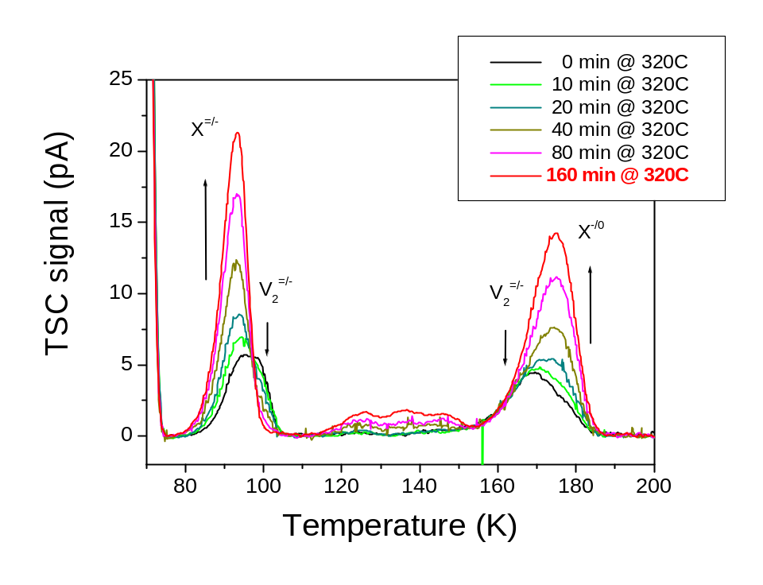
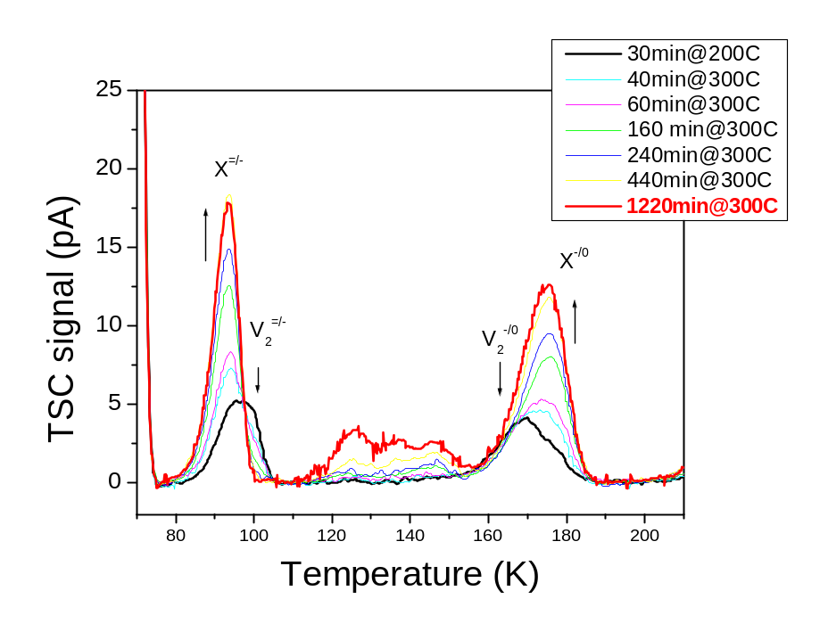
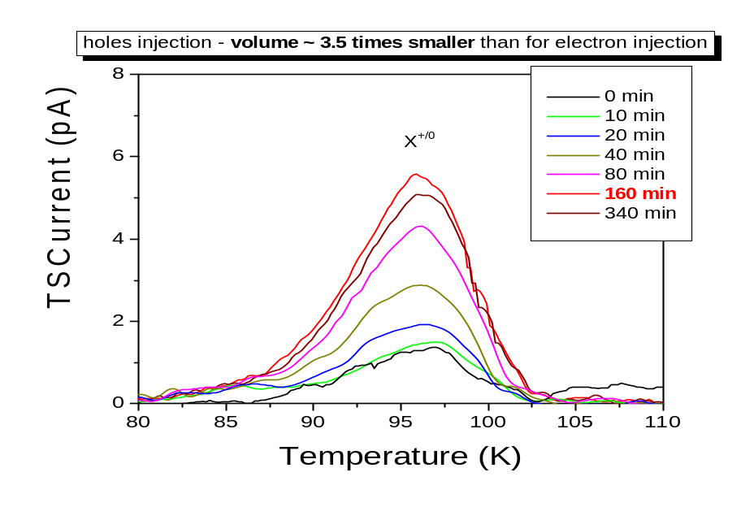
Epi/Cz - same irradiation
dose (520 Mrad) and
annealing at different T
T = 320⁰C
T = 300⁰C
Increasing the annealing temperature [X] increases althougth [V₂] is the same ⇒
The contribution of other defect/impurity becomes important at high T

Slide 11
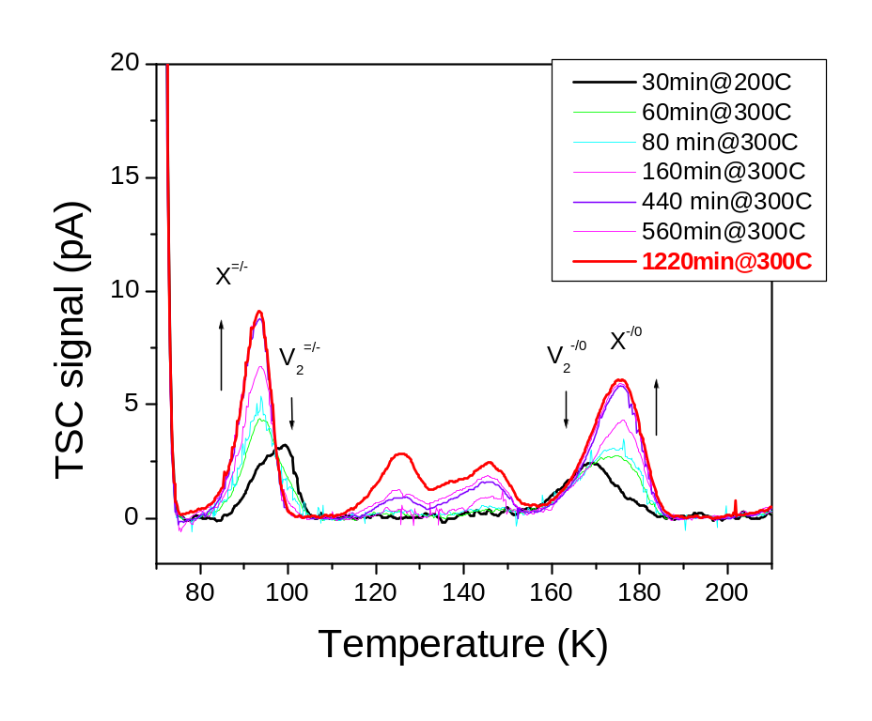
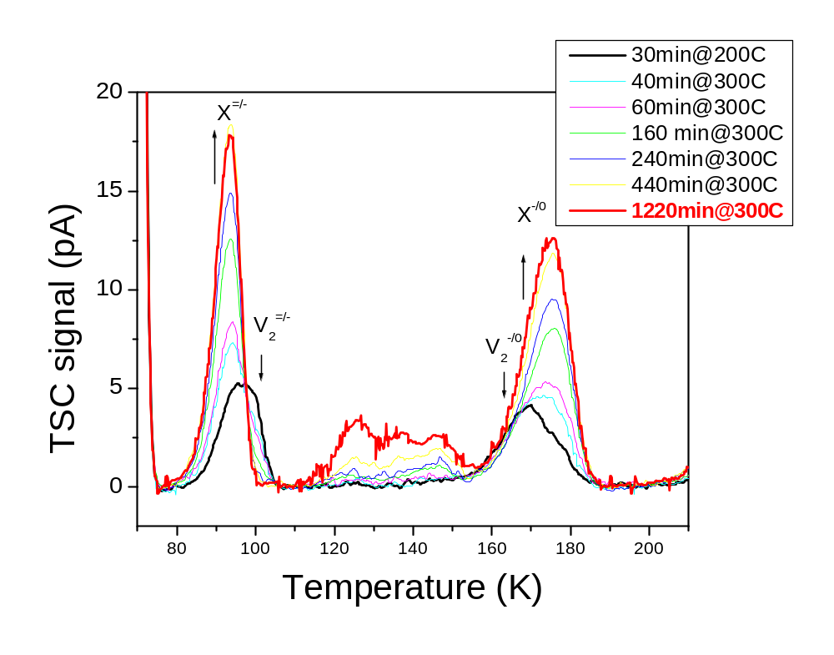
Epi/Cz - same annealing T but different irradiation doses
T = 300 ⁰C
Dose = 305 Mrad
Dose = 520 Mrad
Increasing the irradiation dose [X] increases more than the initial [V₂] ⇒
the involvement of other radiation induced defect (like VO center) in the formation of X centers is possible

Slide 12
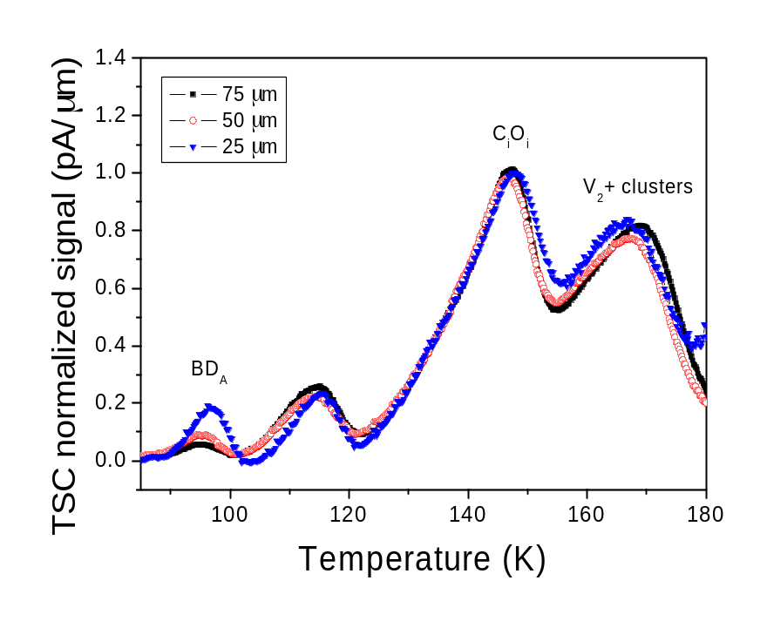
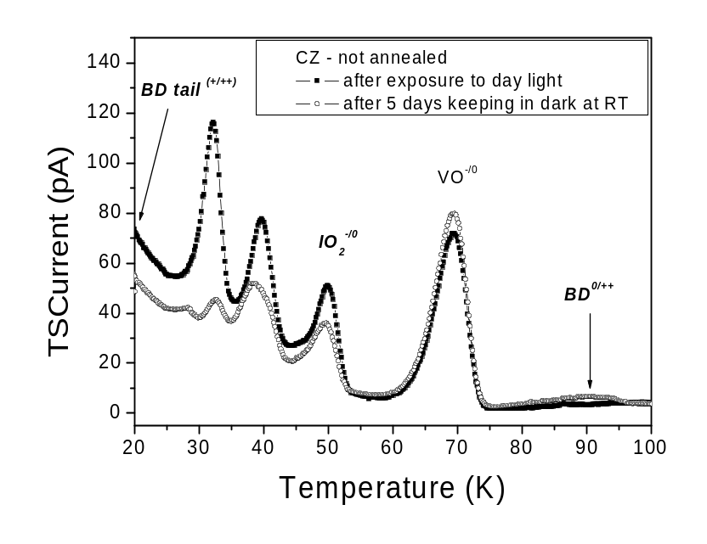
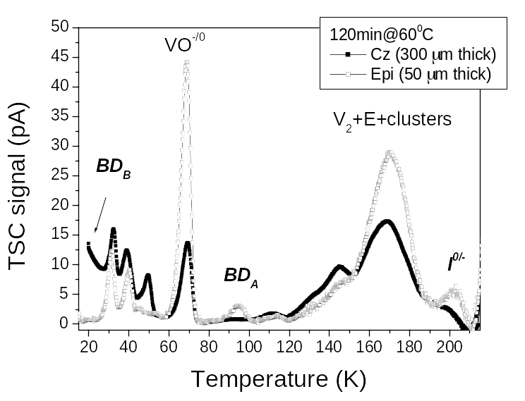
B) 23 GeV proton irradiation (fluences up to 6x10¹⁴/cm²)
The BD and I defect
concentrations can explain
~90% from ΔNeff
~10% of the Δ LC

Slide 13
Summary
Co⁶⁰ – gammas: the radiation induced change of detector properties is understood on the basis of generated defect levels
Two defects the BD and the I-defect are mainly responsible for the macroscopic performance of the diodes
- The I centers (acceptor like at RT) are the source for both introduction of negative space charge and the increase of the LC
- The BD defects are the source for the increase of the positive space charge with the dose in DOFZ diodes and can compensate the deep acceptors effect
24 GeV proton irradiation:
Very promising results in the case of EPI/Cz silicon – most likely due to a large concentration of oxygen dimers migrating from the CZ substrate
Future plans:
Investigation of BD, I and X centers after high levels of Co⁶⁰-gamma and 23 GeV proton irradiation in:
- 150 Ωcm standard and oxygenated Epi/Cz (n and p-type, 70, 100 and 150 μm )
- 100 Ωcm FZ silicon (50 μm)

