Slide 1

Trapping in silicon detectors
G. Kramberger
Jožef Stefan Institute, Ljubljana
Slovenia
G. Kramberger, Trapping in silicon detectors, Aug. 23-24, 2006, Hamburg, Germany

Slide 2
Motivation
Trapping of drifting carriers sets the ultimate limit for use of position sensitive Si-detectors; depletion depth (operating conditions RD39 ,defect engineering RD50, 3D) and leakage current (cooling) can be controlled !
The carriers get trapped during their drift – the rate is determined by effective trapping times!
Why study them?
An input to simulations of operation of irradiated silicon detectors!
  prediction of charge collection efficiency ( LHC, SLHC, etc. )
  optimization of operating conditions
  optimization of detector design ( p+ or n+ electrodes, thickness, charge sharing )
Characterization of different silicon materials in terms of charge trapping!
Defect characterization – how to explain the trapping rates with defects?
  Temperature dependence of trapping times
  Changes of effective trapping times with annealing
  Trapping rates in presence of enhanced carrier concentration
to be discussed at this workshop
G. Kramberger, Trapping in silicon detectors, Aug. 23-24, 2006, Hamburg, Germany

Slide 3
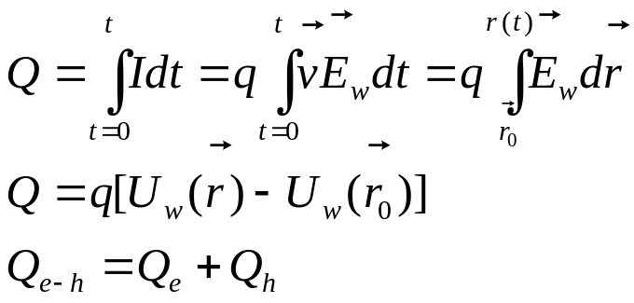
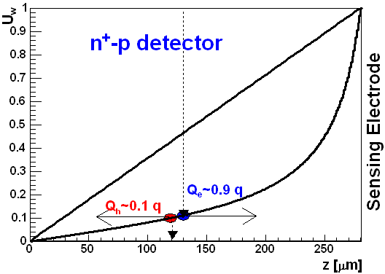
Signal formation
p⁺
hole
280 μm
electron
n⁺
Contribution of drifting carriers to the total induced charge depends on ΔU_{w} !
Simple in diodes and complicated in segmented devices!
For track:
Q_{e}/(Q_{e}+Q_{h})=19%
in ATLAS strip detector
diode
Q_{h}=Q_{e}=0.5 q
ATLAS SD
G. Kramberger, Trapping in silicon detectors, Aug. 23-24, 2006, Hamburg, Germany

Slide 4
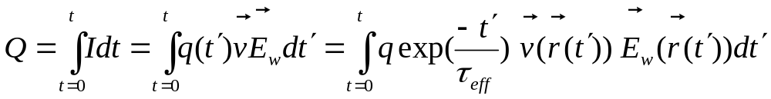
… and trapping complicates equations
trapping
drift velocity
difficult to integrate
I(t)
The difference between holes and electrons is in:
Trapping term ( τ_{eff,e}~τ_{eff,h} )
Drift velocity ( μ_{e}~3μ_{h} )
The drift of electrons will be completed sooner and consequently less charge will be trapped!
n⁺ readout should perform better than p⁺
G. Kramberger, Trapping in silicon detectors, Aug. 23-24, 2006, Hamburg, Germany

Slide 5
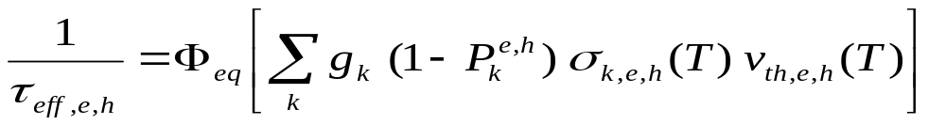
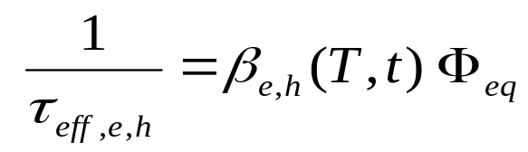
Effective trapping times
equivalent fluence
introduction rate of defect k
occupation
probability
capture
cross-section
thermal velocity
assuming only first order kinetics of defects formed by irradiation at given temperature and time after irradiation
β(-10ºC, t=min Vfd) [10⁻¹⁶ cm²/ns] | 24 GeV protons (average ) | reactor neutrons
Electrons | 5.6±0.2 | 4.1±0.2
Holes | 6.6±0.3 | 6.0±0.3
The β was so far found independent on material;
resistivity
[O], [C] up to 1.8e16 cm⁻³
Type (p / n)
wafer production (FZ, Cz, epitaxial)
G. Kramberger et al, Nucl. Inst. Meth. A481(2002) 297. , A.G. Bates and M. Moll, Nucl. Instr. and Meth. A555 (2005) 113.
O. Krasel et al., IEEE Trans. NS 51(1) (2004) 3055. , E. Fretwurst et al, E. Fretwurst et al., ``Survey Of Recent Radiation Damage Studies at Hamburg'',presented at 3rd RD50 Workshop, CERN, 2003.
G. Kramberger, Trapping in silicon detectors, Aug. 23-24, 2006, Hamburg, Germany

Slide 6
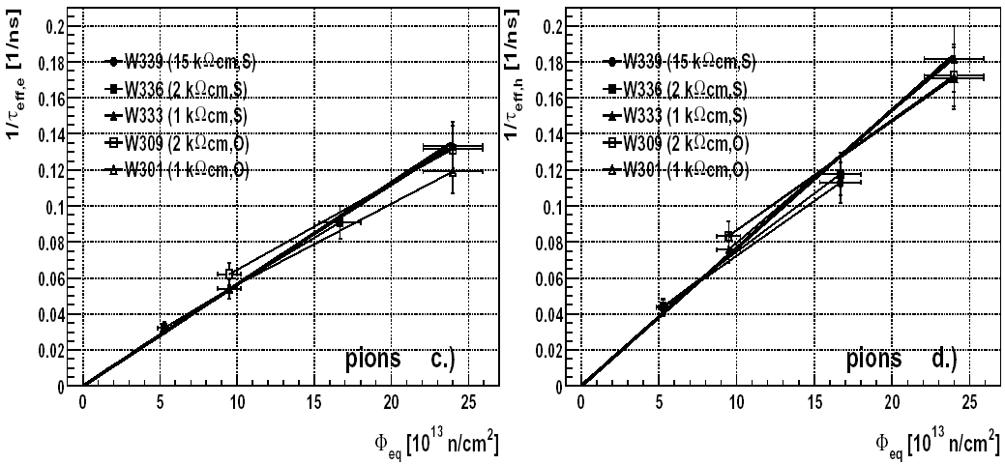
The Charge Correction Method (based on TCT) for determination of effective trapping times requires fully (over) depleted detector – so far we were limited to 10¹⁵ cm⁻².
G. Kramberger, Trapping in silicon detectors, Aug. 23-24, 2006, Hamburg, Germany

Slide 7
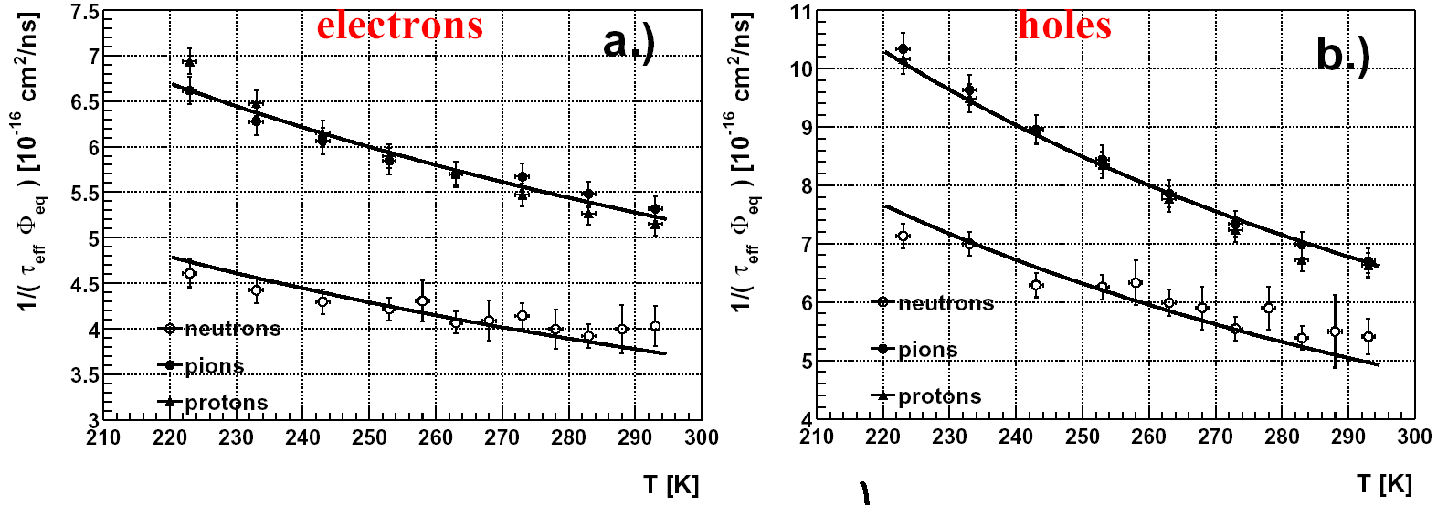


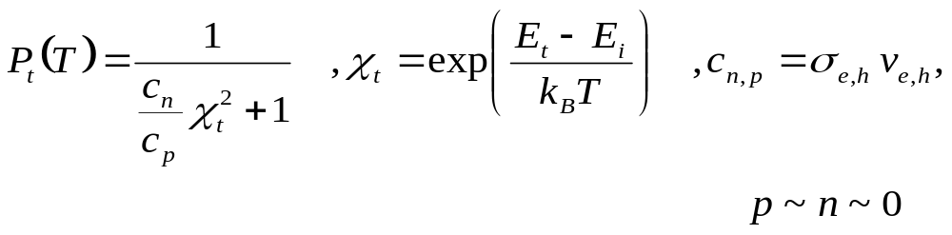
Temperature dependence of effective trapping times
average of all βe,h for standard and oxygenated diodes irradiated with same particle type is shown
similar behavior for neutrons and charged hadrons
Assuming:
No stable minimization for m, E_{k} and σ can be obtained
G. Kramberger, Trapping in silicon detectors, Aug. 23-24, 2006, Hamburg, Germany

Slide 8
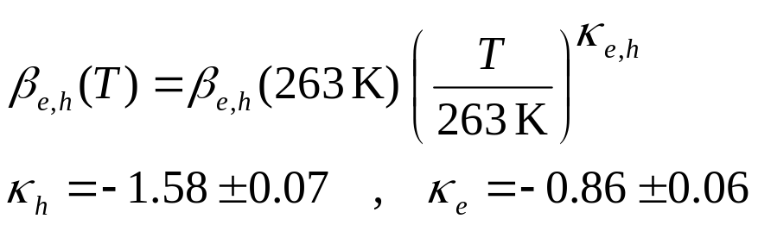

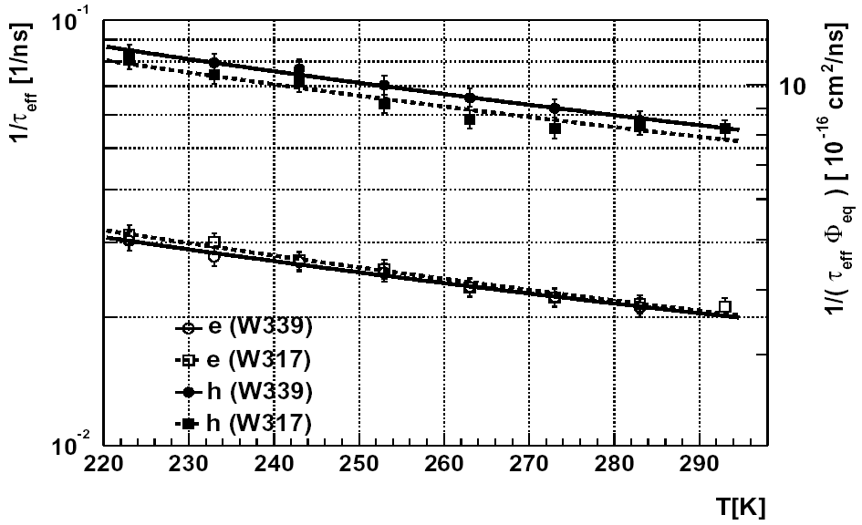
Only effective parameterization can be obtained:
In the minimum of V_{fd}
After 200 h @ 60ºC
How κ_{e} changes with time needs to be studied!
G. Kramberger, Trapping in silicon detectors, Aug. 23-24, 2006, Hamburg, Germany

Slide 9
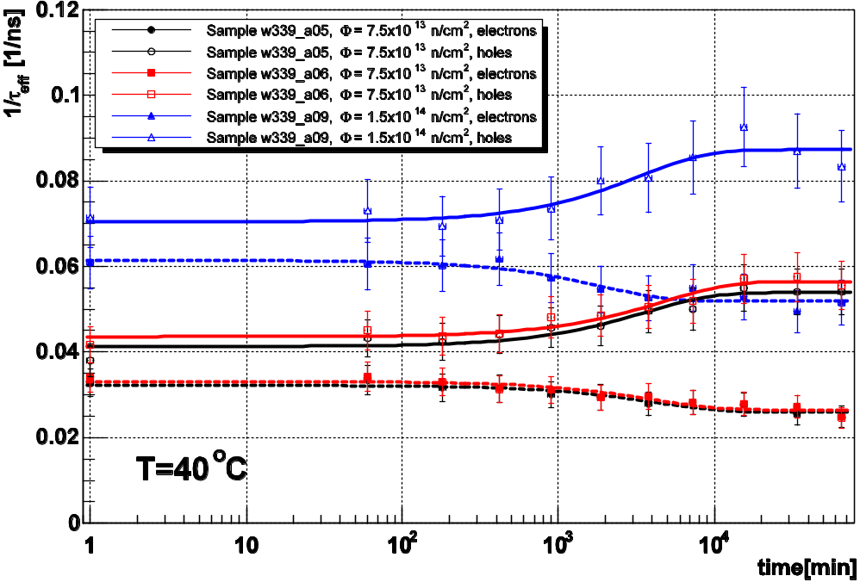
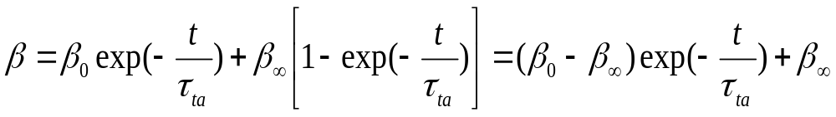
Annealing of effective trapping times I
STFZ 15 Ωcm samples irradiated with neutrons to 7.5e13 cm⁻² and 1.5e14 cm⁻²
Annealing β_{e,h}(20ºC,t) performed at elevated temperatures of 40,60,80ºC:
Increase of β_{h} during annealing
decrease of β_{e} during annealing
Evolution of defects responsible for annealing of trapping times seems to obey 1st order dynamics (τ_{an}≠ τ_{an}(φ))
A B
A B , C stable
A+B C, D stable
A+B C
A+B C, D stable
1st order
1st order for [B]<<[A]
bold red – active
black – inactive
G. Kramberger, Trapping in silicon detectors, Aug. 23-24, 2006, Hamburg, Germany

Slide 10
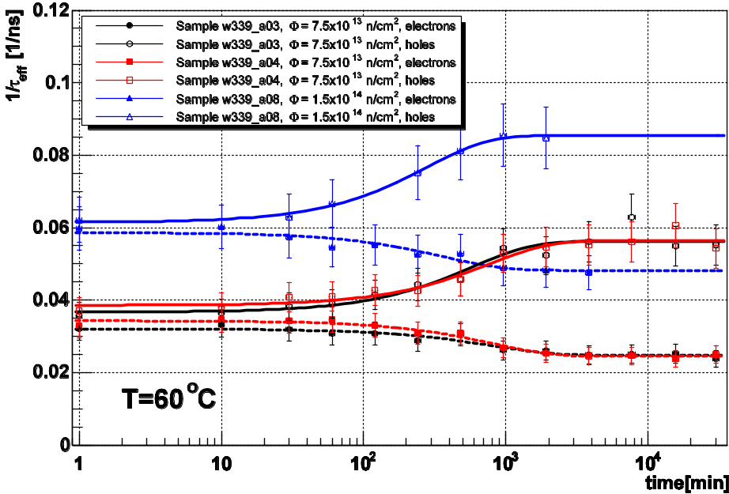
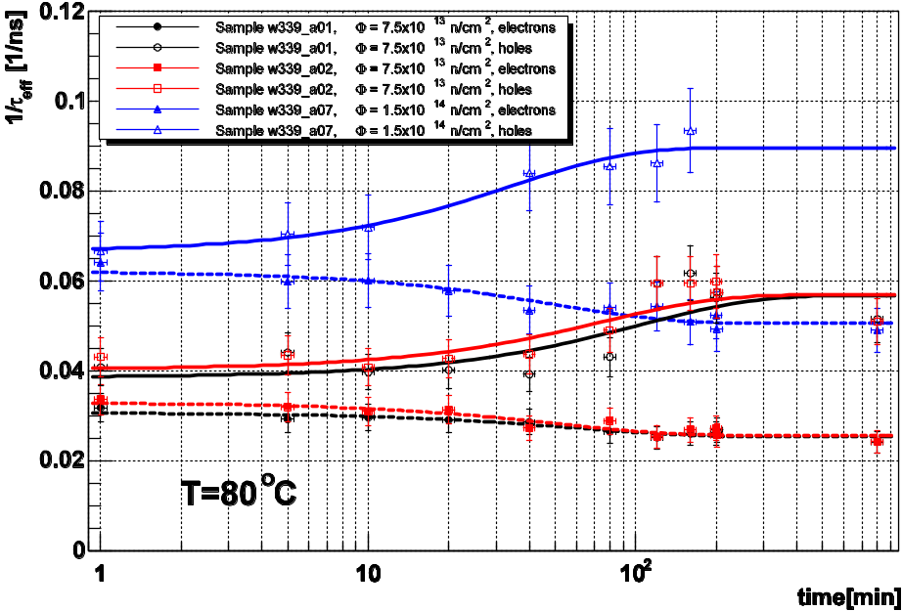
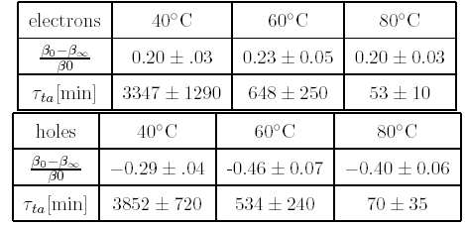
Annealing of effective trapping times II
There is an ongoing systematic study for charged hadron irradiated samples!
G. Kramberger, Trapping in silicon detectors, Aug. 23-24, 2006, Hamburg, Germany

Slide 11
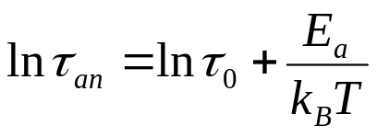
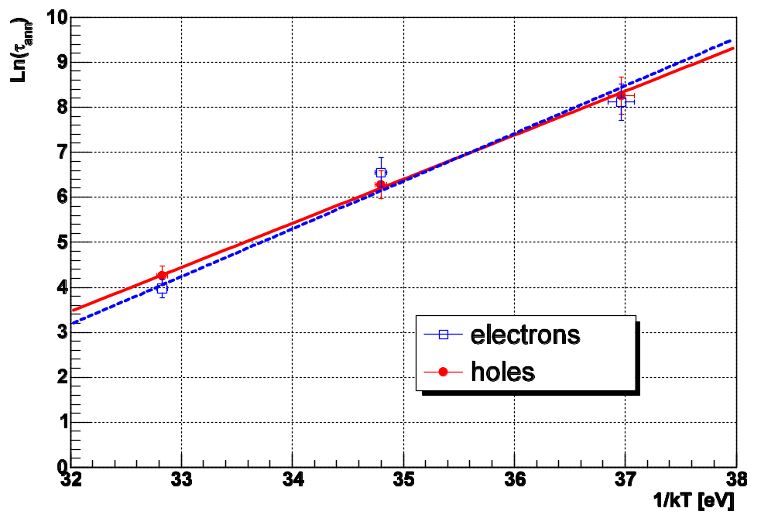
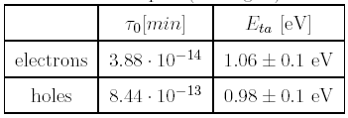
Annealing of effective trapping times III
Arrhenius plot:
similar annealing times for holes and electrons!
activation energy different from that of reverse annealing of N_{eff}
We need also a measurement point close to the real storage temperature of detectors!
G. Kramberger, Trapping in silicon detectors, Aug. 23-24, 2006, Hamburg, Germany

Slide 12
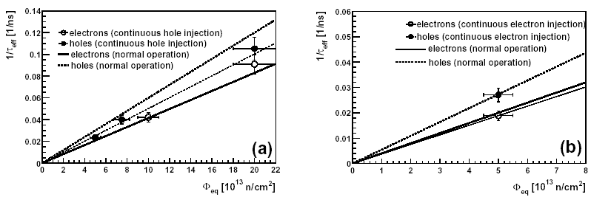
Effective trapping times in presence of enhanced free carrier concentration
p~3-5 x 10⁸ cm⁻³
n~2 x 10⁸ cm⁻³
DC laser
λ=670 nm
DC laser
λ=670 nm
n+
p+
n+
p+
hole injection
electron injection
No significant change – occupation probability of traps doesn’t change much!
G. Kramberger, Trapping in silicon detectors, Aug. 23-24, 2006, Hamburg, Germany

Slide 13
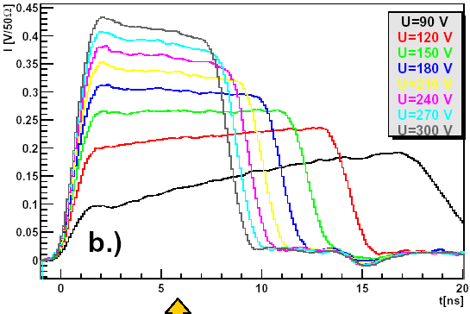
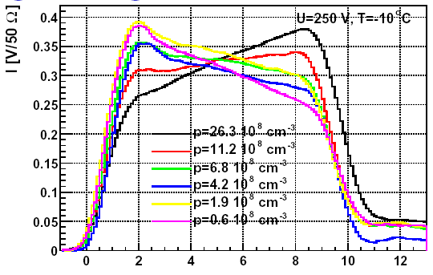
ST FZ 300 μm thick diode (15 kΩcm) irradiated to Φ_{eq}=5·10¹³ cm⁻² (beyond type inversion)
p type
n type
p~2-14 x 10⁸ cm⁻³
Changing the electric field
Changing the DC illumination intensity
Large change of N_{eff} – space charge sign inversion!
G. Kramberger, Trapping in silicon detectors, Aug. 23-24, 2006, Hamburg, Germany

Slide 14
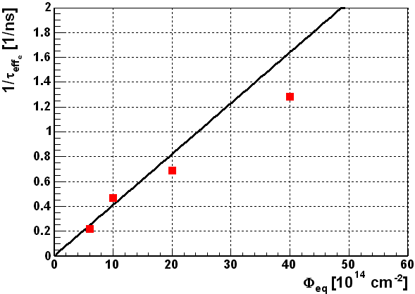
The Charge Correction Method for determination of effective trapping times (TCT measurements) requires fully (over) depleted detector and small capacitance of the sample – so far we were limited to 10¹⁵ cm⁻²
First measurements of effective electron trapping times at fluences above 10¹⁵ cm⁻²!
Epi-75 μm
predicted value
30%
What about the CCE measurements with mip particles ?
VERY PRELIMINARY
G. Kramberger, Trapping in silicon detectors, Aug. 23-24, 2006, Hamburg, Germany

Slide 15
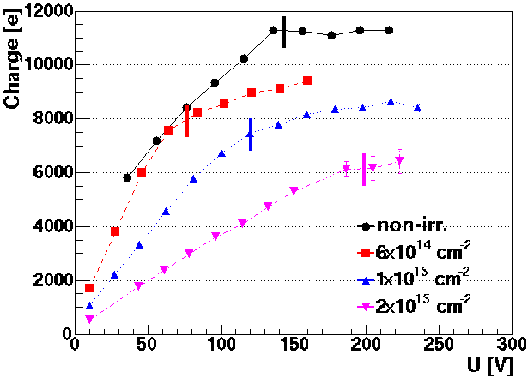
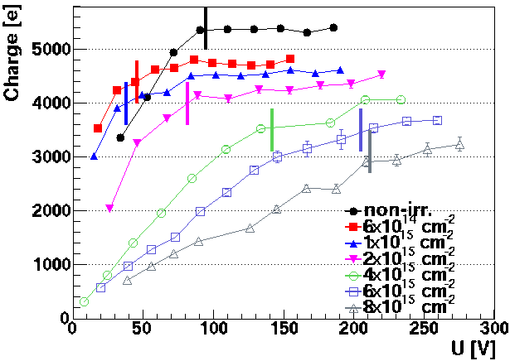
M.I.P. measurements I
V_{fd} from CV is denoted by short line for every sensor!
T=-10ºC
Epi 150
Epi 75
kink in charge collection plot coincides with full depletion voltage from CV measurements! Also for heavily irradiated silicon detectors the full depletion voltage has meaning
the signal for heavily irradiated sensors rises significantly after V_{fd} (trapping)
>3200 e for 8x10¹⁵ cm⁻² neutron irradiated sensor! – ~50% more than expected
G. Kramberger, Trapping in silicon detectors, Aug. 23-24, 2006, Hamburg, Germany

Slide 16
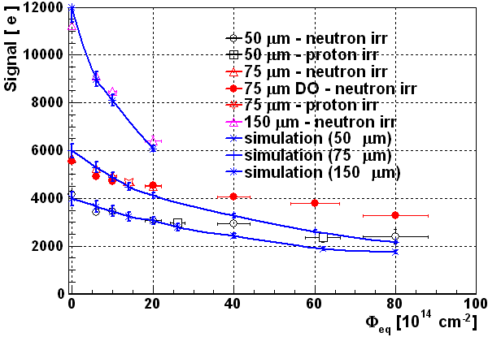
M.I.P. measurements II
Each measurement point was simulated (Vfd, V as for measurements, constant N_{eff})
Trapping times taken as “average” of measurements of several groups
T=-10ºC
At lower fluences the simulation agrees well with data, at higher fluences the simulation underestimates the measurements
What would be the reason? – very likely trapping probabilities are smaller than extrapolated (~ 40-50% smaller)
G. Kramberger, Trapping in silicon detectors, Aug. 23-24, 2006, Hamburg, Germany

Slide 17
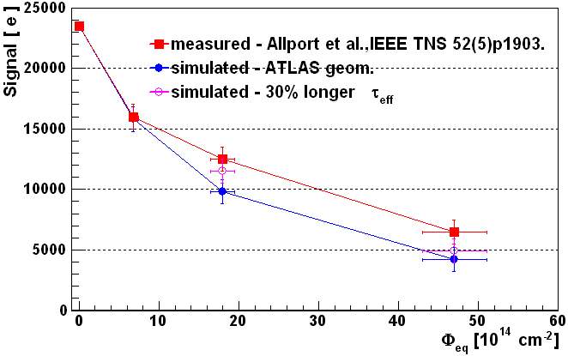
M.I.P. measurements III
n⁺-p – detectors:
ATLAS strip detector geometry:
D=280 μm
strip pitch=80 μm
implant width= 18 μm
T=-10ºC, U_{bias}=900 V, N_{eff} =const.,
V_{fd} assumed to be in minimum
Agreement is acceptable!
no measurements of trapping times at fluences above 10¹⁵ cm⁻². Trapping times at high fluences tend to be longer than extrapolated ☺!
30% smaller trapping at higher fluences gives already reasonable agreement
The trapping times at large fluences may be longer than extrapolated!
G. Kramberger, Trapping in silicon detectors, Aug. 23-24, 2006, Hamburg, Germany

Slide 18
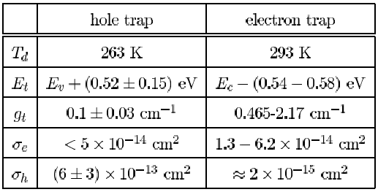
Conclusions & discussion
Seem to be related to I,V complexes and don’t depend significantly on other impurities!
After few 100 MRad ⁶⁰Co irradiation no significant increase of trapping observed
probably related to decay of clusters, but on the other hand charged hadron damage isn’t smaller than neutron damage
Assuming one dominant electron and hole trap their parameters must be within these limits otherwise one can’t explain changes of N_{eff}(p,n) and trapping rates.
Annealing of trapping times seem to be 1st order process. Activation energies are lower than for Neff reverse annealing ? Comparable time constants for holes and electrons.
Trapping probability of electrons and holes decreases with temperature.
G. Kramberger, Trapping in silicon detectors, Aug. 23-24, 2006, Hamburg, Germany

