Slide 1

TSC, DLTS and transient analysis in MCz silicon Detectors at different process temperature, irradiation and thermal treatments.
David Menichelli
Univ. of Florence and INFN, Florence Division
A summary of recent results obtained at Florence Lab. by:
D. Menichelli, M. Scaringella, M. Bruzzi
In collaboration with:
- SMART Project, INFN
- Ioana Pintilie, Bucharest University
- Z. Li, Brookhaven Nat. Lab.
- V. Eremin and E. Verbitskaya, Ioffe Phys. Tech. Inst.
- J. Harkonen, CERN-Univ. of Elsinki

Slide 2
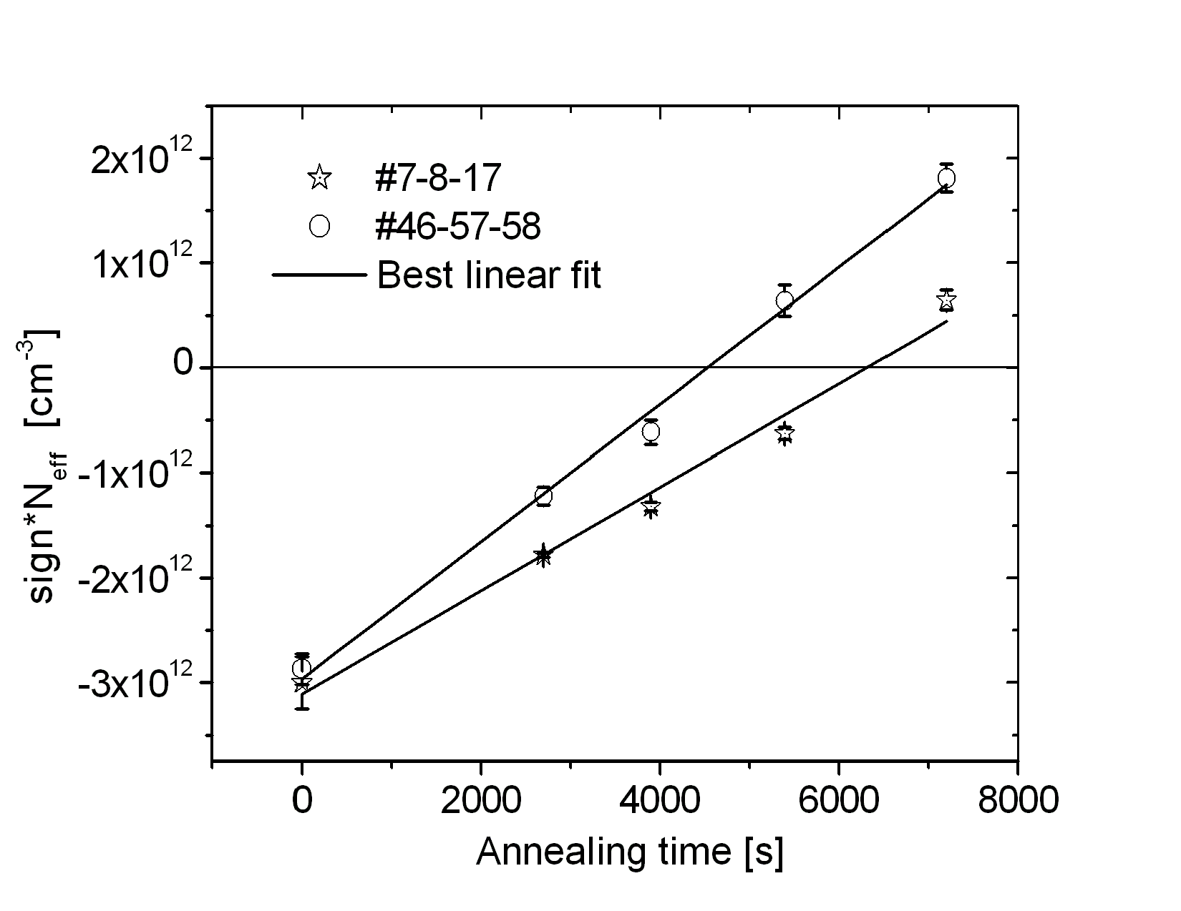
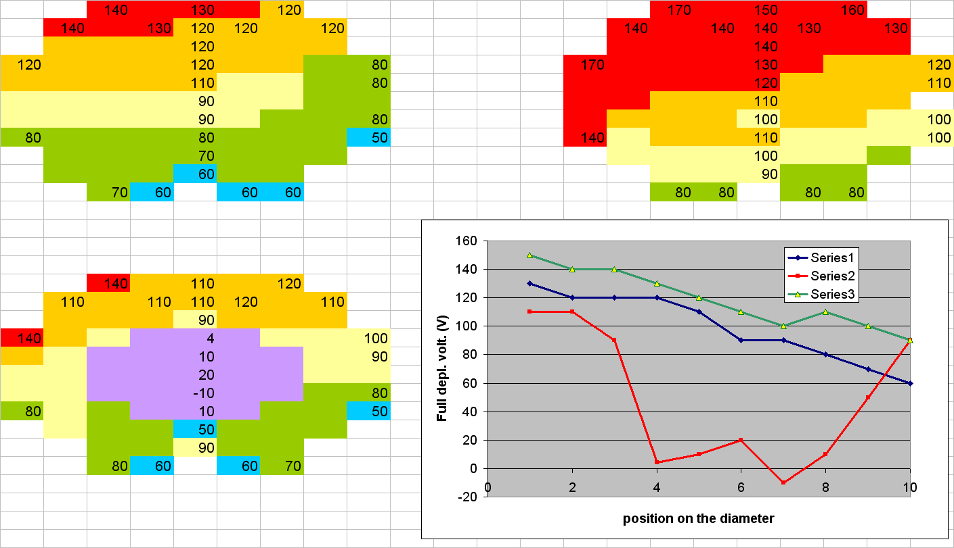
Outline
Samples:
MCz-Si few kWcm by Okmetic.
Processing by IRSTand Helsinki Univ.
within SMART Project (INFN)
Studied issues:
1) TD activation by Thermal Annealing (430°C up to 120min) in p⁺/p/n⁺ devices.
2) TD activation during detector process
Contact sintering at 380°C without LTO vs. standard 420°C with LTO. p⁺/n/n⁺ devices.
3) Doping disuniformity in p⁺/p/n⁺ devices.
4) TD activation by irradiation
24GeV protons at CERN
26 MeV protons at Karlsruhe
fluence up to 1.0x10¹⁵ n/cm²
p+/n/n+ devices

Slide 3
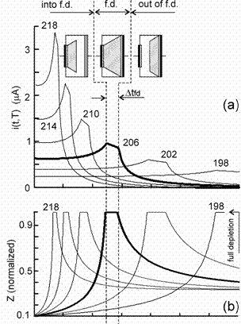
Some remarks about current transients analysis
Non monotonic transient of current in I-DLTS are due to changes of N_{eff} and SCSI. When SCSI occurs, if V_{rev} < V_{fd} , the active volume Z increases, reach the total volume and then decreases, producing a non-monotonic current transient.
By measuring the temperature at which this effect is observed it is possible to reveal which energy level is responsible of SCSI.
D. Menichelli et al. Phys. Rev. B 70, 195209 (2004).

Slide 4
Comparison of TSC spectra before and after thermal treatment at 430°C
Peaks in yellow are donors (by evidence of Poole-Frenkel effect)
after treatment
Thermally activated TD are responsible of the change of sign of N_{eff} in p-type MCz Si.
before
M. Bruzzi et al., J. Appl. Phys. 99, 093706 (2006)

Slide 5
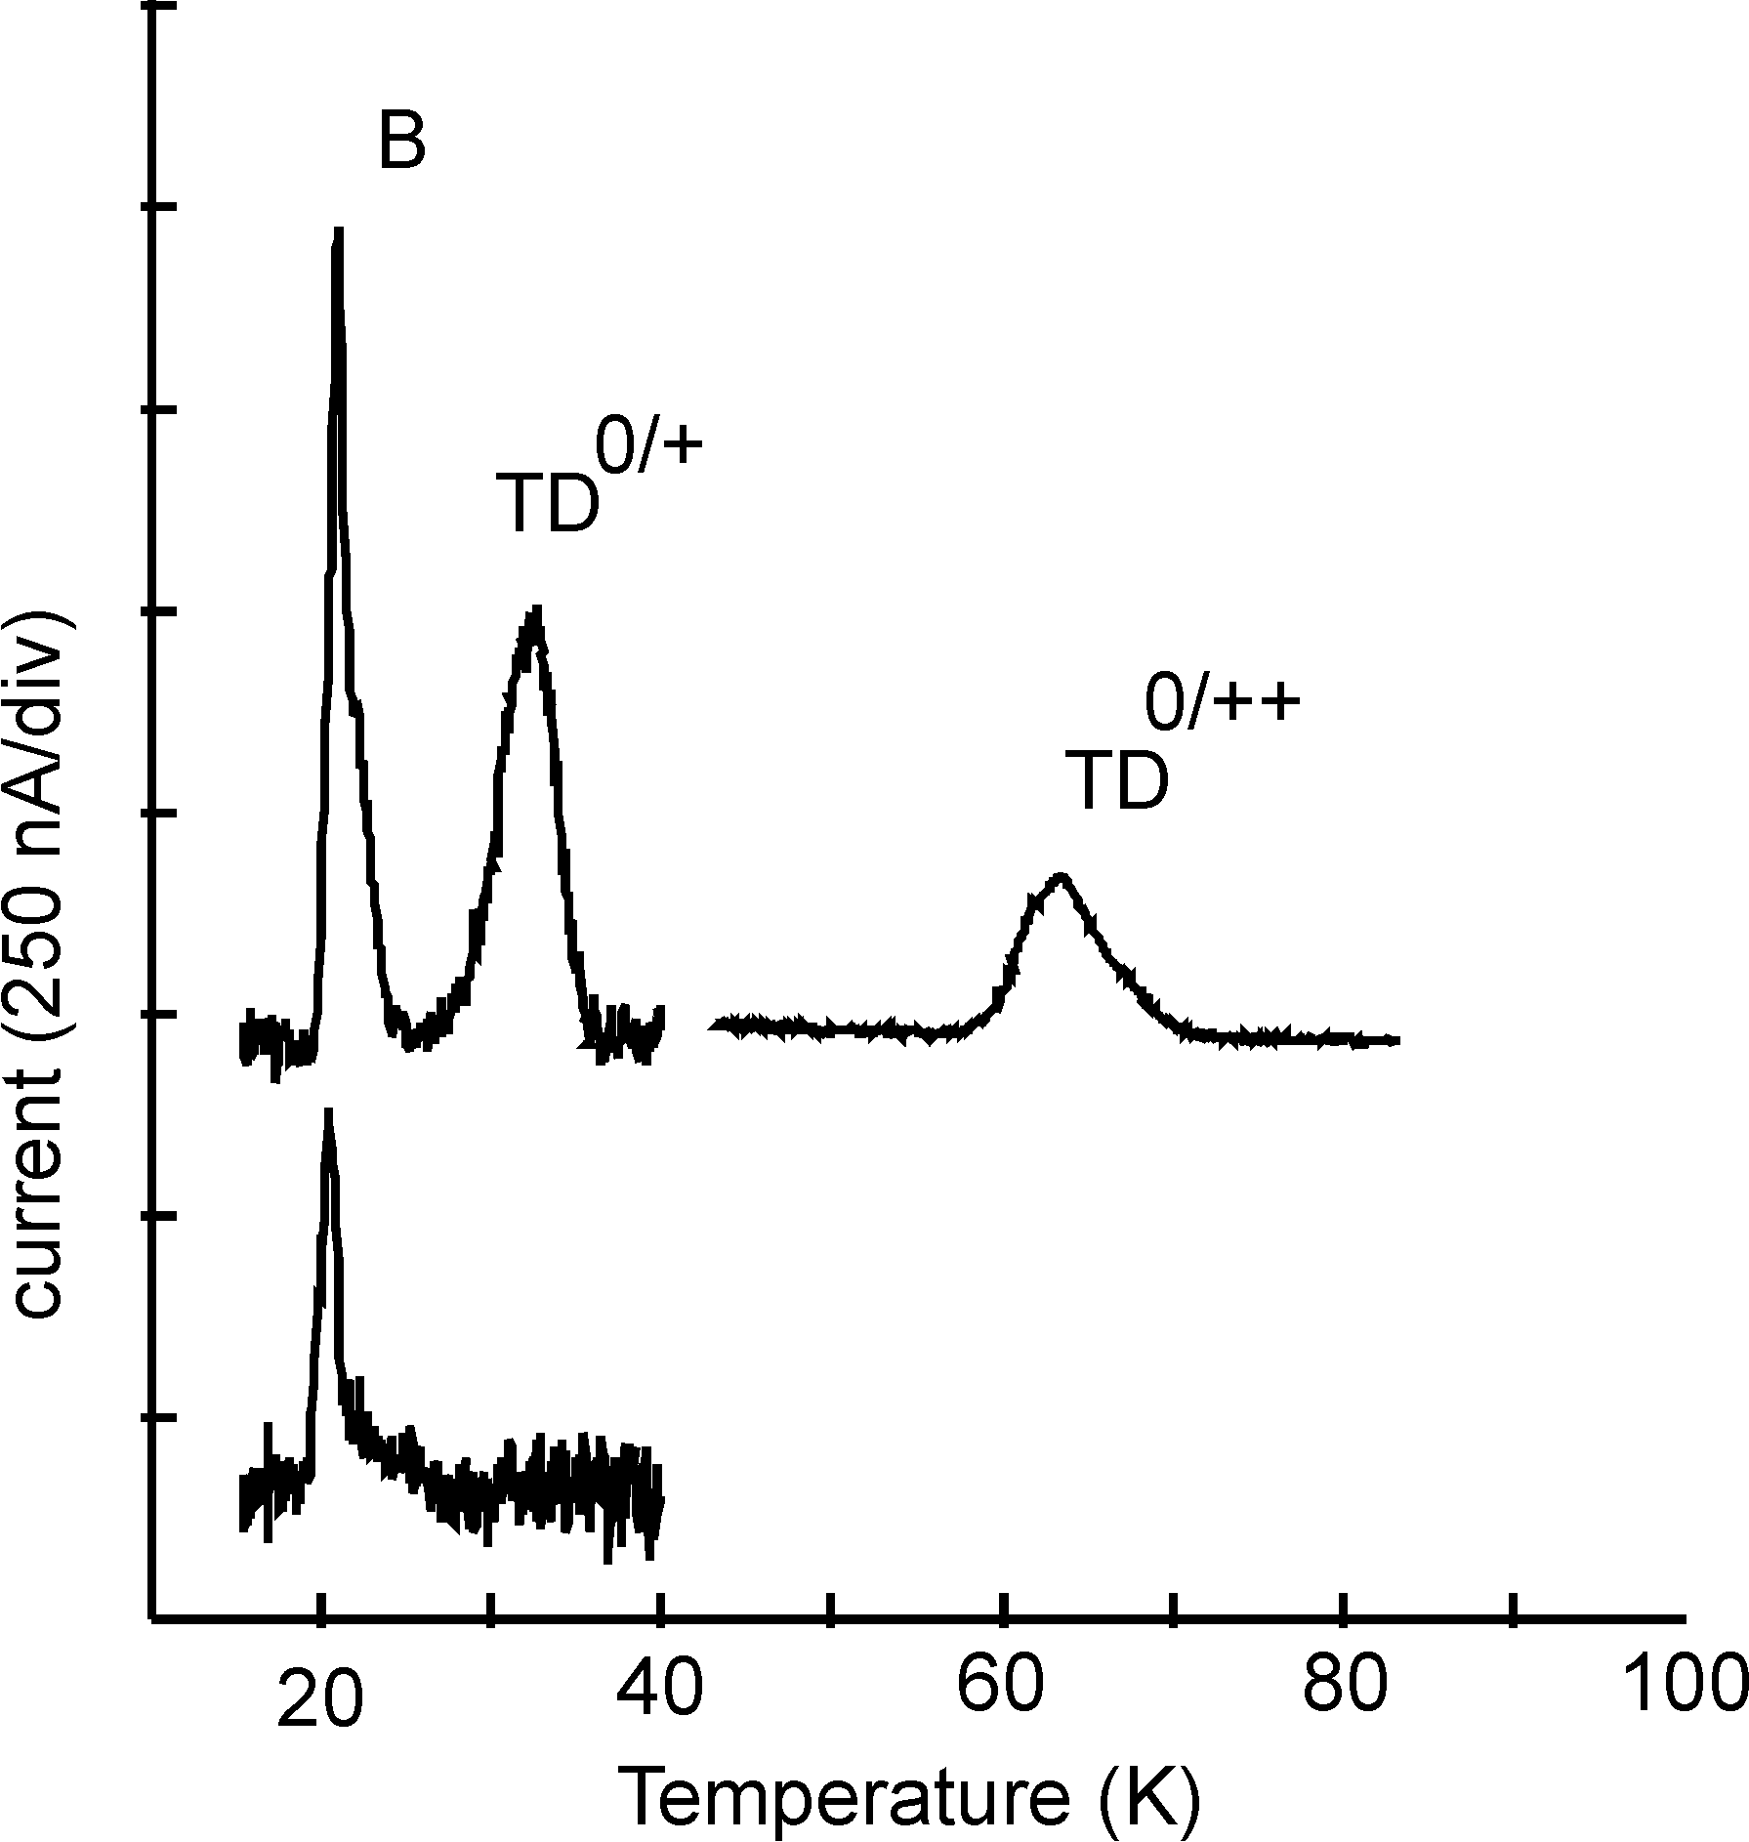
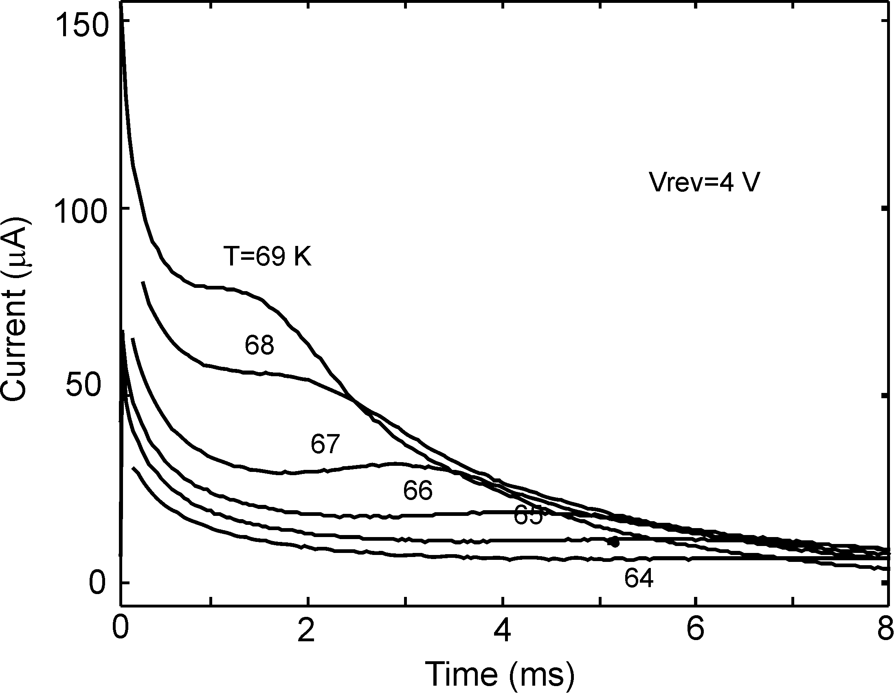
Comparison of i-DLTS spectra before and after thermal treatment at 430°C
TD^{+/++}
current (nA)
After treatment
Before treatment
Before treatment, transients are monotonic ⇨ the space settled by B is not changing type.
After treatment, the current transient presents a peak at T = 60K ⇨ TD^{+/++} is responsible of the change of space charge type.

Slide 6
  TD activation during microstrip detector process
According to TSC studies TD are the main source of non uniformity in p-type MCz Si detectors.
We have studied TDs on two single pad diodes from the same wafer with different V_{fd}
V_{fd}(#5)=10 V, V_{fd}(#14)=110 V.
Area A=13.6 mm²
w = 300 μm.
>1.8 kΩcm corresponding to N_{B}<7.7x10¹² cm⁻³.
Previous measurements on wafers from same batch gave N_{B} = (3.5 ± 0.4)·10¹²cm⁻³
(M. Bruzzi et al. J.App. Phys. 2006)
By integration of the two TD TSC peaks:
[TD]₁₄≅1.4-2.0x10¹² cm⁻³; [TD ]₅≅3.3x10¹² cm⁻³ .
As N_{eff} = N_{B} - [TD], we obtain:
N_{eff}(#5)≅2x10¹¹ cm⁻³ ⇨V_{fd}=14 V
N_{eff}(#14)≅1.5-2.1x10¹² cm⁻³ ⇨V_{fd}=100-140 V
...in good agreement with CV and CCE analysis.

Slide 7
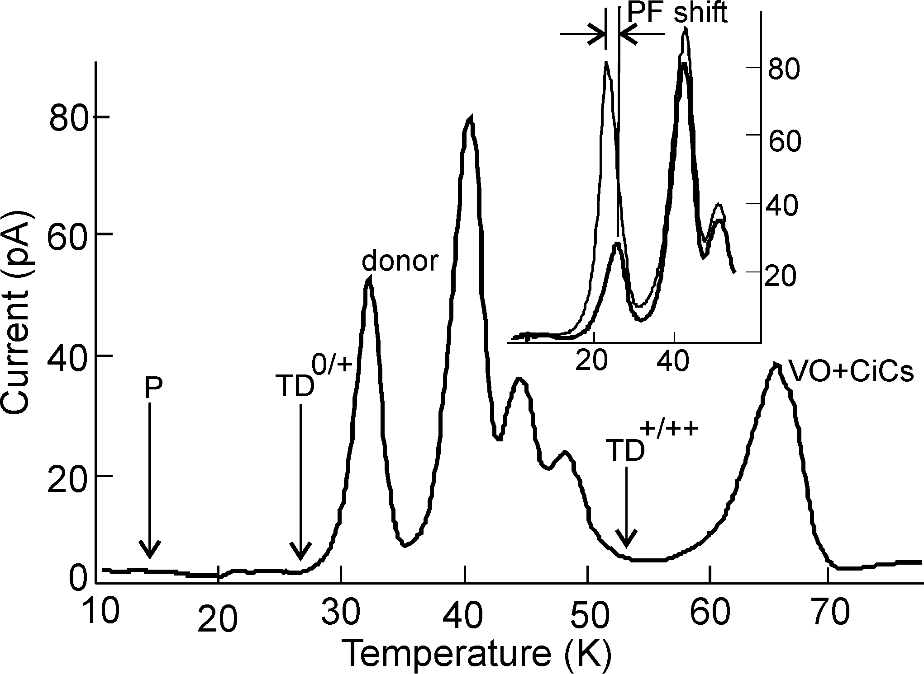
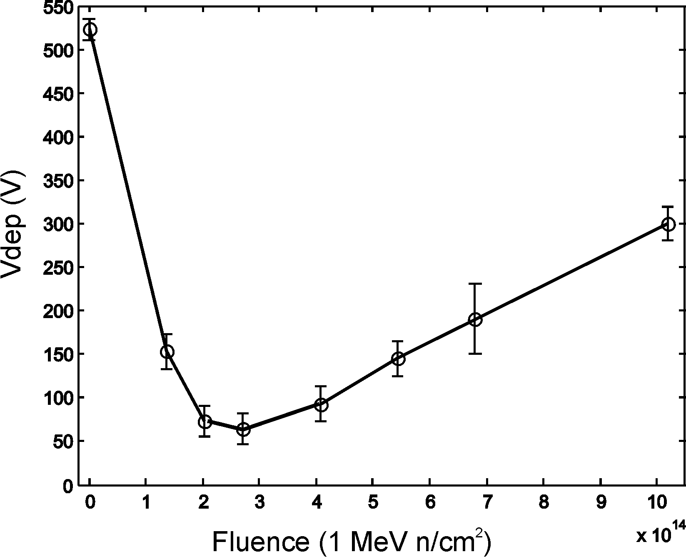
Effect of Irradiation
A radiation-induced peak at 30K is a donor ( but not a TD )
24GeV proton
Φ=4x10¹⁴ n/cm²
200V
100V
30
M. Scaringella et al., NIM A, in press.

Slide 8
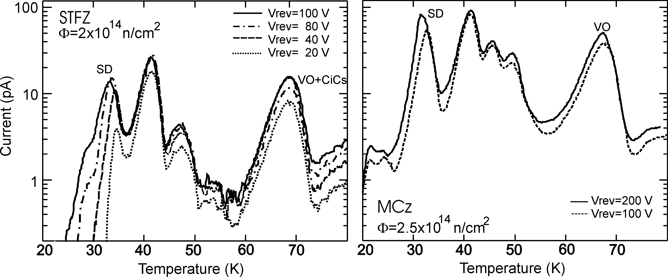
Comparison between irradiated STFZ and MCz (TSC spectra)
Signal can be saturated for STFZ but not for MCz sample
[VO]_{MCz}/[VO]_{STFZ} > 3, [SD]_{MCz}/[SD]_{FZ} > 5.
[SD]_{MCz} ≥ 1·10¹³cm⁻³
[SD]_{MCz}/F ≥ 4.7·10⁻²cm⁻¹.
This rate is close to the net acceptor introduction rate β ≃ 5.50 ·10⁻²cm⁻¹,and SD is expected to substantially influence the space charge density at RT.

Slide 9
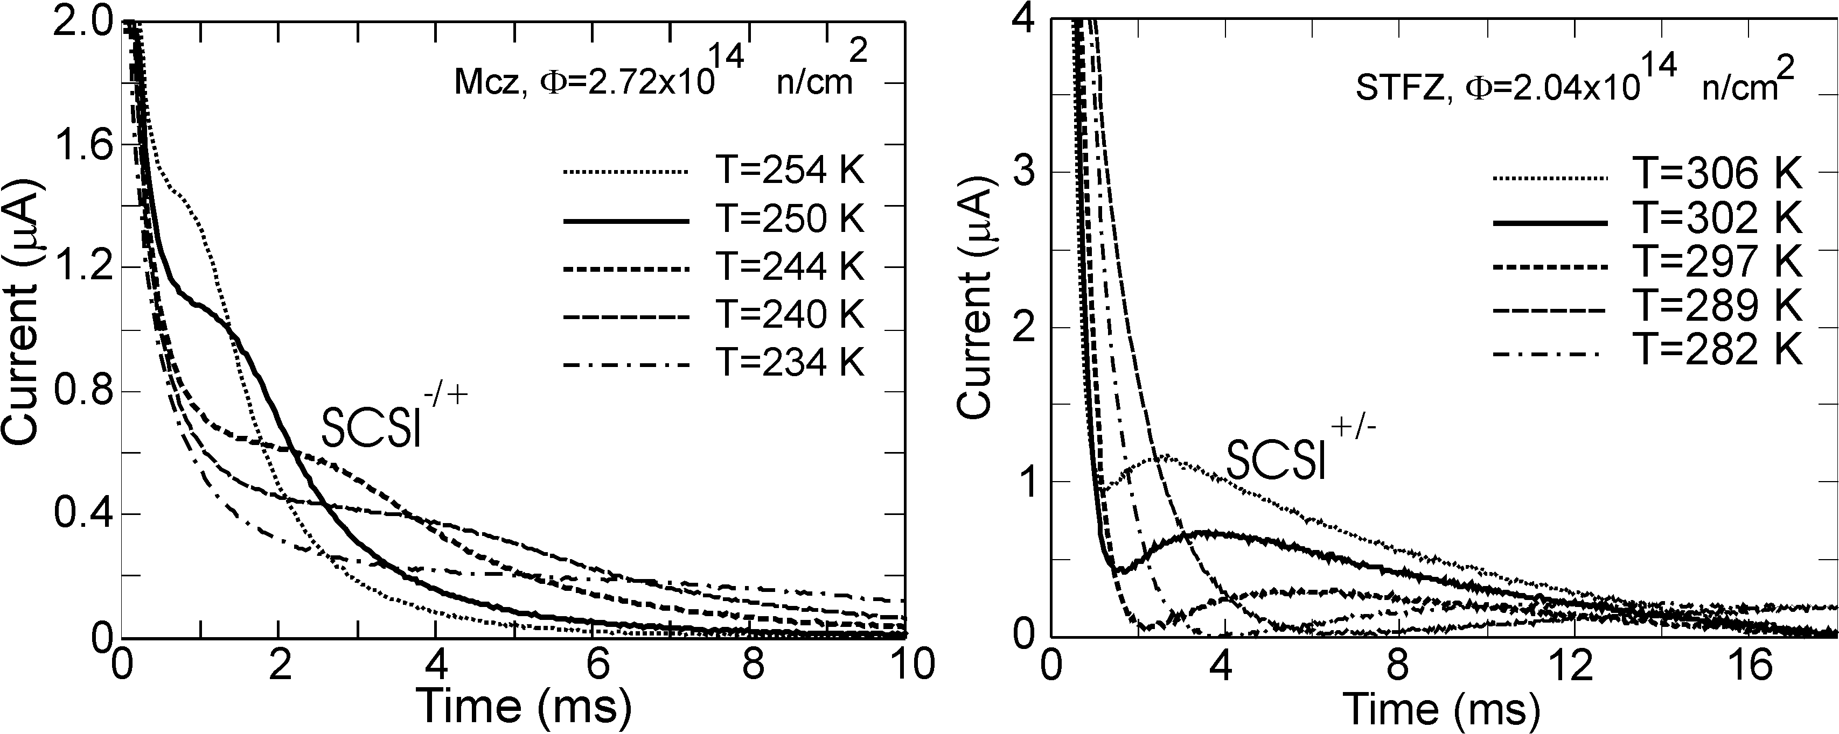
Current transients after irradiation
SCSI during V₂^{-/0} discharge, observed in all samples
SCSI during I^{0/-} discharge, observed only in STFZ
Neff is positive between V₂^{-/0} and I^{0/-} emission
At room temperature N_{eff} is negative only in STFZ
No type inversion in n-type MCz Si up to 10¹⁵ 1MeV n eq. /cm² if irradiation is carried out with 24GeV p (TCT measurements at IOFFE).

Slide 10
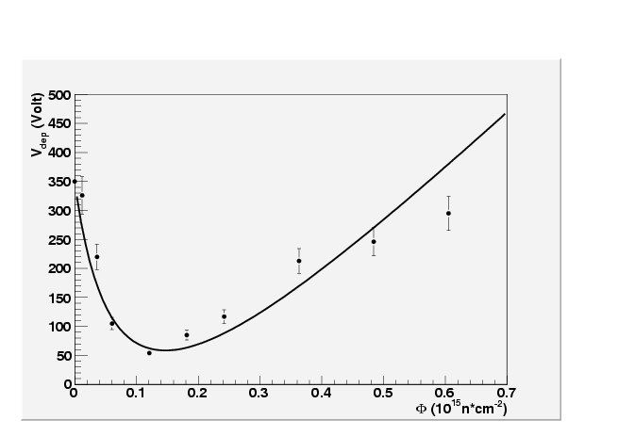
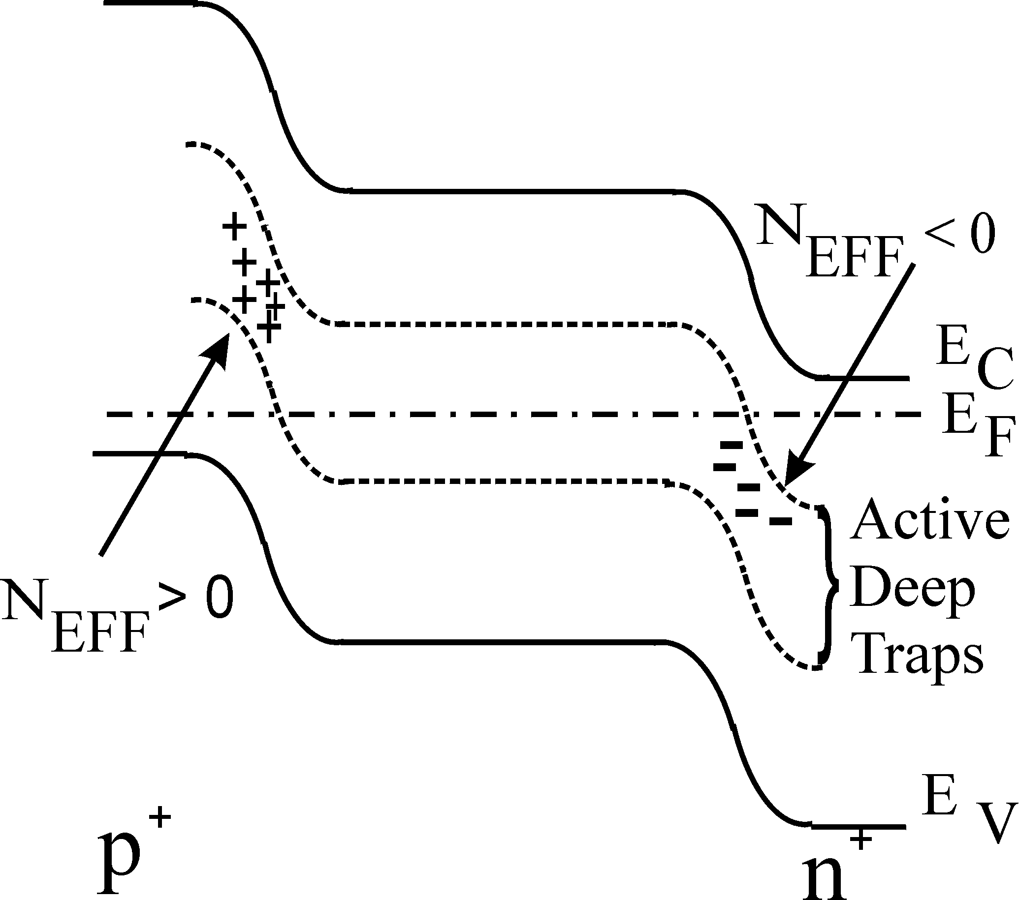
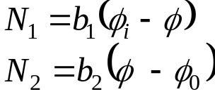
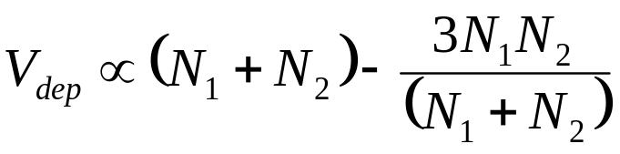
On-going activity: modelling the V_{fd} evolution with the fluence through the double junction. Two major energy levels are considered to be responsible of the junctions at the two contacts.
Ф_{i}=inversion fluence
Ф₀=double junction formation fluence
Simulation of V_{fd} for 26MeV protons irradiation
M. Scaringella et al., NIM A, in press.
Development of double junction with fluence, particle and energy of irradiation and material kind (mcz, epi, fz) is under study by TCT in collaboration with Ioffe Inst..

Slide 11
Conclusions
1) Maps of full depletion voltage along the p-type MCz wafer after microstrip processing show a spread along the wafer diameter with variations of 30V to 100V. This spread is accounted by [TD]~1-3 10¹² cm⁻³.
2) TDs can be activated by thermal treatment at 430°C. They compensate B dopant in p-type MCz Si and can determine type inversion of p-type MCz. TDs activation may be used to control initial doping.
3) No TDs are activated by irradiation (protons up to 1.0·10¹⁵ n/cm²). Anyway, a shallow donor is generated in MCz with a concentration at least five time higher than in STFZ. It may be responsible for the lower stable damage rate β in MCz.
4) The influence of defects on the sign of the space charge density has been investigated by current transients at constant temperature i(T, t). Type inversion is not revealed in MCz up to 1.0·10¹⁵ n/cm², in agreement with TCT carried out at Ioffe Inst.

