Slide 1
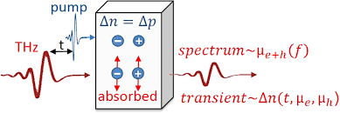
Excess Charge Carriers

Slide 2
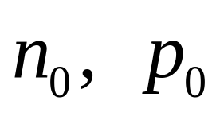
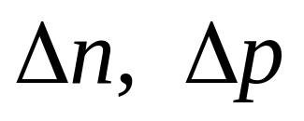
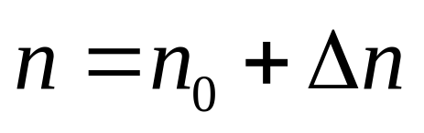
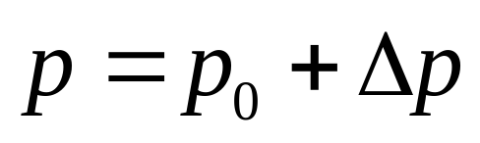
equilibrium concentrations of carriers
excess carrier concentrations
total carrier concentrations

Slide 3
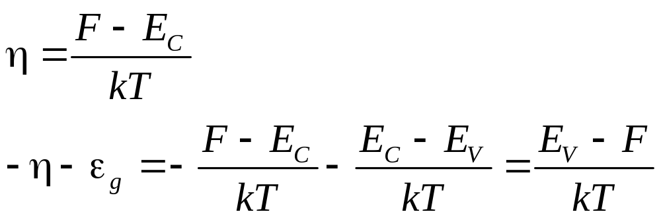
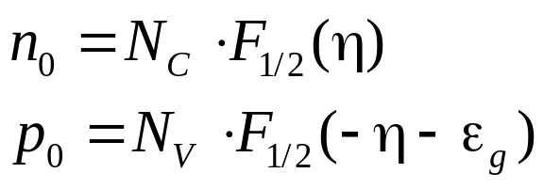
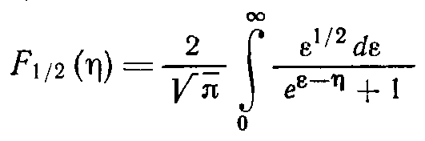
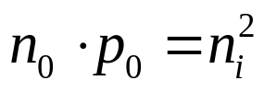
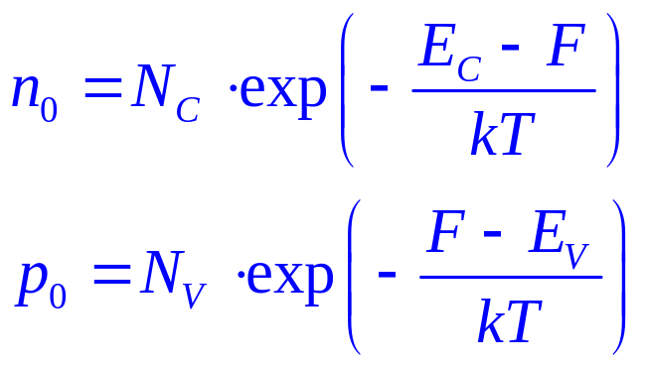
quasi-Fermi levels
non-degenerate semiconductor case

Slide 4
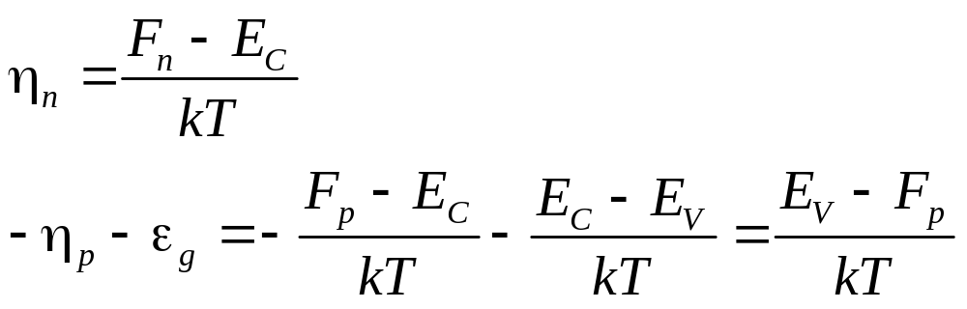
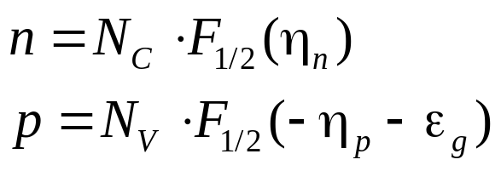
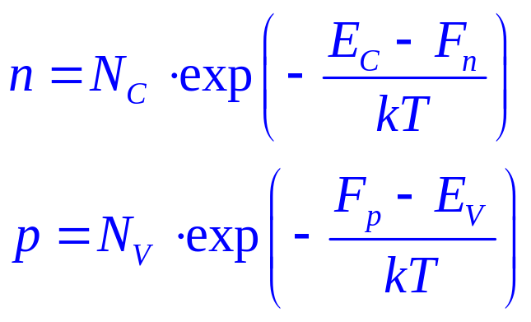
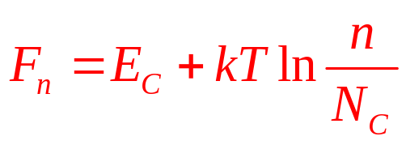
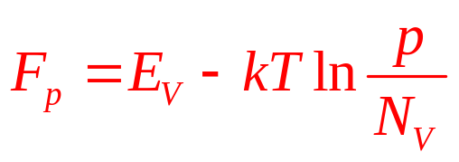
quasi-Fermi levels
non-degenerate semiconductor case

Slide 5
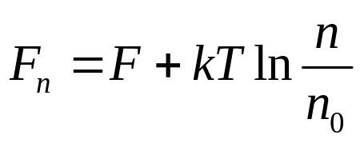
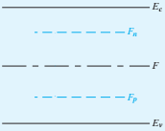
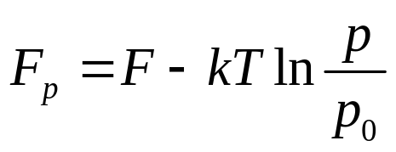
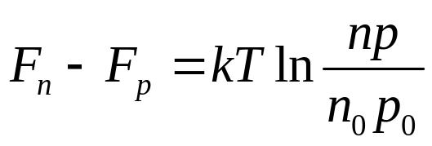
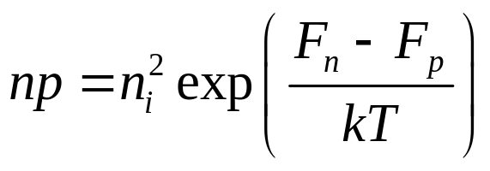
quasi-Fermi levels

Slide 6
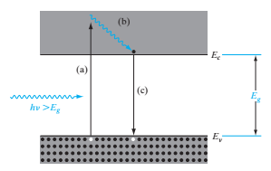
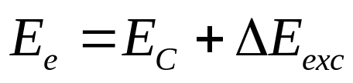
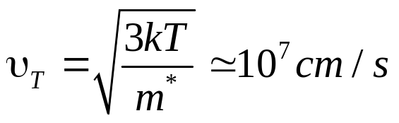


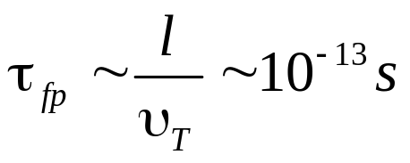
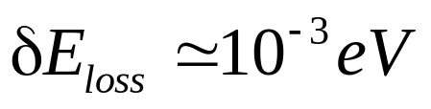
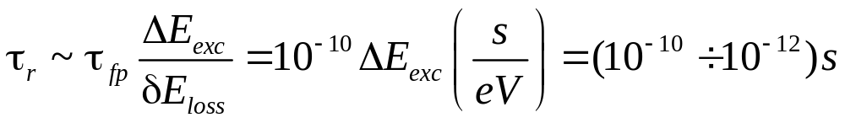

thermalization
free path value

Slide 7


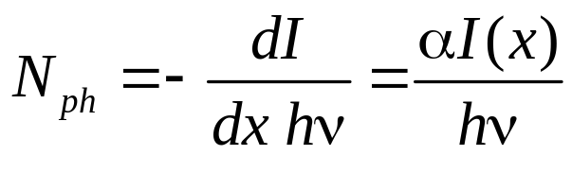
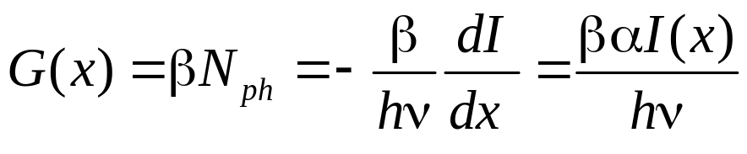
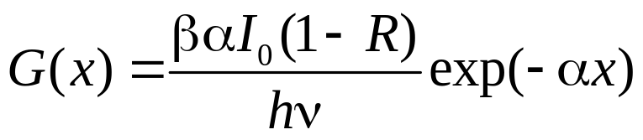


generation rate of excess carriers
I₀
0
dx
d
X
generation rate
β - quantum yield

Slide 8


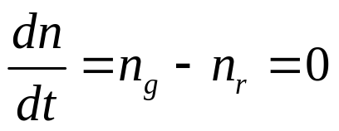
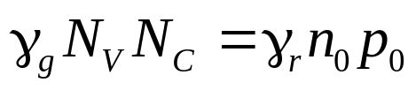
bipolar charge carrier generation
equilibrium state
principle of detailed balance

Slide 9
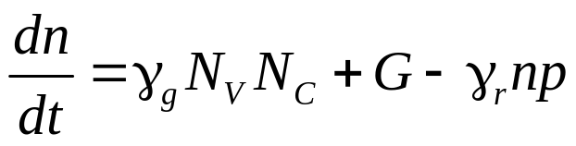
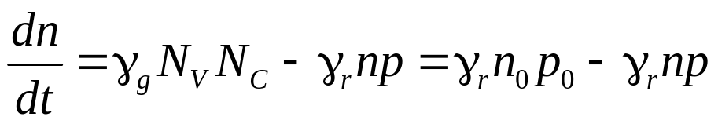
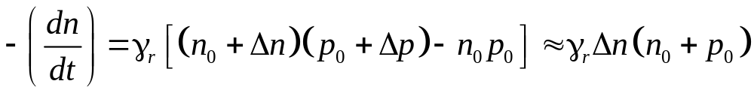
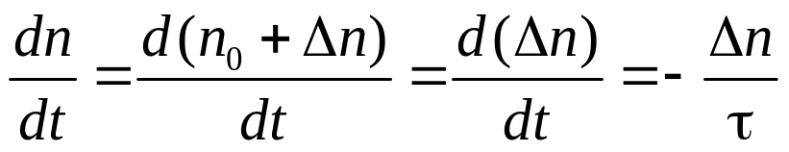
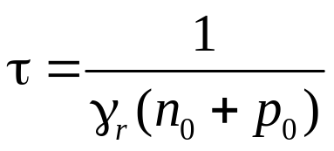
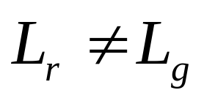
bipolar charge carrier generation
illumination on
illumination off
pair’s life time

Slide 10
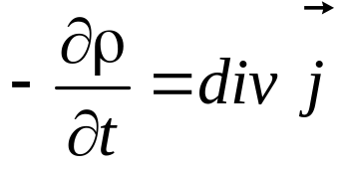


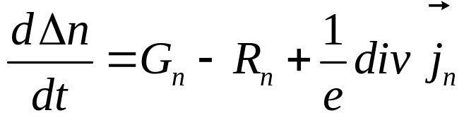
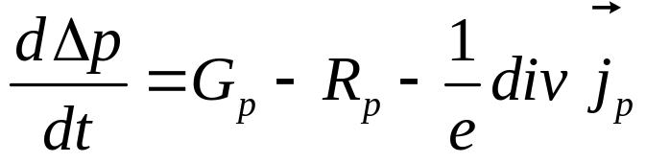
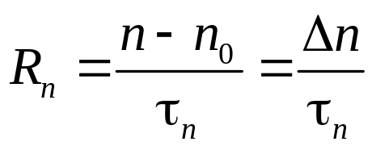
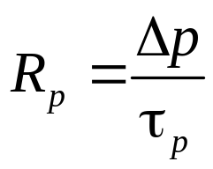
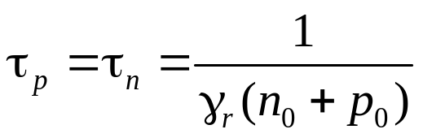
continuity equations
bipolar generation

Slide 11
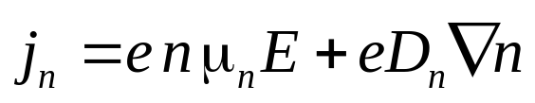
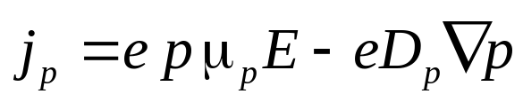
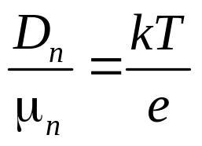
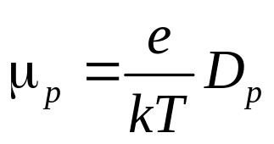
continuity equations
Einstein Relation

Slide 12

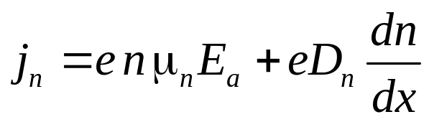
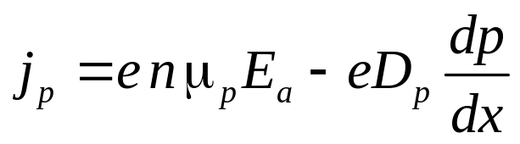
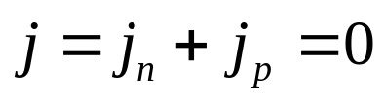


ambipolar diffusion
isolated semiconductor
Dember field

Slide 13







ambipolar diffusion

Slide 14









ambipolar diffusion
n-type semiconductor
p-type semiconductor
intrinsic semiconductor
low injection

Slide 15



ambipolar diffusion, Dember voltage

Slide 16








ambipolar drift

Slide 17






ambipolar drift

Slide 18







ambipolar drift
x
x+dx
X
reduction per unit time in the number of excess carriers, that moving with υ, in the thin layer between x and x+dx
ambipolar mobility
n-type semiconductor
p-type semiconductor

Slide 19




diffusion length, drift length
n-type
0
X
x>0, steady-state case, 1D

Slide 20









diffusion length, drift length
B.C.:
collection length

Slide 21




diffusion length, drift length
weak fields
strong fields

Slide 22

Recombination, Carrier Lifetime

Slide 23


recombination mechanisms
band-to-band (direct) recombination
recombination via defect levels
surface recombination
radiative recombination (ΔΕ to photon)
non-radiative recombination (ΔΕ to phonon)
Auger recombination (ΔΕ to electron)

Slide 24





band-to-band radiative recombination
after bipolar generation

Slide 25







recombination rate
thermal velosity
electron number in
recombination cross-section
total collision number

Slide 26







band-to-band radiative recombination
no traps
low injection level
intrinsic semiconductor
n-type
p-type

Slide 27


band-to-band recombination
band-to-band radiative recombination
E_{G}, eV
n_{i}, cm⁻³
S, cm²
τ_{i}
τ_{i real}
~10⁻³ s
~10⁻³ s
0,3⋅10⁻⁶ s

Slide 28




Auger recombination

Slide 29







Auger recombination

Slide 30




Shockley-Read-Hall recombination
1 – electron capture
2 – electron emission
3 – hole capture
4 – hole emission
Process 1:
1
Process 2:

Slide 31






Shockley-Read-Hall recombination
principle of detailed balance:

Slide 32




Shockley-Read-Hall recombination
S_{n} - capture cross section of electron
S_{n} ~ (10⁻¹²÷10⁻²²) cm²
attractive center
neutral center
repulsive center
polarization interaction
high kinetic energy or tunneling

Slide 33

Shockley-Read-Hall recombination
cascade, T⁻¹-T⁻⁴
multiphonon
radiative
10⁻¹²
10⁻¹⁴
10⁻¹⁵
10⁻¹⁹
10⁻²⁰
10⁻²¹
10⁻²⁴
classical Auger

Slide 34





Shockley-Read-Hall recombination
number electrons on the trap
stationary state

Slide 35




Shockley-Read-Hall recombination

Slide 36





Shockley-Read-Hall recombination

Slide 37








Shockley-Read-Hall recombination
Shockley-Read-Hall equation

Slide 38
















Shockley-Read-Hall recombination
n-type
trap level in the upper half of the gap
trap level in the lower half of the gap

Slide 39



Shockley-Read-Hall recombination
Shockley-Read-Hall equation
shallow traps have little effect on recombination

Slide 40





Shockley-Read-Hall recombination
rate of hole trapping
for electrons
rate of thermal electron emission
recombination center
traping center
Demarcation level

Slide 41









charge relaxation on trap centre
electron concentration on the traps
stationary state
trap

Slide 42

Surface Properties of Semiconductors

Slide 43





surface states
0
E_{C}
Tamm states
irregularity
surface states
E_{V}
X
X
Shockley states
broken bonds
real surface
surface period variation
point defects
growth defects
macrodefects (surface treatment)

Slide 44





surface band bending
n-type, acceptor on surface
electric field, space charge region
electric double layer
depletion region
inversion region
0
d

Slide 45




surface band bending
n-type, donor on surface
I
II
electric field, space charge region
accumulation region
degenerate region
0
d

Slide 46




surface band bending
p-type, acceptor on surface
p-type, donor on surface

Slide 47







surface potential calculation
donor concentration
complete impurity ionization
acceptor surface level
E_{d}
Poisson’s equation

Slide 48





surface potential calculation

Slide 49








surface potential calculation

Slide 50






surface potential calculation

Slide 51




surface potential calculation

Slide 52





surface potential calculation
on the surface:
charge neutrality condition:
on the surface level
in space charge region

Slide 53





surface potential calculation
on the surface (approximation):

Slide 54











surface recombination
L_{n} , L_{p}
if there are no traps
surface recombination velocity

Slide 55








surface recombination, trap levels

Slide 56








surface recombination
donor level
acceptor level

Slide 57







influence of surface recombination on excess carriers
p-type, bipolar generation
low S
(d - sample thickness)
high S

Slide 58

p-n Junction: Electric properties

Slide 59

surface recombination

Slide 60

surface recombination

Slide 61

surface recombination

