Slide 1


Slide 2




https://knu-ua.zoom.us/j/4269516219?pwd=ak1XbmprdFBUQnRZOWszWU91VHdyUT09
Meeting ID: 426 951 6219
Passcode: 1

Slide 3

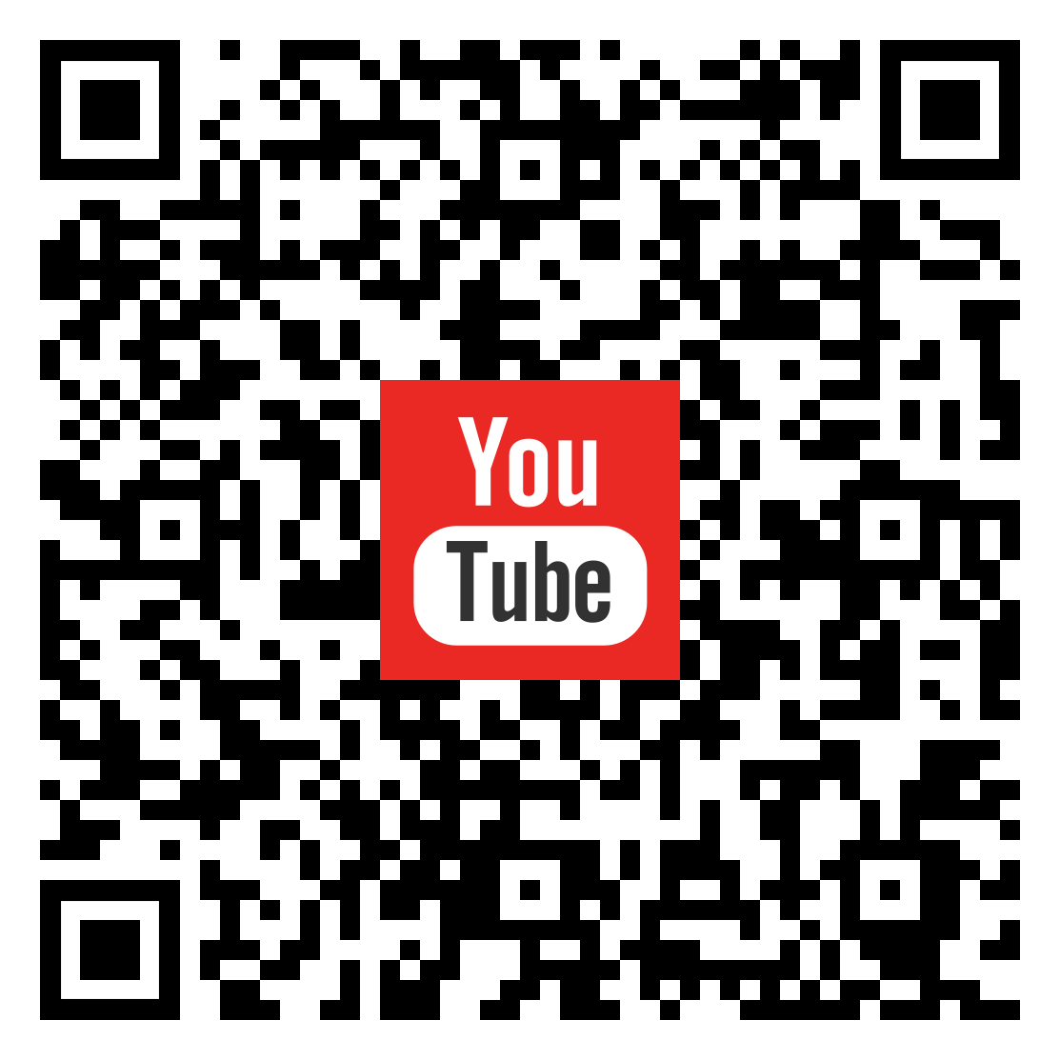
задачники
https://drive.google.com/drive/folders/1NjLqD9PhORVI7biS3N-h-kSZ0nEQGekN?usp=sharing
записи занять
https://www.youtube.com/watch?v=EnFZGZ1wYZ8&list=PLcI6FxPn77NXgHNpM3HOxEZlhMCg6BCqv

Slide 4


bxbjw4m
https://classroom.google.com/c/NjIwNjM1Mjg3NTcz?cjc=bxbjw4m

Slide 5

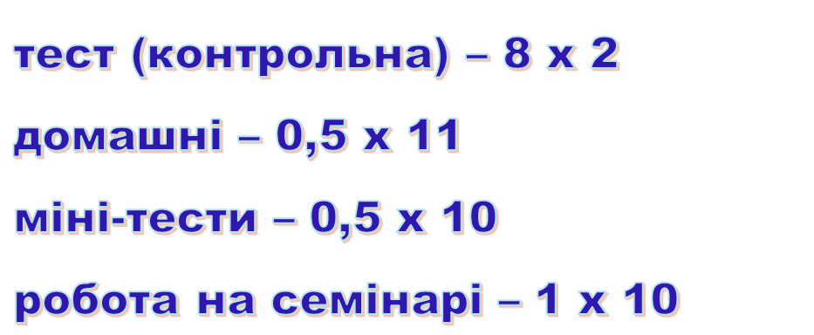

Slide 6
Кінематика

Slide 11
