Slide 1
习题详解2

Slide 2
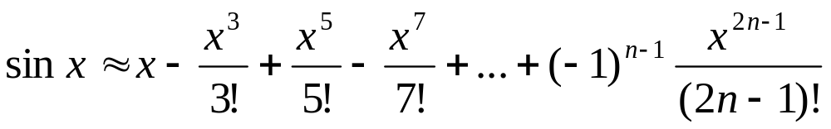
1、输入x的值，通过以下表达式计算,直到第n项的绝对值小于10⁻¹⁵为止:

Slide 3
program test1
implicit none
integer :: n
real :: x,term,sum
real :: err=1e-15
write(*,*)"please input x"
read(*,*)x
n=1
term=x; sum=x
do while(abs(term)>err)
term= term*(-1)*x**2/((2*n)*(2*n+1)) !下一项的值
sum= sum+term !加上下一项之后的sinx的值
n=n+1 !为求再下一项做准备
enddo
write(*,*)"x=",sum
write(*,*)"the result of sinx=",sum
write(*,"(/'sin',f3.1,' =',f6.2/)")x,sum ! 注意这里的输出格式设置
write(*,100)x,sum
100 format(/"sin",f3.1,' =',f6.2/) ! 输出格式设置，与上一个输出中的设置等价
stop
end

Slide 4
2、输入10个学生的学号和成绩，要求打印出其中最高者和最低者的学号、成绩，以及总的平均成绩。

Slide 5
program test2
implicit none
integer :: n,istd,imax,imin
real :: x,xave,xmax,xmin
xave=0.
xmin=100.
xmax=0.
do n=1,10
read(*,*)istd,x
xave=xave+x
if(x<xmin)then
xmin=x
imin=istd
endif
if(x>xmax)then
xmax=x
imax=istd
endif
enddo
xave=xave/10.
print*, "number ",imax,"the maximum point is:" xmax
print*, "number ",imin,"the minimum point is:" xmin
print*, "average point is:" xave
stop
end

Slide 6
3、某物品价格为340元，编写程序，让用户猜测价格，最多允许用户猜6次，并在猜中、以及猜值过高或过低时，给用户以反馈信息‘You are lucky! ’或 'Too high. Try again' 或 'Too low. Try again. ' 等提示

Slide 7
program test3
implicit none
integer :: n
real :: price,guess,err
price=340.
err=340.
n=0
do while(n<6.and.abs(err)>1e-2)
write(*,*)"please input your guess"
read(*,*) guess
n=n+1
err=guess-price
if(abs(err)<1e-2)then
write(*, "('well down! you guess only ',i3,'times.')" )n
write(*, "('the price is ',f7.2 /)")price
exit
else if(err>1e-2.and.n<6)then
write(*, "('Too high.Try again.you still have ',i2,1x,'chance'/)")6-n
else if(err<1e-2.and.n<6)then
write(*, "('Too Low.Try again.you still have ',i2,1x,'chance'/)")6-n
else
write(*,*)"You have guess 6 times, game over."
write(*,"(/)")
endif
enddo
stop
end

Slide 8
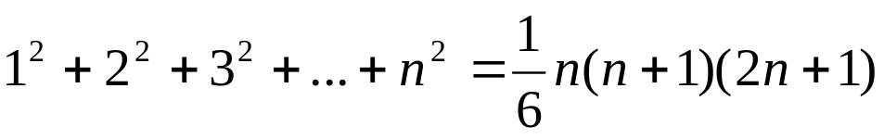
4、编写程序验证下面公式：

Slide 9
program test4
implicit none
integer :: n,i,iright,ileft
write(*,*)"please input an integer number"
read(*,*) n
ileft=n*(n+1)*(2*n+1)/6
iright=0
do i=1,n
iright=iright+i**2
enddo
if(iright/=ileft)then
write(*,*) "the equation is error"
else
write(*,*) "the equation is right"
endif
stop
end

Slide 10
5、输入一个班学生成绩(人数不定)，按优、良、中、及格和不及格五个等级统计人数,及占总人数的百分比。
优：90∼100；良：80∼89；中：70∼79；及格：60∼69；不及格：0∼59
提示：学生成绩为x, 从键盘输入，输入成绩为负数表示输入结束

Slide 11
program test5
implicit none
integer :: n1,n2,n3,n4,n5,n
real ::per1,per2,per3,per4,per5
real :: x
n1=0;n2=0;n3=0;n4=0;n5=0
do while(.true.) ! 'do' is also ok
write(*,*)"please input point(input negative if it is end): "
read(*,*) x
if(x<0.)then
print*,"input a negative, it is end"
exit
else if(x<60)then
n1=n1+1
else if(x<70)then
n2=n2+1
else if(x<80)then
n3=n3+1
else if(x<90)then
n4=n4+1
else if(x<100)then
n5=n5+1
else
print*,"error, point is greater than 100"
endif
enddo

Slide 12
n=n1+n2+n3+n4+n5
if (n/=0)then
per1=real(n1)/real(n)
per2=real(n2)/real(n)
per3=real(n3)/real(n)
per4=real(n4)/real(n)
per5=real(n5)/real(n)
write(*,200)n
write(*,100)per5,per4,per3,per2,per1
else
write(*,*)"no input"
endif
100 format(/,'优秀 ：',f6.2/,'良好 ：',f6.2/,'中 ：',f6.2/'及格 ：',f6.2/'不及格：',f6.2/)
200format(/,' the total number is:',i3)
stop
end

