Slide 1
Computer Architecture
DLA STOPWATCH
ENIO BITRI
LAZARON SHYTA

Slide 2
What is it about?
A stopwatch that displays the time in four decimal digits and counts from 00.00 to 99.99 seconds.
It contains a RESET command, which re-sets the count to 00.00
signal, START/STOP, which enables (starts) and suspends (stops) the counting.
There is a switch control that turns the display

Slide 3
Components used
4 Hex Digit Display
Used to convert hexadecimal code to decimal digit. There are used 4 Hex Digit Displays, 2 for the whole-number part and 2 other for the fractional part. They display from 00.00 to 99.99.
4 P-Type Transistors
Each Hex Digit Display is connected with one P-Type transistor. With the transistors we can command the displays to turn on or off. The counting still continues even if the display doesn’t show the number when we push the button Screen On/Off.
3 D FLIP FLOP
D Flip-Flops are used to divide the clock cycle in order to adjust the time, so the stopwatch will not be too fast or slow. (Clock Frequency-2KHz divided by 3 D Flip-Flops)

Slide 4
…
4 Counters
Counters are used to count from 0-9 when the clock cycle signal is entered. There are two counters for the whole-number part and for the fractional part.
3 Comparators
Comparators are used to compare the counters number output with the constant 0. When the first counter goes to 0, this is used as a clock cycle for the second counter and so on.
4 Multiplexer
Used to convert this number as a hexadecimal code in order to be outputted in the Hex Digit Displays.

Slide 5
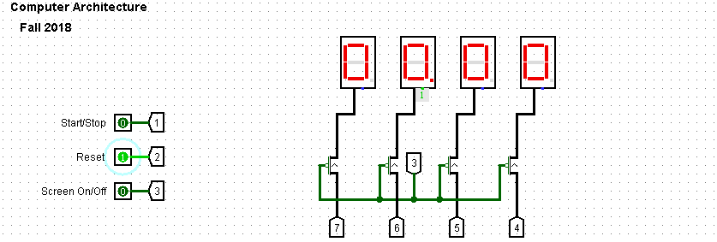
Initial Front-End

Slide 6
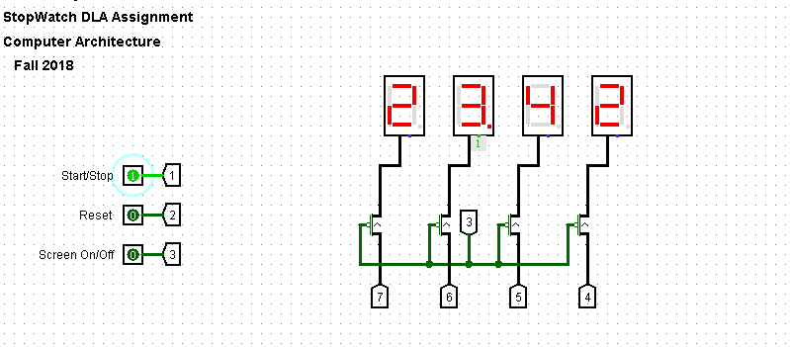
After executing Start/Stop

Slide 7
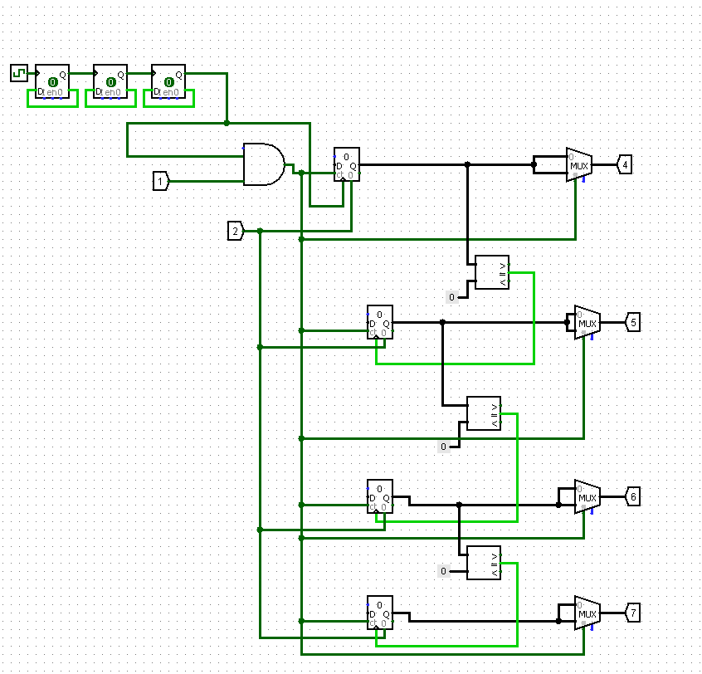
Circuit

Slide 8
Thank you for your attention

