Slide 1
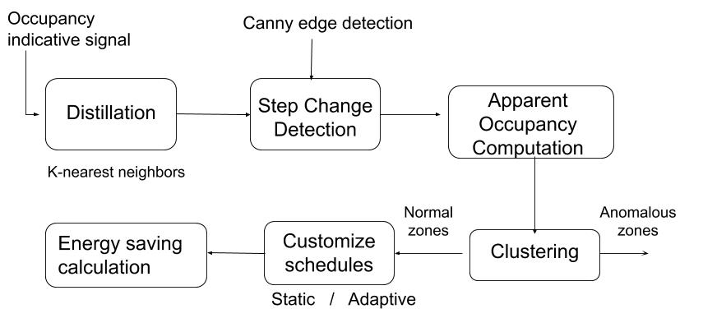
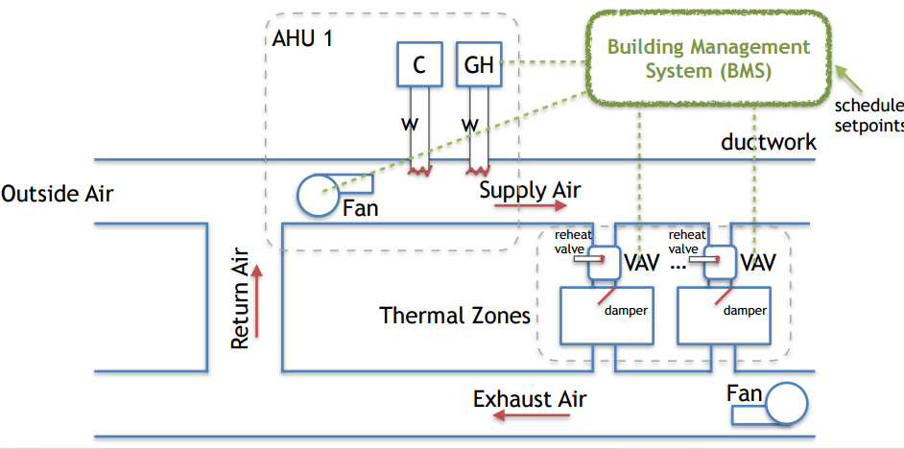
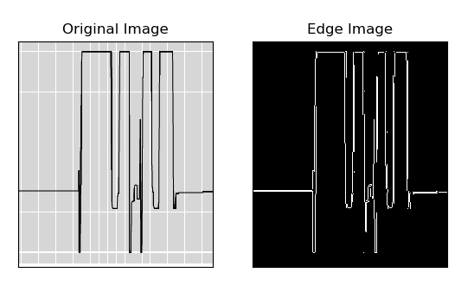
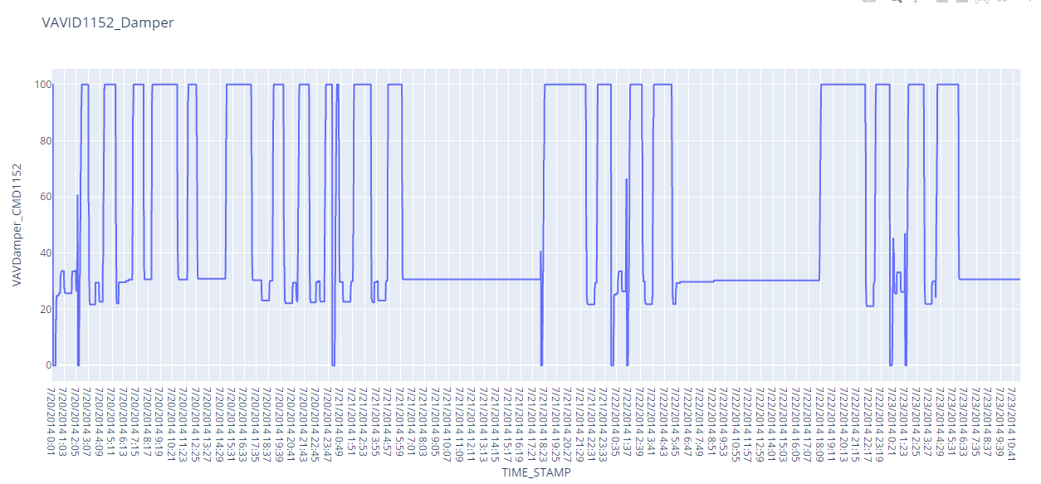
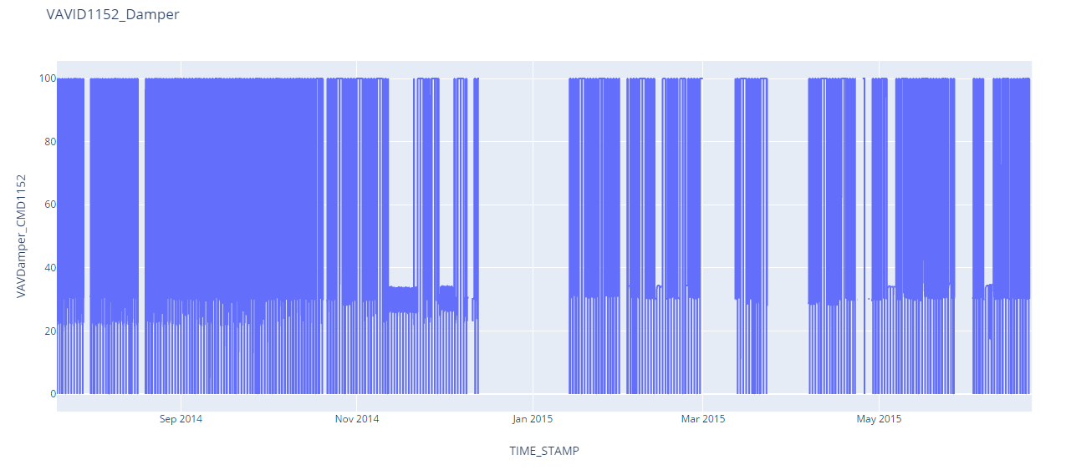
Non-intrusive Occupancy Estimation and zone-customized schedules
Linzhang Wu, Khandaker Hossain,
lw568@scarletmail.rutgers.edu kmh312@scarletmail.rutgers.edu
Advisor: Prof. Jorge Ortiz
Goal
Methodology
Our goal is to replicate the machine learning paper “Non-Intrusive Techniques for Establishing Occupancy Related Energy Savings in Commercial Buildings” and obtain slightly better results with a different data set.
Import data Clean data Modeling
Obtain patterns of human occupancy ed,
Apply clustering to gather the similar occupancy zones.
Generate customized schedule
Motivations and Objectives
Motivations
The HVAC systems traditionally run on a single static schedule . Lacking customized per-zone schedules causes extremely inefficiency in energy consumption
Occupancy sensors are not commonly available in all zones
An entry of human occupant raises the amount of heat load in a zone
The response of sensors in Variable Air Volume system can provide occupancy indicative signal non-intrusively
Objectives
Extract occupancy state information from VAV dampers and/or reheat valves
Define per-zone schedules and calculate the energy saving
Related Works
The intrusive methods dealt with obstacles stemming from lack of software and require hardware updates. To tackle this, less intrusive methods need to be implemented, such as Wi-Fi detection & HVAC sensors.
Measurements of environmental signals such as CO2 concentration, room temperature are being carried out. But unfortunately this method requires a long training phase.
4 things for future work. Investigate the length of time where occupancy remains constant; Then upload this data into a thermodynamics simulator; Third, we want to evaluate efficacy of non-intrusive techniques to determine occupancy when the heat load generated by occupants is too small compared to the other heat-generating sources to produce a noticeable signature in the occupancy indicative signal, finally classify the anomalies into categories of possible faults.
Current Results
By just looking at one single room, the occupancy state is periodical daily and weekly
Data cleansing algorithm slightly effects the original data
Figure 1. Commercial Building’s HVAC system
Research Challenges
Several confounding effects contribute to the change of heat load in a zone cause mess occupancy indicative signals
The complete ground truth of occupancy is impossible to obtain in a large building
The dataset is one-year period leading great complexity in data preprocessing and consume more time in running time.
Novelty
References
A much larger dataset of three commercial buildings containing adequate types of units of VAV system in one year.
This will improve accuracy in the process of training.
Fixed the sensors types to be consistent for easier clustering and abnormity detection for all three buildings
[1] Ardakanian, Omid & Bhattacharya, Arka & Culler, David. (2016). Non-Intrusive Techniques for Establishing Occupancy Related Energy Savings in Commercial Buildings. 21-30. 10.1145/2993422.2993574.
[2] Figure 1. Commercial Building’s HVAC system. https://webdocs.cs.ualberta.ca/~oardakan/files/ISS4ETalk16.pdf
[3]Dataset obtained from: https://openei.org/datasets/dataset/long-term-data-on-3-office-air-handling-units

