Slide 1
PRESENTS · EST. 2026
SPEAK EASY
Language doesn't get learned. It gets played.
COLUMBIA
CHARLOTTE
KIDS

Slide 2
THE PROBLEM
Everybody is "learning" a language.
Nobody is speaking one.
✗
✗
✗
✗
APPS DON'T SPEAK BACK
CLASSROOMS ARE STERILE
ADULTS ARE BORED
KIDS TUNE OUT
Duolingo gives you streaks. It doesn't give you confidence at a bar, in a meeting, or at your kid's school.
Fluorescent lights. Worksheets. The same five sentences. No wonder people quit.
Most adult language programs are repackaged childhood school. We're not children. We have wine money.
Drill-and-kill flashcards lose to YouTube. Culture and play win.

Slide 3
THE INSIGHT
Language is social.
So we built a program that runs on the only currency that works for language:
PLAYING IT.
GAMES · DOLLARS · CONVERSATION · DRINKS · CULTURE

Slide 4
BRAND DNA
A speakeasy on a Monopoly board.
Every class is a turn. Every conversation is a roll. Every word you risk pays you in Speak Easy Dollars.
GO
JAIL
FREE PARKING
CHANCE
$
$
$
$
Showing up pays. Walk through the door, collect $200.
Speak the wrong language? Time-out. Get out by playing a card.
End-of-night jackpot for the table that took the most risks.
Curveballs, prompts, accents, dares. The deck always speaks.

Slide 5
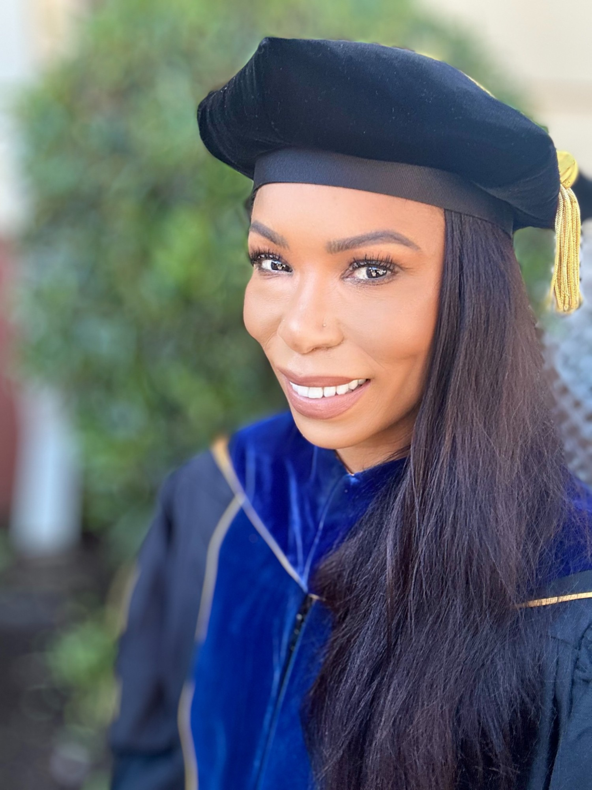
WHO'S BEHIND IT
Three decades of teaching.
Now in a bar near you.
TITLE DEED
PhD
Comparative Literature — University of Michigan
MA
Comparative Literature, with Graduate Certificate in Women's Studies
BA
English & French — Amherst College
EDUCATOR SINCE 1996
Not a chatbot. Not an app. A real teacher who has done this for as long as some of your students have been alive.

Slide 6
ONE BRAND. THREE ROOMS.
Pick the room. Same Speak Easy Dollars.
COLUMBIA
CHARLOTTE
KIDS
WHO Spanish speakers learning English
WHERE Columbia, SC — bar near USC
WHEN Tue / Thu / Sat · 6:30 PM
VIBE Speakeasy meets game night
OPEN Now
$10 first night · $99 month pass
WHO Adults — happy hour Spanglish
WHERE Charlotte, NC — 2 venues rotating
WHEN Wed / Fri · 6–8 PM
VIBE After-work cocktail lounge
OPEN Pilot launching
Free first night · $50/mo · drink specials
WHO K–5 kids learning Spanish
WHERE Afterschool, on-site at schools
WHEN 8-week sessions, weekly meet
VIBE Culture Club + games + crafts
OPEN Pilot fall 2026
Pricing TBD · pilot pricing for first school

Slide 7
COLUMBIA
WHY IT WORKS
TITLE DEED
Spanish speakers walk in. English happens.
THE ANCHOR
Two drinks in, the speakeasy economy takes over. You earn Speak Easy Dollars for risking words you wouldn't try on Duolingo. You spend them on rounds.
Where Speak Easy was born.
NIGHTS
Tue · Thu · Sat
TIME
6:30 PM
PRICING
VENUE
Bar near Columbia College
$10
$20
$35
$99
$199
LANGUAGE
Spanish → English
FORMAT
Games · Drinks · Dollars
FIRST NIGHT
DROP-IN
WEEK PASS
MONTH PASS
3-MONTH
CONTACT
803.881.6626
speak.easy.columbia@gmail.com

Slide 8
CHARLOTTE
After-work, after-hours, after the apps.
THE EXPERIMENT
OPEN
Same brand. Different city. Drink discount included.
WED · FRI
Two Charlotte bars host us on rotation, three months at a time. Locals stop in for cocktails. They leave with Spanglish, a new crew, and a stack of Speak Easy Dollars.
6 – 8 PM
happy hour pricing
FREE FIRST NIGHT · $10 DROP-IN · $50 MONTH · DRINK SPECIALS AT EVERY VENUE

Slide 9
KIDS
DRAFT · IN PROGRESS
Eight weeks. Five grades.
One afterschool classroom that doesn't feel like school.
WK
1
HOLA
WK
2
FAMILIA
WK
3
COMIDA
WK
4
MERCADO
WK
5
FIESTA
WK
6
CUENTOS
WK
7
JUEGOS
WK
8
FINALE
Themes inspired by Culture Club. Final curriculum locks once source materials are reviewed.

Slide 10
PARTNER VALUE
If you host us, here's the deal.
BARS · RESTAURANTS
SCHOOLS · PTAs
Pack your off-nights with a recurring crowd
30–50 paying customers per session, drinking
Free local press: "the bar that teaches Spanish"
Speak Easy handles marketing & programming
Zero risk: revenue share, no rent up front
Turnkey 8-week afterschool, K–5 mixed
Bilingual enrichment with real outcomes
Parent goodwill: not another worksheet
Instructor + materials + games included
Week-8 finale showcase for families

Slide 11
PRICING
Built to be the easiest yes of your week.
TIER | COLUMBIA | CHARLOTTE | KIDS
First night | $10 | FREE | —
Drop-in | $20 | $10 | —
Week pass | $35 | — | —
Month pass | $99 | $50 | —
3-month course | $199 | — | —
8-week session | — | — | $129 school · $300 in-home
Charlotte includes drink specials at every venue · Columbia and Kids include all materials · No hidden fees anywhere.
THE HOUSE ALWAYS PAYS YOU BACK — IN SPEAK EASY DOLLARS

Slide 12
THE ASK
Pick your card. We'll deal you in.
BAR OWNERS
SCHOOLS · PTAs
STUDENTS
HOST US.
PILOT US.
ENROLL.
Two off-nights on your calendar become Speak Easy nights. We bring the crowd. You pour the drinks. Revenue share, no rent.
Eight weeks. One classroom. K–5 mixed. We provide instructor, materials, games, showcase. You provide the room.
Show up Tuesday. $10. We'll do the rest. By month two you're ordering rounds in your second language.
WE ARE TAKING MEETINGS NOW.

Slide 13
KNOCK THREE TIMES.
SPEAK EASY
speak.easy.columbia@gmail.com
803.881.6626
COLUMBIA · CHARLOTTE · KIDS

