Slide 1
EchoTrack 进度报告

Slide 2
Device Problem
In this week, we have tried some of our device including HUAWEI, XiaoMI and IPAD. Some problem remains:
When using HUAWEI, we find out the device are not supporting dual-channel Audio generating, instead giving a “pseudo stereo” with controlling volume of each . In this case, we are sending chirp from both of the speaker, which has problem.
When using IPAD, we notice the sampling rate of hardware is 44100Hz. According to Nyquist rate, while the chirp reaching 23000Hz, we cannot generate an adapted butterworth filter towards it.

Slide 3
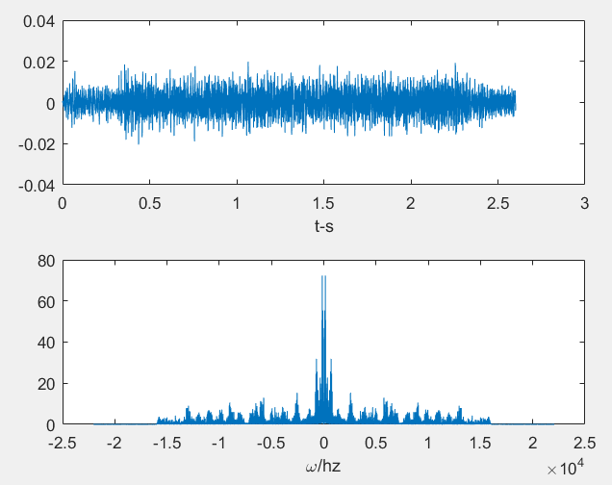
We tried to do some approach using IPAD, however the collecting module on IPAD seems problematic.
In this figure we plot out the received signal from IPAD some how has been filtered out by the device. We can easily find that we are not able to detect echo lower than 15Khz

Slide 4
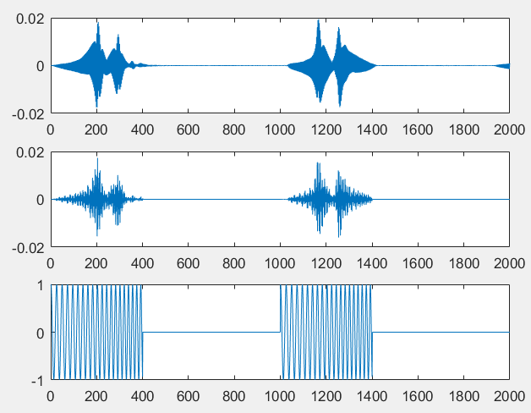
We also meet problem with peak detection.
These 2 pics are the result we use to detect peak.
The former one is we call the matlab “dechirp” function to realize peak detection.

Slide 5
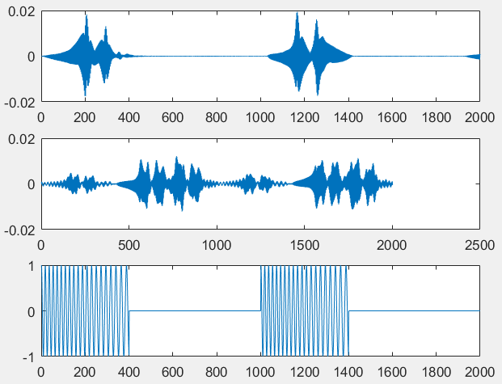
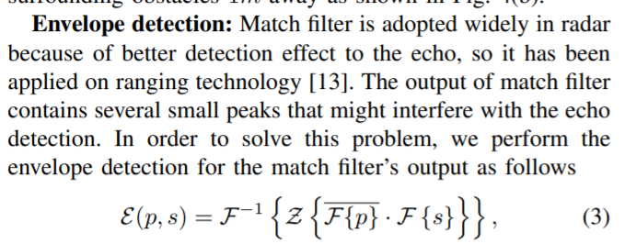
We also meet problem with peak detection.
These 2 pics are the result we use to detect peak.
The second one is which we reference from the paper using match filter.

Slide 6
Following Work
Try to find an usable device and finish the envelop detection.
If hard, making approach on a signal channel FMCW to finish distance detection in 2D phase.

