Slide 1
EchoTrack 进度报告

Slide 2
OutLine
In this week, we make our approach on dechirp method to distinguish the receive signal and echo signal. We manage to line up the receive signal periodically with the transmit signal in order to do efficient and stable echo track. Also, for each window, we are able to estimate the frequency difference between the direct received sound and echo sound.
However there are still some problems in the time consumption in the algorithm since the line up will automatically takes around 30s to run.

Slide 3
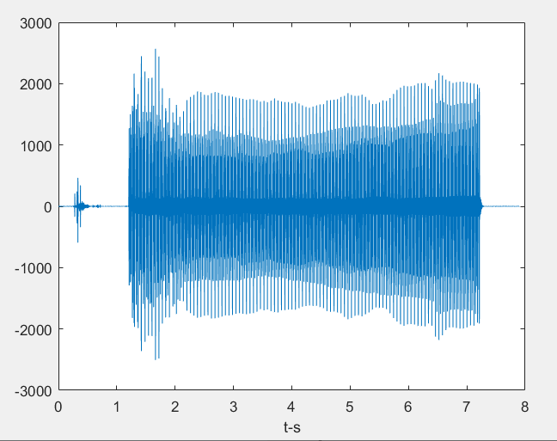
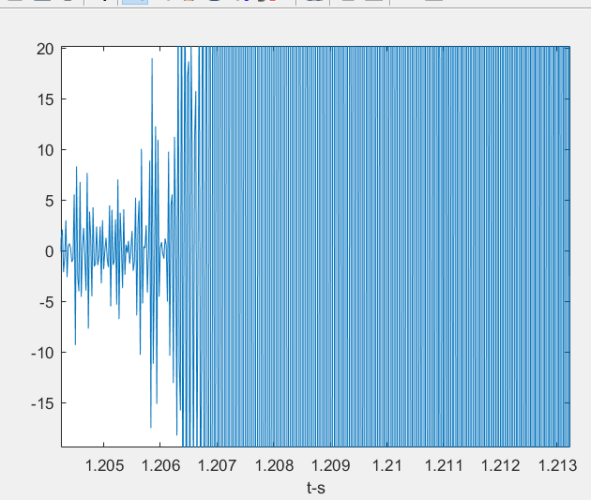
Initially we try to line up the signal with exact start point to do windowed analysis.
We extract a sliding window length 20ms and step length 2ms. In each window we apply dechirp of windowed signal with original chirp of length 20ms to check if we get the first highest peak. No tice we ignore the peaks below 2*10⁶
due to the gain of the filter.

Slide 4
After we finish Line up, we try to calculate window by window to dechirp the original signal finding the echo distant.
In this approach, we basically aware that our original emitted signal is composite of 20ms up chirp, 20ms down chirp and 20ms blank, so according to the paper we set the window size on 66ms with 10% overlap between windows.
Finally, we detect the highest 2 peaks on frequency domain and calculate their frequency difference.

Slide 5
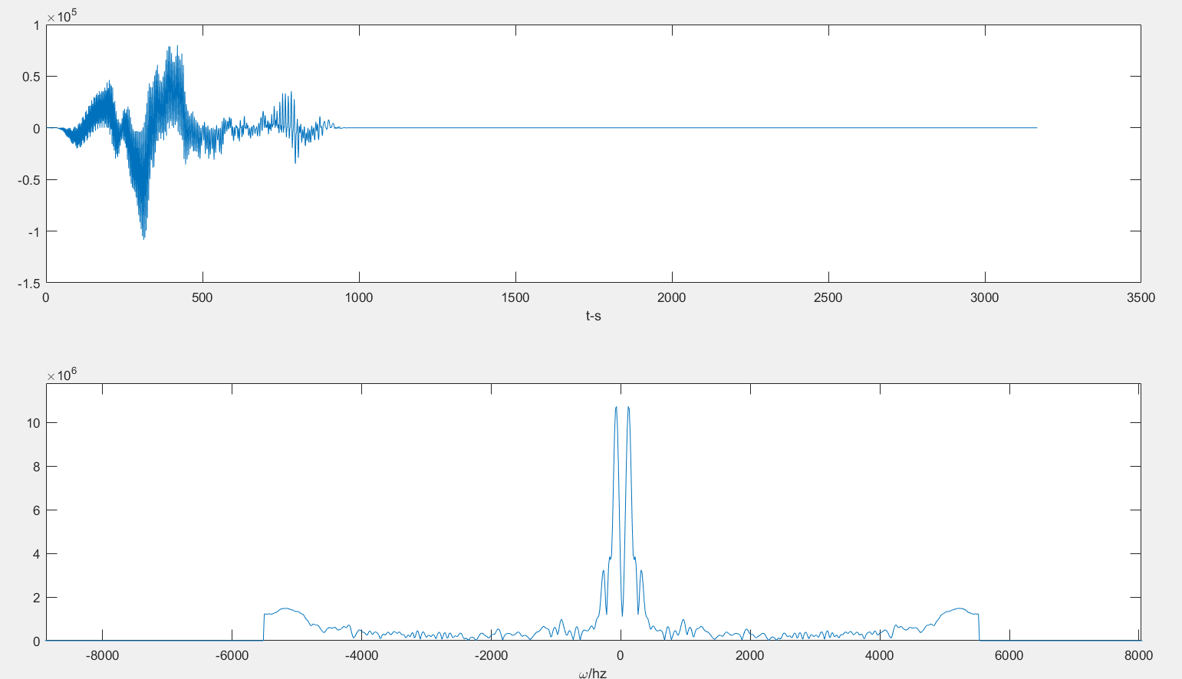

Slide 6

In this part, we can clearly observed that there are some echo peaks beside the main peak. According to our detecting program we can give out the
frequency difference between those 2 peaks is about 100hz.
Notice:
Our chirp is of 20ms and in frequency range (16000,23000)Hz,
Which means the frequency raising rate is 7000/0.02 = 350000 Hz/s
In 100Hz the sound is able to transmit:
340m/s * 100Hz / 350000Hz/s = 10cm

Slide 7
Following Work
In this week, we approximately reach an acceptable result on distance checking. The following work is to
① try to reduce the initial calculating time
② make an precise conclusion on exact distant
③ try to capture the moving trend

