Slide 1
EchoTrack 进度报告

Slide 2
OutLine
In this week, we mainly finish the work we leave on last week. We try to calculate the real distance between the object and the speakers. However, the rounding error is considerably big, we are now trying to fix this problem.

Slide 3
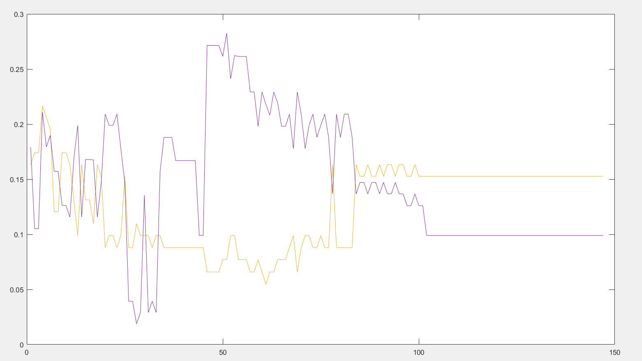
Distant Detect when Object is 10cm from device

Slide 4
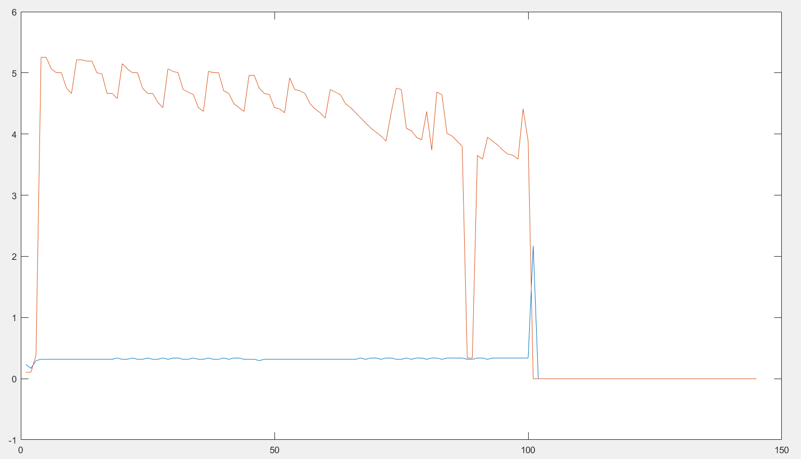
Distant Detect when Object is 20cm from device

Slide 5
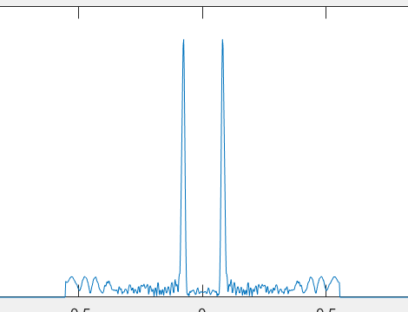
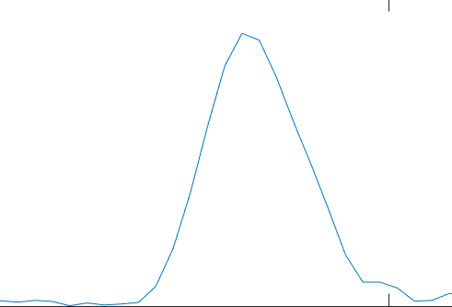
We can clearly notice that the result is not ideal in the second case, we suppose that is the second highest peak is not detected which cause severe error.

Slide 6
Following Work
The following work is to finish the current project. Which has problem in simultaneously process and extract. Before that, we are going to:
① make an precise conclusion on exact distant
② try to capture the moving trend

