Slide 1
EchoTrack 进度报告

Slide 2
Problem
In this week, we arrange our device and able to transmit double channel chirp. However, there are still remaining problem in dechirp. In this case, we generalize some simulation environment to verify our design is not problematic.

Slide 3
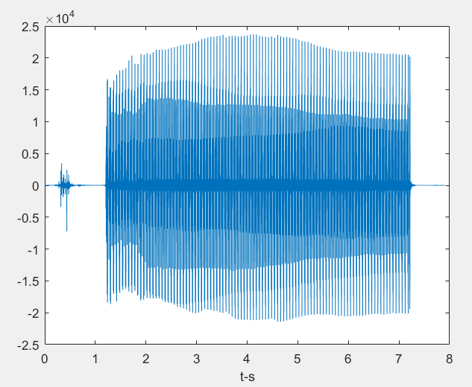
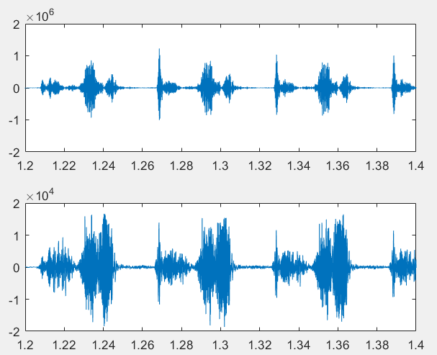
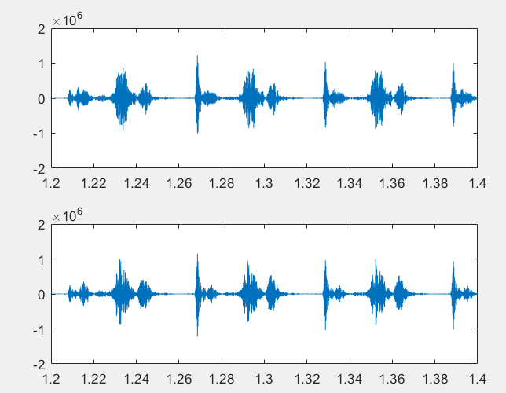
We apply dechirp in verified way towards received signal
In fig 1 we can clearly observed that the dechirp is working some how with clear peak detection.
In fig 2 however the dechirp using different reference get the similar result.

Slide 4
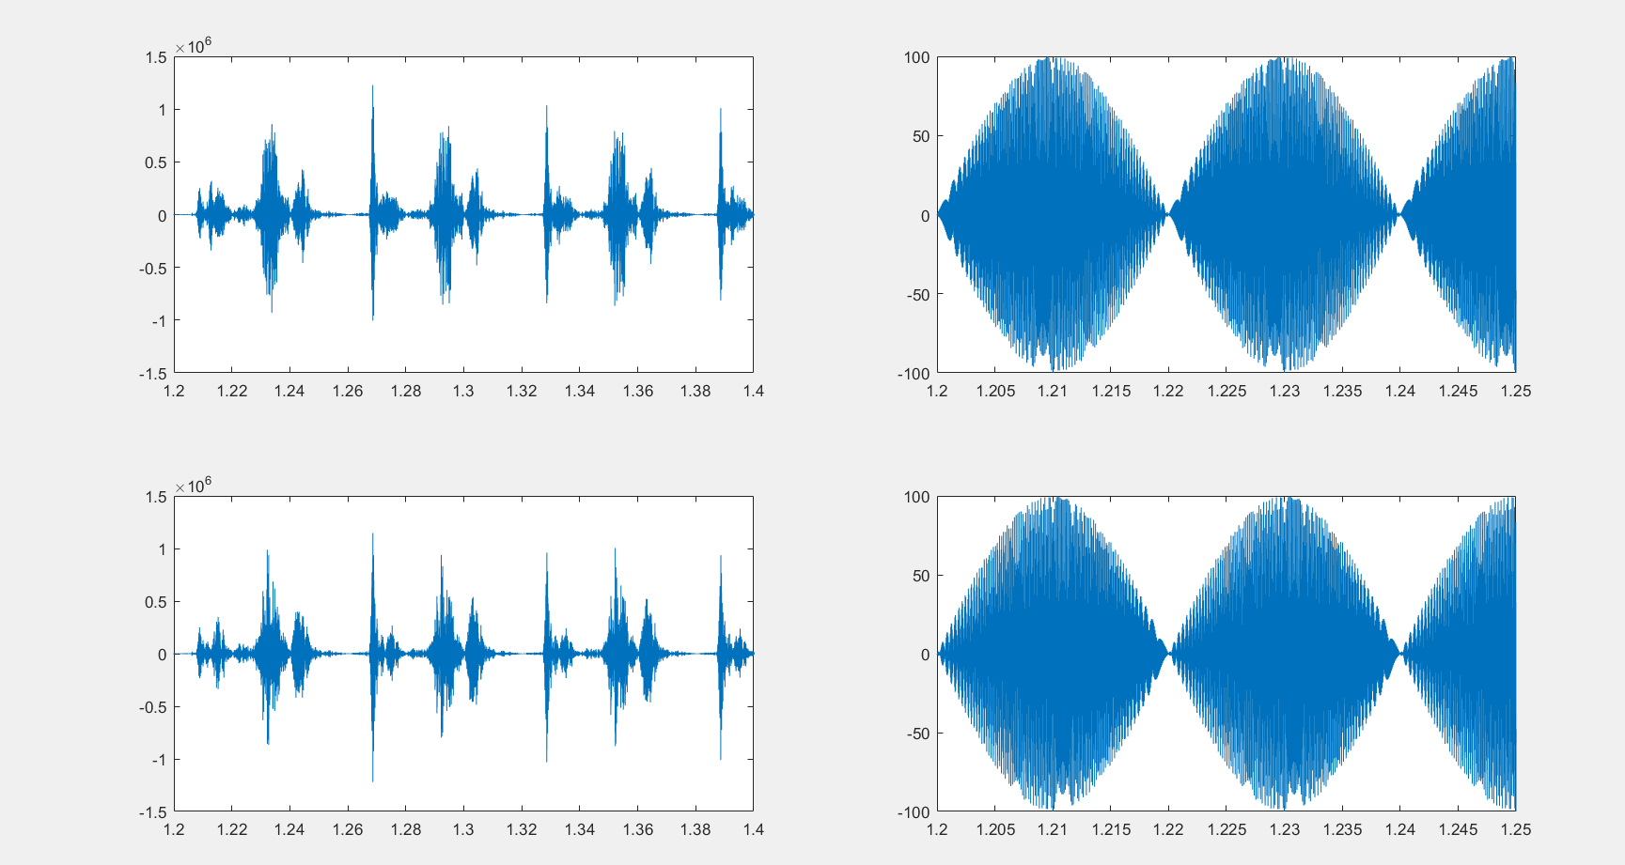

Slide 5
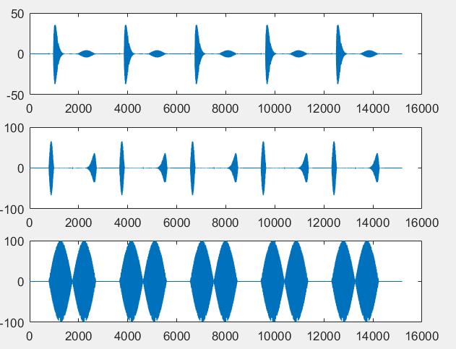
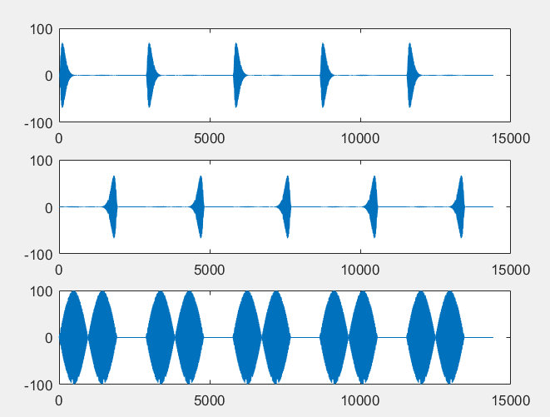
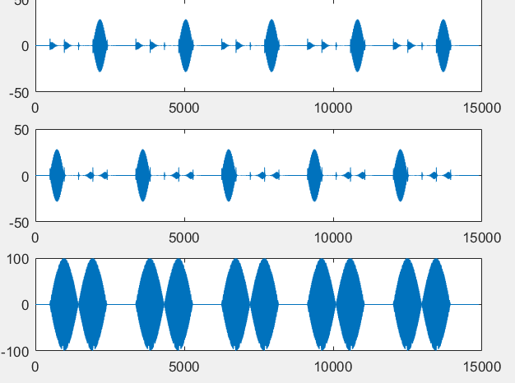
To verify our design, we check our original signal and do the dechirp, we find the dechirp is some our not as predict.

Slide 6
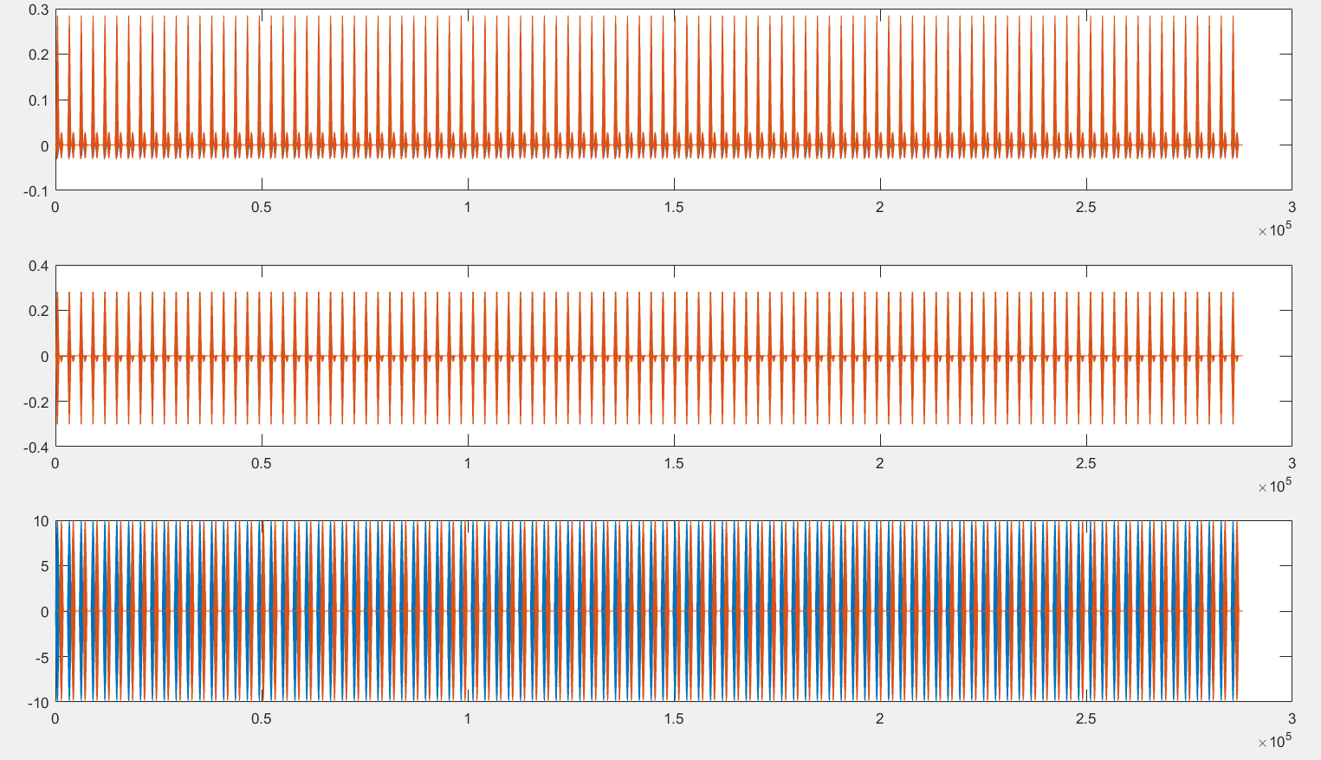
However, the dechirp works perfectly when there are no noise.

Slide 7
Following Work
Try to find an usable device and finish the envelop detection.
If hard, making approach on a signal channel FMCW to finish distance detection in 2D phase.

