Slide 1
Location and Tracking Base on Acoustic Signal
11711613 王天麒
11712319 成为
11712421 叶冠辉

Slide 2

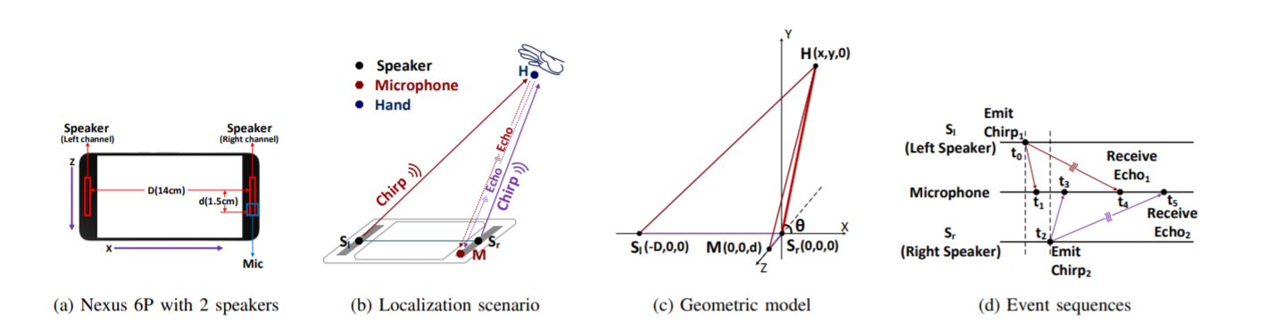
Work
We are objecting to implement a device-free hand tracking and location with Commercial-Off-The-Shelf mobile device(smart phone) and develop a simple distance and location measurement application in mobile phone.

Slide 3
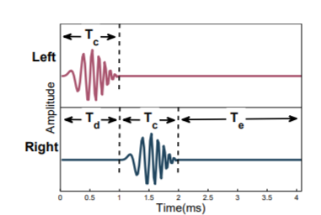
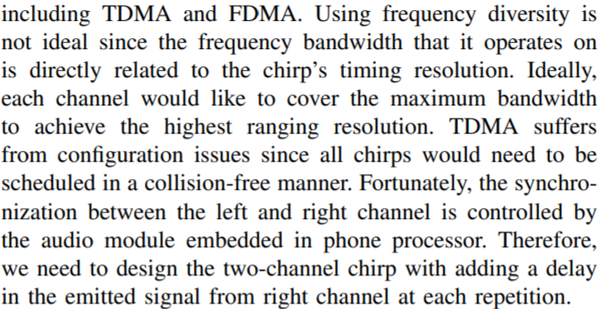
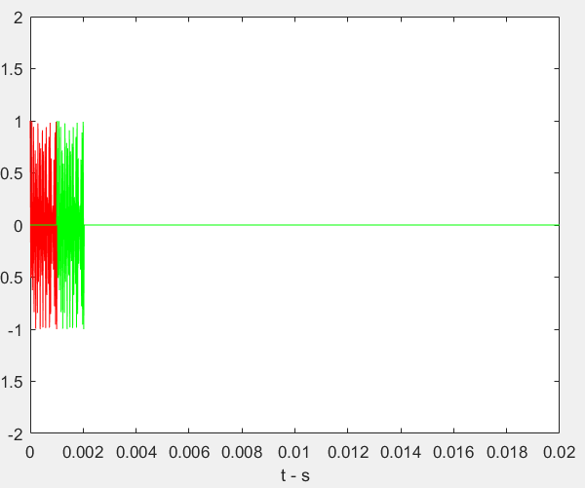
Signal Generation
[1]

Slide 4
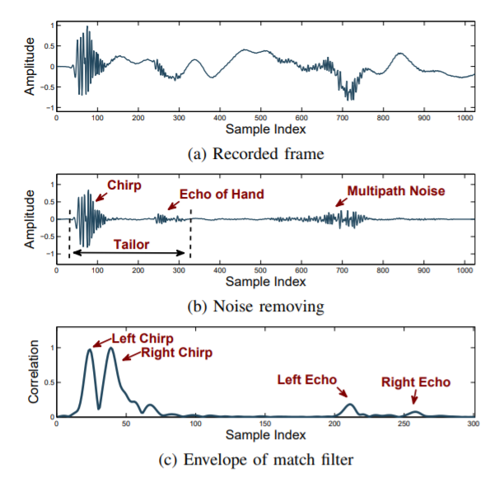
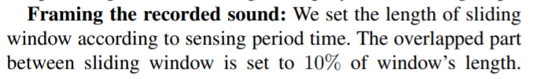



[1]

Slide 5
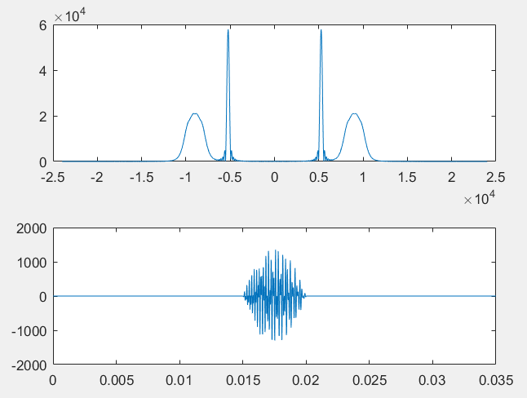

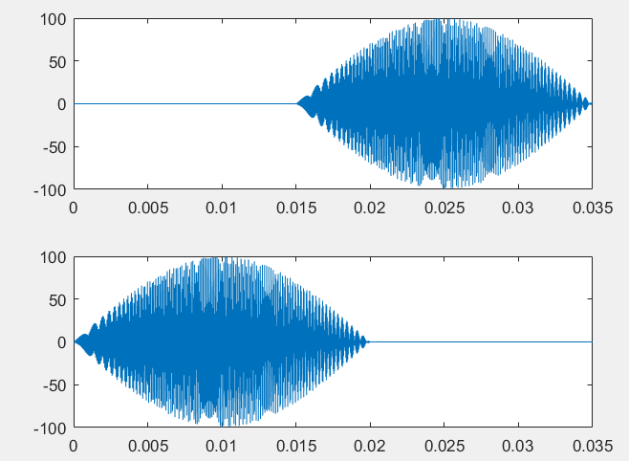


Dechirp
By mixing (i.e., multiplying) the received signals with the pseudo transmitted signals and applying a similar procedure, we have:
where Rn is the distance between the transmitter and receiver during the n-thinterval, fnp is the peak frequency of the mixed signals, c is the propagation speed of the audio signal, T is the chirp duration, and B is the bandwidth of the chirp signal, which is equal to fmax −fmin. Considering the above equations for two intervals, we can derive
If the distance between the transmitter and the receiver in the ﬁrst interval(denoted as R1)is known, Rn can be determined based on:

Slide 6
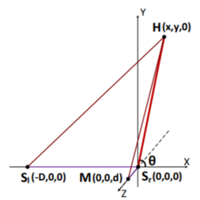
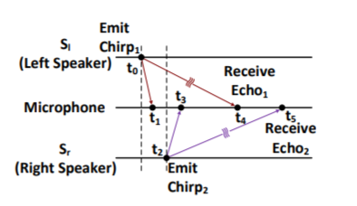
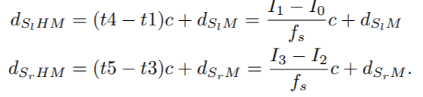
Distance Extract

Slide 7
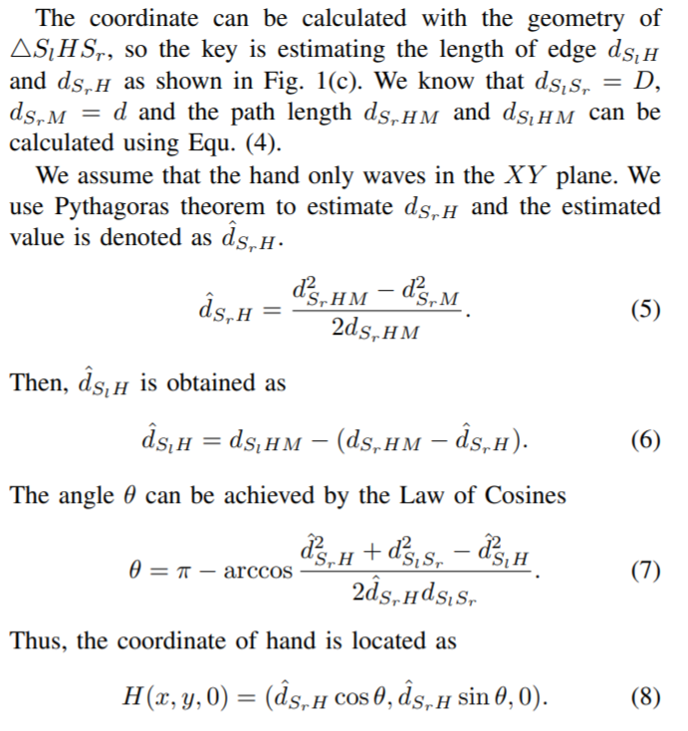
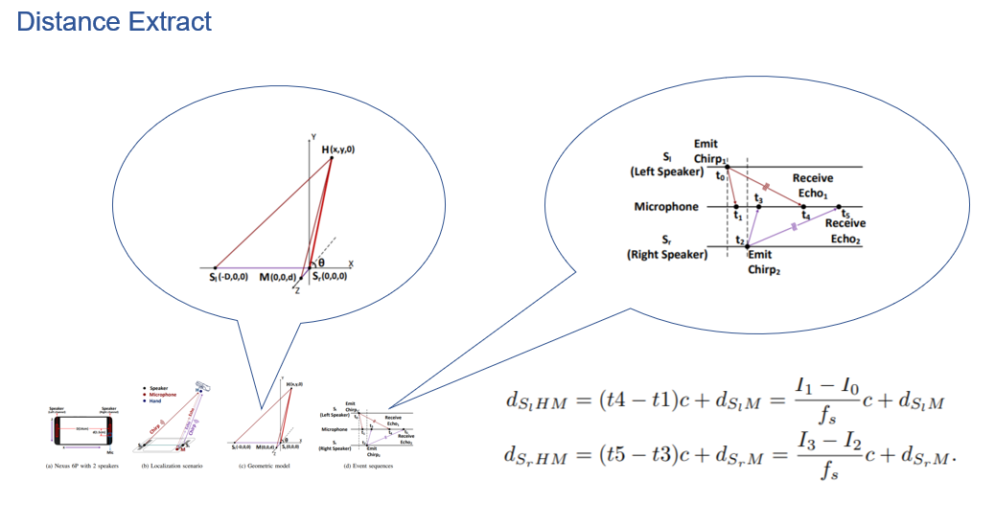
Coordinates Calculation

Slide 8
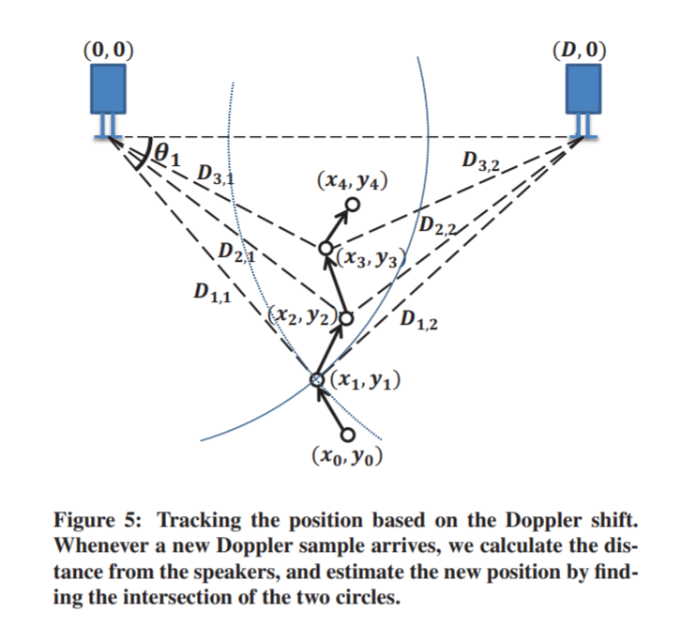
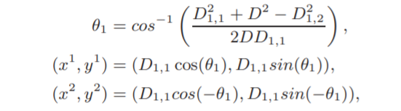
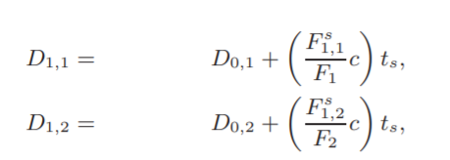
Doppler shift

Slide 9
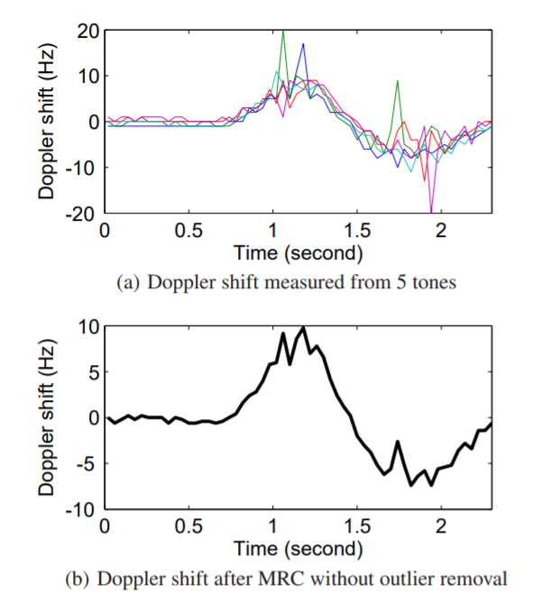
Doppler shift
One approach is to apply Maximal Ratio Combining (MRC) technique used in the receiver antenna diversity, which averages the received signal weighted by the inverse of the noise variance. It is known to be optimal when the noise follows a Gaussian distribution [5]. However, we ﬁnd some frequencies may incur signiﬁcantly higher noise than others, and it is important to remove such outliers before combining them using a weighted average. In our system, the Doppler sampling interval is 40 ms. [4]

Slide 10
Low-Latency Acoustic Phase (LLAP)
LLAP ﬁrst extracts the sound signal reﬂected by the moving hand/ﬁnger after removing the background sound signals that are relatively consistent over time. Second, LLAP measures the phase changes of the sound signals caused by hand/ﬁnger movements and then converts the phase changes into the distance of the movement. LLAP achieves a tracking accuracy of 3.5 mm and a latency of 15 ms on COTS mobile phones with limited computing power. For mobile devices with two or more microphones, LLAP is capable of 2-D gesture tracking that allows users to draw in the air with their hands/ﬁngers. [3]

Slide 11
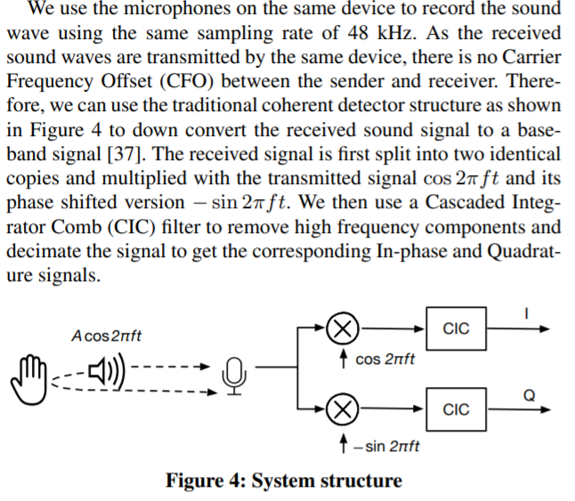
Low-Latency Acoustic Phase (LLAP)

Slide 12
3D tracking from 1D locations
we place four microphones at four corners of arec tangle. We have two pairs of microphones in the vertical position and the other two pairs in the horizontal position. Thus, by computing the intersection of all the resulting1D positions, we can compute the 3D location. [6]

Slide 13
Difficulty
Signal processing during long time. Because we aim to implement a real-time distance measurement application, too long a delay is not allowed.
Measurement accuracy cannot ensure. We are consider using OFDM [2] to improve Measurement accuracy.
For different smart phone the distance between speakers and microphone is also different. So portability also is a big question here.
The measurement processing part may be a difficult task to move into a smart phone.

Slide 14
References
[1] CHEN H, LI F, WANG Y. Echotrack: Acoustic device-free hand tracking on smart phones[C]//IEEE INFOCOM 2017-IEEE Conference on Computer Communications. [S.l.]: IEEE, 2017: 1-9.
[2] NANDAKUMAR R, IYER V, TAN D, et al. Fingerio: Using active sonar for fine-grained finger tracking[C]//Proceedings of the 2016 CHI Conference on Human Factors in Computing Systems. [S.l.]: ACM, 2016: 1515-1525.
[3] WANG W, LIU A X, SUN K. Device-free gesture tracking using acoustic signals[C]//Proceedings of the 22nd Annual International Conference on Mobile Computing and Networking. [S.l.]: ACM, 2016: 82-94
[4] YUN S, CHEN Y C, QIU L. Turning a mobile device into a mouse in the air [C]//Proceedings of the 13th Annual International Conference on Mobile Systems, Applications, and Services. [S.l.]: ACM, 2015: 15-29.
[5] G. Woo, P. Kheradpour, D. Shen, and D. Katabi. Beyond the bits: Cooperative packet recovery using physical layer information. In Proc. of ACM MobiCom, 2007.
[6] Wang A , Gollakota S . MilliSonic: Pushing the Limits of Acoustic Motion Tracking[J]. 2019.
[7] MAO W, HE J, QIU L. Cat: high-precision acoustic motion tracking [C]//Proceedings of the 22nd Annual International Conference on Mobile Computing and Networking. [S.l.]: ACM, 2016: 69-81.

Slide 15



