Slide 1
Location and Tracking Based on Acoustic Signal
11711613 王天麒
11712319 成为
11712421 叶冠辉

Slide 2
Abstract
Traditional tracking systems: energy-intensive and facing the risk of privacy leakage
Microphones and speakers are cheap, energy saving and have already been widely deployed (e.g., on smartphones)
With one microphone and two speakers on the smartphone, the speakers send ultrasonic signals with different frequencies and the microphones receive the signals reflected by the hand.

Slide 3
Related Work
EchoTrack[1]: FMCW signal
FingerIO[2]: OFDM
Low-Latency Acoustic Phase (LLAP)[3]
CAT[4]: Doppler shift

Slide 4
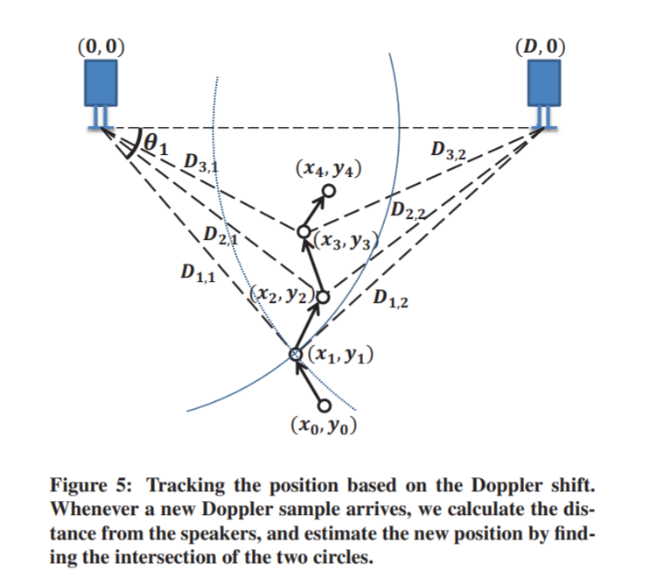
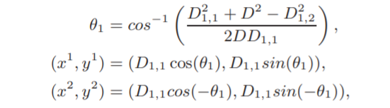
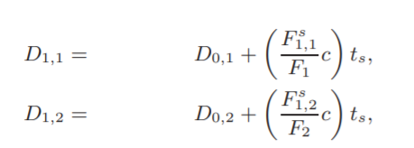
Doppler shift
Figure1[4]

Slide 5
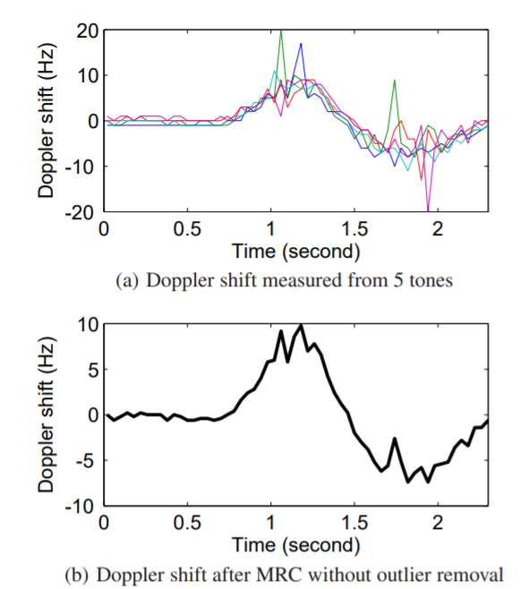
Doppler shift
Maximal Ratio Combining (MRC): averages the received signal weighted by the inverse of the noise variance.
Some frequencies may incur signiﬁcantly higher noise than others, and it is important to remove such outliers before combining them using a weighted average.
In the system, the Doppler sampling interval is 40 ms. [4]
Figure2 [4]

Slide 6
Low-Latency Acoustic Phase (LLAP)
For mobile devices with two or more microphones, LLAP is capable of 2-D gesture tracking that allows users to draw in the air with their hands/ﬁngers. [3]
extracts the sound signal by the moving hand/ﬁnger after removing the background sound signals
measures the phase changes of the sound signals
converts the phase changes into the distance of the movement

Slide 7
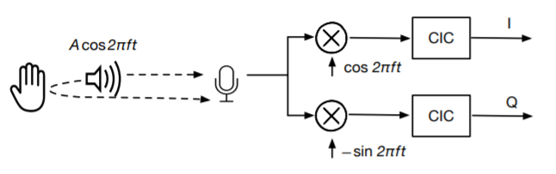
Low-Latency Acoustic Phase (LLAP)
As the received sound waves are transmitted by the same device, there is no Carrier Frequency Offset (CFO) between the sender and receiver.
use the traditional coherent detector structure as shown in Figure 3 to down convert the received sound signal to a baseband signal:
The received signal is split into two identical copies
multiplied with the transmitted signal cos2πft and its phase shifted version −sin2πft
use a Cascaded Integrator Comb (CIC) ﬁlter to remove high frequency components and decimate the signal to get the corresponding In-phase and Quadrature signals.
Figure3 [4]

Slide 8
3D tracking from 1D locations
we place four microphones at four corners of a rectangle. We have two pairs of microphones in the vertical position and the other two pairs in the horizontal position. Thus, by computing the intersection of all the resulting 1D positions, we can compute the 3D location. [6]

Slide 9
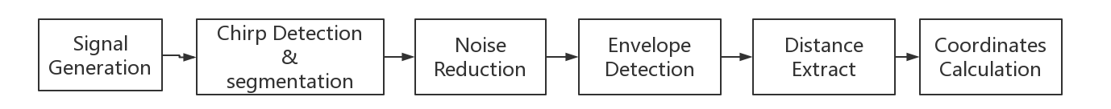
Work
We are objecting to implement a device-free hand tracking and location with Commercial-Off-The-Shelf mobile device(smart phone) and develop a simple distance and location measurement application in mobile phone.

Slide 10
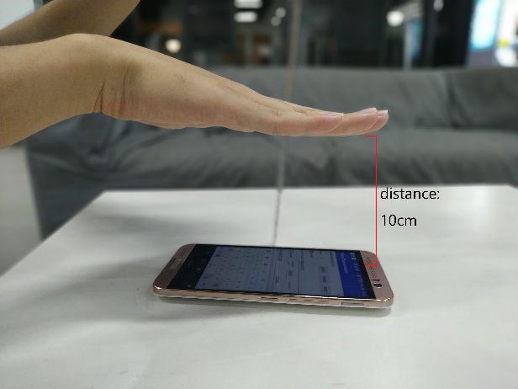
Work
In our current approach, we applying our experiment on a relatively open and quiet indoor environment. We transmit the chirp and record signal simultaneously. Since the signal we generate is suitable for echo detection with in 6m, we set our target(hand) near the device to ensure we can receive an clearly reflection.

Slide 11
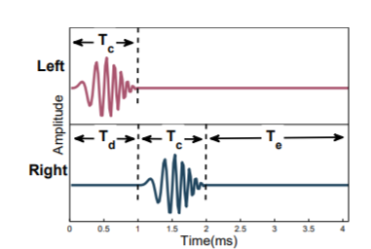


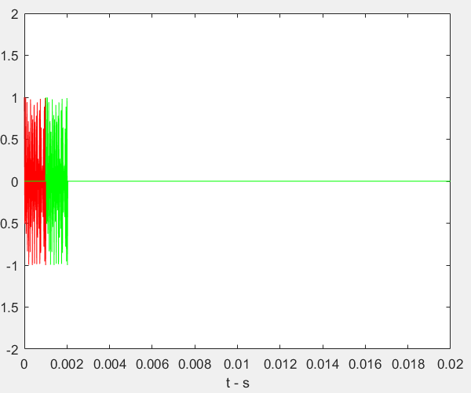


Signal generation
TDMA and FDMA
Figure4[1]

Slide 12
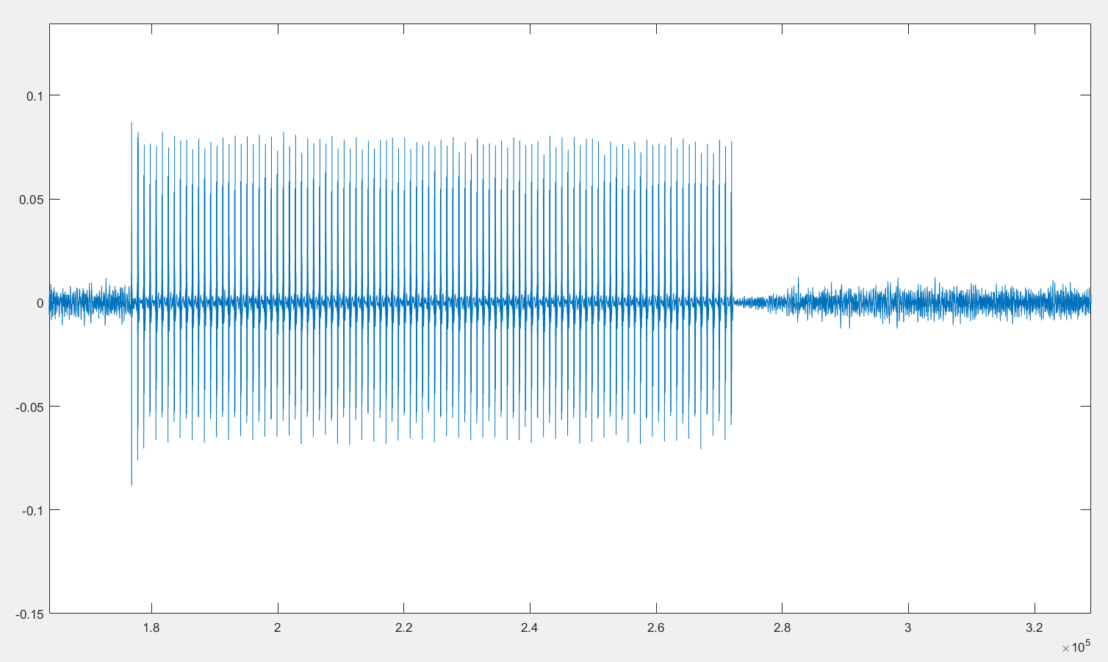
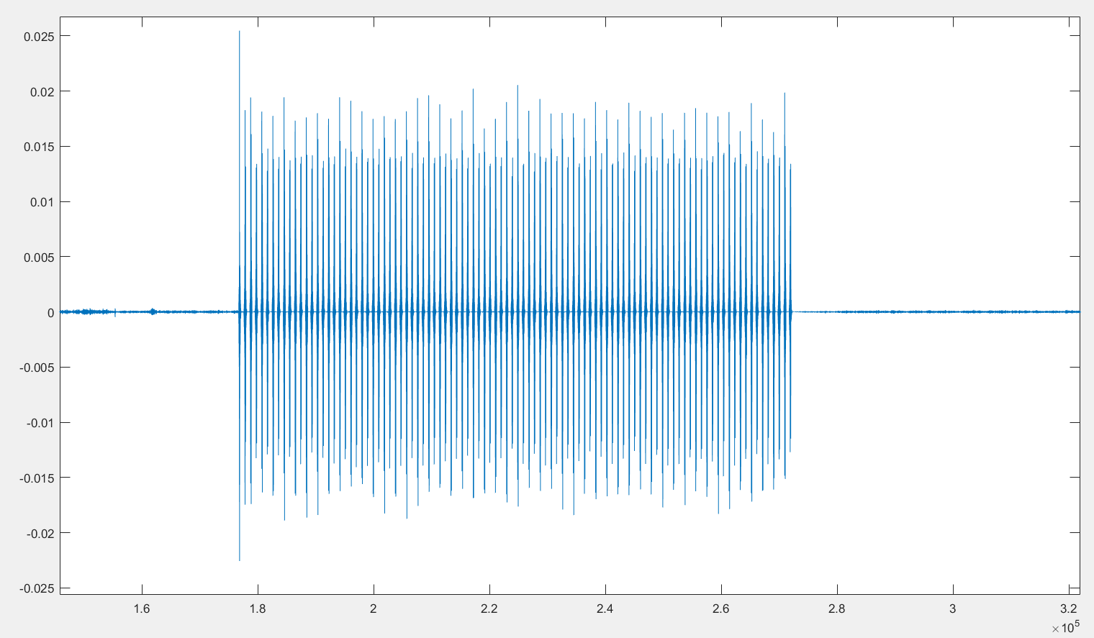
Noise Reduction
chirp’s echos are hiding in environment noise, so the sound should process though band-pass filter which reserve 16kHz to 23kHz. After that the most of noise has been eliminate.
Original signal
Signal though band-pass filter.

Slide 13
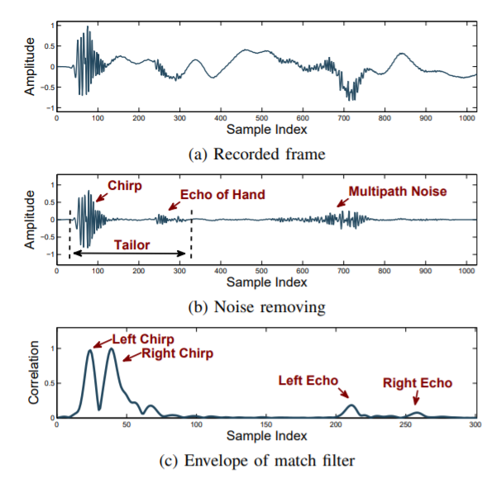
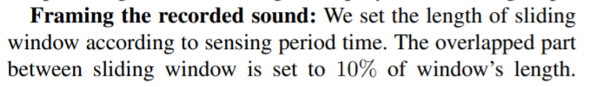



Match ﬁlter
Figure6 [1]
[1]

Slide 14
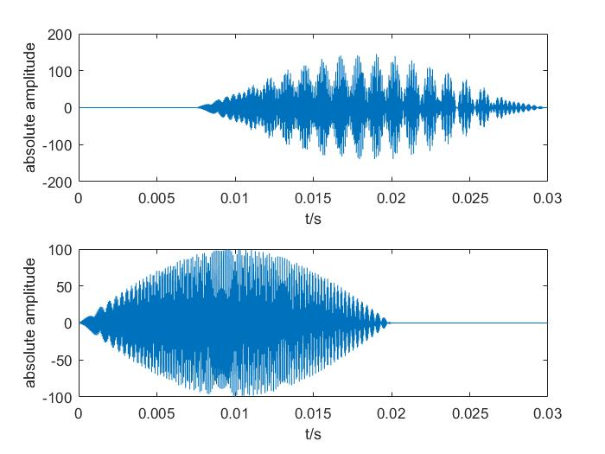

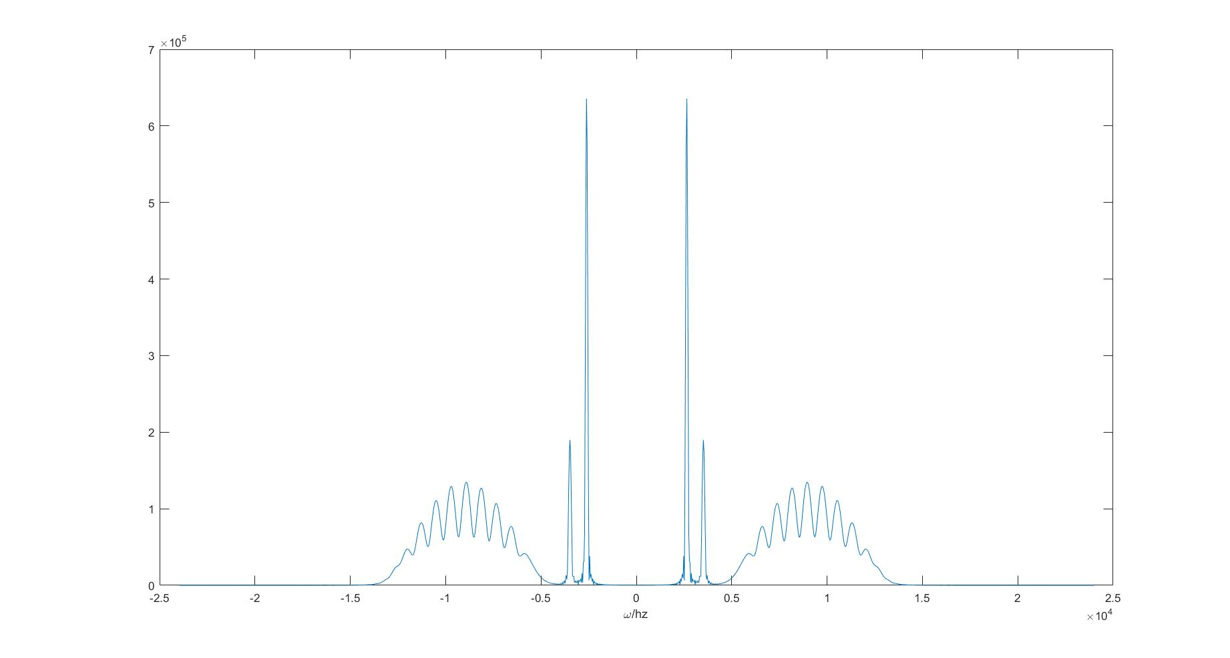


Dechirp
mixing the received signals with the pseudo transmitted signals and applying a similar procedure:
Rn: the distance between the transmitter and receiver during the n-th interval
fnp : the peak frequency of the mixed signals
c : the propagation speed of the audio signal
T : the chirp duration
B : the bandwidth of the chirp signal
Considering the above equations for two intervals, we can derive
If R1 is known, Rn can be determined based on:
original chirp and recived chirp with
time domain latency and echo
[7]
frequency domain after dechirp

Slide 15
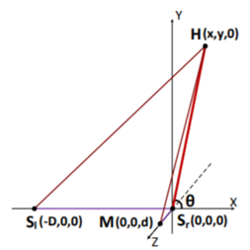
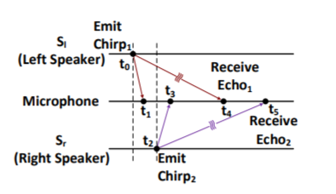
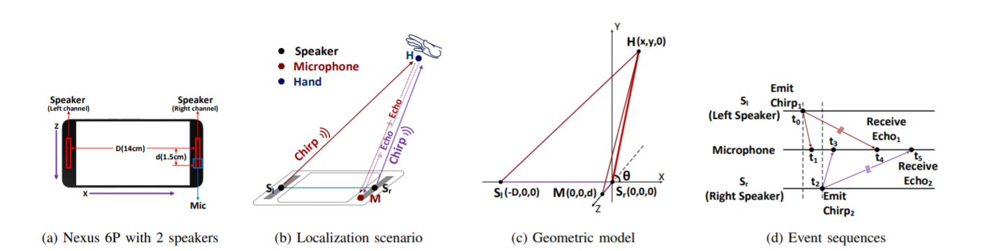
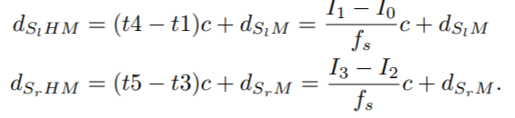
Distance Extract

Slide 16
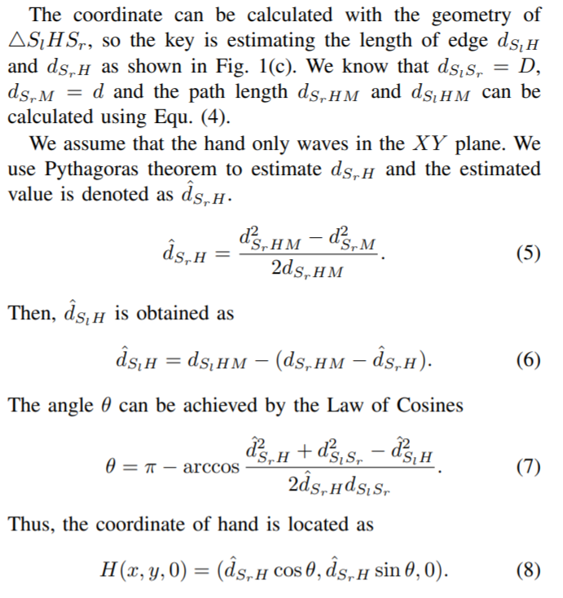
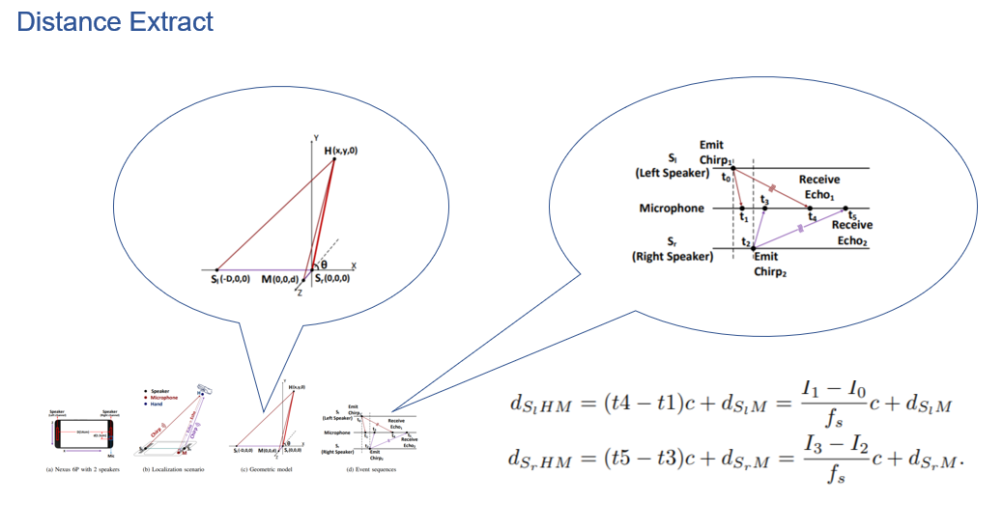
Coordinates Calculation

Slide 17
Progress
Now, we make our approach on dechirp method to distinguish the receive signal and echo signal. We are able to line up the receive signal periodically with the transmit signal to do efficient and stable echo track. Also, for each window, we are able to estimate the frequency difference between the direct received sound and echo sound.

Slide 18
Challenge
Signal processing during long time. Because we aim to implement a real-time distance measurement application, too long a delay is not allowed.
Measurement accuracy cannot ensure. We are consider using OFDM [2] to improve Measurement accuracy.
For different smart phone the distance between speakers and microphone is also different. So portability also is a big question here.
The measurement processing part may be a difficult task to move into a smart phone.

Slide 19
References
[1] CHEN H, LI F, WANG Y. Echotrack: Acoustic device-free hand tracking on smart phones[C]//IEEE INFOCOM 2017-IEEE Conference on Computer Communications. [S.l.]: IEEE, 2017: 1-9.
[2] NANDAKUMAR R, IYER V, TAN D, et al. Fingerio: Using active sonar for fine-grained finger tracking[C]//Proceedings of the 2016 CHI Conference on Human Factors in Computing Systems. [S.l.]: ACM, 2016: 1515-1525.
[3] WANG W, LIU A X, SUN K. Device-free gesture tracking using acoustic signals[C]//Proceedings of the 22nd Annual International Conference on Mobile Computing and Networking. [S.l.]: ACM, 2016: 82-94
[4] YUN S, CHEN Y C, QIU L. Turning a mobile device into a mouse in the air [C]//Proceedings of the 13th Annual International Conference on Mobile Systems, Applications, and Services. [S.l.]: ACM, 2015: 15-29.
[5] G. Woo, P. Kheradpour, D. Shen, and D. Katabi. Beyond the bits: Cooperative packet recovery using physical layer information. In Proc. of ACM MobiCom, 2007.
[6] Wang A , Gollakota S . MilliSonic: Pushing the Limits of Acoustic Motion Tracking[J]. 2019.
[7] MAO W, HE J, QIU L. Cat: high-precision acoustic motion tracking [C]//Proceedings of the 22nd Annual International Conference on Mobile Computing and Networking. [S.l.]: ACM, 2016: 69-81.

Slide 20



