Slide 1
EchoTrack实现进度报告
-EchoTrack: Acoustic Device-free Hand Tracking

Slide 2
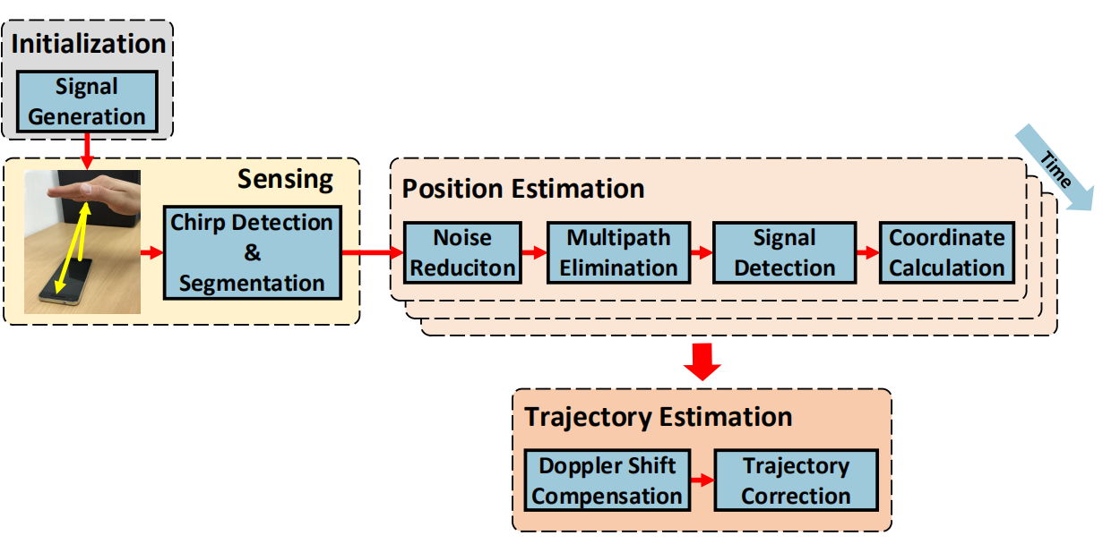
Initialization Stage:
The system generates the predesigned two-channel chirp, then initializes the microphone and speakers so that the microphone has been turned on before the speaker works.
Sensing Stage: The microphone continues to record the
sound while the speakers send the two-channel chirp peri-
odically. Then, the audio stream is partitioned into several
fragments including original chirp and its echo.
Position Estimation Stage:
This stage contains the following steps: noise reduction, multipath elimination, signal detection and coordinate calculation.
Trajectory Estimation Stage:

Slide 3
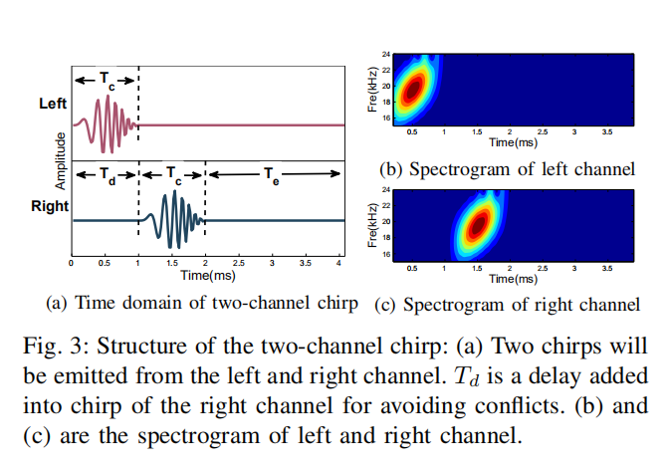
Initialization Stage
Signal Generation
commercial phone only can record the signal with frequency below 24kHz.
Background noise and human conversation, music and FM radio have frequencies up to 14kHz
16kHz to 23kHz

Slide 4
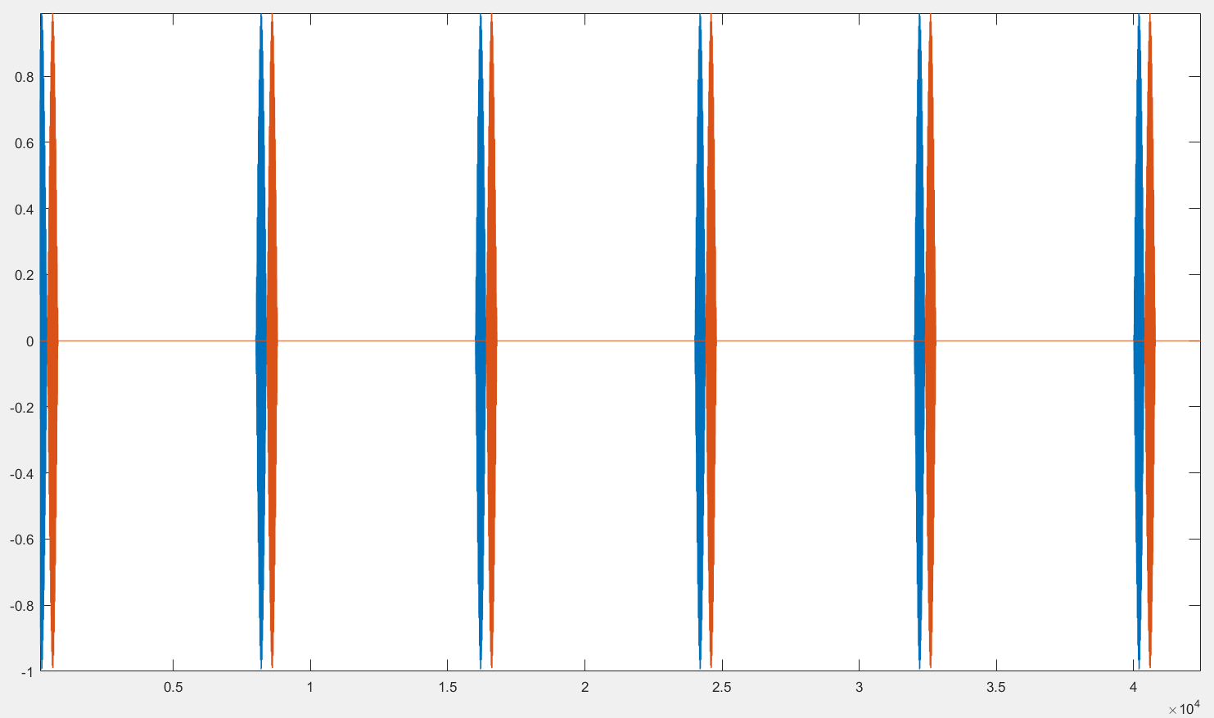
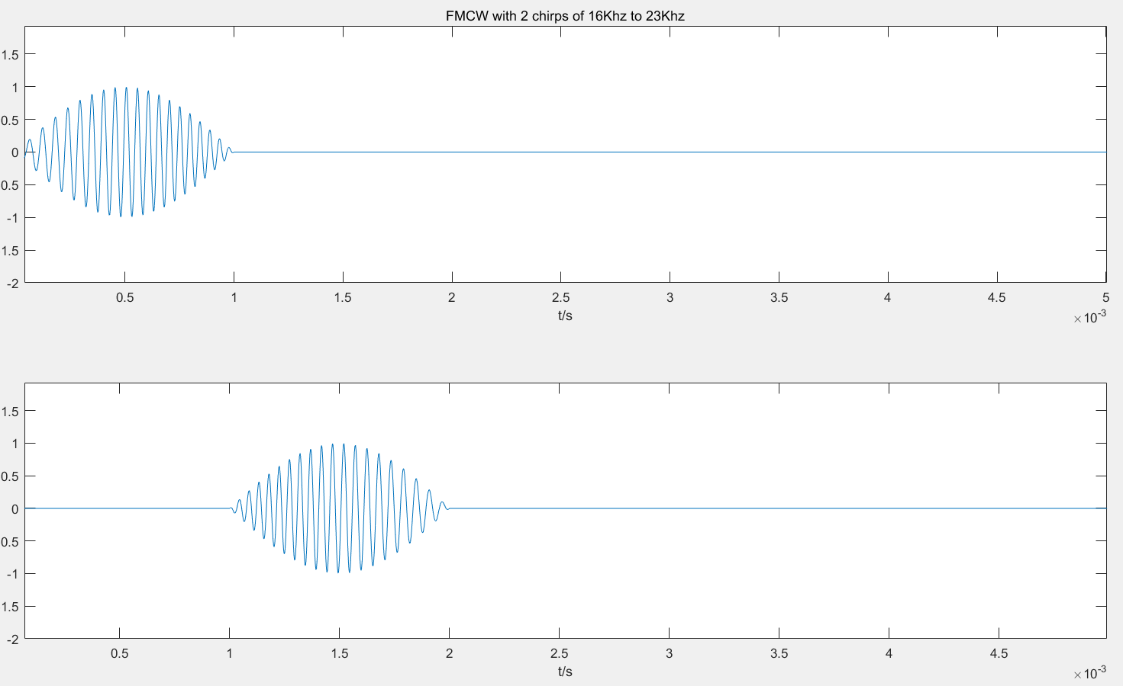
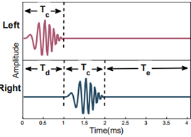
T = 20ms
每个声道发出的FMCW
持续时间 = 1ms
重复100次
生成2s的音频
Problem
没有设置两个信号间的delay Tc

Slide 5
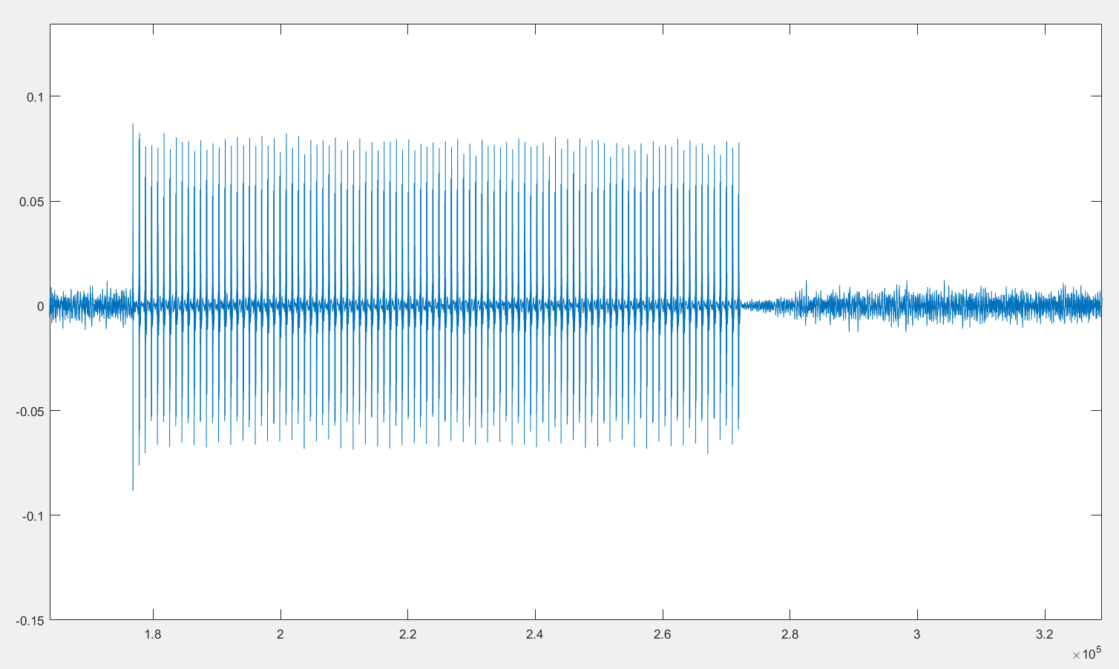
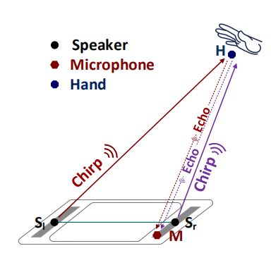
Receive Signal
Problem
生成的音频强度太大会使扬声器有蜂鸣声
接受的音频是双声道声音（使用的手机有4个mic）

Slide 6
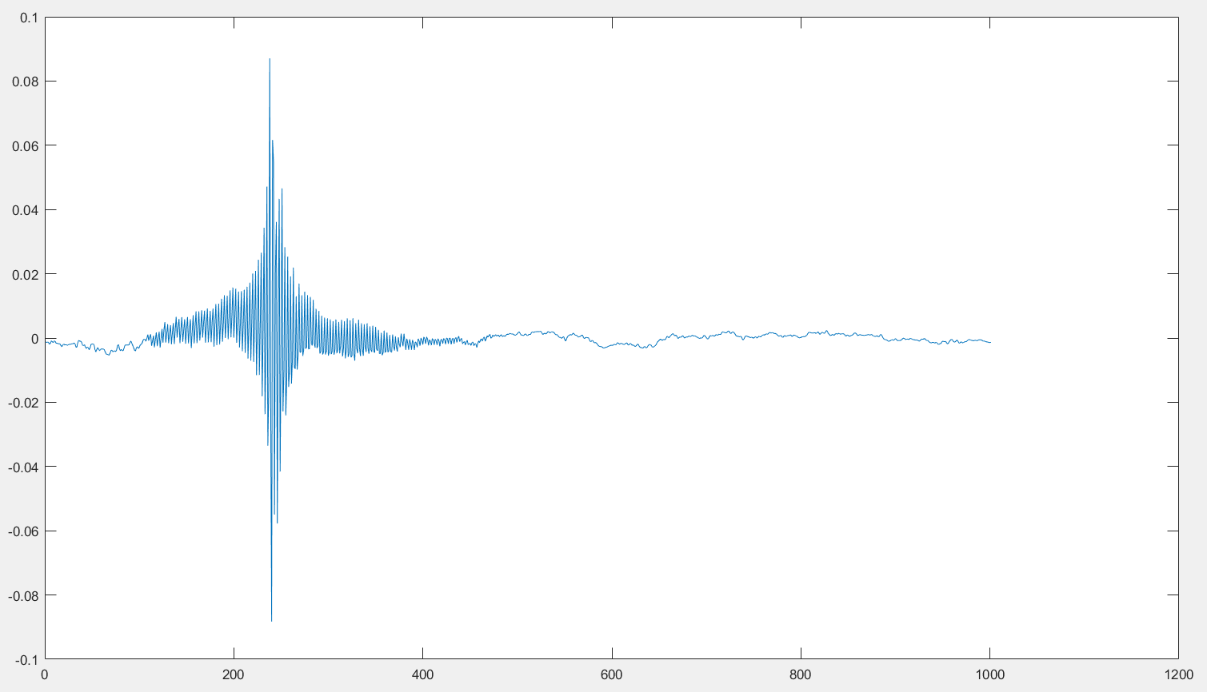
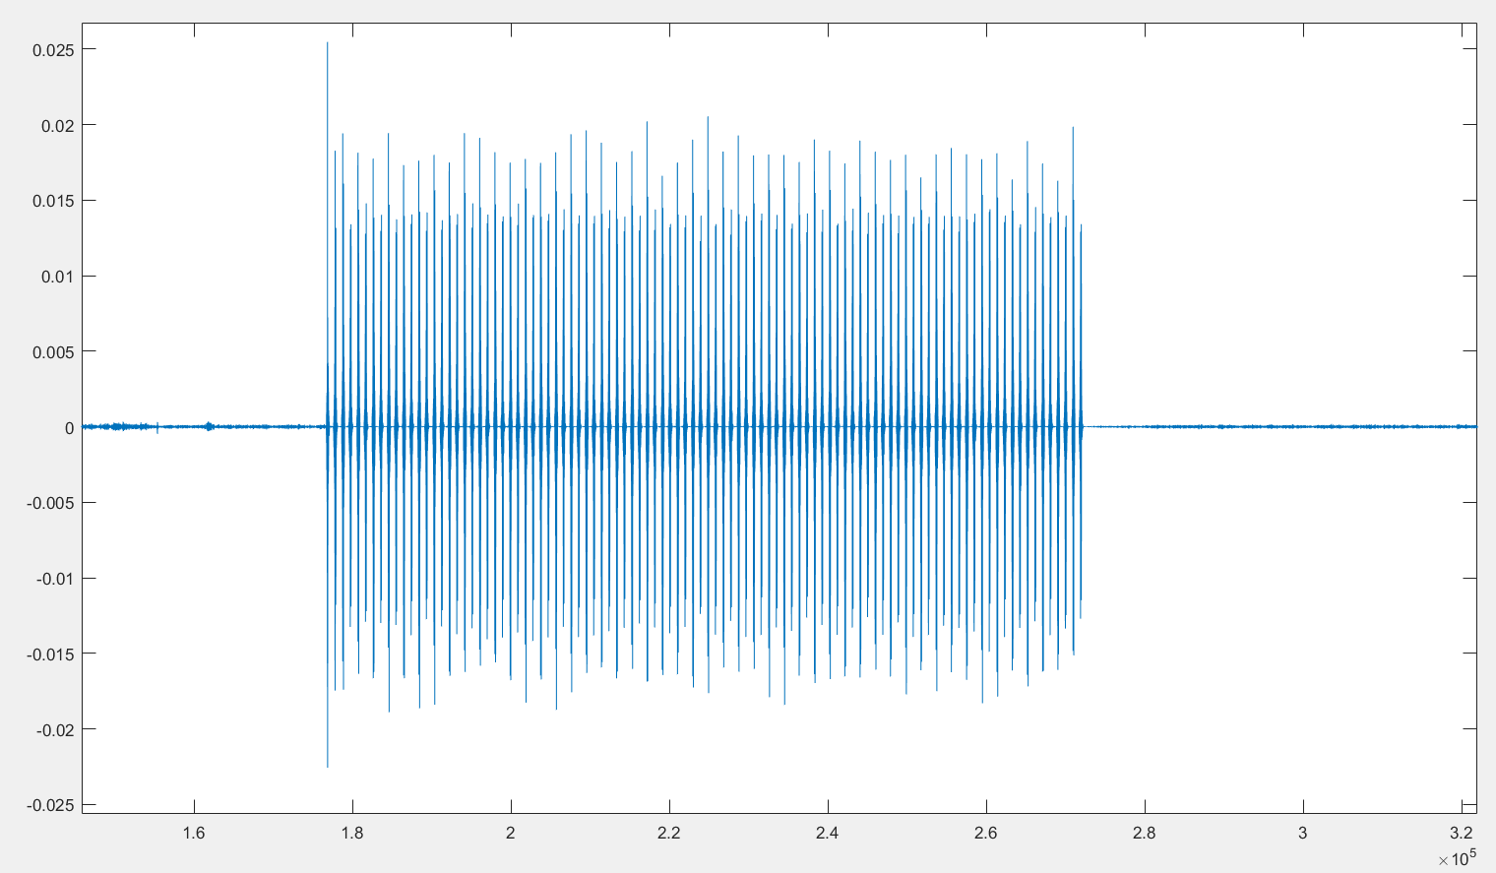
Filter out 16kHz to 23kHz
Problem
没有看见回声信号
分辨不出来两个speaker的信号

Slide 7
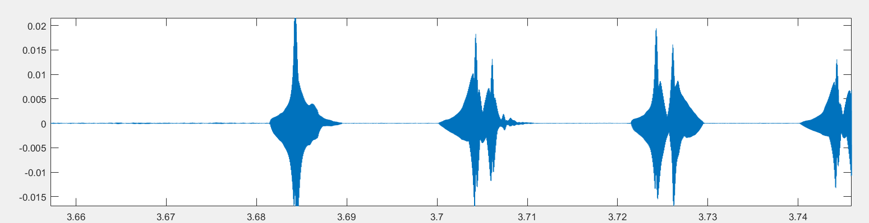
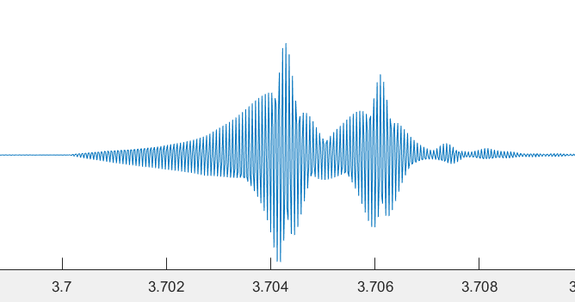
Receive Signal
滤波后有部分chirp的返回能隐约辨认出，但是回声的幅值远小于直接接收的幅值

Slide 8
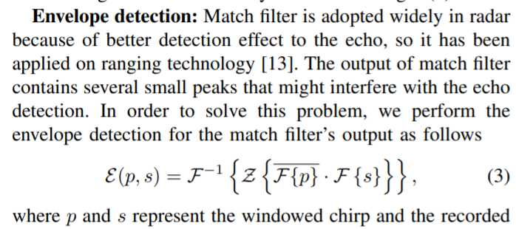
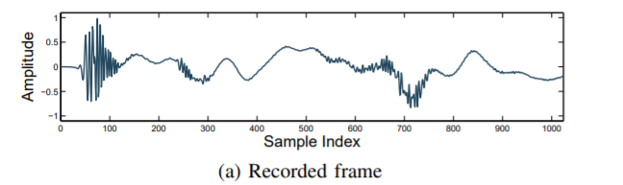
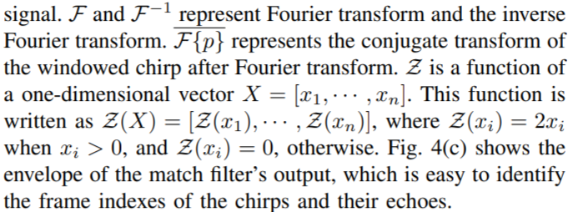
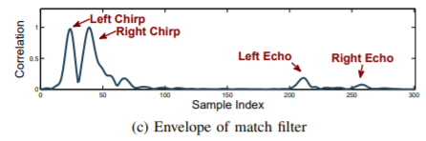
Envelop Detection
Problem:
难以找到哪里取出的包络线，并且匹配滤波器的输入不知道从哪来

Slide 9
Problem

Slide 10
Follow-on work
实现距离测量
1. 重新生成有时间间隔的双声道FMCW
2. 更换不同的手机尝试接受声音
3. 找到峰值

