Slide 1

CPU Scheduling Simulator
Mukunda Joshi and Eli Perchenok
CSE 4300 – Operating Systems

Slide 2
Overview
CPU Scheduling determines which process runs next on the CPU.
Goal: Build a simulator to compare algorithms using turnaround and waiting time.

Slide 3
Implemented Algorithms
In this project, we implemented four CPU scheduling algorithms:
• Shortest Job First (SJF)
• Shortest Remaining Time First (SRTF)
• Round Robin (RR)
• Priority Scheduling

Slide 4
Simulator Design & Structure
Written in C using structs to store process data
  Dynamic queues for Round Robin
  Calculates completion, turnaround, and waiting times

Slide 5
How the Program Works
User selects scheduling algorithm (SJF, SRTF, RR, Priority)
  User enters process arrival and burst times
  For Round Robin: user enters time quantum
  Program simulates scheduling order based on selected algorithm
  Computes completion, turnaround, and waiting times for each process
  Prints final results and averages to the terminal

Slide 6
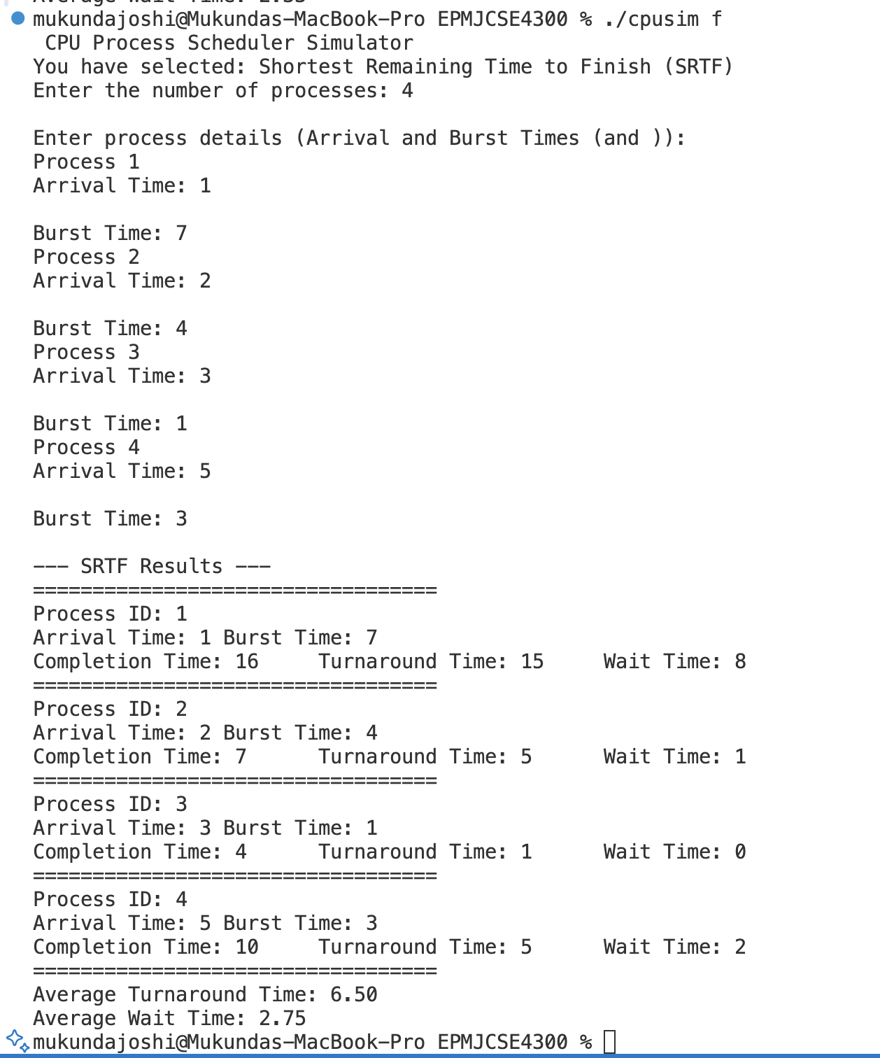
SRTF Output

Slide 7
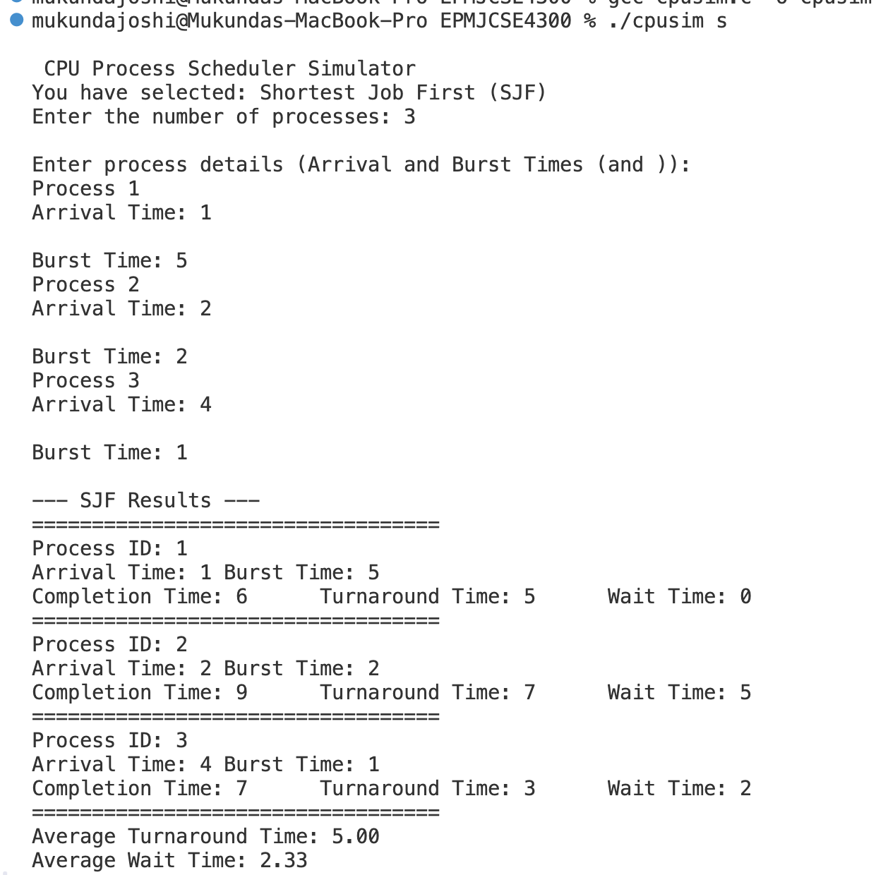
SJF Output

Slide 8
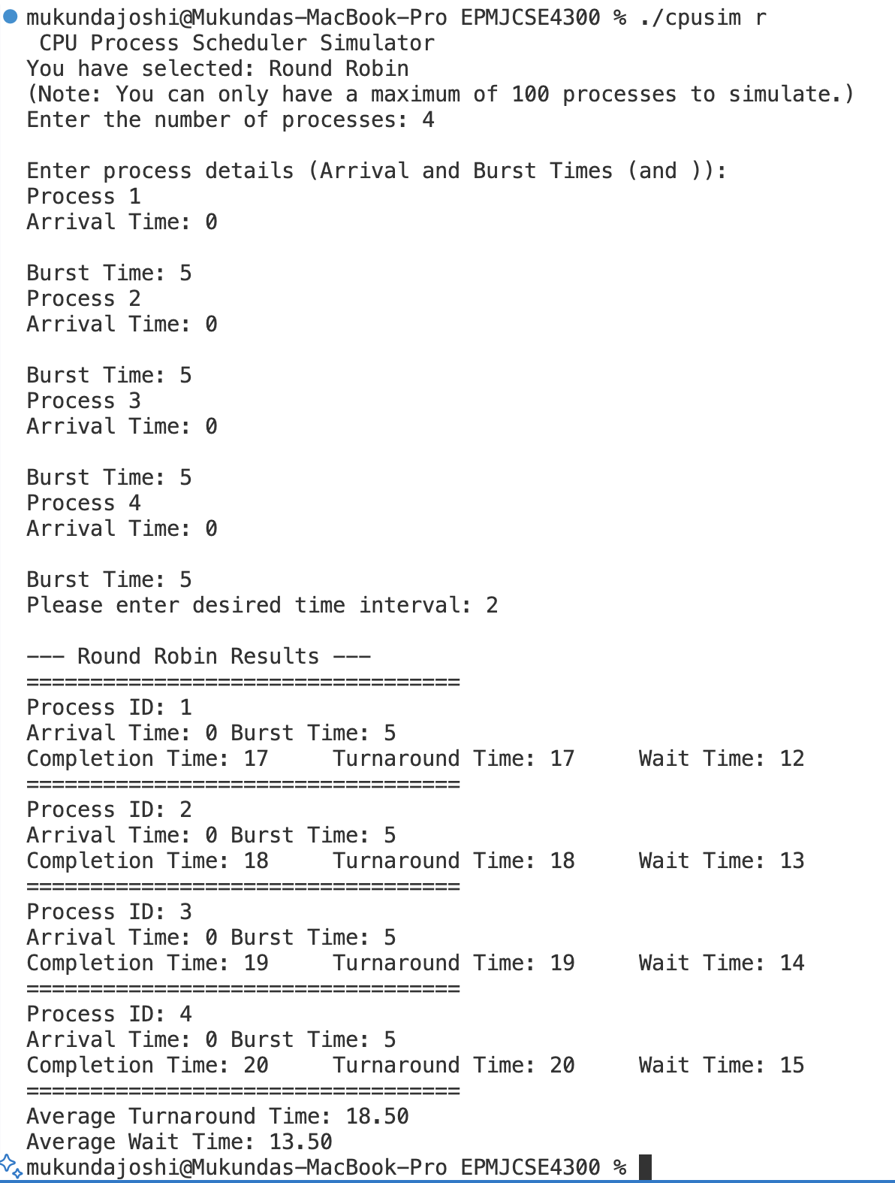
Round Robin Output

Slide 9
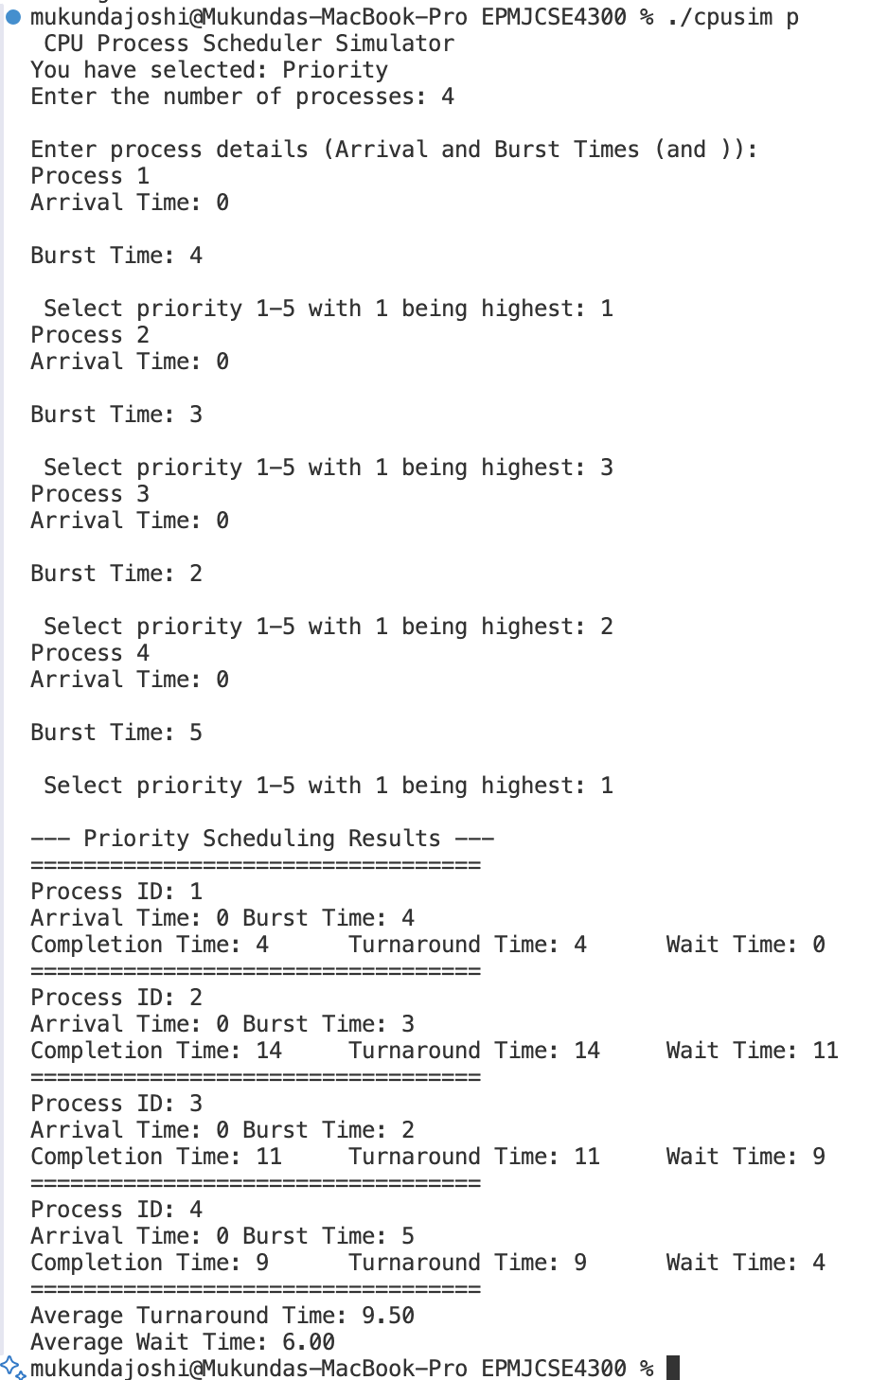
Priority Output

Slide 10
Conclusions & Key Takeaways
• Project Completed Successfully: Built a fully functional C-based CPU Scheduling Simulator implementing SJF, SRTF, Round Robin, and Priority Scheduling
• Understanding Trade-offs: Results highlight differences in waiting and turnaround times between preemptive and non-preemptive policies.
• Hands-On OS Experience: Strengthened understanding of process states, CPU bursts, preemption, and context switching.

