Slide 1
Principal Components Analysis
Paul Teggin

Slide 2
Contents
What is PCA?
Case study: yield curve data
Theoretical interlude
Applying PCA to the yield curve data
Applying PCA to the yield curve differences
Other uses of PCA

Slide 3
What is PCA?
Principal Components Analysis (PCA) is a technique to simplify high-dimensional data sets
It allows focus to be given to the most important elements of variation
The classic actuarial example is yield curve data
The complexity of modelling all the points on the yield curve can be reduced to a much smaller number of key components, typically 3
The degree of approximation involved is small
We’ll explain PCA using a case study

Slide 4
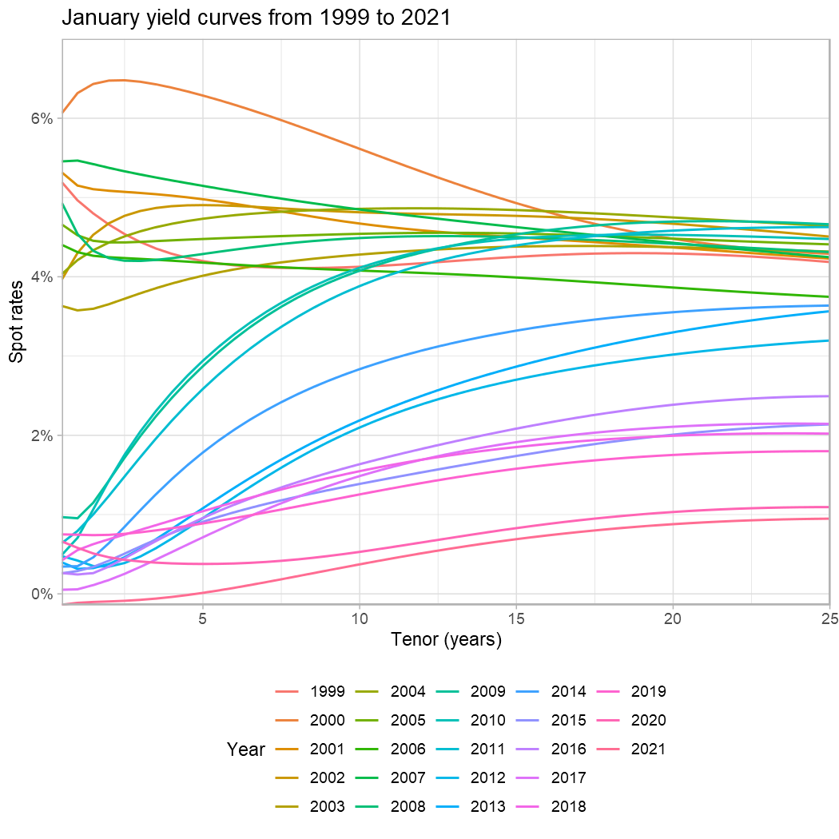
Data
Nominal gilt curves from the Bank of England
Continuously-compounded annual spot rates
Half-integral tenors (0.5, 1, 1.5, …)
Available on a monthly basis from January 1970
Data from June 1998 selected to reflect Bank of England independence being granted
Plot shows January yield curves to give a general sense of the data

Slide 5
Dimensionality
Each yield curve consists of 50 separate data points.
The data points can be thought of as existing in 50-dimensional space
The ‘co-ordinates’ associated with each dimension are the spot rates at each term
Thinking of a yield curve as a point in 50-dimensional space is complex and requires care over dependencies
The complexity comes from the sheer scale of trying to model all 50 dimensions
There are strong dependencies between spot rates at nearby tenors, and to avoid arbitrage opportunities, the 3-year rate (say) cannot be too far from the 2.5-year rate or the 3.5-year rate

Slide 6
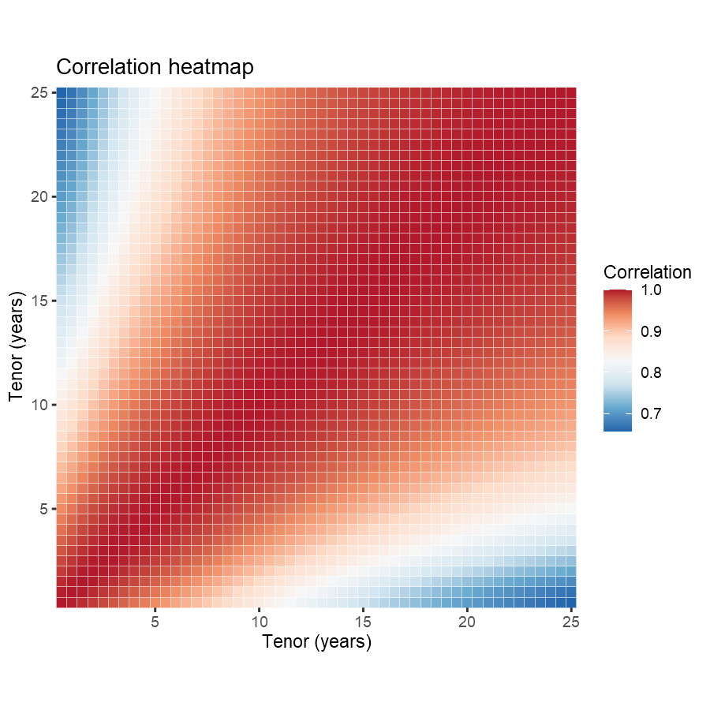
Correlation heatmap
The linkages between nearby tenors show up in significant linear correlations between spot rates of different terms
In the heat-map a large proportion of rates are near 100% (red), and all correlations are above c. 70%
Modelling all 50 points on the yield curve separately would entail modelling this complex dependency structure
This isn’t an insuperable obstacle but many firms prefer to avoid it

Slide 7
PCA is a dimension reduction technique
PCA allows us to simultaneously approximate the description of a yield curve so that it uses a smaller number of dimensions, and also recognise the relationships between spot rates of similar terms
PCA measures the degree of approximation using the ‘variability’ in the data set (to be defined shortly)
Modelling 100% of the variability will in general require all the dimensions to be used
But it is often possible to capture a very large proportion of the variability with a much smaller number of dimensions.
And the dimensions chosen reflect the dependency structure

Slide 8
Theory of PCA (1) - Notation
The yield curve data can be regarded as an $n×p$ matrix $X$
Rows are dates ($n$ = 272)
Columns are tenors ($p$ = 50)
More generally, any set of observations on variables can also be regarded as a matrix $X$
To simplify things, we normalise $X$ so each column has zero mean
For each term, deduct the average yield across all month-ends
We add the means back later on in the process

Slide 9
Theory of PCA (2) - Assessing Variability
Variability in the data set is assessed using the variance-covariance matrix of $X$
We deducted the mean of each column
So within a constant of proportionality the variance-covariance matrix is the ‘sum-of-squares’ matrix $X^{⊤}X$
This is a symmetrical square $p×p$ matrix (50 $×$ 50 in the case of yield curves)
Diagonal entries of $X^{⊤}X$ are proportional to the variance of each spot rate
Off-diagonal entries of $X^{⊤}X$ are proportional to covariances between spot rates of different terms
The covariances incorporate dependencies between spot rates

Slide 10
Theory of PCA (3) - Transform coords
Ideally it would be possible to find a new co-ordinate system (a transformation of the data matrix $X$) in which the covariances were zero
This would deal with the complex dependency structure
Furthermore, if the transformed covariances were zero, then the variability of the transformed matrix would consist only of the variances of the new co-ordinates
Thus there would only be 50 transformed variances to deal with, rather than a 50 $×$ 50 matrix with variances and covariances
This would allow focus to be given more easily to the areas of highest variance

Slide 11
Theory of PCA (4) - Eigendecomposition
Transforming to a system with zero covariances can be achieved by using the eigenvalues and eigenvectors of $X^{⊤}X$
The eigenvalues $λ$ and the eigenvectors $v$ of a matrix $A$ are solutions to the equation $Av=λv$
The key property of eigenvalues and eigenvectors we need for PCA is that we can write diagonalise $X^{⊤}X$ by writing $X^{⊤}X=PDP^{−1}$
$D$ is a diagonal matrix of $p$ eigenvalues $λ_{1}≥λ_{2}≥…≥λ_{p}≥0$
$P$ is a square matrix of $p$ eigenvectors
$P_{i}^{⊤}P_{j}=0$ when $i≠j$, which corresponds to zero linear correlation
Eigendecomposition requires statistical software (or VBA in Excel)

Slide 12
Theory of PCA (5) - Rotation
The matrix of eigenvectors $P$ establishes a rotated co-ordinate system.
$P$ is orthogonal, meaning $P^{−1}=P^{⊤}$
Orthogonal matrices are generalisations of rotations to high-dimensional space
The co-ordinates of each data point in the rotated system are given by the matrix $XP$, called the scores matrix
The term ‘score’ is introduced to avoid confusion between the original and rotated co-ordinates of a data point
We have eliminated the complex dependency structure we saw in the heatmap earlier
The eigenvectors (the columns of $P$) are linearly uncorrelated with each other in the rotated co-ordinate system

Slide 13
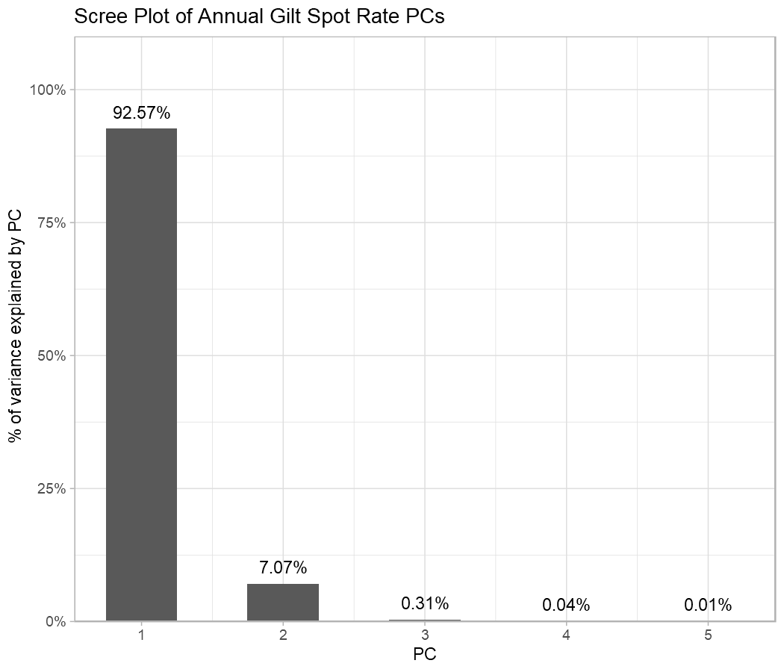
Scree plot - eigenvalues
The eigenvalues measure the variance along each transformed co-ordinate axis, and are in descending order of variability
A good approximation should be obtained by using only a few transformed dimensions.
A scree plot shows the proportion of overall variability explained by each PC
3 PCs explain over 99.9% of the variance
Further PCs would add very little explanatory power

Slide 14
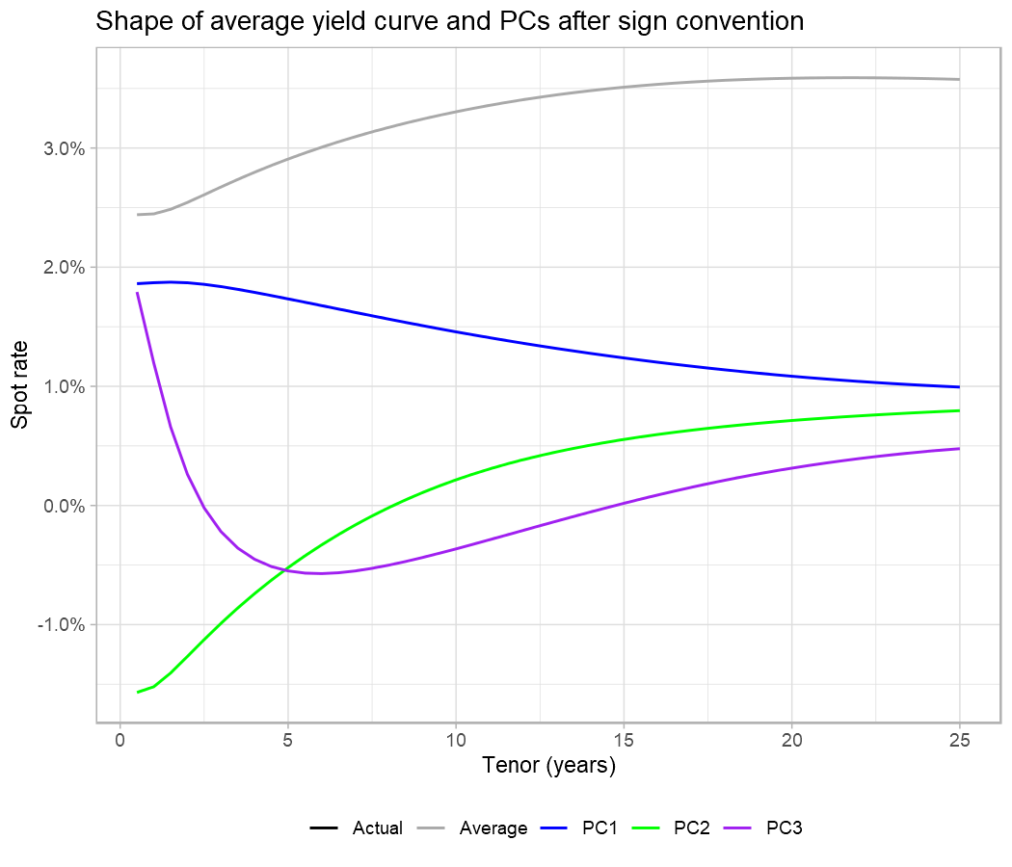
Shape of PC curves - eigenvectors
The chart shows the shape of the first 3 principal components (PC1-PC3), along with the average yield curve.
On average, yields have been 2.5% at the short end, rising to a little over 3.5% at the long end
PC1 is a shift: yield curve variation primarily arises from increases across the curve
PC2 is a twist in the curve
PC3 has what is sometimes called a ‘butterfly’ shape

Slide 15
Yield curve approximation
The scores represent a new co-ordinate system for yield curves
We are no longer thinking about a yield curve as being an amount of a 1-year rate, an amount of a 1.5 year rate, etc, up to 50 dimensions
Now we think of it as a score applied to the shift, another score applied to the twist and a further score applied to the curvature
It is also necessary to add back the average yield curve, which was deducted at the start when the matrix $X$ was normalised
The PC scores and PC curves combine to give an approximation of each yield curve. For example, at 30 June 1998, the scores were:
PC1: 1.86, PC2: -0.504, PC3: 0.486
On the next slide we build up the yield curve from these scores

Slide 16
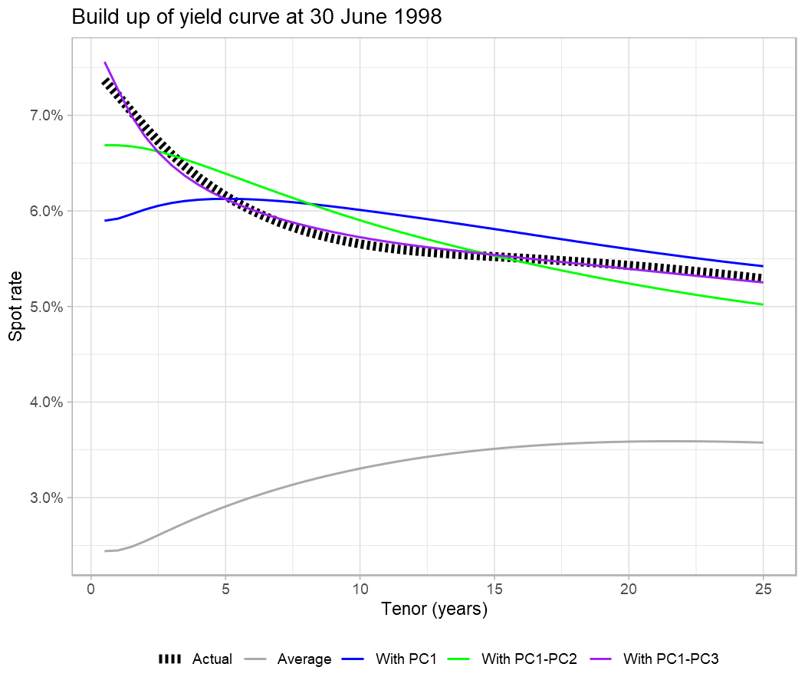
Building up the yield curve from the PCs
Multiplying the transposed PC1 vector by the score of 1.86 and adding back the average gives the blue curve labelled ‘With PC1’ in the chart
This is at about the correct level on average, but has the wrong shape
Once the PC2 vector is brought in the curve is reasonably close to the correct shape
Including PC3 is a refinement that makes it even closer

Slide 17
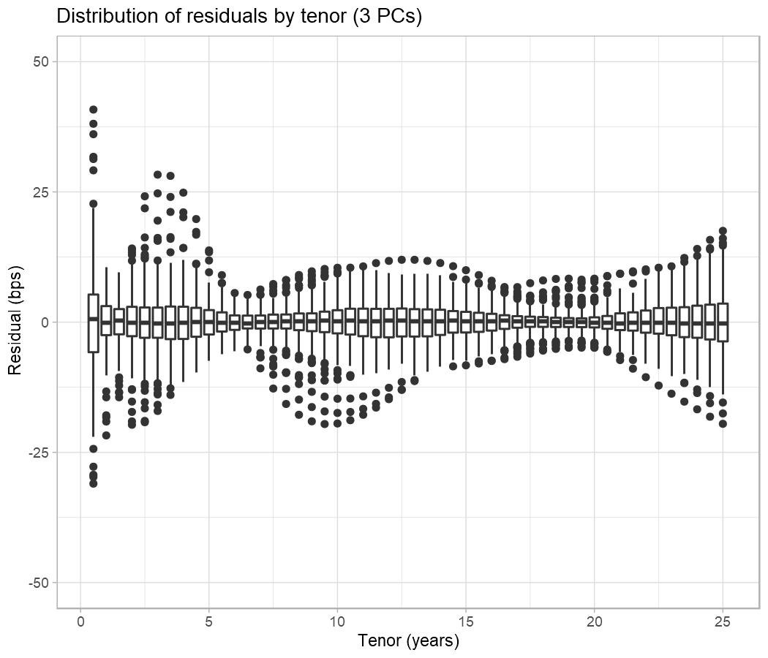
Residuals with 3 PCs
The curve based on 3 PCs at 30 June 1998 was pretty close to the actual yield curve
Put differently, the residuals (actual - modelled) were small across all tenors
The boxplot shows the distribution across all dates of residuals by tenor
The vast majority of residuals are very small but at some dates they are a little higher

Slide 18
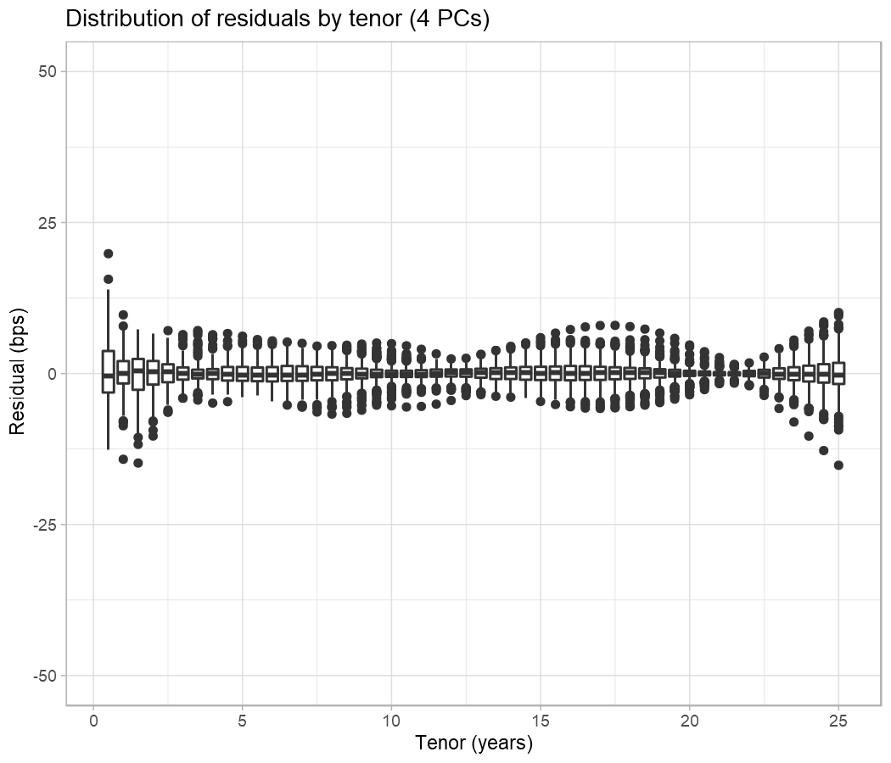
Residuals with 4 PCs
Adding a fourth principal component reduces the residuals
But the fourth PC explains a tiny additional proportion of the overall variability
On balance the additional complexity is not worth the additional accuracy

Slide 19
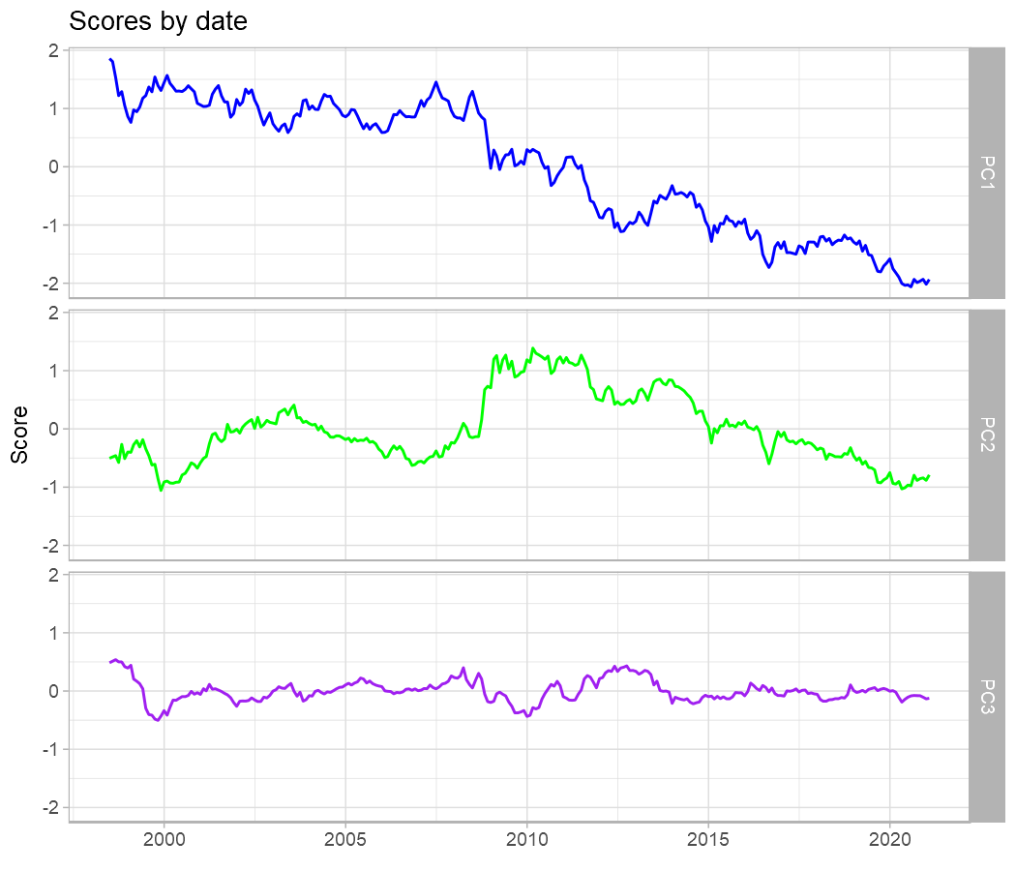
Plotting PC scores at each date
The chart shows the scores at each date
The PC1 series indicates that yield curves generally fell over the period
The PC2 series indicates that yield curves became ‘twisty’ during the credit crisis and gradually became less twisty over the following several years
PC3 is harder to interpret intuitively but again there was some volatility around the time of the credit crisis

Slide 20
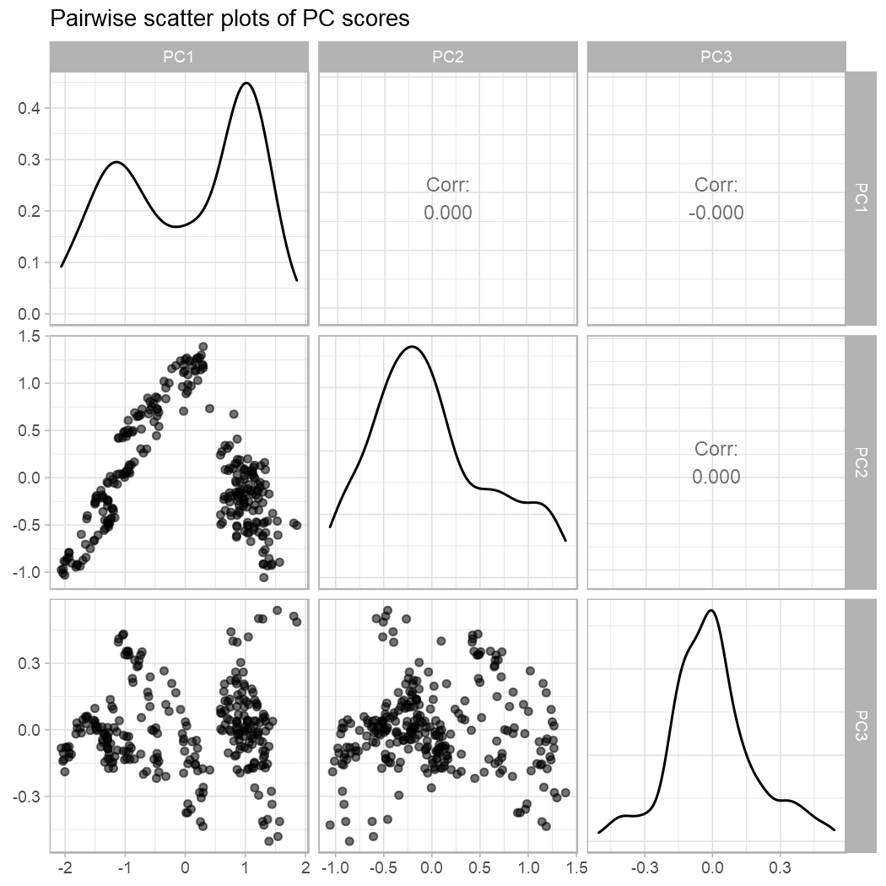
Scores are uncorrelated
The scores are uncorrelated by construction as can be seen in the linear correlations in the upper triangle
Uncorrelated does not imply independent, and the dependency structure is visibly a long way from independence
For example there are two clear ‘zones’ in the PC1/PC2 plot (and the PC1 density is bimodal)
These zones can also be glimpsed in the line plots in the previous slide

Slide 21
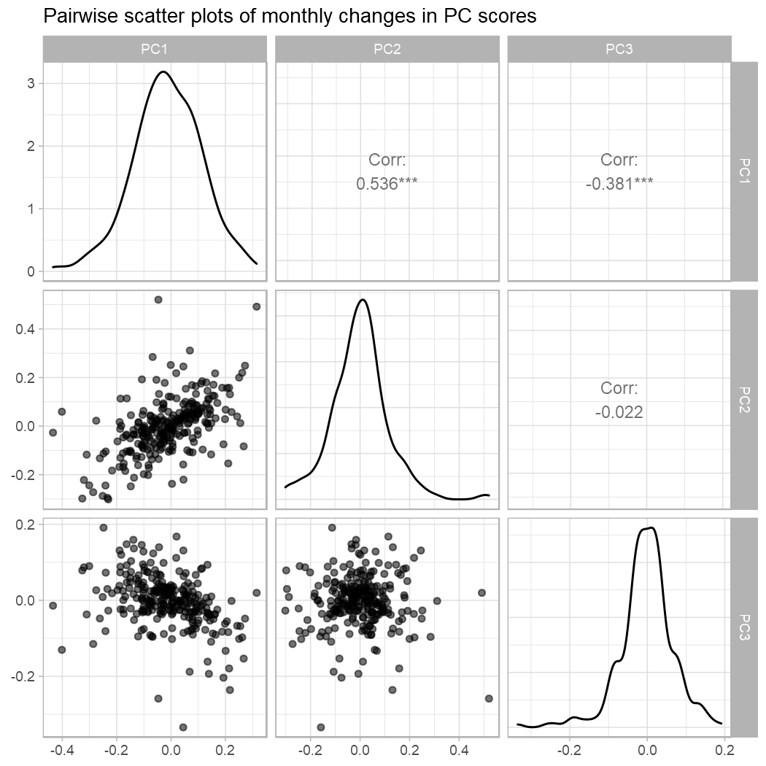
Changes in scores are correlated
For many modelling purposes (e.g. IM, stress testing) we want to work with changes in scores
Just because the scores are uncorrelated does not mean the same applies to changes in scores
In general the changes are correlated - here monthly changes in PC1/PC2 are over 50% correlated, for example
(In the early days of S2 IM development at least one - nameless! - insurer got this point wrong)

Slide 22
Applying PCA to yield curve differences
Several firms take annual overlapping movements in month-end yield curves prior to applying PCA
The input to PCA is then changes in yield curves, rather than the yield curves themselves
The ‘change’ step is at the beginning of the process, rather than after the scores have been calculated
Distributions can be fitted to these scores, and stresses derived for shifts, twists and ‘butterflies’ up and down
The scores are linearly uncorrelated by construction so there is no need to calibrate a dependency structure among the changes, as there was in the case where PCA was applied to the yield curves themselves

Slide 23
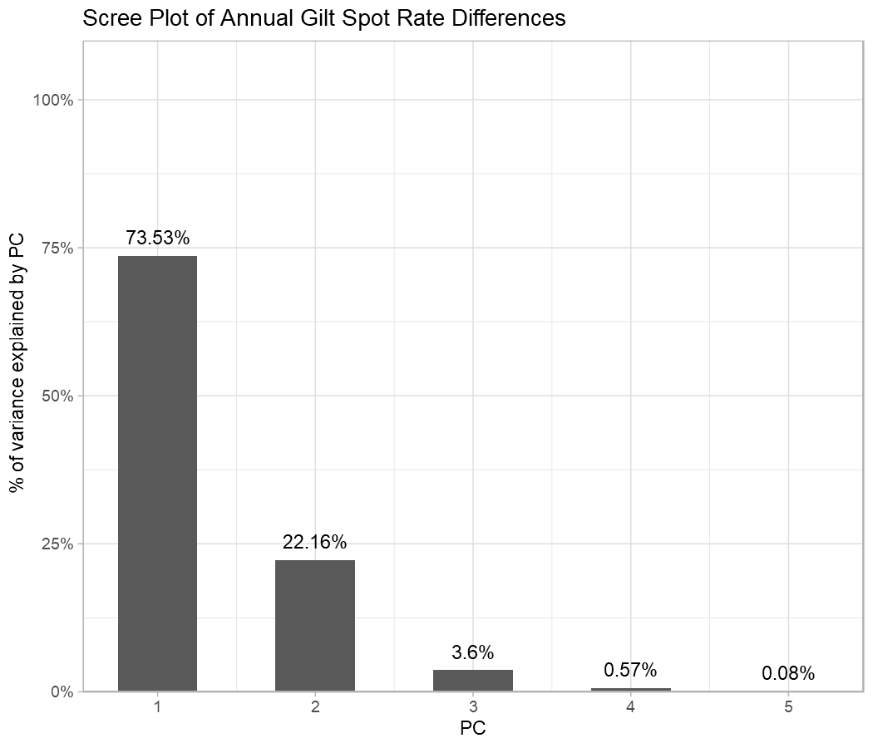
Scree plot of differenced yield curves
After taking monthly overlapping annual differences, PC1 has less explanatory power and PC2 and PC3 have more
3 PCs explain over 99.2% of the variance
This is a little smaller than with yield curves as such, but still very substantial

Slide 24
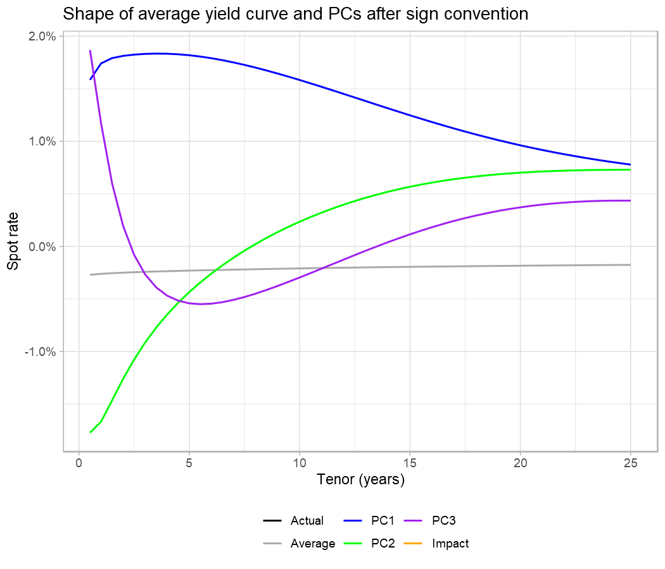
Shape of differenced PC curves
A sign convention and scaling have been applied to align visually with the earlier chart on yield curve PCs
On average, yield curves do not change much over the course of a year, but have tended to reduce slightly
The shapes of PC1, PC2 and PC3 are qualitatively similar on differenced curves to those on undifferenced curves seen earlier

Slide 25
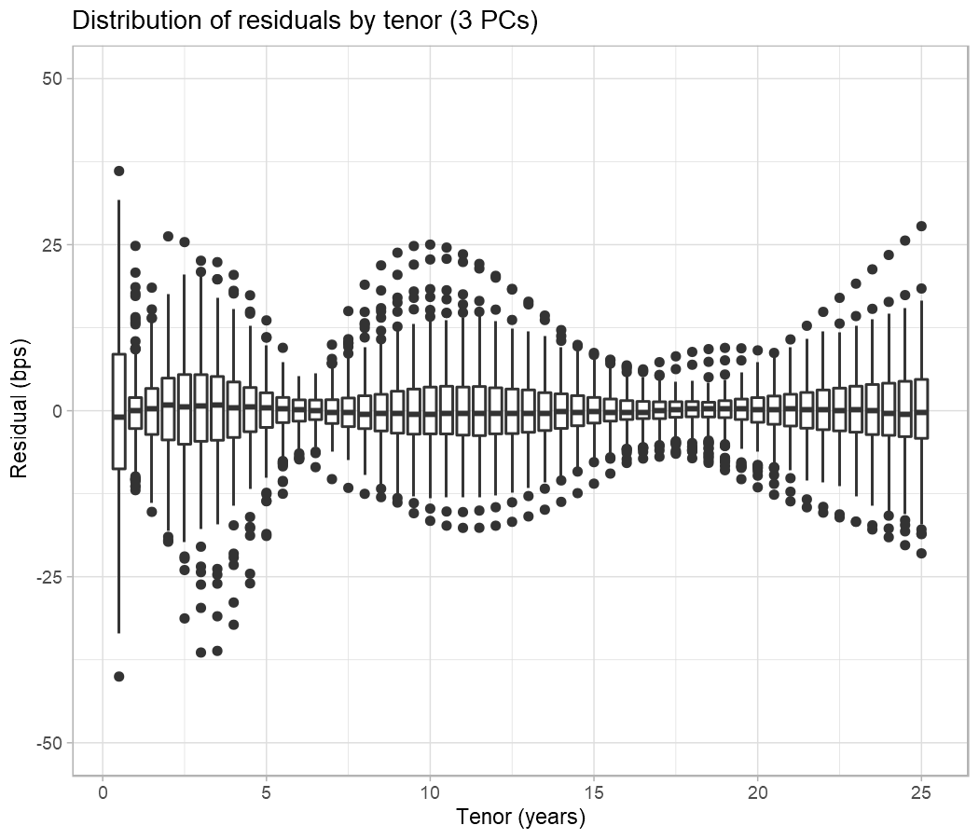
Residuals with 3 PCs (differenced)
Again the residuals are small across all tenors with some outliers
The 3 PCs on the differenced curves explain slightly less variability than before
So the residual distributions are a little wider

Slide 26
Other uses of PCA
Yield curve modelling is the classic actuarial example
It has also been applied to model credit transition matrices
Think of an 8x8 transition matrix as a ‘curve’ with 64 elements
Or even to simplify 8x1 rows for individual ratings
And to identify issues with correlation assumptions
Moving beyond actuarial work, PCA is used widely, for example:
computer vision - think of a square array of pixel values as laid out in a very long ‘curve’
in particular facial recognition - the eigenvectors here are called ‘eigenfaces’ (yes, really)
it is also used to reduce dimensionality before applying other data science techniques

Slide 27
And finally
The whole of this presentation was produced using R Markdown
R code to perform the analyses and produce the charts was interwoven with the presentation text
The charts are produced using ggplot2, an extremely powerful and well-designed visualisation system
The equations are written using LaTeX syntax and converted automatically to Equation Editor format
The .pptx file is automatically output from R Studio
Similar functionality can produce Word documents and interactive web pages
Happy to present on this at a future session if there is interest

