Slide 1

An In-Depth Look at Avocado Sales
U.S. Avocado Industry: 2015-2021 Study

Slide 2
The Study's Questions and Assumptions.
Study Design and Data Analysis
Technical Obstacles and Solutions
Price and Volume Trends in Avocado Sales
Agenda
Avocado Sales across Different Regions
Product Preference
Market Image?
A Closer Look at Avocado Sales Trends
New Metric: Purchasing Power
Key Findings

Slide 3
Questions and Assumptions.
Can price impact the volume (quantity)?
Hypothesis: yes, the price impacts the volume and vice versa
Which areas consumed avocados the most from 2015 to 2021?
Hypothesis: mostly the highly developed areas because of the vegetarian and vegan trends
The plu4770 being the biggest Hass variety, is it also the one consumed the most?
Hypothesis: yes because the consumer tends to go for the cleanest, the most beautiful, the biggest product.
Is the trend in the most consuming city an image of the general trend in the U.S?
Hypothesis: yes

Slide 4
Study Design and Data Analysis
Data tables downloaded from hassavocadoboard.com (primary source)
Formatted, compiled and cleaned in one single dataset.
The columns AveragePrice, TotalVolume, Year, Region, the different plu codes will be considered to answer our questions
Statistical inference and graphical visualization will be employed
Back to Agenda Page

Slide 5
Technical Obstacles and Solutions
The dataset being clean enough, we have missing values in the “bags” column so they won’t be considered.
Problem with the ‘region’ field: there are not only cities but also whole region of the United States such as TotalUS, California, SouthCentral, NorthEast so they’ll have to be put separately
Back to Agenda Page

Slide 6
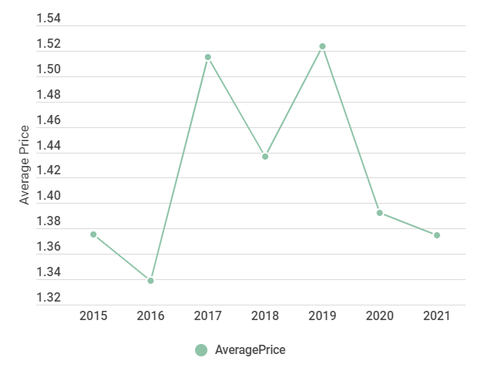
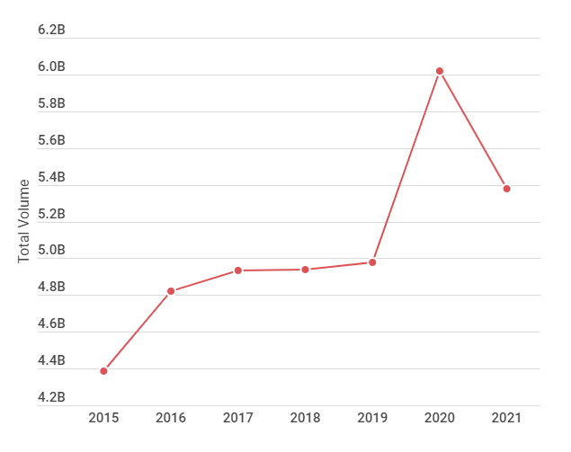
Price and Volume Trends
Aside from the price decrease from $1.5 to $1.3 from 2019 and 2020 which also showed an increase of 1 billion in sales, there are not strong correlations between the price and volume.

Slide 7
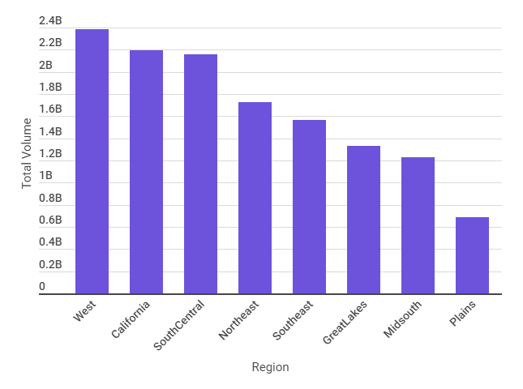
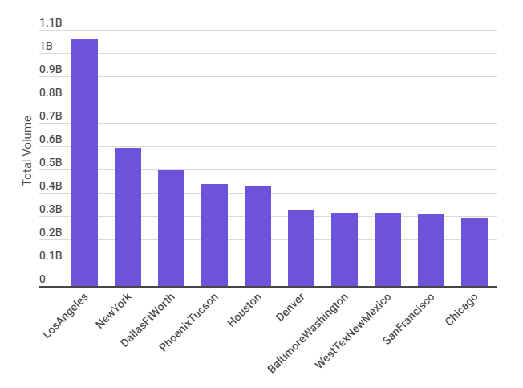
Avocado Sales across Different Regions
Looking at the cities, we see Los Angeles, New York, Houston, Denver, San Francisco, Chicago as the cities who consume the most.

Slide 8
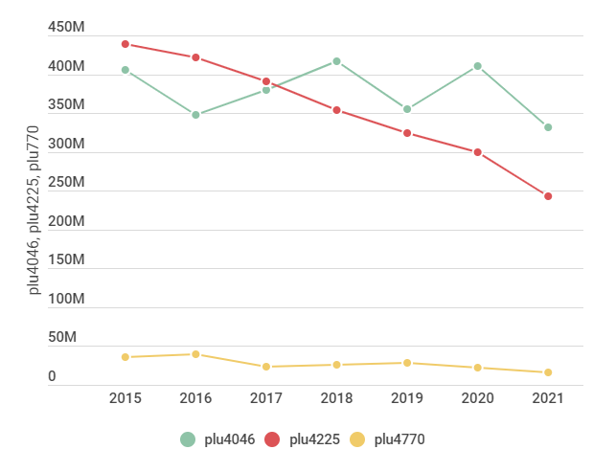
Product Preference
The most popular avocado variety is the plu 4045, the small size avocado

Slide 9
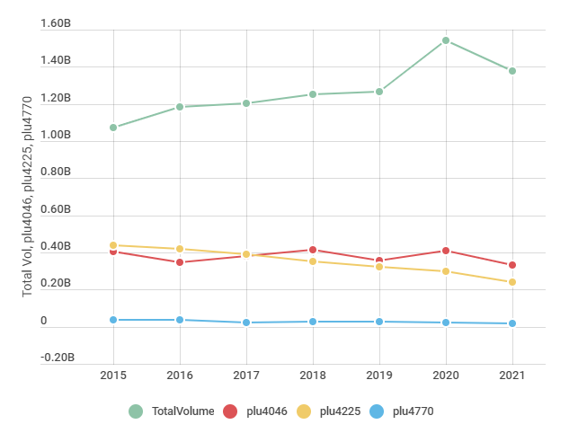
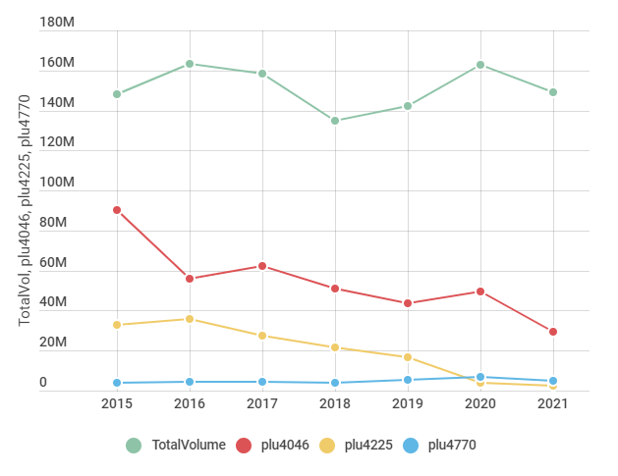
Mirror image?
Volume in the U.S from 2015 to 2021
Volume in Los Angeles from 2015 to 2021

Slide 10
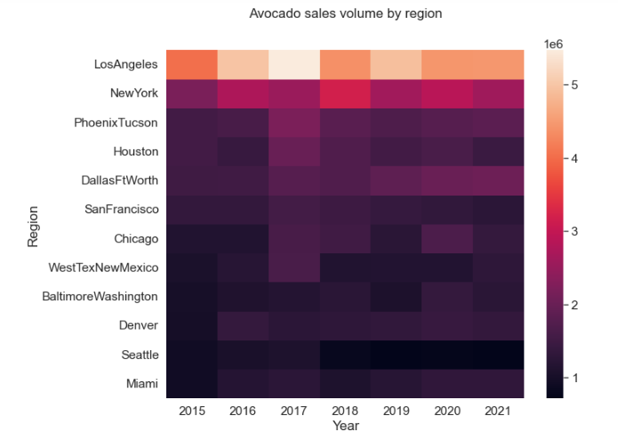
A Closer Look at Avocado Sales Trends
Los Angeles & New York are the two majors contributors to the sales of avocados in the U.S followed by Phoenix, Houston and Dallas.

Slide 11
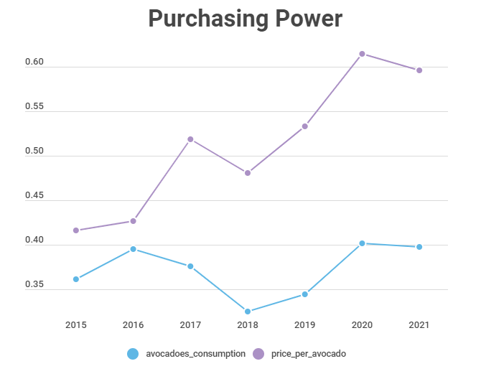
New Metric: Purchasing Power
In 2018, there was a decrease in both the average price per avocado and the number of avocados consumed per person, which contributed to a decrease in overall volume for that year. Also Despite fluctuations in price, the quantity of avocados purchased did not fluctuate significantly.

Slide 12
Key Findings
Does the price have an influence on the volume?
In a sense yes but it is not significant enough to have an influence, other variables come into place.
Which areas consumed avocados the most from 2015 to 2021?
West, California and South Central have consumed the most avocados from 2015 to 2021. Los Angeles is the city where the most avocados were sold during that period (1.05 billion avocados sold)
The plu4770 being the biggest Hass variety, is it also the one consumed the most?
Quite the opposite, the PLU4770 is the least sold while the smaller one, the PLU 4046 is now the one sold the most. However it would be important to compare the production units to the units sold to see if the fact that the PLU4770 being sold the least is because it is also the least produced.

Slide 13
Is the trend in the most consuming city an image of the general trend in the U.S?
No, the trend in Los Angeles tends to be stabilized around 150 million every year while the general trend in the U.S tends to increase over the years.
Los Angeles and New York consume the most avocados, followed by Dallas, Houston, Phoenix, Chicago and San Francisco.
Despite the price increase, the general cost of living increasing as well, the number of avocados bought per habitant doesn’t fluctuate significantly

