Slide 1
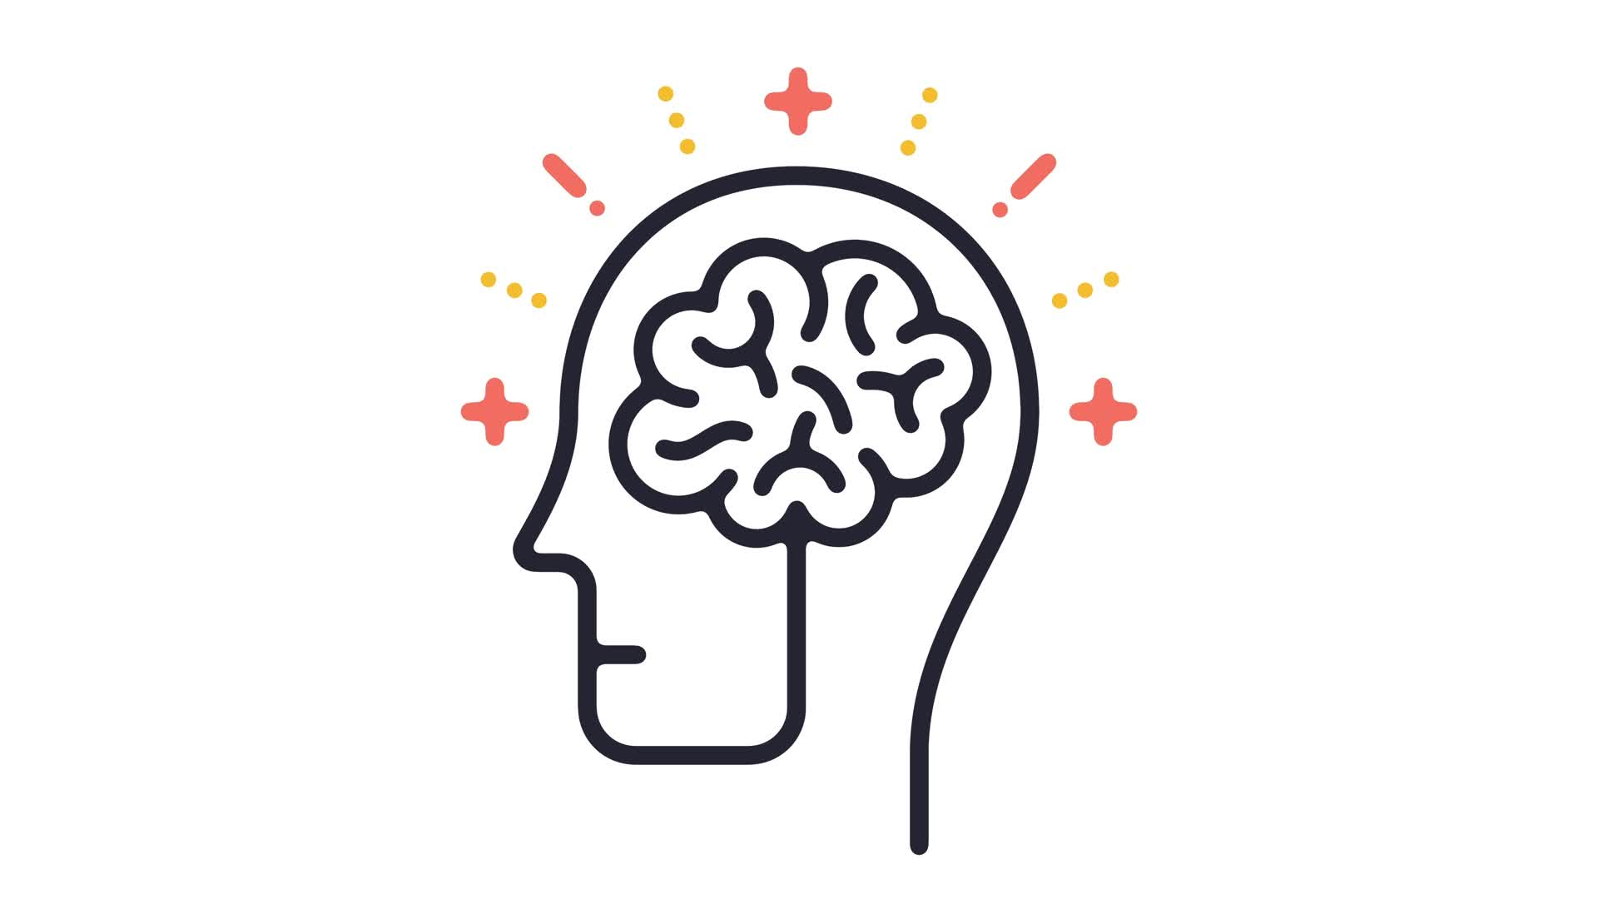
Behavioral Activation
Lukas Grünzweil, Erik Reitbauer, Almir Hadzic, Leon Marazovic, Matthias Darabos

Slide 2
Introduction to Vanilla
What is it?
If you don't want to do something, get up and do it.
Activation leads to a dopamine rush.
Doing something helps improve mood (e.g., sports).

Slide 3
Breaking the Cycle of Anxiety
Find Enjoyable Activities:
Engage in something you enjoy.
Choose activities that provide a sense of accomplishment.
Connect with others through shared experiences.

Slide 4
Getting Started on a Task
Strategies:
Don’t wait for motivation; get up and start the task.
Break large tasks into smaller, manageable actions.
Schedule tasks to create a fixed time for completion.
Celebrate your achievements; avoid comparisons.
Share your accomplishments with friends for encouragement.

Slide 5
Reflection on Current Behaviors
Current Habits:
I procrastinate doing my homework and tasks until the last possible day.

Slide 6
Part 2: Behavioral Activation Exploration
Identifying "Vanilla" Moments:Example:
Reluctance to attend a football match due to fatigue.
Before Action: Tired and unmotivated.
After Action: Happy and energized.

Slide 7
Part 3: Practicing Behavioral Activation
Engage in a Chosen Activity:
Activity Example: Tidying up my room (15 minutes).

Slide 8
Conclusion
Key Takeaways:
Taking action leads to increased motivation and improved mood.
Regular reflection and small steps can enhance productivity and well-being.

