Slide 1
ReggaeGit
Design Draft

Slide 2

Service Introduction Page
Browser
ReggaeGit.com
E-mail
gentlebuuny@gmail.com
Password
**************
Service Introduction
Sign In
Sign Up
This service is damn awesome!!
Sign In
Sign Up

Slide 3




















When signed in
Browser
ReggaeGit.com
Project Title
Calendar
My Project
16-10-02 22:32
Profile
SKT T1 Faker
Visualized Source Code
Chat Box
Users(5)
Steam : blah blah
Kakao : daum daum
Blizzard : watch watch
Kakao : daum daum
Kakao : daum daum
Blizzard : watch watch
Steam : blah blah
Steam : blah blah
Steam : blah blah
Kakao : daum daum
Blizzard : watch watch
Kakao : daum daum
Kakao : daum daum
Blizzard : watch watch
Typing...

Slide 4
Project Title(On-Click)
Browser
ReggaeGit.com
Project Title
My Project
OpenCV: Open Source Computer Vision Library
Resources
Homepage: http://opencv.org
Docs: http://docs.opencv.org/master/
Q&A forum: http://answers.opencv.org
Issue tracking: https://github.com/opencv/opencv/issues
Contributing
Please read before starting work on a pull request: https://github.com/opencv/opencv/wiki/How_to_contribute
Summary of guidelines:
One pull request per issue;
Choose the right base branch;
Include tests and documentation;
Clean up "oops" commits before submitting;
Follow the coding style guide.

Slide 5
Calendar
Jumps to the recent change
Browser
ReggaeGit.com
Project Title
Calendar
My Project
16-10-02 22:32
Profile
SKT T1 Faker
Visualized Source Code
Chat Box
Users(5)
Steam : blah blah
Kakao : daum daum
Blizzard : watch watch
Kakao : daum daum
Kakao : daum daum
Blizzard : watch watch
Steam : blah blah
Steam : blah blah
Steam : blah blah
Kakao : daum daum
Blizzard : watch watch
Kakao : daum daum
Kakao : daum daum
Blizzard : watch watch
Typing...

Slide 6
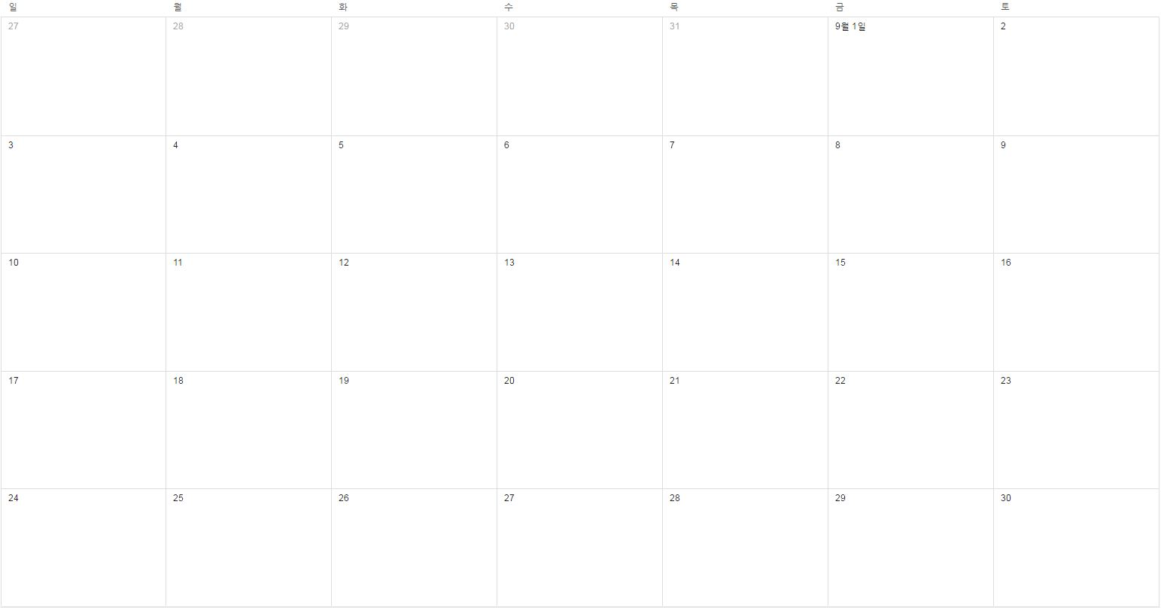
Calendar(On-Click)
Browser
ReggaeGit.com
Calendar
16-10-02 22:32

Slide 7
Visualized Workflow
Browser
ReggaeGit.com
Project Title
Calendar
My Project
16-10-02 22:32
Profile
SKT T1 Faker
Visualized Source Code
Chat Box
Users(5)
Steam : blah blah
Kakao : daum daum
Blizzard : watch watch
Kakao : daum daum
Kakao : daum daum
Blizzard : watch watch
Steam : blah blah
Steam : blah blah
Steam : blah blah
Kakao : daum daum
Blizzard : watch watch
Kakao : daum daum
Kakao : daum daum
Blizzard : watch watch
Typing...

Slide 8

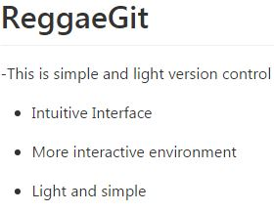
Visualized Workflow
Browser
ReggaeGit.com
Project Title
Calendar
My Project
16-10-02 22:32
Profile
SKT T1 Faker
Visualized Source Code
Chat Box
Users(5)
Steam : blah blah
Kakao : daum daum
Blizzard : watch watch
Kakao : daum daum
Kakao : daum daum
Blizzard : watch watch
Steam : blah blah
Steam : blah blah
Steam : blah blah
Kakao : daum daum
Blizzard : watch watch
Kakao : daum daum
Kakao : daum daum
Blizzard : watch watch
Typing...

Slide 9
Visualized Workflow
Browser
ReggaeGit.com
Project Title
Calendar
My Project
16-10-02 22:32
Profile
SKT T1 Faker
Visualized Source Code
Chat Box
Users(5)
First Group
Steam : blah blah
Kakao : daum daum
Blizzard : watch watch
Kakao : daum daum
Kakao : daum daum
Blizzard : watch watch
Steam : blah blah
Steam : blah blah
Steam : blah blah
Kakao : daum daum
Blizzard : watch watch
Kakao : daum daum
Kakao : daum daum
Blizzard : watch watch
Second Group
Personal Branch
Typing...

Slide 10




Visualized Workflow
Browser
ReggaeGit.com
Project Title
Calendar
My Project
16-10-02 22:32
Profile
SKT T1 Faker
Visualized Source Code
Chat Box
Users(5)
Steam : blah blah
Kakao : daum daum
Blizzard : watch watch
Kakao : daum daum
Kakao : daum daum
Blizzard : watch watch
Steam : blah blah
Steam : blah blah
Steam : blah blah
Kakao : daum daum
Blizzard : watch watch
Kakao : daum daum
Kakao : daum daum
Blizzard : watch watch
Typing...

Slide 11
Visualized Workflow
Browser
ReggaeGit.com
Project Title
Calendar
My Project
16-10-02 22:32
Profile
SKT T1 Faker
Visualized Source Code
Chat Box
Users(5)
Steam : blah blah
Kakao : daum daum
Blizzard : watch watch
Kakao : daum daum
Kakao : daum daum
Blizzard : watch watch
Steam : blah blah
Steam : blah blah
Steam : blah blah
Kakao : daum daum
Blizzard : watch watch
Kakao : daum daum
Kakao : daum daum
Blizzard : watch watch
Typing...

Slide 12
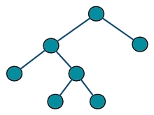
Visualized Workflow
Browser
ReggaeGit.com
Project Title
Calendar
My Project
16-10-02 22:32
Profile
SKT T1 Faker
Visualized Source Code
Chat Box
Users(5)
Steam : blah blah
Kakao : daum daum
Blizzard : watch watch
Kakao : daum daum
Kakao : daum daum
Blizzard : watch watch
Steam : blah blah
Steam : blah blah
Steam : blah blah
Kakao : daum daum
Blizzard : watch watch
Kakao : daum daum
Kakao : daum daum
Blizzard : watch watch
Typing...

Slide 13
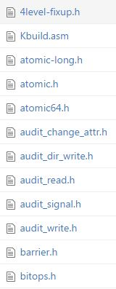
Visualized Workflow
Browser
ReggaeGit.com
Project Title
Calendar
My Project
16-10-02 22:32
Profile
SKT T1 Faker
Visualized Source Code
Chat Box
Users(5)
Steam : blah blah
Kakao : daum daum
Blizzard : watch watch
Kakao : daum daum
Kakao : daum daum
Blizzard : watch watch
Steam : blah blah
Steam : blah blah
Steam : blah blah
Kakao : daum daum
Blizzard : watch watch
Kakao : daum daum
Kakao : daum daum
Blizzard : watch watch
Typing...

Slide 14
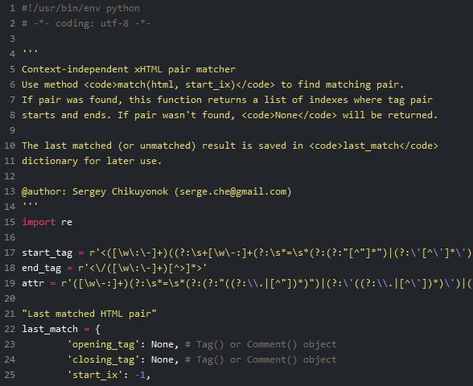
Code Viewer(On-Click)
Browser
ReggaeGit.com
Visualized Source Code
Calendar
16-10-02 22:32
Profile
SKT T1 Faker
Chat Box
Users(5)
Steam : blah blah
Kakao : daum daum
Blizzard : watch watch
Kakao : daum daum
Kakao : daum daum
Blizzard : watch watch
Steam : blah blah
Steam : blah blah
Steam : blah blah
Kakao : daum daum
Blizzard : watch watch
Kakao : daum daum
Kakao : daum daum
Blizzard : watch watch
Typing...

Slide 15
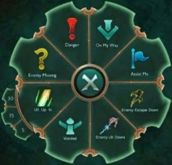
Code Viewer(Ping System)
Browser
ReggaeGit.com
Visualized Source Code
Calendar
16-10-02 22:32
Profile
SKT T1 Faker
Chat Box
Users(5)
Steam : blah blah
Kakao : daum daum
Blizzard : watch watch
Kakao : daum daum
Kakao : daum daum
Blizzard : watch watch
Steam : blah blah
Steam : blah blah
Steam : blah blah
Kakao : daum daum
Blizzard : watch watch
Kakao : daum daum
Kakao : daum daum
Blizzard : watch watch
Typing...

Slide 16
Code Viewer(Ping System)
Browser
ReggaeGit.com
Visualized Source Code
Calendar
16-10-02 22:32
Profile
SKT T1 Faker
Chat Box
Users(5)
Steam : blah blah
Kakao : daum daum
Blizzard : watch watch
Kakao : daum daum
Kakao : daum daum
Blizzard : watch watch
Steam : blah blah
Steam : blah blah
Steam : blah blah
Kakao : daum daum
Blizzard : watch watch
Kakao : daum daum
Kakao : daum daum
Blizzard : watch watch
Typing...

Slide 17
Code Viewer(Sticky Note)
Browser
ReggaeGit.com
Visualized Source Code
Calendar
16-10-02 22:32
Profile
SKT T1 Faker
Chat Box
Users(5)
Steam : blah blah
Kakao : daum daum
Blizzard : watch watch
Kakao : daum daum
Kakao : daum daum
Blizzard : watch watch
Steam : blah blah
Steam : blah blah
Steam : blah blah
Kakao : daum daum
Blizzard : watch watch
Kakao : daum daum
Kakao : daum daum
Blizzard : watch watch
Typing...

Slide 18
Code Viewer(Sticky Note)
Browser
ReggaeGit.com
Visualized Source Code
Calendar
16-10-02 22:32
Profile
SKT T1 Faker
Chat Box
Users(5)
Steam : blah blah
Kakao : daum daum
Blizzard : watch watch
Kakao : daum daum
Kakao : daum daum
Blizzard : watch watch
Steam : blah blah
Steam : blah blah
Steam : blah blah
Kakao : daum daum
Blizzard : watch watch
Kakao : daum daum
Kakao : daum daum
Blizzard : watch watch
Typing...

Slide 19
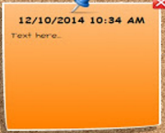
Code Viewer(Sticky Note)
Browser
ReggaeGit.com
Visualized Source Code
Calendar
16-10-02 22:32
Profile
SKT T1 Faker
Chat Box
Users(5)
Steam : blah blah
Kakao : daum daum
Blizzard : watch watch
Kakao : daum daum
Kakao : daum daum
Blizzard : watch watch
Steam : blah blah
Steam : blah blah
Steam : blah blah
Kakao : daum daum
Blizzard : watch watch
Kakao : daum daum
Kakao : daum daum
Blizzard : watch watch
Typing...

