Slide 1

Chinese Club at Browning!
Week 0:
Orientation / Introduction to the language

Slide 2
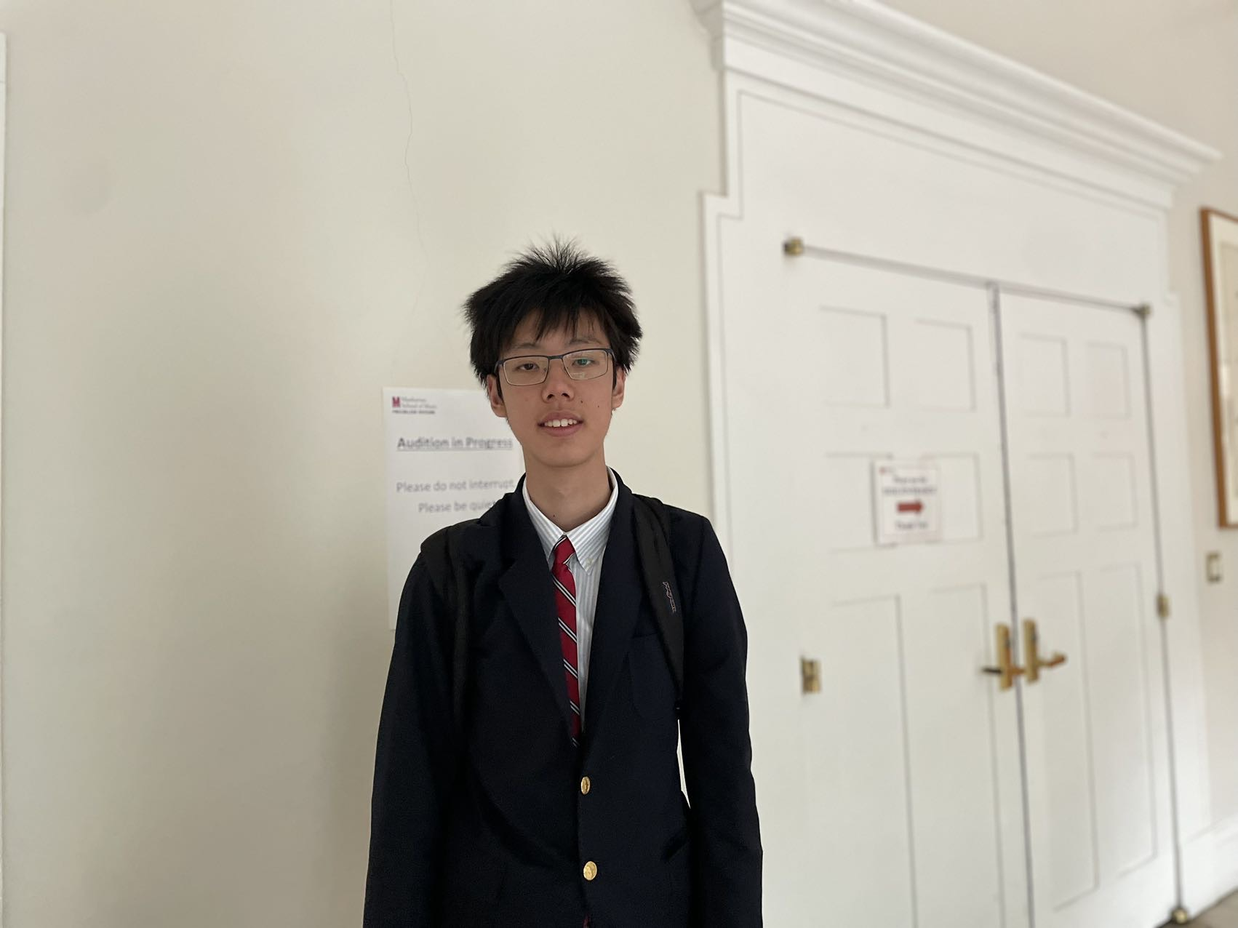
About Us:
Lucas (Yichen) Jiao (Chinese Name: 焦绎尘) [G9]:
Born in Beijing China in December 2008
Speaks Chinese daily with parents and extended family
Enrolled for a year in a Chinese international school
Jonathan Guo (Chinese Name: 郭德皞) [G11]:
- ok
- ok
- ok

Slide 3
Advantages of learning chinese
Chinese is the 2nd most spoken language in the world. By learning The language, you would open yourself up to many more individuals.
You’re learning a language spoken in a place with rich historical background and significant innovations.
3. Many other languages like Japanese and Korean derive from Chinese, sharing characters and pronunciations.

Slide 4
Challenges of learning Chinese
Chinese is the only language in the world where tone changes the meaning of words.
Unlike western languages, Chinese lacks an alphabetical system.

Slide 5
Some things to keep in mind:
Be respectful to others: Don’t interrupt during a lesson in a way that disrupts other people’s learning.
Do not create pressure for others: Chinese is a difficult language! Don’t cause pressure for your peers if they are struggling with a particular topic/concept.
Help others: If you see your peers confused with a topic that you understood, use your knowledge to the fullest and help them understand.
Have fun: We want you to have fun and enjoy the process of learning the language. Reach out to us if you feel like at any point that this club is adding high levels of stress or anything alike.

Slide 6
Covered Topics:
Semester I – Speaking.
The primary focus of the first semester is to lay a foundation on how to interpret and speak Chinese.
Semester II – Writing / Reading
Once we’ve explored how to speak and listen to Chinese, we can start reading and writing. Passages from various sources will be frequently used.
Extra Resources:
Each week will contain an optional set of some vocabulary words (in both pinyin or Chinese characters) in quizlet. These may come in handy during the excersises in each class.

Slide 7
LESSON 0:
Speaking your first sentence.

Slide 8
How to greet someone
You might know that “Hello” in Chinese is 你好 or “ni hao”. We can add on to this by introducing our name. Here’s how we might do that
我叫 <Name> (”Wo Jiao” <Name>) -- > My name is <Name>.
Here’s an example:
你好，我叫 Lucas! -- > Hello, My name is Lucas!
We can also ask for their name through the following:
你好，我叫Lucas。你叫什么？(”Ni jiao shen me?”) -- > Hello, my name is Lucas. What is yours?

Slide 9
Now Your Turn:
Introduce yourself using the phrases described above, substituting the name parameter with yours.

Slide 10
Extra Resources:
PPT Link: https://github.com/lLukii/Chinese-Class
Quizlet: https://quizlet.com/jp/818427771/lesson-0-booster-words-flash-cards/?i=58mhyx&x=1jqt
Contact Us: Email: ljiao@browning.edu, jguo@browning.edu
WeChat ID: TheRealLukii (Lucas Jiao)
Chinese Practice Discord Server:
[Has not been implemented]

