Slide 1
TEE is not a Healer, TEE-Rex is
Sadegh Keshavarzi and Gregory Chockler
University of Surrey
Alexey Gotsman
IMDEA Software
PODC’26
Notes:
Let's first start with what a TEE is

Slide 2



Trusted Execution Environments (TEE)
Process
Supports secure code execution and volatile state storage
Reduces Byzantine Fault Tolerance (BFT) to Crash Fault Tolerance (CFT)
TEE
OS
Notes:
Is an enclave in the CPU that…
TEE implementations are available from different vendors
Shared promise: Turn arbitrary (Byzantine) failures into crash failures
Q: Too good to be true. Is it the healer it claims to be?

Slide 3

Data Persistence with TEEs
External storage is not protected
Durable state must be sealed (encrypted with TEE’s secret key) before it can be persisted
Expensive
Process
TEE
OS
Is sealing secure?
Notes:
Protection interrupted on restart
TEEs part of the CPU
Sealing is expensive, especially if the state is large

Slide 4
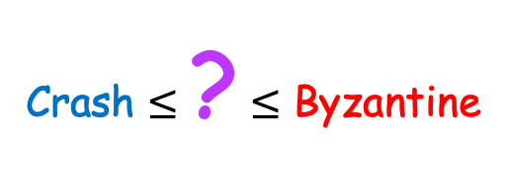
Rollback Attacks
On restart an attacker can replace the latest sealed version with an older one
Undetectable: both versions are correctly signed
Restarted process behaves correctly afterwards
Process
TEE
OS
Crash $≤$ ? $≤$ Byzantine
Notes:
TEE loses all its state (it’s volatile)
Malicious OS
The persistent state is not completely wrong
Type of failure relative to Byzantine and crashes

Slide 5
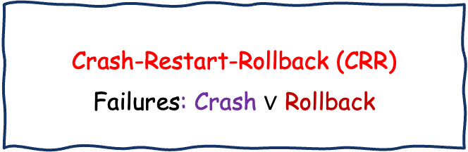



Our Contribution: Roadmap
Static Failure Models
Dynamic Failure Models
Crash-Restart-Rollback (CRR)
Failures: Crash $∨$ Rollback
$$≺$$
Dynamic CRR (CRR-D)
Failures: Crash
Every process can rollback
Crash Fault
Tolerance (CFT)
Tight Bounds for Registers Resilience, Time Complexity Persistent Storage Usage
Byz Fault
Tolerance (BFT)
$$≼$$
$$≼$$
Notes:
See how TEEs fit into distributed computing
Dynamic more useful for practical
Dynamic because no one is guaranteed to be safe: no threshold

Slide 6
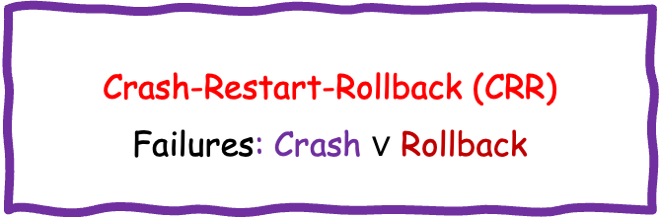
Our Contribution: Roadmap
Static Failure Models
Dynamic Failure Models
Crash-Restart-Rollback (CRR)
Failures: Crash $∨$ Rollback
$$≺$$
Dynamic CRR (CRR-D)
Failures: Crash
Every process can rollback
Crash Fault
Tolerance (CFT)
Tight Bounds for Registers Resilience, Time Complexity Persistent Storage Usage
Byz Fault
Tolerance (BFT)
$$≼$$
$$≼$$

Slide 7
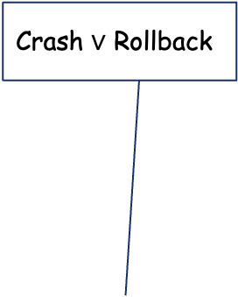
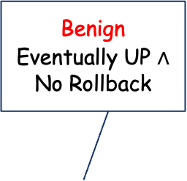



Static Failure Models: CRR(k, r, b)
Crash $∨$ Rollback
Static Failure Models
Rollback
Benign
Eventually UP $∧$ No Rollback
Crash-Restart-Rollback (CRR)
Failures: Crash $∨$ Rollback
$$≤b$$
$$≤r$$
Tight Bounds for Registers Resilience, Time Complexity Persistent Storage Usage
$$≤k$$
|Processes| = n
Notes:
Similar to classical BFT and CFT
Benign are allowed to restart but won’t misbehave
The rest never crash

Slide 8

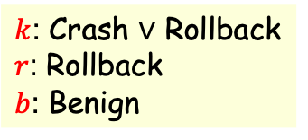
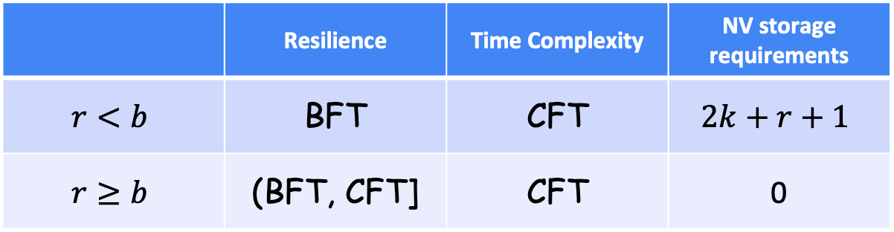
$k$: Crash $∨$ Rollback
$r$: Rollback
$b$: Benign
Tight Bounds for CRR(k, r, b)
Wait-free atomic MWMR register can be implemented IFF
$$n≥2k+\min\left(r, b\right)+1$$
 | Resilience | Time Complexity | NV storage requirements
$$r<b$$ | BFT | CFT | $$2k+r+1$$
$$r≥b$$ | (BFT, CFT] | CFT | 0
Notes:
n is the number of processes. This is resilience
Stronger results in the paper
4 message delays
CFT resilience when b=0
Separation from BFT
Stable storage only helps when resilience is Byzantine
TEEs improve BFT resilience but only with terms and conditions, such as r and b
This improvement only happens when not relying on stable storage
The overhead of sealing is useless for resilience. You would expect a performance penalty to help with resilience

Slide 9
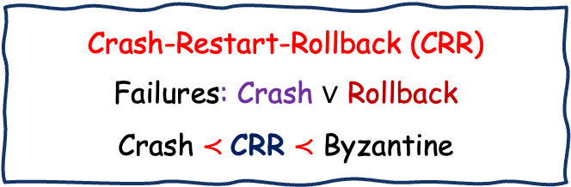
Our Contribution: Roadmap
Static Failure Models
Dynamic Failure Models
If all processes can simultaneously crash & restart, no implementation is possible
Crash-Restart-Rollback (CRR)
Failures: Crash $∨$ Rollback
Crash $≺$CRR $≺$ Byzantine
$$≺$$
Dynamic CRR (CRR-D)
Failures: Crash
Every process can rollback
Tight Bounds for Registers Resilience, Time Complexity Persistent Storage Usage
Notes:
Cornerstone
If left unchecked…

Slide 10





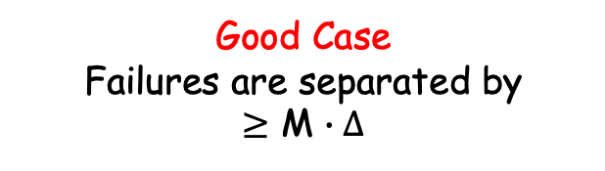
Dynamic Failure Models: CRR-D(d, c)
Crash
Crash
$$∨$$
Crash & Restart
$$≤c$$
$$≤d$$
$$≤d$$
Good Case
Failures are separated by $≥$ M $∙Δ$
Bad Case
At most $c≥d$ can crash & restart
Notes:
All replicas can crash in the good case
Good case requires replicas to restore their state independently of the protocol
Delta is an external observer assumption. Thus, it is equivalent to asynchrony
Generalises the static case
Left hand side falls apart without synchrony, so we need to add another parameter for the bad case

Slide 11



Crash
$$≤c$$
Tight Bounds for CRR-D(d, c), c ≥ d
$$≤d$$
Wait-free atomic MWMR register can be implemented IFF
$$n≥d+c+1$$
Best Case Resilience | Good Case Latency | NV storage requirements
CFT | CFT | 0
Notes:
Best case happens when c = d
As you might have guessed, 0 because everyone can roll back

Slide 12

Upper Bounds for CRR-D(d, c)
[KCG - DISC’25]
TEE-Rex: New Wait-Free Atomic MWMR Register Construction
Incorporates novel distributed state recovery protocol on restart to guarantee termination in the good case executions
First correct implementation under asynchrony & without stable storage
Uncovers bugs in 7 key prior publications
PODC, DISC, USENIX Security, CCS, NDSS, …
Notes:
Emphasise: We present a new algorithm TEE-Rex
Recovery is needed for the good case unlike the static case because everyone will roll back eventually
Problem remained open until recently despite numerous attempts

Slide 13
Ongoing work
Forking resistance
Multiple enclaves in a process
Same code, different state
Equivocation!
Process
TEE
TEE
TEE
Notes:
Bane of all evil in distributed systems

Slide 14

Ongoing work (cont’d)
Generalise the dynamic model
Protocol-independent benchmark
Superior to reconfiguration?
Better resilience
Recover
Reconfigure
Notes:
Reconfiguration is usually blocking

Slide 15


Ongoing work (cont’d)
Process
Harder problems
Consensus
Partial synchrony
State-Machine Replication
Minimal Trusted Code Base
TEE
OS
Notes:
Code inside the TEE must be verified
No BUGS!

Slide 16
Thank You!

Slide 17
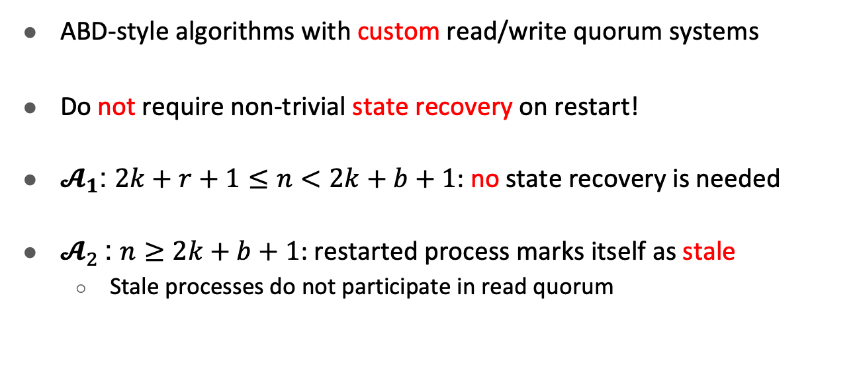
Upper Bounds for CRR(k, r, b)
ABD-style algorithms with custom read/write quorum systems
Do not require non-trivial state recovery on restart!
$𝓐_{1}$: $2k+r+1≤n<2k+b+1$: no state recovery is needed
$𝓐_{2}$: $n≥2k+b+1$: restarted process marks itself as stale
Stale processes do not participate in read quorum
Notes:
Do not depend on the knowledge of $r$ or $b$

Slide 18
State Recovery Protocol: Take 1
READ
WRITE(v₁)
(0, v₀)
P1
(0, v₀)
(1, v₁)
P2
(0, v₀)
(0, v₀)
P3
On Restart
Notes:
This is relevant even for diskless crash-recovery that was investigated in this paper, and they actually got it wrong
The same problem exists in a more recent paper that focused on rollbacks in TEE-based systems

Slide 19
State Recovery Protocol: Take 1
WRITE(v₁)
(0, v₀)
P1
(0, v₀)
P2
(0, v₀)
P3
On Restart
Not crash-consistent
[Michael et al., DISC’17]
Notes:
[Michael et al., DISC’17]

Slide 20
State Recovery Protocol: Take 1
WRITE(v₁)
(0, v₀)
P1
(0, v₀)
P2
(0, v₀)
P3
On Restart
Crash-consistent
Notes:
The consistent cut of blue points precedes the yellow one

Slide 21
Incarnation Numbers
Not crash-consistent
Discard P3’s response
(P3, 0)
WRITE(v₁)
(P3, 1)
(0, v₀)
P1
0
(0, v₀)
(P3, 1)
P2
0
(0, v₀)
P3
0
1
On Restart
Notes:
Challenge: How to identify crash-consistent responses
Solution: [replacement][UW] -- track the replica incarnations
Assume for a moment that every replica can count incarnations locally (e.g., with persistent register in the CPU), then crash-consistency is easy
But this assumption is not realistic
We don’t have nv storage to rely on
persistent CPU registers do not exist/slow
TEEs do not support it anymore

Slide 22
Incarnation Number Challenges: Rollback
Store/retrieve incarnation number via crash-consistent quorums!
(P3, 0)
WRITE(v₁)
(P3, ?)
(0, v₀)
P1
0
(0, v₀)
(P3, ?)
P2
0
(0, v₀)
Rollback-resistant counter
P3
0
?
On Restart
Notes:
RB-resistant counter is a useful abstraction for sealing

Slide 23
Incarnation Number Challenges: Distributed Storage
(0, v₀)
(P3, 0)
(P3, 1)
(P3, 1)
P1
0
(0, v₀)
(P3, 0)
(P3, 1)
(P3, 1)
P2
0
(0, v₀)
On Restart
P3
0
?
1
Recover State
Read last incarnation number
Store new incarnation number
Notes:
Crashes are possible when writing an incarnation number
Should be careful not to finalize an incarnation number before it was fully written to a write quorum
Then need to store non-finalized incarnation numbers separately from the ones used for verifying writes

Slide 24
Incarnation Number Challenges: Distributed Storage
Crash-consistent!
Crash-consistent!
(0, v₀)
(P3, 0, 0)
(P3, 0, 1)
(P3, 1, 1)
P1
0
(0, v₀)
(P3, 0, 0)
(P3, 0, 1)
(P3, 1, 1)
P2
0
(0, v₀)
On Restart
P3
0
?
1
Recover State
Read last incarnation number
Store new incarnation number
Notes:
What if multiple replicas are recovering?

Slide 25
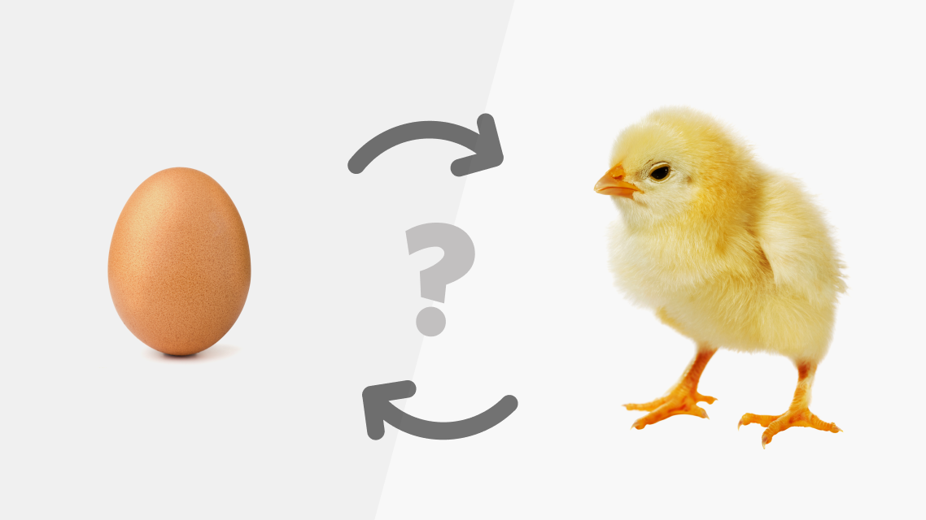
Incarnation Number Challenges: Simultaneous Recovery
Reusing incarnation numbers is safe!
(0, v₀)
P1
0
(0, v₀)
Store new incarnation number
P2
0
(0, v₀)
?
On Restart
P3
3
(P4, ?)
(0, v₀)
(P3, ?)
P4
0
?
On Restart
Store new incarnation number
Notes:
In this example everyone is eventually up so we need liveness according to our condition
Need recovery for incarnation numbers and vice versa
It is safe for P3 to use any incarnation number smaller than future ones
Problem is being mistaken for crash-consistent

Slide 26
Incarnation Number Challenges: Simultaneous Recovery
Enabled by two-stage write
(0, v₀)
P1
0
(0, v₀)
P2
0
(P3, 3)
0
3
(0, v₀)
On Restart
P3
3
(P3, 3)
(P3, 0)
(P3, 3)
(0, v₀)
P4
0
0
On Restart
Not crash-consistent??
Store new incarnation number
Crash-consistent!
Notes:
UW needs 5 replicas in this case
We can relay finalised incarnation numbers because of the two-stage write

Slide 27
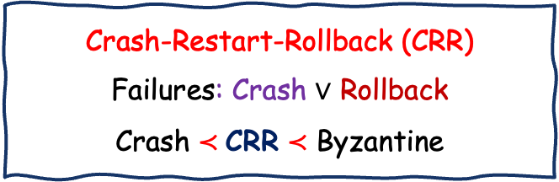
Conclusions
Static Failure Models
Dynamic Failure Models
Crash-Restart-Rollback (CRR)
Failures: Crash $∨$ Rollback
Crash $≺$CRR $≺$ Byzantine
$$≺$$
Dynamic CRR (CRR-D)
Failures: Crash
Every process can rollback
Crash Fault
Tolerance (CFT)
Tight Bounds for Registers Resilience, Time Complexity Persistent Storage Usage
Byz Fault
Tolerance (BFT)
$$≼$$
$$≼$$

