Slide 1

Some Burp Suite’s Features

Slide 2
Table of contents
1
2
3
Burp Intruder
Burp Collaborator
Crawling

Slide 3
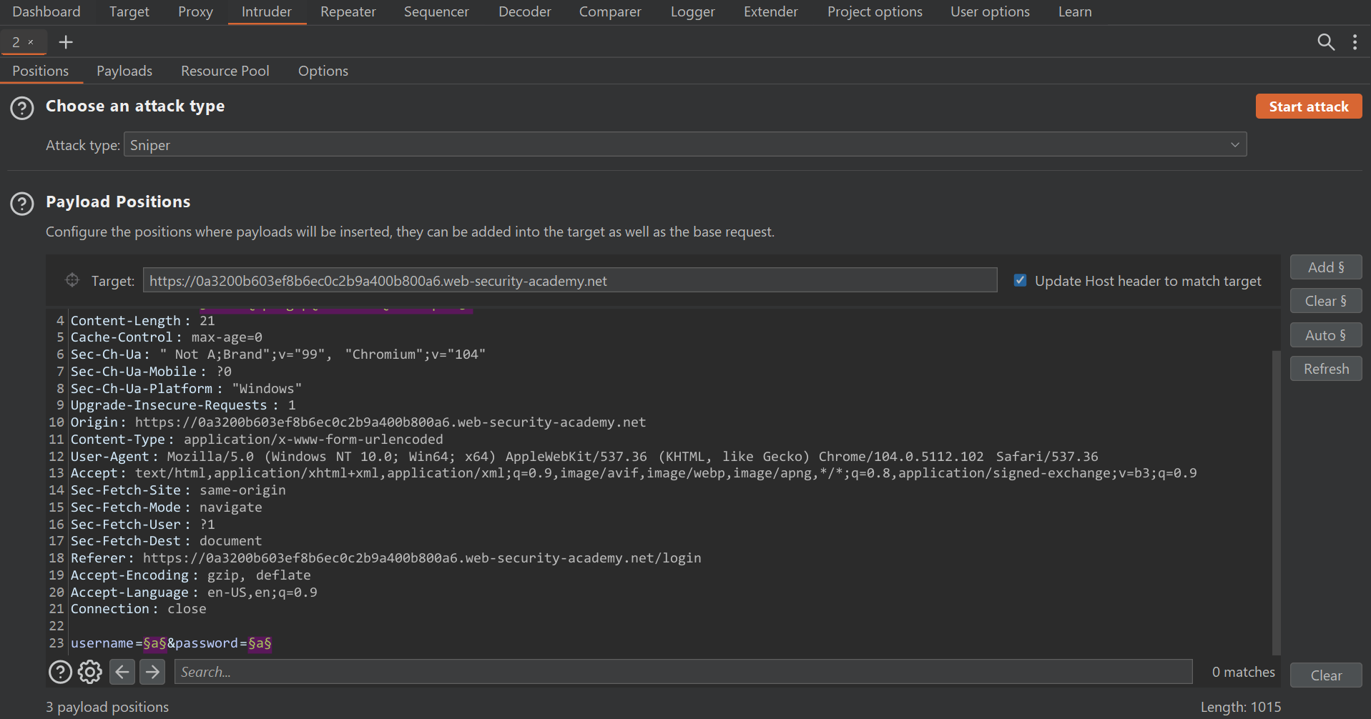
1. Burp Intruder
Burp Intruder is a powerful tool for performing highly customizable, automated attacks against websites. It lets you configure attacks that send the same request over and over again, inserting different payloads into predefined positions each time.

Slide 4
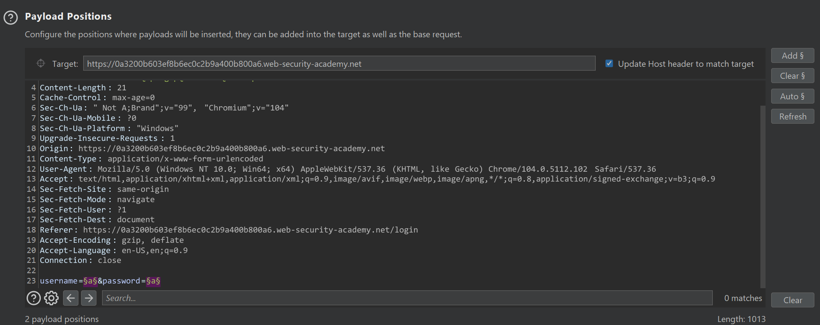
Positions Tab
Payload Positions

Slide 5
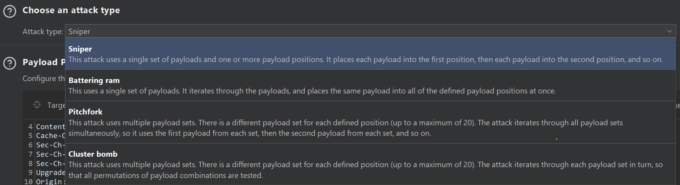
Positions Tab
Attack Type

Slide 6
Positions Tab
Demo: Lab: Username enumeration via different responses | Web Security Academy (portswigger.net)

Slide 7
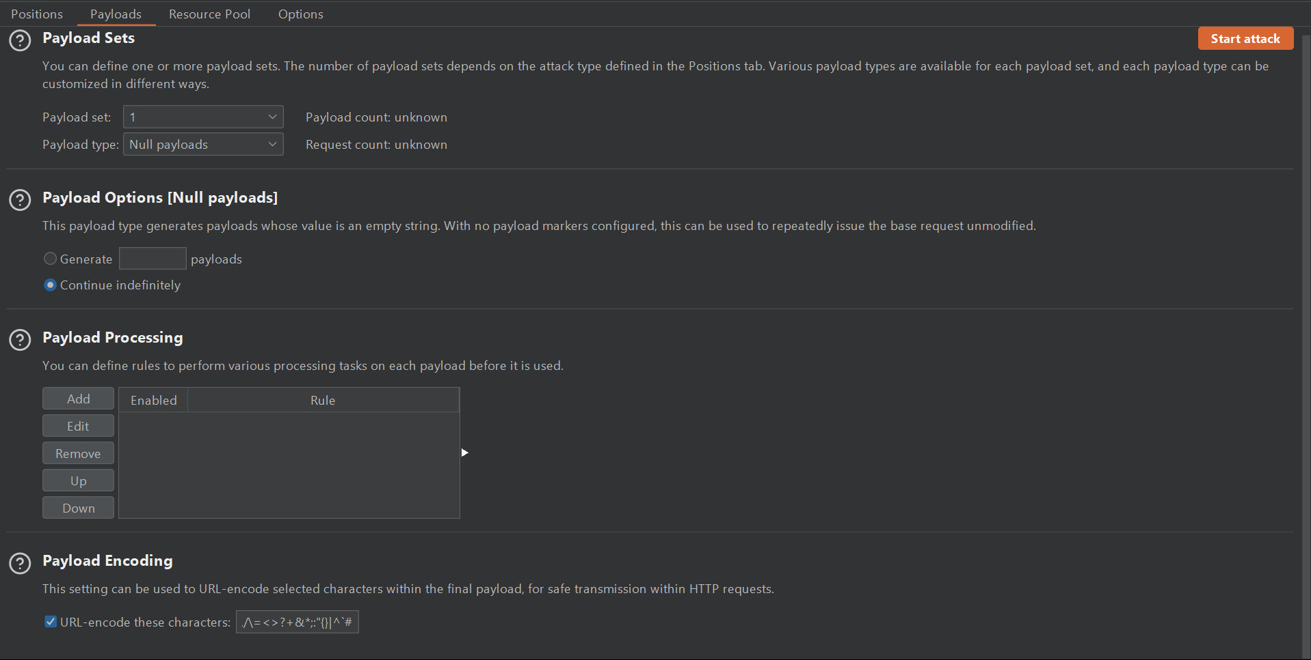
Payload Tab

Slide 8
Payload Tab
Payload sets
- Burp Suite has various payload type such as: Simple list, Runtime file, Custom iterator, Character substitution, Case modification, Recursive grep, Illegal Unicode, Character blocks, Numbers, Dates, Brute forcer, Null payloads, Character frobber, Bit flipper, Username generator, ECB block shuffler, Extension-generated, Copy other payload

Slide 9
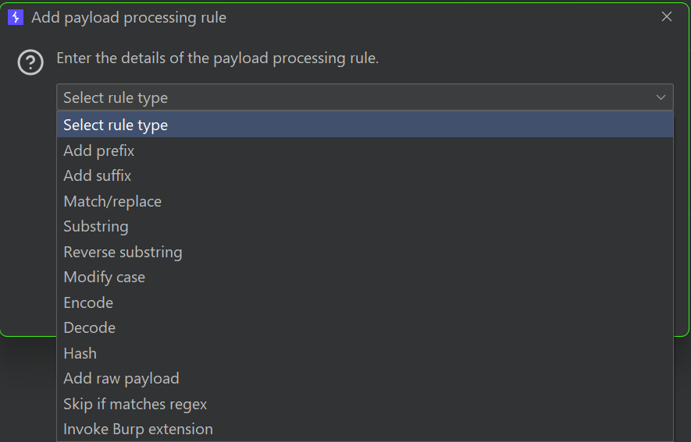
Payload Tab
Payload sets

Slide 10
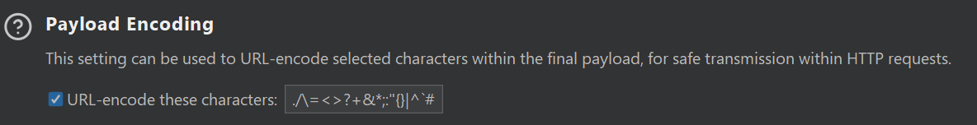
Payload Tab
Payload sets

Slide 11
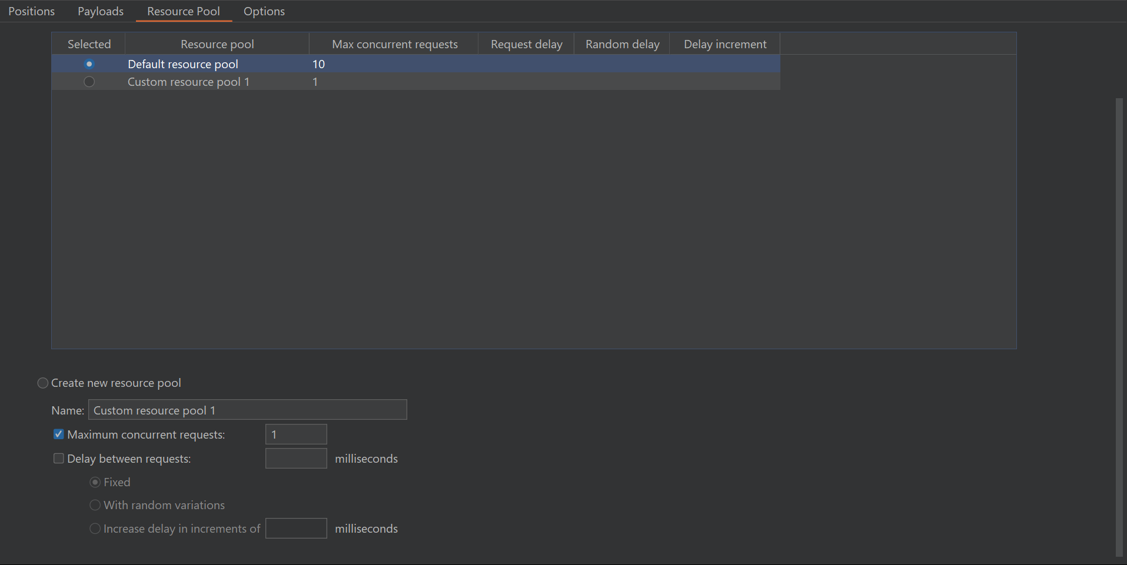
Resource Pool Tab

Slide 12
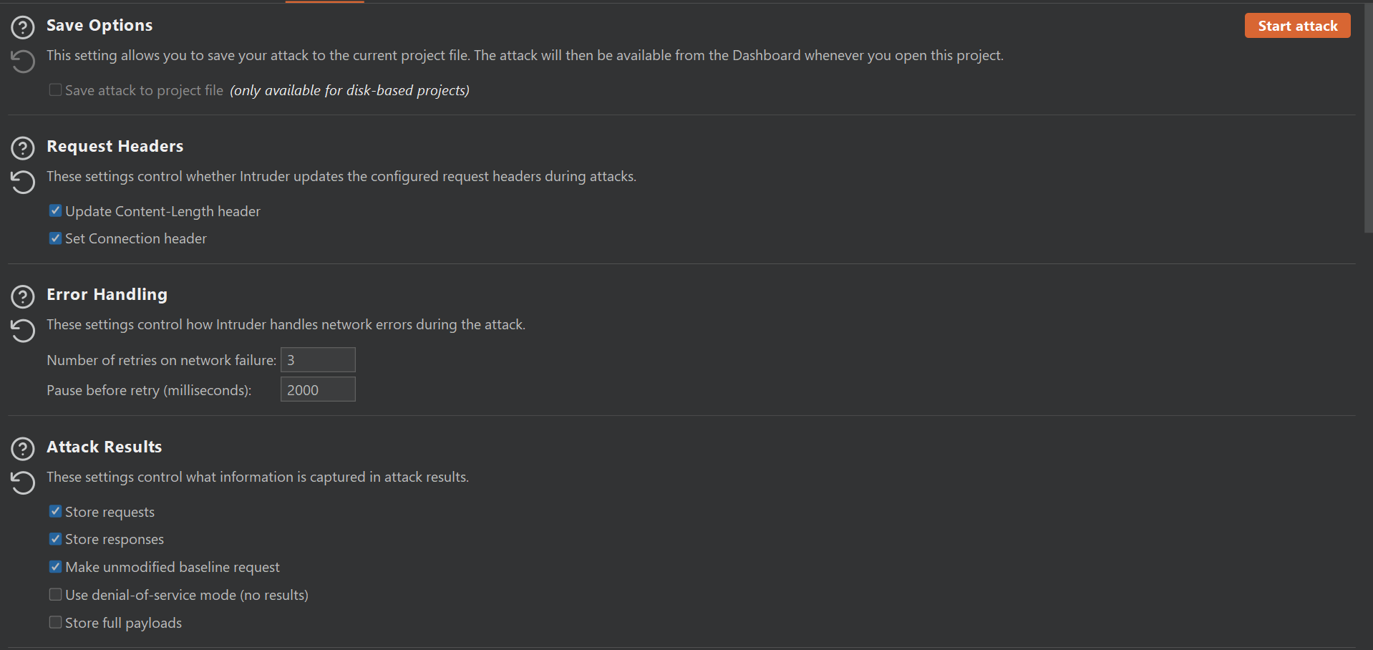
Options Tab

Slide 13
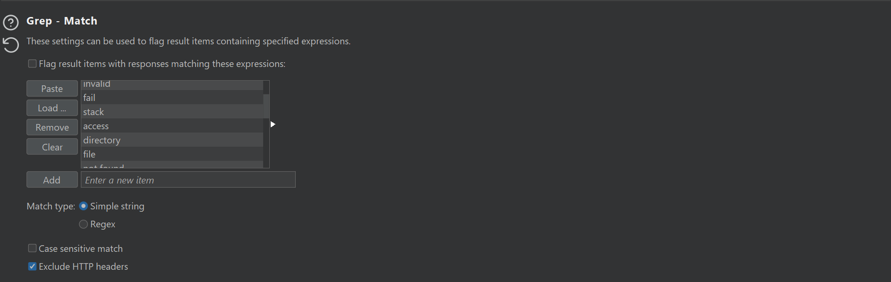
Options Tab

Slide 14
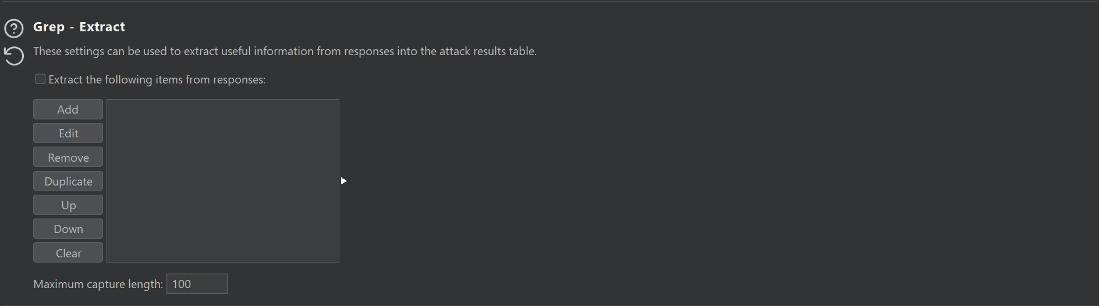
Options Tab

Slide 15
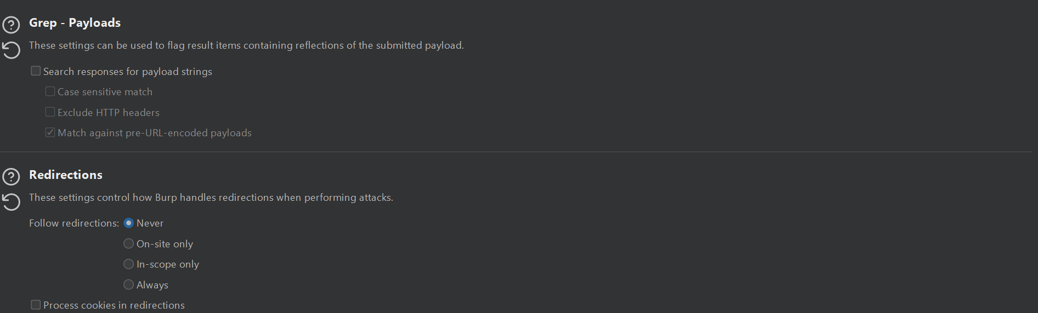
Options Tab

Slide 16
1. Burp Intruder
Demo: Lab: Web shell upload via race condition | Web Security Academy (portswigger.net)

Slide 17
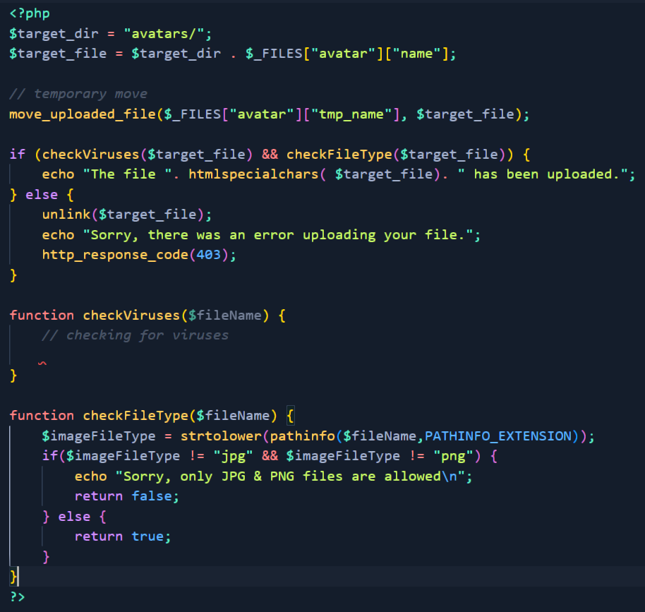

Slide 18
2. Burp Collaborator
Burp Collaborator is a network service that Burp Suite uses to help discover many kinds of vulnerabilities such as:
- Blind injection-based vulnerabilities.
- Service-specific vulnerabilities can be detected by submitting payloads targeting those services to the target application, and analyzing the details of the resulting interactions with a collaborating instance of that service.
- Some vulnerabilities arise when an application can be induced to retrieve content from an external system and process it in some way.

Slide 19
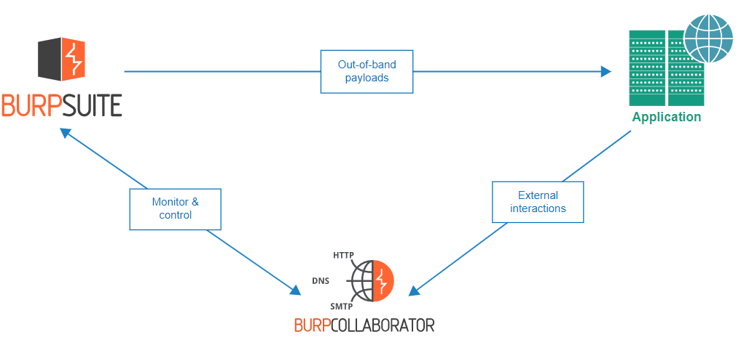
2. Burp Collaborator

Slide 20
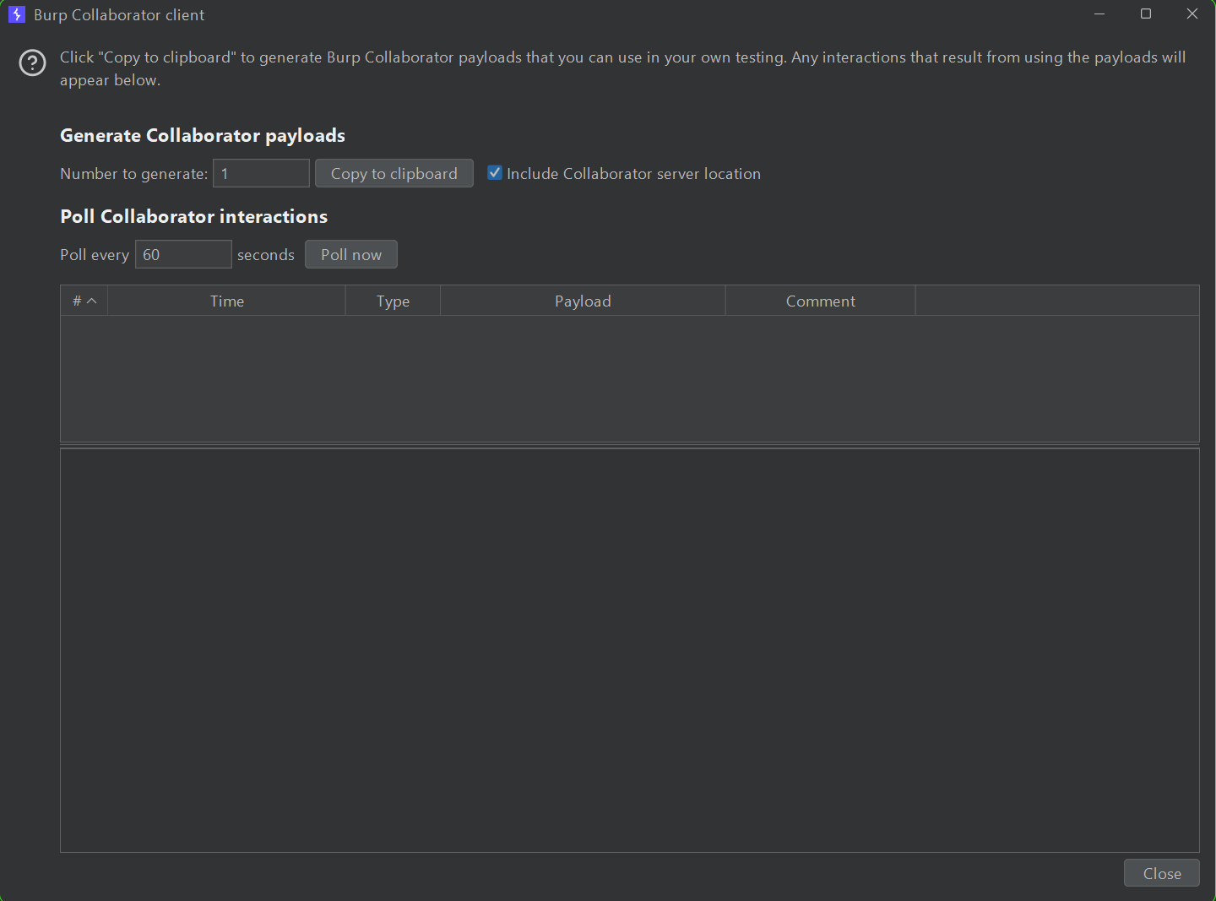
2. Burp Collaborator
Example of Burp Collaborator: 1mo4tkdmp73tztnwim9dmzt7nytphe.oastify.com

Slide 21

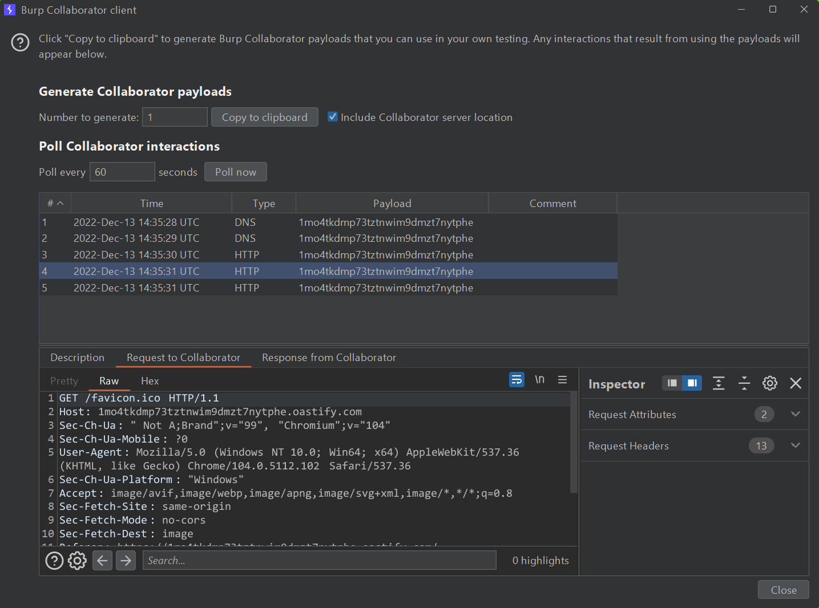
2. Burp Collaborator

Slide 22
2. Burp Collaborator
Protocols that Burp Collaborator support: DNS, HTTP/HTTPS, SMTP/SMTPS

Slide 23
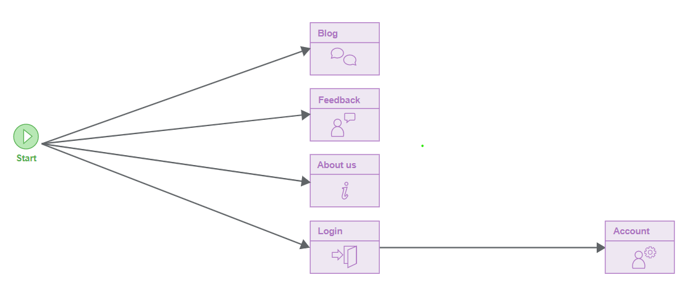
3. Crawling
The crawl phase of a scan involves navigating around the application, following links, submitting forms, and logging in where necessary, to catalog the content of the application and the navigational paths within it.

Slide 24
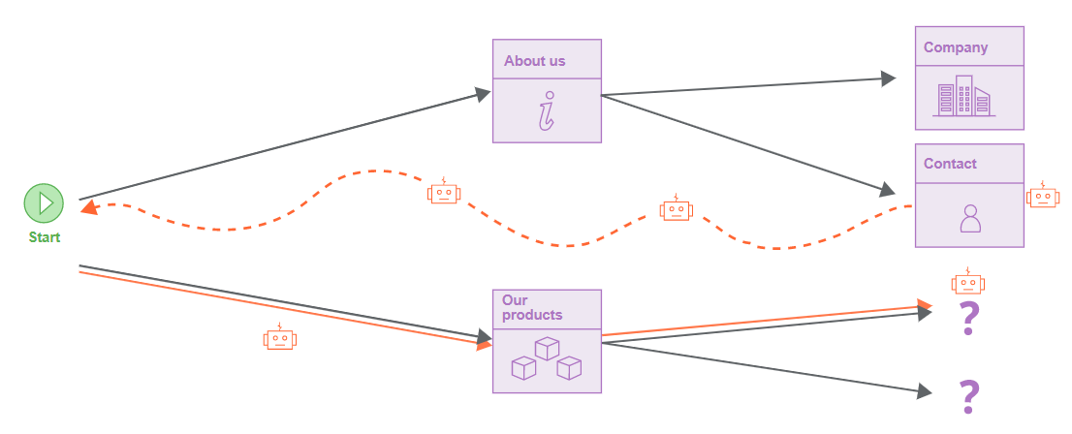
3. Crawling

Slide 25
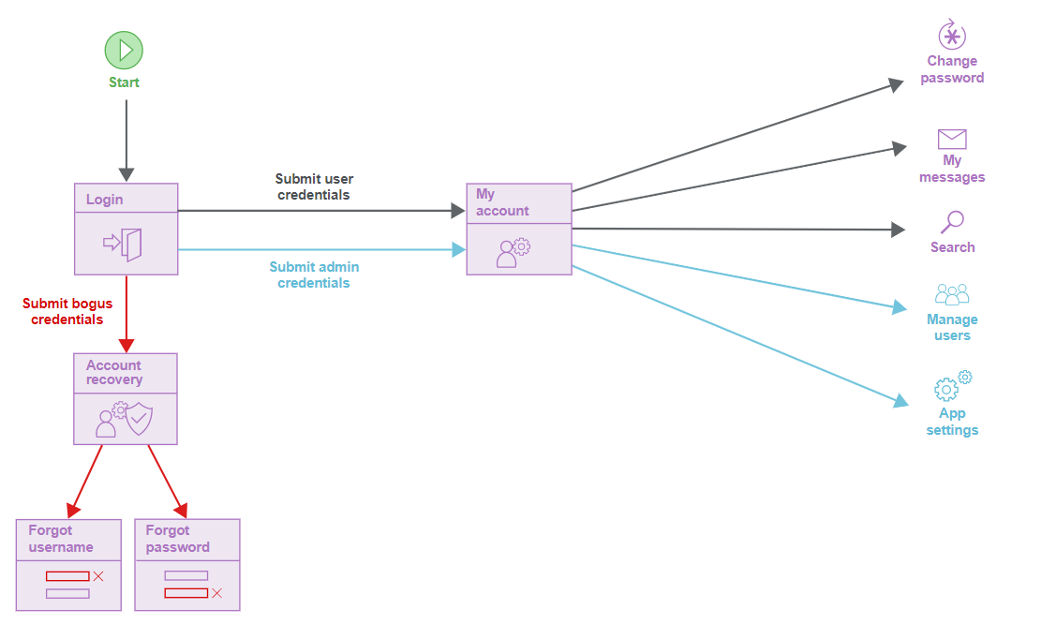
3. Crawling
Application Login

Slide 26
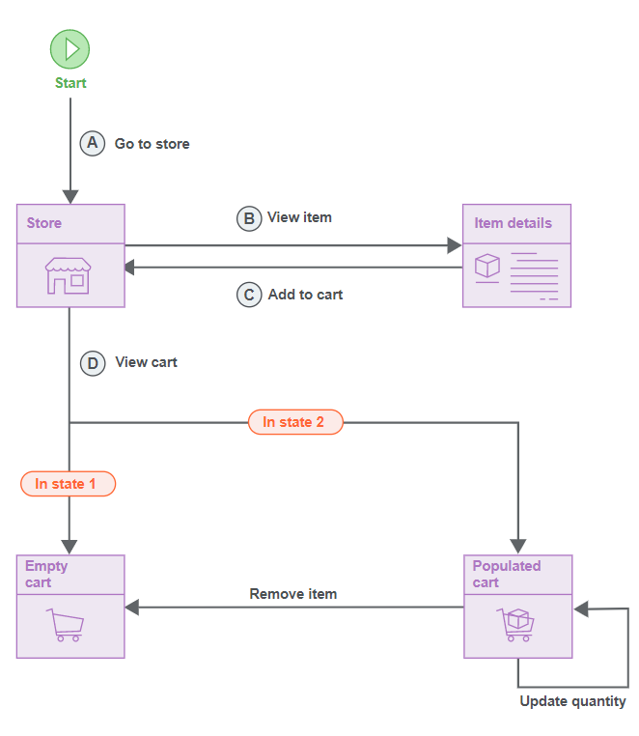
3. Crawling
Detecting changes in application state

Slide 27
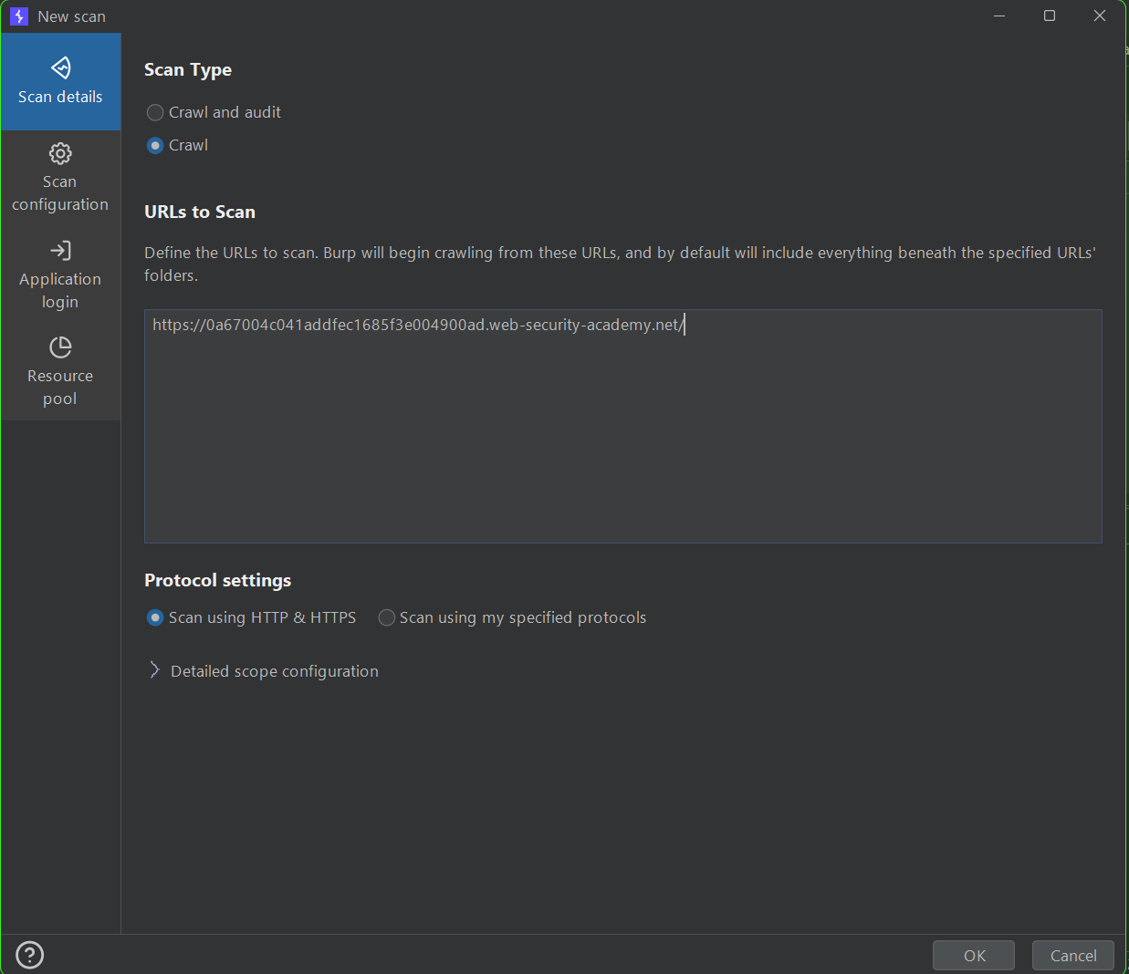
3. Crawling

Slide 28
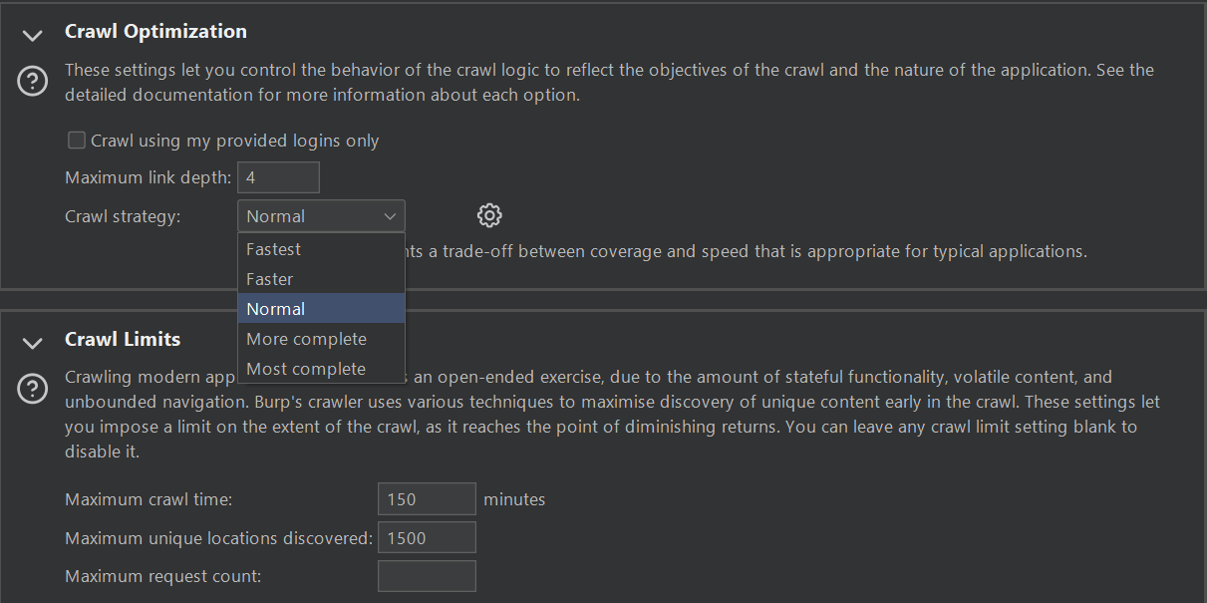
3. Crawling
Scanning Configuration

Slide 29
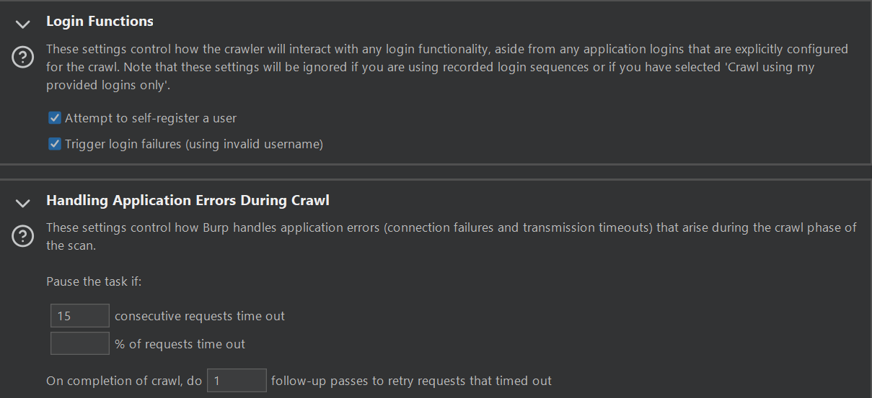
3. Crawling
Scanning Configuration

Slide 30
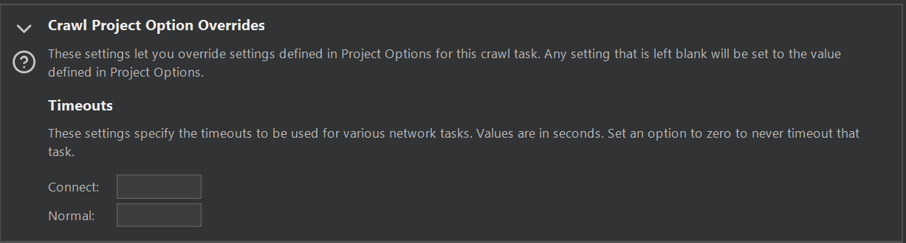
3. Crawling
Scanning Configuration

Slide 31
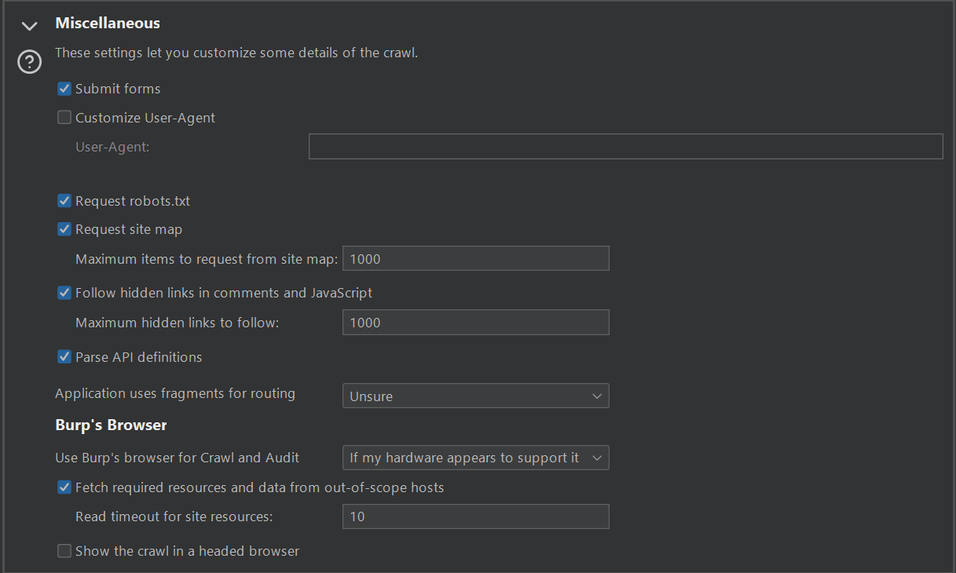
3. Crawling
Scanning Configuration

Slide 32
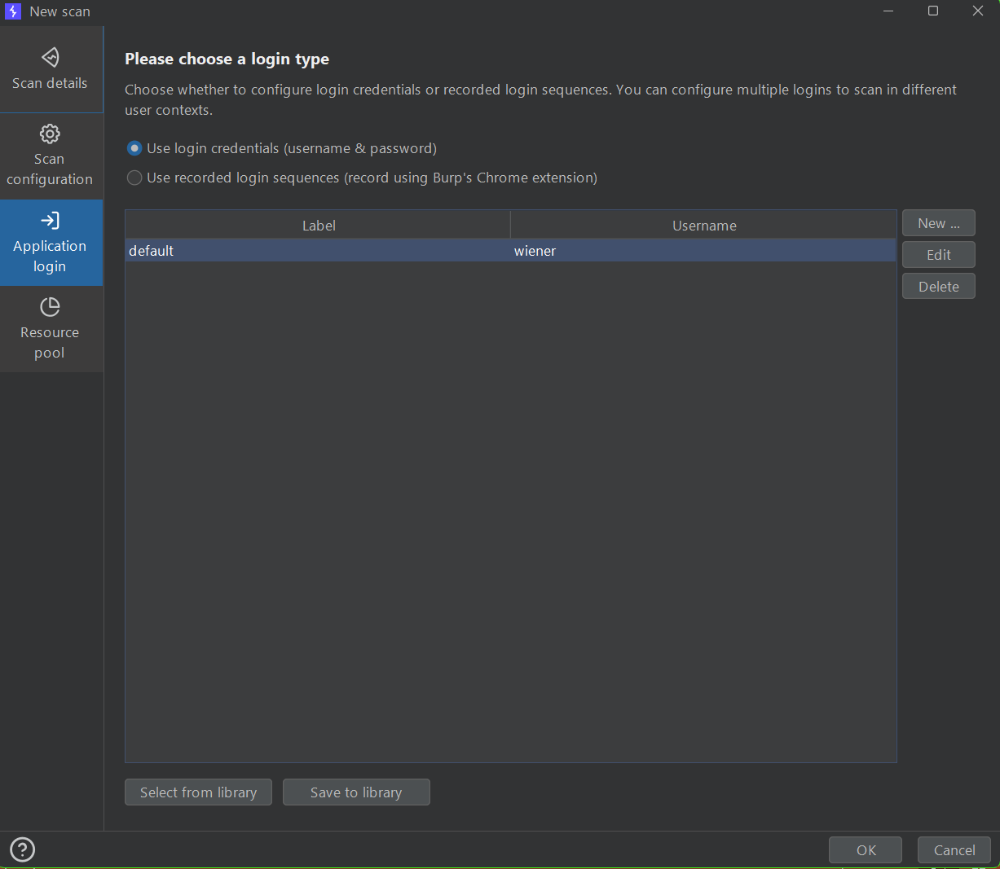
3. Crawling
Application Login: We can let the crawler use a valid credential for a login form

Slide 33
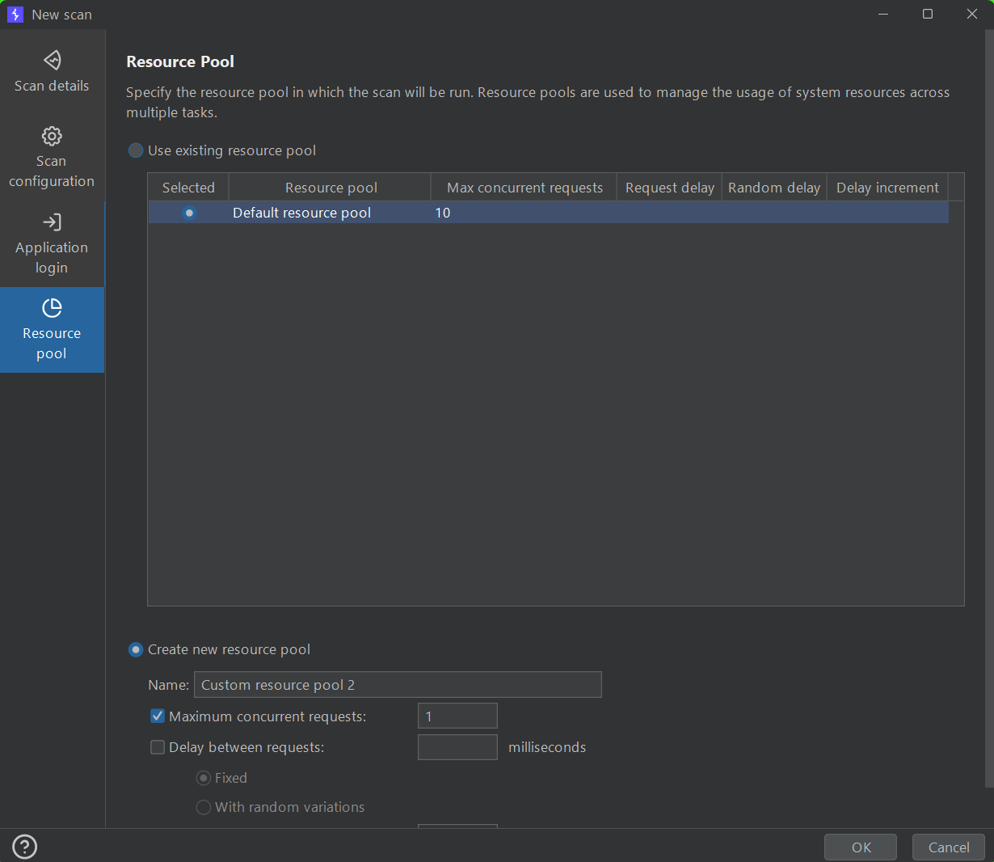
3. Crawling
Resource Pool

Slide 34
3. Crawling
Demo: Lab: High-level logic vulnerability | Web Security Academy (portswigger.net)

Slide 35
Reference
Burp Suite documentation - PortSwigger

