Slide 1

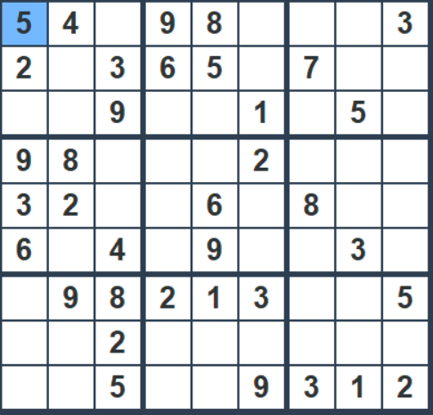
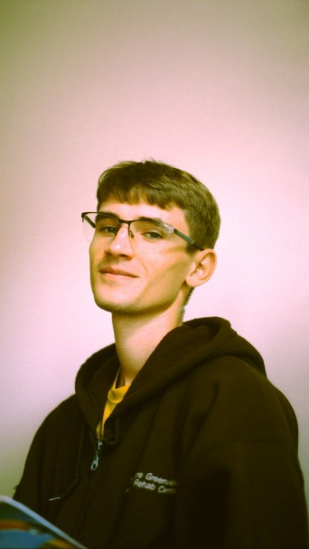

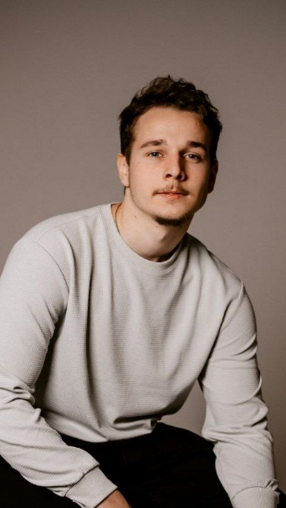
SUDOKU GAME
Над проєктом працювали:
Nikolaichuy Igor
(grinsidewest) Main role in the teamCreation and partial implementation of the protocol on platforms and correction of some functions in the interface
Vladislav Khiras
(KL-Mort)
Main role in the team: implementation of all functions on STM and UART protocol
Roman Siokalo
(roma2005n)
Key role in the team, implementation of most functions for the UI interface

Slide 2
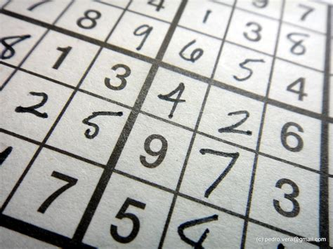
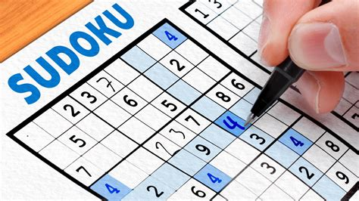
SUDOKU GAME
Our project features a Sudoku mathematical puzzle implemented with a distributed system architecture. The system is split into two primary layers: computing logic executed on an STM32 microcontroller (C-based backend) and a graphical user interface (GUI) developed in Python using the Tkinter library.

Slide 3
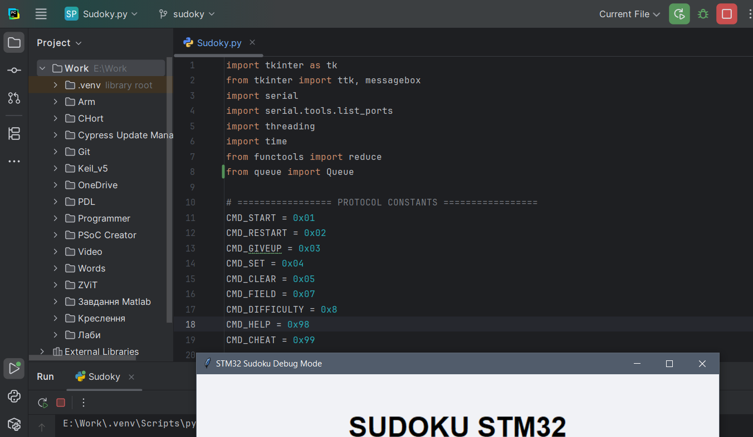
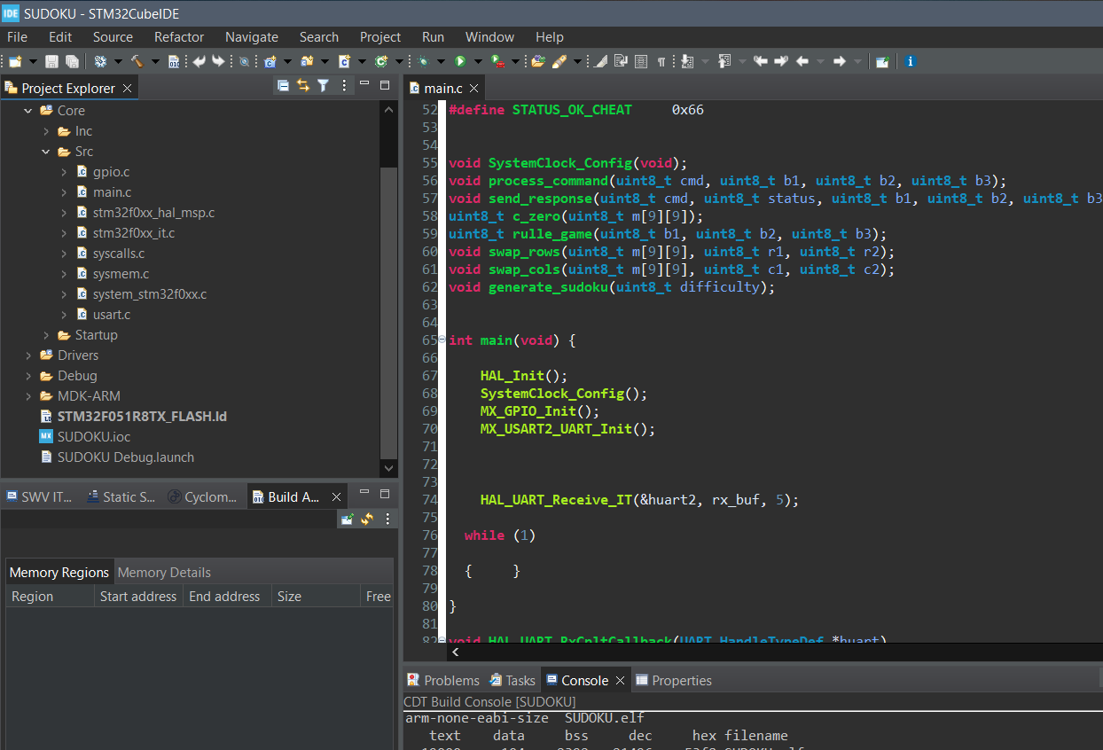
SUDOKU GAME
Team Roles & Responsibilities
Vladyslav Khirash (KL-Mort)
Full-cycle STM32 Firmware Development: Implemented UART drivers, interrupts, and system timers.
Algorithm Engineering: Developed the random Sudoku matrix generation algorithm and game rule validation logic.
System Integration: Managed state synchronization between hardware and PC.
Roman Syokalo (roma2005n)
UI Architecture: Developed the base interface layout using the Tkinter library.
Front-end Development: Implemented visual menu elements and core gaming features.
Ihor Nikolaihcuk (grinsidewest)
Protocol Development: Designed and partially implemented the inter-system communication protocol.
Testing & Development: Performed functional UI testing and contributed to interface creation.

Slide 4
SUDOKU GAME
The system logic is split between an STM32 (C-based backend) and Python (Tkinter-based frontend). I designed the firmware architecture, along with the move generation and validation algorithms, and resolved critical bugs related to port logic and keyboard focus. Data exchange is handled via UART at 115200 baud using a proprietary protocol with 6/84-byte packets and XOR checksum protection. Implementing multithreading in Python eliminated UI lag, while STM32CubeIDE and Git were utilized to ensure system stability and version control

Slide 5
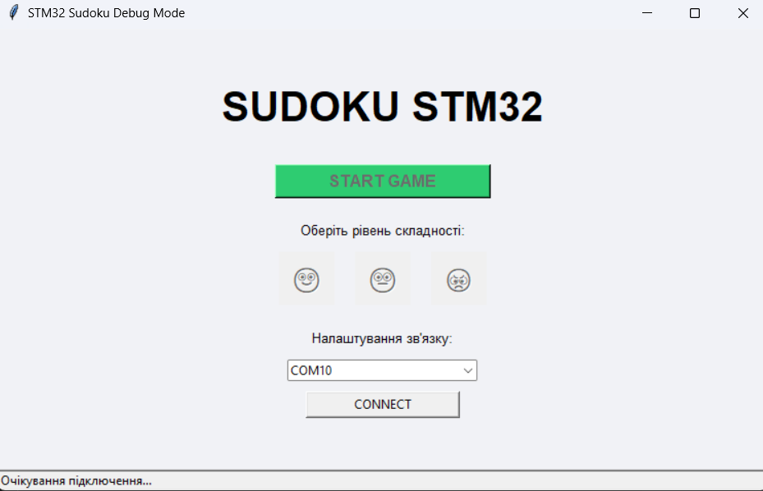
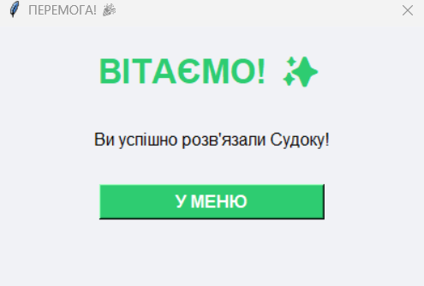
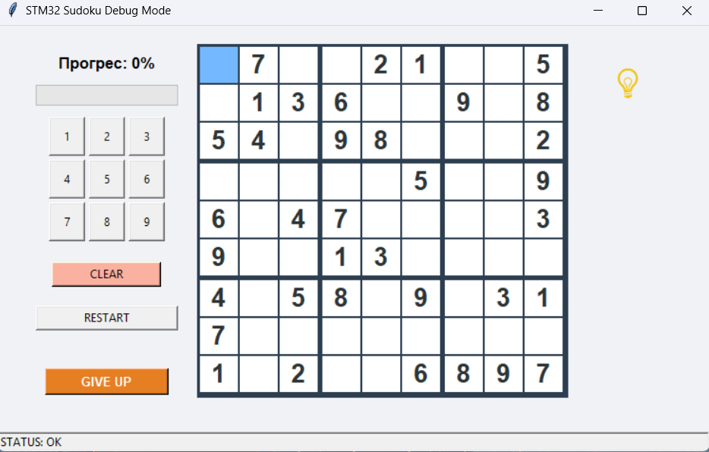
SUDOKU GAME
We have developed a complete Sudoku game featuring three difficulty levels, procedural level generation, and a hint system for players. Hardware integration is established via UART, utilizing a custom communication protocol with XOR checksum validation.

Slide 6
SUDOKU GAME
Integrated System: Developed a robust hardware-software ecosystem using a distributed architecture between an STM32 microcontroller and a PC via UART.
Core Logic: Offloaded 100% of game logic to the STM32, including real-time grid generation, move validation, and game-state monitoring.
Robust Communication: Implemented a custom protocol featuring variable-length packets (6/84 bytes) and XOR-based checksums for high data integrity.
Resilient UX: Built a multi-threaded Python GUI that supports dynamic difficulty levels, interactive hints, and automated serial port reconnection logic.
Engineering Value: Demonstrated practical synchronization of embedded firmware and high-level software for complex, real-time applications.

