Slide 1


WAZZER
WAZ
WAZZER
LA ESPADA

Slide 2









WAZ
WAZZER
WAZZER
LA ESPADA

Slide 3
EXISTING SOLUTIONS
EXISTING SOLUTIONS
?
PROBLEM
PROBLEM
WAZZER
WAZ
WAZZER
Anemia is a condition where the reduced oxygen-carrying blood has capacity (usually due to low hemoglobin).
Hot water can lead to low blood pressure, dizziness, or fainting.
Cold water worsens with cold sensitivity and poor circulation
LA ESPADA

Slide 4
OUR GOAL
OUR GOAL
PROBLEM
PROBLEM
EXISTING SOLUTIONS
EXISTING SOLUTIONS
Anemia is a condition where the reduced oxygen-carrying blood has capacity (usually due to low hemoglobin).
Hot water can lead to low blood pressure, dizziness, or fainting.
WAZZER
WAZ
WAZZER
?
Cold water worsens with cold sensitivity and poor circulation
LA ESPADA

Slide 5
OUR GOAL
OUR GOAL
EXISTING SOLUTIONS
EXISTING SOLUTIONS
?
DEMO
To prevent dizziness, fainting, and circulatory stress in people with anemia by maintaining a safe, stable water temperature during showering in real time.
DEMO
LA ESPADA

Slide 6
HOW THE PROJECT WORKS
HOW THE PROJECT WORKS
OUR GOAL
OUR GOAL
To prevent dizziness, fainting, and circulatory stress in people with anemia by maintaining a safe, stable water temperature during showering in real time.
DEMO
DEMO
LA ESPADA

Slide 7
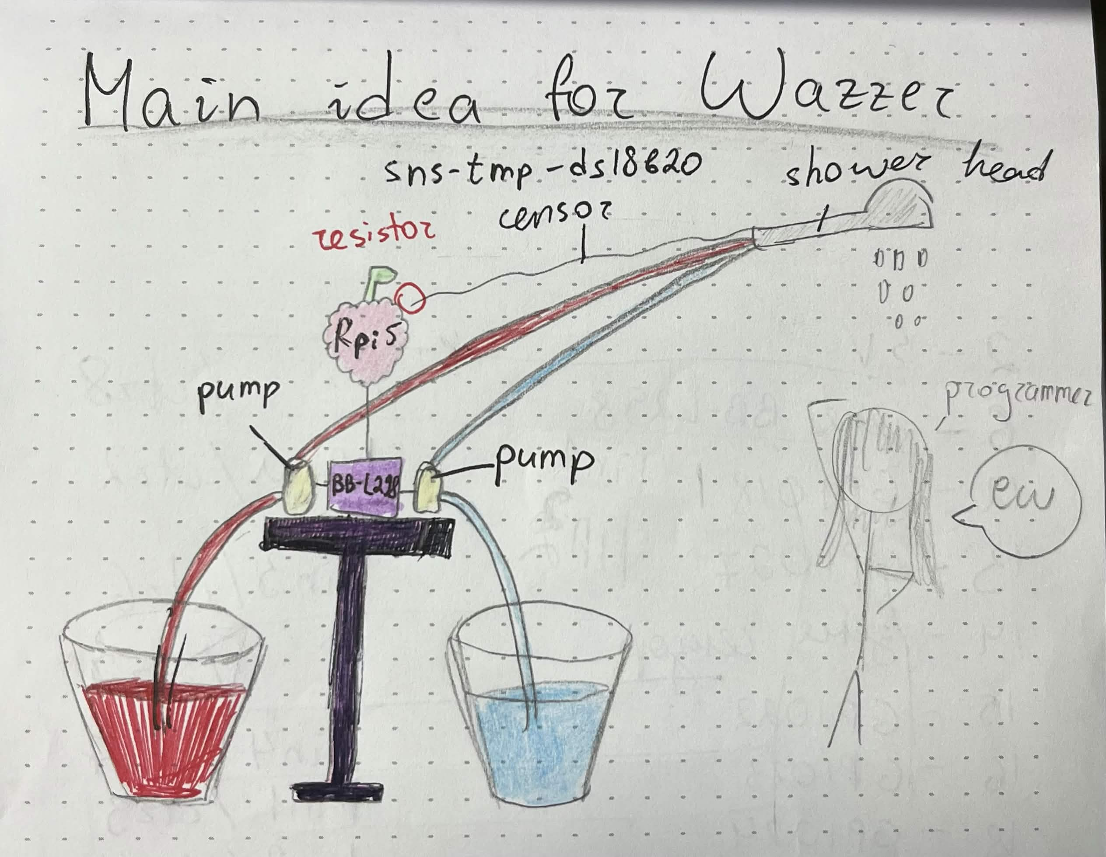
USED TECHNOLOGIES
USED TECHNOLOGIES
HOW THE PROJECT WORKS
HOW THE PROJECT WORKS
DEMO
DEMO
LA ESPADA

Slide 8








WORK PROCESS
WORK PROCESS
USED TECHNOLOGIES
USED TECHNOLOGIES
HOW THE PROJECT WORKS
HOW THE PROJECT WORKS
LA ESPADA

Slide 9
EXPERIENCE
EXPERIENCE
WORK PROCESS
WORK PROCESS
HTML, CSS, JAVASCRIPT
SQL, FLASK
USED TECHNOLOGIES
USED TECHNOLOGIES
PYTHON, RASPBERRY PI
Was mostly terrible at the start (had to set up github for 2h, idea was unclear, no correct parts, no knowledge, bugs), ended up working our way up thanks to our mentor and a bit of other external help
KOTLIN, ANDROID STUDIO
LA ESPADA

Slide 10
WORK PROCESS
WORK PROCESS
EXPERIENCE
EXPERIENCE
Was mostly terrible at the start (had to set up github for 2h, idea was unclear, no correct parts, no knowledge, bugs), ended up working our way up thanks to our mentor and a bit of other external help
Outstanding mentor(s..!) ☺
Some team members took on more responsibility than expected, others were less involved
Gained valuable experience by working in unfamiliar areas
LA ESPADA

Slide 11
WAZZER
WAZ
EXPERIENCE
EXPERIENCE
WAZZER
Outstanding mentor(s..!) ☺
Some team members took on more responsibility than expected, others were less involved
Gained valuable experience by working in unfamiliar areas
LA ESPADA

Slide 12
WAZ
WAZZER
WAZZER
LA ESPADA

