Slide 1
Notes For Project 1 MSDS 6372

Slide 2
Imputation (Replace Missing Values)
Important because observations with missing values are dropped when methods are used that include the missing variable and other variables
Methods for replacing missing values
Mean, median, or mode of non-missing observations
Substitution: The value from a new observation that was not selected to be in the sample (not applicable for project)
Hot deck: A randomly chosen value from an observation that has similar values on other variables
Cold deck: A systematically chosen value from an observation that has similar values on other variables
Regression: The predicted value obtained by regressing the missing variable on other variables (Watch out for Collinearity here)
Stochastic regression: The predicted value from a regression plus a random residual value
Interpolation and extrapolation: An estimated value from other observations from the same individual (not applicable for project)

Slide 3
Using LASSO Coefficients for Prediction
There is no way to test for the statistical significance of LASSO regression coefficients.
In Homework 2 we learned that the LASSO method used in estimation of regression coefficients for variable selection may give estimators with lower Mean Squared Error than OLS.
Hence, technically LASSO regression coefficients can give better estimates to use for prediction.
However, there is no guarantee the LASSO regression coefficients will give better predictions.
You may check model fit statistics with a test data set when comparing LASSO with OLS coefficients.
Also, bootstrapping (leave data out) methods may be used to evaluate the goodness of LASSO coefficients.

Slide 4
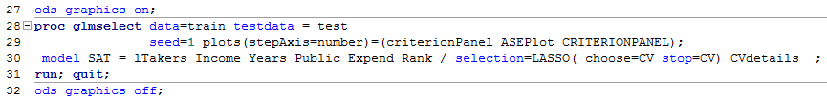
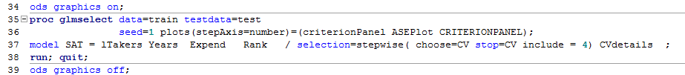
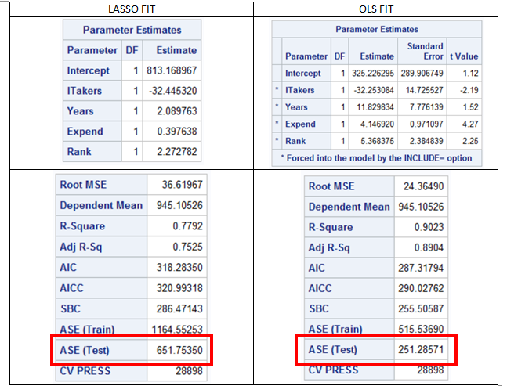
Output from Homework 2
Shows how coefficients from LASSO selection which are constrained estimates give different model fit results as compared to using the LASSO selected variables with OLS fitted coefficients

Slide 5
Comparing LASSO and OLS (Stepwise) Estimators
Use estimators to score data with a test data set in SAS where scoring calculates estimates of response (dependent) variables using regression coefficients derived with LASSO and OLS methods.
Calculate errors and SSEs using LASSO estimates, OLS estimates using LASSO selected variables, and OLS estimates using OLS selected variables.
Calculate RSQ, and ADJRSQ using LASSO estimates, OLS estimates using LASSO selected variables, and OLS estimates using OLS selected variables.
M. Selzer has developed a SAS program with macro variables to do this. Available in project1.zip in file compareOLSLasso.sas

Slide 6
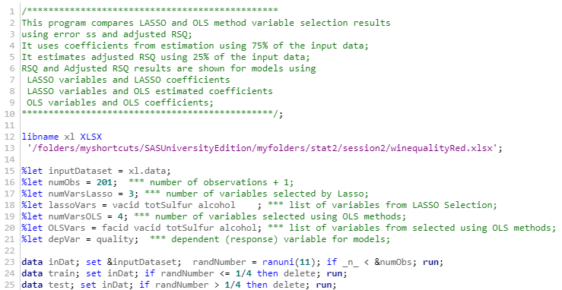
SAS Program to Evaluate LASSO and OLS Estimators Data Inputs (Using Wine Quality Data as Example) compareOLSLasso.sas
Macro Variable Inputs

Slide 7
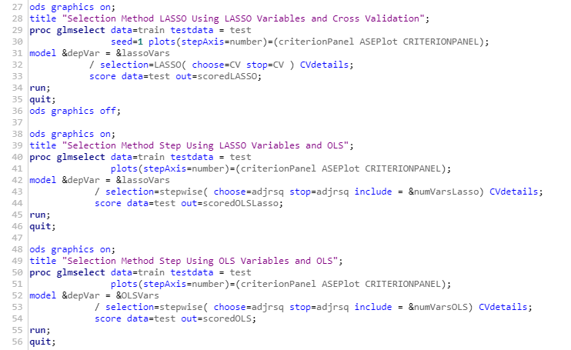
SAS Example LASSO and OLS Estimators – Continued Estimation

Slide 8
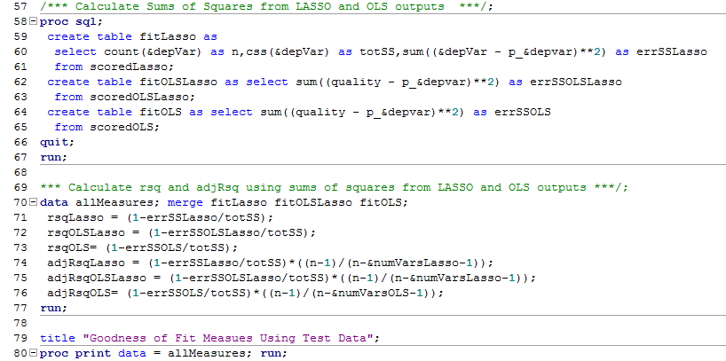
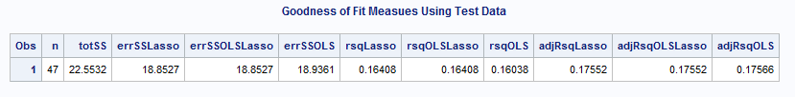
SAS Example LASSO & OLS Estimators – Continued Output

Slide 9
Interaction Terms
For Goal 1, note that interaction terms are specified by the product of covariates.

Slide 10
Confidence Intervals For Prediction and Other Typo Correction
See section Goal 2.5 of project description
Use proc autoreg for predictions and confidence intervals.
Note typo correction: specification in Goal 2.5 of part e should be part d.
Also, typo in Goal 1.5 part d. Interval k-fold should read Internal k-fold.

