Slide 1
Web scraping
Lauren Oey
Data Science Club
May 29, 2019

Slide 2
Some times the perfect data set that you are seeking is readily available online!

Slide 3
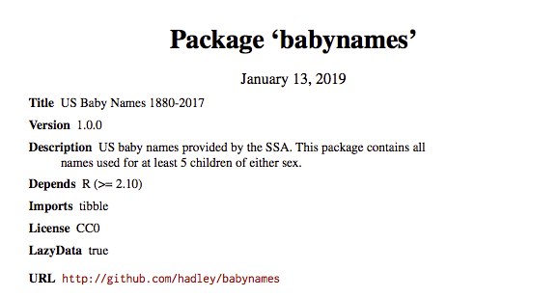
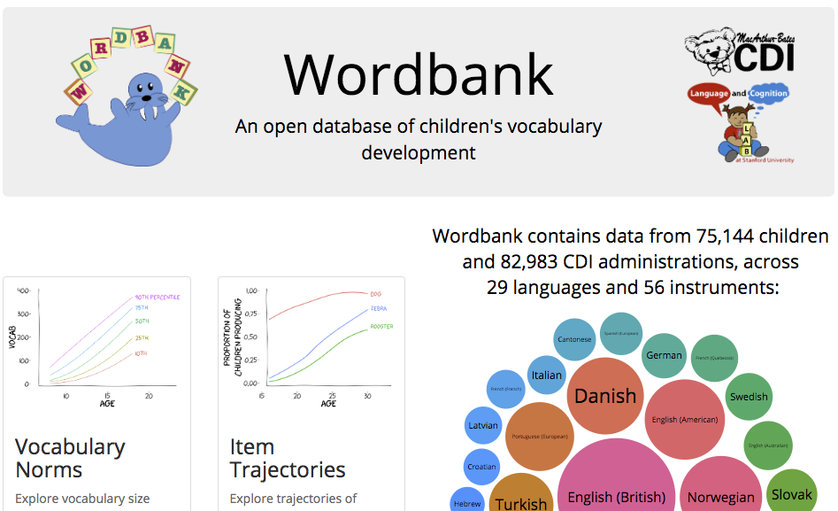
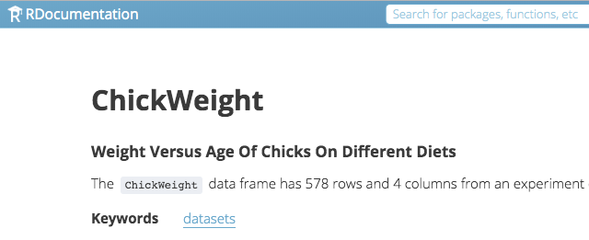
Some data sets are available in R packages

Slide 4
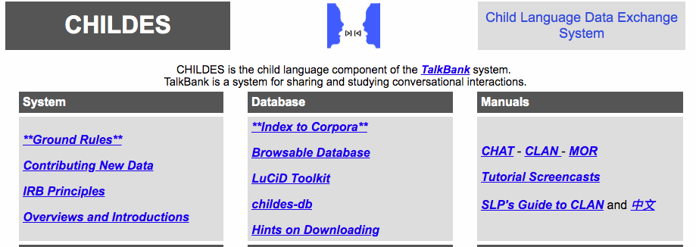
Others are…

Slide 5
What is web scraping?

Slide 6
Why would this skill be useful?

Slide 7
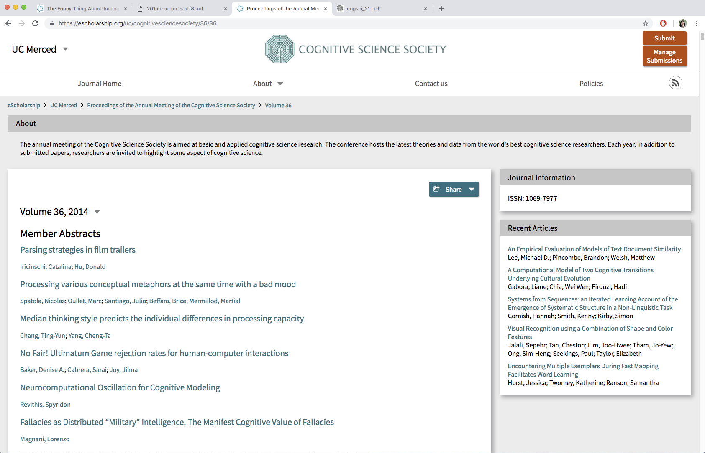
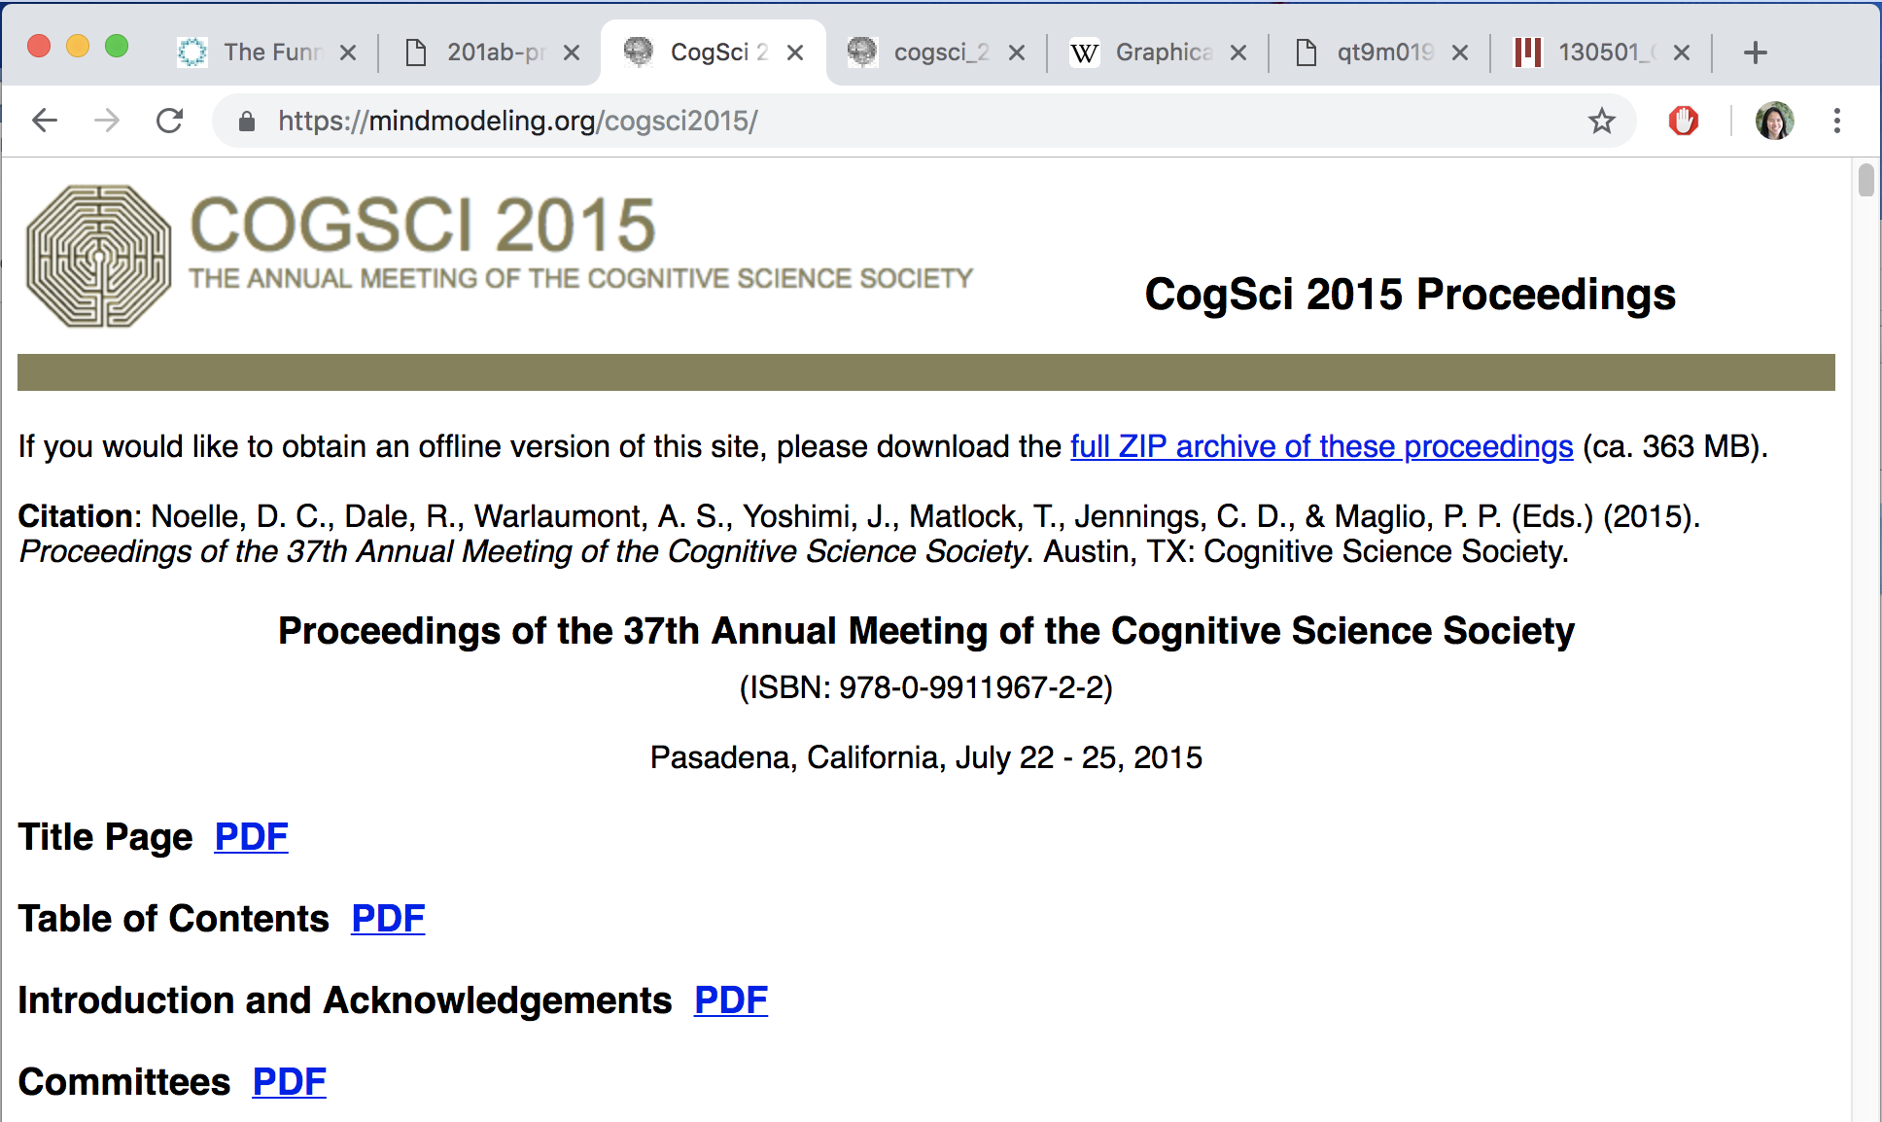
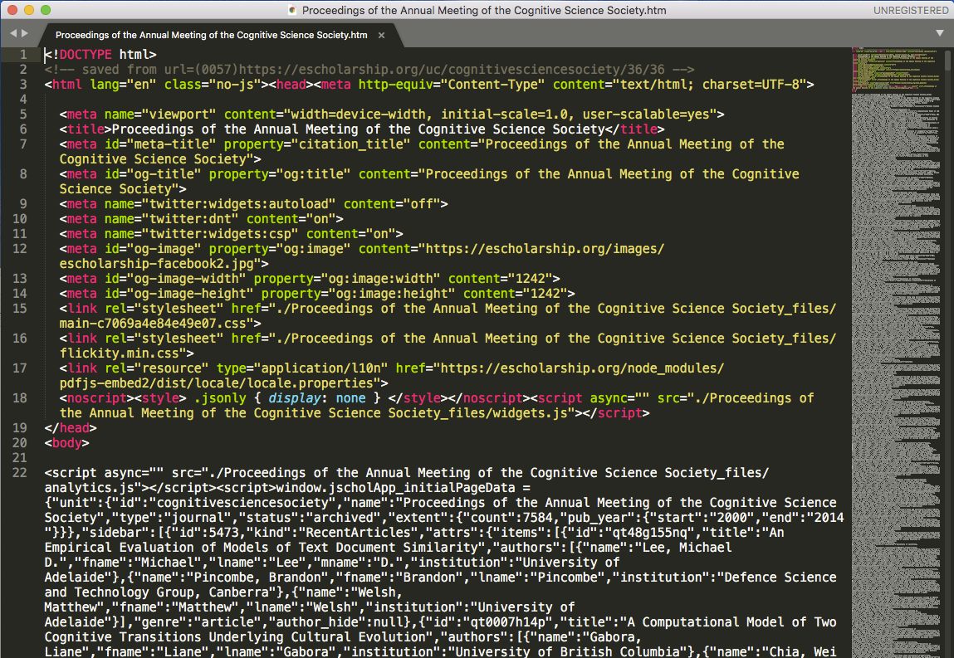
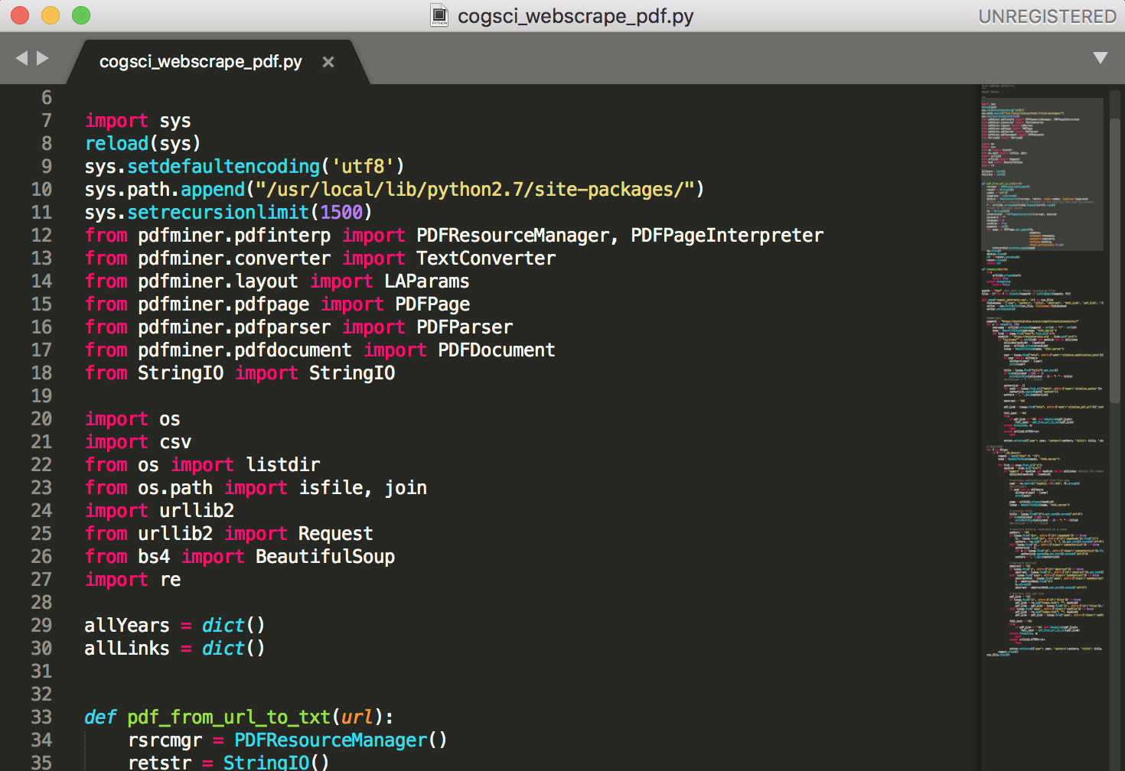
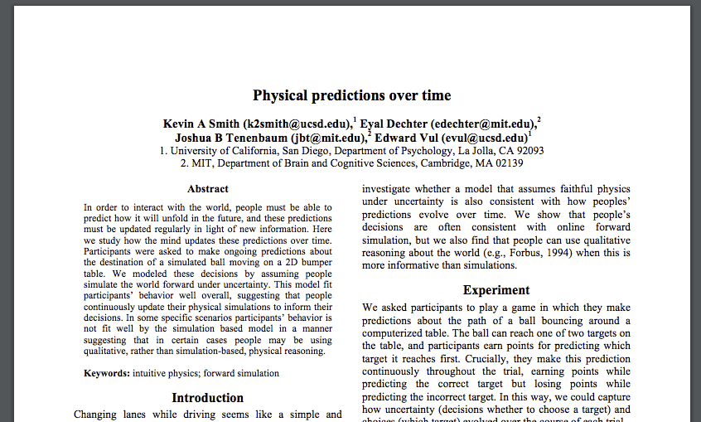
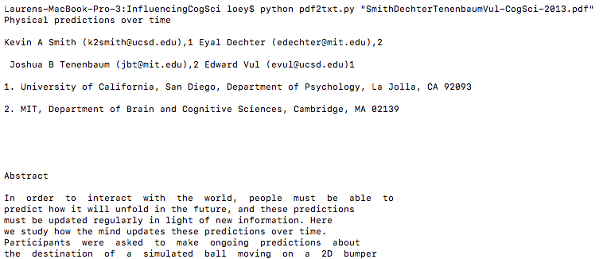
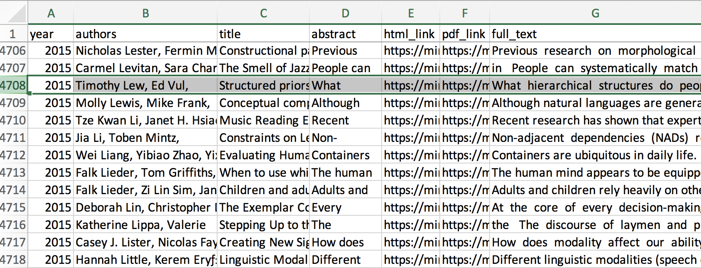
Web Scraping with Beautiful Soup
urllib – URL handling
Beautiful Soup – HTML parser
PDFMiner – PDF to text converter
regex – text pattern search
GUIs
HTML
python
PDF
pdf2txt.py/pdfminer
CSV

