Slide 1
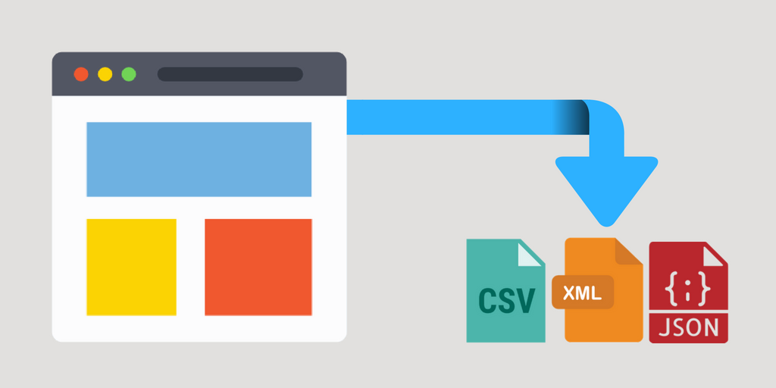
Web scraping
Lauren Oey
Data Science Club
May 29, 2019

Slide 2
Some times the perfect data set that you are seeking is free and readily available online!

Slide 3
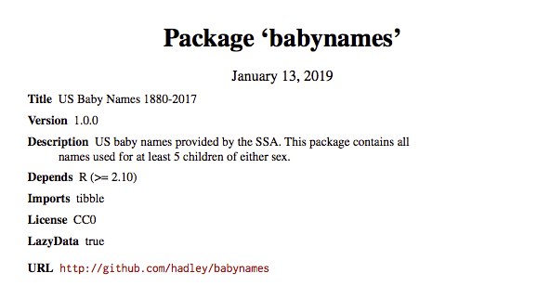
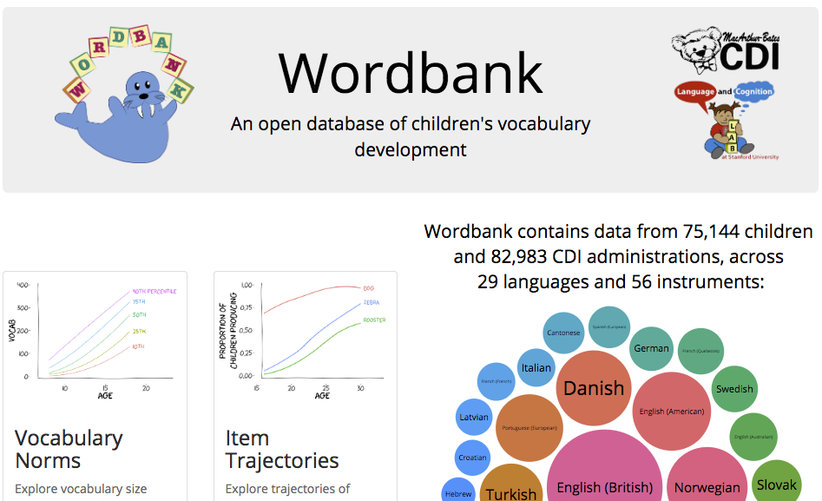
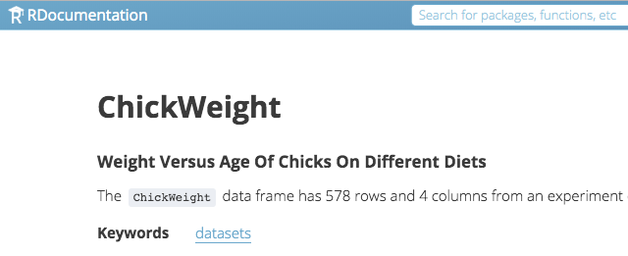
Some data sets are available in R packages…

Slide 4
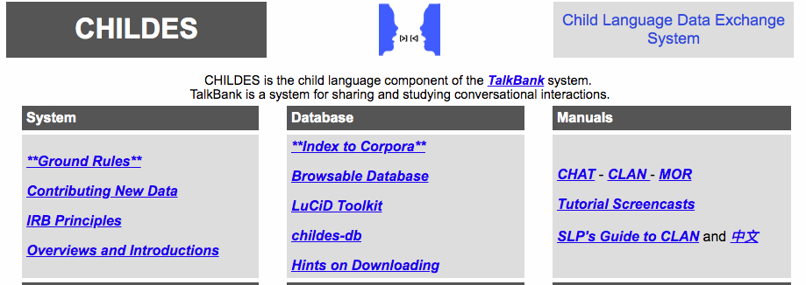


Others are available online via other means…

Slide 5
But some times it’s not and you need to retrieve the data from the web yourself…

Slide 6
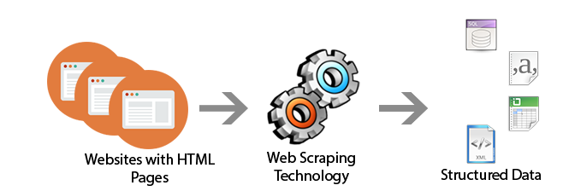
What is web scraping?

Slide 7
Beautiful Soup (bs4)
Python library for extracting data from HTML files
https://www.crummy.com/software/BeautifulSoup/bs4/doc/

Slide 8
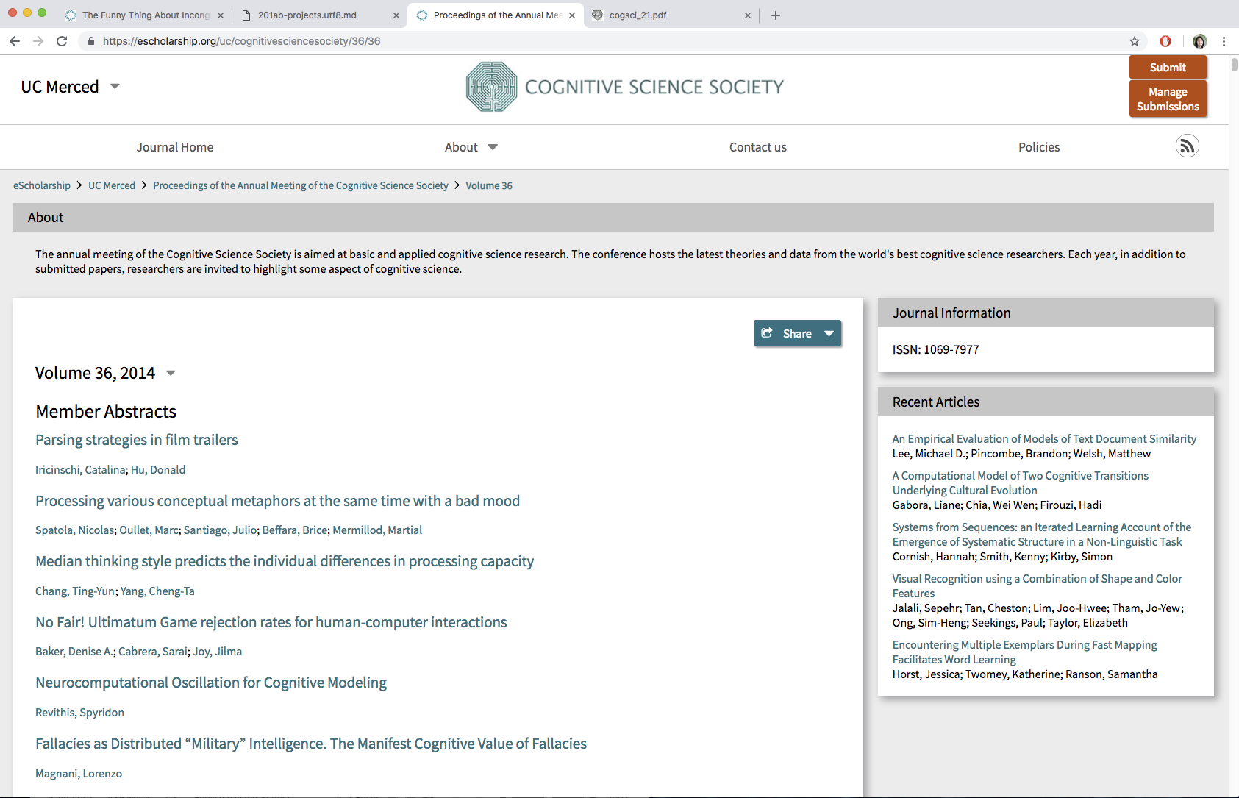
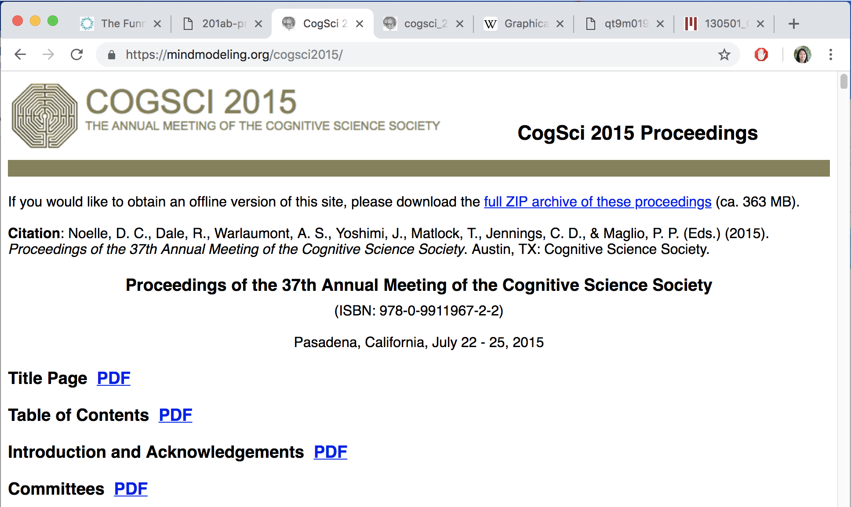
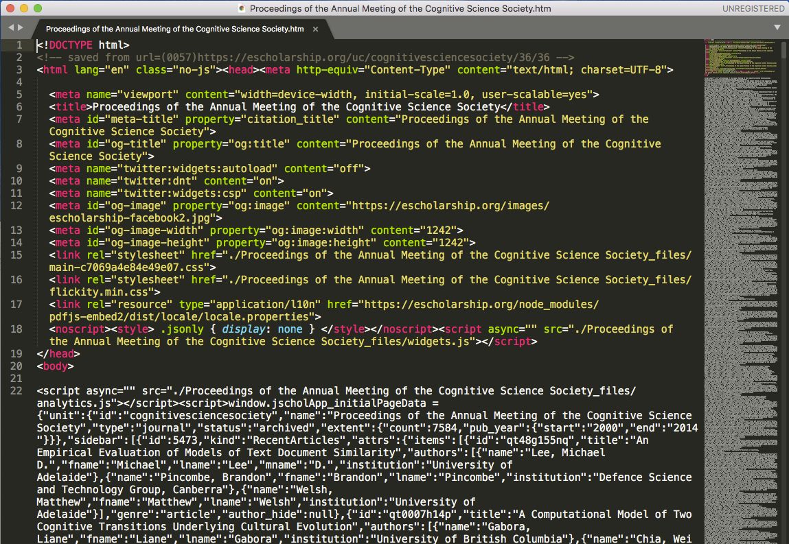
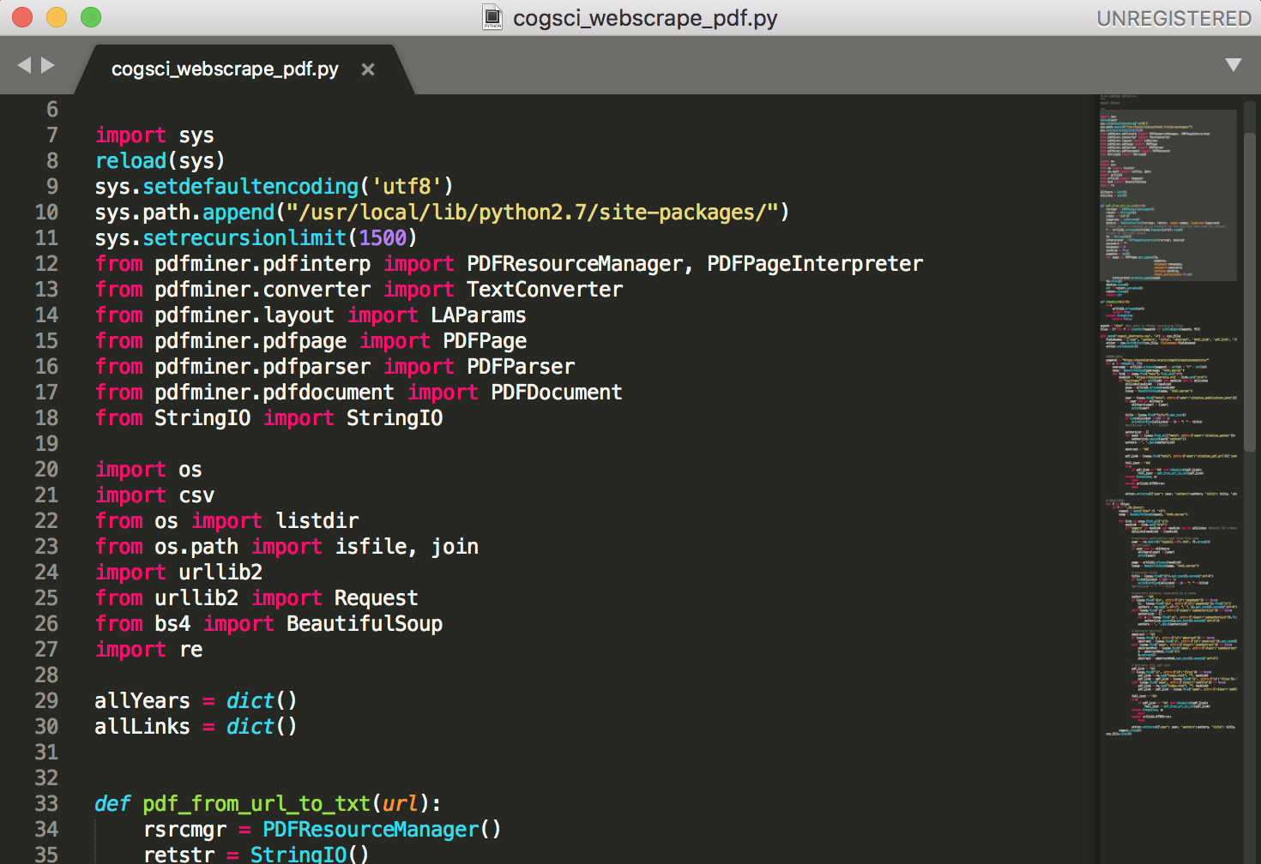
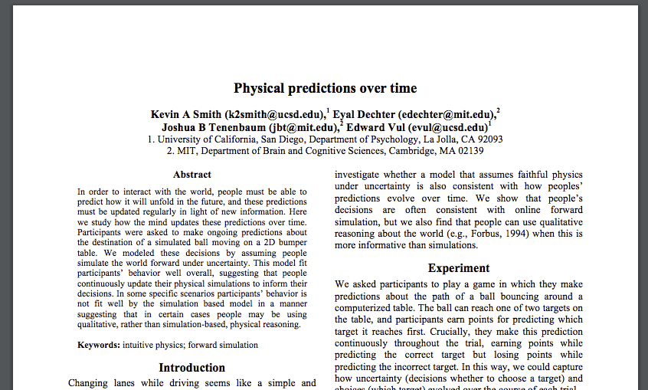
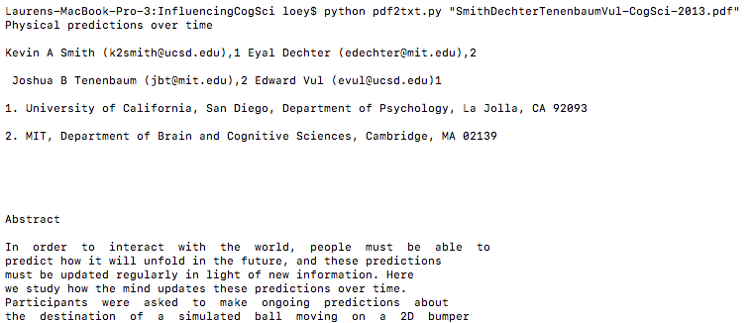
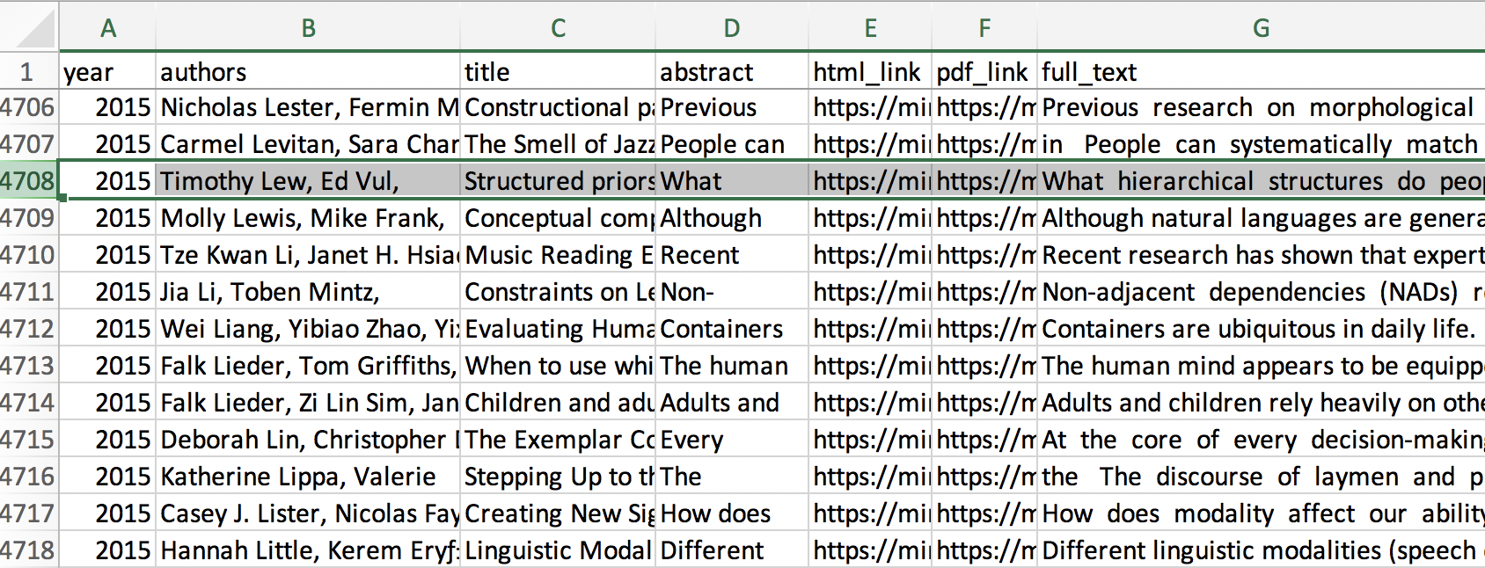
Web Scraping CogSci with Beautiful Soup
urllib – URL handling
Beautiful Soup – HTML parser
PDFMiner – PDF to text converter
regex – text pattern search
GUIs
HTML
python
PDF
pdf2txt.py/pdfminer
CSV

Slide 9
Tutorial

