Slide 1


Imperial College London
Sergey Loginov
Malik Gafirov

Slide 2
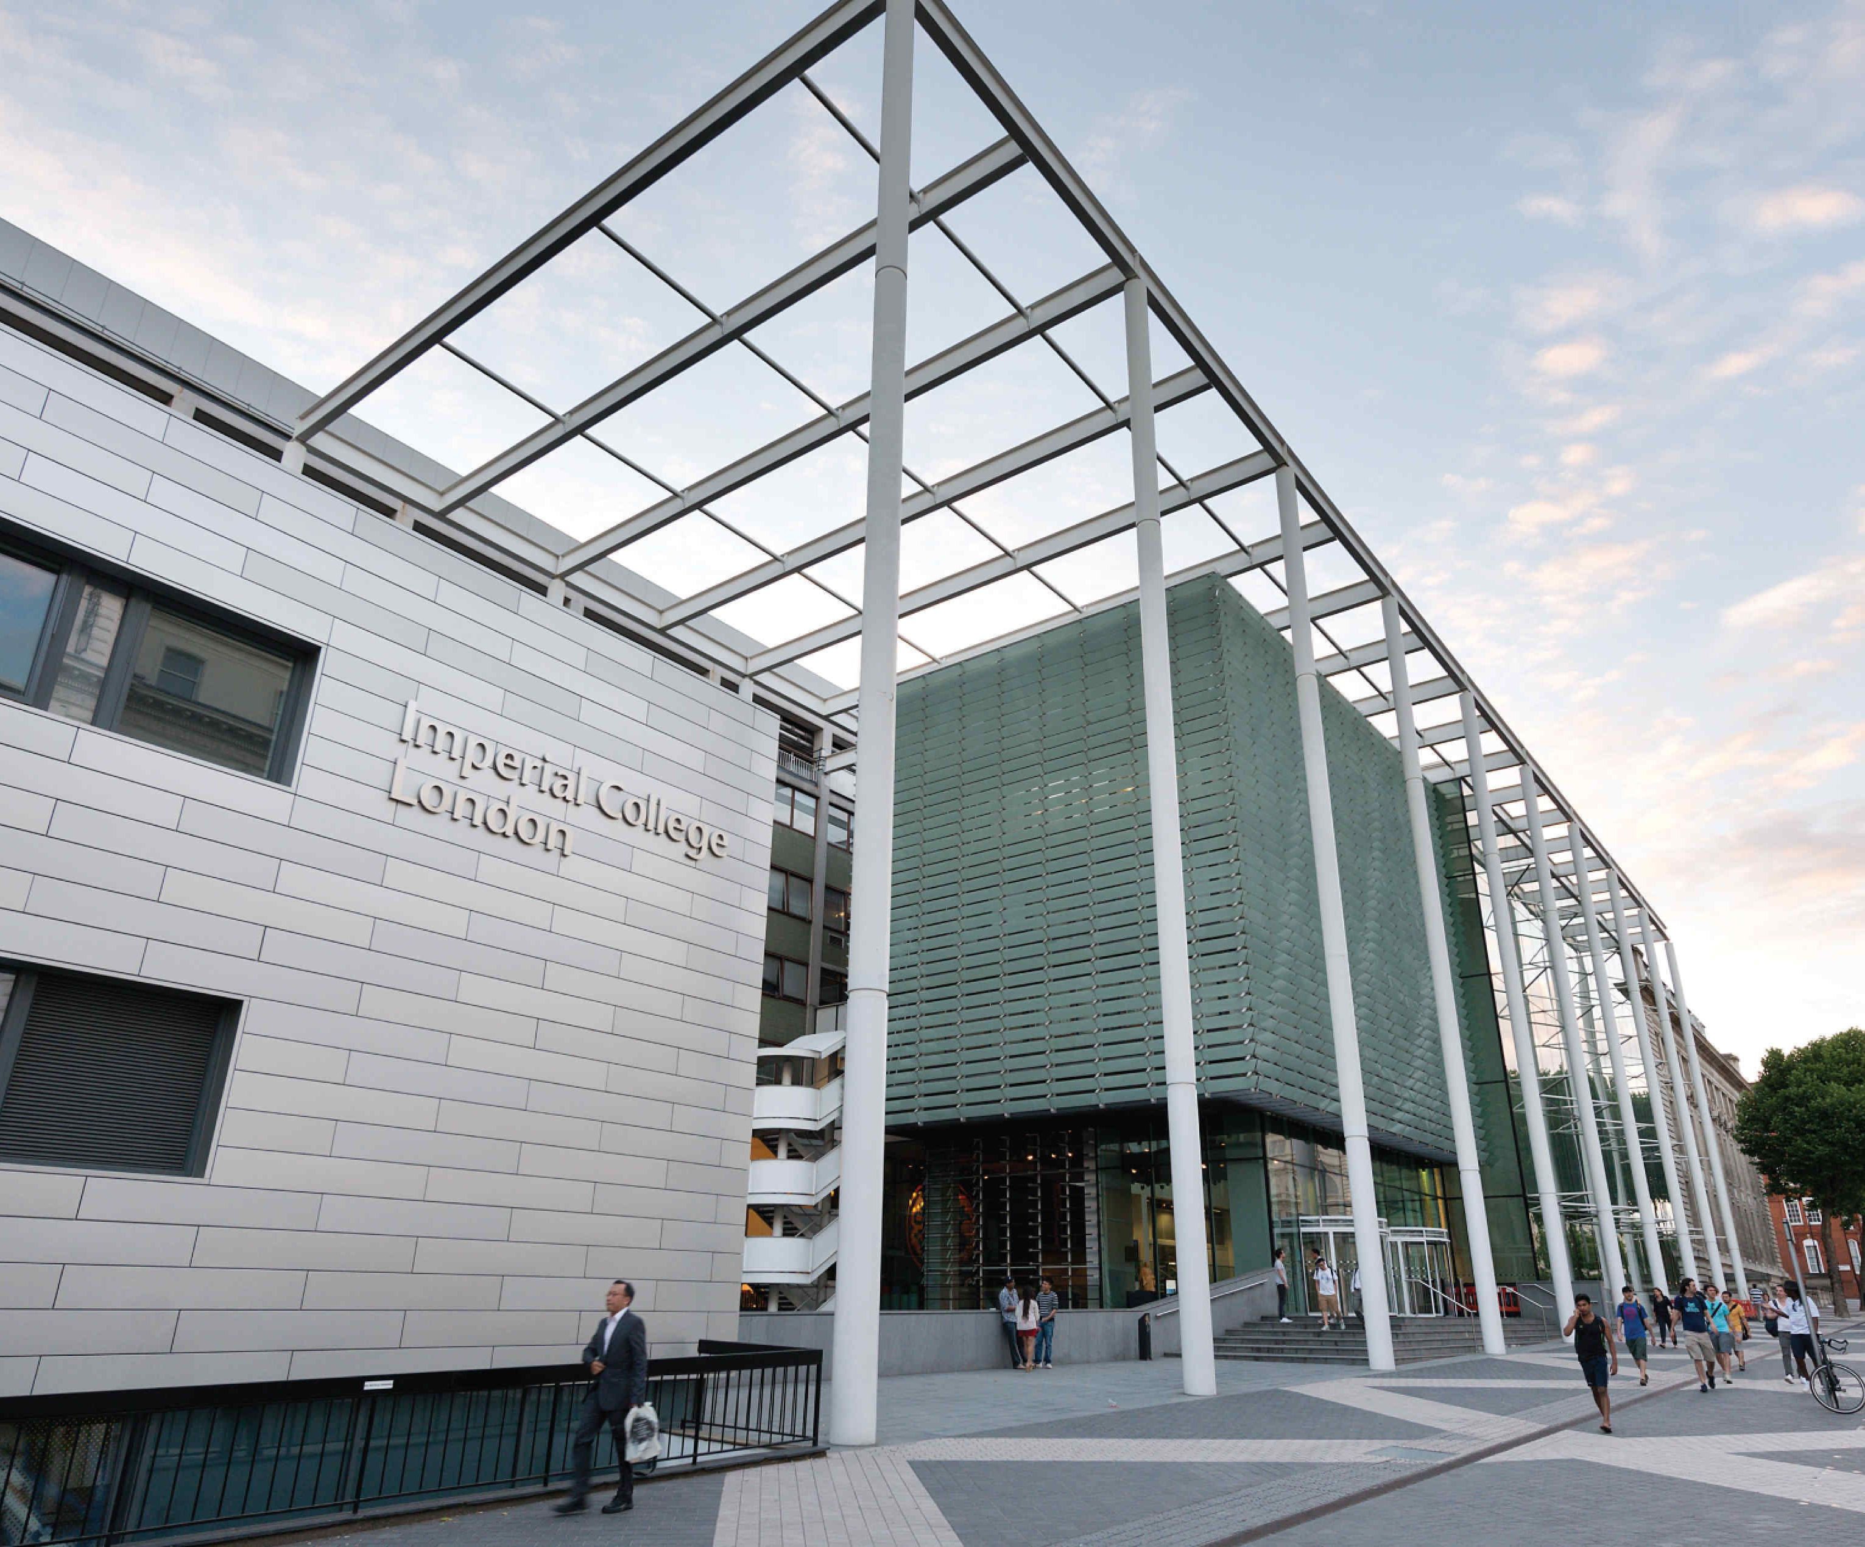
Basic information
ICL was founded in 1907
The main campus is located in South Kensington
Budget 1.072 billion £
Affiliations:
ACU
EUA
Global Alliance of Technological Universities
LERU
Russell Group
SES
Lion
Main campus

Slide 3
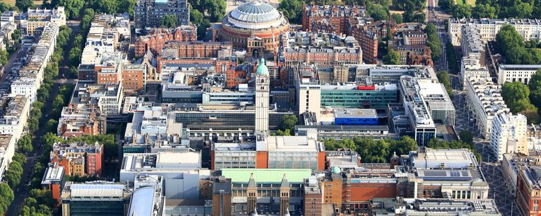
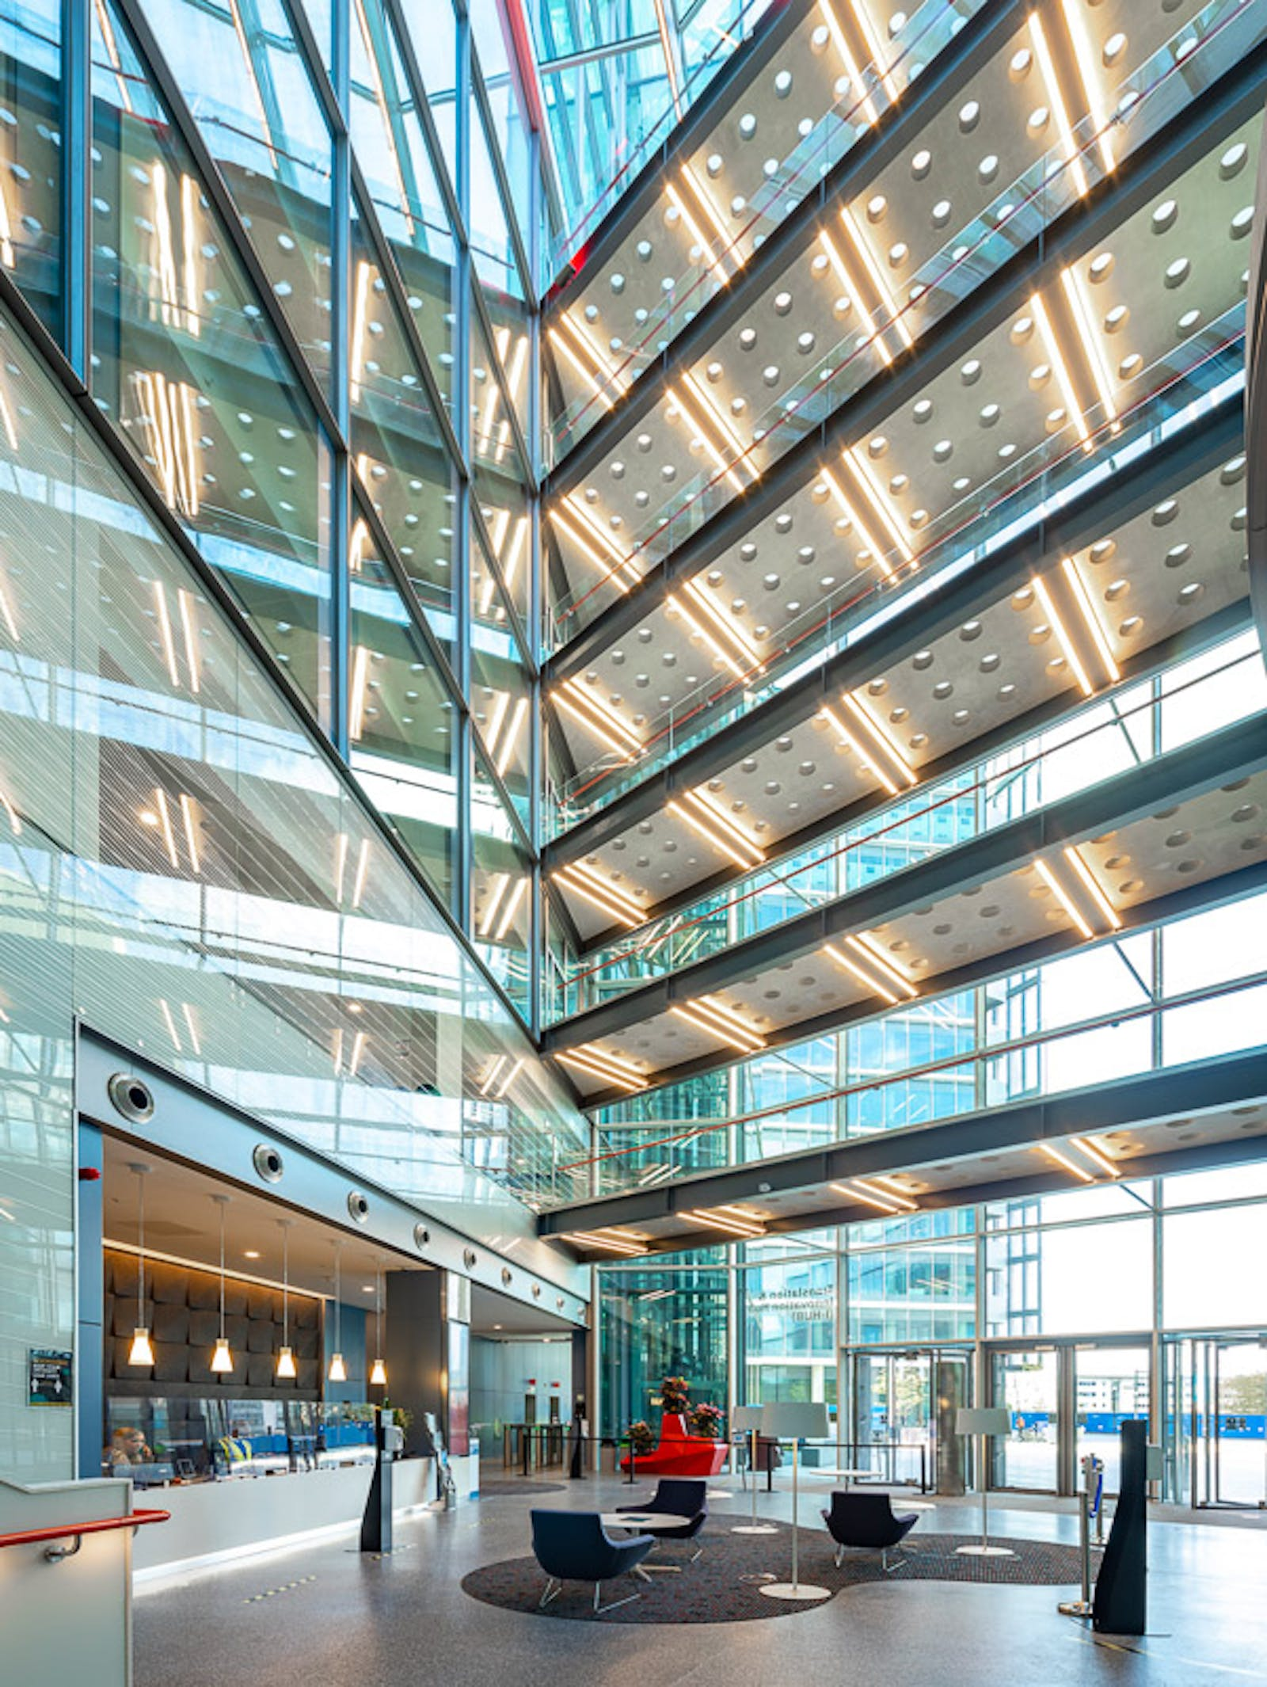
Some facts and stats
9 campuses
7/1 students/staff ratio
114 bachelor’s, 153 master’s, 50 doctor’s programs
4 faculties
6 hours of academic load per day
15 alumni awarded the Nobel prize
1st place in UK and 2nd in Europe in innovation rating
ICL bird’s-eye view
”South Kensington is our main campus and it is here that most undergraduate and postgraduate activity takes place. It's a compact site in the heart of 'Albertopolis' and is home to a huge range of architectural styles from the Edwardian Royal School of Mines building to the ultra-modern Norman Foster-designed Business School. There's plenty of green space too, including a beautiful landscaped square, with our famous Queen's Tower at one end“, from imperial.ac.uk
Main campus hall

Slide 4
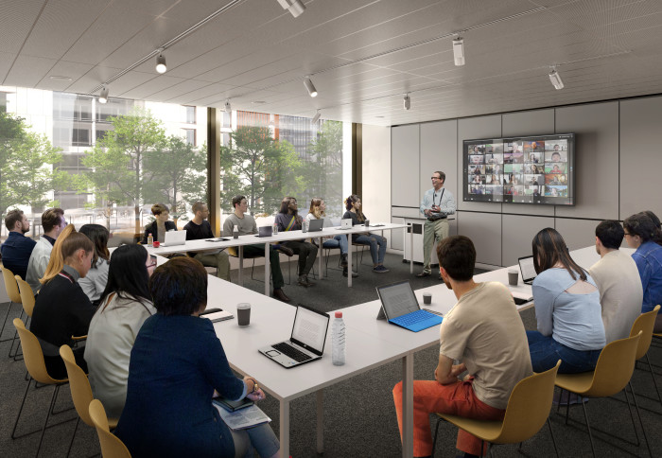
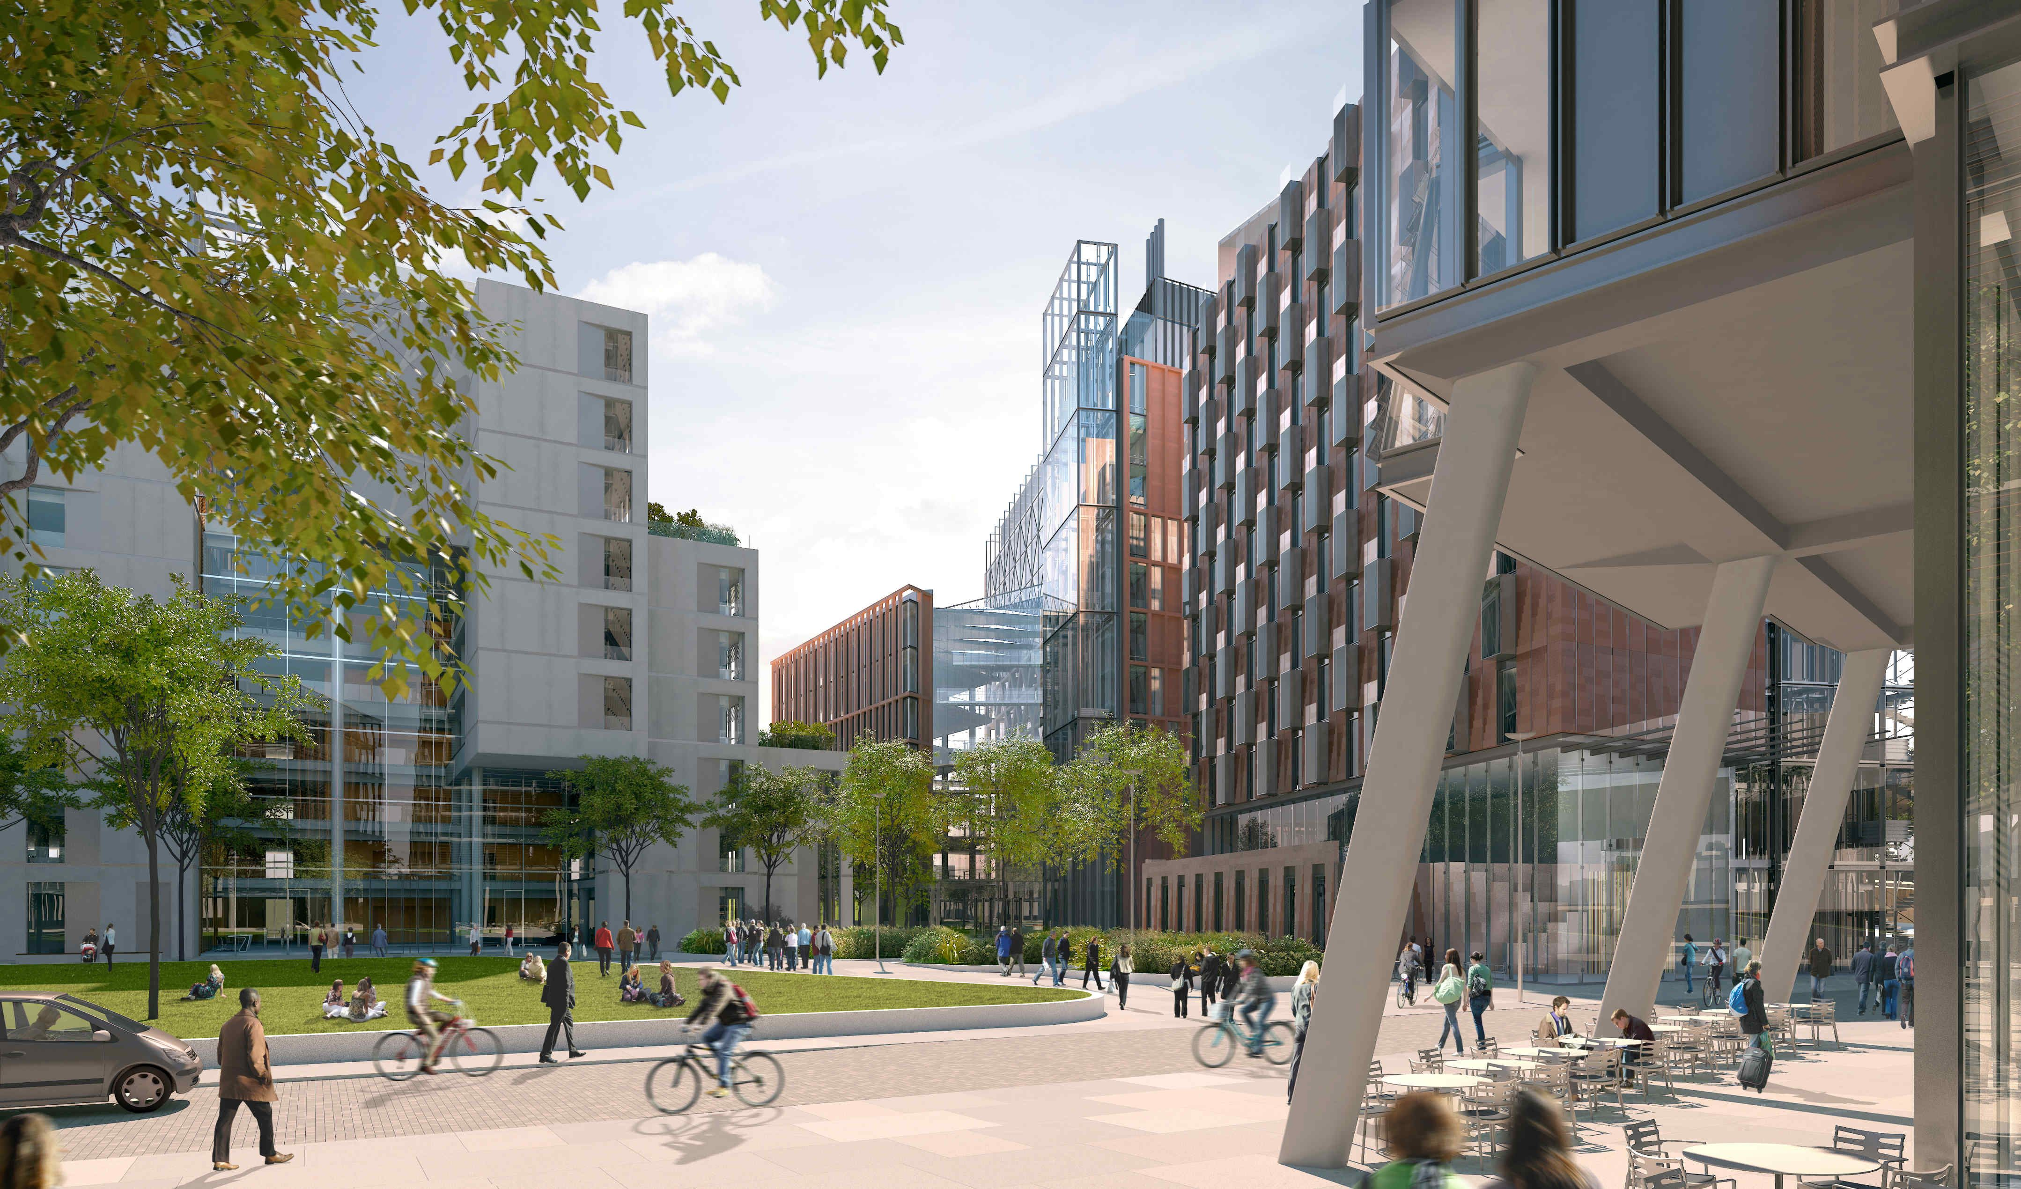
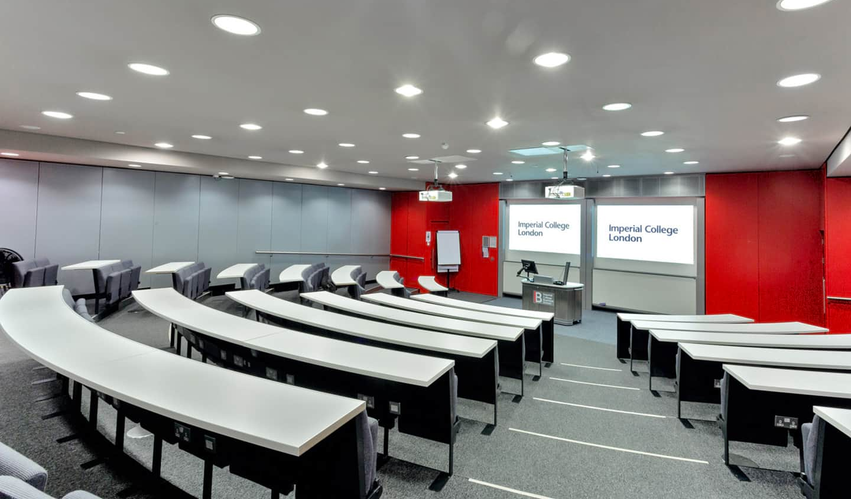
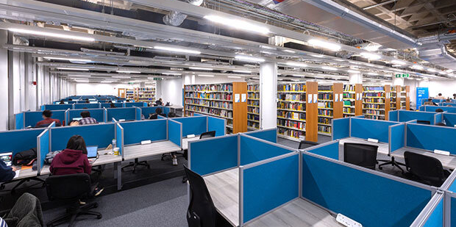
Faculties and INSide
The University consists of 4 faculties:
Faculty of Engineering
Faculty of Medicine
Faculty of Natural Sciences
Imperial College Business School
Square classroom
Behind the wall
Lecture hall
ICL library

Slide 5
Global Ratings
Rating | Place in the world | Place in Europe
Times Higher Education World University Rankings 2023 | 10 | 3
QS World University Rankings 2023 | 6 | 3
Academic Ranking of Top 500 World Universities 2022 | 6 | 23
US News Best Global Universities 2022 | 4 | 20

Slide 6
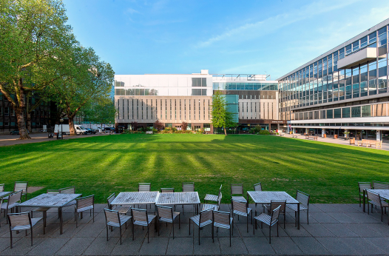
Why you should study at ICL
Academic excellence
Top-level study
Higher place in ratings
About 45% international students
250+ student social groups and clubs
Grants and scholarships, such as President Undergraduate Scholarship – 3000 £ Chevening Scholarship – up to 60000 £ Imperial Scholarship – up to 64000 £
Modern and innovating infrastructure
Wide opportunities and lots of places for relax
Main chill area

