Slide 1
Humanoid Locomotion via EMG Latent Action Priors with Muscle Synergies
Lalitha Sivakumar
Master Thesis Presentation
21.09.2026

Slide 2
Motivation
1

Slide 3
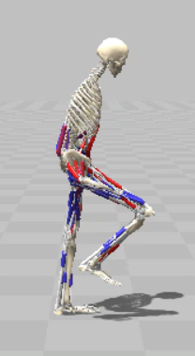
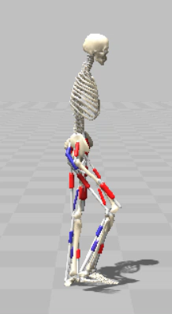
Control in Musculoskeletal Systems
Reward Engineering
Imitation Learning
Physics driven exploration
Noise based exploration
Low level representation learning
  What happens if we structure the action space using human muscle coordination patterns, rather than structure discovered from the body's own dynamics?
2
Notes:
1.5mins
Controlling musculoskeletal systems in simulation is a valuable field of work for clinicians, roboticists and for development of assistive design devices etc. This control problem is much harder than a torque actuated system.
Even for humans, this is a skill that we aquire from practice to learn control as toddlers. This is because muscle activation dynamics are non-linear and are complicated.
To start with, we have more number of muscles than joints. Muscles can, for example only contract but cant push, so the body has to find a coordination strategy in which the forces don’t cancel each other out.
You can see this in the video that's playing, that even balancing is hard.
PLAY 2ND
With reinforcement learning, the challenge is amplified because look at this example. The task is to keep walking, so the model, because of the freedom that comes with being associated with movement of muscles, resorts to a hopping behaviour.
Researchers have approached this in several ways: tuning the reward to penalize undesirable gaits, imitating motion capture data, exploring using the body's own dynamics, and using for example using correlated noise instead of white noise.
My work belongs to a different domain, in which we can change how the action itself is represented. In walking, a small number of muscle synergies account for most of the observed muscle activity, which reduces the search space.
My thesis asks: what happens if we derive that structure from human muscle data, rather than learning it purely in simulation?

Slide 4
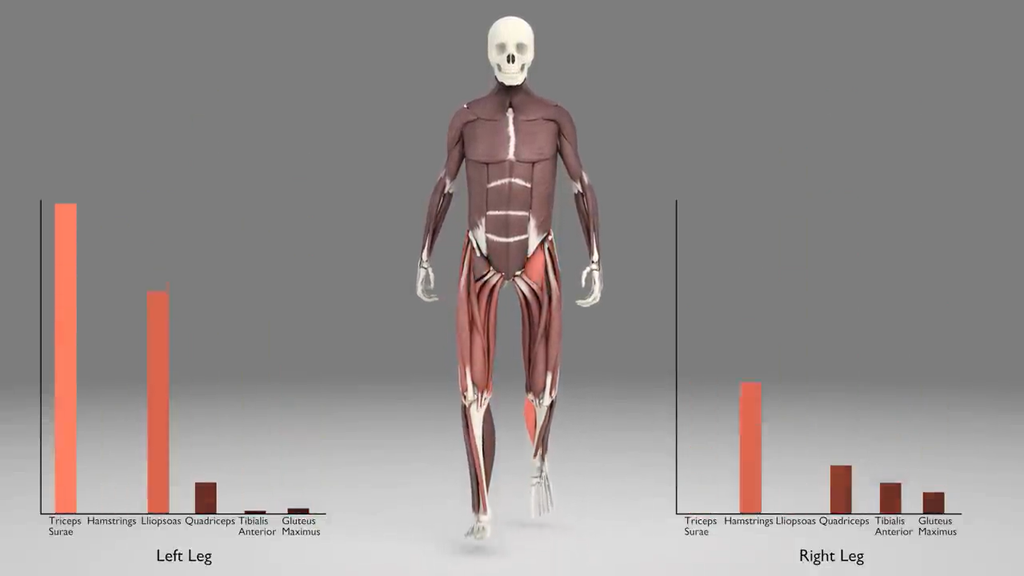
Electromyography (EMG)
Muscle activity during gait
Co-activation structure
Good proxy for muscle activation.
PROS
Human subjects ≠ model body
EMGs reflects activation, not the exact force.
CONS
Hypothesis
EMG-derived action space leads to faster learning
(sample efficiency) and/or more human-like gait.
Video source: The CADARN Learning Portal (2014)- Leg Muscles During Walking.
3
Notes:
1min.
Human muscle data comes from surface electromyography, and there are several public datasets of people walking in different modes. - In the video, you can see the coordinated structure of walking: some muscles switch on while others go quiet, and this shows up clearly in the EMG.
Walking is repetitive, so we analyze the EMGs over a gait cycle, from one heel strike to the next heel strike of the same foot.
This signal shows the brain's intent to activate a muscle rather than the exact force, but it's still a good proxy for activation.
The biggest limitation is that a subject's EMG doesn't necessarily transfer to the body we simulate. We want to see how far it gets us.
So our exploratory hypothesis is that an EMG-derived action space helps the policy find coordinated gait strategies earlier and learn faster or makes the gait more human-like, or both.

Slide 5
Methods
EMG Prior
4
Notes:
10sec
The idea is to use EMG signals as a prior, which is an inductive bias to reduce the search space for the policy to get coordinated actions.
Top 3 takeaways for methods – write accordingly

Slide 6
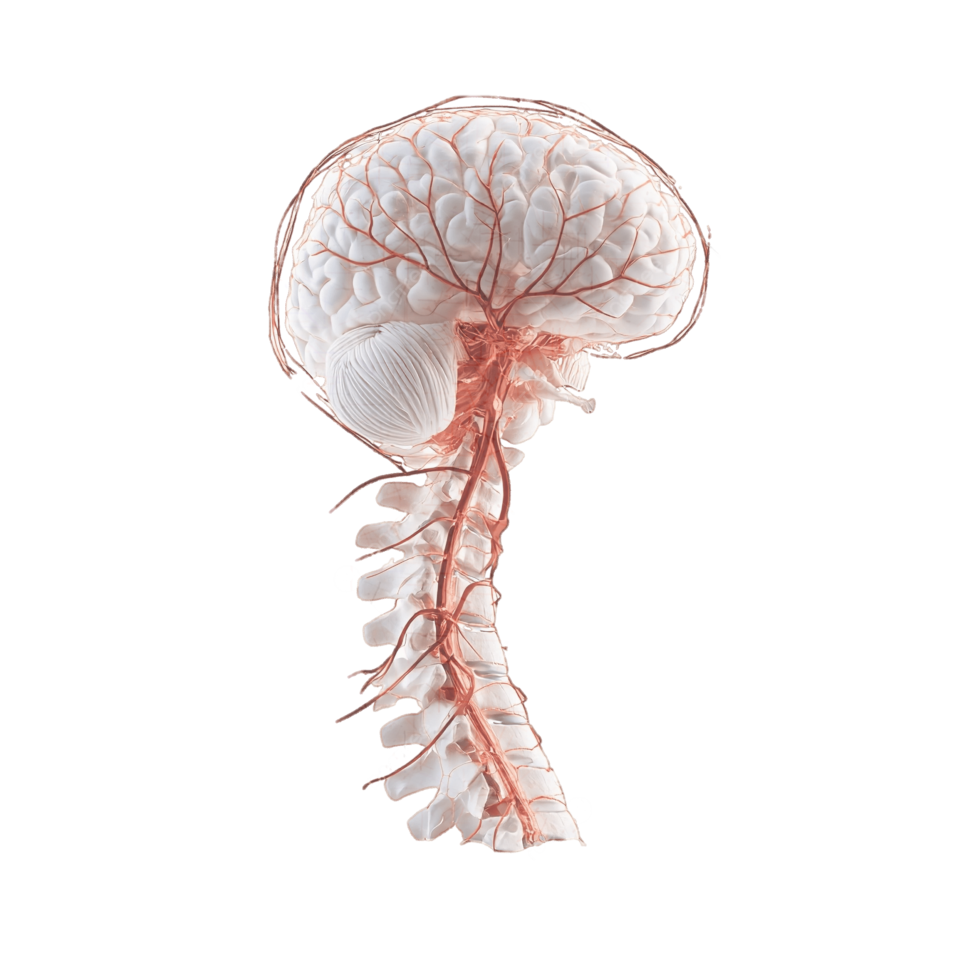
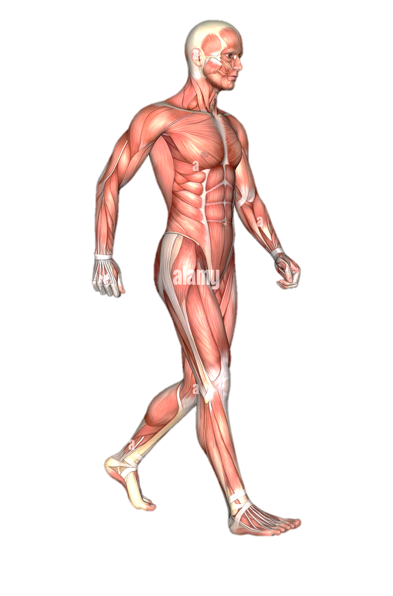
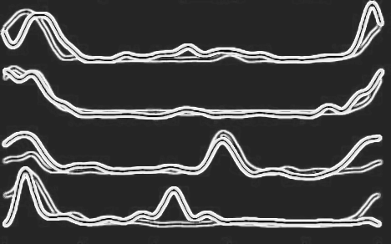












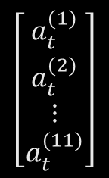


EMG Prior
Dataset
Descending
commands
Synergies
$$\left[\begin{matrix}a_{t}^{(1)} \\ \begin{aligned}a_{t}^{(2)} \\ ⋮\end{aligned} \\ a_{t}^{(11)}\end{matrix}\right]$$
$k∈$ $[ 1 , 11]$
$${\text{a}}_{t}=$$
$$∈$$
$$[0,1]$$
Motor modules
stance
HS
Mid
Stance
Heel
Off
TO
Mid
Swing
HS
0
60
swing
100
sEMG
Goniometer
Force Plates
5
[2] J. Camargo, A. Ramanathan, W. Flanagan, A. J. Young. "A comprehensive, open-source dataset of lower limb biomechanics in multiple conditions of stairs, ramps,
and level-ground ambulation and transitions." Journal of Biomechanics, vol. 119, 110320, 2021. https://doi.org/10.1016/j.jbiomech.2021.110320
Notes:
(45secs)
To design the prior, we need to find the handful few movements that explain most variance in muscle activity and these are called muscle synergies.
The synergies are motor modules that the CNS recruits to execute a descending command, in this case, to keep walking. This all happens in a quick instant.
Again, we need these to shrink the action space to the few coordinated patterns we actually use, so
the policy only explores plausible gaits.
We get the EMGs from the Camargo dataset, from one person whose body composition is the closest to the body models in simulation. They’re recorded with electrodes in 11 from the lower body.
We also use data from goniometer for joint angles and the force plates for evaluations.
This person’s EMG signals over many trials are pooled and they form the input vector at with 11 commands at each instant.

Slide 7
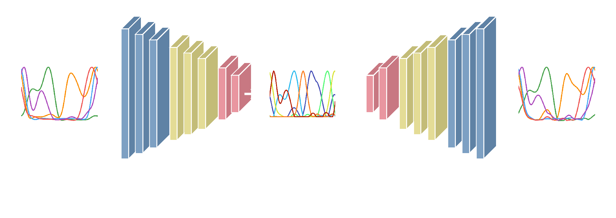
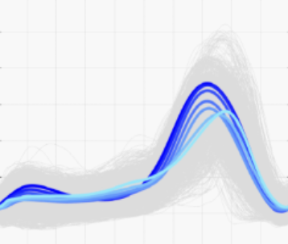
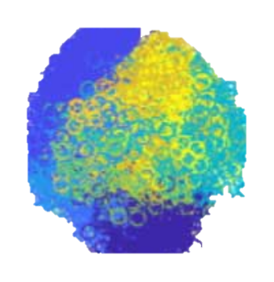






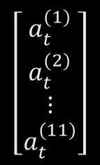

EMG Prior
Autoencoder
$$a_{t}$$
$$a_{l}$$
$${\overset{ˆ}{a}}_{t}$$
$${\text{a}}_{t}$$
$$\left[\begin{matrix}a_{t}^{(1)} \\ \begin{aligned}a_{t}^{(2)} \\ ⋮\end{aligned} \\ a_{t}^{(11)}\end{matrix}\right]$$
🔐
$$∈$$
$$[0,1]$$
6
Notes:
(30secs)
This input vector is fed into the encoder. This compresses it down to 6 dimensions for each instant, and the decoder then reconstructs the original 11 muscle pattern from just those 6 values.
The loss function is a simple MSE along with a tuned penalty to penalize latent activations that exceed a specific threshold.
After training AE, decoder’s weights are frozen and this would be used as the prior.

Slide 8

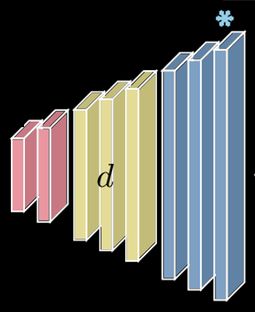






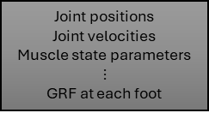
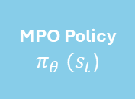
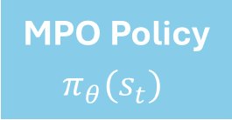




EMG Prior
Policy
$$a_{t}$$
Environment
Musculoskeletal sim
$$a_{t}$$
$${a_{full}}_{t}$$
Joint positions
Joint velocities
Muscle state parameters
$$⋮$$
GRF at each foot
Environment
Musculoskeletal sim
$${\overset{ˆ}{a}}_{t}$$
Joint positions
Joint velocities
Muscle state..
$$r_{t}$$
$$s_{t}$$
🔐
$$r_{t}$$
$$s_{t}$$
MPO Policy
$π_{θ} (s_{t}$)
MPO Policy
$π_{θ}(s_{t})$
$$a_{l}$$
$a_{t}$ $=\left(1−ω\right)$. ${\overset{ˆ}{a}}_{t}+ ω. {a_{full}}_{t}$
Reward
Forward velocity at 1.2 m/s
[3] Hausdörfer, von Rohr, Lefort, Schoellig. Latent Action Priors for Locomotion with Deep Reinforcement Learning, arXiv:2410.03246
7
Notes:
(1min.)
We base our approach on the MPO algorithm. The standard loop is shown on the left, where the policy get the state as joint positions, velocities, grfs, muscle state etc. from the simulation environment and outputs corresponding action based on a reward rt.
Our approach is shown on the right side, where we can see that the policy outputs both a_full_t, which is its own free action from random exploration AND a latent code a_l with 6 dimensions.
This goes through the frozen decoder to get reconstructed action a_hat that contains actions for all actuators mapped from our dataset to the model.
The final action a_t is weighted by omega, which is a tradeoff for how much the policy leans on the decoder vs. its own free output.
And the reward is a simple forward velocity reward to match the target speed of 1.2m/s

Slide 9
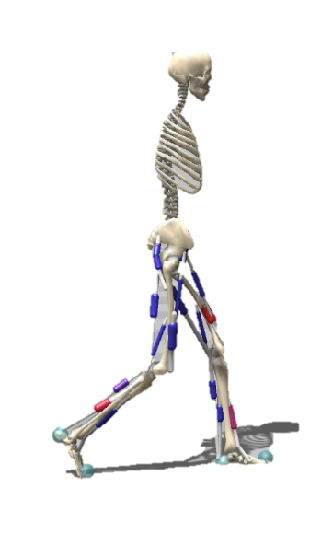
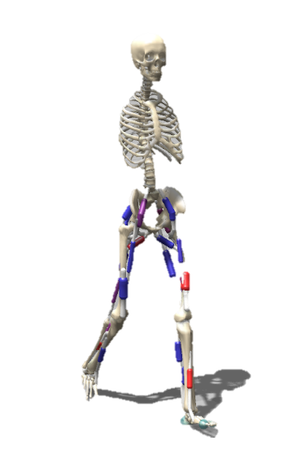
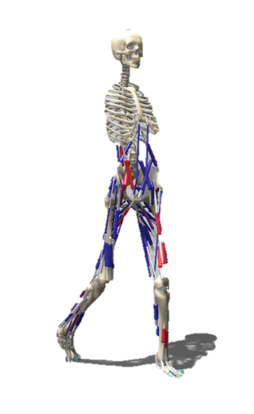
SCONE Models
Not all models have the same 11 actuators per leg!
H0918
67%
64%
22%
# of DOFs
# of muscles
H0918
H1622
H2190
Model | #DOFs | #Muscles | 3D | trunk | toes | engine
H0918 | 9 | 18 | ❌ | ❌ | ❌ | Hyfydy
H1622 | 16 | 22 | ✅ | ❌ | ❌ | Hyfydy
H2190 | 21 | 90 | ✅ | ✅ | ❌ | Hyfydy
8
Notes:
(35secs)
Not all …
The prior only works on muscles with an exact or approximated match. We mapped the muscles based on knowledge from biomechanics to reasonably match as many actuators as possible. After that, for example we are left with 67% for the 2D human body model H0918.
The other 2 models are 3D which increases the DOF and are more complex, with 64% and 22% coverage respectively.

Slide 10

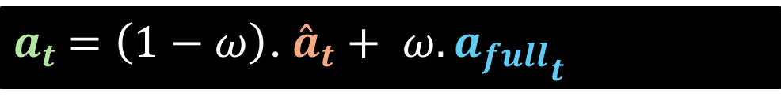

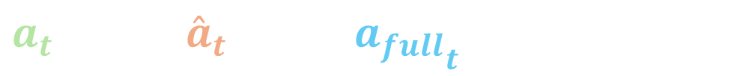


Comparison conditions
For each muscle at time t,
$a_{t}$ $=\left(1−ω\right)$. ${\overset{ˆ}{a}}_{t}+ ω. {a_{full}}_{t}$
$$⇛ ω=0.1,$$
$a_{t}$ $=0.9$ ${\overset{ˆ}{a}}_{t} +0. 1{a_{full}}_{t}$
Prior variants
Control variants
Baselines
$$ω=0$$
$ω=1$ (No prior)
Untrained Prior + $ω=0.1$
Untrained Prior + $ω=0.5$
MPO
DEP+MPO
$$ω=0.1$$
$$ω=0.5$$
9
Notes:
(45 secs)
The final action for each muscle, for an omega of 0.1 comes out to be 0.9 x actions from decoder and only 0.1 times policy’s free actions. Of course, again, this only applies to cases with muscle coverage.
With this, we define 3 groups of conditions for comparing results.
Prior variants sweep omega on the trained prior. This tells us which properties benefit from more freedom for the policy, and which benefit from staying close to the prior.
We have control variants that let us find if prior should have been trained on real EMG structure or if any untrained signal in the same bounds also good enough.
We also compare with pure MPO and MPO with a state of the art online controller DEP.

Slide 11
Results
Reinforcement learning performance
10
Notes:
Let’s look at results from RL metrics

Slide 12
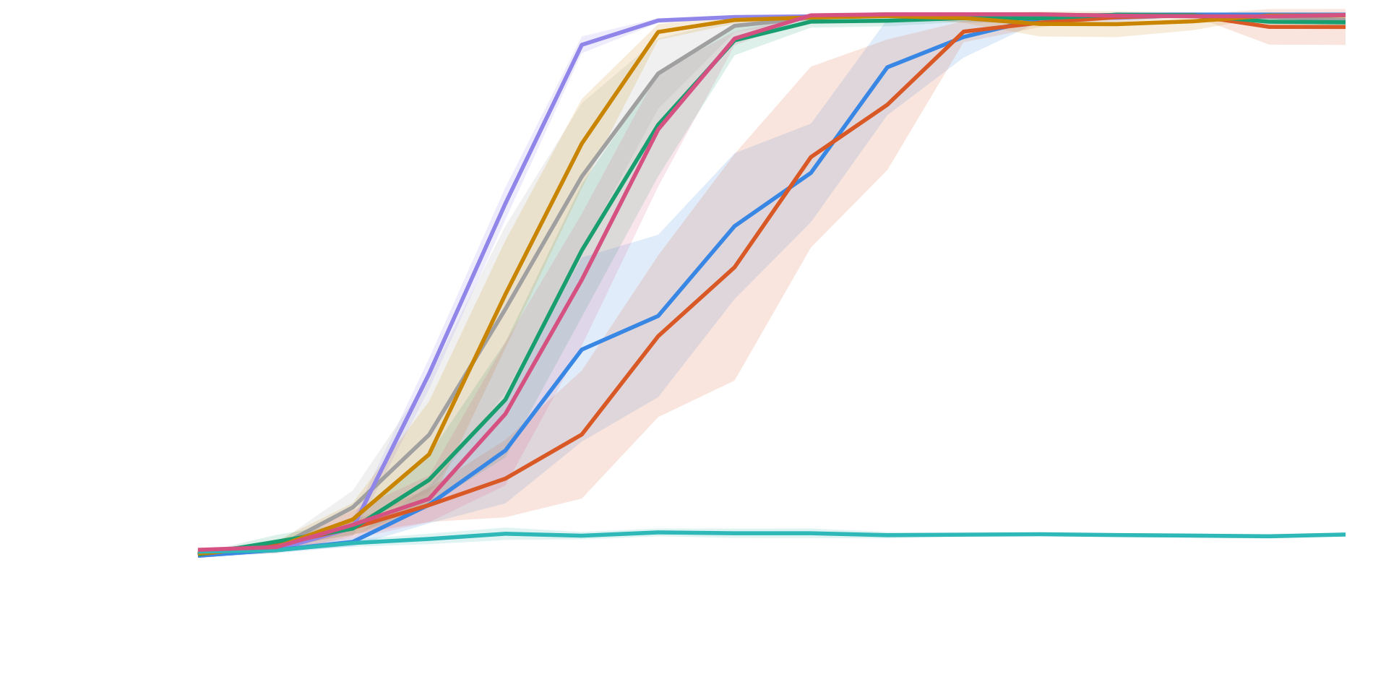
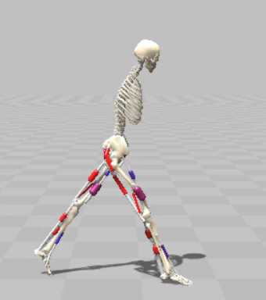

Test Performance H0918
Same pattern observed in more complex models.
Only prior + MPO with res (w=0)
Prior + MPO with res (w=0.1)
Prior + MPO with res (w=0.5)
No Prior + MPO (w=1)
Untrained prior + MPO with res (w=0.5)
Untrained prior + MPO with res (w=0.1)
MPO
DEP + MPO
Prior + $ω=0.1$
11
[4] Park, Choi, Ahn & Ahn (2026), Muscle Synergy Priors Enhance Biomechanical Fidelity in Predictive Musculoskeletal Locomotion Simulation. arXiv:2603.10474
Notes:
(1.5mins)
This is test performance for the 2D model H0918 where we show the mean episode return from running 20 rollouts per checkpoint. Curves here are averaged across 3 seeds.
The baseline conditions MPO which is the gray curve and DEP+MPO , the purple curve reach the ceiling really quickly. The DEP controller is known to perform better than MPO in find coordinated movement faster so that tracks.
The yellow curve is the control variant where we keep all decoder outputs to 0. This also reaches max return pretty early. This is because they’re free to shape their actions towards the reward from their first update.
The pink and cyan blue curves are from the untrained decoder with different omegas. This is interesting, because with a 0.1 residual, the policy is constrained with an untrained decoder that doesn’t have real structure.. so it performs poorly. But for the same condition with a 0.5 prior, the policy has more freedom to correct the bad prior and peforms competitively.
The blue, orange and green curves are our prior variants. When a higher residual of 0.5 is allowed, maximum score is reached faster as in the green curve.
Except for the untrained decoder with 0.1 residual, episodes from all cases don’t fall.
Same test performance pattern is seen in the more complex models too.
The video here is to show examples from the Prior with a 0.1 residual. All videos are obtained from rollouts of best performing seed.
rve is prior with no residual and the orange one is prior with a small residual. Prior with higher omega is the green curve. MPO and DEP+MPO are gray and purple curves respectively. The yellow curve is the no prior condition, which converges only second to DEP+MPO case.
Control variants and baselines converge the fastest; all other prior variants are slower to converge in all bodies. All variants tie in the score, and all variants have a 0% fall rate for each episode!
DEP +MPO case, null and pure MPO climb fastest due to _____________. Our prior variants are the slowest to converge here as ____.

Slide 13
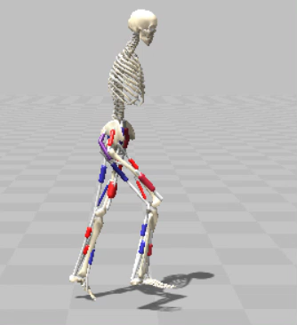
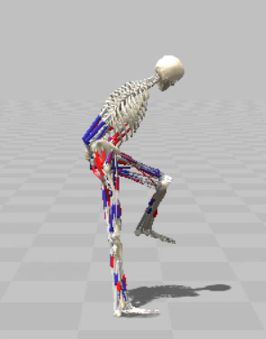


Test Performance
H1622
H2190
Prior + $ω=0$ condition exhibited degenerate gait behaviours
High fall rate and unconverging test performance!
Prior + $ω=0.1$
12
Notes:
20s
You can also see the test performance of the complex models with our approach. For H1622, the prior with no residual exhibited degenerate gaits so its excluded from analysis. For the H2190 case, none of the test curves converged to the maximum return, and the fall rate was higher between rollouts.
So our first part of the hypothesis didn’t hold.

Slide 14
Results
Biomechanical Fidelity
13
Notes:
-8mins
Let’s look at how close our approach gets us to natural gaits.

Slide 15
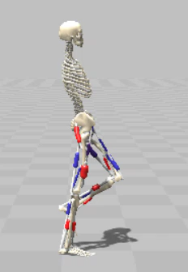
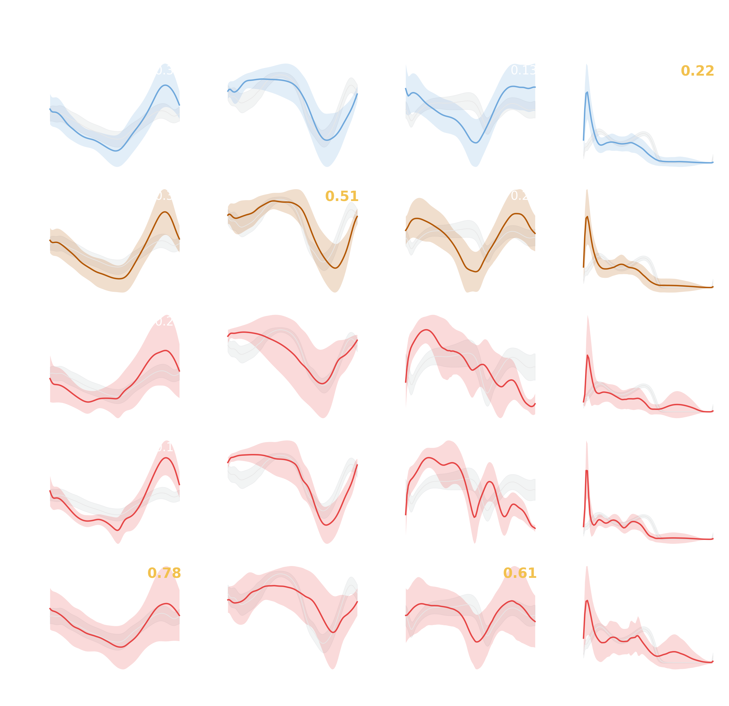
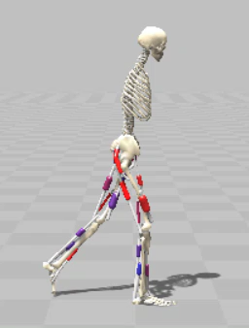


Kinematics – H0918
Prior + $ω=0.5$ significantly improves hip and ankle kinematics
fraction of the gait cycle where the model's joint angle
lies within ±1 SD of the human reference.
Hip (+flexion)
Knee (+ extension)
Ankle (+ dorsiflexion)
Vertical GRF [BW]
MPO
fraction of the predicted joint-angle (or GRF) waveform that
falls within ±1SD of the human reference band
Prior +
$ω=0.5$
14
Notes:
47 secs
Here we compare joint kinematics for H0918 model where we see the hip, knee and ankle angles over the gait cycle.
The performance is scored with an experimental match metric, that tells us how often the condition’s joint angle trajectories lie within human reference band in the gait cycle.
Here, I’ve selected 5 subjects from the Camargo dataset with similar body compositions as the subject whose data was used to train the decoder.
We can see that the prior with a 0.5 residual has a significant advantage over baselines in hip and ankle angles. We can also see this from the example videos where I show the best performing seed for MPO vs our approach.
This could be the case because the prior is successful at forcing muscles to act together in the coordination patterns closer to humans. The residual only gives the policy room to fix from this starting point.

Slide 16
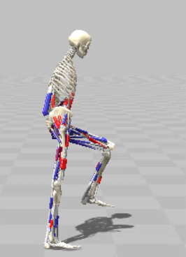
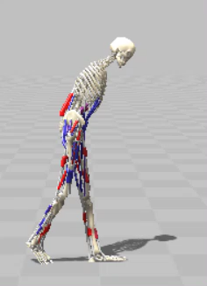
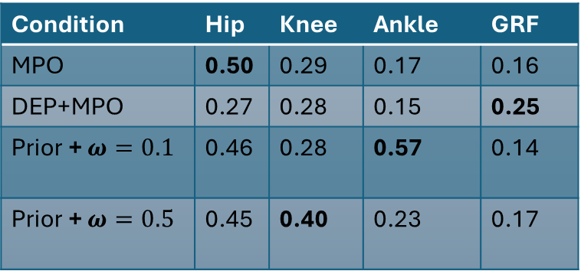


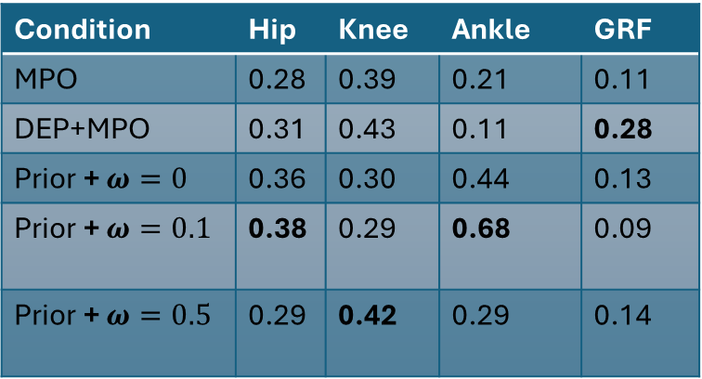
Kinematics – H1622, H2190
Prior + $ω=0.5$ for overall win; Prior + $ω=0.1$improves ankle kinematics here
Condition | Hip | Knee | Ankle | GRF
MPO | 0.50 | 0.29 | 0.17 | 0.16
DEP+MPO | 0.27 | 0.28 | 0.15 | 0.25
Prior + $ω=0.1$ | 0.46 | 0.28 | 0.57 | 0.14
Prior + $ω=0.5$ | 0.45 | 0.40 | 0.23 | 0.17
H2190
H1622
DEP + MPO
Condition | Hip | Knee | Ankle | GRF
MPO | 0.28 | 0.39 | 0.21 | 0.11
DEP+MPO | 0.31 | 0.43 | 0.11 | 0.28
Prior + $ω=0$ | 0.36 | 0.30 | 0.44 | 0.13
Prior + $ω=0.1$ | 0.38 | 0.29 | 0.68 | 0.09
Prior + $ω=0.5$ | 0.29 | 0.42 | 0.29 | 0.14
Prior +
$ω=0.5$
H2190
15
Notes:
30 sec
The advantage we observed, transfers to the complex models too.
Prior with a 0.5 residual is performs competitively overall, although here we are able to see that constraining the prior further with a 0.1 residual gives us better ankle angles in both the models.
We can see the performance of the H2190 model where we can visually observe the effect. While using our approach, the model leans forward much lesser and stays within bounds of human gait as much as possible which is reflected in the metrics.

Slide 17
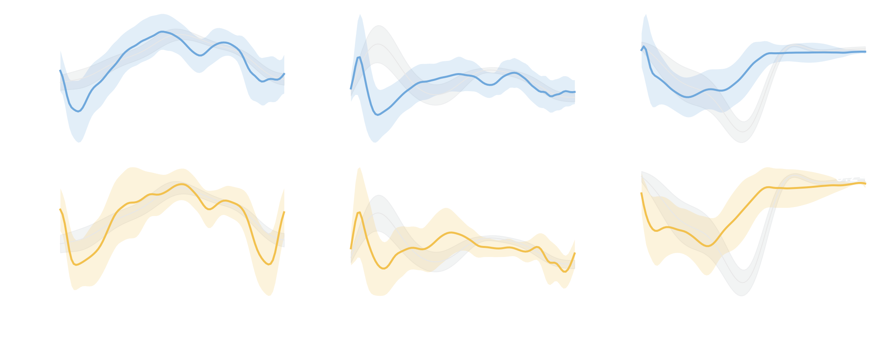
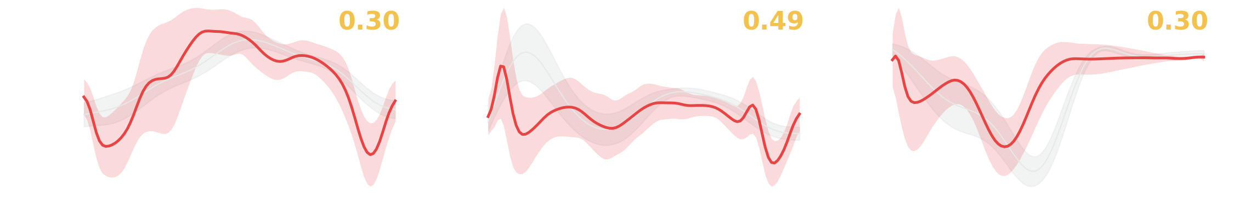

Kinetics – H0918
Prior + $ω=0.5$ performs competitively
Knee Moment (Nm/kg)
Ankle Moment (Nm/kg)
16
Notes:
15secs
Kinetics tells us about the forces or torques that produce these movements.
We can see that by using a prior with a 0.5 residual, the knee moments improve significantly here and performs similarly to the baselines in hip and ankle moments.

Slide 18

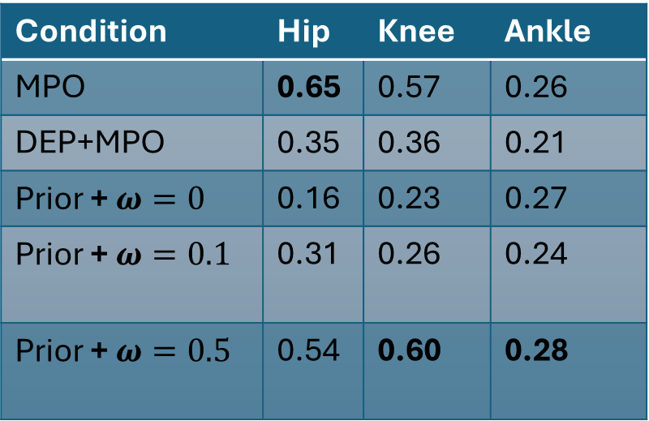
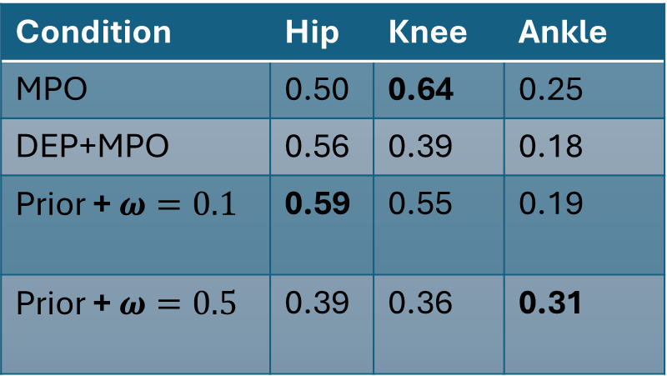
Kinetics – H1622, H2190
Prior + $ω=0.5$ performs well overall
H1622
H2190
Condition | Hip | Knee | Ankle
MPO | 0.50 | 0.64 | 0.25
DEP+MPO | 0.56 | 0.39 | 0.18
Prior + $ω=0.1$ | 0.59 | 0.55 | 0.19
Prior + $ω=0.5$ | 0.39 | 0.36 | 0.31
Condition | Hip | Knee | Ankle
MPO | 0.65 | 0.57 | 0.26
DEP+MPO | 0.35 | 0.36 | 0.21
Prior + $ω=0$ | 0.16 | 0.23 | 0.27
Prior + $ω=0.1$ | 0.31 | 0.26 | 0.24
Prior + $ω=0.5$ | 0.54 | 0.60 | 0.28
17
Notes:
25 secs
Prior with a 0.1 residual constrains the policy more and compared to the 0.5 residual runs, it rescues the hip and knee kinetics and delivers close to baseline performance.
The advantage of prior with a 0.5 residual us more pronounced in the complex H2190 model where it performs the best overall, especially in knee kinetics.

Slide 19
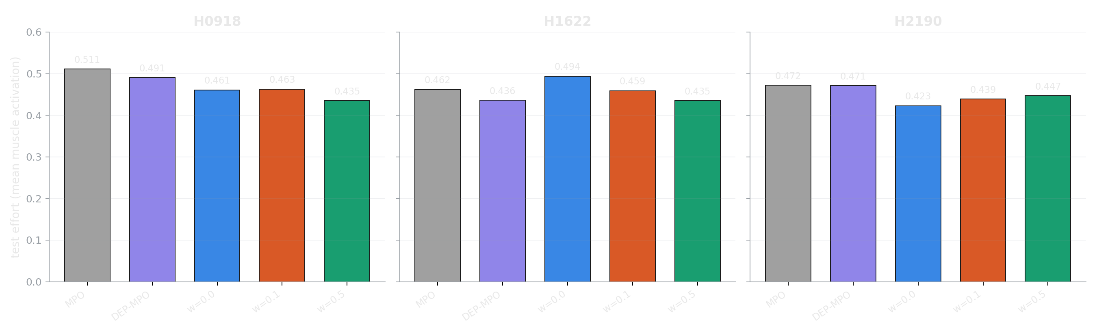

Test Effort
Prior variants with roughly 10-15% lesser effort
$$\text{effort}=\frac{1}{T⋅N}\sum_{t=1}^{T}{\sum_{i=1}^{N}{a_{i}}}\left(t\right)$$
time
muscle
18
Notes:
24 secs
Let’s look at test effort which measures the mean muscle activation across all muscles throughout the walk task. Goal is to use less effort on average, which is closer to how humans walk in an energy efficient manner.
The prior variants use about 10-15pct less effort than the baselines across models on average.

Slide 20
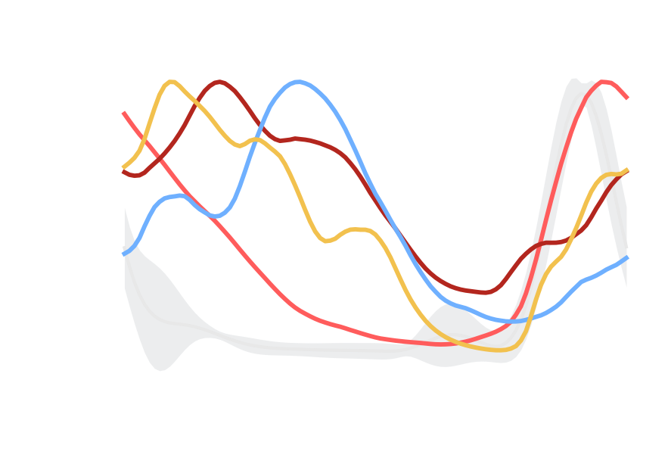

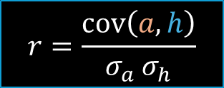
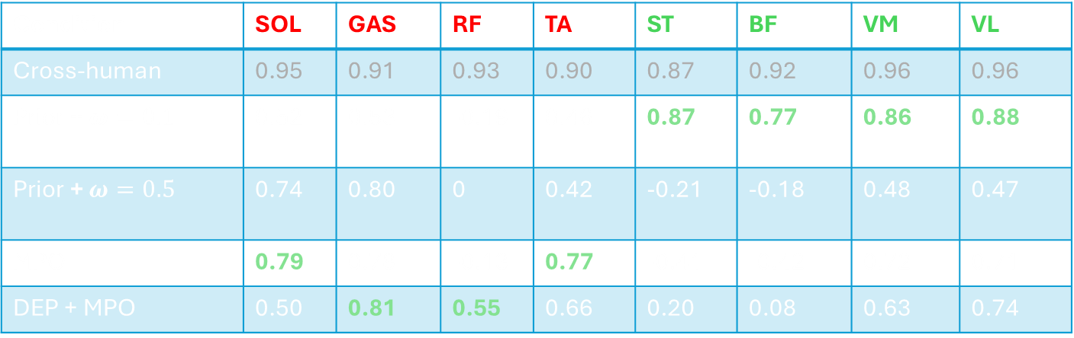
Mus
Muscle Activity H1622
Prior + $ω=0.1$ is advantageous for a few specific muscles, same results for H2190
model waveform
human waveform
The task leaves coordination open and real content resolves it where an unconstrained policy can’t!
$$r=\frac{\operatorname{cov}\left(a,h\right)}{σ_{a} σ_{h}}$$
Condition | SOL | GAS | RF | TA | ST | BF | VM | VL
Cross-human | 0.95 | 0.91 | 0.93 | 0.90 | 0.87 | 0.92 | 0.96 | 0.96
Prior + $ω=0.1$ | 0.52 | 0.53 | -0.19 | 0.46 | 0.87 | 0.77 | 0.86 | 0.88
Prior + $ω=0.5$ | 0.74 | 0.80 | 0 | 0.42 | -0.21 | -0.18 | 0.48 | 0.47
MPO | 0.79 | 0.78 | -0.13 | 0.77 | -0.41 | -0.42 | 0.72 | 0.71
DEP + MPO | 0.50 | 0.81 | 0.55 | 0.66 | 0.20 | 0.08 | 0.63 | 0.74
19
Notes:
1.7 mins
Finally, let's see how well the conditions reconstruct muscle activity on h1622.
I report the Pearson r correlations, where we again base our comparisons to the 5 subjects we saw in kinematics and kinetics. A correlation of 1.0 means that we get both the magnitude and the timing right on that muscle, and a high enough negative correlation is when we only get the timing wrong. The table has the 8 muscles that are common to all three models.
I have highlighted those muscles in red where we perform worse than baselines. For both H1622 and H2190, the 4 muscles highlighted in green perform much better than the baselines when prior with a 0.1 residual is used. For the H0918 model, this didn’t yield any benefit in muscle activity, and this could be because the task was simple enough.
An example is shown where we can see the reconstruction of the bicepsfemoris muscle, and the light red curve is the prior with 0.1 residual condition and it follows somewhat closer to the human pattern compared to other methods.
This clearly tells us that the prior is showing to help in those cases where the task leaves coordination open and real content resolves it when unconstrained baselines can’t. We don’t really have to get the activations of these muscles near human band to achieve a stable gait, so the baselines compromise and that’s where our approach helps.
Here, using the prior with a 0.5 residual only improves reconstruction of the Soleus and Gastroc muscles but otherwise it performs very similarly to the baselines.
Pearson r is the covariance of the model waveform a and the human waveform h, divided by the product of their standard deviations. It stays between −1 and +1.

Slide 21
Conclusion
We built an action-space prior from real human EMG, capturing how muscles coordinate during walking.
Balancing the prior with a learned residual improved several measures of biomechanical fidelity over the baselines.
Using EMG-based models offers a promising foundation to achieve physiologically realistic simulation performance of human movement.
20
Notes:
1min
So these were the key results from my thesis.
To conclude, we built an action space prior from real EMG signals that captures muscle coordination during walking. The baselines are state of the art, and they’re already good enough to achieve the task in all the models with a well defined setup.
Since we saw clear advantages in joint kinematics and kinetics, we can conclude that the constraining the action space with the prior is helping the policy choose more actions that come from this coordination.
The right balance of prior with the learned residual helps us achieve human-like performance in many biomechanics measures. The cost we pay is in test performance and with a slightly higher fall rate between episodes during training.
The idea of using real muscle data from humans to bias the action space is definitely a promising foundation for simulating human movement. This could be of potential value for biomechanics research, rehabilitation and assistive-device design and neuromuscular control.

Slide 22
Limitations/Future Work
Data is just from a few healthy subjects one dataset.
Results are only from a 3 seed training budget.
Deliberately simple velocity reward, to isolate the prior's effect; not tuned for natural or robust gait.
Prior captures muscle coordination per timestep, not temporal structure.
21
Notes:
1min.
Our prior is trained on one healthy subject from the Camargo dataset, and we evaluated on only five similar subjects. Testing on more diverse populations and datasets is a natural next step.
Second, we used 3 seeds per condition, which is on the low end. Future runs should use more seeds for tighter confidence intervals.
Third, we used a simple velocity reward on purpose to isolate prior’s effect, but a full reward system which guides the policy towards natural gait could be tested.
Lastly, the prior we use is only spatial. Adding a temporal component, such as a gait-phase input to the decoder so actions follow the gait cycle, or noise models that capture temporal correlation is a promising extension.

Slide 23
Thanks for your time.
Questions?

Slide 24
Supplementary

Slide 25
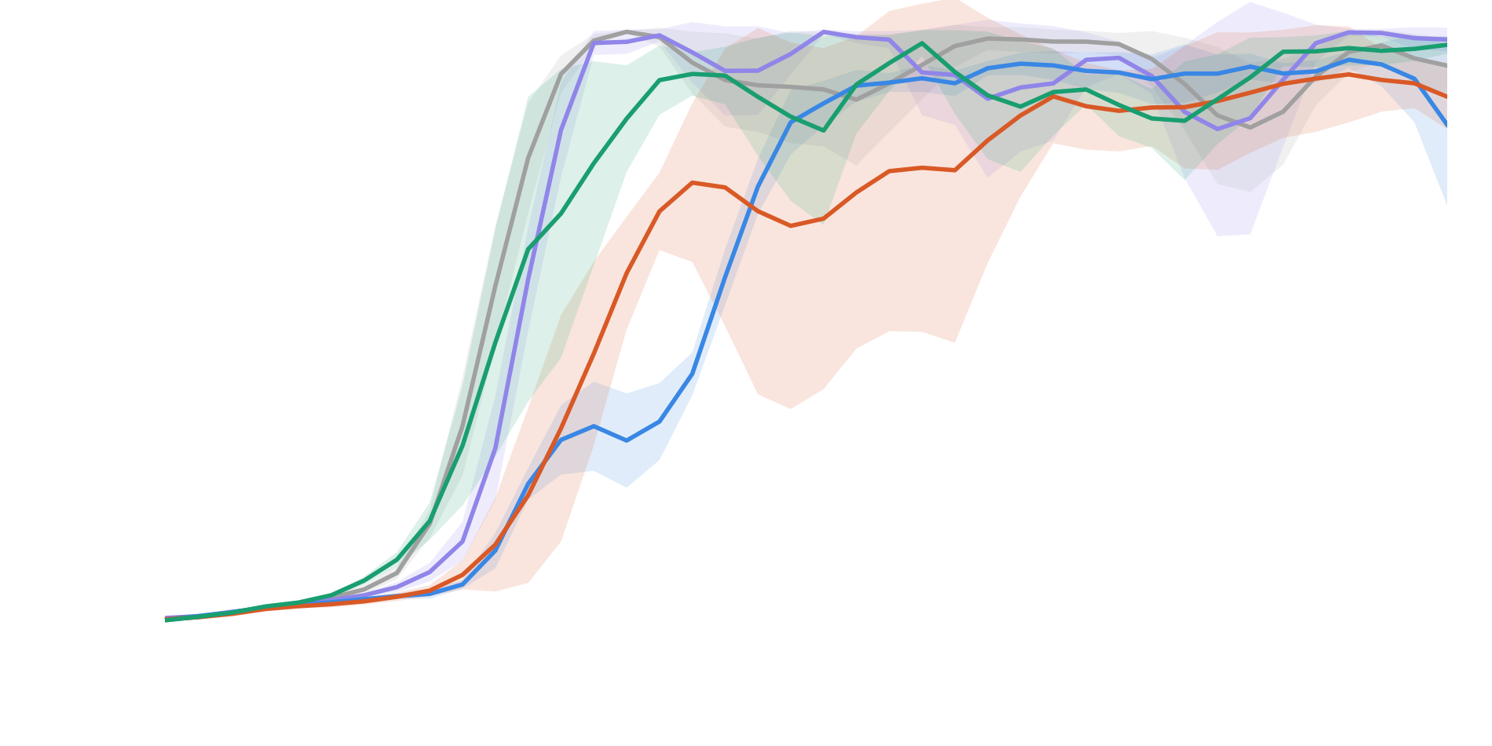

Test Performance H1622
Fully constraining leads to hopping behaviour in 2/3 seeds due to stiffened knee!
Only prior + MPO with res (w=0)
Prior + MPO with res (w=0.1)
Prior + MPO with res (w=0.5)
MPO
DEP + MPO
Prior + $ω=0.1$
EMG prior variants converge around 7M steps (slower than control and baseline variants) with a 4-10% fall rate.
Notes:
(30secs)
Moving on to the 3D model, the task is difficult with more degrees of freedom to stabilize against, as we can see from the video. The same pattern upholds here for all variants.
Since the control variants have the same results as before for all bodies, I have excluded them from the plot.
Prior with a residual of $ω=0.1$ scores slightly lesser and other approaches almost tie in final score.

Slide 26
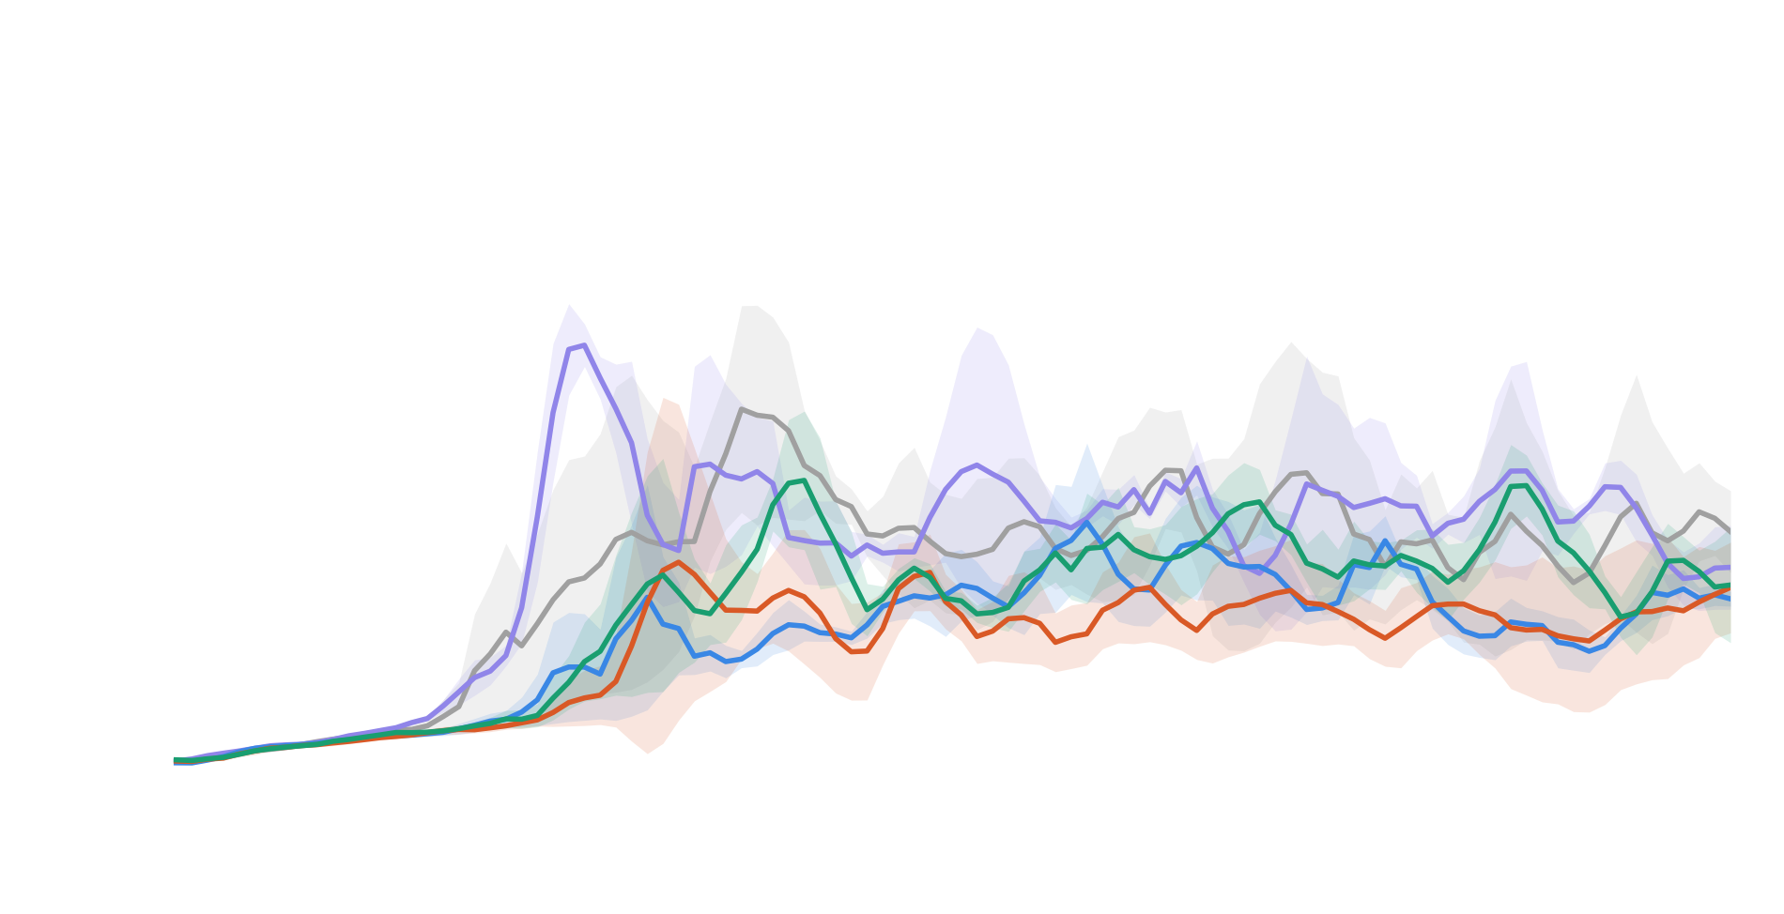

Test Performance H2190
Only prior + MPO with res (w=0)
Prior + MPO with res (w=0.1)
Prior + MPO with res (w=0.5)
MPO
DEP + MPO
Prior + $ω=0.1$
Inconsistent model, but we have individual episodes in all cases reaching scores in the range of 957-1000.
Notes:
(32 secs)
Both the baselines and our approach (prior and control variants) don’t converge on the most complex model.
I observed that even after extending the experiments to 75M steps, it doesn’t improve. As you can see in the video, the model has a full trunk-stabilizing muscle group, but none of it has any EMG coverage at all; the only trunk muscle we do map is an abdominal flexor, so there's nothing in the prior actively holding the trunk upright.
Fall rate is extremely high! All methods in comparison fall at the rate of anywhere between 60-80%.

Slide 27
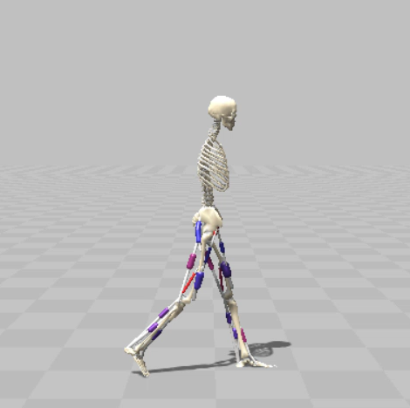
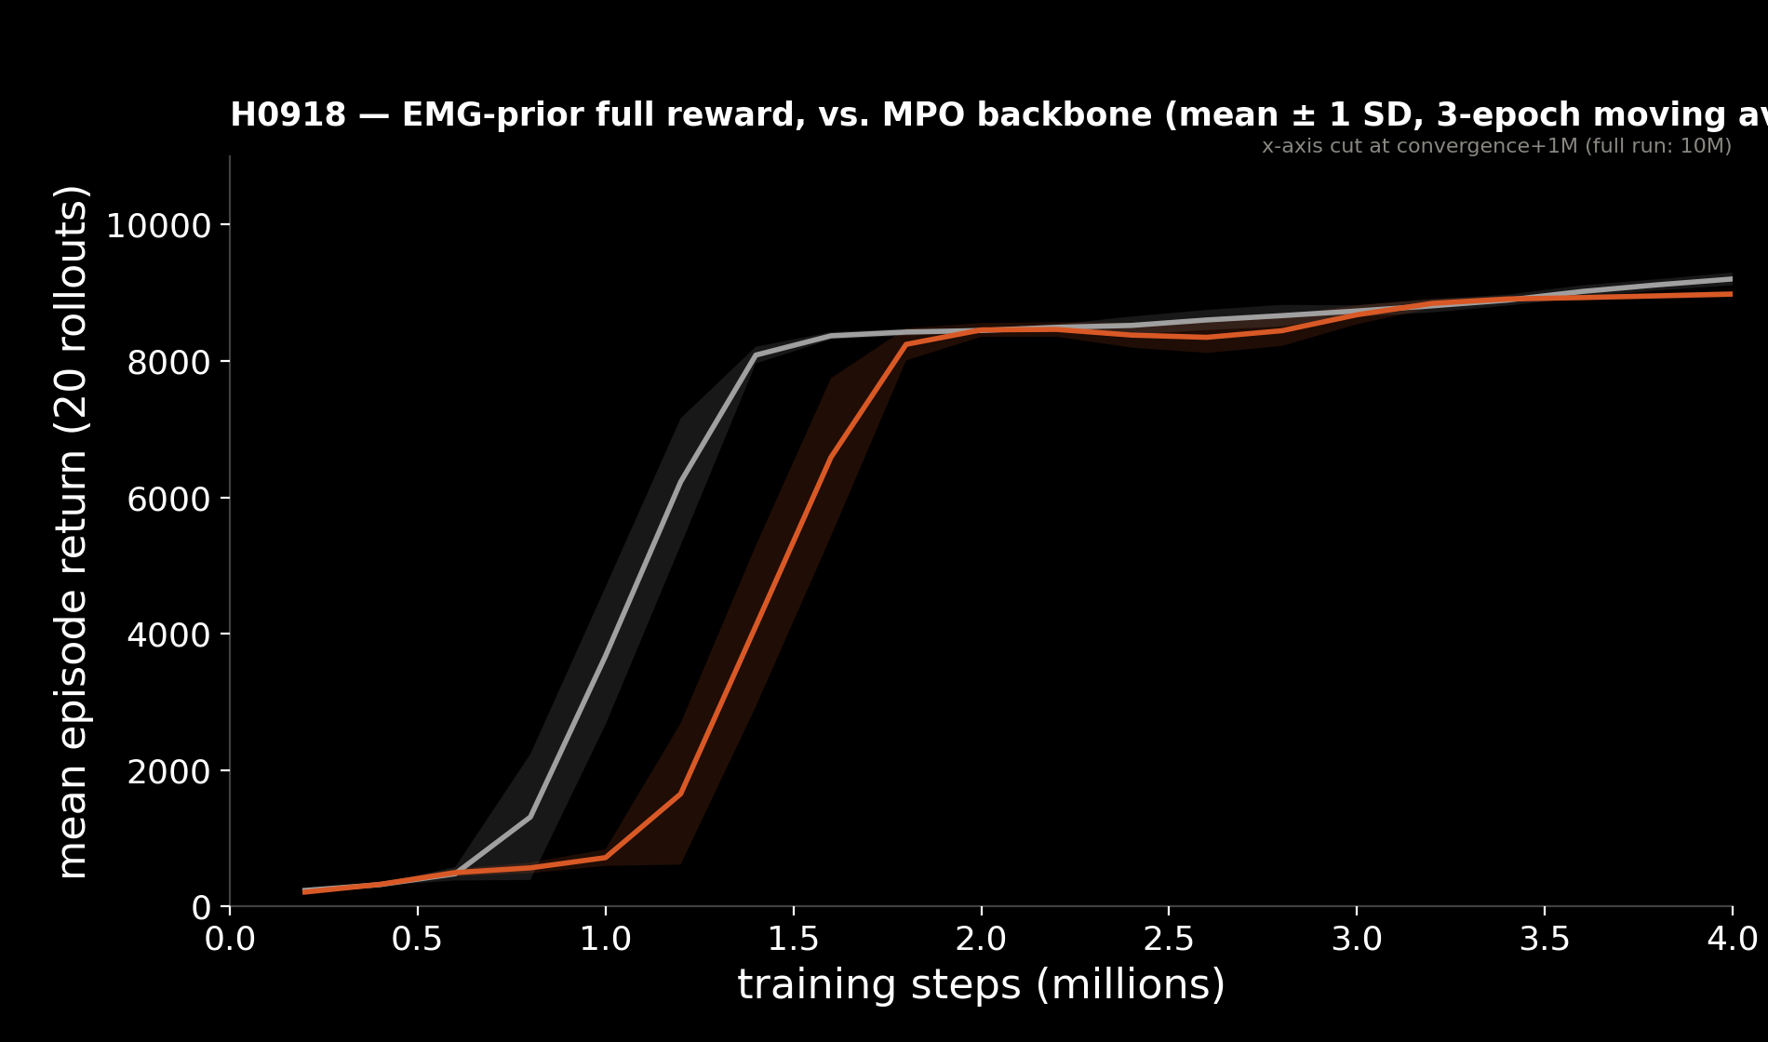
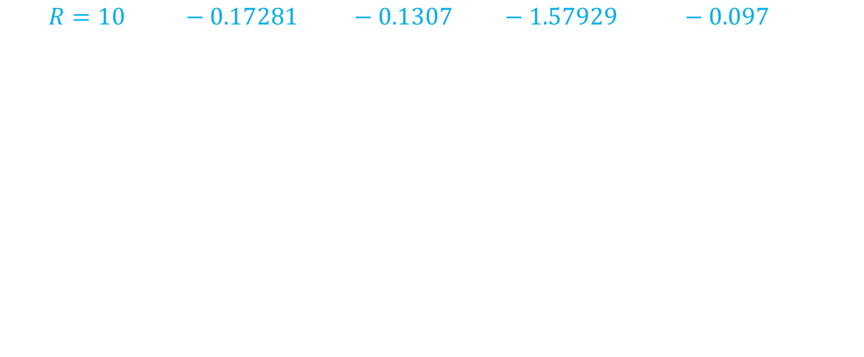
Full Rewards
$$R=10 g\left(v\right)−0.17281 r_{GRF}−0.1307 τ_{lim}−1.57929 f_{musc}−0.097 s_{exc}$$
MPO
Prior + MPO (w=0.1)
Same pattern in other cases x bodies!
[5] Schumacher et al. (2025), iScience. https://doi.org/10.1016/j.isci.2025.112203
Notes:
(20 secs)
- To check whether our results aren’t just the consequence of using a simple reward, we also ran a full reward variant where we drive it towards more natural walking with granular penalties for unnatural behavior.
Here’s the video for our H0918 model for example, where the gait is visibly more natural. But this holds true also for baseline and control variants.
A richer reward makes everything look better, and we see the same story as for the simpler reward variant with baselines beating our prior variants with lower omega.
g(v) = velocity-tracking term, GRF = ground-reaction-force penalty, τ_limit = joint-limit torque, f_muscle = active-muscle fraction, s_exc = excitation smoothness.

Slide 28
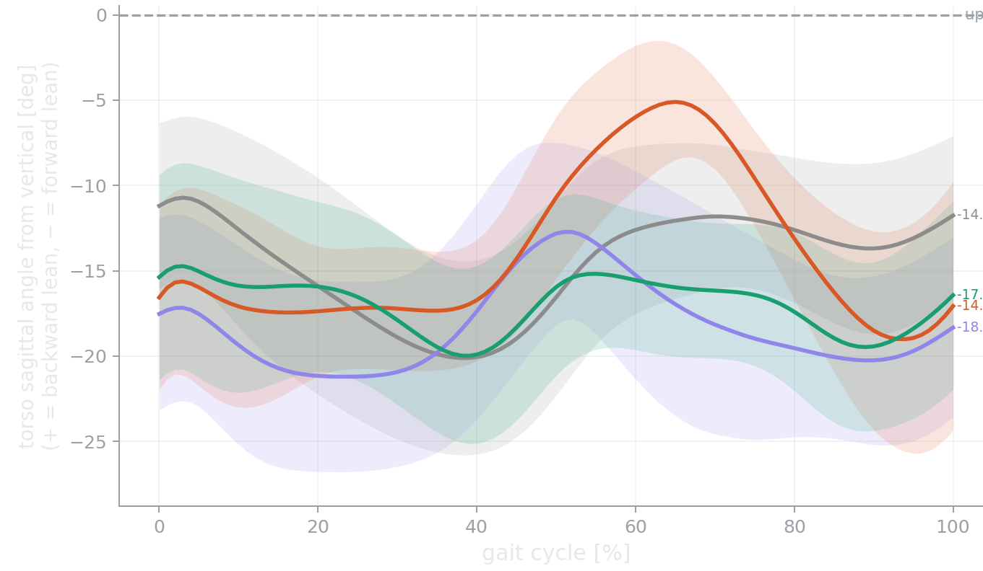
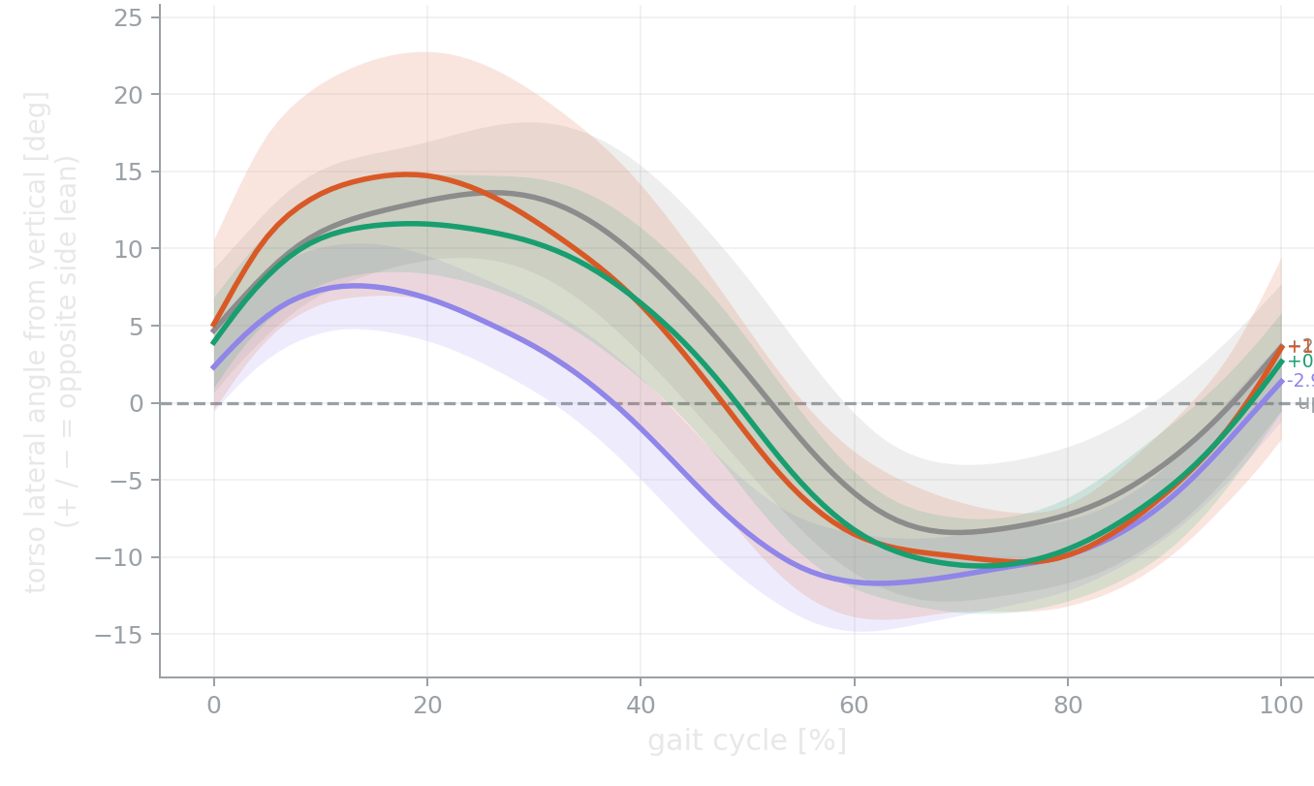
Torso Oscillations
Prior variants (except for w=0) perform equally well in all bodies
Saggital
Lateral
Notes:
H1622 - Sagittal: ω=0.1 most upright (−14.0°), narrowly ahead of MPO (−14.6°), clearly ahead of ω=0.5 (−17.0°) and DEP-MPO (−18.3°).
- Lateral: actually ω=0.5 is closest to symmetric here (+0.8°), with ω=0.1 close behind
(+1.5°) — both beat MPO (+2.8°) and DEP-MPO (−2.9°).
H2190 (already clean, no exclusions needed):
- Sagittal: ω=0.5 is the clear winner (−27.3°), beating both backbones by a wide margin
(−37.4°/−42.2°). Notably, ω=0.1 is the worst condition on this body — the opposite of
H1622.
Trunk posture is more upright than both backbones on both bodies we tested — H1622
at ω=0.1, H2190 at ω=0.5.
CLAUDE: Poor proximal (hip/hamstring) coordination is a classic driver of compensatory trunk lean in real gait — if the base
of support is badly timed, the trunk leans forward to keep balance. Your prior already fixes hamstring timing dramatically (confirmed on two metrics, independent of this trunk analysis). The trunk improvement is plausibly a downstream consequence of that?

Slide 29
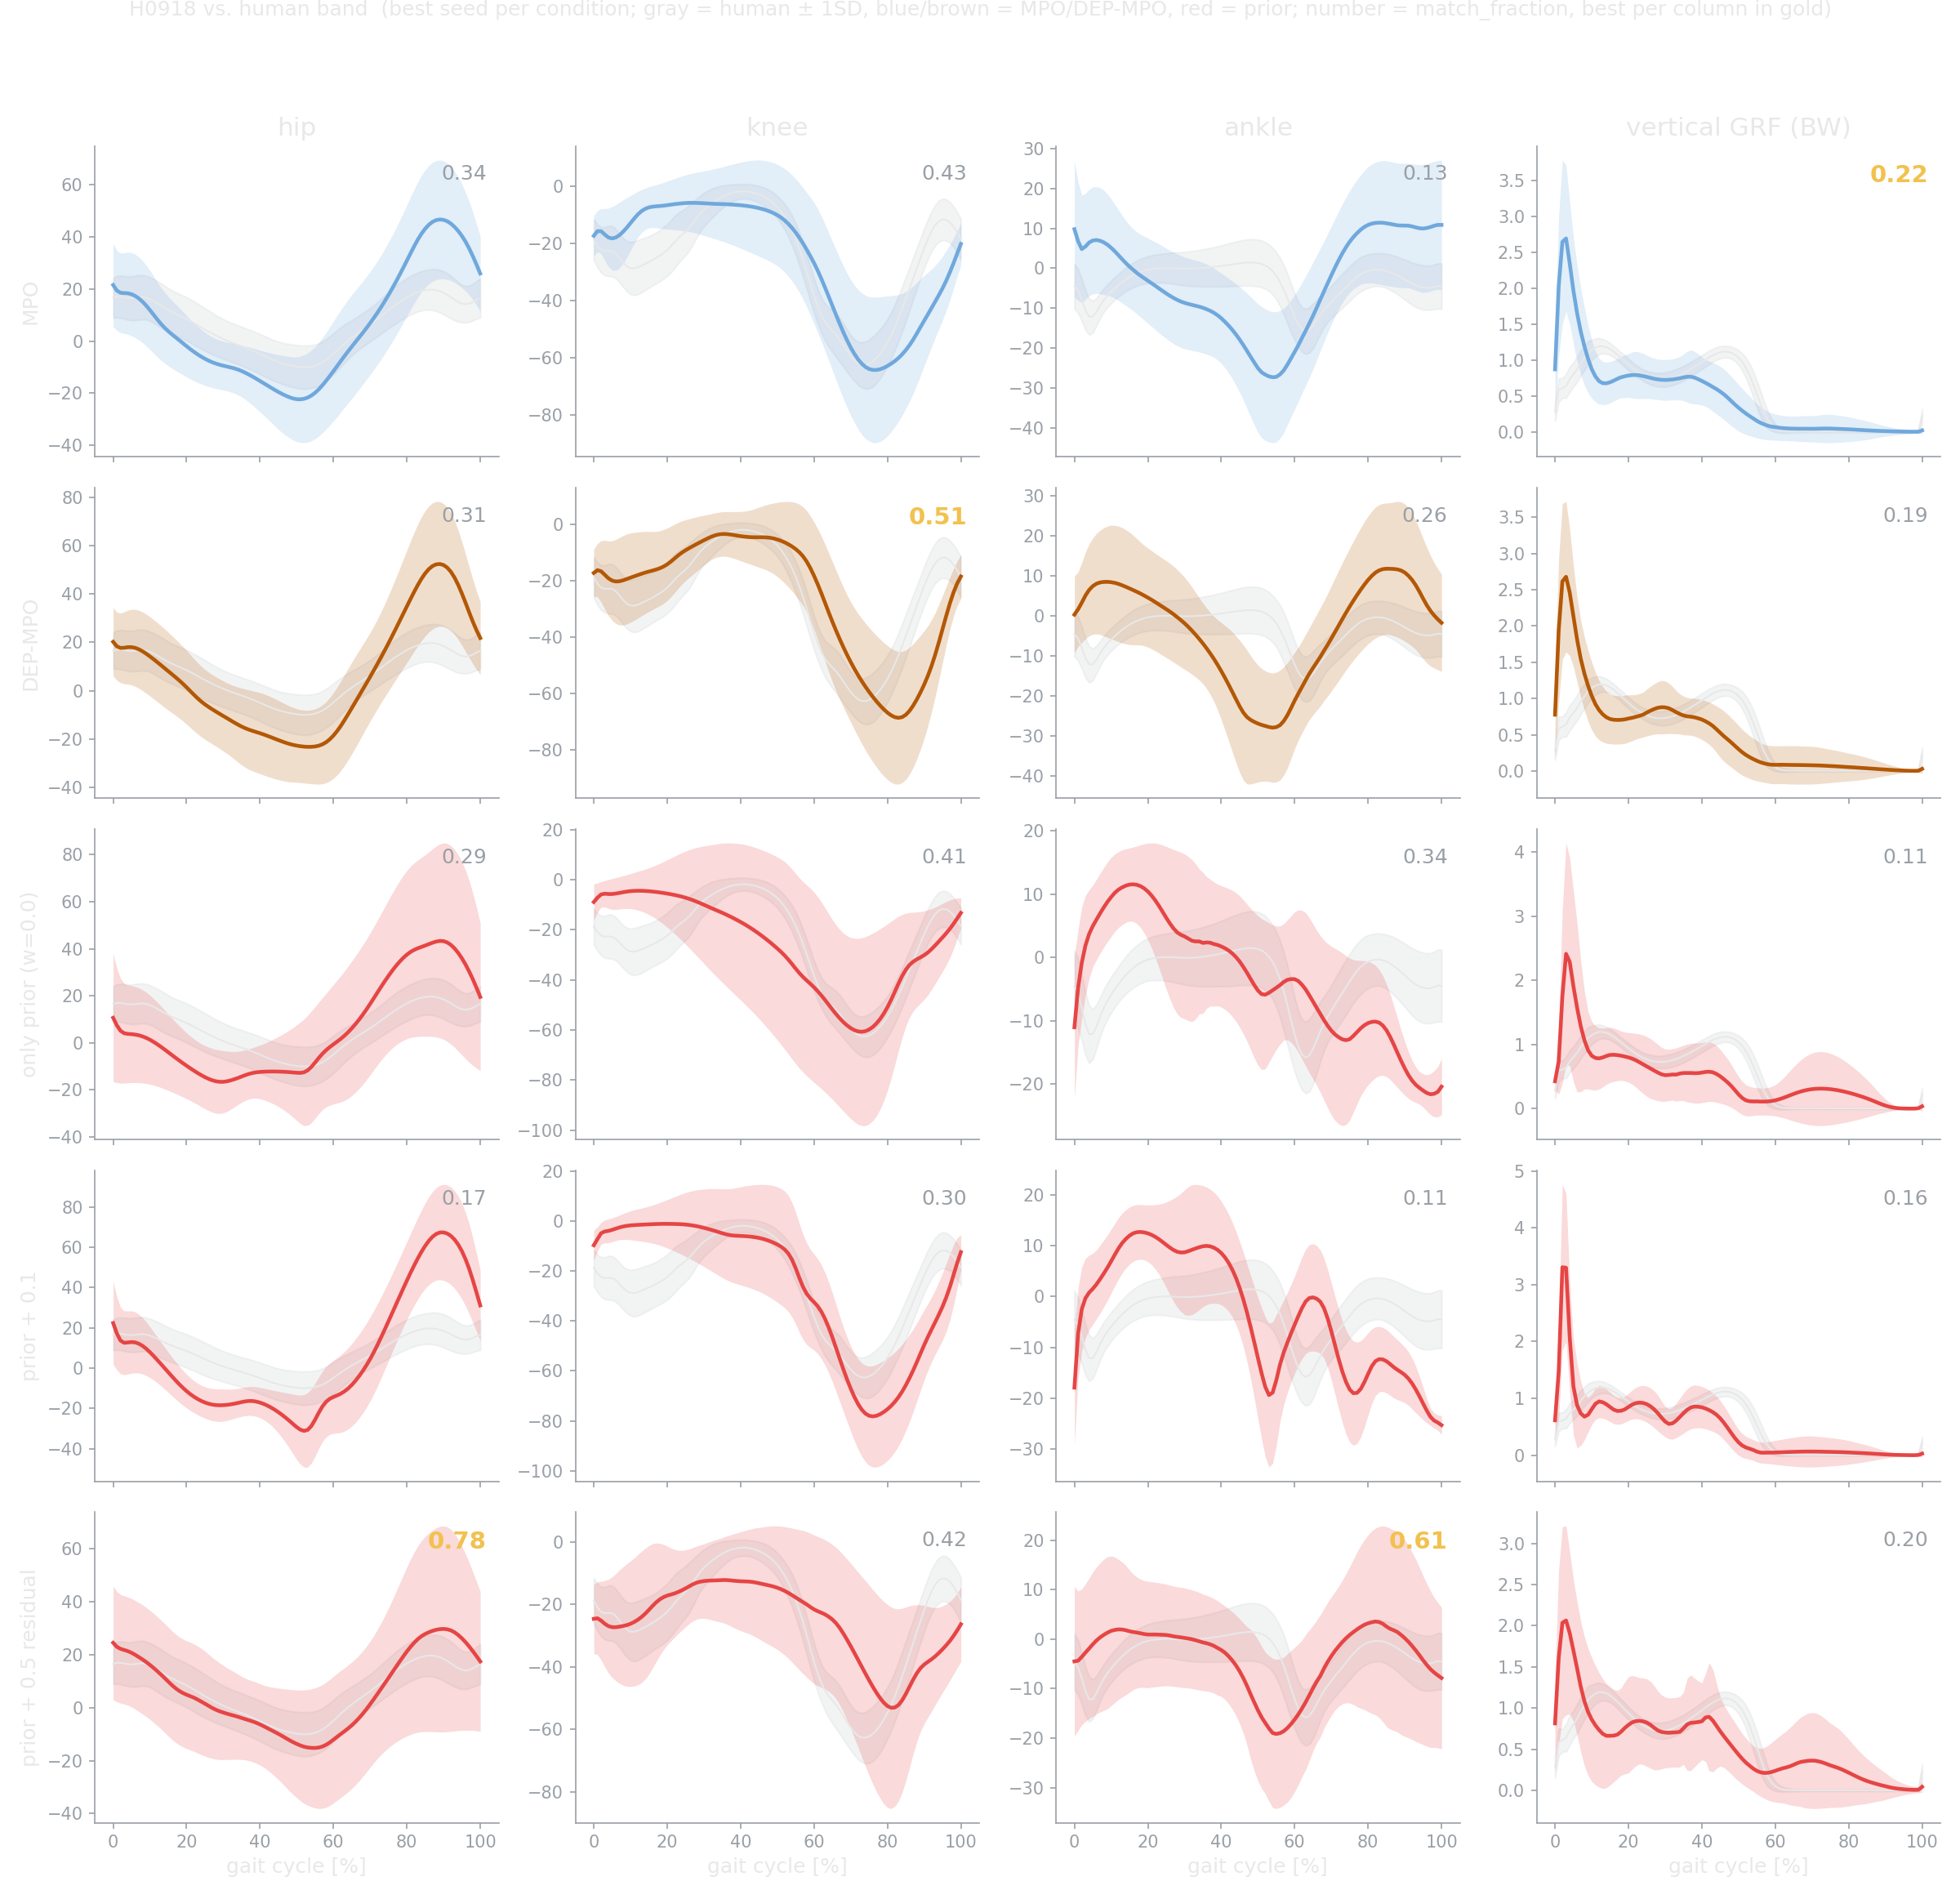
Kinematics H0918 Full

Slide 30
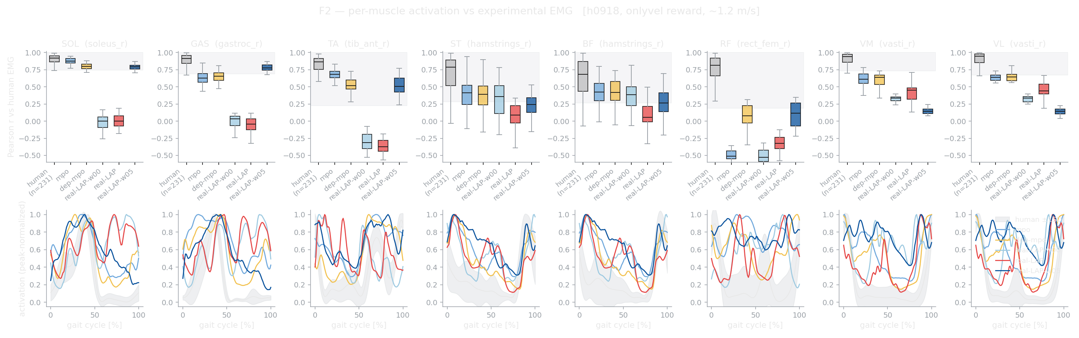
H0918

Slide 31
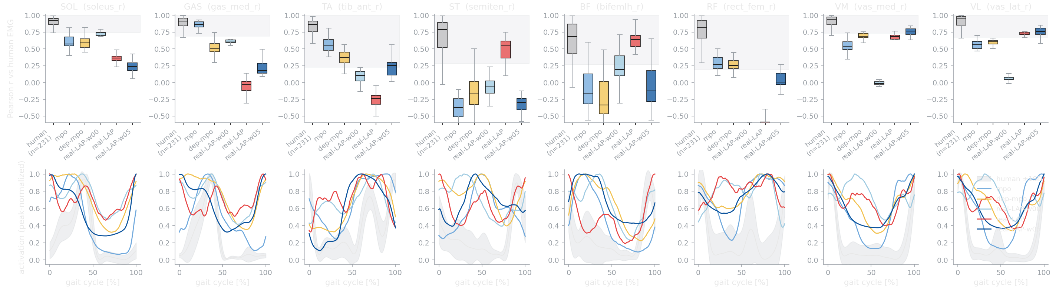
H2190

Slide 32

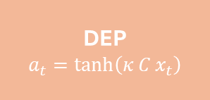









Training Locomotion Policies
SOTA Baselines
+ Controller
$$r_{t}$$
$$r_{t}$$
MPO Policy
$π_{θ} (s_{t}$)
$$s_{t}$$
$$s_{t}$$
Environment
Musculoskeletal sim
MPO Policy
$π_{θ} (s_{t}$)
Environment
Musculoskeletal sim
https://www.nature.com/articles/s41598-025-34956-7
https://www.nature.com/articles/s41598-025-34956-7
Joint positions and velocities
Muscle state parameters
$$⋮$$
GRF at each foot
Joint positions and velocities
Muscle state parameters
$$⋮$$
GRF at each foot
DEP
$$a_{t}=\tanh\left(κ C x_{t}\right)$$
$$a_{t}$$
$$a_{t}$$
  What happens if we bias the action space to be grounded in recorded human muscle
  activity, rather than discovered from the body's own physics alone?
Notes:
(1min.) – don’t need this slide
Let’s look at how standard locomotion policies are trained. We base our approach with MPO, which is an off policy algorithm that reuses past experience via a replay buffer without needing fresh rollouts for each update.
- On the left, we can see a simple loop where the MPO policy gets the state from the simulation environment. State includes information from the simulation envt like joint angles, positions, target speed, muscle state etc.
The body model is muscle actuated, so the policy turns this to muscle excitations a_t trained by reward r_t.
Onto the right side we see this combined with a state of the art controller DEP which self organizes each actuator based on a feedback loop online. This is known to help find coordinated movement faster than random exploration.

Slide 33




EMG as a Latent Action Prior
Autoencoder learns muscle synergies.
Handful of shared activation patterns explain most of the variance in muscle activity.
We introduce the trained decoder as the prior, which serves as an inductive bias on the action space.
Locked at $k=6$ synergies to reconstruct $11$ muscles.
$$R^{2}$$
$$k$$
[1] Spüler et al. (2016). Extracting Muscle Synergy Patterns from EMG Data Using Autoencoders. ICANN 2016, LNCS, pp. 47–54. doi:10.1007/978-3-319-44781-0_6
Notes:
(38sec)
So how do we actually ground exploration in real human data?
Even though walking involves activity from many muscles and joints, most of the variance could be explained by a handful of shared activation patterns called synergies.
We learn these synergies with an autoencoder which is a nonlinear model that has advantage over linear models in both lower dimensions and also in reconstructing complex signals.
We will use the decoder as our prior which is like an inductive bias, which constrains the action space on real EMG patterns. In our setup, 6 synergies were enough to reasonably reconstruct most muscles.

