Slide 1












Tactical
Sandbox
ALTIS

Slide 2
Tactical
Sandbox
STRATIS

Slide 3
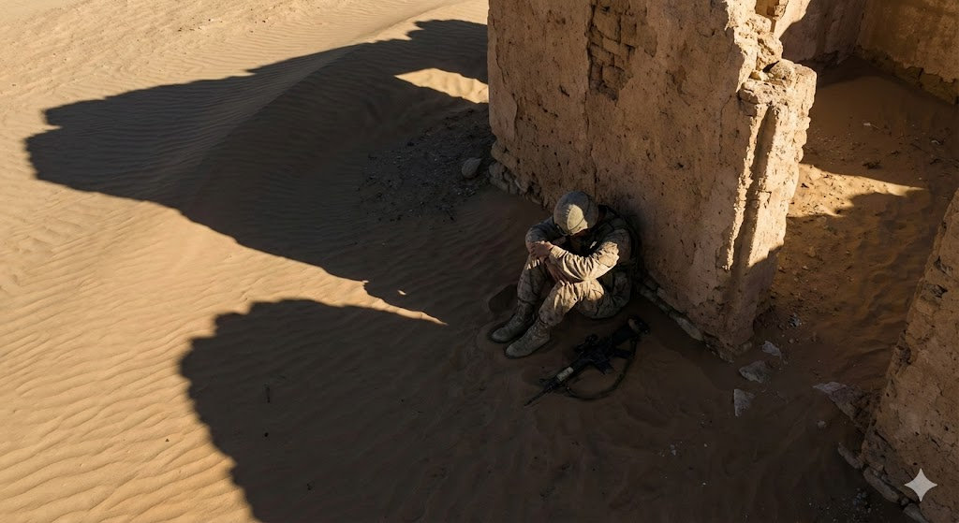
Acute Stress
Disorder

