Slide 1












Tactical
Sandbox
ALTIS

Slide 2
Tactical
Sandbox
STRATIS

Slide 3
Tactical
Sandbox
MALDEN

Slide 4
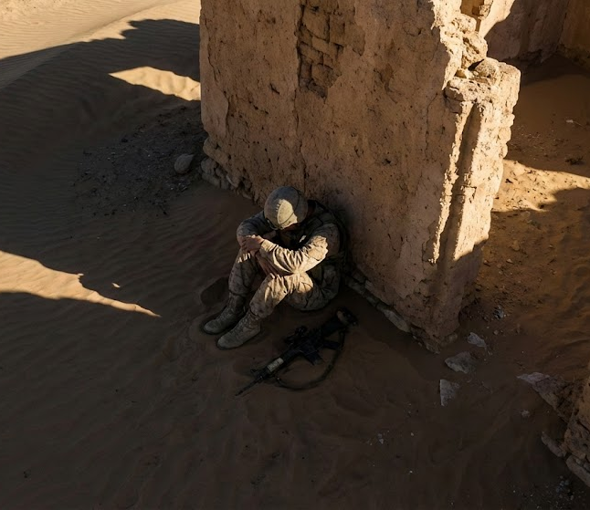
Acute Stress
Disorder

