Slide 1
Fitbuddy
Lachezar bogomilov
Dragomir todorov

Slide 2

Overview

Slide 3
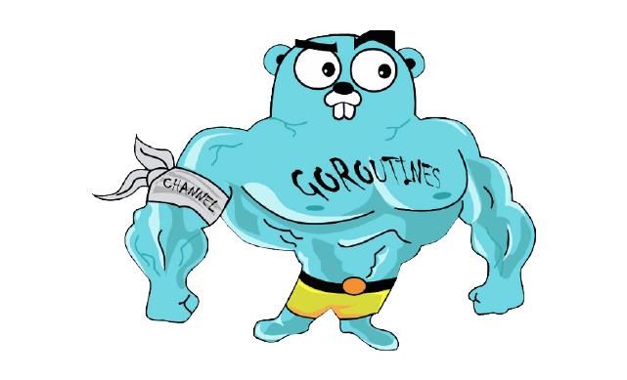
Functionality
Account Management
Dashboard
Workout Tracker
Meal Tracker
Sleep Tracker
Goal Tracker
Coaching
Booking
Leaderboard
Forum

Slide 4







Architecture

Slide 5
DEMO

Slide 6


Thank you for your attention

Slide 7


