Slide 1
Smart Wedding Contract
TTM4195 | Assignment 3 | Group 2
Norwegian University of Science and Technology

Slide 2
Outline
Design Conecpt
Regsitry Contract
Wedding Contract
Development & Unittesting
Demonstration
Challenges
Notes:
Design concept: 3-4 min
registry: 4
Wedding: 3
Development: 1-2
Deomnstration: 2 min
Challenges: whatever time is lefft

Slide 3
Design 1: One Contract for Everything
Keeps track of all weddings
Ensures correct wedding procedures
Wedding
(responsible for everything)
initializeWedding(…)
changeAuthorities(…)
issueWeddingCertificate(…)
IsMarried(…)
approveGuest(…)
revokeEngagement(…)
voteAgainstWedding(…)
confirmWedding(…)
divorce(…)
Notes:
Moritz

Slide 4
Design 1: One Contract for Everything
Advantages
Simple deployment
Disadvantages
Manage many sets of variabel for each weddding
Messy implementation
How to handle parallel weddings or engagements?
Wedding
(responsible for everything)
initializeWedding(…)
changeAuthorities(…)
issueWeddingCertificate(…)
IsMarried(…)
approveGuest(…)
revokeEngagement(…)
voteAgainstWedding(…)
confirmWedding(…)
divorce(…)
Notes:
Moritz

Slide 5
Design 2: Registry and Wedding Contract
Wedding Contract
(implementation of the wedding procedure)
approveGuest(…)
revokeEngagement(…)
voteAgainstWedding(…)
confirmWedding(…)
divorce(…)
…
Contract Factory: Registry deployes a new wedding contract for each initiated wedding
Deployes new
Wedding Registry
(checks who is married, manages wedding Tokens)
initializeWedding(…)
changeAuthorities(…)
issueWeddingCertificate(…)
(only callable by Wedding Contracts)
burnWeddingCertificate(…)
(only called by Wedding Contracts)
…
Deployes new
Wedding Contract
(implementation of the wedding procedure)
approveGuest(…)
revokeEngagement(…)
voteAgainstWedding(…)
confirmWedding(…)
divorce(…)
…
…
Deployes new
…
Notes:
Moritz

Slide 6
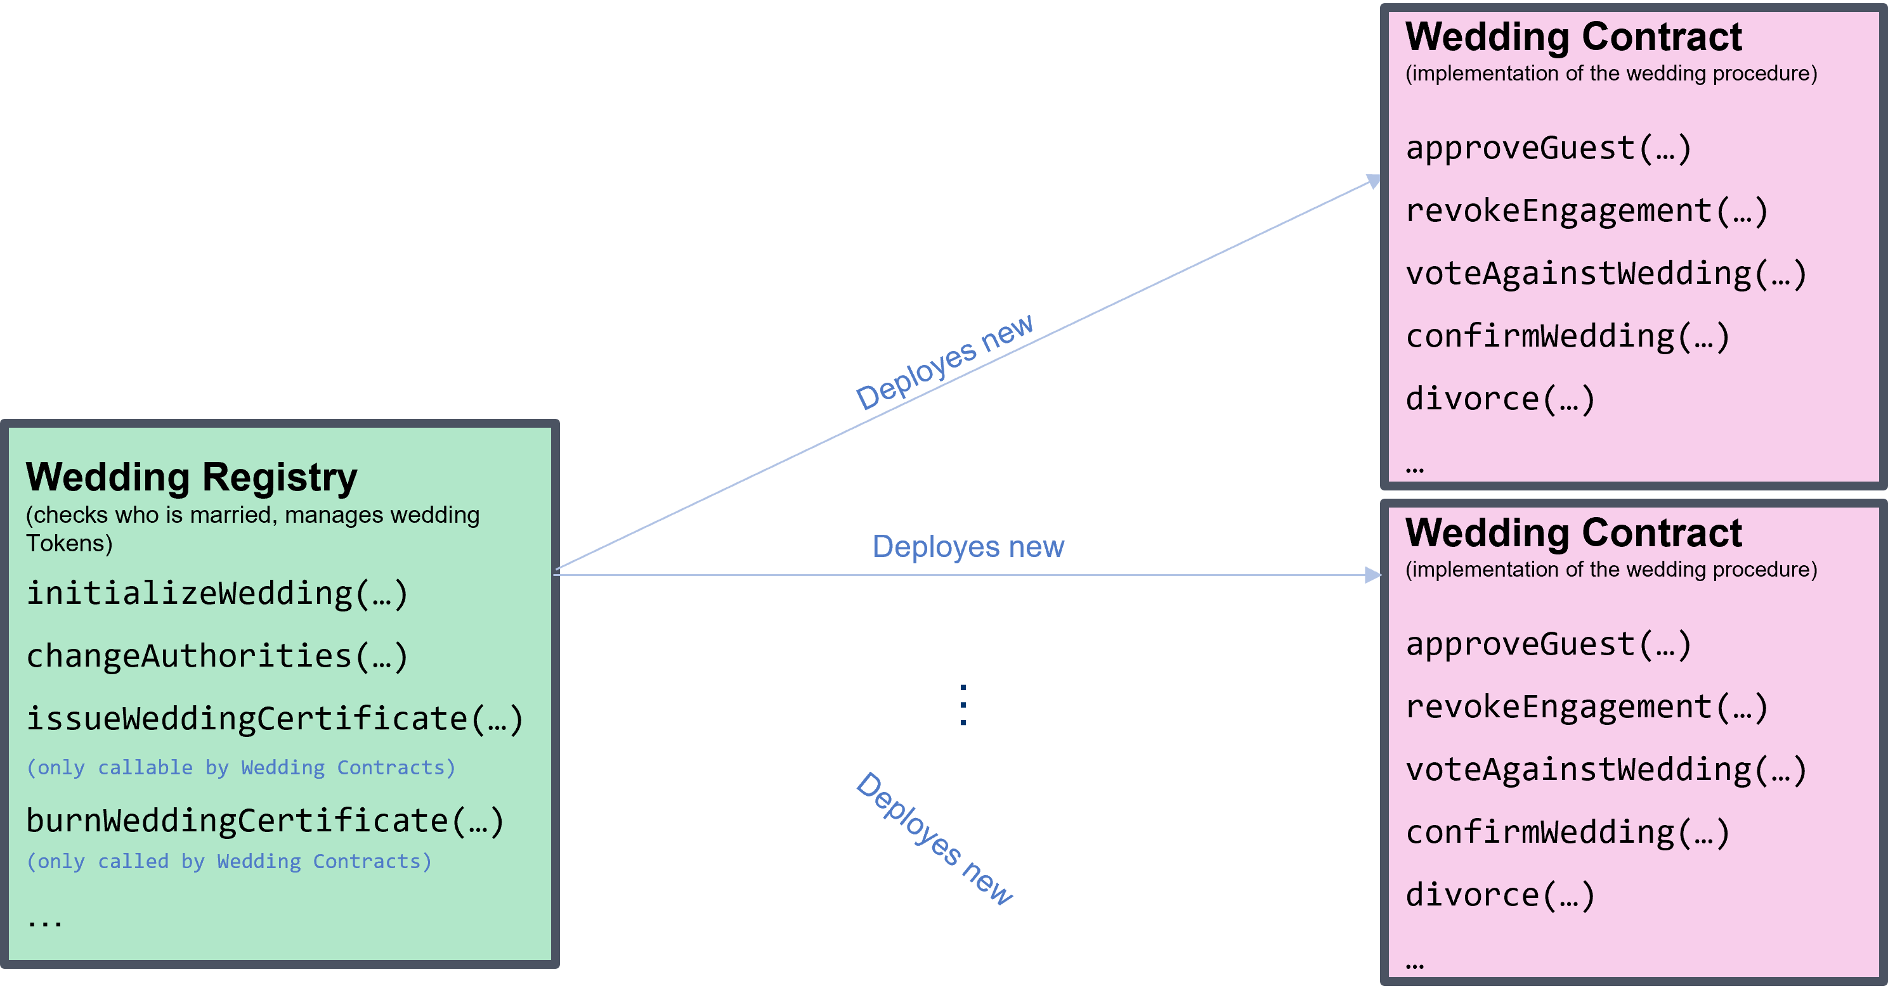
Design 2: Registry and Wedding Contract
Advantages
Disadvantages
Nice separation of concerns
Clear implementation
Each Wedding has their own contract
→Good usability
Very expensive to initiate a wedding

Slide 7
Design 3: Registry and Wedding Proxies
Registry deploys cheap proxies which reference implementation of shared wedding contract
Contains (changable) address of
Wedding
Proxy
Wedding Contract
(implementation of the wedding procedure)
approveGuest(…)
revokeEngagement(…)
voteAgainstWedding(…)
confirmWedding(…)
divorce(…)
…
Wedding Registry
(checks who is married, manages wedding Tokens)
initializeWedding()
changeAuthorities(…)
changeWeddingImplementation(…)
issueWeddingCertificate(…)
(only callable by Wedding Contracts)
burnWeddingCertificate(…)
(only called by Wedding Contracts)
…
Deploy
new
Wedding
Proxy
Use
implementation
of
Wedding
Proxy
… …
Notes:
Moritz

Slide 8
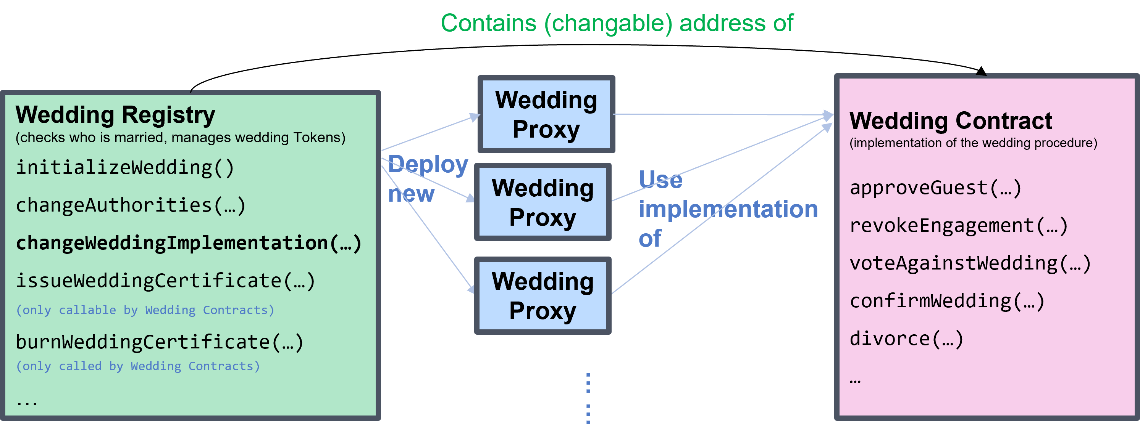
Design 3: Registry and Wedding Proxies
Advantages
Disadvantages
All advantages from before
Only small proxy call overhed
Wedding procedure can be changed without redeploying registry
Still minor gas overhead
Notes:
Moritz

Slide 9
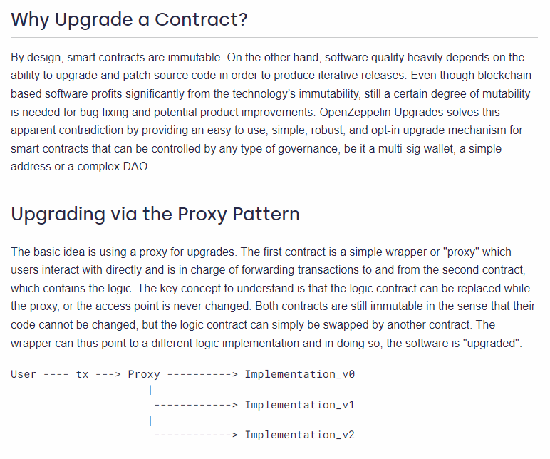




Why all this Proxy stuff?
Source: https://docs.openzeppelin.com/upgrades-plugins/1.x/proxies
Notes:
Moritz

Slide 10


Why all this Proxy stuff?
Source: https://docs.openzeppelin.com/upgrades-plugins/1.x/proxies
Notes:
Moritz

Slide 11
Registry Contract
Manages whos married to whom
ERC721
No use of ERC721URIStorage
Tokens are owned by Proxy contracts
Mapping from spouse address to proxy address
Onchain Wedding data directly associated with tokens by values in Wedding contract
Notes:
Lada

Slide 12
Wedding Contract
Handles the Wedding Procedure
Allows polygamic Weddings!!!
Procedure based on blockchain times
Calls Registry contract once a wedding is finalized
Only interacted with via proxies
Can updated by deploying new version
Notes:
Jonathan

Slide 13
Wedding Procedure
Authority: Deploy WeddingImplementationContract()
Authority: Deploy RegistryContract(Authorities, WeddingImplemetationContract-address)
Fiance 1: registry_contract.initiateWedding([fiance1, fiance2], weddingDate)
Fiance 2: WeddingContract.approveGuest(Guest1)
Fiance 1: WeddingContract.approveGuest(Guest1)
Fiance 1: WeddingContract.approveGuest(Guest2)
Fiance 2: WeddingContract.approveGuest(Guest2)
Guest 1: WeddingContract.voteAgainstWedding()
Fiance 1: WeddingContract.confirmWedding()
Fiance 2: WeddingContract.confirmWedding() -> WeddingContract: WeddingRegistry.issueWeddingToken()
Fiance 1: WeddingContract.divorce()
Authority: WeddingContract.dicorce() -> WeddingContrac: WeddingRegistry.burnWeddingToken()
setup
Event: initiateWedding
Before
wedding day
Event: inviteSend
new Wedding-Proxy deployed
Event: inviteSend
Wedding Day
before 10am
Event: votedAgainstWedding
Wedding Day
after 10am
Event: issuedWeddingCertificate
After
wedding day
Time
Notes:
Jonathan

Slide 14
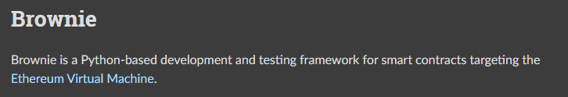
Development
How to do automated unittest for a Smart Contract?
How to avoid waiting for certain timestamps?
Remix (VMs) does not help with that ☹
Compiling Contracts
Deploying contract to local Ganache blockchain
Python wrappers for Smart Contracts & blockchain interface
→Allows unittesting with python testing frameworks
Source: https://eth-brownie.readthedocs.io/en/stable/
Notes:
Moritz

Slide 15
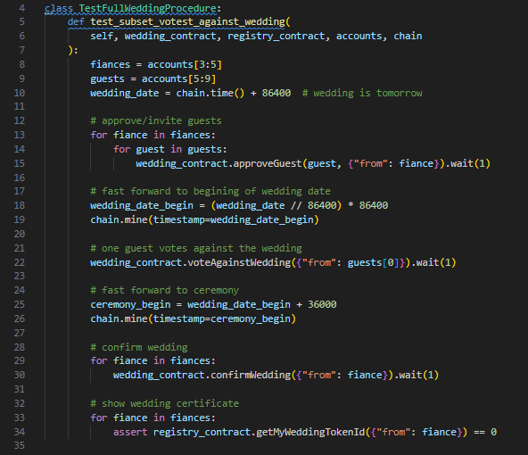
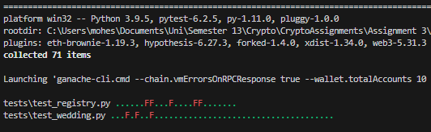
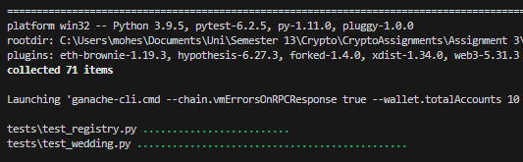
Unittest Example
Notes:
Moritz

Slide 16
Demo
Authority: Deploy WeddingImplementationContract()
Authority: Deploy RegistryContract(Authorities, WeddingImplemetationContract-address)
Fiance 1: registry_contract.initiateWedding([fiance1, fiance2], weddingDate)
Fiance 2: WeddingContract.approveGuest(Guest1)
Fiance 1: WeddingContract.approveGuest(Guest1)
Fiance 1: WeddingContract.approveGuest(Guest2)
Fiance 2: WeddingContract.approveGuest(Guest2)
Guest 1: WeddingContract.voteAgainstWedding()
Fiance 1: WeddingContract.confirmWedding()
Fiance 2: WeddingContract.confirmWedding() -> WeddingContract: WeddingRegistry.issueWeddingToken()
Fiance 1: WeddingContract.divorce()
Authority: WeddingContract.dicorce() -> WeddingContrac: WeddingRegistry.burnWeddingToken()
setup
Event: initiateWedding
Before
wedding day
Event: inviteSend
new Wedding-Proxy deployed
Event: inviteSend
Wedding Day
before 10am
Event: votedAgainstWedding
Wedding Day
after 10am
Event: issuedWeddingCertificate
After
wedding day
Time
Notes:
Espen

Slide 17
Demo

Slide 18
Demo
Authority: Deploy WeddingImplementationContract()
Authority: Deploy RegistryContract(Authorities, WeddingImplemetationContract-address)
Fiance 1: registry_contract.initiateWedding([fiance1, fiance2], weddingDate)
Fiance 2: WeddingContract.approveGuest(Guest1)
Fiance 1: WeddingContract.approveGuest(Guest1)
Fiance 1: WeddingContract.approveGuest(Guest2)
Fiance 2: WeddingContract.approveGuest(Guest2)
Guest 1: WeddingContract.voteAgainstWedding()
Fiance 1: WeddingContract.confirmWedding()
Fiance 2: WeddingContract.confirmWedding() -> WeddingContract: WeddingRegistry.issueWeddingToken()
Fiance 1: WeddingContract.divorce()
Authority: WeddingContract.dicorce() -> WeddingContrac: WeddingRegistry.burnWeddingToken()
setup
Event: initiateWedding
Before
wedding day
Event: inviteSend
new Wedding-Proxy deployed
Event: inviteSend
Wedding Day
before 10am
Event: votedAgainstWedding
Wedding Day
after 10am
Event: issuedWeddingCertificate
After
wedding day
Time

Slide 19
Demo

Slide 20
Demo
Authority: Deploy WeddingImplementationContract()
Authority: Deploy RegistryContract(Authorities, WeddingImplemetationContract-address)
Fiance 1: registry_contract.initiateWedding([fiance1, fiance2], weddingDate)
Fiance 2: WeddingContract.approveGuest(Guest1)
Fiance 1: WeddingContract.approveGuest(Guest1)
Fiance 1: WeddingContract.approveGuest(Guest2)
Fiance 2: WeddingContract.approveGuest(Guest2)
Guest 1: WeddingContract.voteAgainstWedding()
Fiance 1: WeddingContract.confirmWedding()
Fiance 2: WeddingContract.confirmWedding() -> WeddingContract: WeddingRegistry.issueWeddingToken()
Fiance 1: WeddingContract.divorce()
Authority: WeddingContract.dicorce() -> WeddingContrac: WeddingRegistry.burnWeddingToken()
setup
Event: initiateWedding
Before
wedding day
Event: inviteSend
new Wedding-Proxy deployed
Event: inviteSend
Wedding Day
before 10am
Event: votedAgainstWedding
Wedding Day
after 10am
Event: issuedWeddingCertificate
After
wedding day
Time

Slide 21
Demo

Slide 22
Demo
Authority: Deploy WeddingImplementationContract()
Authority: Deploy RegistryContract(Authorities, WeddingImplemetationContract-address)
Fiance 1: registry_contract.initiateWedding([fiance1, fiance2], weddingDate)
Fiance 2: WeddingContract.approveGuest(Guest1)
Fiance 1: WeddingContract.approveGuest(Guest1)
Fiance 1: WeddingContract.approveGuest(Guest2)
Fiance 2: WeddingContract.approveGuest(Guest2)
Guest 1: WeddingContract.voteAgainstWedding()
Fiance 1: WeddingContract.confirmWedding()
Fiance 2: WeddingContract.confirmWedding() -> WeddingContract: WeddingRegistry.issueWeddingToken()
Fiance 1: WeddingContract.divorce()
Authority: WeddingContract.dicorce() -> WeddingContrac: WeddingRegistry.burnWeddingToken()
setup
Event: initiateWedding
Before
wedding day
Event: inviteSend
new Wedding-Proxy deployed
Event: inviteSend
Wedding Day
before 10am
Event: votedAgainstWedding
Wedding Day
after 10am
Event: issuedWeddingCertificate
After
wedding day
Time

Slide 23
Demo

Slide 24
Demo
Authority: Deploy WeddingImplementationContract()
Authority: Deploy RegistryContract(Authorities, WeddingImplemetationContract-address)
Fiance 1: registry_contract.initiateWedding([fiance1, fiance2], weddingDate)
Fiance 2: WeddingContract.approveGuest(Guest1)
Fiance 1: WeddingContract.approveGuest(Guest1)
Fiance 1: WeddingContract.approveGuest(Guest2)
Fiance 2: WeddingContract.approveGuest(Guest2)
Guest 1: WeddingContract.voteAgainstWedding()
Fiance 1: WeddingContract.confirmWedding()
Fiance 2: WeddingContract.confirmWedding() -> WeddingContract: WeddingRegistry.issueWeddingToken()
Fiance 1: WeddingContract.divorce()
Authority: WeddingContract.dicorce() -> WeddingContrac: WeddingRegistry.burnWeddingToken()
setup
Event: initiateWedding
Before
wedding day
Event: inviteSend
new Wedding-Proxy deployed
Event: inviteSend
Wedding Day
before 10am
Event: votedAgainstWedding
Wedding Day
after 10am
Event: issuedWeddingCertificate
After
wedding day
Time

Slide 25
Demo

Slide 26
Demo
Authority: Deploy WeddingImplementationContract()
Authority: Deploy RegistryContract(Authorities, WeddingImplemetationContract-address)
Fiance 1: registry_contract.initiateWedding([fiance1, fiance2], weddingDate)
Fiance 2: WeddingContract.approveGuest(Guest1)
Fiance 1: WeddingContract.approveGuest(Guest1)
Fiance 1: WeddingContract.approveGuest(Guest2)
Fiance 2: WeddingContract.approveGuest(Guest2)
Guest 1: WeddingContract.voteAgainstWedding()
Fiance 1: WeddingContract.confirmWedding()
Fiance 2: WeddingContract.confirmWedding() -> WeddingContract: WeddingRegistry.issueWeddingToken()
Fiance 1: WeddingContract.divorce()
Authority: WeddingContract.dicorce() -> WeddingContrac: WeddingRegistry.burnWeddingToken()
setup
Event: initiateWedding
Before
wedding day
Event: inviteSend
new Wedding-Proxy deployed
Event: inviteSend
Wedding Day
before 10am
Event: votedAgainstWedding
Wedding Day
after 10am
Event: issuedWeddingCertificate
After
wedding day
Time

Slide 27
Demo

Slide 28
Challenges
How to efficiently check wehther someone is married
Reducing gas costs (→Proxies)
Polygamy edge cases
2 out of N for divorce
How to handle duplicates in list?
Differences between Görli testchain and local Ganache chain
Efficient Testing (→Brownie)
Notes:
Espen / Lada

