Slide 1
School of Rock v. The School of Hard Knocks
By: Anthony Lathrop

Slide 2

Data Collection
Data was collected by using Reddit’s API (PRAW)
A custom function was used to request 1000 posts from each Subreddit

Slide 3
Exploratory Data Analysis (EDA) & Cleaning
A custom function was defined to vectorize and clean the data
Text was converted to lowercase, punctuation was removed using Regular Expressions and English stopwords were removed

Slide 4
Preprocessing & Visualizations
Text data pulled from the two subreddits was preprocessed by CountVectorizer
Seaborn was used to visualize the most common words in both subreddits:

Slide 5
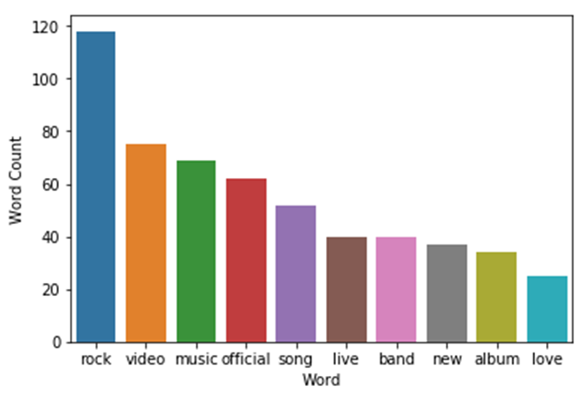
School of Rock

Slide 6
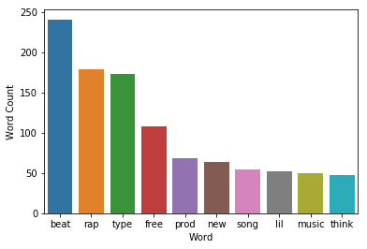
School of Hard Knocks

Slide 7
Modeling
In order to vary a wide range of model parameters to find the best model, GridSearch and Pipelines were implemented.
The model that was selected was the model that had the least amount of overfitting and the highest testing accuracy score.

Slide 8
Conclusions and Insights
Let me just take a step back…
We just pulled text data in a massive quantity in real-time from a public internet forum that gives clues to how and where music is created and performed.
What are the implications of this?

